Slide 1
Title 5 and MassDEP Updates
Claire Golden, MassDEP
MEHA Education Seminar
March 7, 2018

Slide 2
Outline
Title 5 Updates
  Wastewater Regulatory Review
    Title 5
    Groundwater
  Stakeholders Group
  I/A approvals
Who’s Who in Wastewater at MassDEP
  Program Changes in Boston
  Regional Contacts
MassDEP’s Website

Slide 3
Title 5 Updates

Slide 4
Wastewater Regulatory Review
EO562 required all Agencies to review regulations.
In 2015 and early 2016 MassDEP conducted its review.
Listening Sessions conducted and public comments received
Some comments received for the Wastewater Program regulations went beyond the EO562 scope.
Stakeholder Group convened in early 2017 to explore these comments.

Slide 5
T5/GW Stakeholder Group Participants
Health Agents
  MEHA
  MHOA
Department of Public Health
Conservation Commissions
Engineers
Home Builders
Commercial Developers
Seasonal Campgrounds
Technology experts
Water Suppliers

Slide 6
T5/GW Stakeholder Comments
Starter home zoning
Uniform statewide code
Holding tanks for peak flows – component sizing
Utilization of unused capacity (GW)
Reduction in gw separation for new construction with I/A
Design flows for multi-residences
Large reporting system category (7,500 – 30,000 gpd)
GW permit threshold raised 10,000 gpd
Designation of nitrogen sensitive areas
Seasonal campground flows and thresholds
Moldering toilets for remote backwoods areas
Reuse of composting toilet leachate

Slide 7
T5/GW Stakeholder Group Meetings
Two meetings in 2017
  Discussed each comment received
  Determined data/information needed for each comment
  Determined Starter Home and Home Rule Comment were outside of this group’s scope
Meeting on March 6th, 2018 to discuss:
  Guidance language for component sizing and approval process to utilize unused capacity at wastewater treatment facility
  Interest in the formation of Technical Workgroup to develop testing protocols on pathogen removal related to groundwater separation
  Seeking an academic institute to conduct in depth analysis on multi residence flows

Slide 8
T5/GW Stakeholder Group Meetings
Subgroups to be formed for remaining Comments
  Compost toilet leachate met in October 2017
    Working with DEP, DAR and academic institution to analyze leachate
  Seasonal Campgrounds and Moldering Toilets to meet on March 29th, 2018
Subgroups and dates to be determined for
  Large System Category/Groundwater Threshold
  Nitrogen Sensitive Areas

Slide 9
Contact for the T5/GW Stakeholders Group
Marybeth Chubb
marybeth.chubb@state.ma.us
617-556-1029

Slide 10
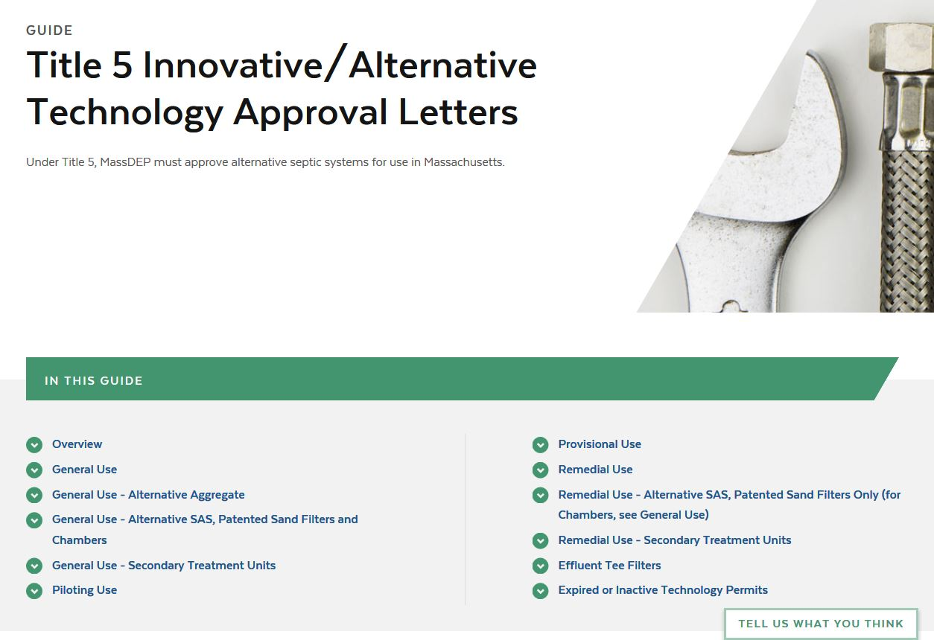
I/A Approvals
https://www.mass.gov/guides/title-5-innovativealternative-technology-approval-letters

Slide 11
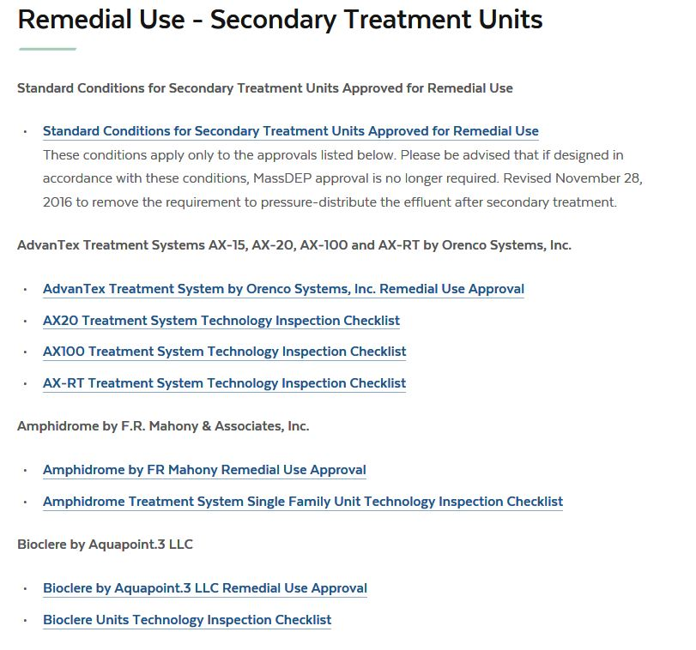

Slide 12
Who’s Who in Wastewater at MassDEP

Slide 13
Program Leadership – MassDEP Boston
Lealdon Langley
Director
Wetlands and Wastewater Programs
Marybeth Chubb
Acting Section Chief
Groundwater, Reuse and Title 5
Susannah (Susy) King
Section Chief
NPDES

Slide 14
Program Leadership – Central Region
Wastewater Section Chief and Title 5 Contact
David Boyer
david.boyer@state.ma.us
508-767-2823

Slide 15
Program Leadership – Northeast Region
Wastewater Section Chief
Kevin Brander
kevin.brander@state.ma.us
978-694-3236
Title 5 Contacts
Claire Golden Wastewater Info Line
claire.golden@state.ma.us 978-694-3215
978-694-3244

Slide 16
Program Leadership – Southeast Region
Wastewater Section Chief
Jeff Gould
jeffrey.gould@state.ma.us
508-946-2757
Title 5 Contact
Brett Rowe
brett.rowe@state.ma.us
508-946-2754
Wastewater Section Chief and
Title 5 Contact (Cape/Islands)
Brian Dudley
brian.dudley@state.ma.us
508-946-2814

Slide 17
Program Leadership – Western Region
Wastewater Section Chief and Title 5 Contact
Paul Nietupski
paul.nietupski@state.ma.us
508-767-2823

Slide 18
MassDEP’s Website

Slide 19
Information
MassDEP’s website now under umbrella of the Commonwealth’s website
Standard formatting
http://mass.gov/dep
Search function
Some old webpages/links

Slide 20
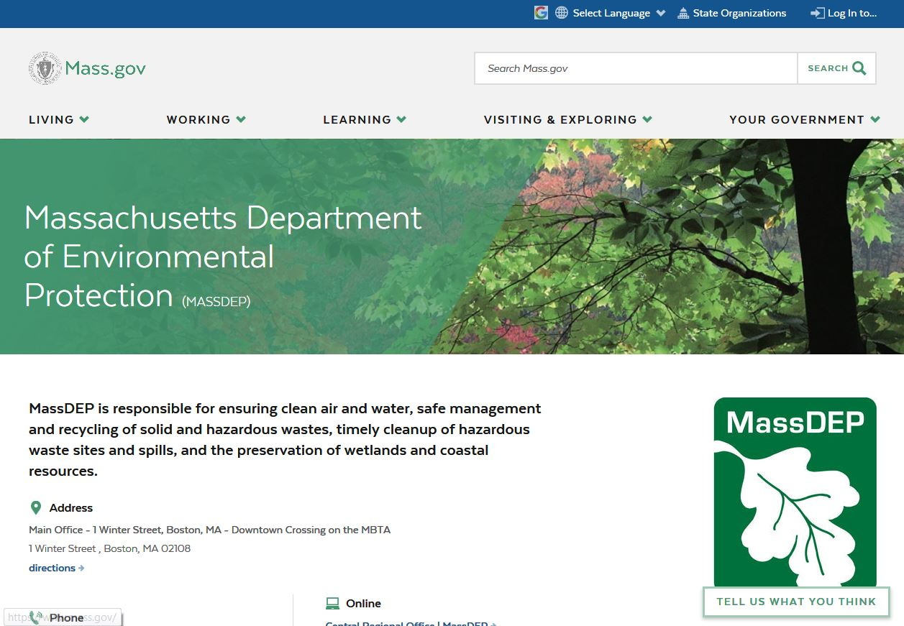

Slide 21
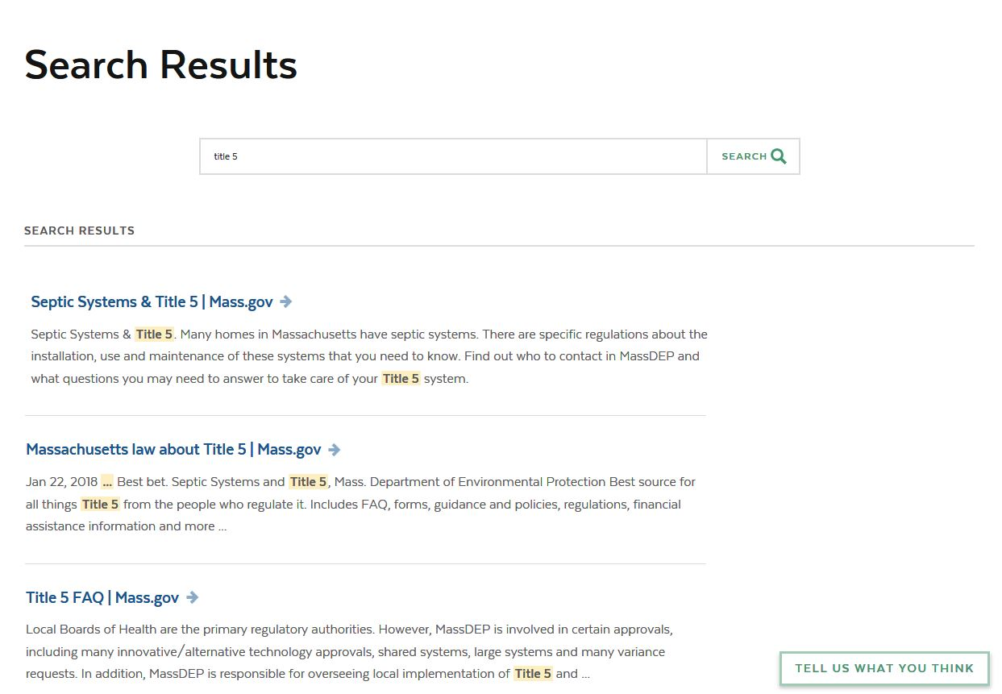

Slide 22
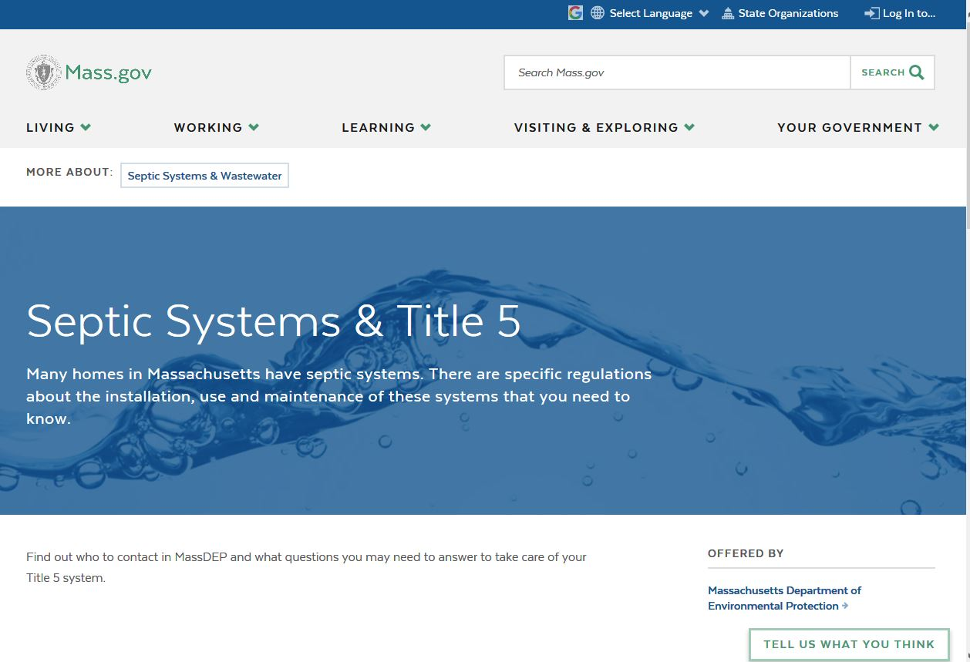

Slide 23
But there are still some old webpages….

Slide 24
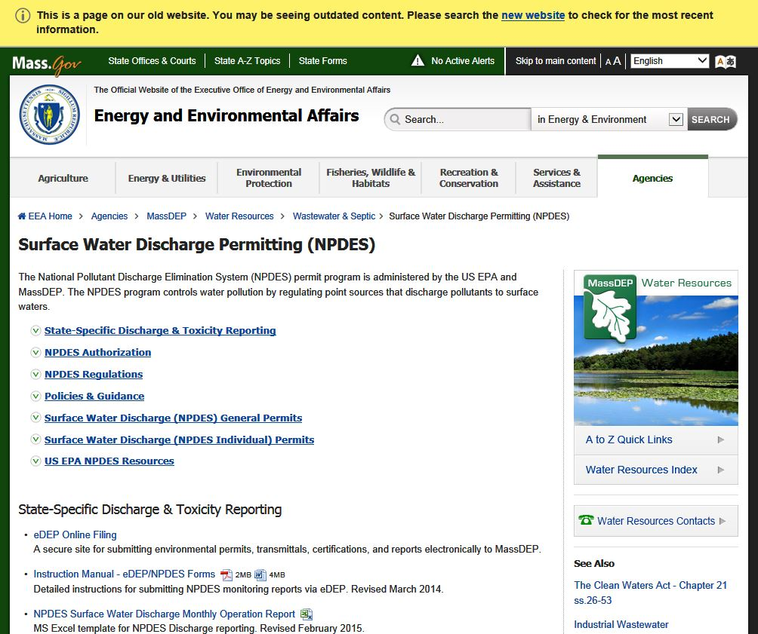

Slide 25


Slide 26
Thank you!

