Slide 1

Construction Inspections for the Inexperienced Inspector
Ted P. Doucette, P.E.

Slide 2

Professional background
California Polytechnic State University at San Luis Obispo –
BS Environmental Engineering
Weston & Sampson Engineers, Inc.
Wind River Environmental
Polaris Engineering
Samiotes Consultants
Full-time Dad – Doucette Engineering

Slide 3
First Impressions
THESE MATTER
Hand Shake
Dress Code?
Attitude
Don’t tip your hand?
Overcompensating
Be on time

Slide 4
Supplies for effective inspections
Field book, writing implement
Tape measure(s)
Camera
Regulations
Approved Plan

Slide 5
Construction inspection safety
Disclaimer – not OSHA substitute
Trench safety
On-site Equipment
Trip hazards
Pests
Heat / Cold

Slide 6
First contact – soil evaluation
Who you’ll meet
Excavation contractor
Soil Evaluator
Owner
Inspector’s (witness) responsibilities
What to record

Slide 7
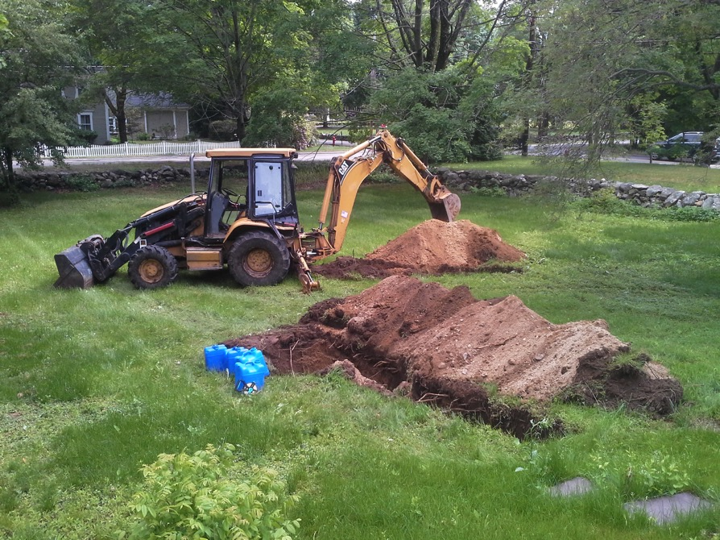
Mainstone Farm, Wayland

Slide 8
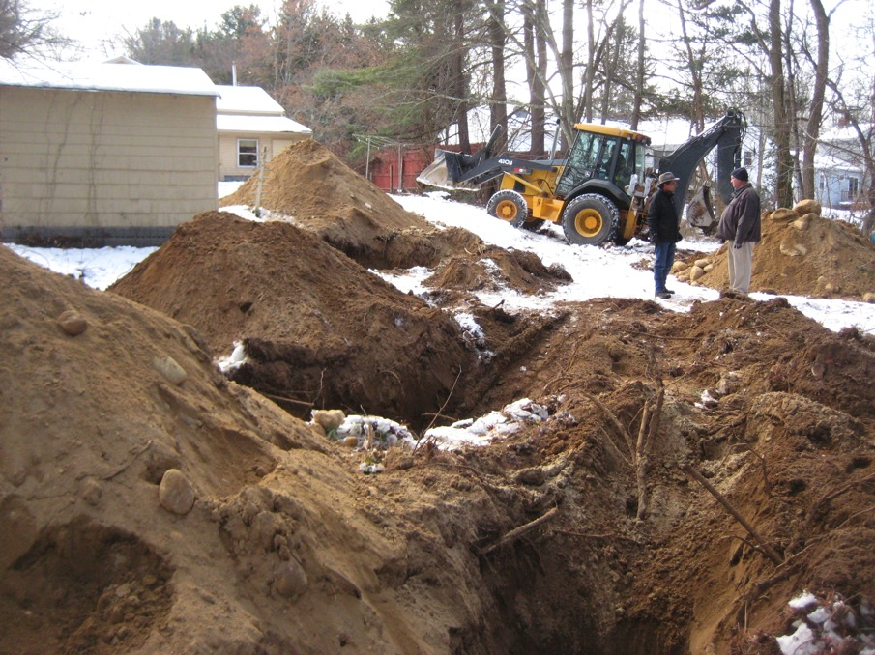
18 Arrowhead Road, Concord

Slide 9
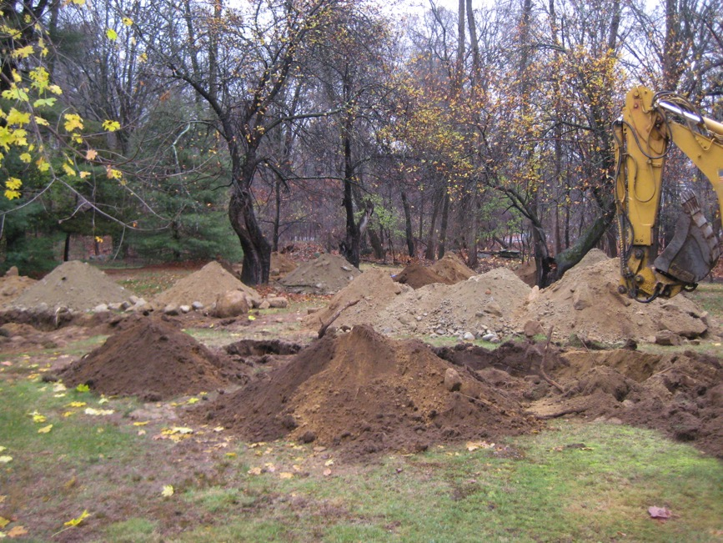
39 Mill Street, Framingham

Slide 10
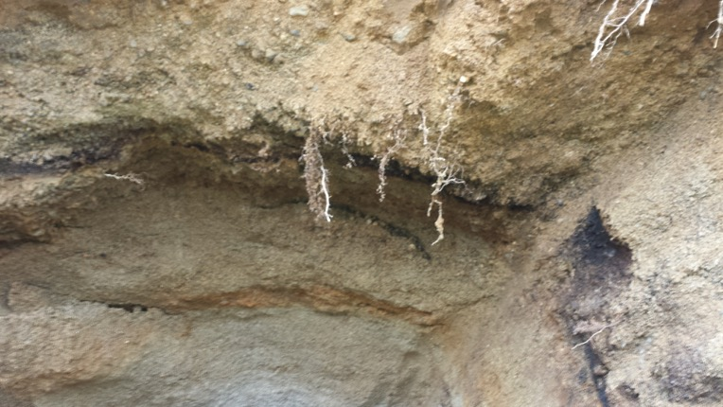
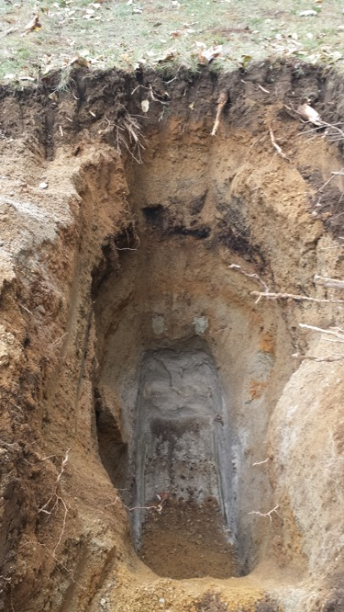
29 Circuit Drive, Stow

Slide 11
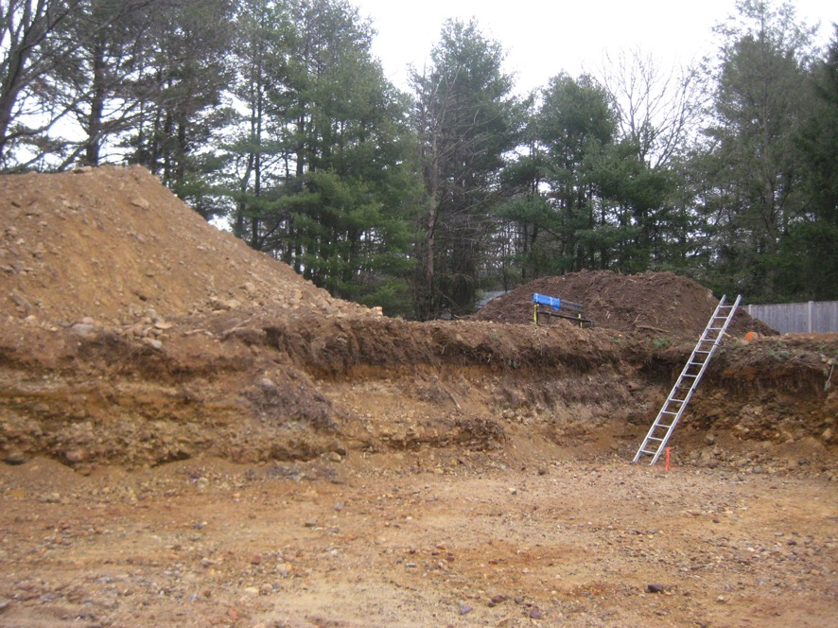
12 Maybury Road, Sudbury

Slide 12
second contact – bottom of bed inspection
Who you’ll meet
Excavation contractor
Bring the approved plan
Correlate what you see with the plan
Inspector’s (witness) responsibilities
What to record

Slide 13
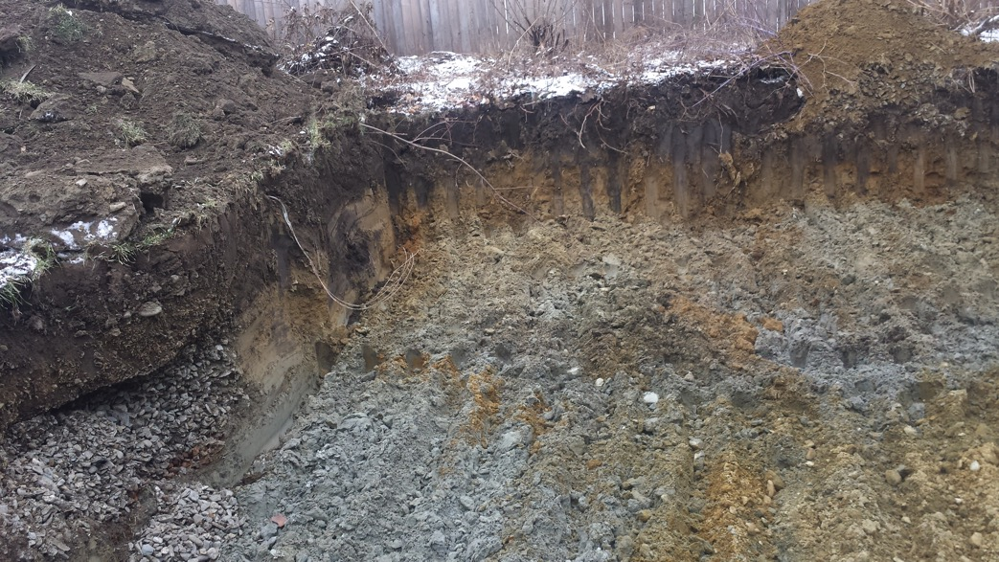
8 Intervale Street, Boylston

Slide 14
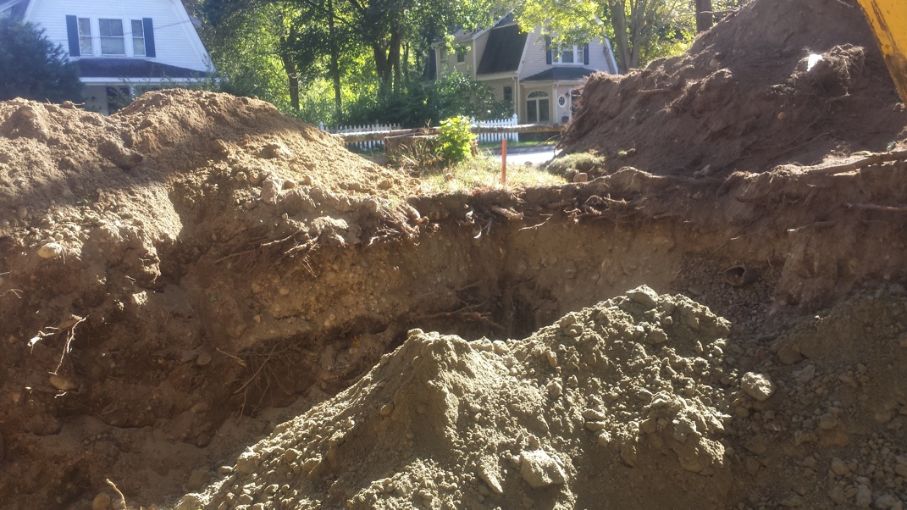
258 Commonwealth Road, Wayland

Slide 15
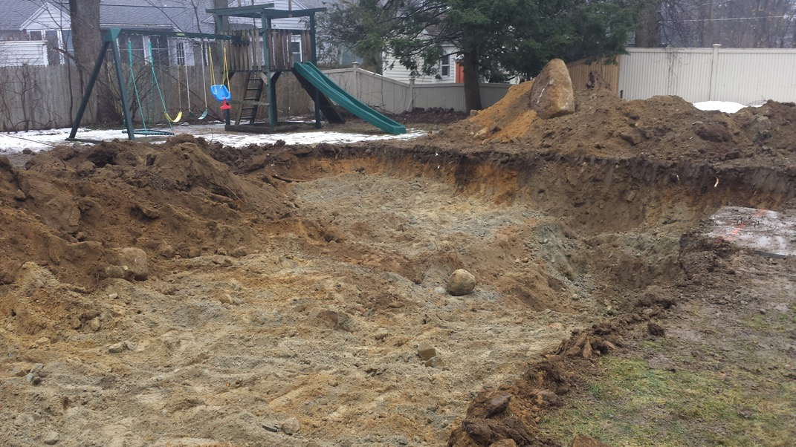
42 Massasoit Road, Sudbury

Slide 16
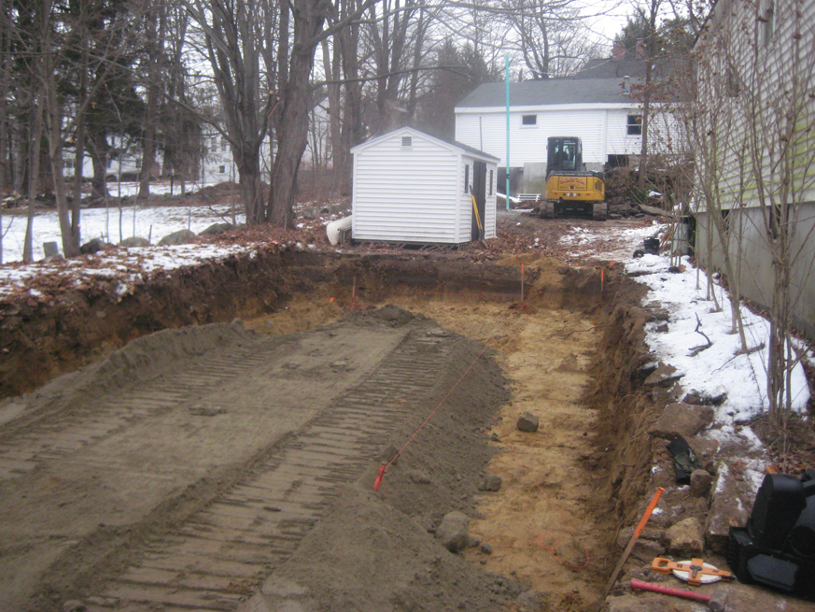
47 Foster Street, Littleton

Slide 17
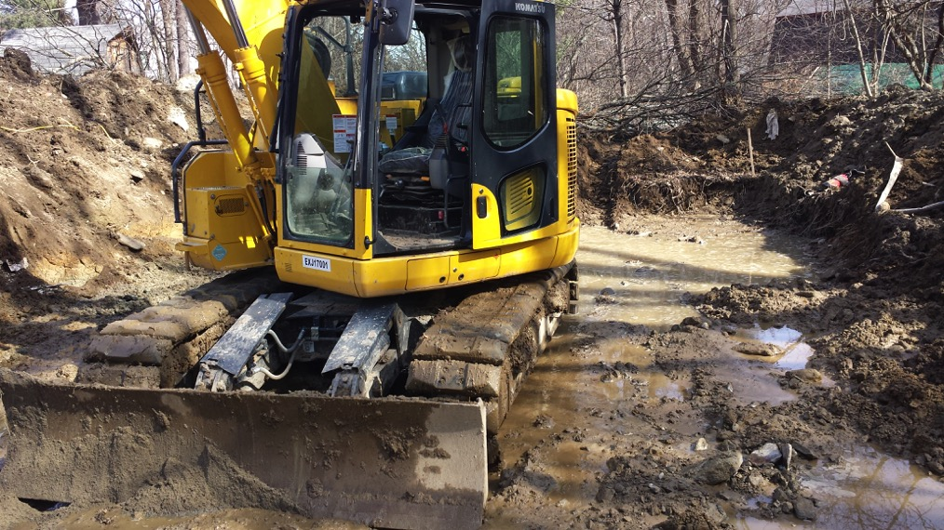
64 Barnes Hill Road, Berlin

Slide 18
third contact – as-built inspection
Who you’ll meet
Excavation contractor
Designer?
Bring the approved plan

Slide 19
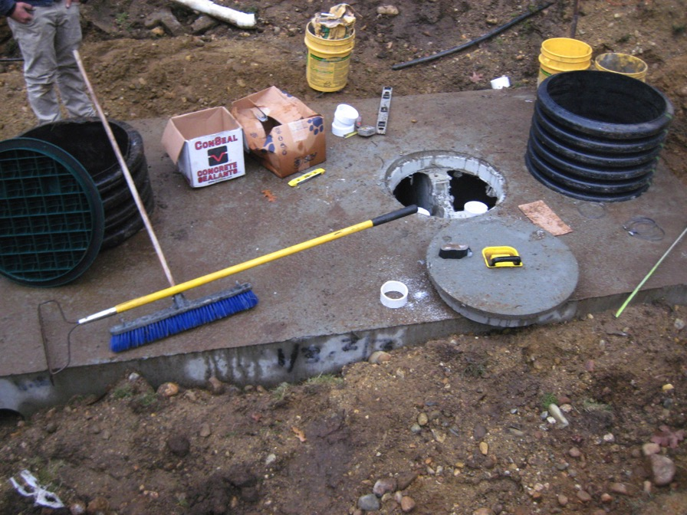
232 Dutton Road, Sudbury

Slide 20
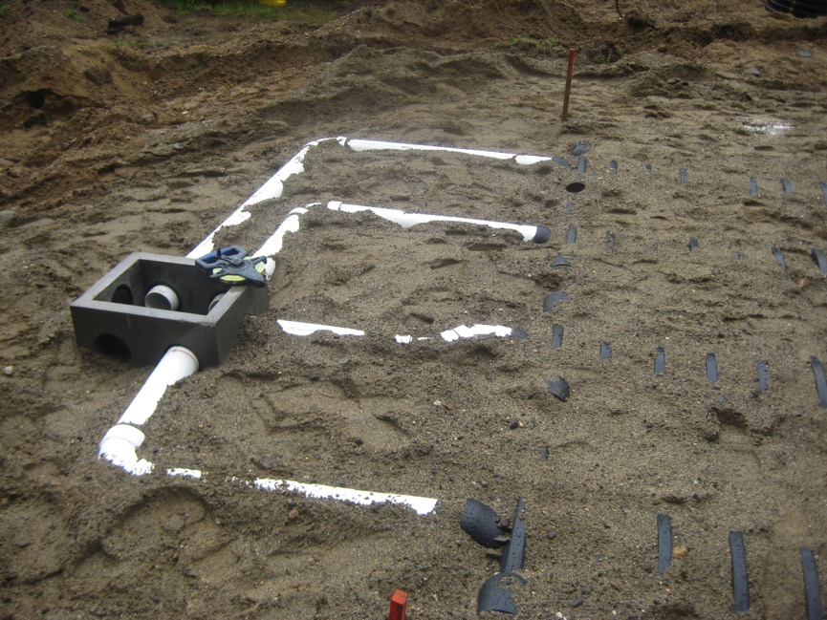
29 Circuit Drive, Stow

Slide 21
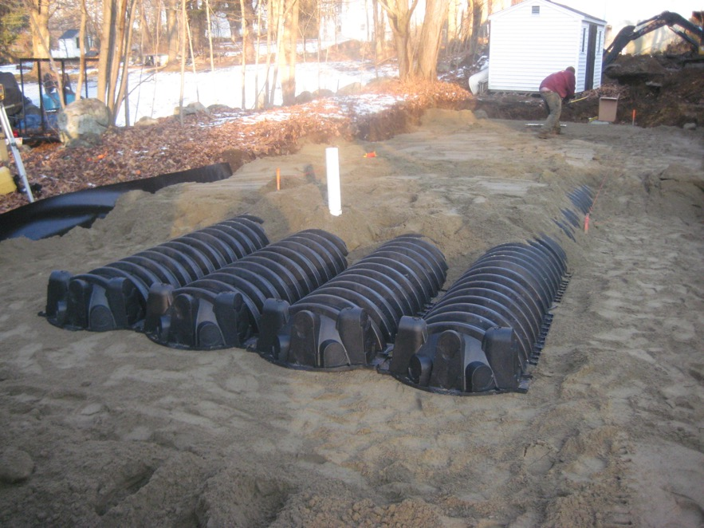
47 Foster Street, Littleton

Slide 22
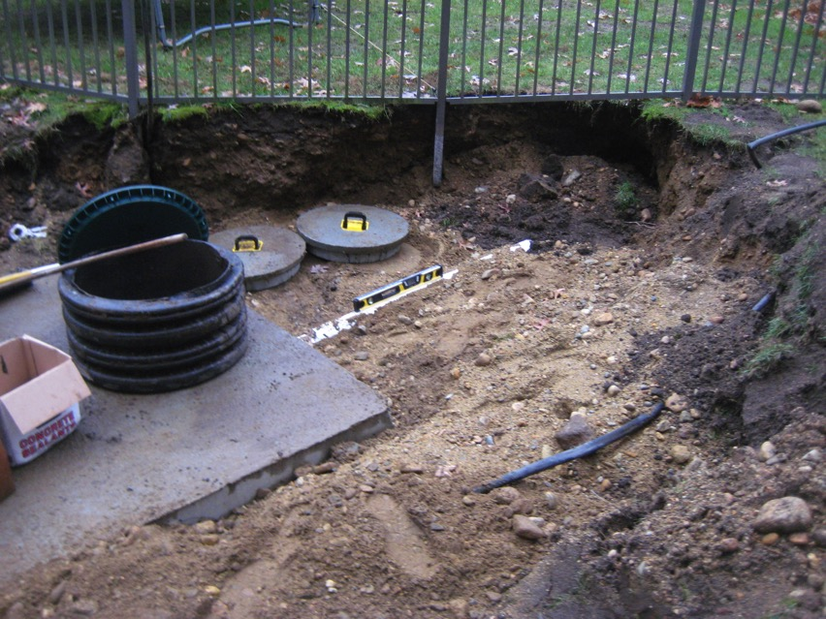
232 Dutton Road, Sudbury

Slide 23
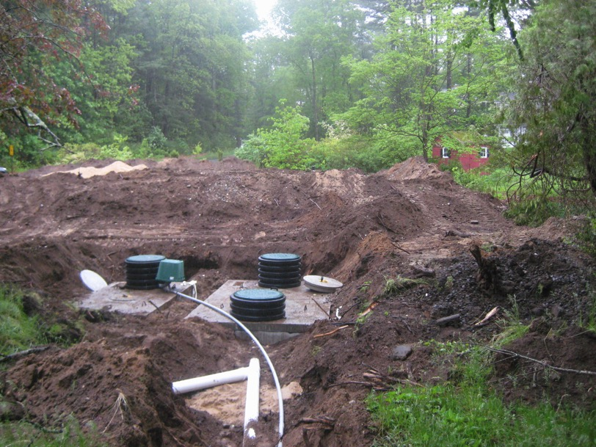
73 Glezen Lane, Wayland

Slide 24
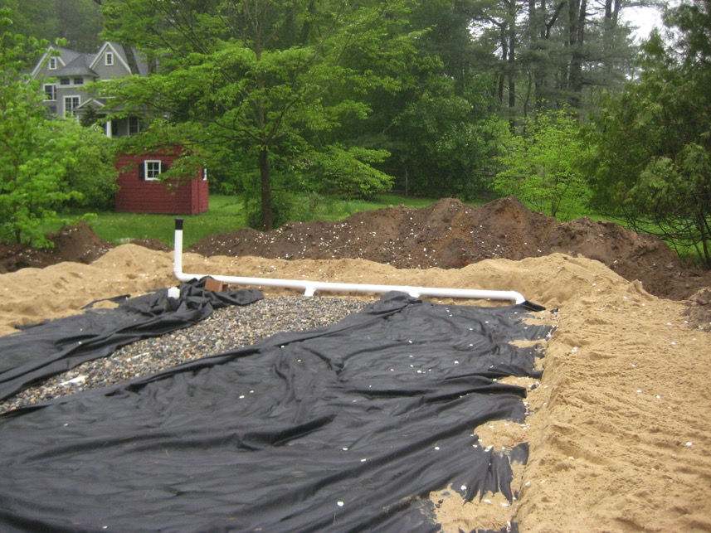
73 Glezen Lane, Sudbury

Slide 25
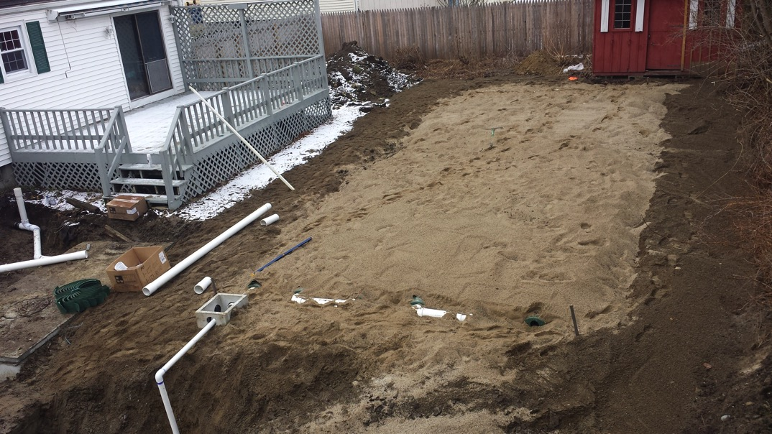
8 Intervale Road, Boylston

Slide 26
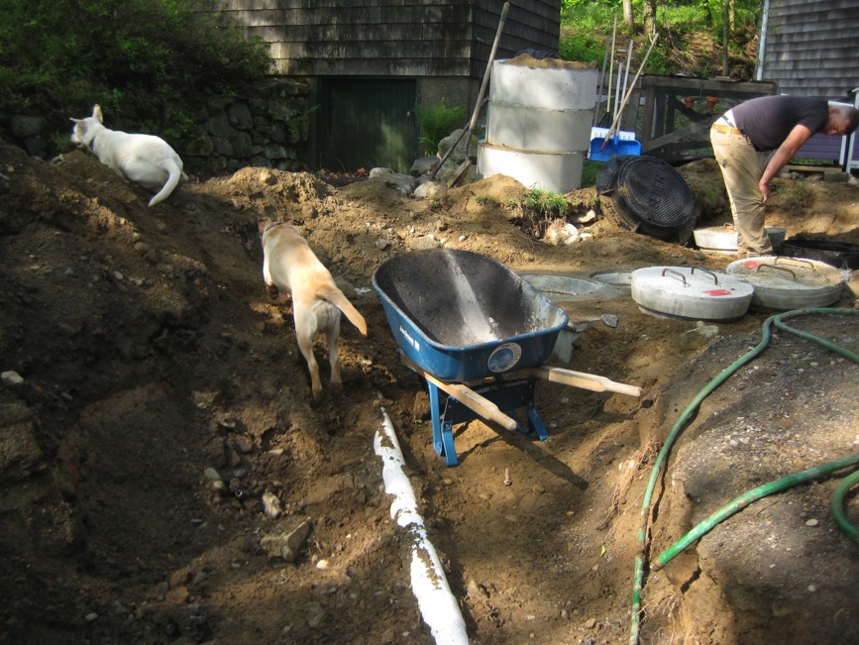
Mainstone Farm, Wayland

Slide 27
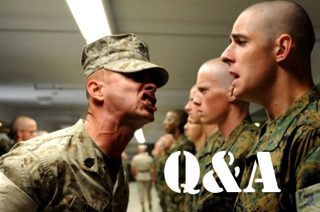

Slide 28
