Slide 1
Green Building with Onsite Wastewater Treatment Systems:
A Comparison of O&M Energy Use and Carbon Generation
Jonathan Kaiser
Project Engineer • Infiltrator Water Technologies
Massachusetts Environmental Health Association (MEHA)
2018 Educational Seminar • Taunton, MA
March 7, 2018
Notes:
Previous study (Kautz, 2015):
Study examined environmental and economic benefits: manufacture and construction

Slide 2
Key Take-Aways
Onsite vs. centralized treatment
  Reduced carbon emissions
  Reduced energy use
  Reduced cost
Onsite is a viable and sustainable alternative to a centralized WWTP

Slide 3
Introduction

Slide 4
Population and Wastewater Infrastructure
Geographic migration shifts housing demand
Increased potable water demand amplifies domestic wastewater production
Wastewater infrastructure needs change with population growth and shifts
Notes:
World’s population increased at a rate of 80 million people per year
US adding over 6,000 people per day (2010 – 2016)
Wastewater infrastructure supporting a population must react to population changes on local level.
Construction of new homes served by onsite or expansion of footprint/capacity of WWTPs

Slide 5
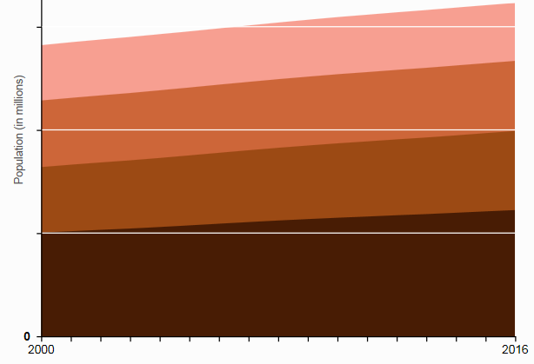
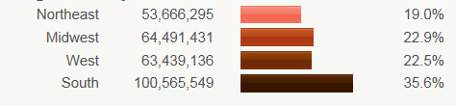
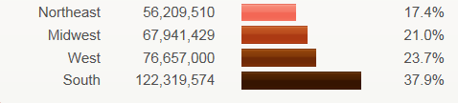
US Census Bureau Population Data
300
Northeast
Midwest
Population (millions)
200
Population (millions)
West
100
South
0
)
2000
2016
2000 Regional Population Data
2016 Regional Population Data
Notes:
Describe top figure
Describe percentage distribution and migration trends from two charts below

Slide 6
US Census Bureau Population Data
2000 Regional Population Data
2016 Regional Population Data
West added 13.2 million people
  2,200 people per day
South added 21.7 million people
  3,700 people per day
Population migration and growth create significant demand for new wastewater infrastructure

Slide 7
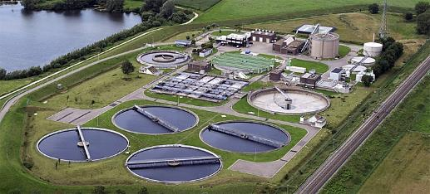
Centralized vs Onsite Wastewater Management
Centralized WWTPs:
Treat 75% of wastewater nationally
Energy-intensive conveyance and treatment processes
Require chemical additions and pump stations
Provide a high degree of treatment
Often discharge to a surface water body
Notes:
Dry-weather flows: WWTPs generally treat all wastewater generated daily
Wet-weather flows: WWTs often overwhelmed, require relief points along network
Raw sewage directly discharged into surface waters (SSOs or CSOs).
US EPA: 1.26 trillion gallons each year

Slide 8
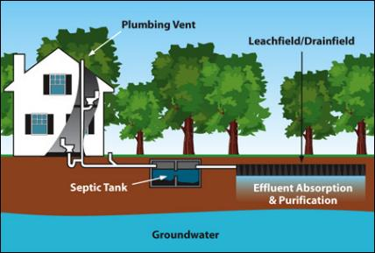
Centralized vs Onsite Wastewater Management
Onsite Wastewater Treatment:
Soil-based treatment system
Often passive
  Relatively low O&M requirements
  Low capital cost
Natural physical, chemical, and biological processes
Notes:
Describe picture below
Why low O&M requirements? 90% of FTE treatment occurs in soil for properly installed systems
Wastewater dispersed using gravity-flow or pressurized methods (small electric pump)

Slide 9
Wastewater Treatment Options
Centralized WWTP
Onsite
Frequently pumped
Energy-intensive treatment processes
Chemical additions common
Typically surface water discharge
Typically gravity-fed
Soil-based treatment system
Typically no energy or chemicals
Recharges groundwater

Slide 10
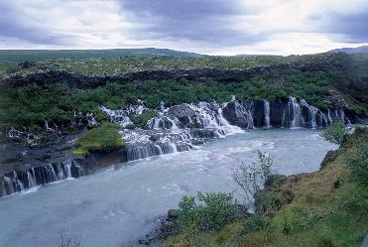
Common Goal
Both centralized WWTPs and onsite wastewater treatment systems aim to meet the goal of the Clean Water Act of 1972:
Regulate the release of contaminants into the water system.
Notes:
CWA (1972):
Establishes basic structure for regulating discharge of pollutants and water quality standards for surface waters
EPA implemented pollution control programs
Made it unlawful to discharge any pollutant from a point source into navigable waters, unless a permit was obtained
Clean Water State Revolving Fund (1987): federal-state partnership that provides communities a permanent, independent source of low cost financing for water quality infrastructure projects.
10

Slide 11
The Flow of Sewage and Funding
Over 25% of existing homes in the U.S. currently utilize decentralized wastewater treatment
0.4% of Clean Water State Revolving Funds for decentralized wastewater treatment systems
75% Centralized
0.4% Decentralized
99.6% Centralized

Slide 12
The Flow of Sewage and Funding
In 2014, NOWRA began lobbying Congress for additional support of onsite wastewater
NOWRA’s goal is to bring onsite funding more in line with the balance of onsite and centralized wastewater treatment nationally
Study intended as a tool for quantifying the economic and environmental advantages of passive onsite wastewater treatment systems
Notes:
OWT creates private-sector business opportunities
OWT are one of the few sources that recharges the nation’s dwindling groundwater supplies
From Carl:
NOWRA lobbying objectives: secure a larger share of existing federal funding for wastewater treatment (decentralized only receives 0.4% of federal wastewater treatment spending)
Language was placed in the FY 2017 House Appropriations bill, requiring EPA to provide more financial and human resources to support decentralized wastewater treatment – NOWRA is working to support a new bill in the legislative season that encourages the consideration of onsite/decentralized whenever federal $ will be spent on wastewater systems for small communities
The Decentralized Wastewater Recycling Congressional Caucus was formed in the US House of Representatives.
It provides our industry with access to members who not only support onsite/decentralized wastewater, but who we can approach to help advance our goals of growing the market for onsite systems, increasing the share of federal funding our industry receives, and establishing policies at the federal agency level which don’t discriminate against our industry – Eric Casey

Slide 13
Study Overview

Slide 14
GOALS
Quantify O&M
  Treatment cost
  Embodied carbon (EC)
  Embodied energy (EE)
Types of systems examined
  Small centralized WWTPs (<2 mgd)
  Medium centralized WWTPs (2 - 22 mgd)
  Gravity onsite wastewater treatment systems
  Pump onsite wastewater treatment systems
    Pump-to-gravity
    Low-pressure pipe
Notes:
“The total primary energy consumed and carbon released over a lifetime”
Centralized WWTP capacity selection: based on rural and suburban areas. Large WWTPs serving densely populated urban areas are generally not treating wastewater originating from low-population-density areas.
Gasoline EC: 9 kg CO2/gal
Gasoline EE: 18 MJ/gal

Slide 15


What is embodied carbon and embodied energy and how is it obtained?
The total primary energy consumed and carbon released over a life cycle
Unit conversion factors for energy sources and chemicals obtained through LCA tools

Slide 16
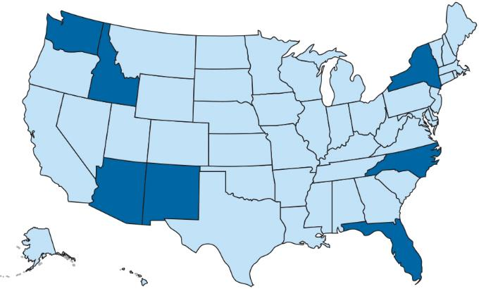
Location of 17 Centralized WWTPs
Notes:
Info from Freedom of Information Laws
Information collected: wastewater flow, electrical usage and cost, fuel usage and cost, O&M costs, influent and effluent water quality parameters, and the types and quantities of chemicals used for treatment.

Slide 17
Gravity Onsite Wastewater Treatment
Water quality:
  Sewage and septic tank effluent BOD and TSS concentrations based on University of Arkansas study (Gross, 2004)
  Soil-based treatment system achieves 90% BOD and TSS removal (Siegrist, 2014)
3-bedroom daily household flow rate of 640 liters per day (WERF 2007)
Non-electric system
Septic tank pump-outs every four years
Notes:
Sewage: BOD/TSS: 250 mg/l
STE: 120 mg/l and 60 mg/l (BOD/TSS)
After soil column: 12 mg/l and 6 mg/l (BOD/TSS)
Pump outs every four years: Barnstable County Wastewater Cost Task Force

Slide 18
Pumped Onsite Wastewater Treatment
Water quality:
  Same sewage, septic tank effluent, and soil treatment assumptions as gravity system
Pump run-time data based on 12 homes monitored during a 2014 North Carolina Department of Health and Human Services (DHHS) field demonstration program
3-bedroom daily household flow rate of 640 liters per day (WERF, 2007)
Septic tank pump outs every four years
Pump replaced every 11 years
U.S. average electricity cost of $0.13/kWh
Notes:
Pump data and run times were monitored for at least one year. Specific pump size and run times were used to calculate site-specific kilowatt hours.
- U.S. average electricity cost: EIA 2017 Residential Average

Slide 19
Results

Slide 20
Treatment Cost

Slide 21
Average Treatment Cost

Slide 22
Embodied Carbon Footprint

Slide 23
Average Embodied Carbon Footprint

Slide 24
Average Embodied Carbon Footprint

Slide 25
Embodied Energy Footprint

Slide 26
Average Embodied Energy Footprint

Slide 27
Average Embodied Energy Footprint

Slide 28
Total Annual Savings
1
2
3
Cost Savings
CO₂ Emission
Savings
Energy
Savings
Cost savings using onsite gravity and pump systems
compared to centralized WWTPs

Slide 29
Total Annual Savings in North Carolina
Over 321,000 onsite gravity and pump systems are installed in North Carolina (DHHS, 2017)
Assuming 60% gravity and 40% pump
Operating onsite systems in lieu of centralized systems reduces the cost of wastewater treatment
Based on study data, annual savings compared to centralized treatment: $218 million
Notes:
Median annual household income in Taunton, MA: $54,785. (2016, U.S. Census Bureau)
$218 million is equal to 4,000 home annual incomes.

Slide 30
Total Annual Savings in North Carolina
Over 321,000 onsite gravity and pump systems are installed in North Carolina (DHHS, 2017)
Assuming 60% gravity and 40% pump
Operating onsite systems in lieu of centralized systems reduces carbon emissions
Annual CO₂ emission reduction:
Equivalent to removing over 37,000 cars
from road for one year

Slide 31
Total Annual Savings in North Carolina
Over 321,000 onsite gravity and pump systems are installed in North Carolina (DHHS, 2017)
Assuming 60% gravity and 40% pump
Operating onsite systems in lieu of centralized systems reduces energy usage
Annual energy savings:
Equivalent to removing over 2,400 homes from electrical grid for one year
Notes:
Equals the number of new building permits in Bristol County, MA from 2012-2016

Slide 32
Conclusions

Slide 33
Benefits of Onsite Wastewater Management
Passive onsite wastewater treatment is highly effective
  - Save money
  - Reduce carbon emissions
  - Reduce energy consumption
Provides distinct advantages as part of the country’s wastewater infrastructure solution
Federal funding for the onsite industry should be adjusted to reflect national usage statistics
Notes:
Promotes private-sector jobs created by small businesses
Shifts installation and O&M costs associated with wastewater to the homeowner, rather than the municipality
Recharges nation’s dwindling groundwater supplies

Slide 34
Key Take-Aways
Onsite vs. centralized treatment
  Reduced carbon emissions
  Reduced energy use
  Reduced cost
Onsite is a viable and sustainable alternative to a centralized WWTP

Slide 35

Questions?
Jonathan Kaiser jkaiser@infiltratorwater.com
(860) 577-7081
Thank you!
Linkedin: https://www.linkedin.com/in/jonathan-kaiser-76248310b/

