Slide 1
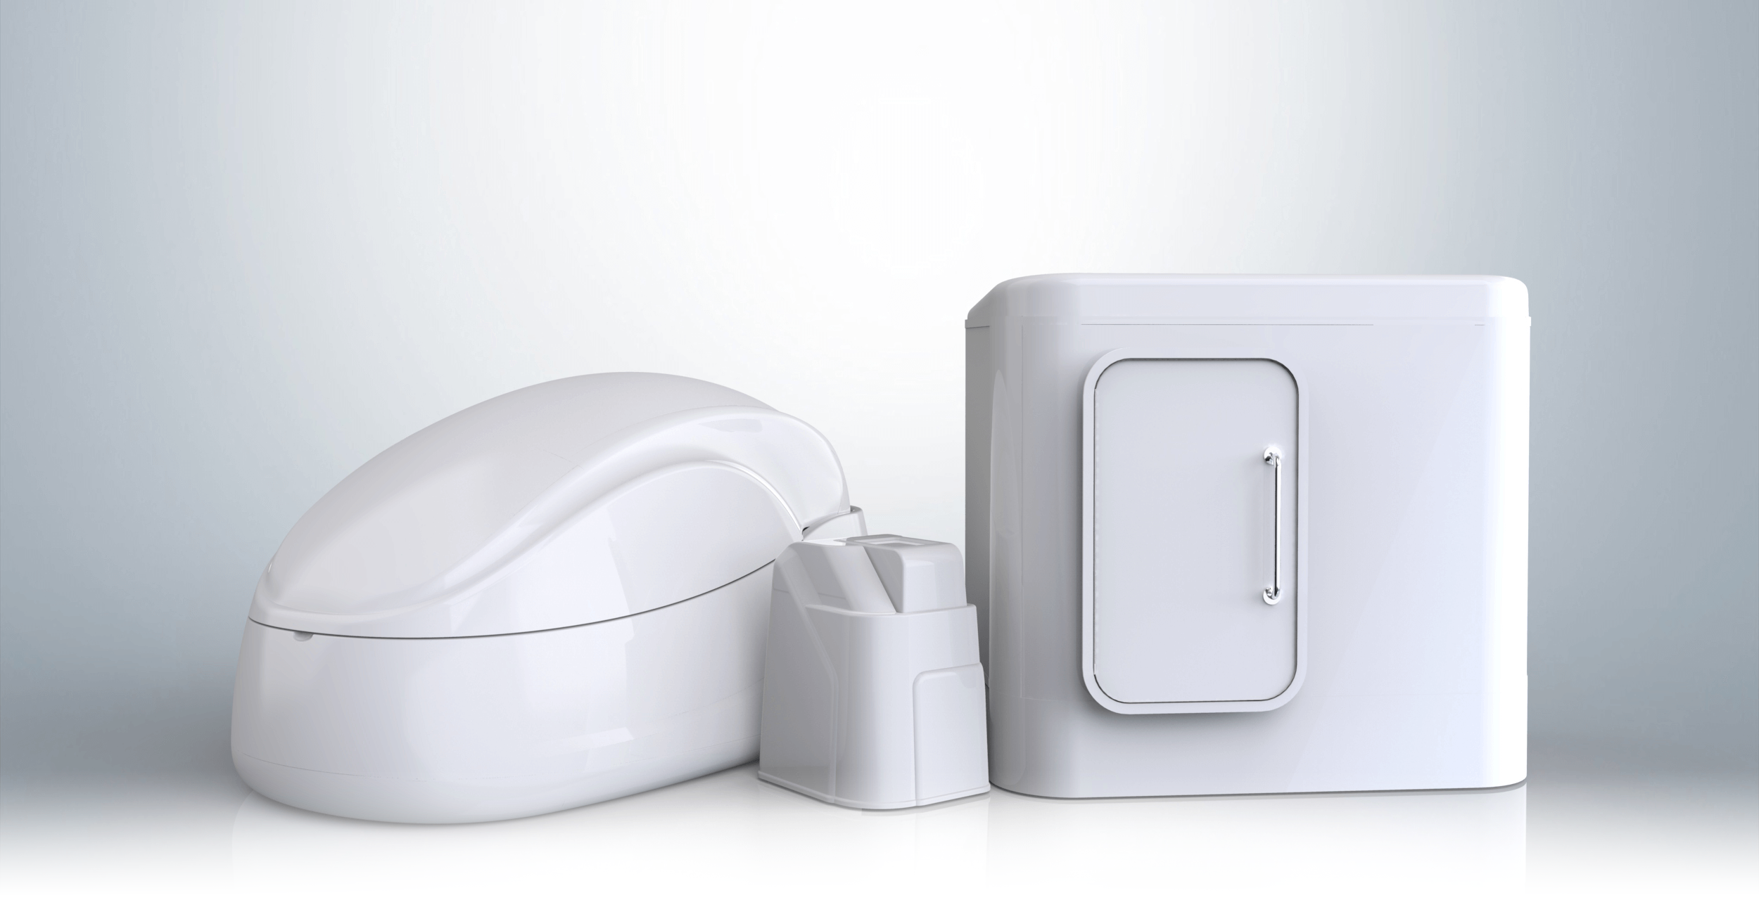
Float Tanks:
Sanitation, Research, and Regulations
Ashkahn Jahromi
ashkahn@floathq.com
Graham Talley
graham@floathq.com

Slide 2
What Are Float Tanks?

Slide 3
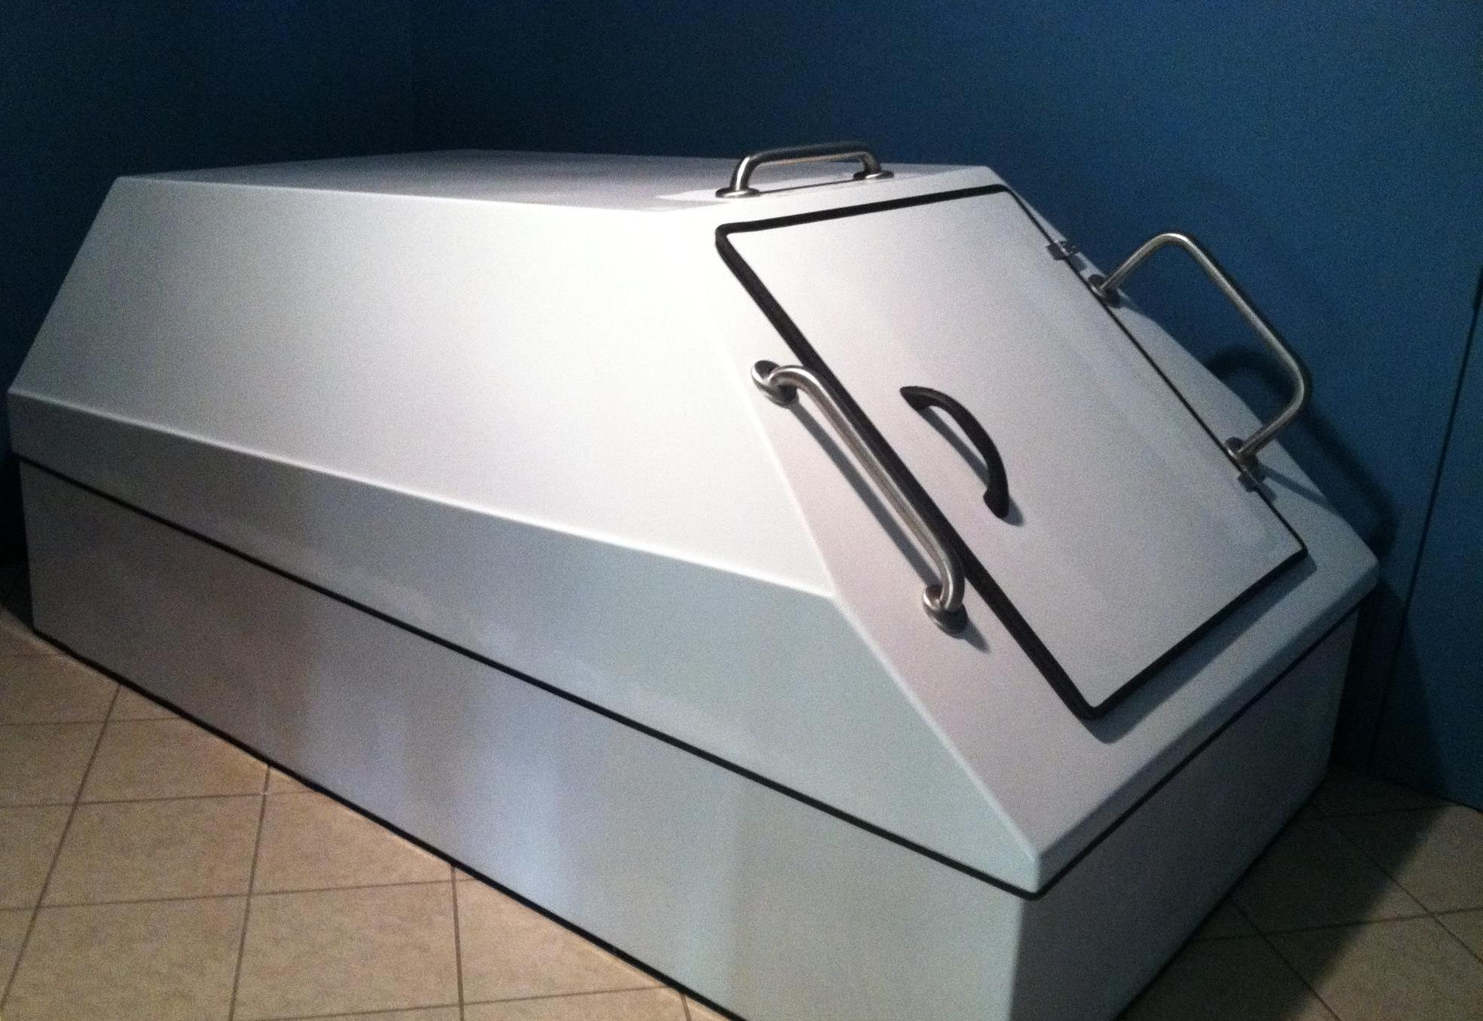
8’
5’

Slide 4
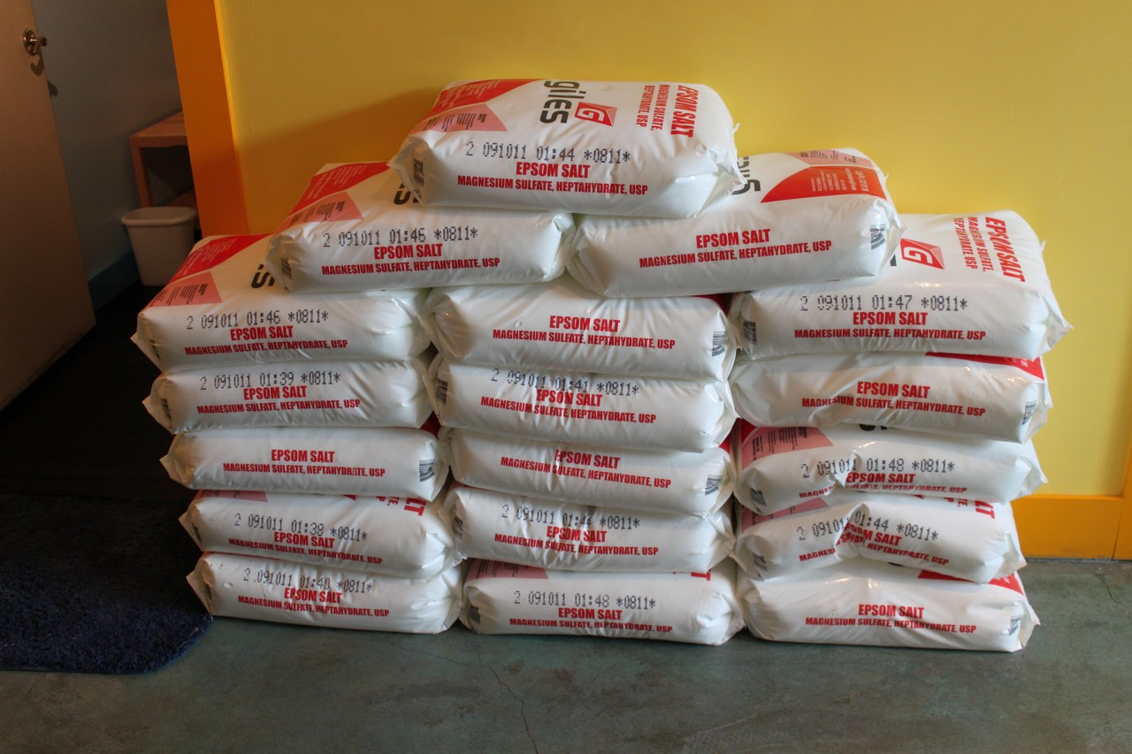
900 lbs

Slide 5
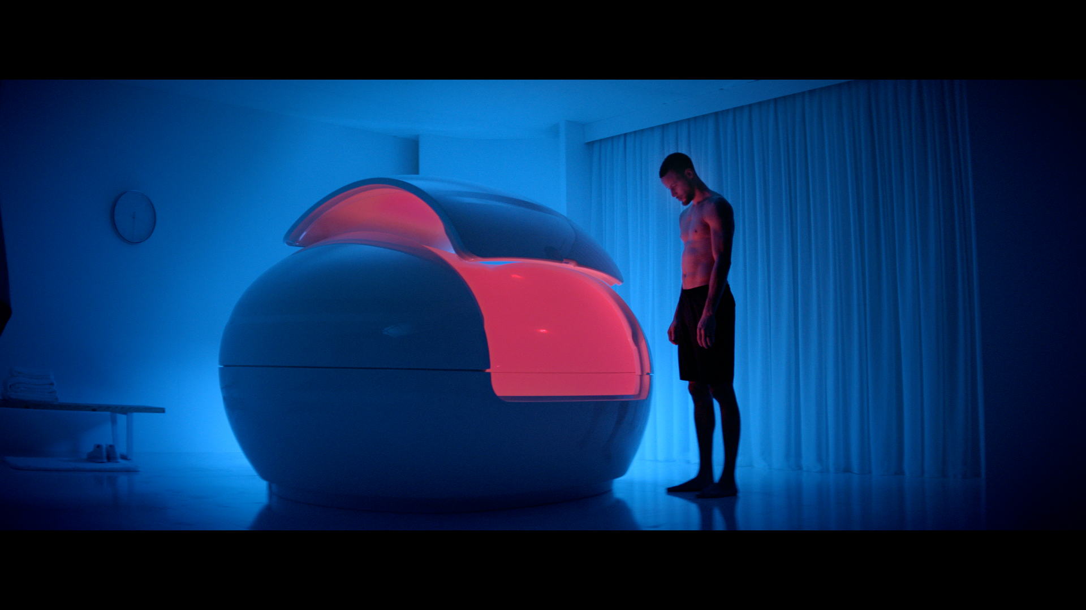

Slide 6
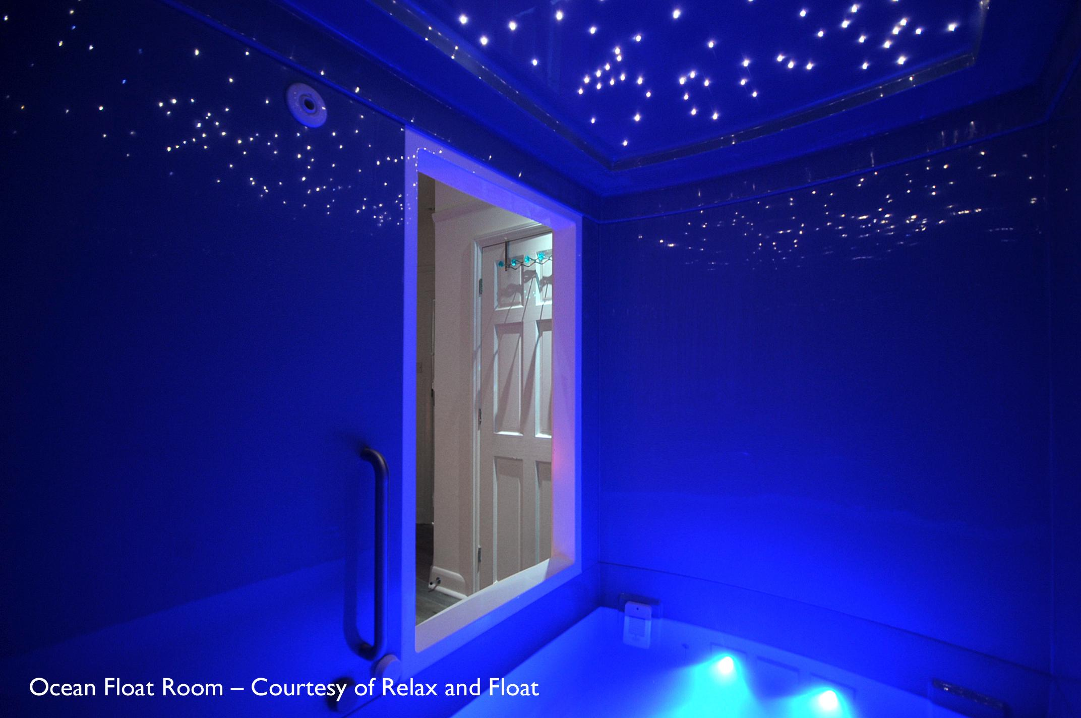
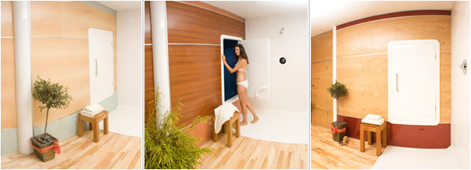
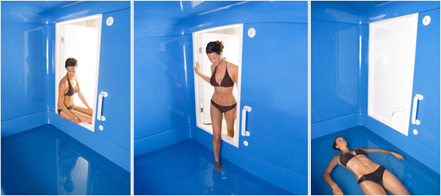

Slide 7
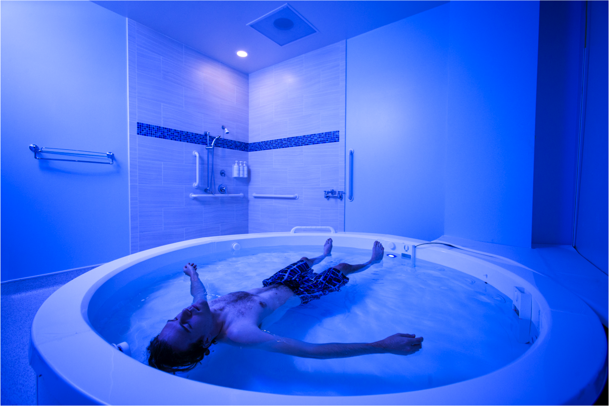
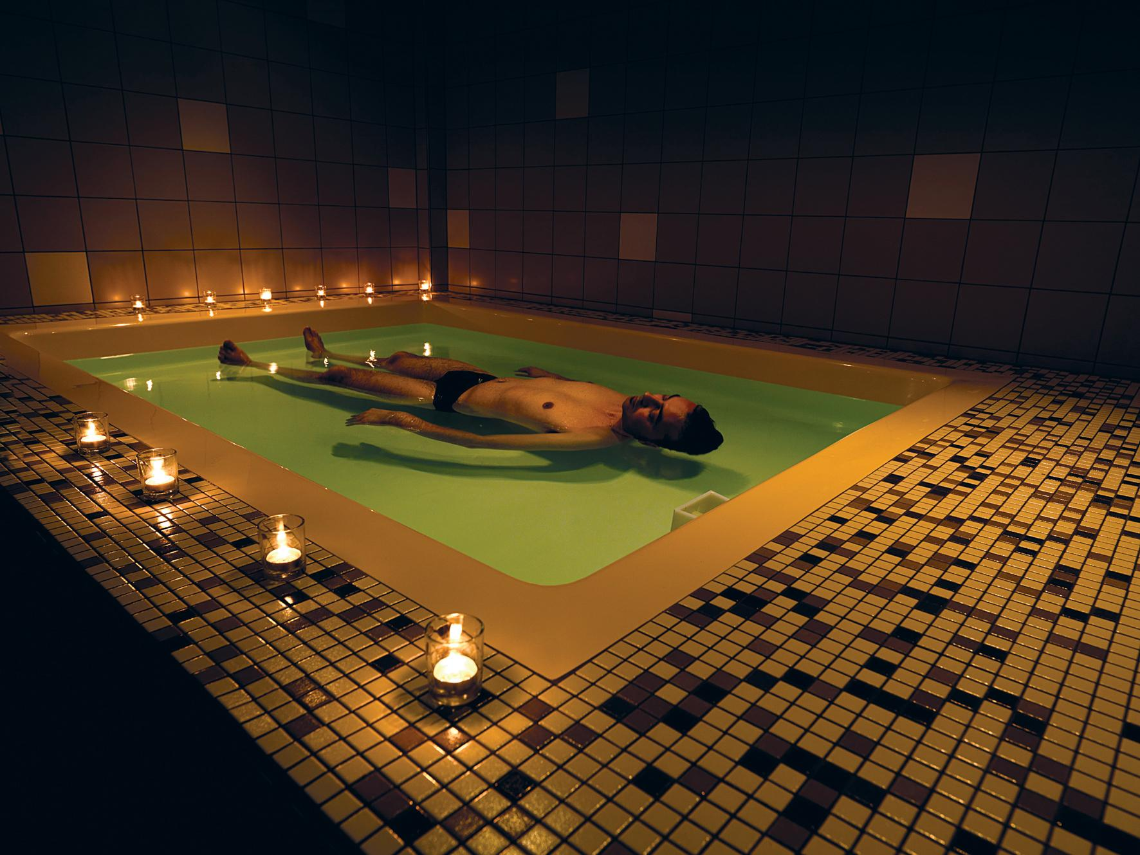
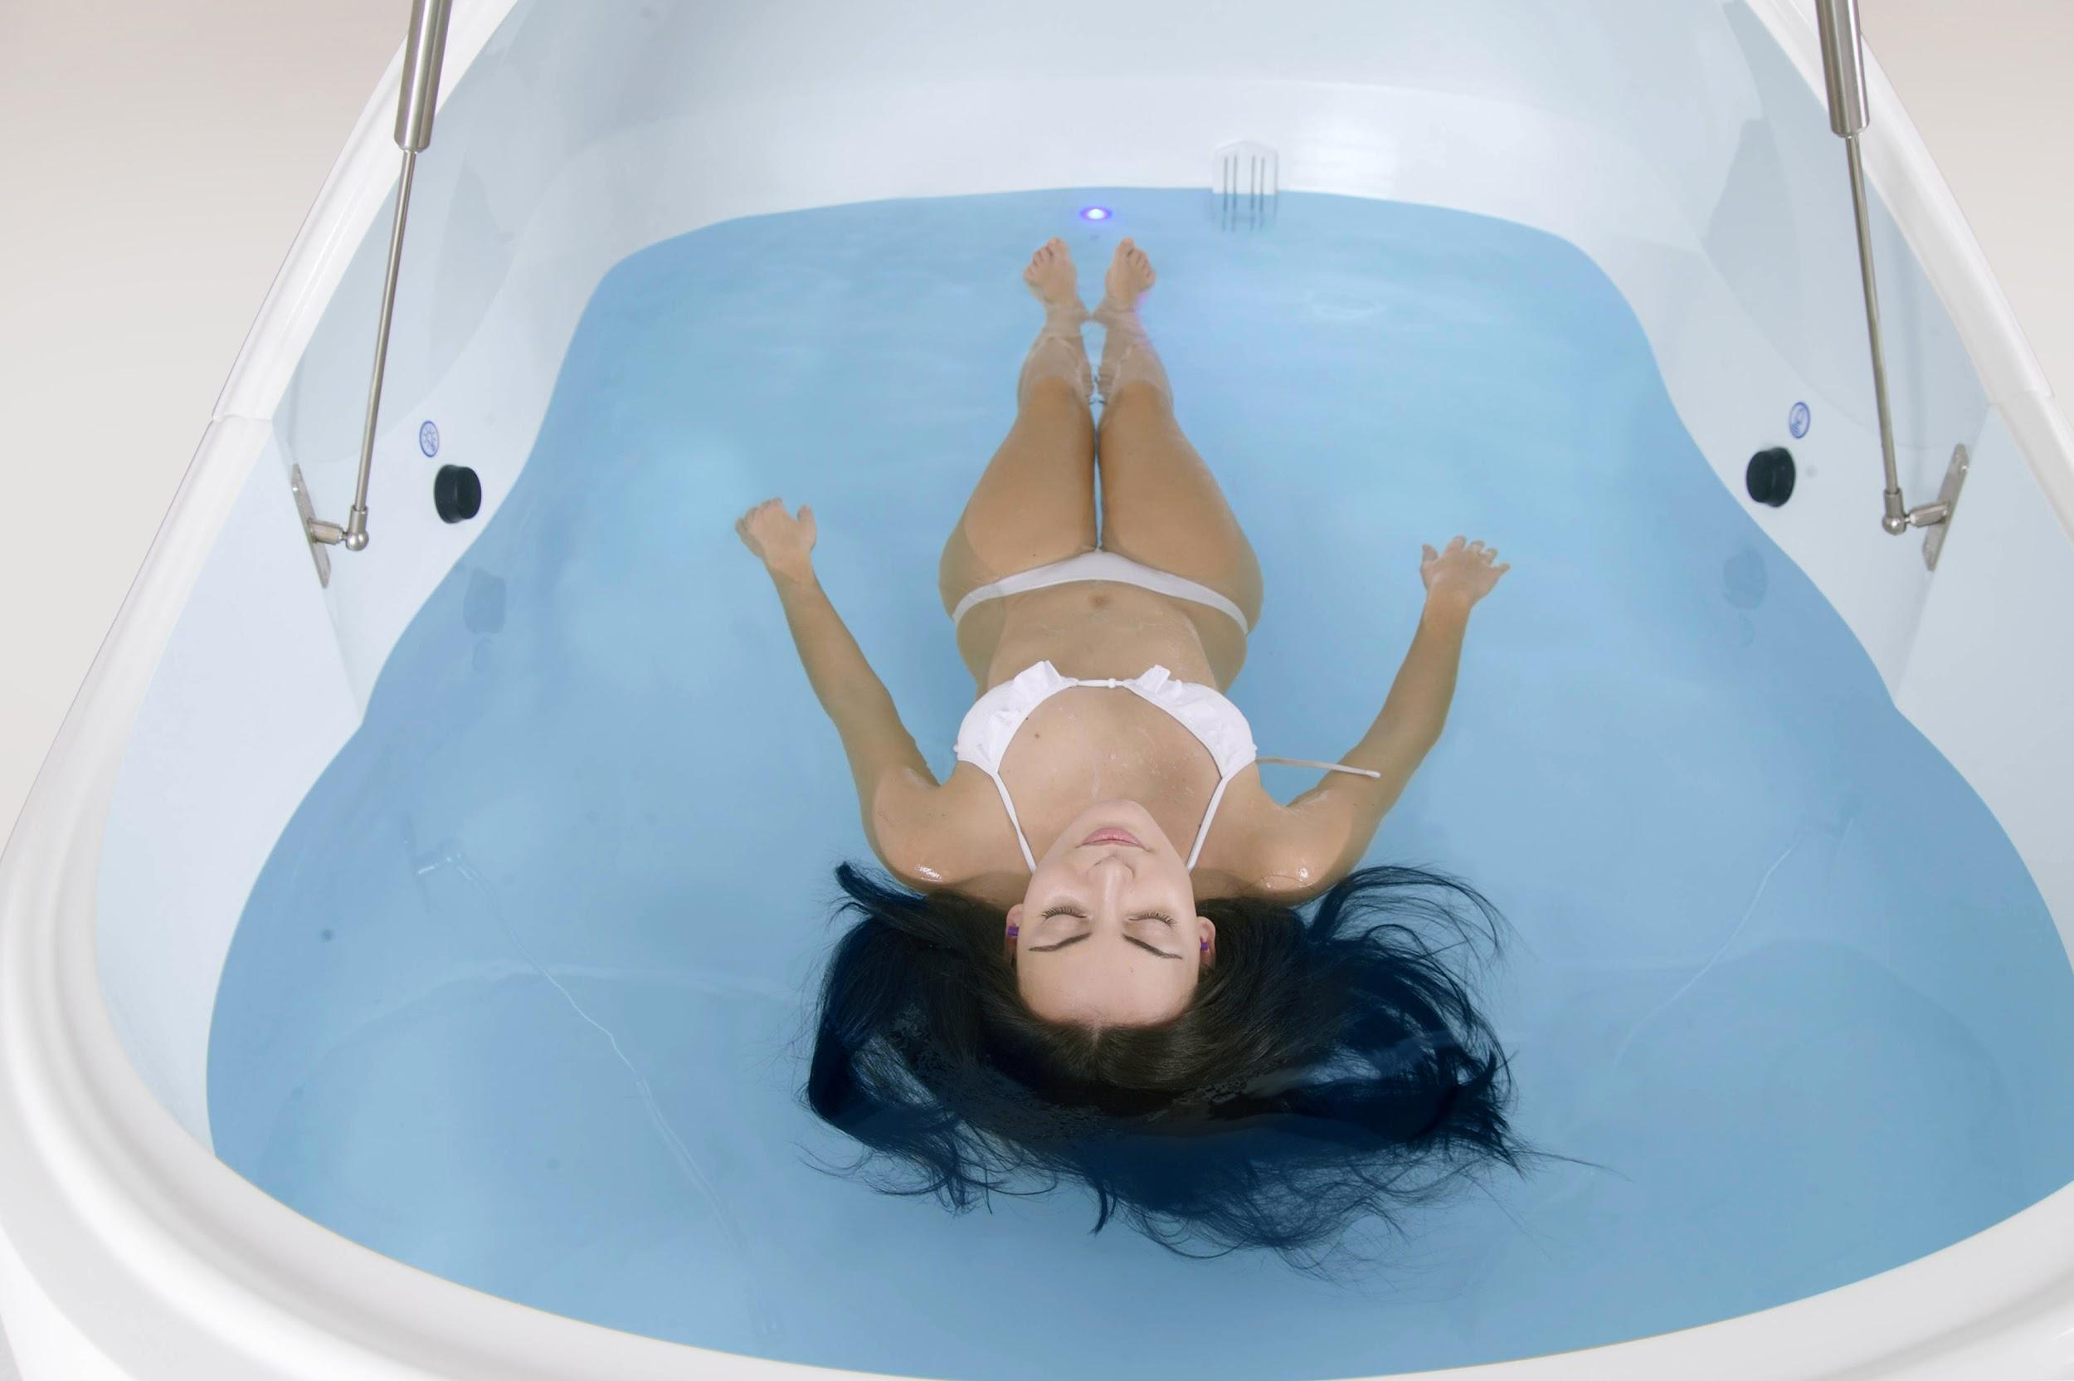

Slide 8
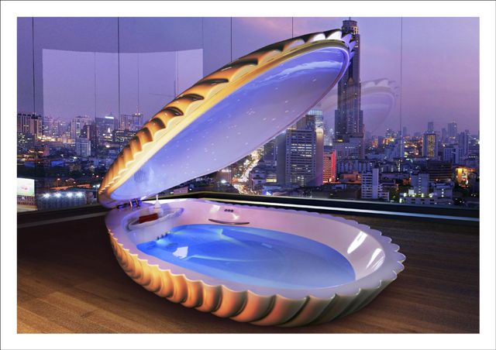

Slide 9
Why People Float
Rest & Recovery
Chronic Pain
Injury Recovery & Prevention
Addiction
Insomnia
Acute Stress Conditions (PTSD)
Meditation & Mindfulness
Exploration

Slide 10



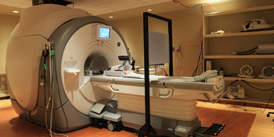

Slide 11
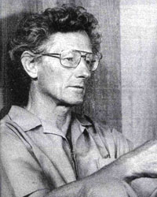

Slide 12
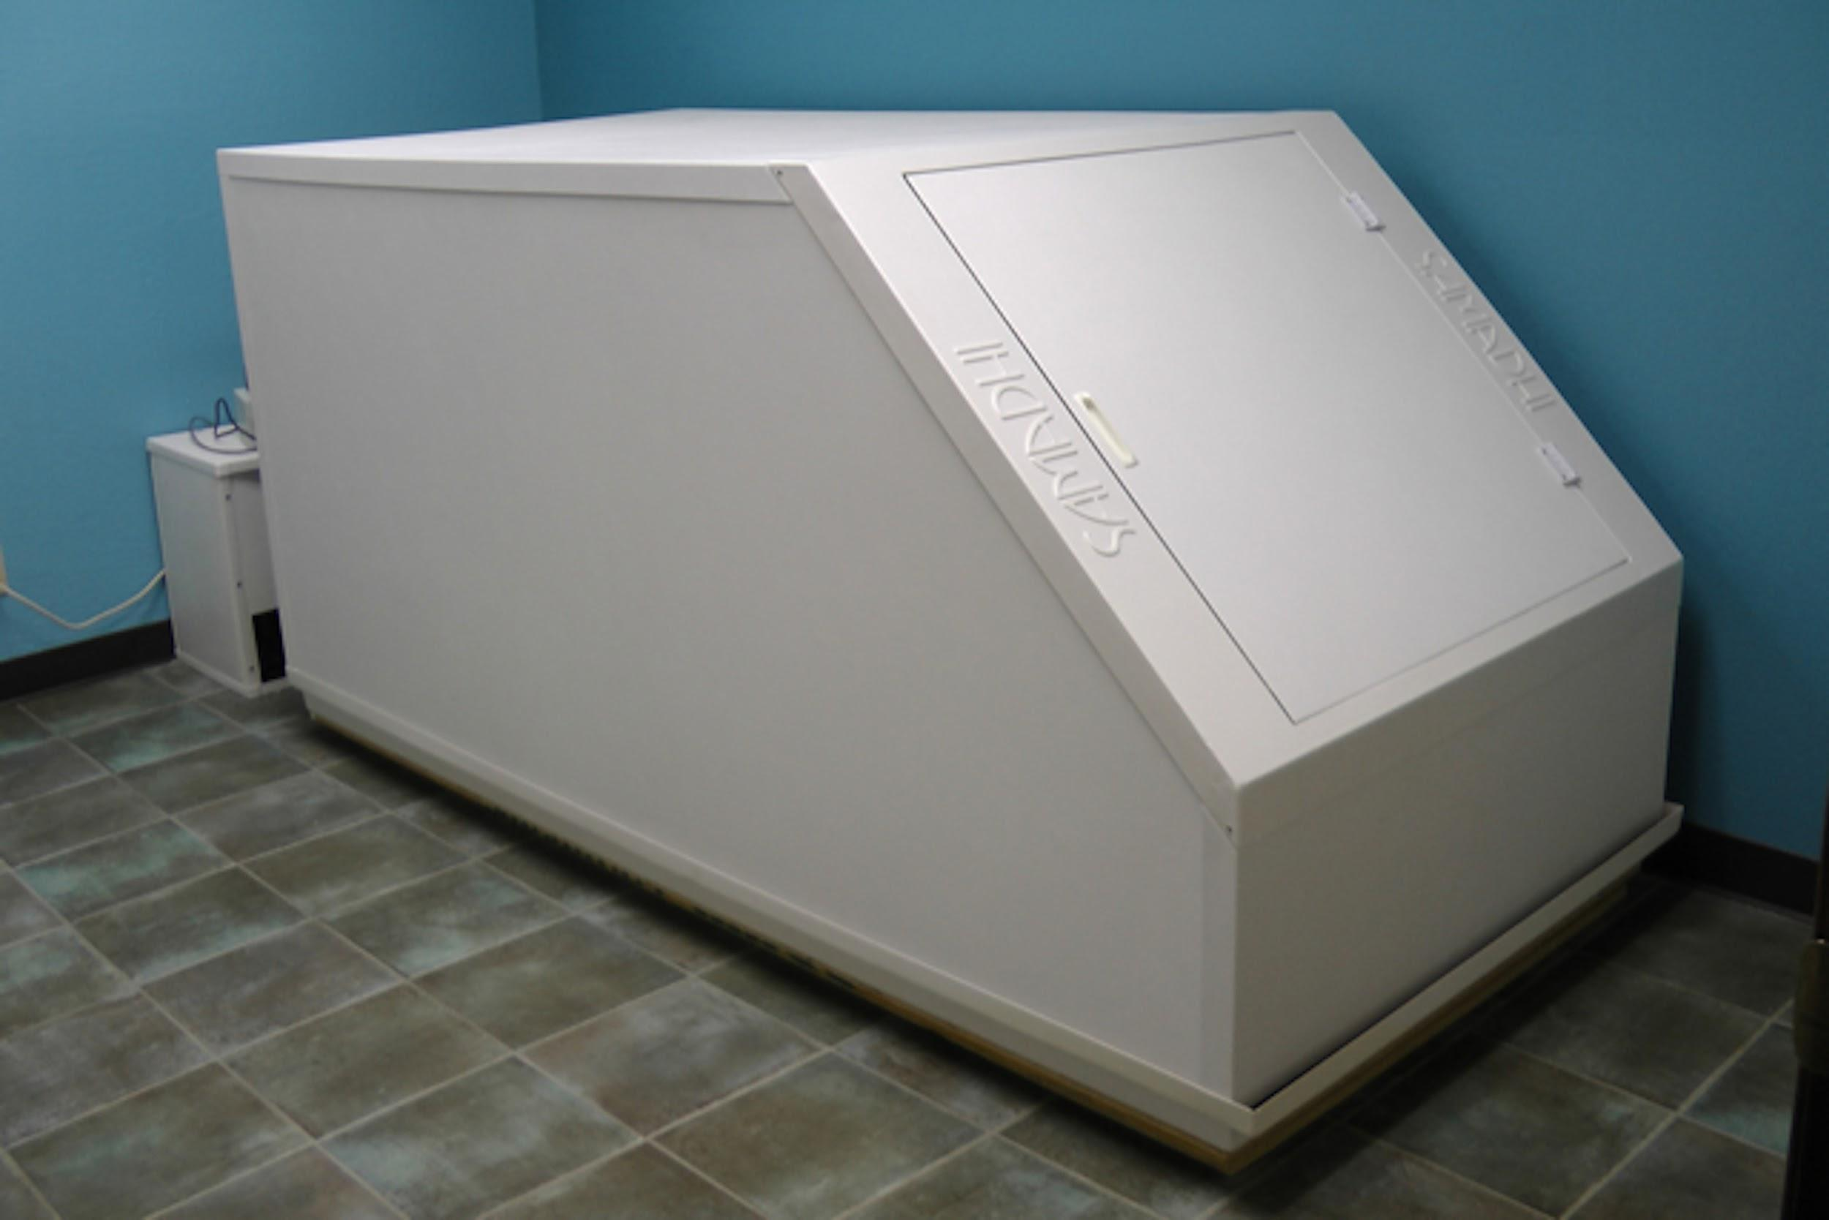

Slide 13
What’s different about float tanks?

Slide 14
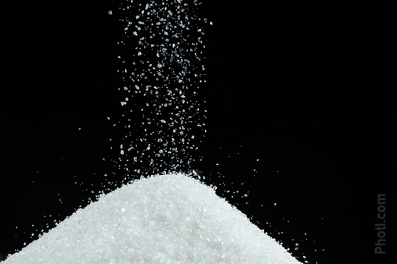
The salt makes the
float solution expensive, so dumping it is only
a last resort.
The salt in the solution makes it extremely corrosive.
Magnesium Sulfate has a significant impact on water chemistry.

Slide 15
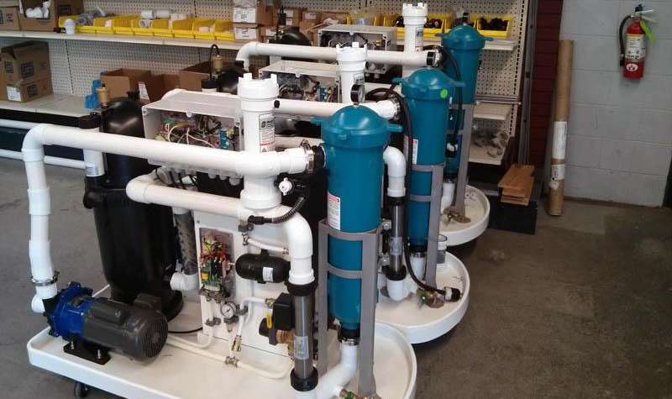
Pumps run between users, not during floats.
Filtration systems are self-contained.

Slide 16
Different level
of risk.

Slide 17
The salt solution is more slippery than regular water.

Slide 18
You’re unmonitored when floating.

Slide 19
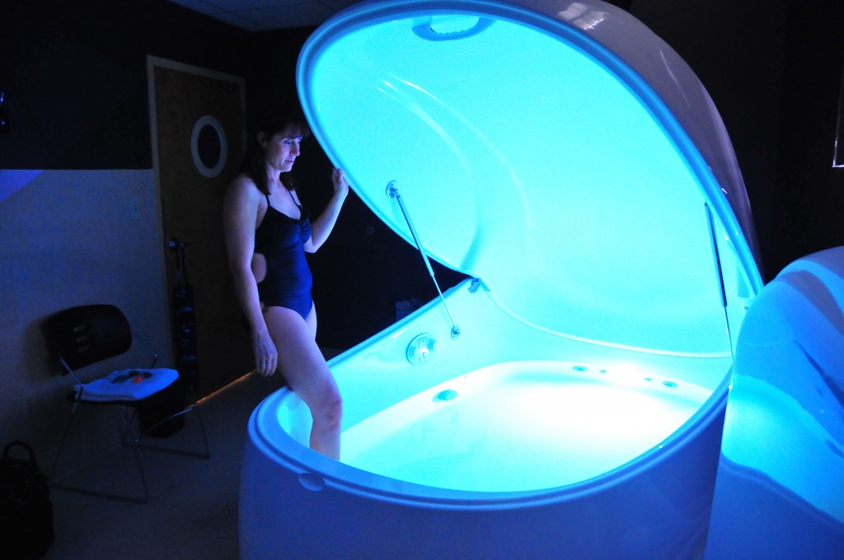
One client
at a time.
Visual check between users.

Slide 20
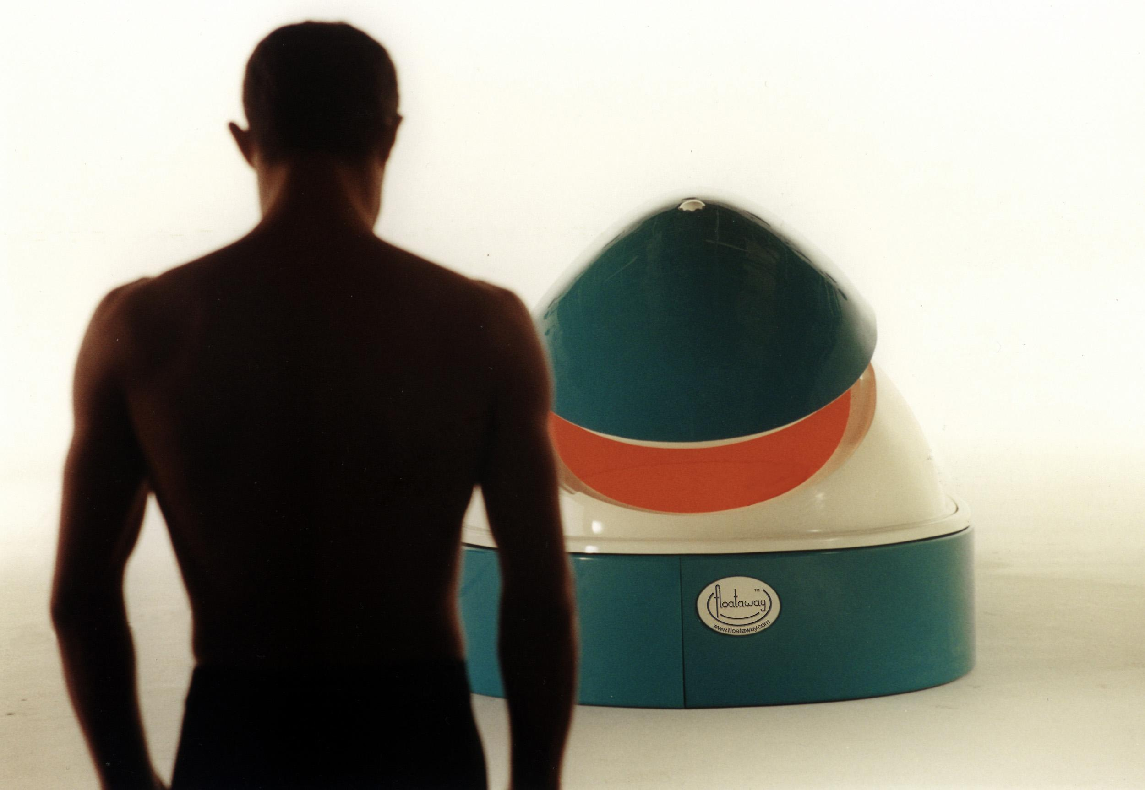
Almost no risk of swallowing the solution.
Shower before and after floating.
No kids in the tank.
Not active and sweating.
Only 11 inches of solution.

Slide 21
Different Treatment Systems

Slide 22
Salt

Slide 23
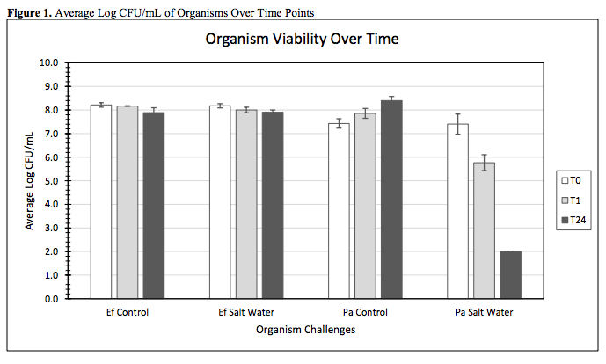

Slide 24
Salt
Chlorine / Bromine
UV + H2O2
Ozone (with or without UV)

Slide 25
Current State of Guidelines and Regulations

Slide 26

CCS 12804

Slide 27

4.12.11 & 5.12.11-0001

Slide 28
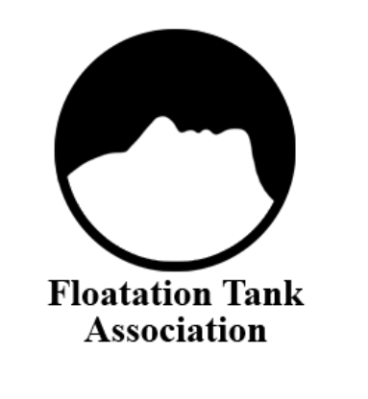
North American
Float Tank Standard
http://www.floatation.org/current-standard

Slide 29
Conclusions

Slide 30
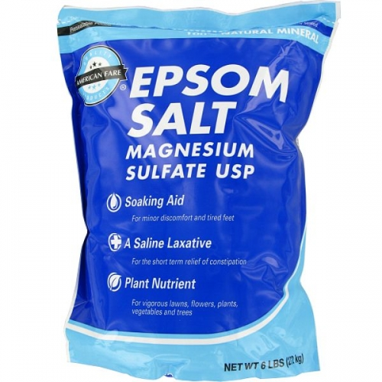
25% Magnesium Sulfate
Does Interesting Things to Water

Slide 31
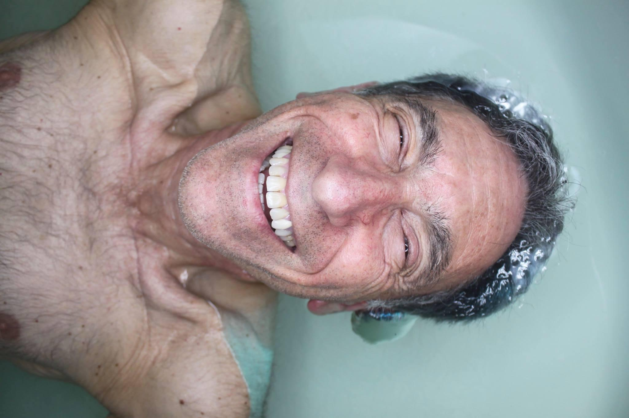
Floating is a low risk activity
that is helping a lot of people.

Slide 32
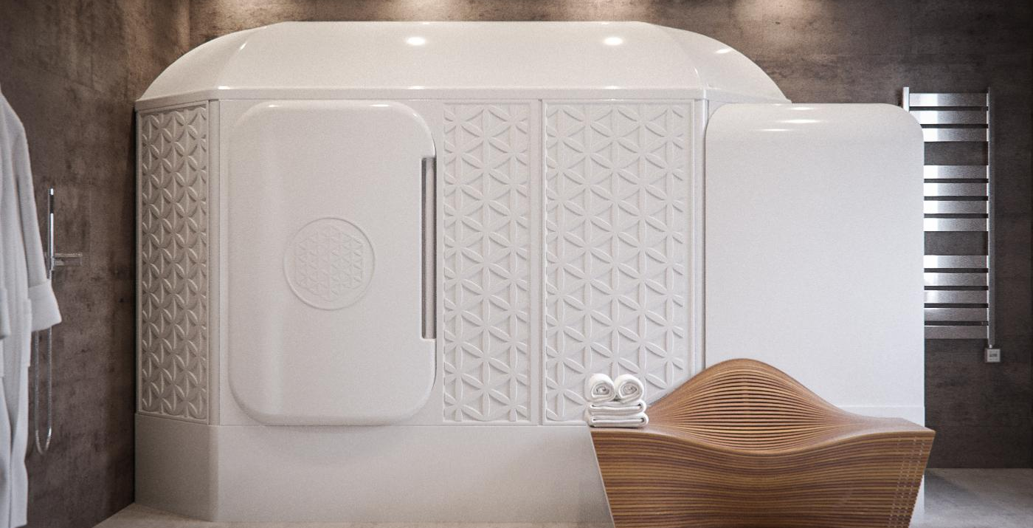
Float tank codes and policies
still have many questions to answer.

Slide 33

Go float!

Slide 34
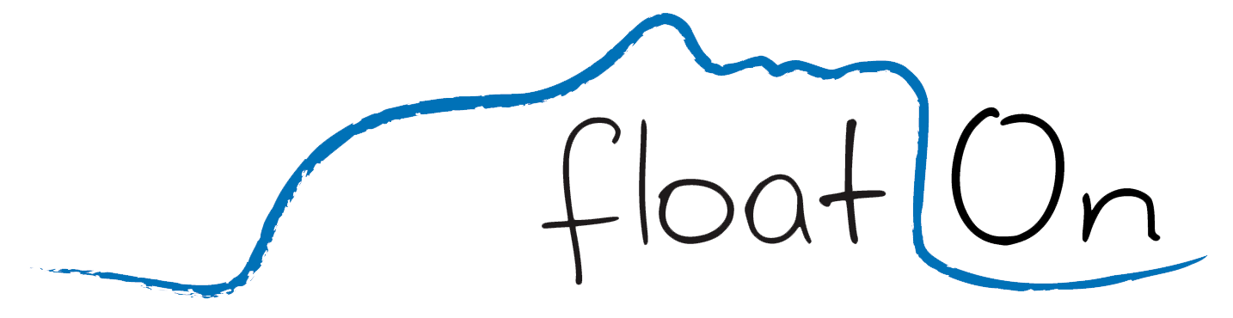
Graham Talley
graham@floathq.com
Ashkahn Jahromi
ashkahn@floathq.com

