Slide 1

New Trends Impacting Retail Food Service
Establishments’ Food Safety
Lisa M. Berger, CP-FS
Berger Food Safety Consulting
www.servingsafefood.com

Slide 2
New Trends in Retail Food Service Establishments
Trends | 1999 | Now
News | “Traditional” News – Newspapers, TV, Magazines | Social Media – primary source for millennial’s and FAST
Liability | Jack-in-the-Box – William Marler | Many law-firms specializing in foodborne illness litigation
Culinary | “Traditional” cooking methods in fast food, ethnic (Chinese, Mexican, Italian, etc. . .), meat and potatoes, diners, family-style chains, etc. . . | Increase use of specialized processes at the retail level. Home delivery Meals in a bag. DIFM Food Delivery (Door Dash, Uber Eats)
Epidemiology | Very basic statistical tools to analyze outbreaks | PulseNet (detect multi-state outbreaks), Reportable Food Registry (identify and report contaminated food) National Outbreak Reporting System (electronic reporting)
Food Code | Based on trends and epidemiology at that time | More current with trends, science and advancements in technology
Technology | Basic tools – analog/digital food thermometers (thermocouple/infrared), flashlight, camera, fact sheets, clip board, inspection forms and pens. | Blue tooth data recording thermometers, TTI’s, electronic inspection reports.
© Copyright 2018. Relavent Systems, Inc. All Rights Reserved. Proprietary and Confidential.

Slide 3
New Trends in Retail Food Service Establishments
Trends | 1999 | Now
News | “Traditional” News – Newspapers, TV, Magazines | Social Media – primary source for millennial’s and FAST
Liability | Jack-in-the-Box – William Marler | Many law-firms specializing in foodborne illness litigation
Culinary | “Traditional” cooking methods in fast food, ethnic (Chinese, Mexican, Italian, etc. . .), meat and potatoes, diners, family-style chains, etc. . . | Increase use of specialized processes at the retail level. Home delivery Meals in a bag. DIFM Food Delivery (Door Dash, Uber Eats)
Epidemiology | Very basic statistical tools to analyze outbreaks | PulseNet (detect multi-state outbreaks), Reportable Food Registry (identify and report contaminated food) National Outbreak Reporting System (electronic reporting)
Food Code | Based on trends and epidemiology at that time | More current with trends, science and advancements in technology
Technology | Basic tools – analog/digital food thermometers (thermocouple/infrared), flashlight, camera, fact sheets, clip board, inspection forms and pens. | Blue tooth data recording thermometers, TTI’s, electronic inspection reports.
© Copyright 2018. Relavent Systems, Inc. All Rights Reserved. Proprietary and Confidential.

Slide 4
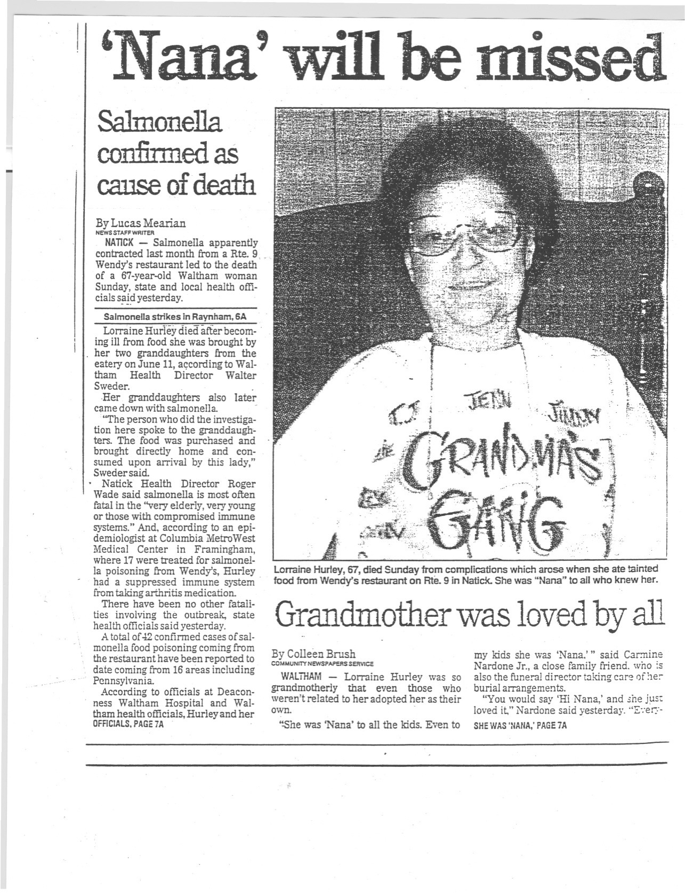
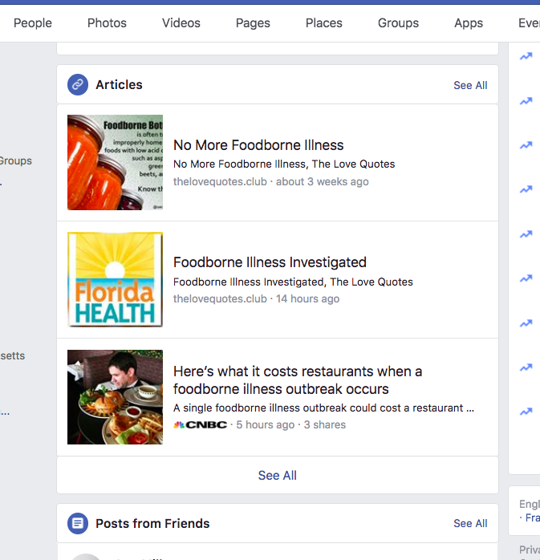
Salmonella Outbreak 1996

Slide 5
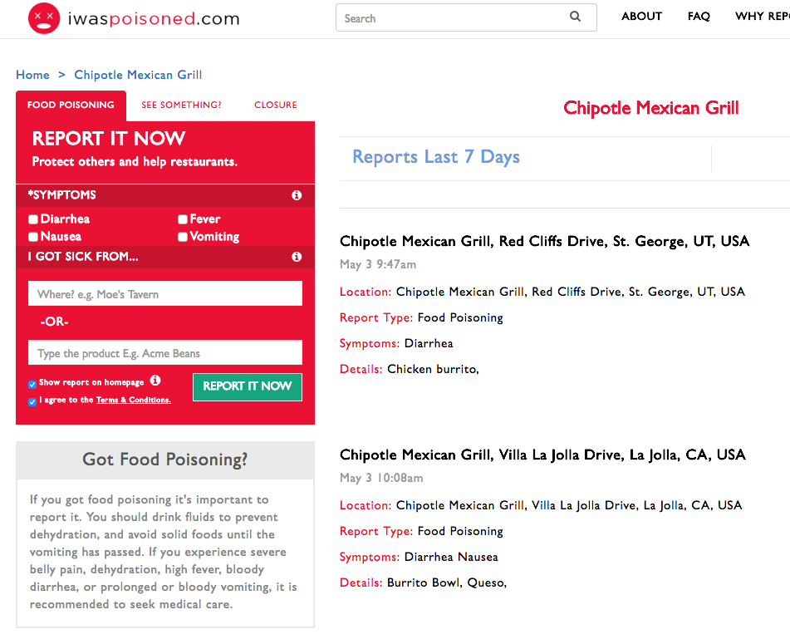

Slide 6



Slide 7
New Trends in Retail Food Service Establishments
Trends | 1999 | Now
News | “Traditional” News – Newspapers, TV, Magazines | Social Media – primary source for millennial’s and FAST
Liability | Jack-in-the-Box – William Marler | Many law firms specializing in foodborne illness litigation
Culinary | “Traditional” cooking methods in fast food, ethnic (Chinese, Mexican, Italian, etc. . .), meat and potatoes, diners, family-style chains, etc. . . | Increase use of specialized processes at the retail level. Home delivery Meals in a bag. DIFM Food Delivery (Door Dash, Uber Eats)
Epidemiology | Very basic statistical tools to analyze outbreaks | PulseNet (detect multi-state outbreaks), Reportable Food Registry (identify and report contaminated food) National Outbreak Reporting System (electronic reporting)
Food Code | Based on trends and epidemiology at that time | More current with trends, science and advancements in technology
Technology | Basic tools – analog/digital food thermometers (thermocouple/infrared), flashlight, camera, fact sheets, clip board, inspection forms and pens. | Blue tooth data recording thermometers, TTI’s, electronic inspection reports.
© Copyright 2018. Relavent Systems, Inc. All Rights Reserved. Proprietary and Confidential.

Slide 8


Slide 9
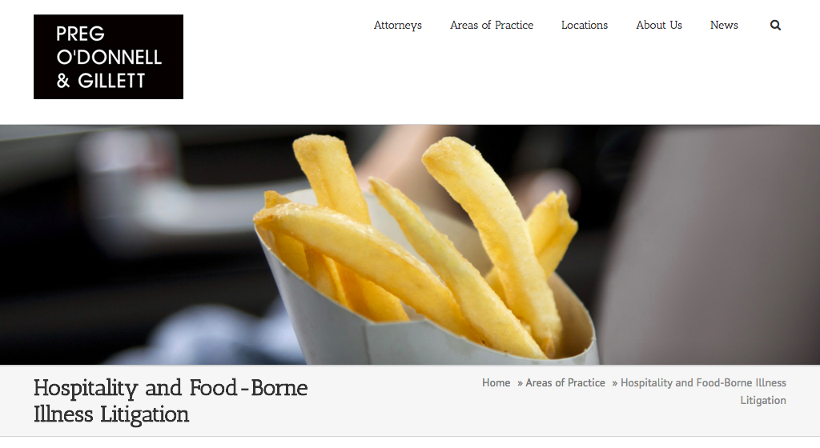

Slide 10


Slide 11


Slide 12
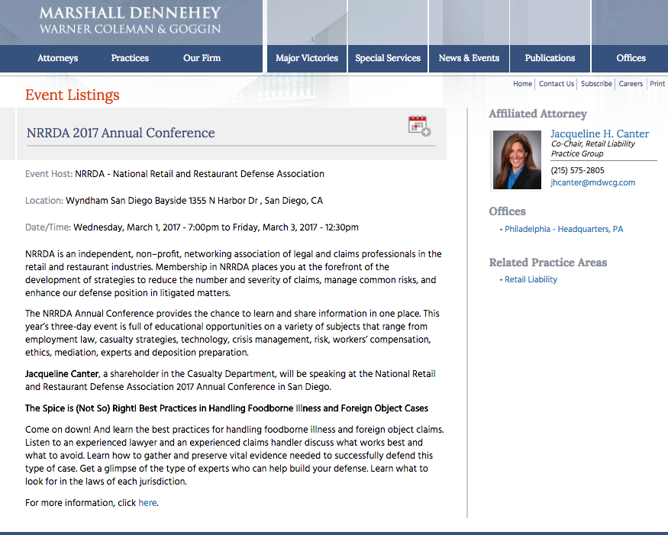
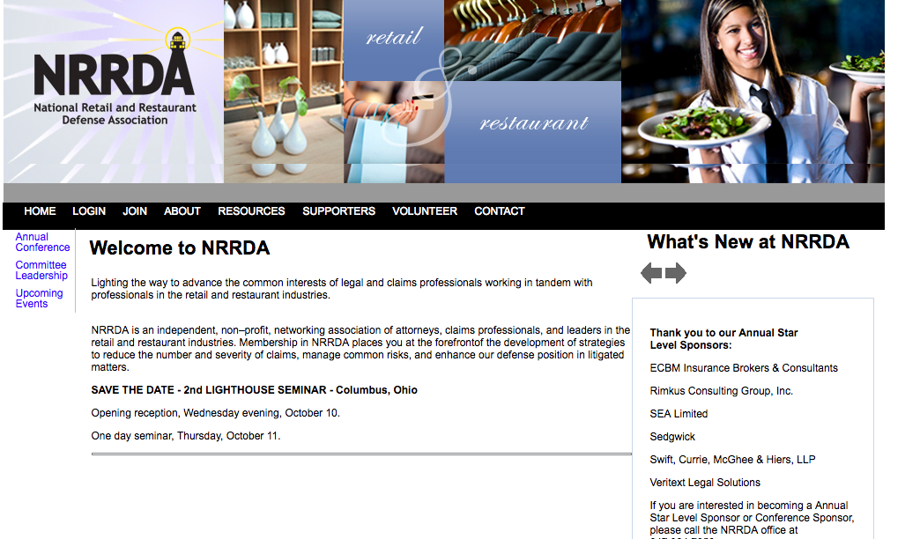

Slide 13
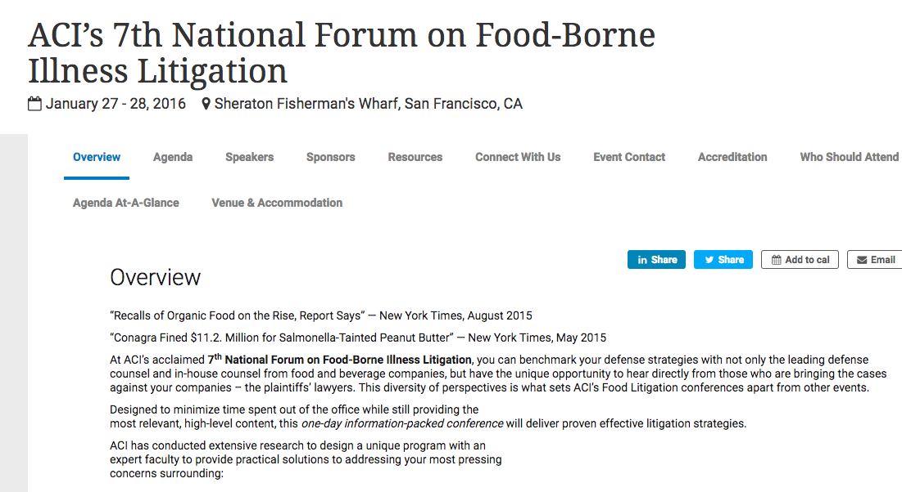

Slide 14
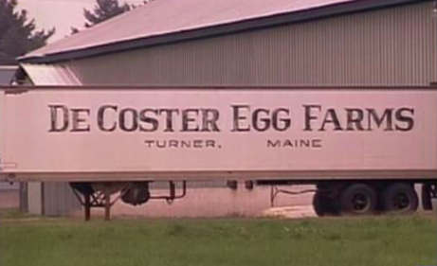

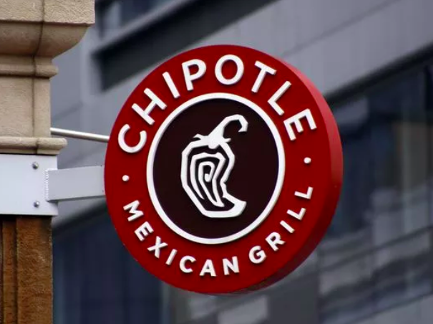

Slide 15
New Trends in Retail Food Service Establishments
Trends | 1999 | Now
News | “Traditional” News – Newspapers, TV, Magazines | Social Media – primary source for millennial’s and FAST
Liability | Jack-in-the-Box – William Marler | Many law firms specializing in foodborne illness litigation
Culinary | “Traditional” cooking methods in fast food, ethnic (Chinese, Mexican, Italian, etc. . .), meat and potatoes, diners, family-style chains, etc. . . | Increase use of specialized processes at the retail level. Home delivery Meals in a bag. DIFM Food Delivery (Door Dash, Uber Eats)
Epidemiology | Very basic statistical tools to analyze outbreaks | PulseNet (detect multi-state outbreaks), Reportable Food Registry (identify and report contaminated food) National Outbreak Reporting System (electronic reporting)
Food Code | Based on trends and epidemiology at that time | More current with trends, science and advancements in technology
Technology | Basic tools – analog/digital food thermometers (thermocouple/infrared), flashlight, camera, fact sheets, clip board, inspection forms and pens. | Blue tooth data recording thermometers, TTI’s, electronic inspection reports.
© Copyright 2018. Relavent Systems, Inc. All Rights Reserved. Proprietary and Confidential.

Slide 16
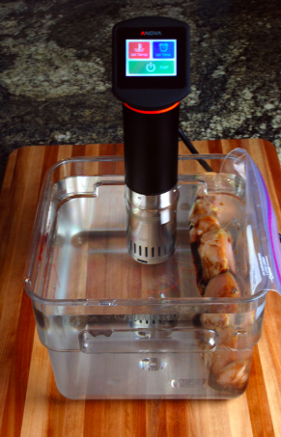
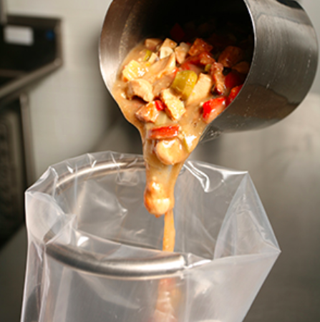
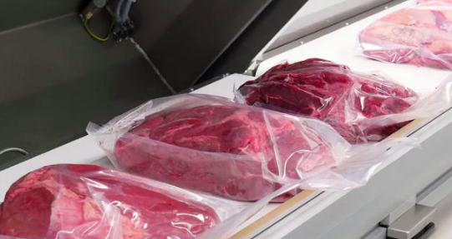
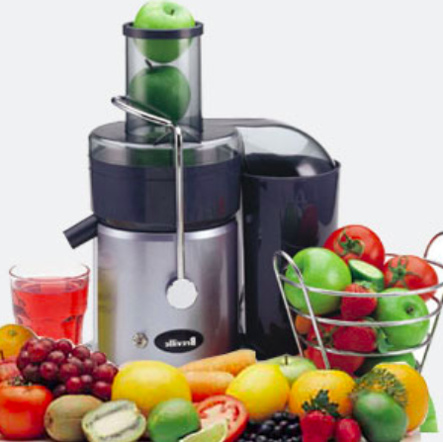
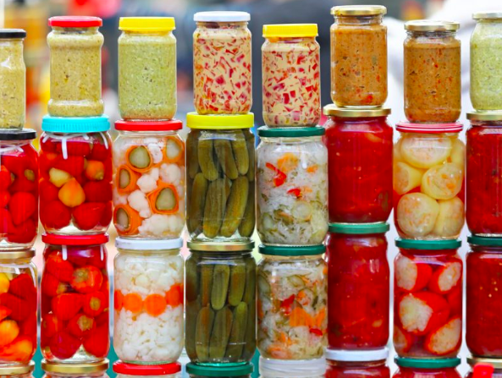


Slide 17



Slide 18
New Trends in Retail Food Service Establishments
Trends | 1999 | Now
News | “Traditional” News – Newspapers, TV, Magazines | Social Media – primary source for millennial’s and FAST
Liability | Jack-in-the-Box – William Marler | Many law firms specializing in foodborne illness litigation
Culinary | “Traditional” cooking methods in fast food, ethnic (Chinese, Mexican, Italian, etc. . .), meat and potatoes, diners, family-style chains, etc. . . | Increase use of specialized processes at the retail level. Home delivery Meals in a bag. DIFM Food Delivery (Door Dash, Uber Eats)
Epidemiology | Very basic statistical tools to analyze outbreaks | PulseNet (detect multi-state outbreaks), Reportable Food Registry (identify and report contaminated food) National Outbreak Reporting System (electronic reporting)
Food Code | Based on trends and epidemiology at that time | More current with trends, science and advancements in technology
Technology | Basic tools – analog/digital food thermometers (thermocouple/infrared), flashlight, camera, fact sheets, clip board, inspection forms and pens. | Blue tooth data recording thermometers, TTI’s, electronic inspection reports.
© Copyright 2018. Relavent Systems, Inc. All Rights Reserved. Proprietary and Confidential.

Slide 19
New New
New Tools in Epidemiology and Disease Reporting
1996 – PulseNet
Connects FBI cases to detect outbreaks. Uses DNA fingerprinting to detect multi-state outbreaks.
2009 – Reportable Food Registry (RFR)
Identify and contain contaminated ingredients in our food supply. We can now find the source and alert the public sooner.
2009 – National Outbreak Reporting System (NORS)
Web-based platform that allows easy reporting of water and foodborne outbreaks

Slide 20
New Trends in Retail Food Service Establishments
Trends | 1999 | Now
News | “Traditional” News – Newspapers, TV, Magazines | Social Media – primary source for millennial’s and FAST
Liability | Jack-in-the-Box – William Marler | Many law firms specializing in foodborne illness litigation
Culinary | “Traditional” cooking methods in fast food, ethnic (Chinese, Mexican, Italian, etc. . .), meat and potatoes, diners, family-style chains, etc. . . | Increase use of specialized processes at the retail level. Home delivery Meals in a bag. DIFM Food Delivery (Door Dash, Uber Eats)
Epidemiology | Very basic statistical tools to analyze outbreaks | PulseNet (detect multi-state outbreaks), Reportable Food Registry (identify and report contaminated food) National Outbreak Reporting System (electronic reporting)
Food Code | Based on trends and epidemiology at that time | More current with trends, science and advancements in technology
Technology | Basic tools – analog/digital food thermometers (thermocouple/infrared), flashlight, camera, fact sheets, clip board, inspection forms and pens. | Blue tooth data recording thermometers, TTI’s, electronic inspection reports.
© Copyright 2018. Relavent Systems, Inc. All Rights Reserved. Proprietary and Confidential.

Slide 21
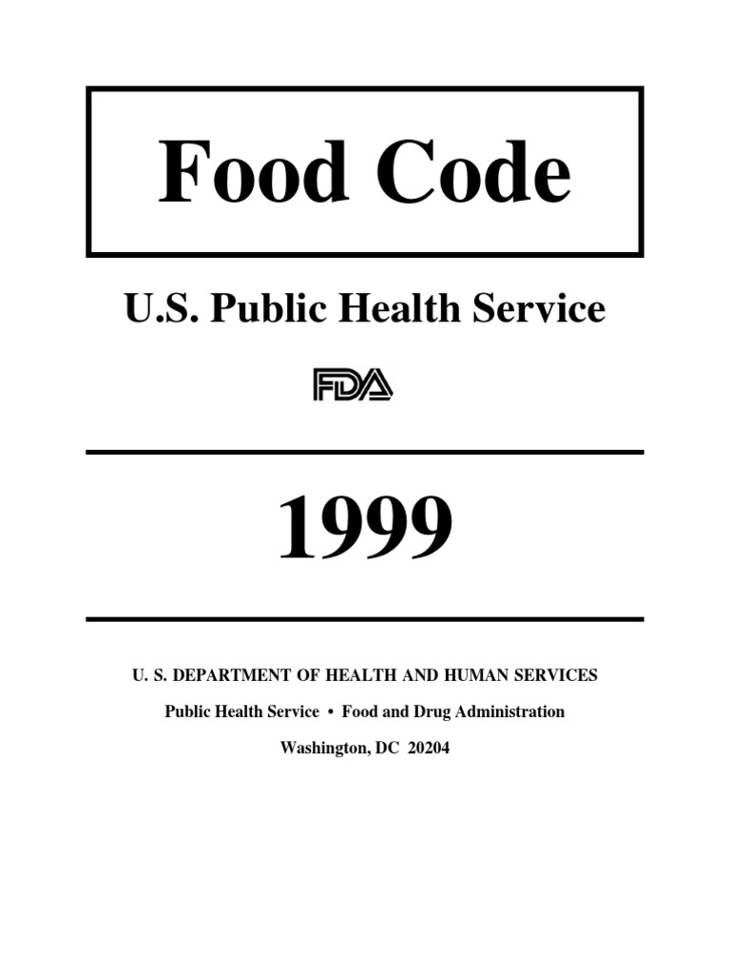
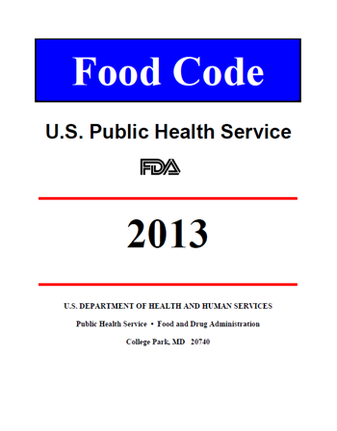
Food Code: Key Changes
Item Numbers
Item Numbers: 1-30
Item Numbers: 1-56
© Copyright 2018. Relavent Systems, Inc. All Rights Reserved. Proprietary and Confidential.

Slide 22
Food Code: Key Changes
Risk Assignment
Red Critical
Black/Blue Critical
Non-Critical
Priority
Priority Foundation
Core
© Copyright 2018. Relavent Systems, Inc. All Rights Reserved. Proprietary and Confidential.

Slide 23
PRIORITY ITEM “contributes directly to the elimination, prevention or reduction to an acceptable level, hazards associated with foodborne illness or injury and there is no other provision that more directly controls the hazard”
PRIORITY FOUNDATION ITEM “supports, facilitates or enables one or more PRIORITY ITEMS)
CORE ITEM “relates to general sanitation, operational controls, sanitation standard operating procedures (SSOPs), facilities or structures, equipment design, or general maintenance”
© Copyright 2018. Relavent Systems, Inc. All Rights Reserved. Proprietary and Confidential.

Slide 24
Food Code: Key Changes
Handwashing
Priority (P)
2-301.12 Cleaning Procedure
Observation – Employees not washing hands
Priority Foundation (Pf)
6.301.11 Handwashing Cleanser, Availability
Observation – No soap available at the handwashing sink.
Core (C)
2-301.15 Where to Wash
Observation – Employee washing hands in ware washing sink
© Copyright 2018. Relavent Systems, Inc. All Rights Reserved. Proprietary and Confidential.

Slide 25
Food Code: Key Changes
Terminology / Additions
Potentially Hazardous Foods
(PHF’s)
Time/Temperature Control for Safety Food
(TCS)
Added:
Cut leafy greens / Sliced Tomatoes
© Copyright 2018. Relavent Systems, Inc. All Rights Reserved. Proprietary and Confidential.

Slide 26
Food Code: Key Changes
New Regulations
Non-Continuous Cooking requirements identified
Mushrooms – “Mushroom species picked in the wild . . . “
Clean up procedures for vomiting and diarrheal events
Irreversible test strips for high temp. machines
© Copyright 2018. Relavent Systems, Inc. All Rights Reserved. Proprietary and Confidential.

Slide 27
Food Code: Key Changes
Temperature Issues: Hot/Cold Holding
Item #19 3-501.16 Hot and Cold Holding * (F)
Red Critical
Item #21 3-501.16 (A) (1) Proper Hot Holding
Priority
Item #22 3-501.16 (A) (2) and (B) Proper Cold Holding
Priority
Jewelry
Item #23 2-303.11 Jewelry Prohibitions
Non-Critical
Item #40 2-303.11 Jewelry Prohibitions
Core
Clean to Sight & Touch
Item #9 4-601.11 (A) Equip, Food-Contact Surfaces
Red Critical
Item #16 4-601.11 (A) Equip, Food-Contact Surfaces
Priority Foundation (Pf)
© Copyright 2018. Relavent Systems, Inc. All Rights Reserved. Proprietary and Confidential.

Slide 28
New Trends in Retail Food Service Establishments
Trends | 1999 | Now
News | “Traditional” News – Newspapers, TV, Magazines | Social Media – primary source for millennial’s and FAST
Liability | Jack-in-the-Box – William Marler | Many law firms specializing in foodborne illness litigation
Culinary | “Traditional” cooking methods in fast food, ethnic (Chinese, Mexican, Italian, etc. . .), meat and potatoes, diners, family-style chains, etc. . . | Increase use of specialized processes at the retail level. Home delivery Meals in a bag. DIFM Food Delivery (Door Dash, Uber Eats)
Epidemiology | Very basic statistical tools to analyze outbreaks | PulseNet (detect multi-state outbreaks), Reportable Food Registry (identify and report contaminated food) National Outbreak Reporting System (electronic reporting)
Food Code | Based on trends and epidemiology at that time | More current with trends, science and advancements in technology
Technology | Basic tools – analog/digital food thermometers (thermocouple/infrared), flashlight, camera, fact sheets, clip board, inspection forms and pens. | Blue tooth data recording thermometers, TTI’s, electronic inspection reports.
© Copyright 2018. Relavent Systems, Inc. All Rights Reserved. Proprietary and Confidential.

Slide 29
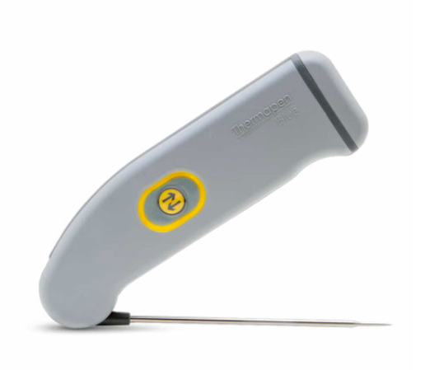
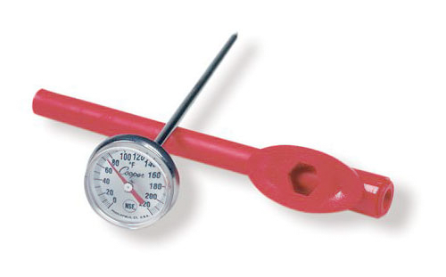


1999
Now
Inspection Tools
© Copyright 2018. Relavent Systems, Inc. All Rights Reserved. Proprietary and Confidential.

Slide 30
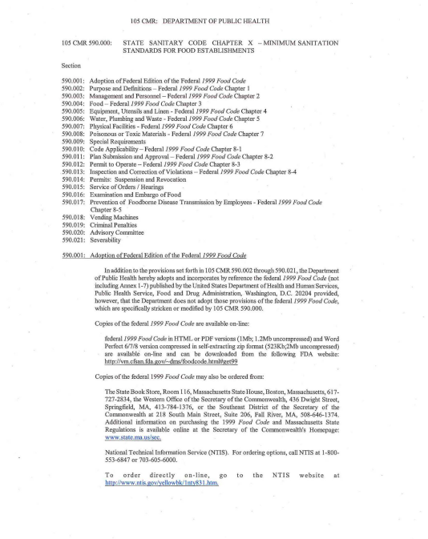

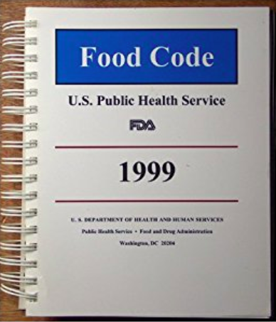


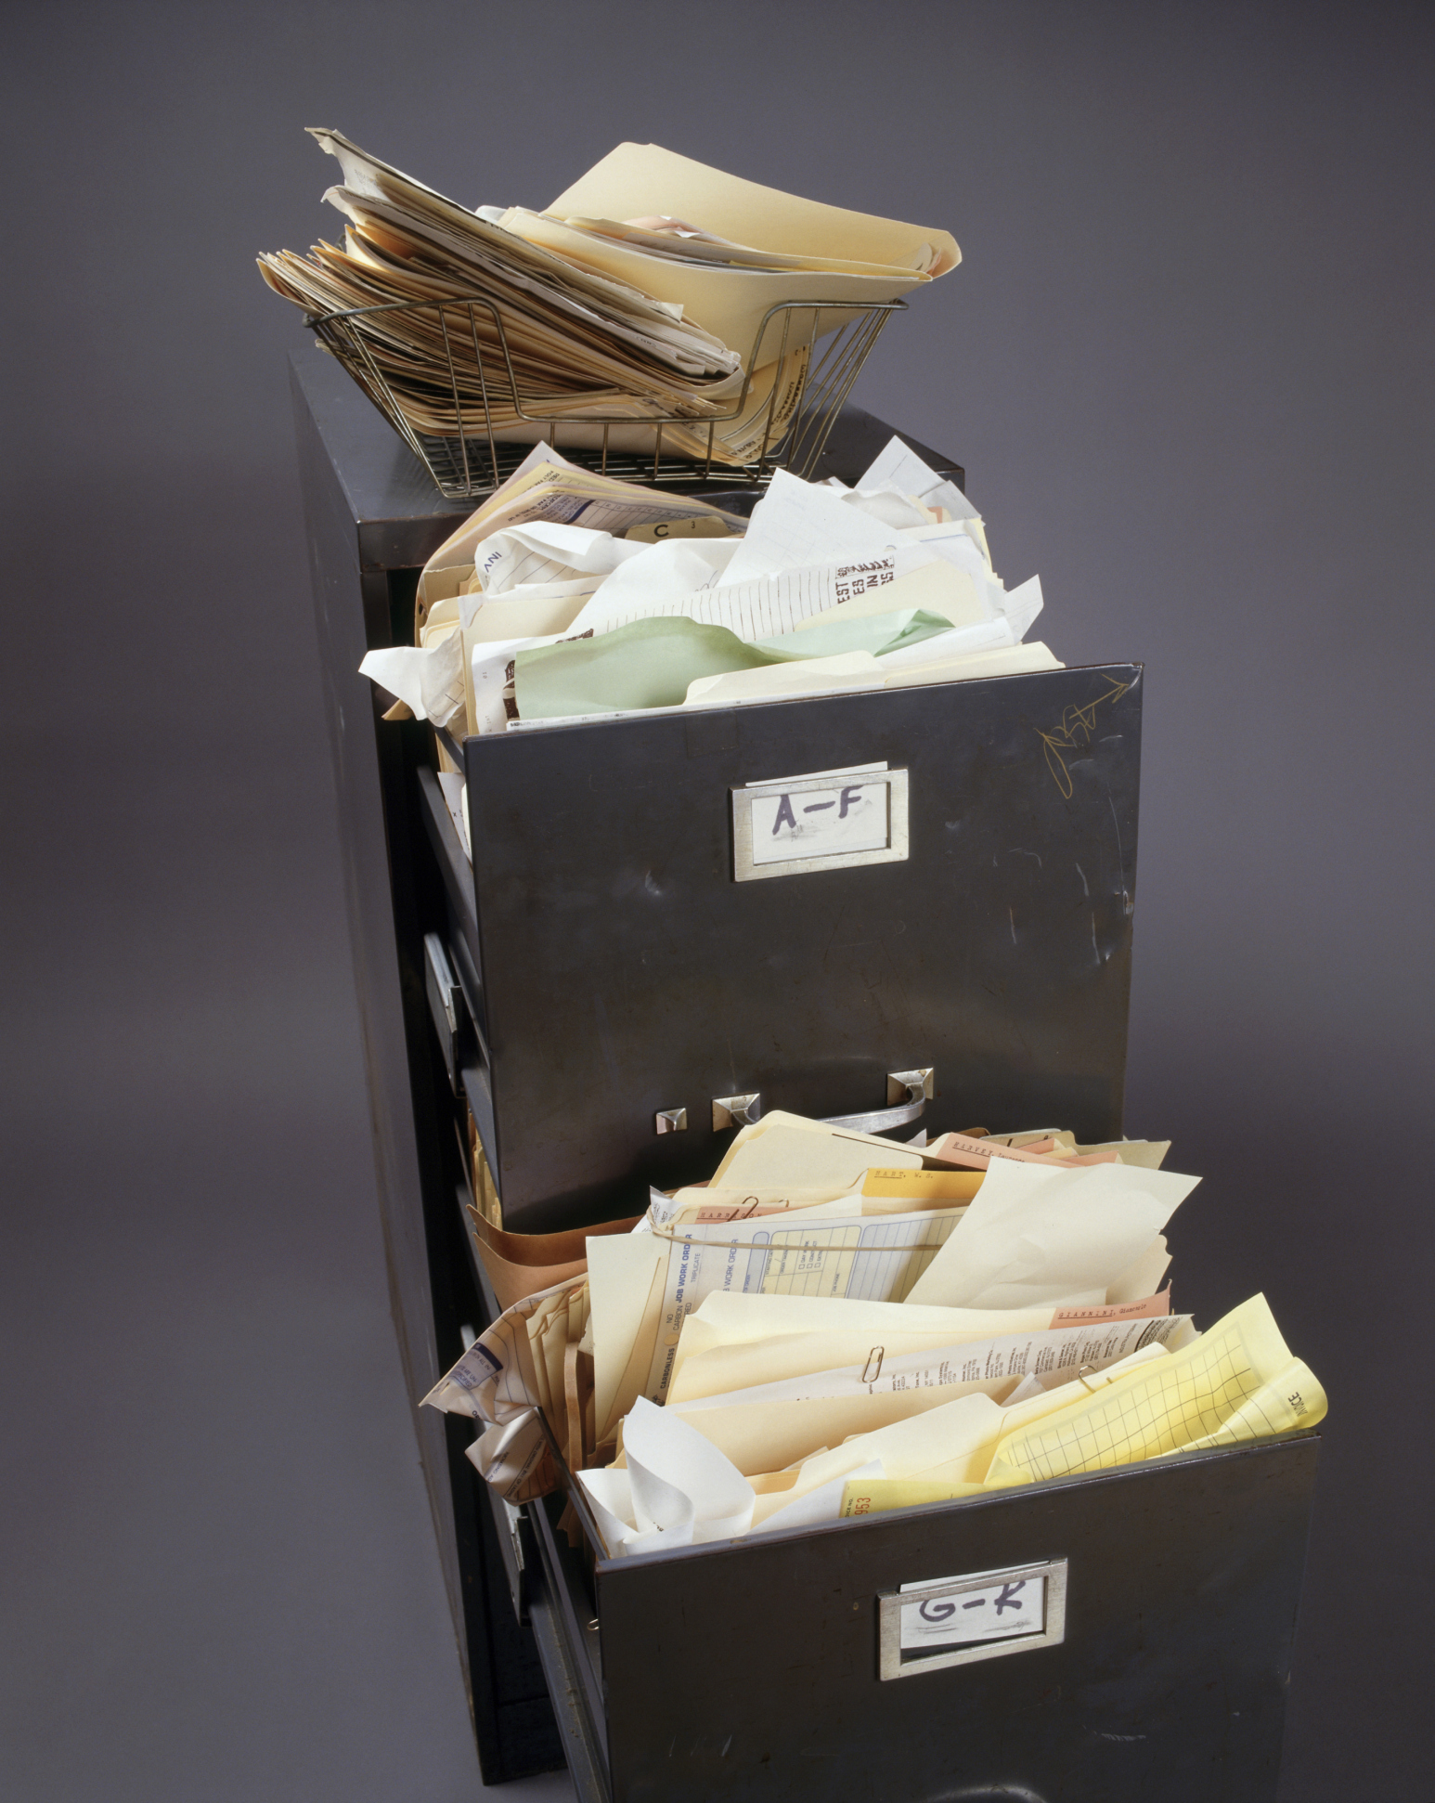
1999
Now
Inspection Reports
© Copyright 2018. Relavent Systems, Inc. All Rights Reserved. Proprietary and Confidential.

Slide 31


Digitizing and Accelerating Food Safety
Let’s take a look!
Brought to you by:
© Copyright 2018. Relavent Systems, Inc. All Rights Reserved. Proprietary and Confidential.
Notes:
There are a bunch of program on the market.
We have developed a fully digital mobile platform for conducting food safety inspection which was born out of the need for me to speed up the process of writing reports and have a legally defensible report. As a consultant, time is money!
https://foodcodepro.com/

Slide 32
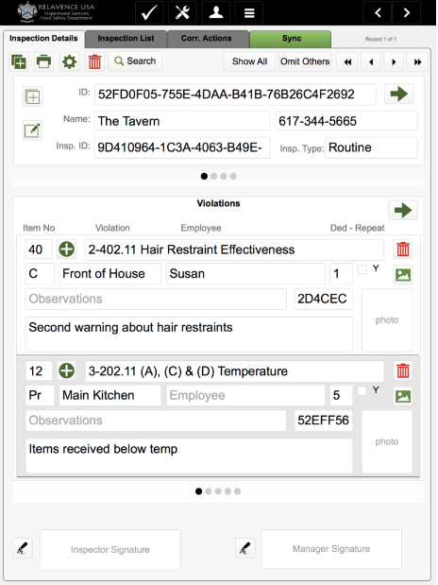
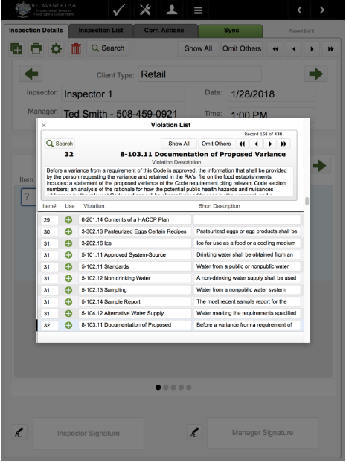
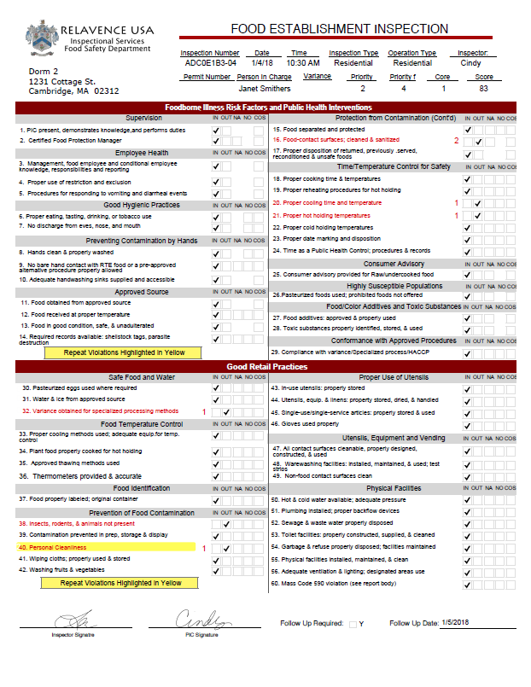
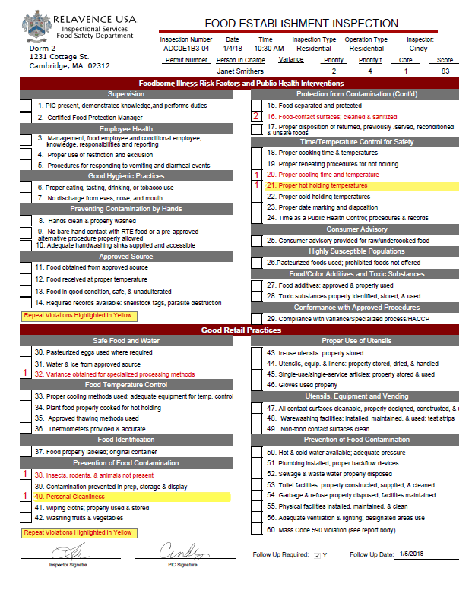
A System For Inspectors, by Inspectors
© Copyright 2018. Relavent Systems, Inc. All Rights Reserved. Proprietary and Confidential.
Notes:
This program is fully capable of seamlessly incorporating photos, has 100% of the 2013 food code and has easy, searchable violations. There are separate temperature summary pages and a FDA Report cover that will automatically propagate violations and corrective actions into this report.
Have to prepare a report for a hearing, this can be done in seconds versus hours.
Our platform was created by inspectors, for inspectors. It’s the accumulation of every feature we’ve needed, wished for and ultimately used over the past 18 years.
It has been used to do over 15,000 inspections and was designed for how inspections get done in the field.
This has made our inspections so much easier, more efficient, consistent, accurate and up to date. We’ve reduced the time it takes to do an inspection by over 40- 75%.

Slide 33
Things have changed and so must we in our quest to reduce the morbidity and mortality due to foodborne illness
Questions???
Lisa M. Berger, CP-FS
Berger Food Safety Consulting
www.servingsafefood.com

