Slide 1
Special Food Processing Requirements
Amanda J. Kinchla
Extension Assistant Professor
UMass Amherst
Food Science Department
Notes:
MA Environmental Health Association
An increasing number of establishments are incorporating special food processes into their operations. These processes require review and approval from the regulatory authority. Attendees will be provided with an overview of the area of concern to review and approve special food processing.

Slide 2


UMass Food Science Extension
Research
Extension
Produce safety
Product development
Regulatory compliance trainings
Technical support
Short courses

Slide 3

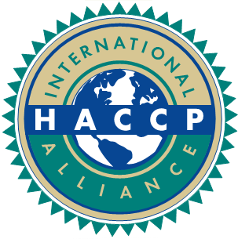

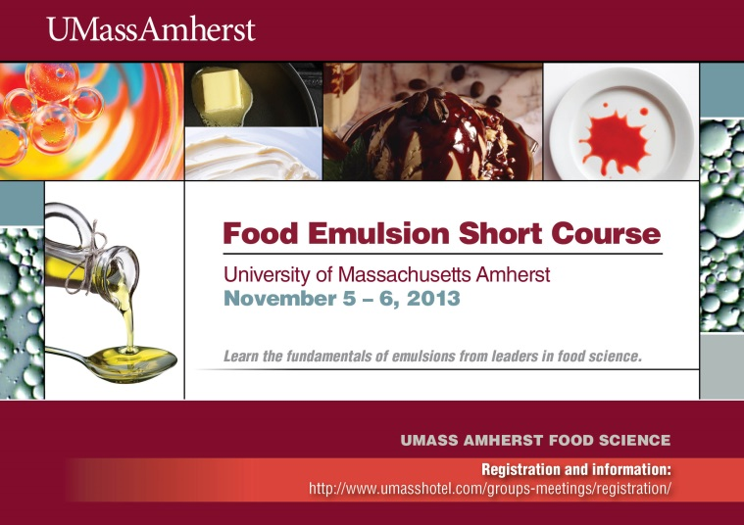
Extension Activities
Short Courses
Preventative Controls for Human Food: June 2018
Better Process
Control School: Nov 2018
Rapid Method (SERS): Dec 2018
Lipid Oxidation: coming 2019!
November 30-December 1, 2017

Slide 4



Food Safety Regulation
Regulation
USDA
  Meat
  Poultry
  Egg Products
FDA
  Other food products
  Dietary supplements
  Bottled water
  Food additives
  Infant formulas
https://www.google.com/imgres?imgurl=http%3A%2F%2Fwww.mygfsi.com%2Fimages%2Fimages%2Fmygfsi%2Fnews-resources%2Fnews%2F201602%2FFood_Safety_web.svg.png&imgrefurl=http%3A%2F%2Fwww.mygfsi.com%2F&docid=KX4LP9en6lMetM&tbnid=WmACtNolTMPPMM%3A&vet=1&w=350&h=450&bih=689&biw=1268&q=what%20is%20food%20safety&ved=0ahUKEwiXncLemKfSAhXry4MKHcxyDQ0QMwg6KBYwFg&iact=mrc&uact=
https://upload.wikimedia.org/wikipedia/commons/thumb/6/6d/Food_Safety_1.svg/150px-Food_Safety_1.svg.png
Notes:
FDA: (although the U.S. Department of Agriculture plays a lead role in regulating aspects of some meat, poultry, and egg products)

Slide 5
Food Safety Regulation: Processing (wholesale)
Juice
Seafood
Meat & Poultry
Low-Acid
Preventive Controls
HACCP
Food Safety
Notes:
Juice – 21 CFR part 120 concerning the safe and sanitary processing of fruit and vegetable juices
Seafood - (21 CFR) part 123, the seafood HACCP regulation
9 CFR 417 - HAZARD ANALYSIS AND CRITICAL CONTROL POINT (HACCP) SYSTEMS. Title 9 - Animals and Animal Products
Low acid - PART 113THERMALLY PROCESSED LOW-ACID FOODS PACKAGED IN HERMETICALLY SEALED CONTAINERS
PART 117CURRENT GOOD MANUFACTURING PRACTICE, HAZARD ANALYSIS, AND RISK-BASED PREVENTIVE CONTROLS FOR HUMAN FOOD

Slide 6
Shelf Stable Acidified Foods
21 CFR 117 - Current Good Manufacturing Practice, Hazard Analysis, and risk-based preventive controls for Human Food

Slide 7
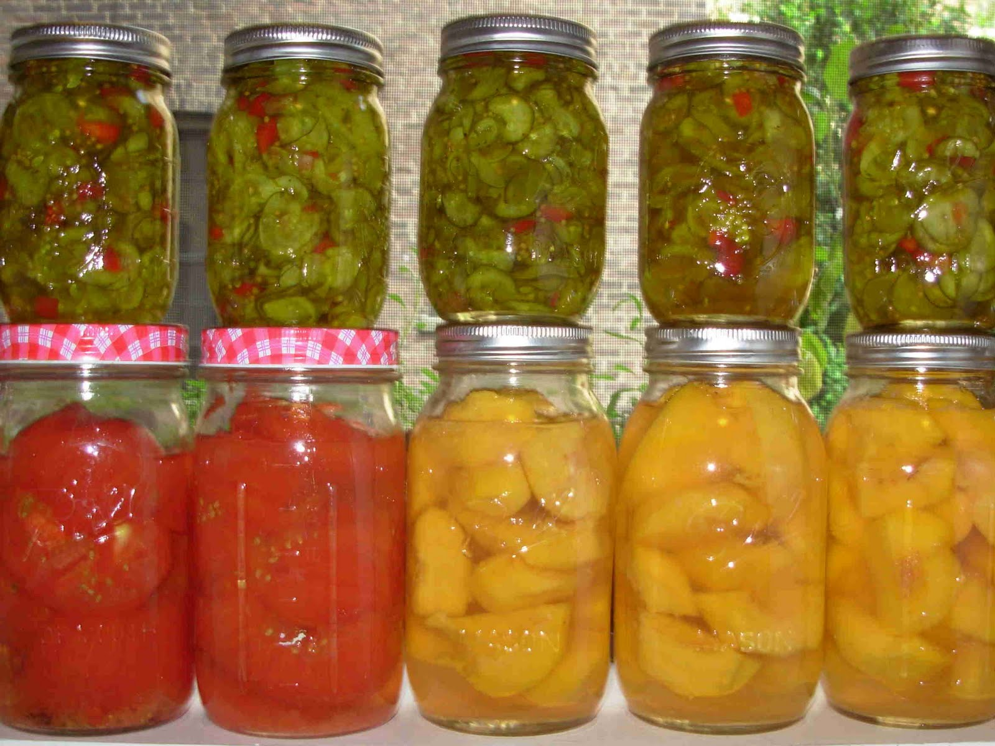
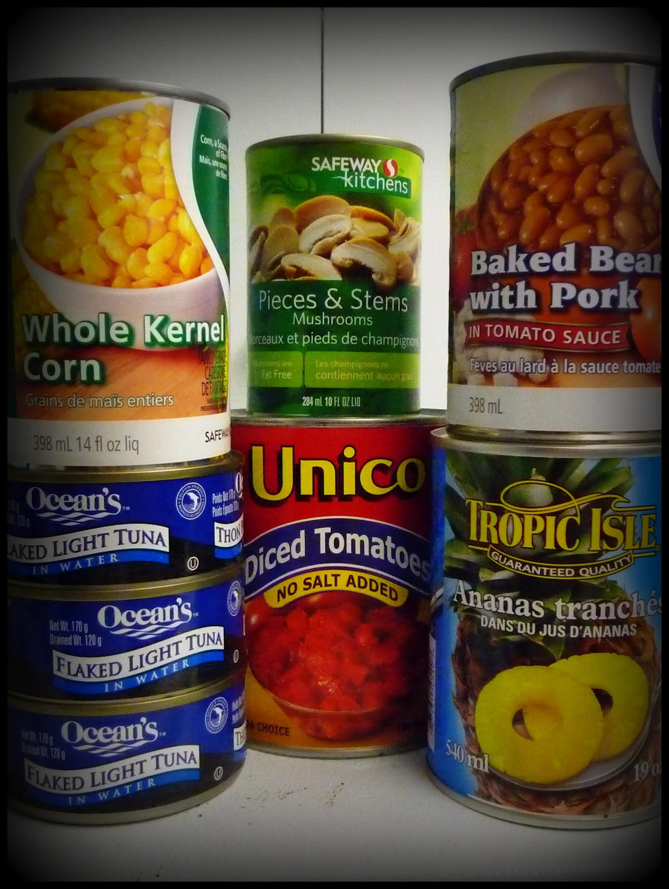
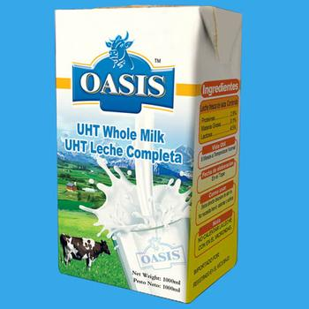
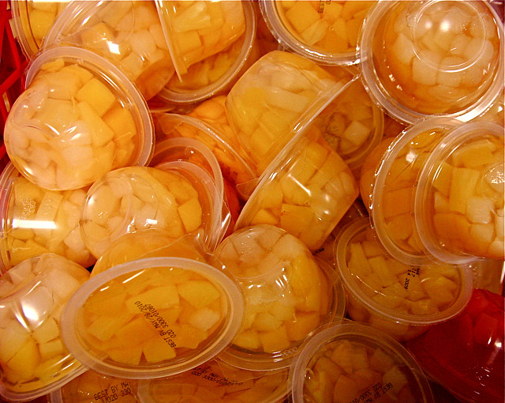
Shelf Stable “Canned” Foods

Slide 8
Commercially Canned Foods
Canning:
  “method of food preservation that renders a food and its container commercially sterile by the application of heat, alone or in combination with pH and/or Aw and/or other chemicals”
  Commercially Sterile = shelf stable
  Free of microorganisms of public health significance and others under non-refrigerated conditions
Codex Alimentarius
Food Science Department
Notes:
Commercially Sterile = free of viable MO’s of public health concern
,,, The definition for commercially sterile products according to Codex Alimentarius¹ is:
“Commercial sterility of food means the conditions achieved by application of heat which renders such food free from microorganisms capable of growing in the food at temperatures at which the food is likely to be held during distribution and storage.” The criterion is ability to grow not presence or absence.
Commercially sterile goods are canned products sterilized under not too intensive heat treatment in order to maintain good sensory product quality. It is accepted that non-pathogenic microorganisms may not have been completely inactivated, but it must be ensured that their growth is practically not feasible as one or more of the above “hurdles” are present in the product (see also page 92).

Slide 9
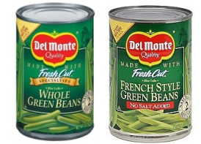

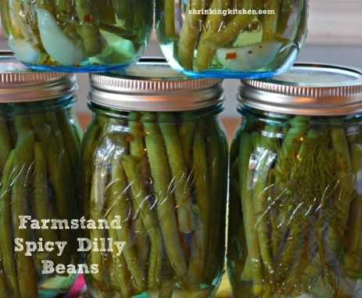
Common Canning Methods
Conventional Canning – fill product in container, seal it, treat (high heat under pressure)
Aseptic – sterilizing the food and the container separately and filling &sealing in a commercially sterile environment
Formulation Control (Acidified) – lowering the finished product pH (≤4.6 and Aw ≤0.85 )
Food Science Department

Slide 10
Canned Products
Low-acid canned foods (LACF)
  pH above 4.6
Acidified low-acid foods*
  Formulated below 4.6
Acid foods
  Natural pH ≤ 4.6
*Sauerkraut, kimchi, and similar fermented foods are not considered “acidified foods” under the FDA Acidified Foods rules.
Food Science Department

Slide 11
Canning Regulations: Thermally Processed Foods
Code of Federal Regulation | Specific to: | Summary of Regulation
CFR 110 | GMP | Good Manufacturing Practices
CFR 113 | Low-acid Foods | Ex. Canned green beans, lentil soup pH >4.6 & Aw >0.85
CFR 114 | Acidified Foods* | Ex. Pickled products, pH < 4.6 & Aw > 0.85
CFR 117 | Current Good Manufacturing Practice, Hazard Analysis, and risk-based preventive controls for Human Food | Hazard analysis Preventive controls* Process, food allergen, sanitation, supply-chain and other Recall plan* Management of PC: Procedures for monitoring, corrective action and verification*
Excluded: refrigerated products, jellies/jams/preserves, fermented foods and products with Aw <0.85.
Food Science Department
Access Title 21 CFR: www.ecfr.gov
Notes:
PART 117—CURRENT GOOD MANUFACTURING PRACTICE, HAZARD ANALYSIS, AND RISK-BASED PREVENTIVE CONTROLS FOR HUMAN FOOD

Slide 12
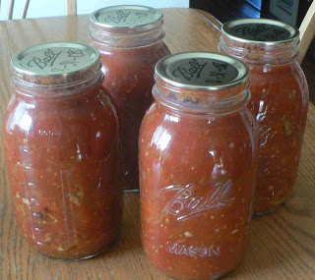
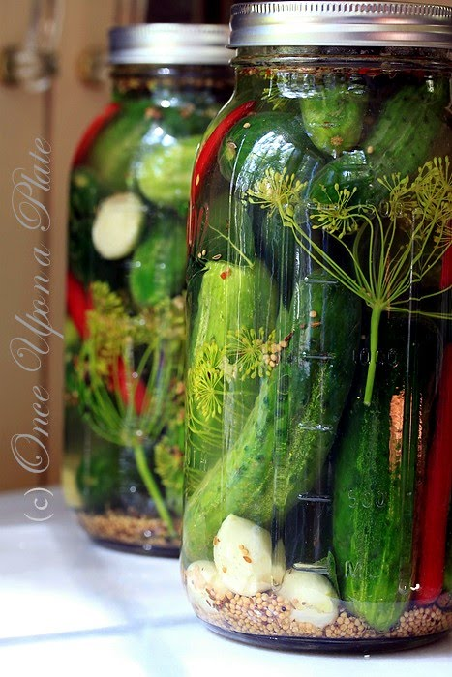
Getting Started
Establish conditions for thermal processing
(hermetically sealed containers)
    108.25: acidified
    108.35: low-acid
Process Authority Review
  Cornell
  Univ. Maine
  NC State
All processors* shall register with the FDA
All operators of thermal processing products (low acid & acidified) must attend a training approved by FDA Commissioner (BPCS)
  UMass is hosting BPCS – November 2018
Food Science Department
Notes:
Establishment for processing (name & location)
Process method (acidity/pH control)
Thermal processing
List of foods packed
FDA filed Scheduled Process
Process Authority “… a person who has expert knowledge of thermal processing requirements for low-acid foods packaged in hermetically sealed containers, or has expert knowledge in the acidification and processing of acidified foods.”

Slide 13
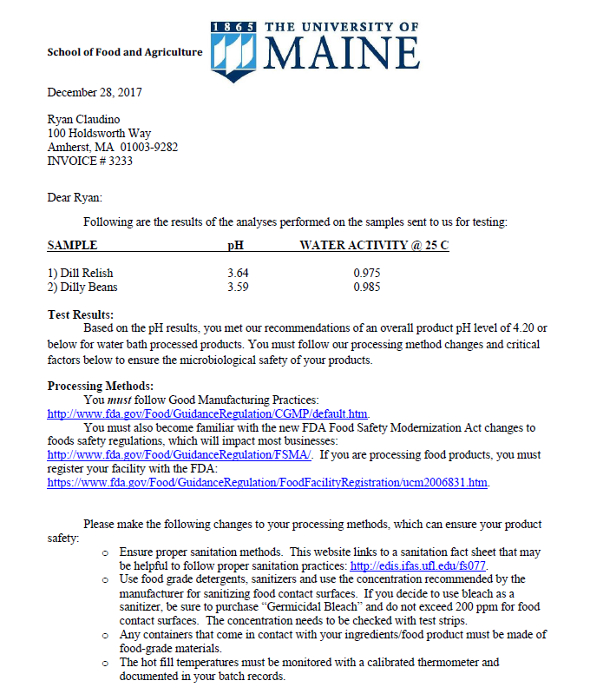
Scheduled Process
SAMPLE pH WATER ACTIVITY @ 25 C
1) Dill Relish 3.64 0.975
2) Dilly Beans 3.59 0.985
Dilly Beans:
The product temperature must be monitored prior to water bath canning. The temperature must be at least 100 deg F or higher before water bath processing. You must check the center of the coldest container, which is usually the first container filled after all the containers from the entire batch have been filled.
The products must be hot filled into sanitized jars and immediately water bath canned. A water bath canning time of 10-minutes is adequate for 16-ounce containers or less and
also 32-ounce containers.
Be sure to have at least 1 inch of water covering your containers and you are timing your water bath processing time once the water reaches a rolling boil (212 deg F) with the containers in the water bath.

Slide 14
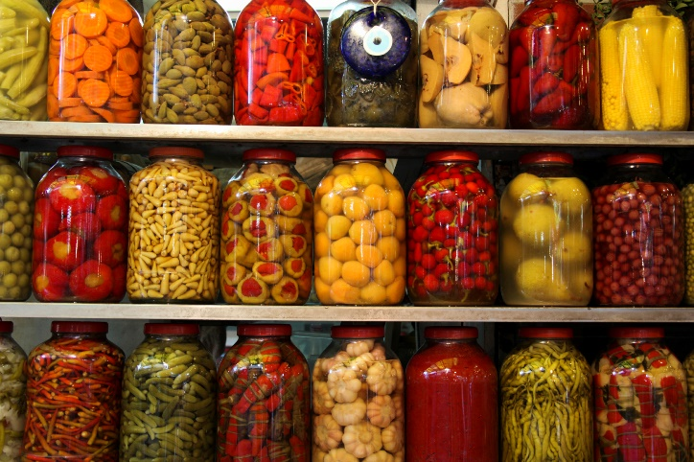
BPCS – UMass, November 2018
Acidified Only, November 2018
http://ag.umass.edu/upcoming-events
Food Science Department

Slide 15
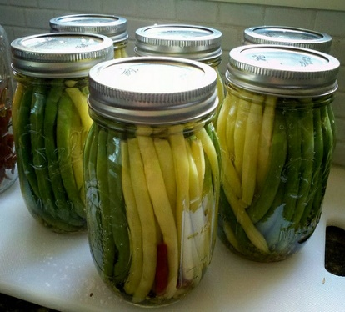
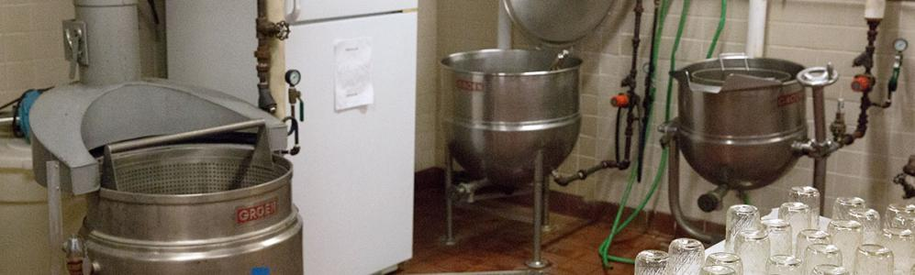
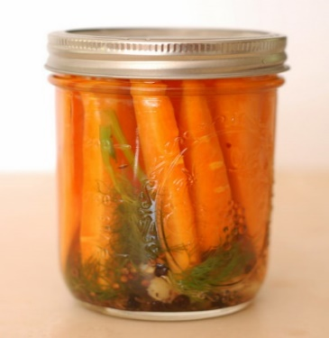
UMass – Product Development
Establish FDA approved scheduled processes for acidified shelf-stable foods to increase usage of specialty crops
12 science based, minimally processed value-added products (acidified shelf-stable products)
Goal - increase the production of specialty crops through value-added processing

Slide 16
UMass – Product Development

Slide 17
Preventive Controls for Human Food
21 CFR 117 - Current Good Manufacturing Practice, Hazard Analysis, and risk-based preventive controls for Human Food

Slide 18
Food Safety Modernization Act (FSMA)
Most sweeping reform of food safety in US since 1937 Food, Drug and Cosmetic Act.
Seven Rules
  Produce Safety Rule
  Preventive Controls for Human Food
  Foreign supplier verification programs
  Accreditation of third-party auditors for foreign facilities
  Preventive controls for animal food
  Mitigation for intentional adulteration
  Sanitary transportation of human and animal food

Slide 19
Other Risk-based Food Safety Programs
US Space program
Low-acid canned food regs
FDA Seafood HACCP regs
FDA Juice HACCP regs
USDA HACCP regs
Codex HACCP Annex
NCIMS Dairy HACCP
Image source: Microsoft clip art
Chapter 1, Food Safety Plan
Overview for Preventive Controls for Human Food
Notes:
Risk‐based approaches to managing food safety were pioneered during development of food for the U.S. space program in the 1960s
At that time, end‐product testing was the focus of quality control programs.
The focus shifted to preventing hazards through product formulation and process control in a risk‐based manner. The concept was called Hazard Analysis and Critical Control Point (HACCP).

Slide 20
Preventive Controls Include More Than HACCP
Verification &
Recordkeeping
Hazard Analysis
Preventive Controls
(CCPs, allergen, sanitation, supplier, etc.)
Parameters & Values
Monitor
Corrective Action or Corrections
Critical Control Points (CCPs)
Critical Limits
Chapter 2, Food Safety Plan
Overview for Preventive Controls for Human Food, Slide 4
Notes:
The preventive controls process incorporates controls beyond those managed as process‐related CCPs in the HACCP framework.
These PCs address not only CCPs, but also controls for hazards related to food allergens, sanitation, suppliers and others requiring a PC.
The PC approach also recognizes that critical limits, defined by NACMCF as: “A maximum and/or minimum value to which a biological, chemical or physical parameter must be controlled at a CCP to prevent, eliminate or reduce to an acceptable level the occurrence of a food‐safety hazard” may not be required for some preventive controls.
The broader term, parameters and values, supports identification of a frequency or other metric to assess compliance.
Further, immediate corrections (like re‐cleaning a line before start up) may be more appropriate than formal corrective action involving product risk evaluations for some preventive controls.

Slide 21
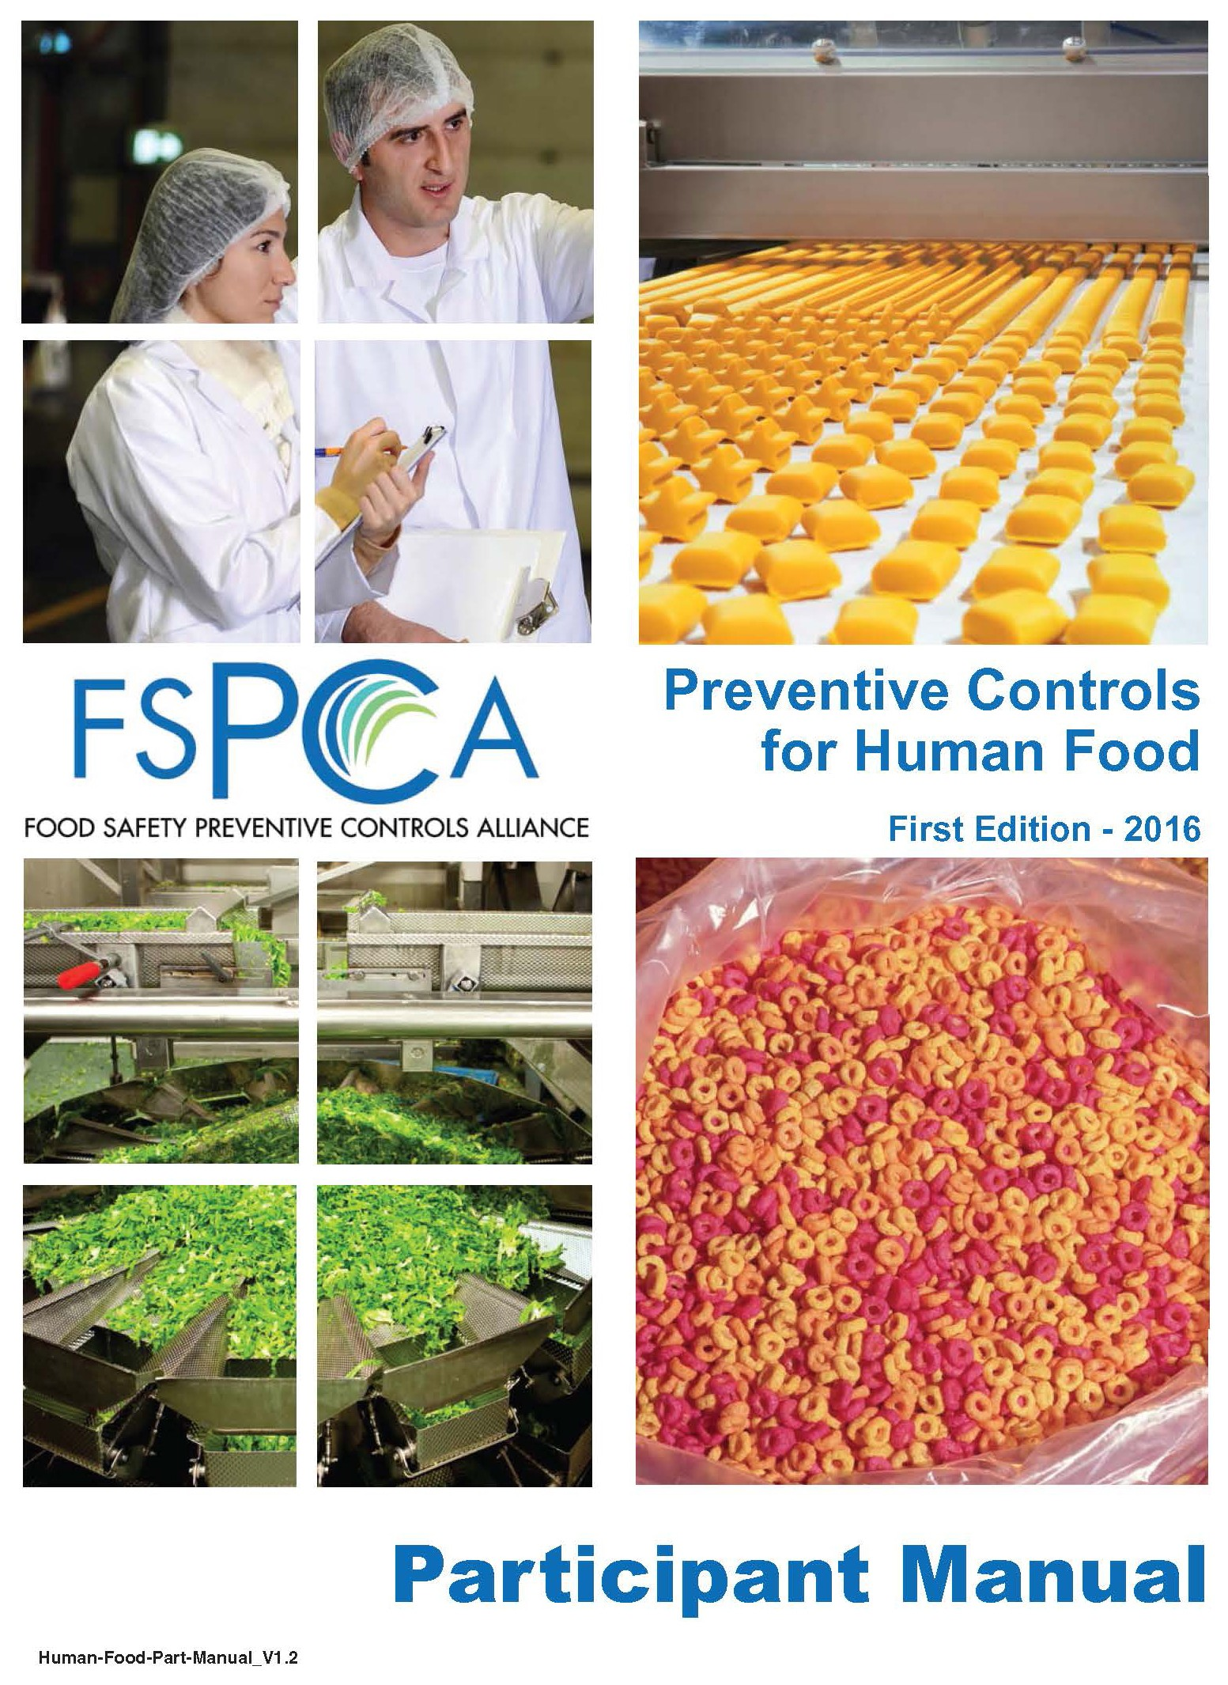
Requirements
CURRENT GOOD MANUFACTURING PRACTICE, HAZARD ANALYSIS, AND RISK-BASED PREVENTIVE CONTROLS FOR HUMAN FOOD
Subparts of PC Rule CFR 117
General Provisions
Current Good Manufacturing Practice
Hazard Analysis and Risk-based Preventive Controls
Modified Requirements
Withdrawal of a Qualified Facility Exemption
Requirements Applying to Records that Must be Established and Maintained
Supply-chain Program
http://bookstorefspca.ifpti.org/index.php/for-instructors/fspca-participant-manual.html

Slide 22
General Approach to Preventive Controls
1. Identify
Hazard
2. Understand
Cause
5. Review & Adjust
3. Implement Preventive Controls
4. Monitor Effectiveness

Slide 23
Contents of a Food Safety Plan
Required
Hazard analysis
Preventive controls*
  Process, food allergen, sanitation, supply-chain and other
  Recall plan*
Procedures for monitoring, corrective action and verification*
Useful
Facility overview and Food Safety Team
Product description
Flow diagram
Process description
* Required when a hazard requiring a preventive control is identified
Chapter 2, Food Safety Plan
Overview for Preventive Controls for Human Food, slide 19
Notes:
A written HA is the first required element in a FSP. This must be written, regardless of whether any hazards requiring a PC are identified.
When a HA identifies hazards requiring a preventive control, the FSP also includes written PC documents, as appropriate to the facility and food, to ensure safe food is being produced. This includes the following:
process controls, food allergen controls, sanitation controls, supply-chain controls, a recall plan, or other controls
You are required to maintain implementation records to document that you have implemented your FSP.
Monitoring, corrective action and verification procedures for each of the PCs identified must also be included in your FSP.
Because your FSP will be used or reviewed by regulators, employees, auditors, etc., it may be useful to include a brief description of your facility along with a list of your food safety team members, a product description, a process flow diagram, and a process description to help people understand the structure of the FSP.

Slide 24
Definitions
Food Safety Plan
  A set of written documents that is based on food safety principles; incorporates hazard analysis, preventive controls, supply-chain programs and a recall plan; and delineates the procedures to be followed for monitoring, corrective actions and verification.
  Adapted from 21 CFR 117.126
Food safety system
  The outcome of implementing the Food Safety Plan and its supporting elements

Slide 25
Requirements of FSMA for covered facilities to establish and implement a food safety system that includes a hazard analysis and risk-based preventive controls.
  A written food safety plan specific to your facility and products
  Required to have one Preventive Controls Qualified Individual (PCQI)

Slide 26
Food Safety Plan Overview Summary
A written Food Safety Plan, specific to the facility, is required to include a hazard analysis
When hazards requiring a preventive control are identified, the following are required, as appropriate:
  Preventive controls
    Process, food allergen, sanitation, supply-chain and others determined through the hazard analysis process
    A recall plan
  Implementation procedures
    E.g., validation studies and monitoring, corrective actions and verification procedures
The format is flexible

Slide 27
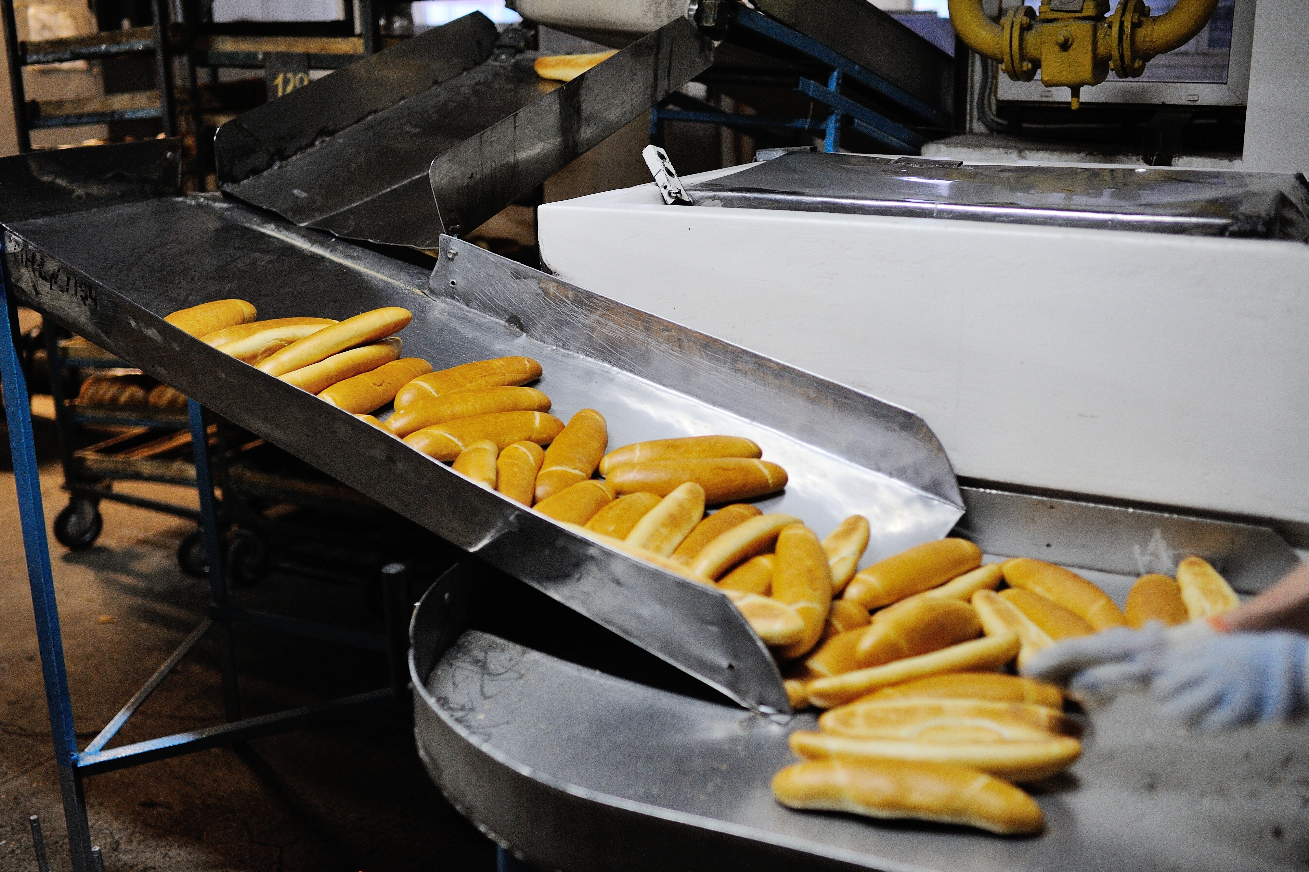
Challenges - Preventive Controls Rule
Validation justification
  Technical competency
  Scientific availability
Resources
  FDA PC Guidance
  TAN
Uncertainty of compliance
  State
  Processor
Awareness
Capacity challenges
Liability & accountability
http://foodsafety.merieuxnutrisciences.com/wp-content/uploads/ 2017/04/shutterstock_566689867.jpg

Slide 28

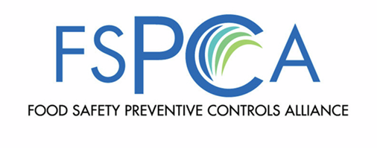
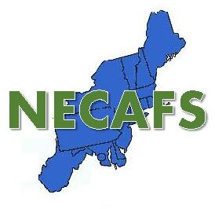
FSMA Support: Produce & Preventive Control
Preventive Control
FDA
  2017 Compliance Audit
  NECAFS – April 16th
FSPCA
  Food Safety Preventive Control Alliance Conference
Extension
  PC Trainings
  Application Research
Regional Centers

Slide 29
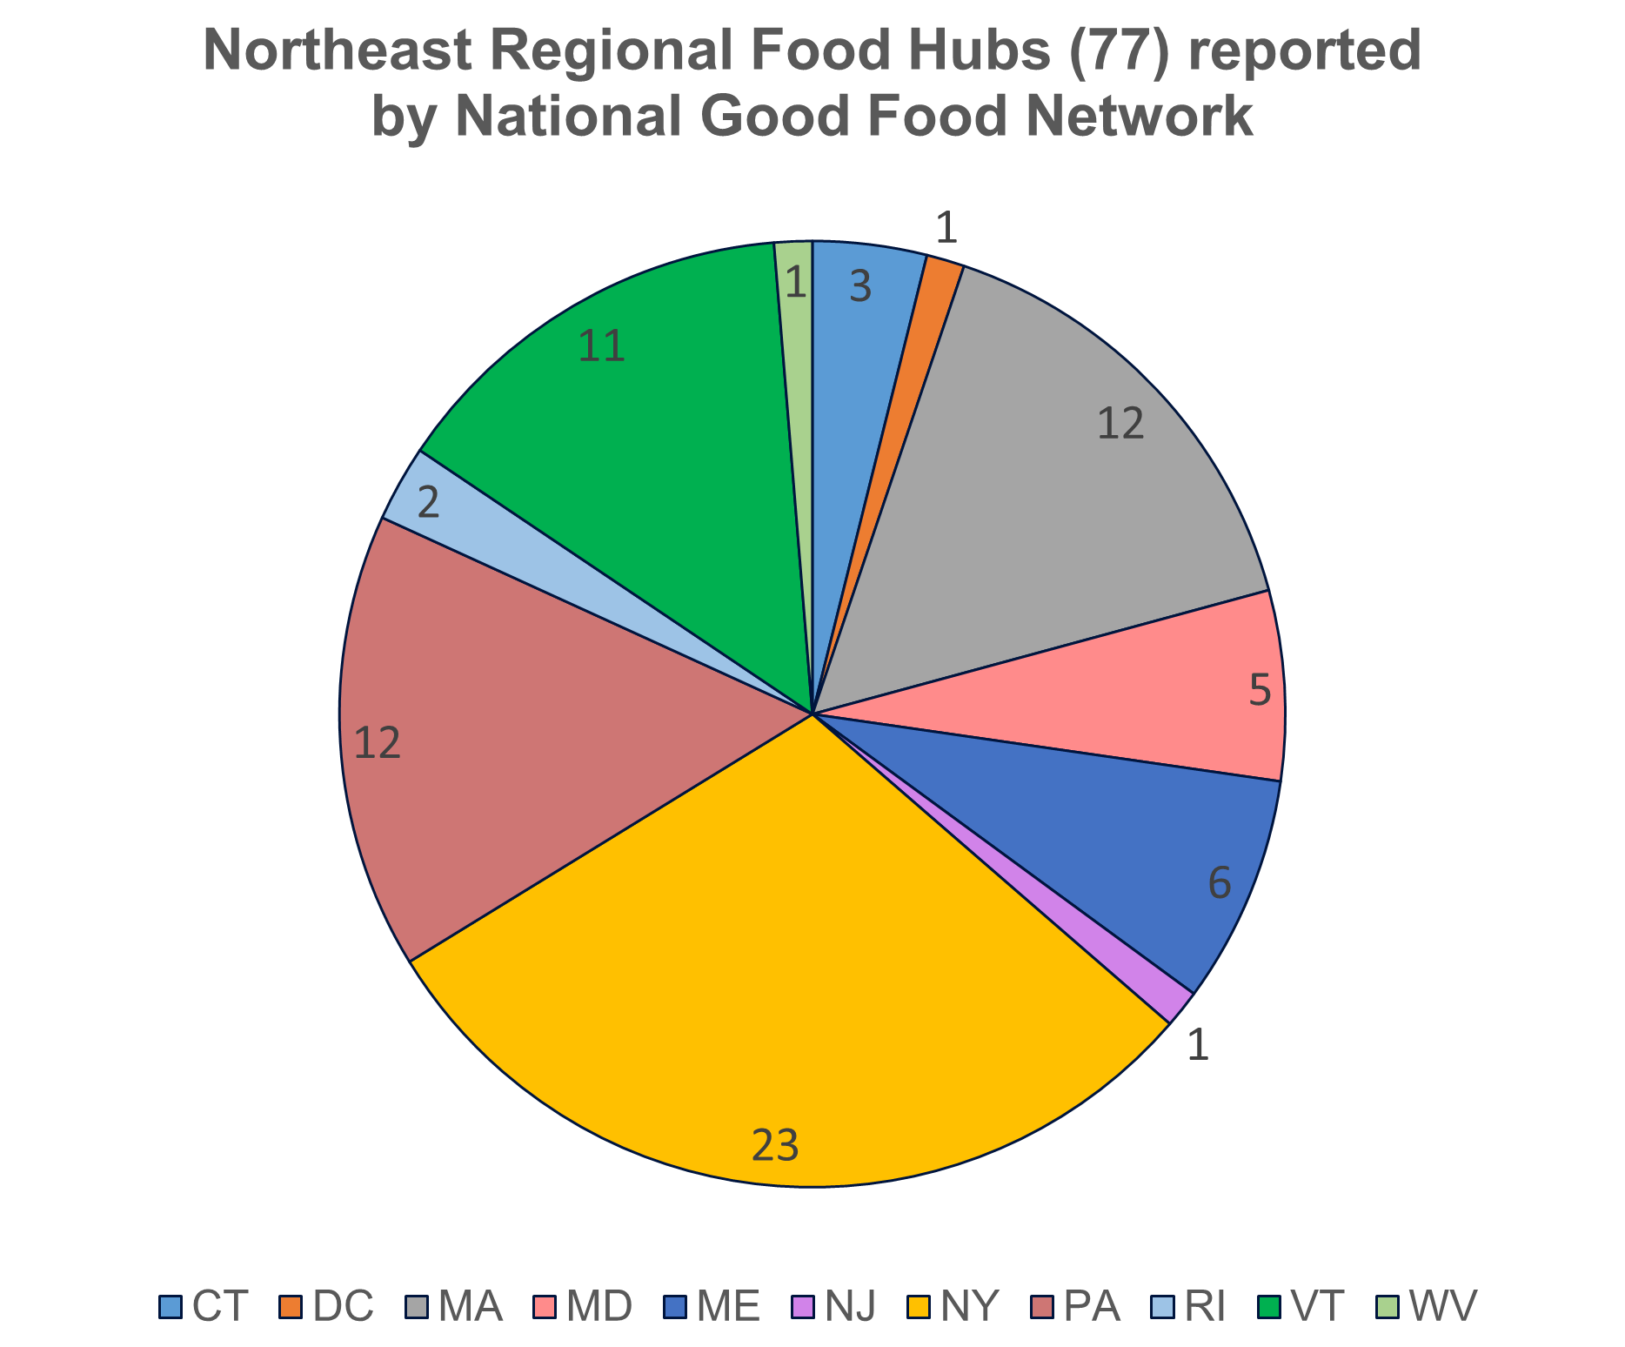
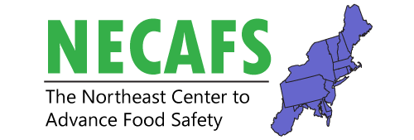


Food Safety Management Training for Small and Emerging Food Businesses:
Integrating a Food Safety Culture from Concept to Commercialization
Amanda Kinchla, UMass-Amherst, amanda.kinchla@foodsci.umass.edu; Nicole Richard & Lori Pivarnik, URI
FSOP, USDA-NIFA Grant
Project Status:
Planning Period
Problem Statement / Issue Definition:
The development of shared-use processing facilities - challenged with regulation and food safety compliance.
Increase feasibility of locally and regionally produced agricultural products, - provide a focused educational delivery of customized training to food entrepreneurs to understand critical food safety considerations from concept to commercialization.
Approach / Methods:
Conduct a needs assessment
Develop a curriculum and online training tools, field a pilot test and evaluate
Implement a sustainable food safety program
Results / Outcomes: The outcome of this project will be a sustainable food safety program, specifically tailored to the needs of small and emerging food businesses. This will include online tools, a food safety educational program, and a “train the trainer” curriculum to provide technical support for the northeast region.
Current Status: Established advisory board; Draft needs assessment; Survey review – targeted this summer; Survey administered – September 2019.
Food Safety Project Round Table

Slide 30
Summary
Value-added foods have different regulatory requirements depending on the food product and risk
Juice – HACCP
Seafood – HACCP
Meat & Poultry HACCP
Canned Foods
  Product formulation verified
  Scheduled Process
  Filing with government (FDA)
  Training
Preventive Controls
  Hazard analysis
  Preventive controls*
    Process, food allergen, sanitation, supply-chain and other
    Recall plan*
  Procedures for monitoring, corrective action and verification*
Notes:
An increasing number of establishments are incorporating special food processes into their operations. These processes require review and approval from the regulatory authority. Attendees will be provided with an overview of the area of concern to review and approve special food processing.

Slide 31
Thank you
Questions?
Amanda Kinchla
Food Safety Specialist
Interim Academic Director of Innovation Engineering
University of Massachusetts, Amherst amanda.kinchla@foodsci.umass.edu
413-545-1017

