Slide 1
VAPING
The Next Flavors of Addiction: vaping & cannabis
D.J. Wilson
Tobacco Control Director
Massachusetts Municipal association
December 13, 2018

Slide 2
VAPING AND THE ADOLESCENT BRAIN
PUBLIC HEALTH CONCERNS:
  Student vape use rates = Student smoking rates of 2 decades ago
    Current: 7.7% high school smokers – 20%+ high school vapers (YRBS)
  Teen brains become addicted to nicotine quicker – Rental Cars
  ”Dual Use” of both traditional tobacco and vape
  Could be more addictive to vape than tobacco

Slide 3
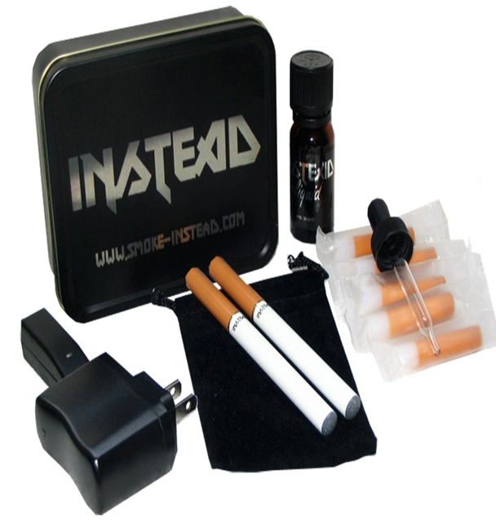
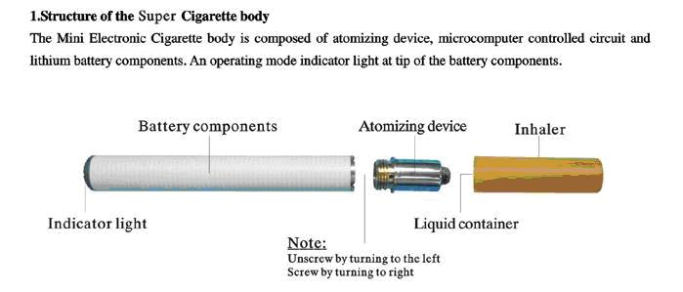
E-CIGARETTE CONSTRUCTION
Battery-operated heating elements & replaceable cartridges - Heated atomizer converts contents of cartridge into vapor
Notes:
Okay. Well, I’m sure you’re all familiar with these products by now. Electronic (or e-) cigarettes (or similar electronic delivery devices) are often shaped like traditional cigarettes, cigars or pipes that are designed to deliver nicotine or other substances to a user through an inhaler.
They typically use a battery-operated atomizer that converts the contents of a replaceable cartridge into vapor, that people inhale. Hence the word “vaping,” instead of “smoking.” Most e-cigarettes heat a liquid or gel (called e-juice, or simply juice or liquid) that contains nicotine, although some may contain lobelia, which is a nicotine substitute (also called “pukeweed”)
(Incidentally, this is important b/c some laws define e-cigarettes in a way that limits them to heating liquid nicotine. So it’s a good idea to use more inclusive definitions when regulating these devices.)

Slide 4
Vaping basics 1.0
First products were called electronic cigarettes or “e-cigarettes”
Cost about $100
Looked similar to a cigarette
Available in tobacco or menthol flavors and usually with 2-3 nicotine strengths
Price came down and disposable e-cigarettes became available for about $10 each

Slide 5
Vaping basics 2.0
Municipalities expanded sales regulations to include “Nicotine Delivery Products”
Flavored products became available
Tank systems, or “mods” sold separate from “e-juices” – great for THC!
E-juice mixing became common in vape shops
Municipalities began banning e-cigarette use in smoke-free locations
Reports of accidental exposure to e-juices by kids

Slide 6
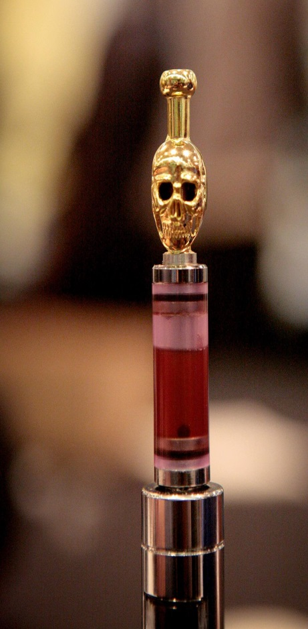
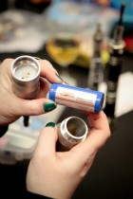
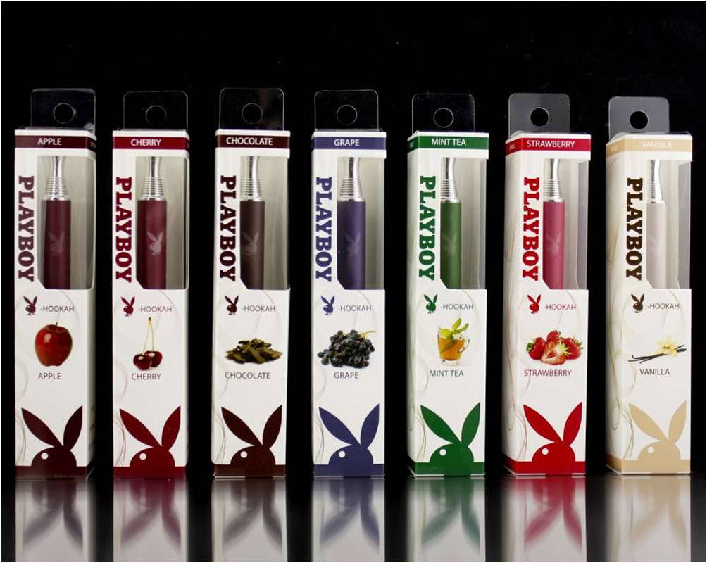
Innovative New Brands - MODS
Notes:
Here are a few more examples of e-cigarette brands, models and accessories, including e-hookah. It’s a booming market.

Slide 7
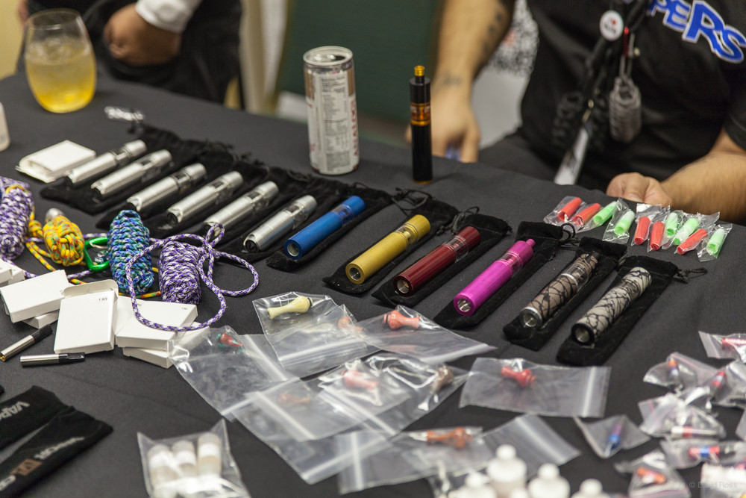
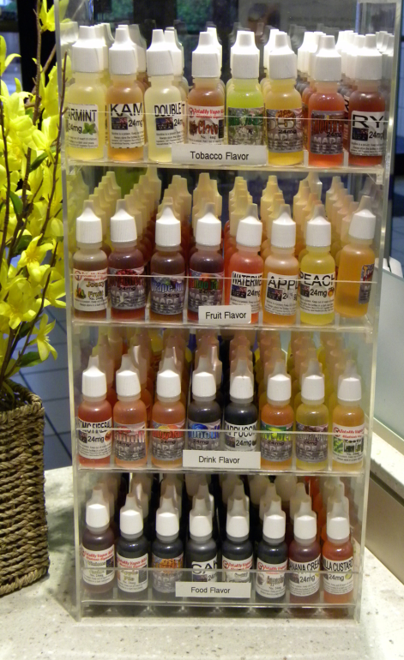
Growing Industry
Notes:
If you visit a tobacco store today, you’ll quickly see that electronic tobacco products no longer simply resemble traditional cigarettes. They now come in shapes that look like flashdrives, pens, clarinets, and even lipsticks.
In fact, over 250 brands of e-cigarettes are available today.

Slide 8
Vaping basics 3.0
Attorney General regulations for cigarette sales expanded to include e-cigarettes, with or without nicotine. This bans in-store mixing, requires child-resistant caps
Legislative “Omnibus” bill at Statehouse crafted to ban the sale of e-cigarettes by minors, ban the use of e-cigarettes in smoke-free locations and uses an expanded “Tobacco Products” definition
Start hearing about THC being added to e-juices and “closed systems”
Juul becomes popular

Slide 9
Vaping basics 4.0
Juul’s unique design, high nicotine content and affordable price make it a student favorite
Lots of negative publicity -- gets attention of U.S. Food and Drug Administration
YRBS high school survey results on vaping indicate a rate that equals the smoking rate at the start of the state’s anti-smoking program 25 years ago
Copycats flourish!

Slide 10
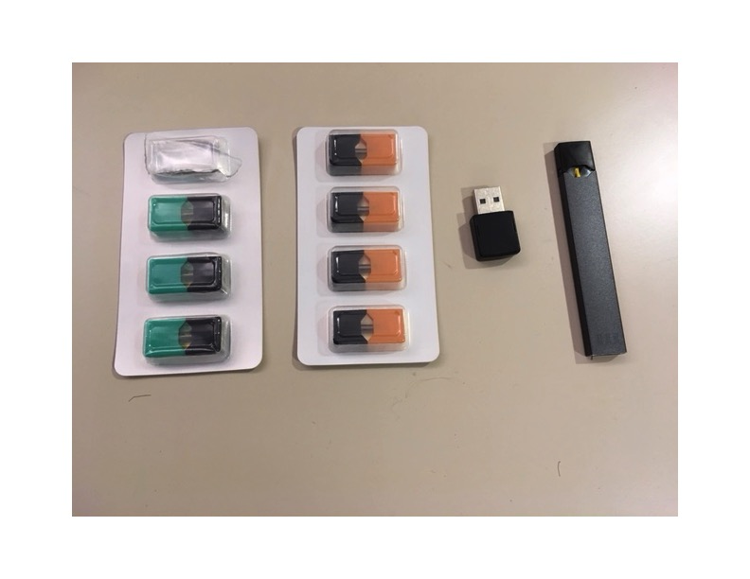
JUUL

Slide 11
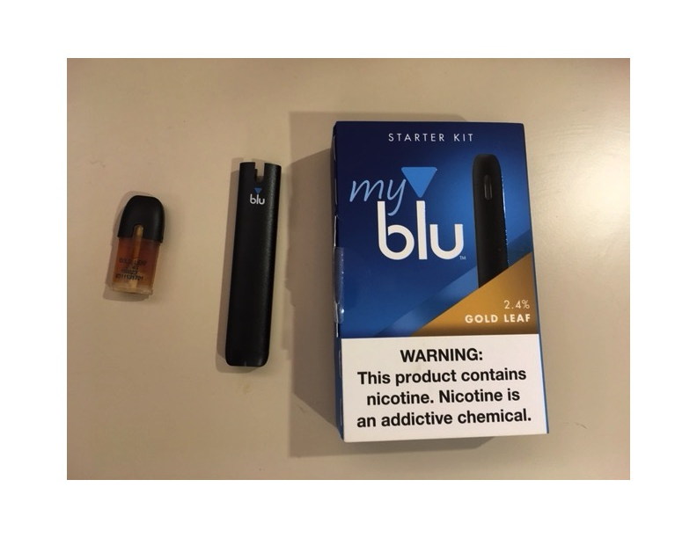
Blu

Slide 12
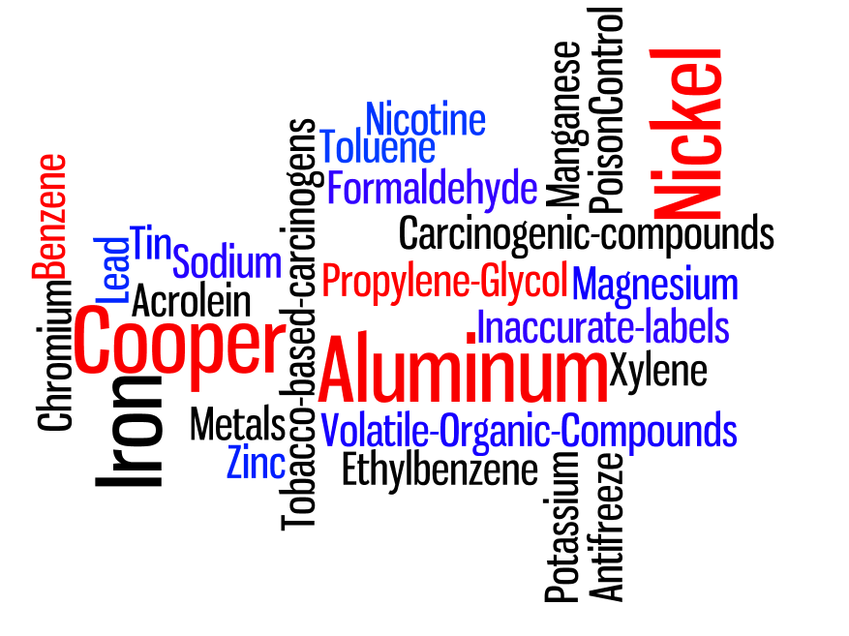
NOT JUST WATER VAPOR
Require
ingredient
disclosure
Notes:
904(a)(1) and 904(c)(1)- Submission of Health Info 21 USC 387d
Recent studies have shown that e-juice contains a wide variety, and differing amounts, of chemicals, depending on the brand you use. Here are just some of the chemicals that have been found in e-juice. These chemicals include the stuff that makes the vapor, which contains Pro-Pill-lean (propylene) glycol, vegetable glycerin, food flavoring, and generally nicotine, as well as chemicals such as formaldehyde, lead, benzene, many of which are either carcinogenic or cause reproductive toxicity.
Most of the nicotine is derived from tobacco, although some of it is synthetically derived.

Slide 13
And flavors may be harmful as well
There are researchers who suggests that certain flavorings may generate higher levels of toxic chemicals than others.‍ Among our e-cigarette–only participants, the use of fruit-flavored products produced significantly higher levels of the metabolites of acrylonitrile. This is of particular interest to adolescent e-cigarette use, because one of the main reasons teenagers report using e-cigarettes is the appealing flavors.
  “Adolescent Exposure to Toxic Volatile Organic Chemicals From E-Cigarettes”, Mark L. Rubinstein, MD,a Kevin Delucchi, PhD,b,c Neal L. Benowitz, MD,d Danielle E. Ramo, PhDb,c, PEDIATRICS, Volume 141, number 4, April 2018

Slide 14
LOCAL Vaping sales general
Typically two types of local regulation:
BOARD OF HEALTH:
  Sales and distribution
  Second-hand smoke or use
SCHOOLS:
  Expand School Smoking Policy to include vaping

Slide 15
POLICIES federal
  FDA conducts compliance checks on cigarettes and vaping products
  Currently no oversight as to construction or design of vaping hardware
  Currently no oversight as to quality of “e-juices”
  However, JUUL and 4 other manufacturers must provide to FDA how they will keep kids from buying their product
  JUUL’s San Francisco office raided by FDA for evidence

Slide 16
POLICIES
Massachusetts new state law
Complicated Minimum Legal Sales Age jump from 18 to 21 BUT should substantially reduce ”social sources” in high school
No exemption for parents or guardians, as has been the case for decades
Will simplify Education Reform Act - No tobacco use or vaping:
  In public and private school buildings
  On public and private school buses
  On public and private school property
  At school-sponsored events
  By anyone – students, staff, administrators, visitors, residents

Slide 17
Expanded tobacco product definition
Includes:
  Traditional tobacco products
  Lists variations of e-cigarettes
  “regardless of nicotine content”
  Relies on “vaporization or aerosolization”
  Excludes FDA-approved cessation products

Slide 18
local sales policies regarding vape
Sales to Minors: Vaping soon to be covered by state law in 2019
Minimum Legal Age: 210 cities and towns have moved to 21 and include vapes – New State Law complicates this a bit!
Tobacco Sales Ban for Pharmacies: 172 municipalities have enacted – state law in 2019
Minimum Pricing and Excise Taxes: MA does not have – only sales tax applies

Slide 19
local sales policies regarding vape
Permit Capping: Cities and towns now seeking ways to work a separate “sub-cap” for “retail tobacco stores (tobacconists & vape shops)
Flavored tobacco product sales restriction: All include vape, per federal court-tested Providence city ordinance. Original policy excludes menthol, mint and wintergreen, as the feds do, but 2 municipalities contemplating removing that restriction.

Slide 20
Local Vaping and usage
2004 state “Smoke-Free Workplace Law”: Does not address vaping though the new law will starting in 2019
140 cities and towns ban vaping in smoke-free locations per the state law and their own local second-hand smoke policies

Slide 21
POLICIES
SCHOOLS
New State Law charges school committees to establish a policy regarding violations.
Schools can use the expanded Tobacco Product definition which reads:
  Tobacco Product: Any product containing, made, or derived from tobacco or nicotine that is intended for human consumption, whether smoked, chewed, absorbed, dissolved, inhaled, snorted, sniffed, or ingested by any other means, including, but not limited to: cigarettes, cigars, little cigars, chewing tobacco, pipe tobacco, snuff; or electronic cigarettes, electronic cigars, electronic pipes, electronic hookah, liquid nicotine, “e-liquids” or other similar products, regardless of nicotine content, that rely on vaporization or aerosolization. “Tobacco product” includes any component or part of a tobacco product. “Tobacco product” does not include any product that has been approved by the United States Food and Drug Administration either as a tobacco use cessation product or for other medical purposes and which is being marketed and sold or prescribed solely for the approved purpose.
Sample can be found at http://makesmokinghistory.org/dangers-of-vaping/schools/
Seek to establish an “84” Chapter

Slide 22
INTERSECTION OF
VAPING AND MARIJUANA
USE:
“Smoking” definition used to include anything that can be “combusted and inhaled”
  But 228 municipalities retain this definition
Vaping seen as efficient way to use medical marijuana for pain relief
Pot bars/pot clubs on back burner for state’s CCC – only about 14 “smoking bars” in state

Slide 23
INTERSECTION OF
VAPING AND MARIJUANA
SALES:
Drug paraphernalia sales laws loosened
Money to be made in the sale of legalized hardware
Flavored cigars and “e-juices” help mask pot smell
Tank/mod systems allow for any type of liquid solution to be vaped
Local tobacco sales permit (289)
  Fee pays for compliance checks
  Permits municipalities to suspend permit for repeat offenders

Slide 24
What you can do?
http://makesmokinghistory.org/dangers-of-vaping/
Educate yourself on the variety of products – the Tobacco Industry will always be ahead of us! Visit a convenience store!
FDA, if they choose to limit flavors, with or without menthol, will have an open comment period. Great to have schools comment about what they see locally. Would also be so helpful to have internet sales banned!
Remember that these products almost always contain nicotine, leading to addiction

