Slide 1


LOCAL PUBLIC HEALTH
Environmental health in Massachusetts
(enter your name), MEHA Ambassador
An affiliate of the
National Environmental Health Association
Notes:
Introductions to class noting this is their opportunity to ask question of an experienced Environmental Health practitioners in Municipal Public Health. You are an Ambassador for the State Association spreading the word on carriers in Environmental Health. As environmental health specialists, directors and health agents you are uniquely qualified to attract, mentor and educate the next generation of local and public health environmental health practitioners.

Slide 2
Topics to be Covered
Local Public Health
Role of Local Public Health
Environmental Health
Employment
Local, State, Federal, National
Role of Environmental Health
Credentials
Continuing Education Resources
Internships
Tuition Waiver
Notes:
We will review all areas of Municipal Environmental Health –and other topics as noted

Slide 3
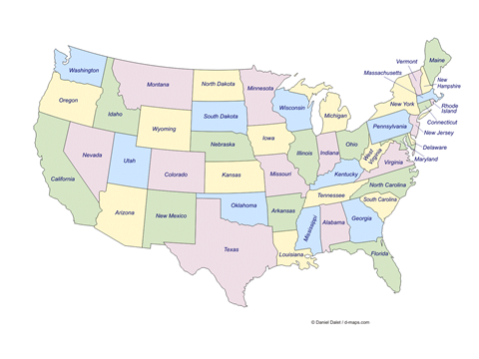
The US Public Health System
Federal
Tribal
State
Local
  County
  City
  Town
  Regional Communities
Massachusetts has 351 Public Health Departments!
Notes:
Overview of US Public Health and discuss the difference of West Coast CA to East Cost MA - Massachusetts have a very unique state and local public health delivery system. When presenting to groups outside MA it is suggested to become familiar with that States Public Health System. Also note most states in the US are structured like CA,

Slide 4


Local Public Health
In Massachusetts
Local Public Health in MA is decentralized.
    351 independent boards of health
    All have legal authority to enact local public health laws
MA had no dedicated state funding for a local public health dept. to operate, leaving funding decisions left to each municipality. But that is starting to change!
Regional Grants and Specialized Services
Notes:
Further overview of MA Public Health giving examples of how Massachusetts is different. Note: speak to Nashoba Regional Health District v. an individual city or town? Briefly discuss PHE & ARPHA grants. These new funding sources are also resulting in new job opportunities.

Slide 5

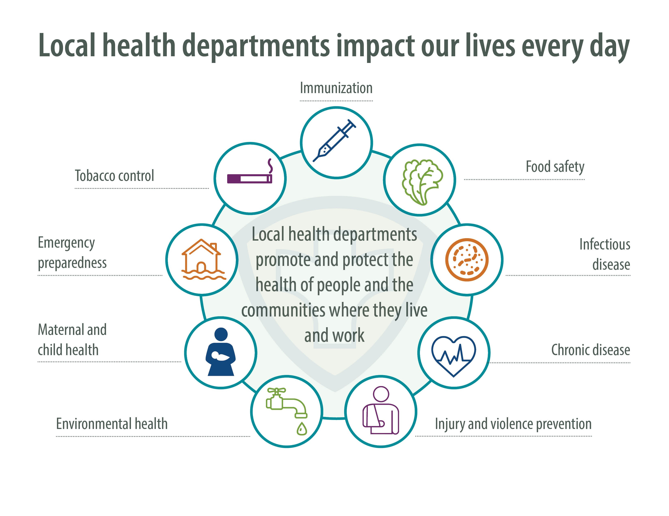
Role of Local Public Health
Notes:
The Many Roles of Local Public Health is Reviewed and will be covered in specific slides coming up

Slide 6
Environmental Health
Key Stakeholders -Potential Employment
Federal
EPA
HHS
CDC
HUD
FDA
FEMA
OSHA
USDA
DHS
CPSC
State
DEP
DPH
DLWH
Comm. San
MEMA
OTS
F&D
Dept. Ag
CLPP
Env. Health
DSS
DPS
Dept. Ed
Notes:
Brief Review of Federal – State (next slide Local) Quiz class on some of the acronyms on the slide, This could be on the final exam – LOL
Also note many potential jobs are with these stakeholders.

Slide 7
Environmental Health
Definition:
Environmental Health is a key division of the Public Health system. Environmental health practitioners are on the “front line” in the public health battle to prevent injury, disease and possible death. Many tools (science, technology, laws & regulations) are used to achieve this mission.
Notes:
Core Environmental Health Text such as Salvato, , Friis, Moller & others have definitions. This is one the Pat Maloney has put together for his Intro to Environmental Health Class.

Slide 8
Role of Environmental Health in
Local Public Health
Permitting
Licensing
Regulatory
Code Enforcement
Technical Assistance
Education
Notes:
Local Public Health's Main Role in Environmental Health. Examples of Technical Assistance:– Providing environmental health guidance for building projects, field turf issues, air quality issues and more……
Also note these “Roles” vary depending on the size and scope of the Community/Population and Department.

Slide 9



Environmental Health
Food Safety – Municipal Level
Restaurants
Retail Stores
Mobile Food
Fairs/Festivals
Mass Gatherings
Cottage Food
Marijuana Hemp Edibles
Notes:
Food Safety is an ever-changing environmental discipline. FDA Retail standards, food processes, food sectors (slide above), federal, state and local requirements and various certifications (e.g., ServSafe, CF-SP, HACCP) put an increasing knowledge base demand on state and local regulators.

Slide 10

Environmental Health
Housing Code
Apartments
Condos
Lodging Homes
Dorms
Group Homes
Problem Properties
Community Issues
Emergency Shelters
Airbnb
Notes:
For urban Environmental Health Programs – Housing can be a close 2nd as pre-inspections, inspections, re-inspections, condemnation proceedings, general code enforcement and court filings require an evolving subject matter expertise.

Slide 11
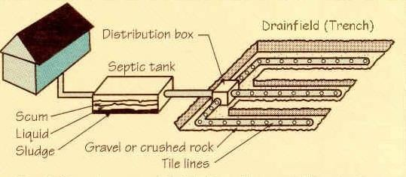
Environmental Health
Sewage Disposal
New England Health Departments continue to have some of the most progressive requirements for sewage disposal systems.
Notes:
Title 5, in addition to food and housing regulatory programs, is a core municipal environmental health program that also demands and ever-increasing time commitment, knowledge and expertise to monitor, educate and enforce. Licensed Soil Evaluators (SE), and System Inspectors (SI) are central to the implementation of T5 at the local level.

Slide 12


Environmental Health
Pest Control
Rats and mice can spread a variety of diseases, including rat bite fever, leptospirosis, lymphocytic choriomeningitis virus infection, and in other parts of the country, hantavirus infection and plague.
Notes:
Rodents are becoming a national challenge to many Health Departments – Environmental Health staff usually handle these complaint investigations

Slide 13
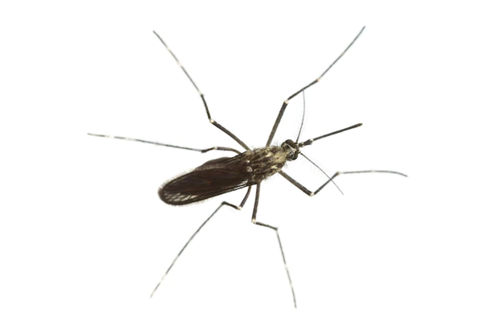
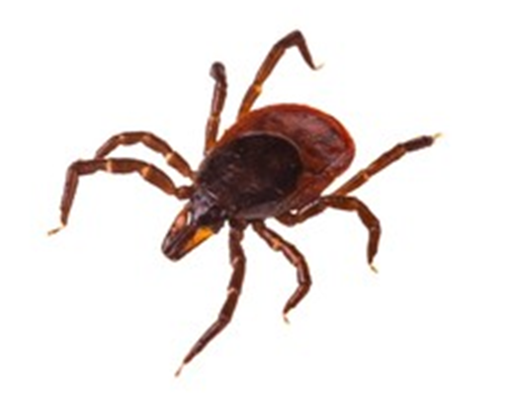
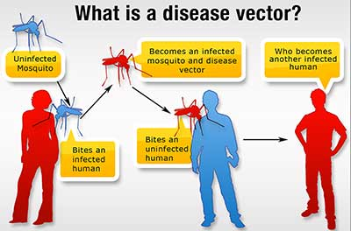
Environmental Health
Vector Control
Vector-borne diseases are a major public health concern.
Environmental health professionals are on the frontline of helping individuals, institutions, and communities reduce threats from mosquitoes, ticks, and other vectors.
Examples of vector-borne diseases include West Nile Virus, Lyme disease, plague, tularemia, malaria, Eastern Equine Encephalitis, Dengue Fever, and Rocky Mountain Spotted Fever.
Notes:
Focus on WNV and EEE… LBOH have strong and mutually beneficial relationships with their mosquito control projects

Slide 14

Environmental Health
Hazardous Materials
As part of the New England effort to prevent mercury from being improperly disposed in the waste stream, many health departments held thermometer swap events
Many health departments also hold Household Hazardous Waste Days, either yearly, bi-yearly, or monthly
Notes:
Massachusetts was one of the first communities to hold a Household Hazardous Materials collection day- Can you guess who? Lexington Board of Health!

Slide 15
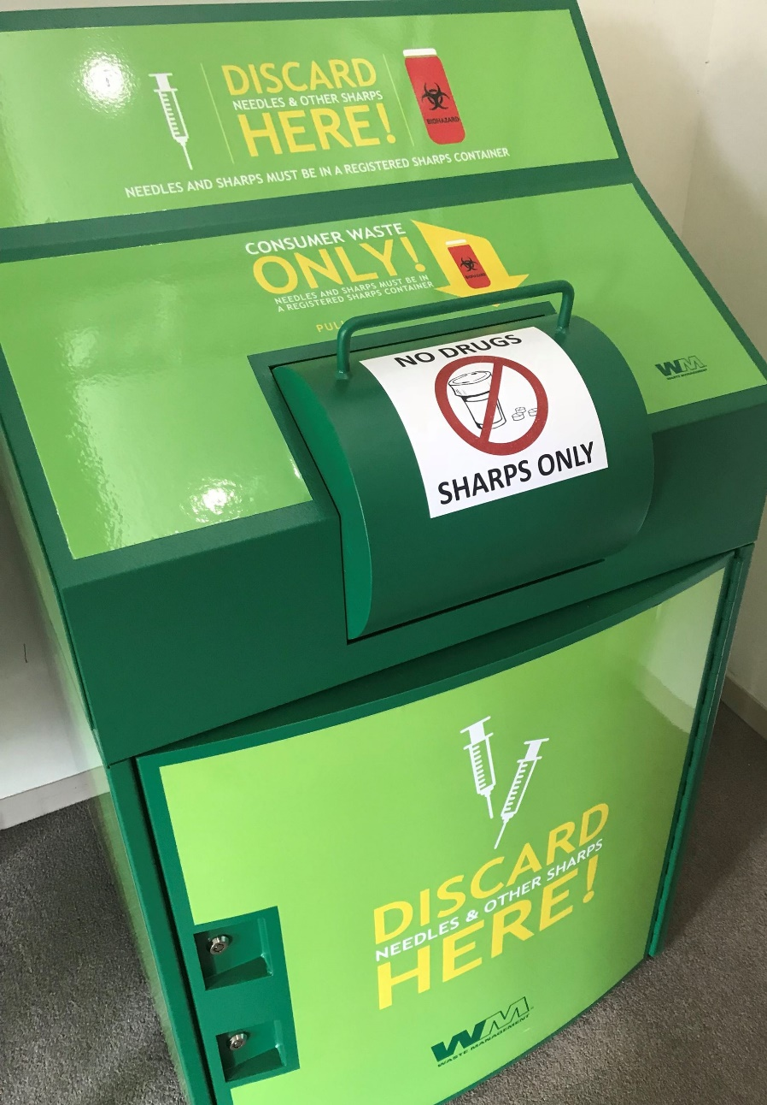
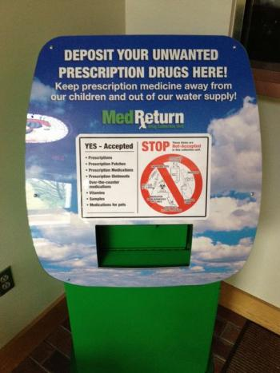
Environmental Health
Medical Waste
Medical Waste (Sharps) and Light Bulb Collection
Pharmaceuticals Collection (Police)

Slide 16



Environmental Health
Body Art
Permitting of Body Art Establishments is one of the newest programs in the New England Region. Thanks to the NEHA model guide for Body Art the process was implemented with minimal issues.
Notes:
Briefly discuss NEHA model guide and MA state of local regulations. Since MDPH has a model guidance document and LBOH must develop their own regulatory program.

Slide 17

Environmental Health
Solid Waste
Residential
Commercial
Recycling
Landfill – Transfer Station
Infectious Waste
Hazardous Waste
Polystyrene
Plastic Bags
Notes:
Mention MDEPs role in these programs? Climate change impacts

Slide 18



Environmental Health
Mass Gatherings
Notes:
What is a mass gathering? US Open, Woodstock

Slide 19
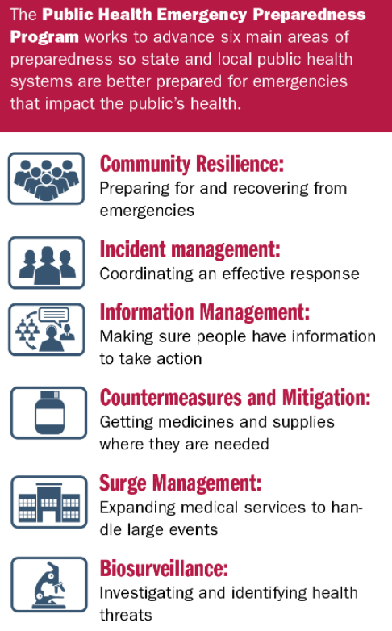
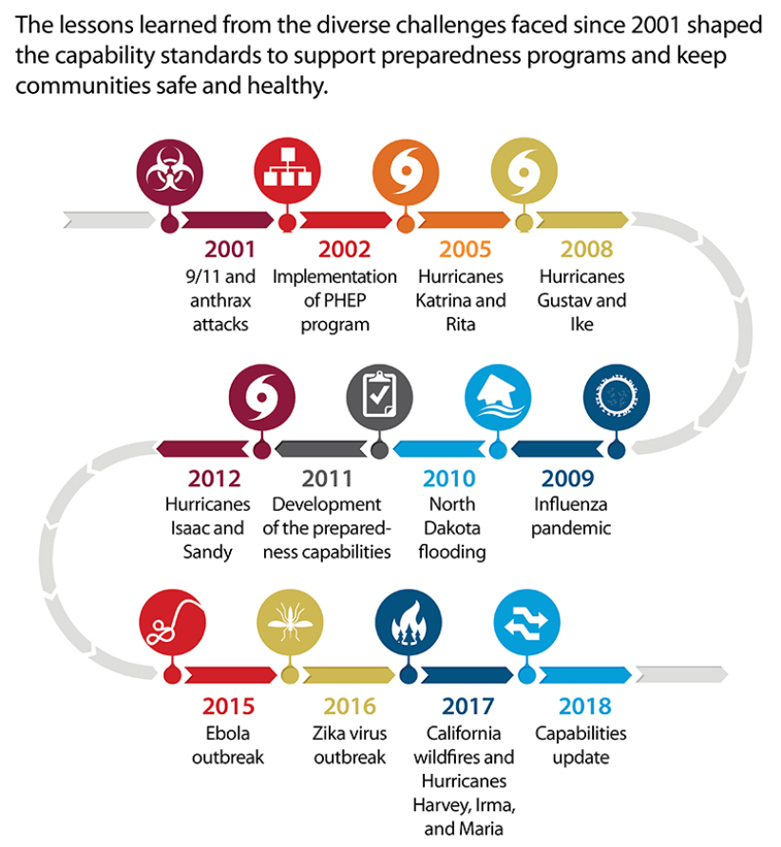
Environmental Health
Public Health Emergencies
Notes:
Fires, floods, electrical outages- And Now – Pandemics!!!

Slide 20
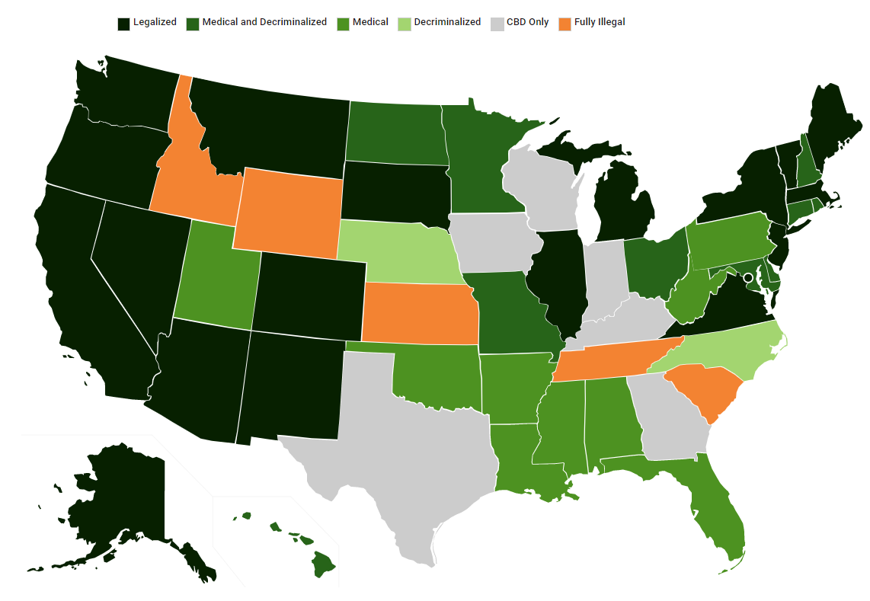
Environmental Health
Marijuana
Notes:
Environmental Health practitioners can inspect these establishments for Public Health compliance

Slide 21
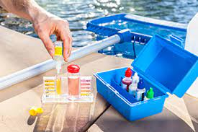
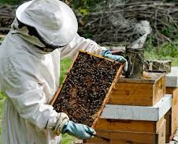

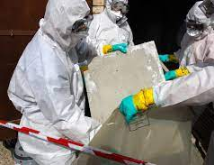

Environmental Health
..and more!
Swimming Pools
Children’s Camps
Asbestos Removal
Lead & Mold
Keeping of Animals
General Nuisance Issues
Emergency Preparedness
Notes:
And the list goes on…………….

Slide 22
Employment
Internships in Environmental &
Public health
Local
National
International
State
Federal
Notes:
The following slides address Internships – Employment – Credentials and Loan Waivers for persons choosing a Public Health Career

Slide 23

Employment Locations
Local Level
Massachusetts Environmental Health Association: https://maeha.org/
MA Health Officers Assoc: http://www.mhoa.com/
City and Town Web Pages
  https://www.boston.gov/career-center
  https://www.worcesterma.gov/human-resources/employment-opportunities
  https://www1.nyc.gov/site/doh/about/employment/job-search.page

Slide 24



Employment Locations
State Level
https://massanf.taleo.net/careersection/ex/jobsearch.ftl?f=ORGANIZATION(11500120189)&a=null&multiline=true&ignoreSavedQuery
Links to Public Health and Environmental Health positions with various departments
http://www.opm.gov/ Links to various Federal Departments and Agencies
Search titles:
  Consumer Safety Officer
  Public Health
  Environmental Health
  Inspector
  Sanitarian

Slide 25

Employment Locations
National Level
National Environmental Health Association: www.NEHA.org
American Public Health Association:
www.APHA.org
National Assoc. of City and County Health Organizations:
http://www.naccho.org/careers/
  Consumer Safety Officer
  Public Health
  Environmental Health
  Inspector
  Sanitarian
https://careers.internationalmedicalcorps.org/careers.aspx
Environmental Health Dream Job! http://wdw.disneycareers.com/en/search-jobs/advanced-search/

Slide 26

Employment Opportunities
Civil Service
Varies from State to State
New York State is very active for positions:
  State
  County
  City
  Town/Village
https://statejobsny.com/public/howitworks.cfm
http://www1.nyc.gov/jobs/exams.page
*Some jurisdictions have residency requirements (Boston, NYC etc.)
Notes:
Some States have a Civil Service System that Requires Examinations and or Degree/Credential Requirements for being eligible for Positions.
Attendee’s expically students should be made aware of this.

Slide 27

Credentials
Registered Sanitarian - RS
Registered Environmental Health Specialist - REHS
  State Registration
  National Registrations
  Civil Service Rankings
Certified Health Officer - CHO
Certified Lead Inspector
Lead Determinator
Certified Asbestos Inspector
Notes:
Briefly review the many Credentials practitioners can obtain. Some require additional years of experience and specialty training

Slide 28




Credentials
Certified Professional Food Manager*
Certified in Food Safety Supplier Audits & Auditor
Certified in Comprehensive Food Safety - CCFS
Certified Professional Food Safety Specialist - CP-FS
HACCP-Auditor*
Certified Foodborne Outbreak Investigator - CFOI
Certified Pest Control Operator*
*Can be acquired without employment experience
This Photo by Unknown Author is licensed under CC BY
Notes:
Additional experience and training are also needed for these credentials. These credentials also vary from State to State

Slide 29


Credentials
Licensed Soil Evaluator - SE
Certified Pool Operator – CPO*
Certified Hazardous Materials Practitioner (CHMP)
Licensed Site Professional - LSP
Certified in Public Health – CPH*
Certified Health Education Specialist – CHES*
*Can be acquired without employment experience
Notes:
Additional experience and training are also needed for these credentials. These credentials also vary from State to State

Slide 30
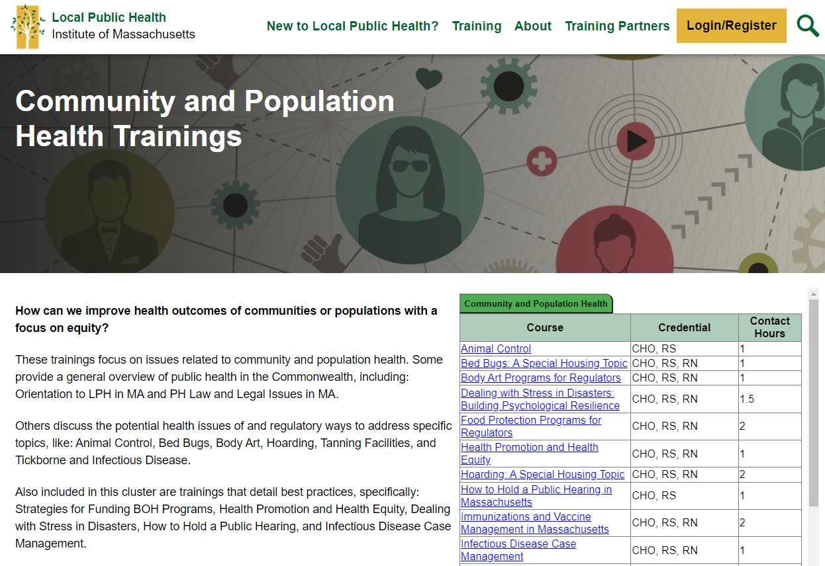
Continuing Education
Notes:
Highly recommend accessing LPHI online training courses to build foundational environmental practice knowledge.

Slide 31
Continuing Education
MASSACHUSETTS PUBLIC HEALTH INSTITUTE
https://sites.bu.edu/masslocalinstitute/training/on-your-time-trainings
NATIONAL ENVIRONMENTAL HEALTH ASSOCIATION
https://www.neha.org/professional-development/education-and-training/neha-e-learning
FOOD AND DRUG ADMINISTRATION (FDA)
Office of Training Education and Development (OTED) | FDA
https://www.fda.gov/training-and-continuing-education/office-training-education-and-development-oted
CENTERS OF DISEASE CONTROL (CDC)
CDC Learning Connection EPHOC – https://www.cdc.gov/nceh/ehs/elearn/ephoc.htm
(Environmental Health Specific)

Slide 32
Internships
Local, State, and Federal
State Internship Opportunities:
  Academic Public Health Corps https://www.mass.gov/info-details/academic-health-department-academic-public-health-corps
Federal Internship Opportunities:
  USAJOBS Help Center | Students & recent graduates
  https://www.usajobs.gov/help/working-in-government/unique-hiring-paths/students/
  US Public Health Service https://www.usphs.gov/students/
https://mhoa.com/municipal-links/ (To all Health Depts. in MA)
  Select community
  Communicate in writing
  Seek contacts for support – promotion
  Sell yourself, training, certification, skills and examples of projects you can do:
    Pamphlets, water sampling, level one inspections, nuisance complaint investigations, standing water complaints and issues.
  Follow-up with an email – call or even make a visit!
Notes:
Trainings, internships and certain certifications (i.e., ServSafe) can be acquired as a student intern and serve to build a solid and advantageous resume for those seeking environmental health employment in government and non-government settings.

Slide 33
Tuition Waiver Opportunities
Indian Health Service:
IHS - Loan Repayment Program https://www.ihs.gov/loanrepayment/
Health Resources and Service Administration (HRSA):
National Health Service Corps – Loan Repayment Program https://nhsc.hrsa.gov/loan-repayment/nhsc-loan-repayment-program
Commissioned Corps of the US Public Health Service:
Loan Repayment Benefit Program https://www.usphs.gov/professions/public-health-professional/
Notes:
It is important to check with employers if they participate in these programs and under what conditions.

Slide 34

Any Questions?
Take a MEHA – Student Member Application – First Year is Free!
Notes:
Br sure to hand out MEHA applications! First year of membership is free AND add to resume to show Professional Membership

