Slide 1


Reviewing a HACCP Plan
Reduced Oxygen Packaging (ROP)
Without A Variance
Cook-Chill - Pulled BBQ Chicken
Presenter
Pamela Ross-Kung, M.S. R.S. President, Safe Food Management
9/29/2022

Slide 2
Background
During the past decade, retail food establishments have expanded their operations to include food processing-type operations, such as reduced oxygen packaging, acidification, fermentation, smoking, curing, and drying, often using sophisticated technologies and equipment. These specialized processes present a significant health risk if not conducted under strict operational procedures.
For this reason, if a retail establishment conducts a specialized process, they must provide a HACCP plan to the health department for approval before beginning that operation.

Slide 3
For jurisdictions that have adopted The Food Code and/or additional requirements, regulators are responsible for ensuring that HACCP plans are valid prior to approving them to ensure that they will eliminate or significantly reduce identified hazards that may contribute to foodborne illness.
Today’s Goal:
Review a sample HACCP plan so you can see how all the pieces fit together.

Slide 4
Primary Resource
Regulatory information is based primarily on the U.S. Public Health Service 2013 FDA Food Code with 2015 Amendments (hereinafter referred to as The Food Code) and supplemental MA regulations 105 CMR 590.000: State Sanitary Code Chapter X: Sanitation Standards for Food Establishments, therefore regulators may need to modify information based on their jurisdictional requirements.

Slide 5
Applicable Regulations for Specialized Processes or Operations Requiring a HACCP Plan
§ 8-201.13 When a HACCP Plan is Required
§ 8-201.14 Contents of a HACCP Plan
§ 8-103.12 Conformance with Approved Procedures

Slide 6
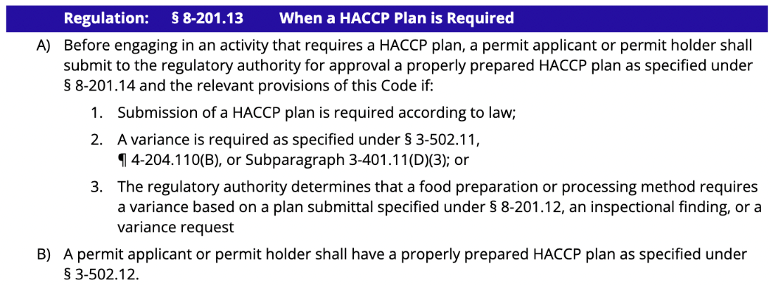

Slide 7
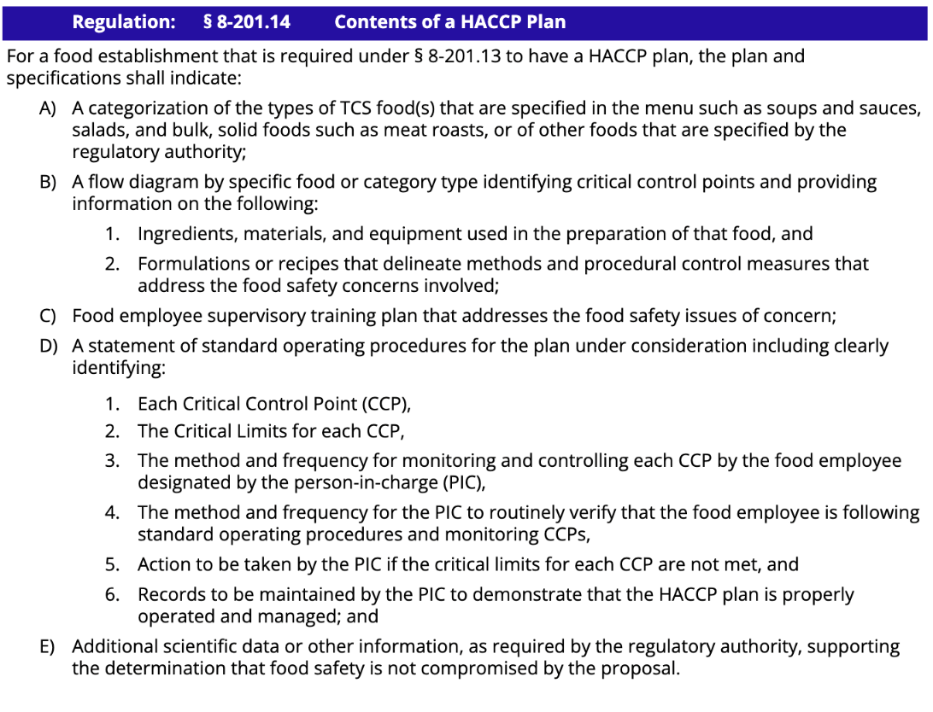

Slide 8
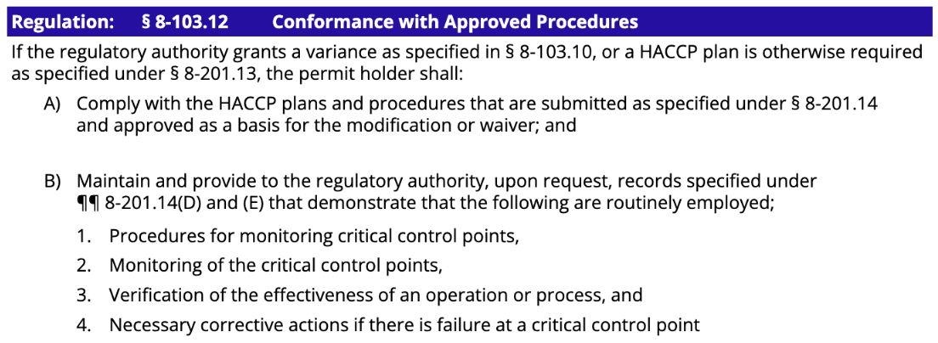

Slide 9
§ 3-502.12
Reduced Oxygen Packaging Without a Variance, Criteria
Request Letter
As required by ¶ 8-201.13 (B) of the 2013 FDA Food Code, we are submitting a HACCP plan, requesting approval to vacuum package cooked, pulled BBQ chicken using a cook-chill process as outlined in ¶ 3-502.12 (D) which allows foods to be vacuum packaged, without a secondary barrier, using time-temperature combinations that provide equivalent food safety protection to control the growth and toxin formation of C. botulinum and the growth of Listeria monocytogenes without the need for a variance provided that an approved HACCP plan is in place.
The information required by relevant sections of the Food Code, as shown on the following pages, has been incorporated into our HACCP plan. We have also developed and implemented comprehensive SSOPs that are essential to ensuring that food is not being compromised before or after the vacuum packaging process. We will keep the HACCP plan, SSOPs, and relevant records in a binder for review during inspections.

Slide 10
§ 3-502.12
Reduced Oxygen Packaging Without a Variance, Criteria
Cook-Chill
(D) A food establishment that packages food using a cook-chill process shall:
(1) Provide to the regulatory authority (RA) prior to implementation, a HACCP Plan that contains the information as specified under ¶¶ 8-201.14 (B) and (D) (see below);
¶ 8-201.14 (B)
(A) A categorization of the types of TCS food(s) that are specified in the menu such as soups, salads, and bulk, solid foods such as meat roasts, or of other foods that are specified by the regulatory authority;
(B) A flow diagram by specific food or category type identifying critical control points (CCPs) and providing information on the following:
Ingredients, material, and equipment used in the preparation of that food, and
Formulation or recipes that delineate methods and procedural control measures that address the food safety concerns involved;

Slide 11
¶ 8-201.14 (D)
A statement of standard operating procedures for the plan under consideration including clearly identifying:
  Each CCP,
  The critical limits for each CCP,
  The method and frequency for monitoring and controlling each CCP by the food employee designated by the person in charge,
  The method and frequency for the Person in Charge (PIC) to routinely verify that the food employee is following standard operating procedures and monitoring CCPs,
  Action to be taken by the person in charge if the critical limits for each CCP are not met, and
  Records to be maintained by the person in charge to demonstrate that the HACCP Plan is properly operated and managed

Slide 12
(2) Ensure the food is:
(a) Prepared and consumed on the premises, or prepared and consumed off the premises but within the same business entity with no distribution or sale of the packaged product to another business entity or the consumer;
(b) Cooked to heat all parts of the food to a temperature and for a time as specified under ¶¶ 3-401.11 (A), (B), and (C),
(c) Protected from contamination before and after cooking as specified under Parts 3-3 and 3-4,
(d) Placed in a package with an oxygen barrier and immediately after cooking and before reaching a temperature below 135°F,

Slide 13
(e) Cooled to 41°F in the sealed package or bag as specified under § 3-501.14 and subsequently:
(i) Cooled to 34°F within 48 hours of reaching 41°F and held at that temperature until consumed or discarded within 30 days after the date of packaging; They have chosen this option
(ii) Held at 41°F, or less for no more than 7 days, at which time the food must be consumed or discarded;
(iii) Held frozen with no shelf-life restriction while frozen until consumed or used.

Slide 14
(f) Held in a refrigeration unit that is equipped with an electronic system that continuously monitors time and temperature and is visually examined for proper operation twice daily,
(g) If transported off-site to a satellite location of the same business entity, equipped with verifiable electronic monitoring devices to ensure that times and temperatures are monitored during transportation, and
(h) Labeled with the product name and the date packaged, and
(3) Maintain the records required to confirm that cooling and cold holding refrigeration time/temperature parameters are required as part of the HACCP plan and:
(a) Make such records available to the regulatory authority upon request, and
(b) Hold such records for at least 6 months; and

Slide 15
(4) Implement written operational procedures as specified under Subparagraphs (B)(5) and (B)(6) of this section.
(B)(5)
Includes operational procedures that:
(a) Prohibit contacting food with bare hands,
(b) Identify a designated area and the method by which:
Physical barriers or methods of separation of raw foods and ready-to-eat foods minimize cross contamination, and
Access to the processing equipment is restricted to responsible trained personnel familiar with the potential hazards of the operation, and
(c) Delineates cleaning and sanitization procedures for food-contact surfaces; and

Slide 16
(B)(6)
Describes the training program that ensures that the individual responsible for the reduced oxygen packaging operation understands the:
(a) Concepts required for a safe operation,
(b) Equipment and facilities, and
(c) Procedures specified under subparagraph (B)(5) of this section and ¶¶ 8-201.14 (B) and (D).

Slide 17
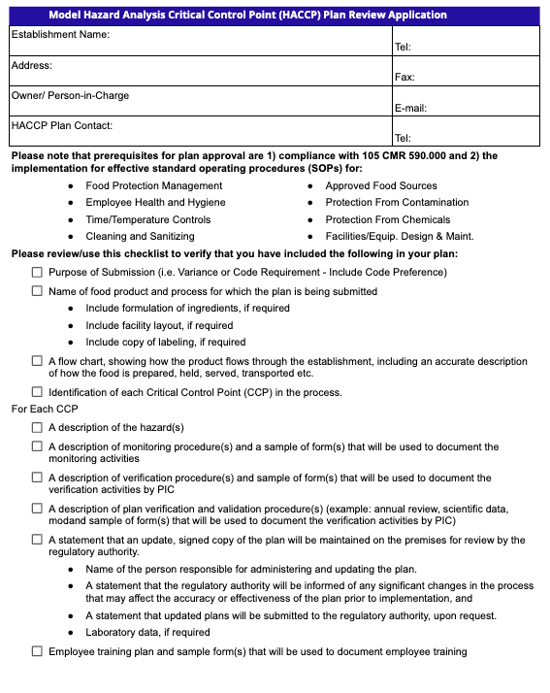

Slide 18
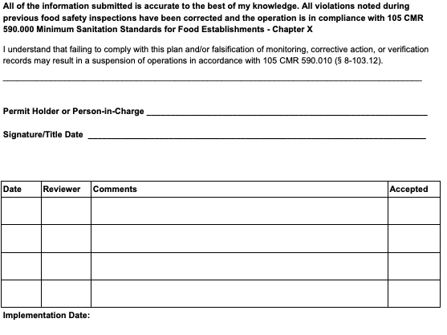

Slide 19
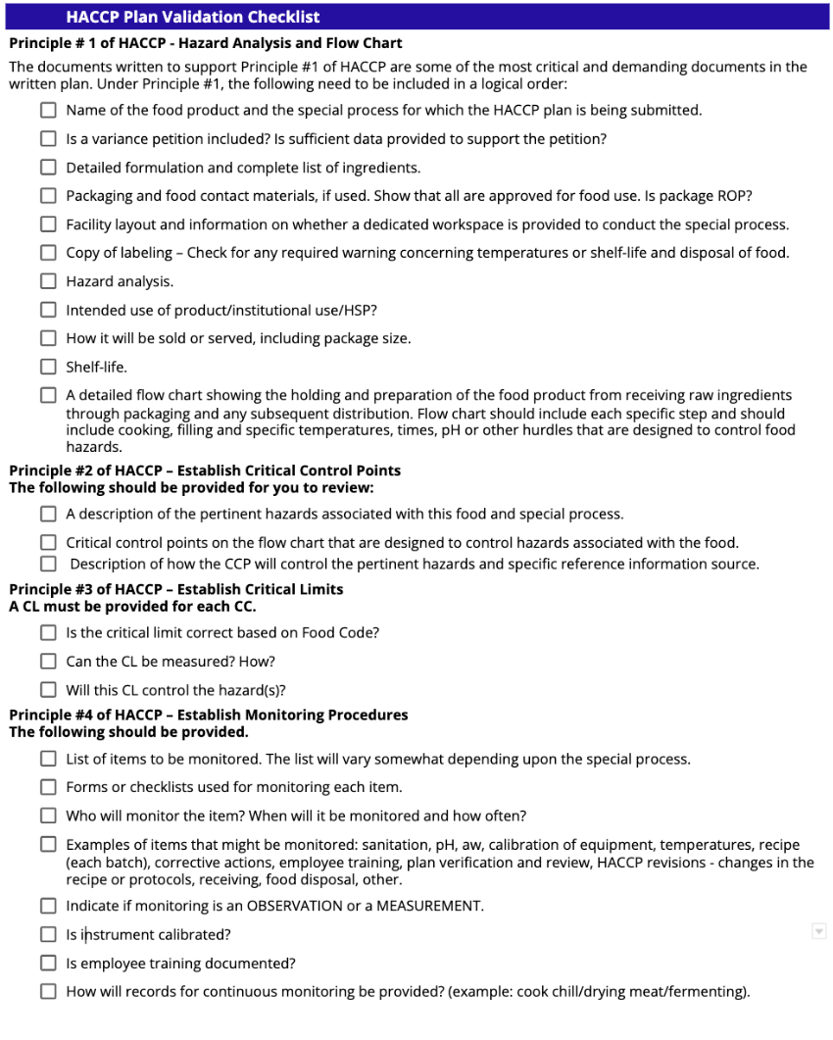

Slide 20
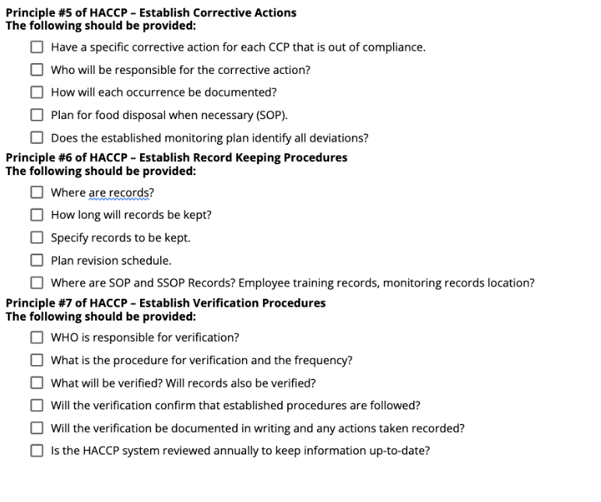

Slide 21
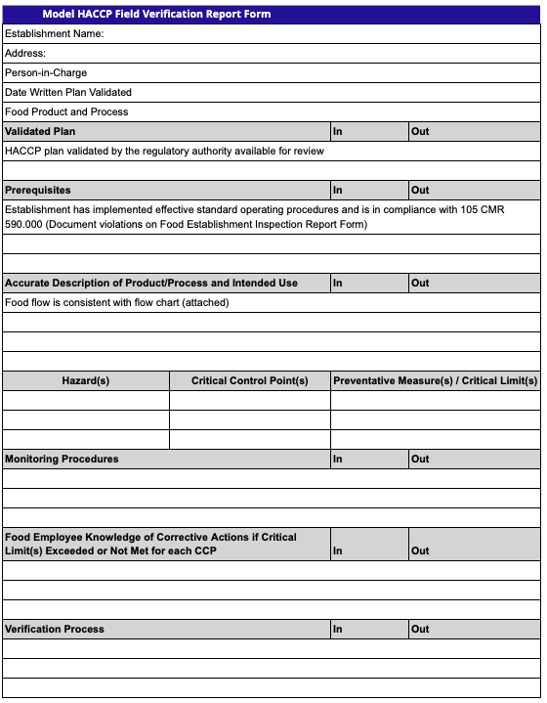

Slide 22
Resources

Slide 23

Field Verification Checklists

Slide 24

A REGULATOR’S GUIDE:
Validation and Verification
Of HACCP Plans
In Retail Food Establishments
May 16, 2022
First Edition

