Slide 1
THE ABCs OF I/As: A GUIDE TO UNDERSTANDING INNOVATIVE ALTERNATIVE TECHNOLOGIES
CLAIRE GOLDEN, MassDEP
YANKEE CONFERENCE, NORTHAMPTON, MA SEPTEMBER 21, 2023

Slide 2
Any proprietary technology mentioned in this presentation is used purely as an example and its inclusion does not constitute a comment upon or endorsement of the technology by the presenter or by MassDEP.
STANDARD
DISCLAIMER

Slide 3
PERSONAL DISCLAIMER
My goal is to keep the terminology that I used in this presentation as generic and universal as possible so as to be applicable and understandable to all states who are represented here. I am concerned that I may fall back into old habits. If I do, please call me out on it. No one is perfect!
Thank you for your patience in this regard!

Slide 4

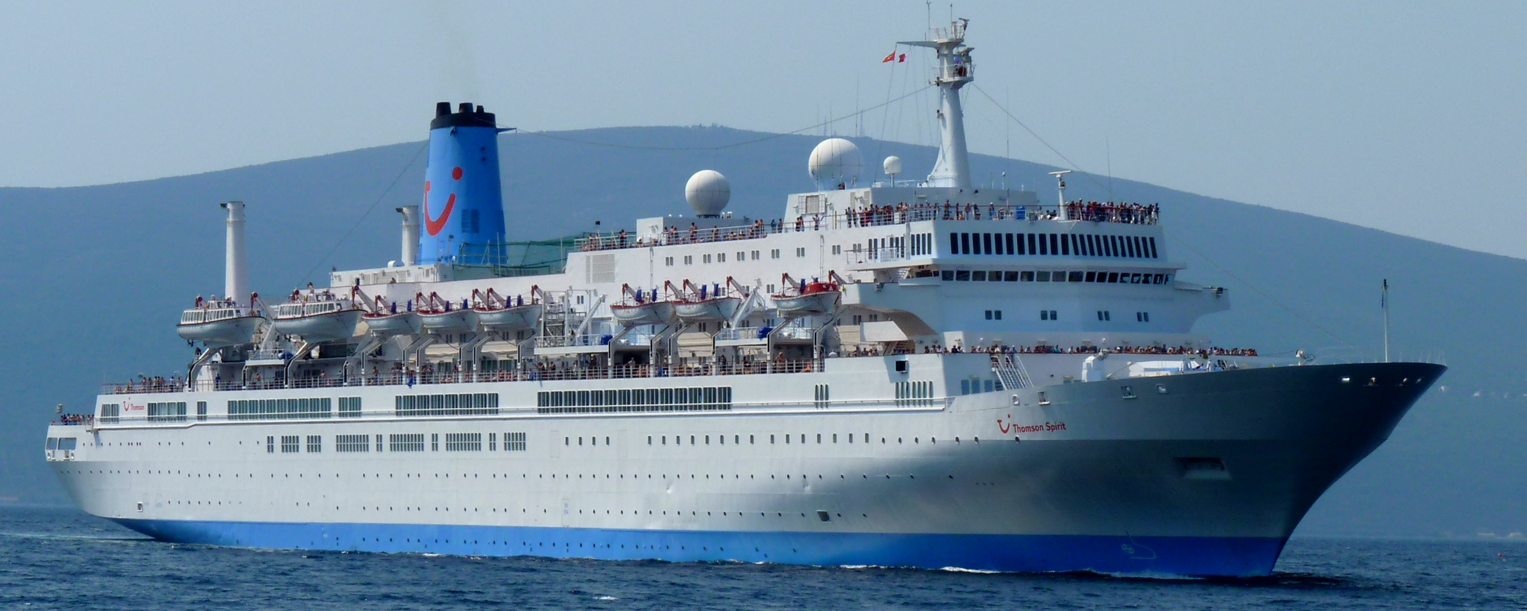
Where did most of the original alternative technologies we know get their start?
MINI QUIZ TO START THE PRESENTATION:
Naval and cruise ships

Slide 5

It’s good to set some ground rules so we don’t find ourselves going down the infamous rabbit hole.

Slide 6
TERMINOLOGY
Septic system
Subsurface disposal system
On-site system
Any on-site disposal system without monthly reporting requirements that resemble a DMR for municipal WWTP
Approving authority
Whoever approves septic systems in your state
State agency/ies; and/or
County; and/or
City/town

Slide 7
Innovative Alternative Technology
What exactly does that mean?

Slide 8
Innovative Alternative Technology
Any proposed component of a subsurface disposal system (aka septic system) that is not expressly permitted by the applicable regulations governing subsurface systems; or
Any proposed septic system component that is expressly required to be approved by the applicable regulations governing subsurface systems. This can either be of the technology itself or its use at a particular location.

Slide 9
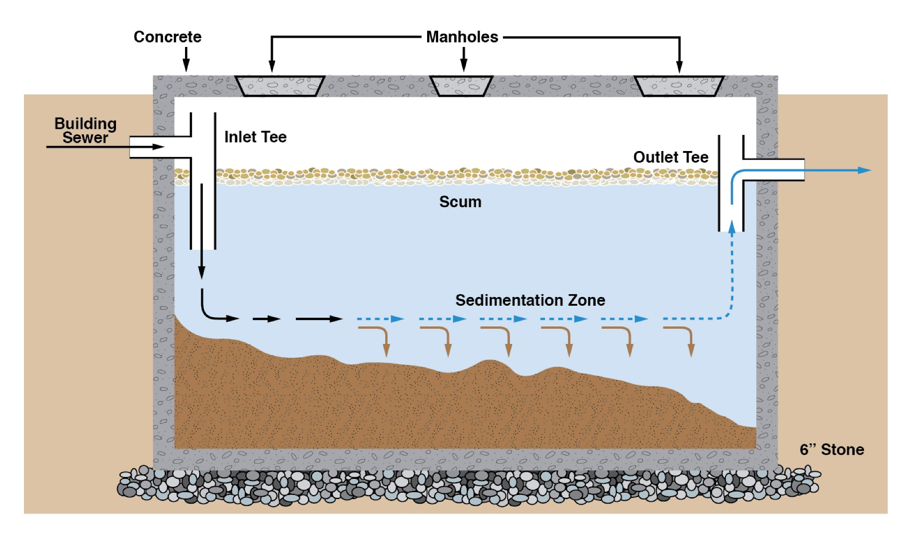
It is good to think of a septic system as a miniature wastewater treatment plant…..
The septic tank provides primary treatment. Heavy solids are removed and other solids are given quiescent conditions and allowed to settle out. Scum is retained and, if there is an effluent tee filter additional particles are captured.

Slide 10
So Let’s Talk about Septic Tanks….
Here in Massachusetts, septic tanks must be:
Be constructed of concrete; fiberglass reinforced plastic; or polyethylene;
Have three accesses; and
Be a minimum of 4 feet deep.
This poses a problem for some plastic tanks: the three accesses makes them structurally unstable.
But sometimes you need plastic tanks because of site constraints, etc.
MassDEP has approved as alternative technologies plastic tanks that have only two accesses and in some access are “low boys”.

Slide 11
LET’S CONTINUE WITH THE WWTP SCENARIO
The major solids have been removed.
Now for some reason, additional treatment is required or desired prior to discharge to the ground.
There are different types of treatment depending on what you require or want:
Maybe this is a repair of an existing system and site conditions may prevent full compliance with design criteria.
Maybe regulations permit design concessions for new construction with the use of alternative technologies
Perhaps this facility is located in an area that requires treatment to remove nutrients (nitrogen or phosphorus).
Perhaps local non-septic regulations are pushing for additional treatment.

Slide 12
REASONS FOR AN ALTERNATIVE TECHNOLOGY
Nitrogen
Loading Issues
Site Constraints
Smaller
Leaching Area
Local Matter
or Good Will

Slide 13
STOP BEFORE PROCEDING

Slide 14
ALTERNATIVE TECHNOLOGY SELECTION RELIES ON TWO THINGS
REASON FOR TECHNOLOGY USE:
Site conditions
Nitrogen loading
Smaller leaching area
Local matter or good will
NATURE OF THE DISCHARGE:
Strength
Frequency
Flow rate

Slide 15
AEROBIC TREATMENT UNITS
Bio-Microbics High Strength FAST
Bio-Microbics MicroFAST*
Clean Solution
Fuji Clean*
Hoot Aerobic Systems
JET BAT Media
NitriFAST*
S&L Modular FAST*
Singulair Bio-Kinetic*
* In addition to secondary treatment demonstrates ability to achieve some nitrogen reduction.

Slide 16
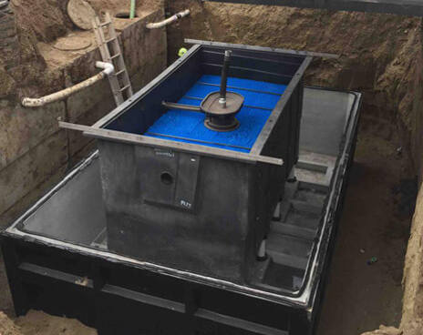
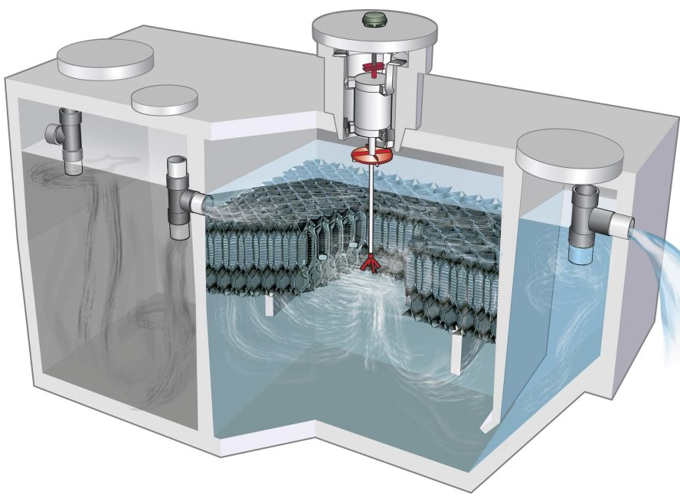
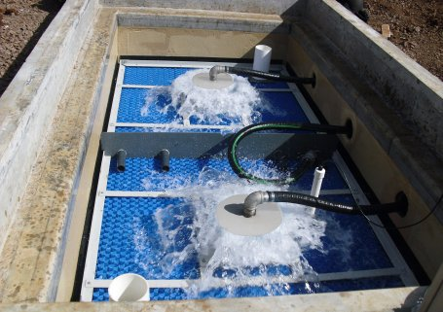
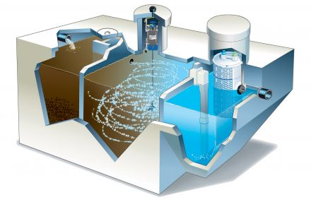
EXAMPLES OF AEROBIC TREATMENT UNITS
Can you name these?

Slide 17
SAND FILTERS
Bottomless sand filter*
Intermittent sand filter
Recirculating sand filter
ruck

Slide 18
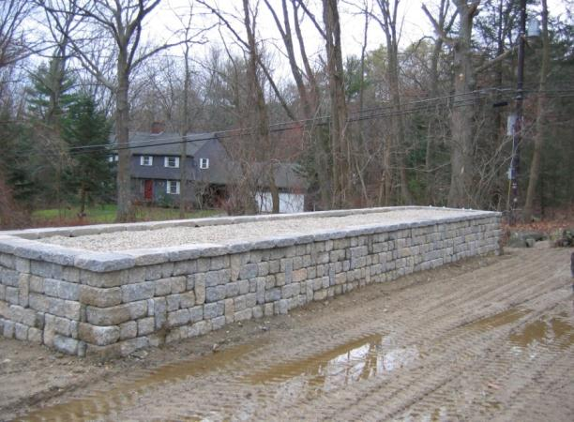
EXAMPLE OF A SAND FILTER

Slide 19
TRICKLING FILTERS
BIOCLERE
SEPTITECH
WATERLOO BIOFILTER

Slide 20
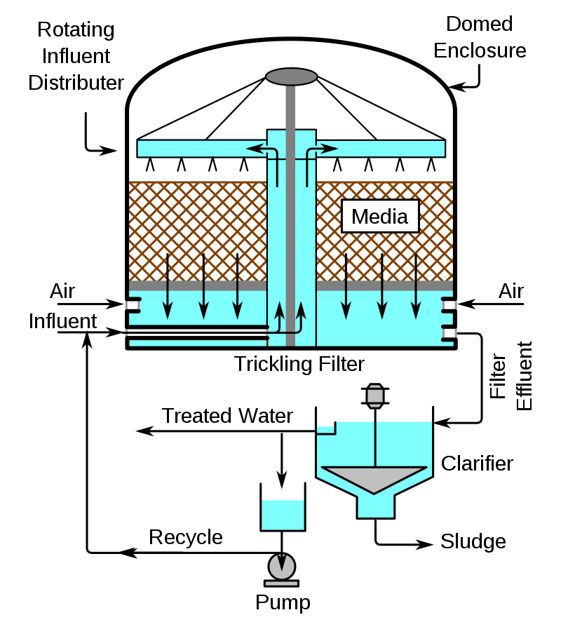
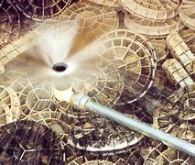
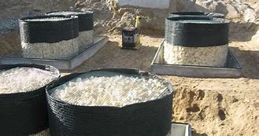
Credit: Wikipedia

Slide 21
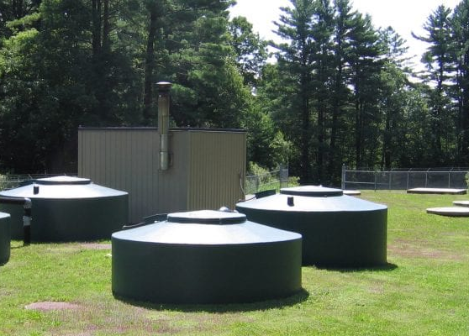
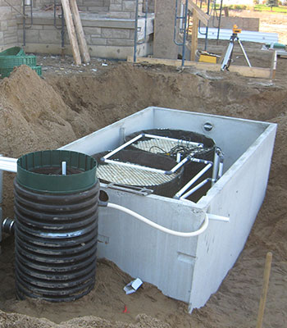
EXAMPLES OF TRICKLING FILTERS

Slide 22
NITRIFYING TECHNOLOGIES*
NitrEx
NitROE WWTS
* Not the only nitrifying technologies.

Slide 23
LEACHING AREA AERATION WITH BACTERIAL AUGMENTATION
PIRANA
SLUDGEHAMMER
SOILAIR

Slide 24
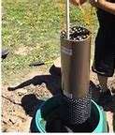
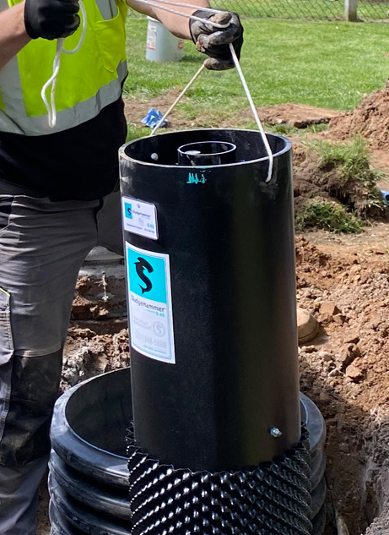
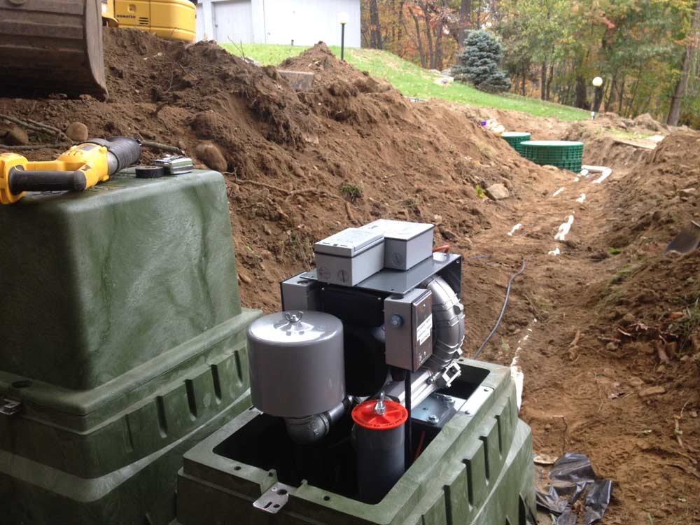
EXAMPLES

Slide 25
SOME ONE-OF-A-KINDS
TEXTILE FILTER WITH AEROBIC TREATMENT
ADVANTEX
SEQUENCING BATCH REACTOR
AMPHIDROME
ACTIVATED SLUDGE W/BIOLOGICAL FILTRATION(MEMBRANE)
BUSSE -MF

Slide 26
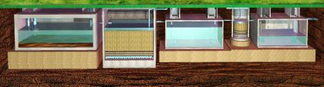
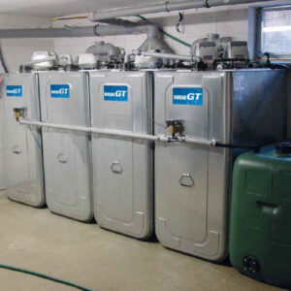
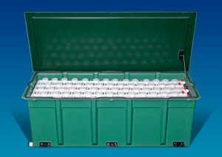

Slide 27
ALTERNATIVE LEACHING AREA: TREATMENT WITH DISPOSAL
Eljen GSF
Infiltrator ATL
Presby Enviro-Septic
Presby Advanced Enviro-Septic
Presby Simple Septic

Slide 28
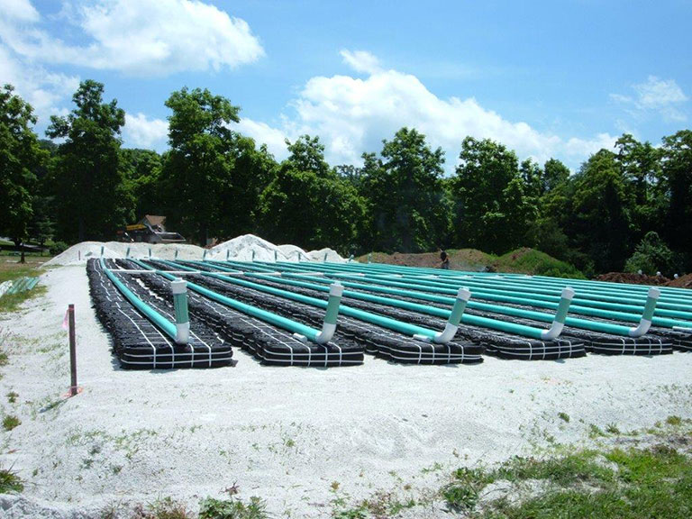
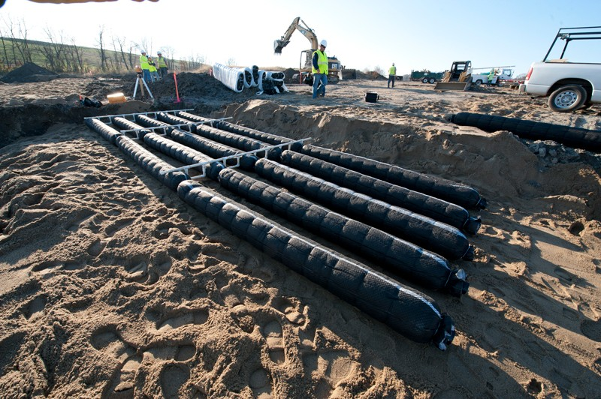
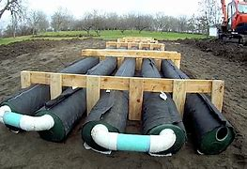
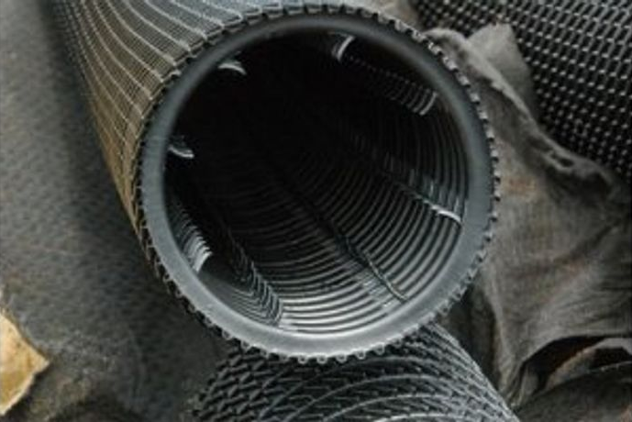

Slide 29
ALTERNATIVE LEACHING AREAS: DISPOSAL ONLY
ARC Chambers
Biodiffuser
Cultec Chambers
Cur-Tech CTL
Eljen Mantis
GeoMat Leaching
Infiltrator Chambers

Slide 30
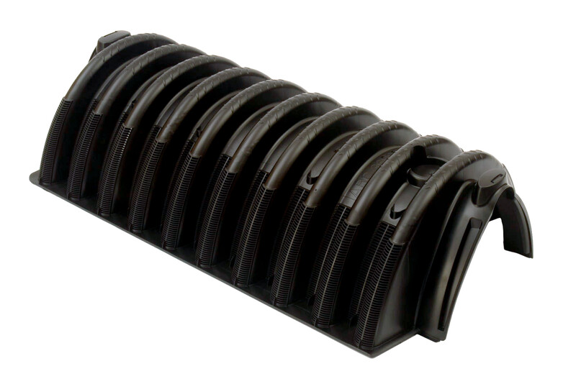
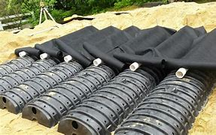
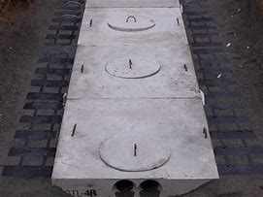
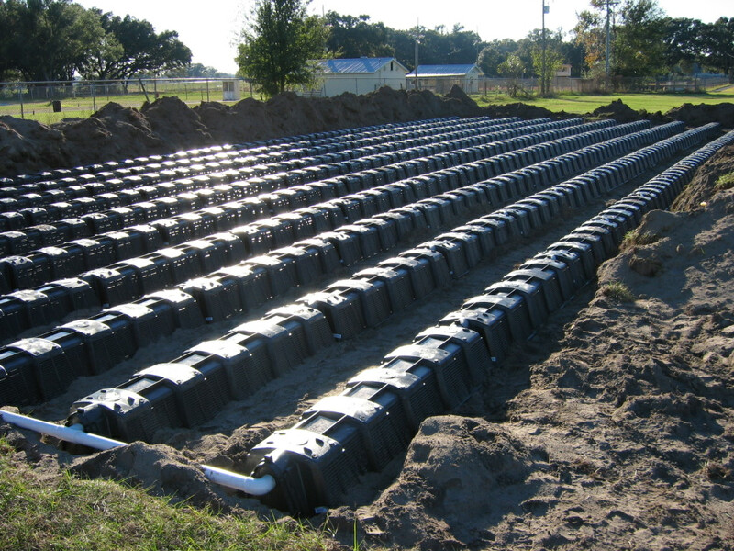

Slide 31
THINGS TO REMEMBER WITH I/As AND TO ASK YOURSELF
DON’T GET INTIMIDATED BY THE TECHNOLOGY: BREAK IT DOWN TO ITS BASIC OPERATIONAL TYPE
DETERMINE WHAT THEY ARE LOOKING TO TREAT
WHAT ARE THEY APPROVED TO TREAT IN YOUR STATE?
ARE THEY PROPOSED FOR USE AS APPROVED OR IS THIS SOMETHING ENTIRELY NEW?
DON’T BE AFRAID TO ASK QUESTIONS OF THE MANUFACTURERE, DESIGNER OR OTHER TOWNS OR STATES WHERE THE TECHNOLOGY MAY BE MORE COMMONLY USED. WE’RE ALL IN THIS TOGETHER.

Slide 32
Thank you for your attention today.
If you have any questions or require any additional information, please contact me directly at:
Claire Golden, MassDEP
617-997-8874
claire.golden@mass.gov

