Slide 1


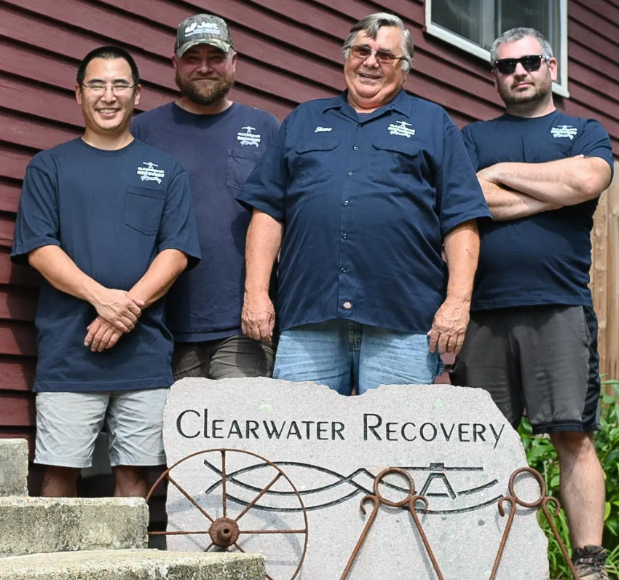
Onsite Denite

Slide 2

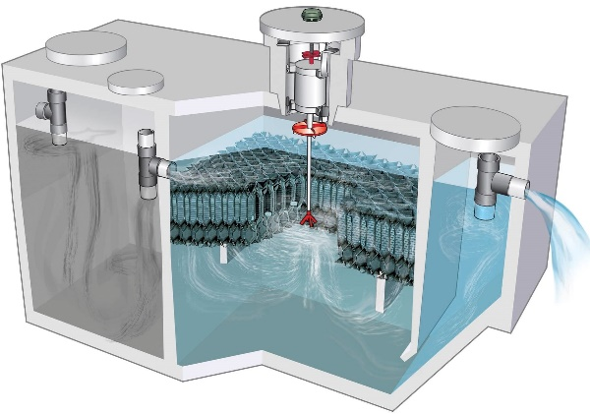
ONSITE DENITE
INTRODUCTION
Innovative Alternative Septic Systems:
JET – MASS DEP Approved to Remove Nitrogen!
JET – Remedial, New Construction and Nitrogen Removal
Benefits of an I/A System with Pros/Cons
JET system – Simple to Install – Simple to Operate!
Permits and Regulations
Small Lot in Zone II – I/A Systems can Help!
JET “BAT” Aerobic Systems
NITROGEN REMOVAL APPROVED
Compliance with Board of Health Requirements:
Operations and Maintenance Service Contracts
Laboratory Testing
Ensure fully functioning equipment

Slide 3
Permit types
Piloting - Approvals with specific conditions
Provisional
Remedial – Repair of failed or failing systems
50% reduction SAS area
2-foot reduction to SHGW
2 feet permeable soil
General - In most cases, assumes equivalent to Title 5 system
Once per year O&M service

Slide 4

Remember the good old days
In the beginning, Mass DEP required quarterly O&M service with laboratory effluent sampling.
Revised in January 2006 – semi-annual service with documented effluent field sampling for dissolved oxygen, pH, and turbidity.
Revised in November, 2012 and again in February, 2013 – operations and maintenance service provided by certified operator in accordance with manufacturer schedule. Effluent monitoring now once per year for single family homes.

Slide 5
Operation and Maintenance Service
To ensure proper operation and maintenance service (O&M) of the on-site treatment system, the owner shall enter into an O&M agreement with a qualified service contractor who's name appears on the company’s current list of service contractors with a minimum Grade Level II Wastewater License.
I/A system approval by Mass D.E.P. is based on NSF Standard 40 or 245.
Semi-annual O&M service is required.
Operation and Maintenance, Effluent quality, Monitoring, and Inspection

Slide 6
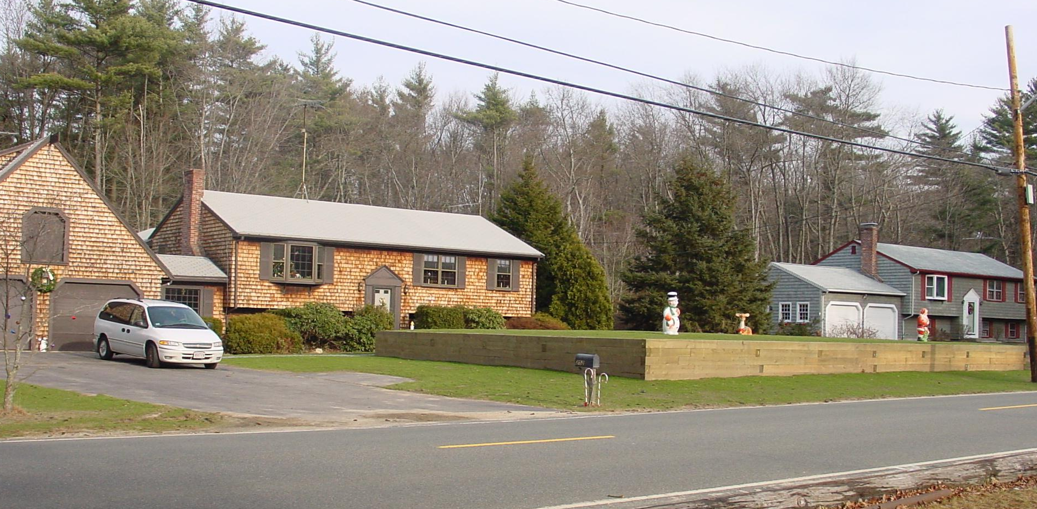
Miracle on Myrtle Street
You finally find the house of your dreams, complete with a circular driveway
You pass papers
And on moving day you find…..

Slide 7
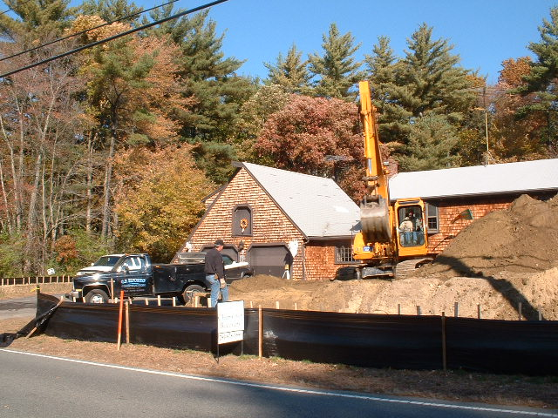
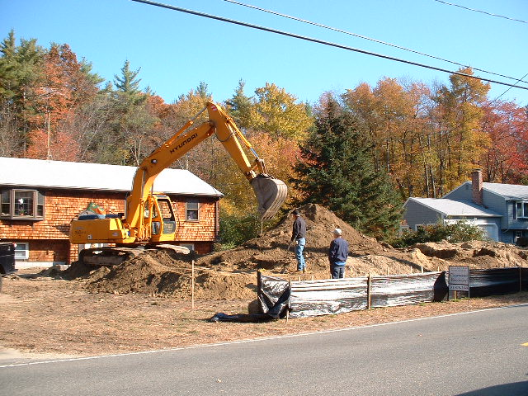
After consulting with Clearwater Recovery,
the new homeowners found out the Board of Health
would approve use of a Jet system to get rid of the mound.
Silverado Construction began the project by removing the mound and the septic tank.

Slide 8
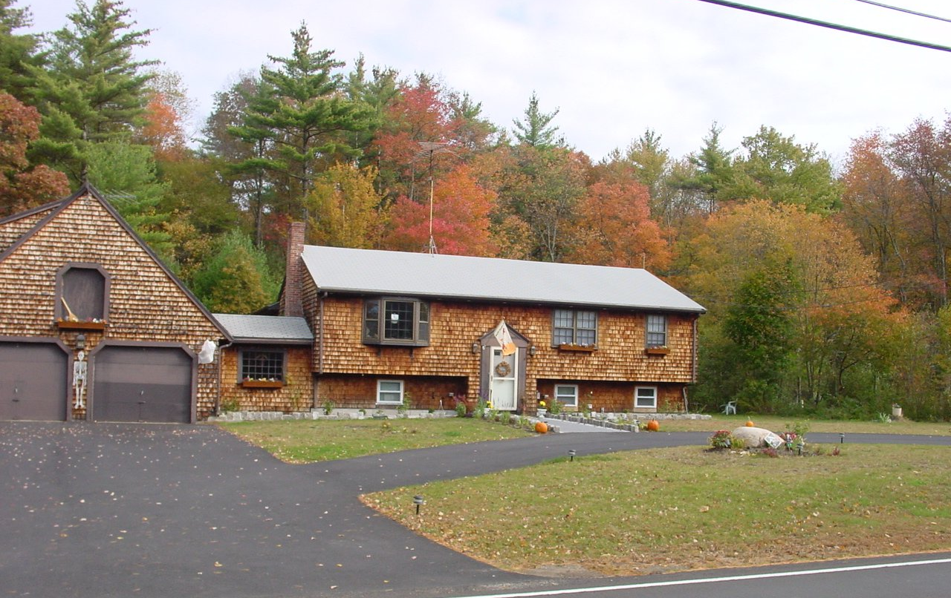
After!

Slide 9

New approvals & components used in MA
If you want to experience honest, dependable, responsive, service-oriented wastewater treatment specialists, you want JET –
a company founded on innovation
and anchored by service.

Slide 10
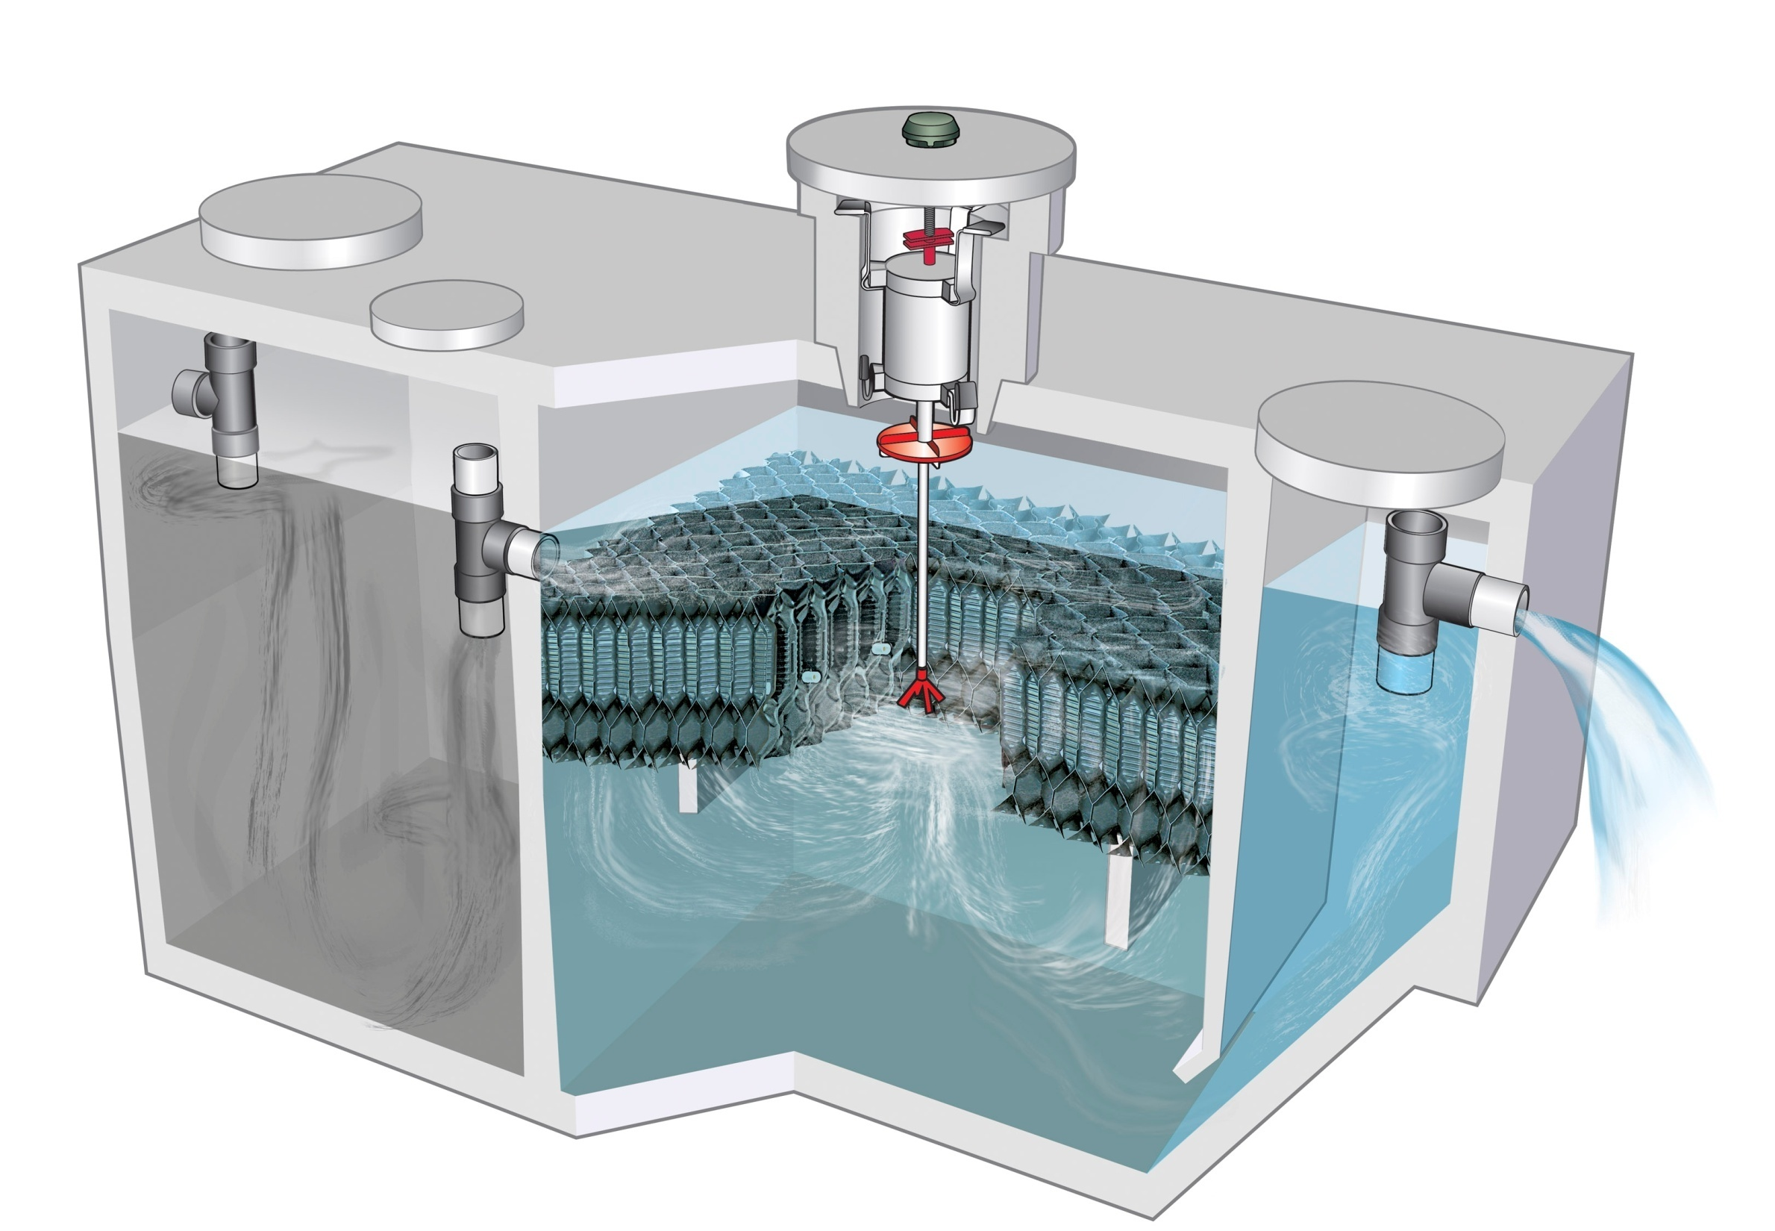

Slide 11

Residential Wastewater
General Specifications
Overall Plant Capacity - 1,200 Gallons
Precast Concrete
    3 Yards
    2 1/2” thick walls
    Approximately 10,000 lbs.
Divided Into Three Compartments
    Pretreatment
    Treatment
    Settling

Slide 12
Jet
J-500-800PLT
Plastic Tank

Slide 13
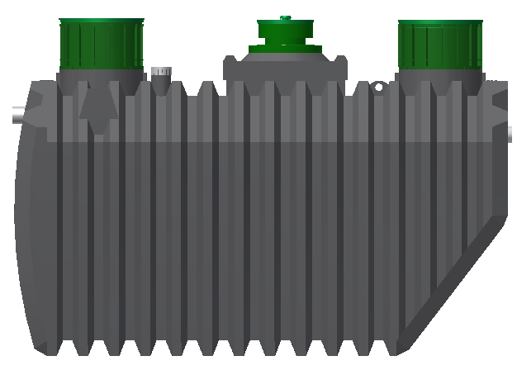
Treatment from 500 to 800 GPD

Slide 14
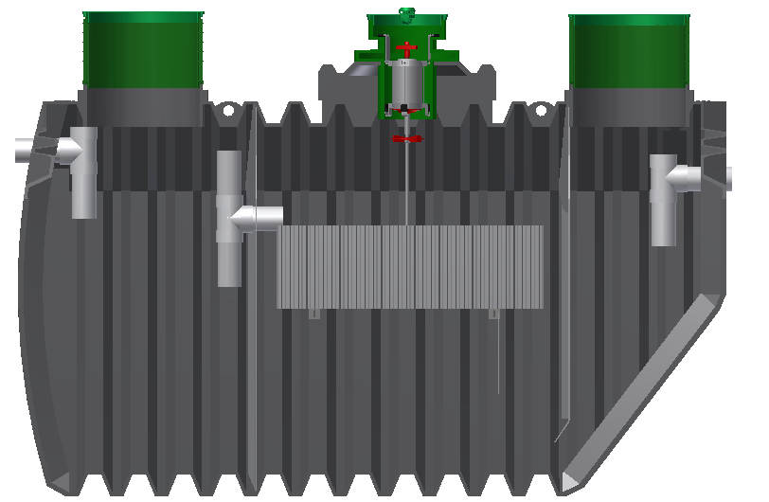
Residential Wastewater
General Specifications
J500PLT / J800PLT
Plastic Tank
Length: 123” (3.12m)
Width: 62” (1.57m)
Height: 73” w/o Riser (1.85m)
Height: 86” with Riser (2.18m)
Inlet Height: 59” at invert (1.49m)
Outlet Height: 56” at invert (1.42m)
Invert Drop: 3” (.076m)
Clarifier
230 Gallons
(.86m3)
Pretreatment
500 Gallons
(1.89m3)
Treatment
680 Gallons
(2.57m3)
Functional Capacity: 1410 Gallons (5.32m3)
Total Capacity: 1929 Gallons (7.29m3)
Freeboard: 12 Inches (.30m)
Nominal Wall Thickness: .625 Inches (.015m)
Weight: 1050 Pounds (476 kilogram)
Notes:
PLT manufactured at Jet 2012

Slide 15
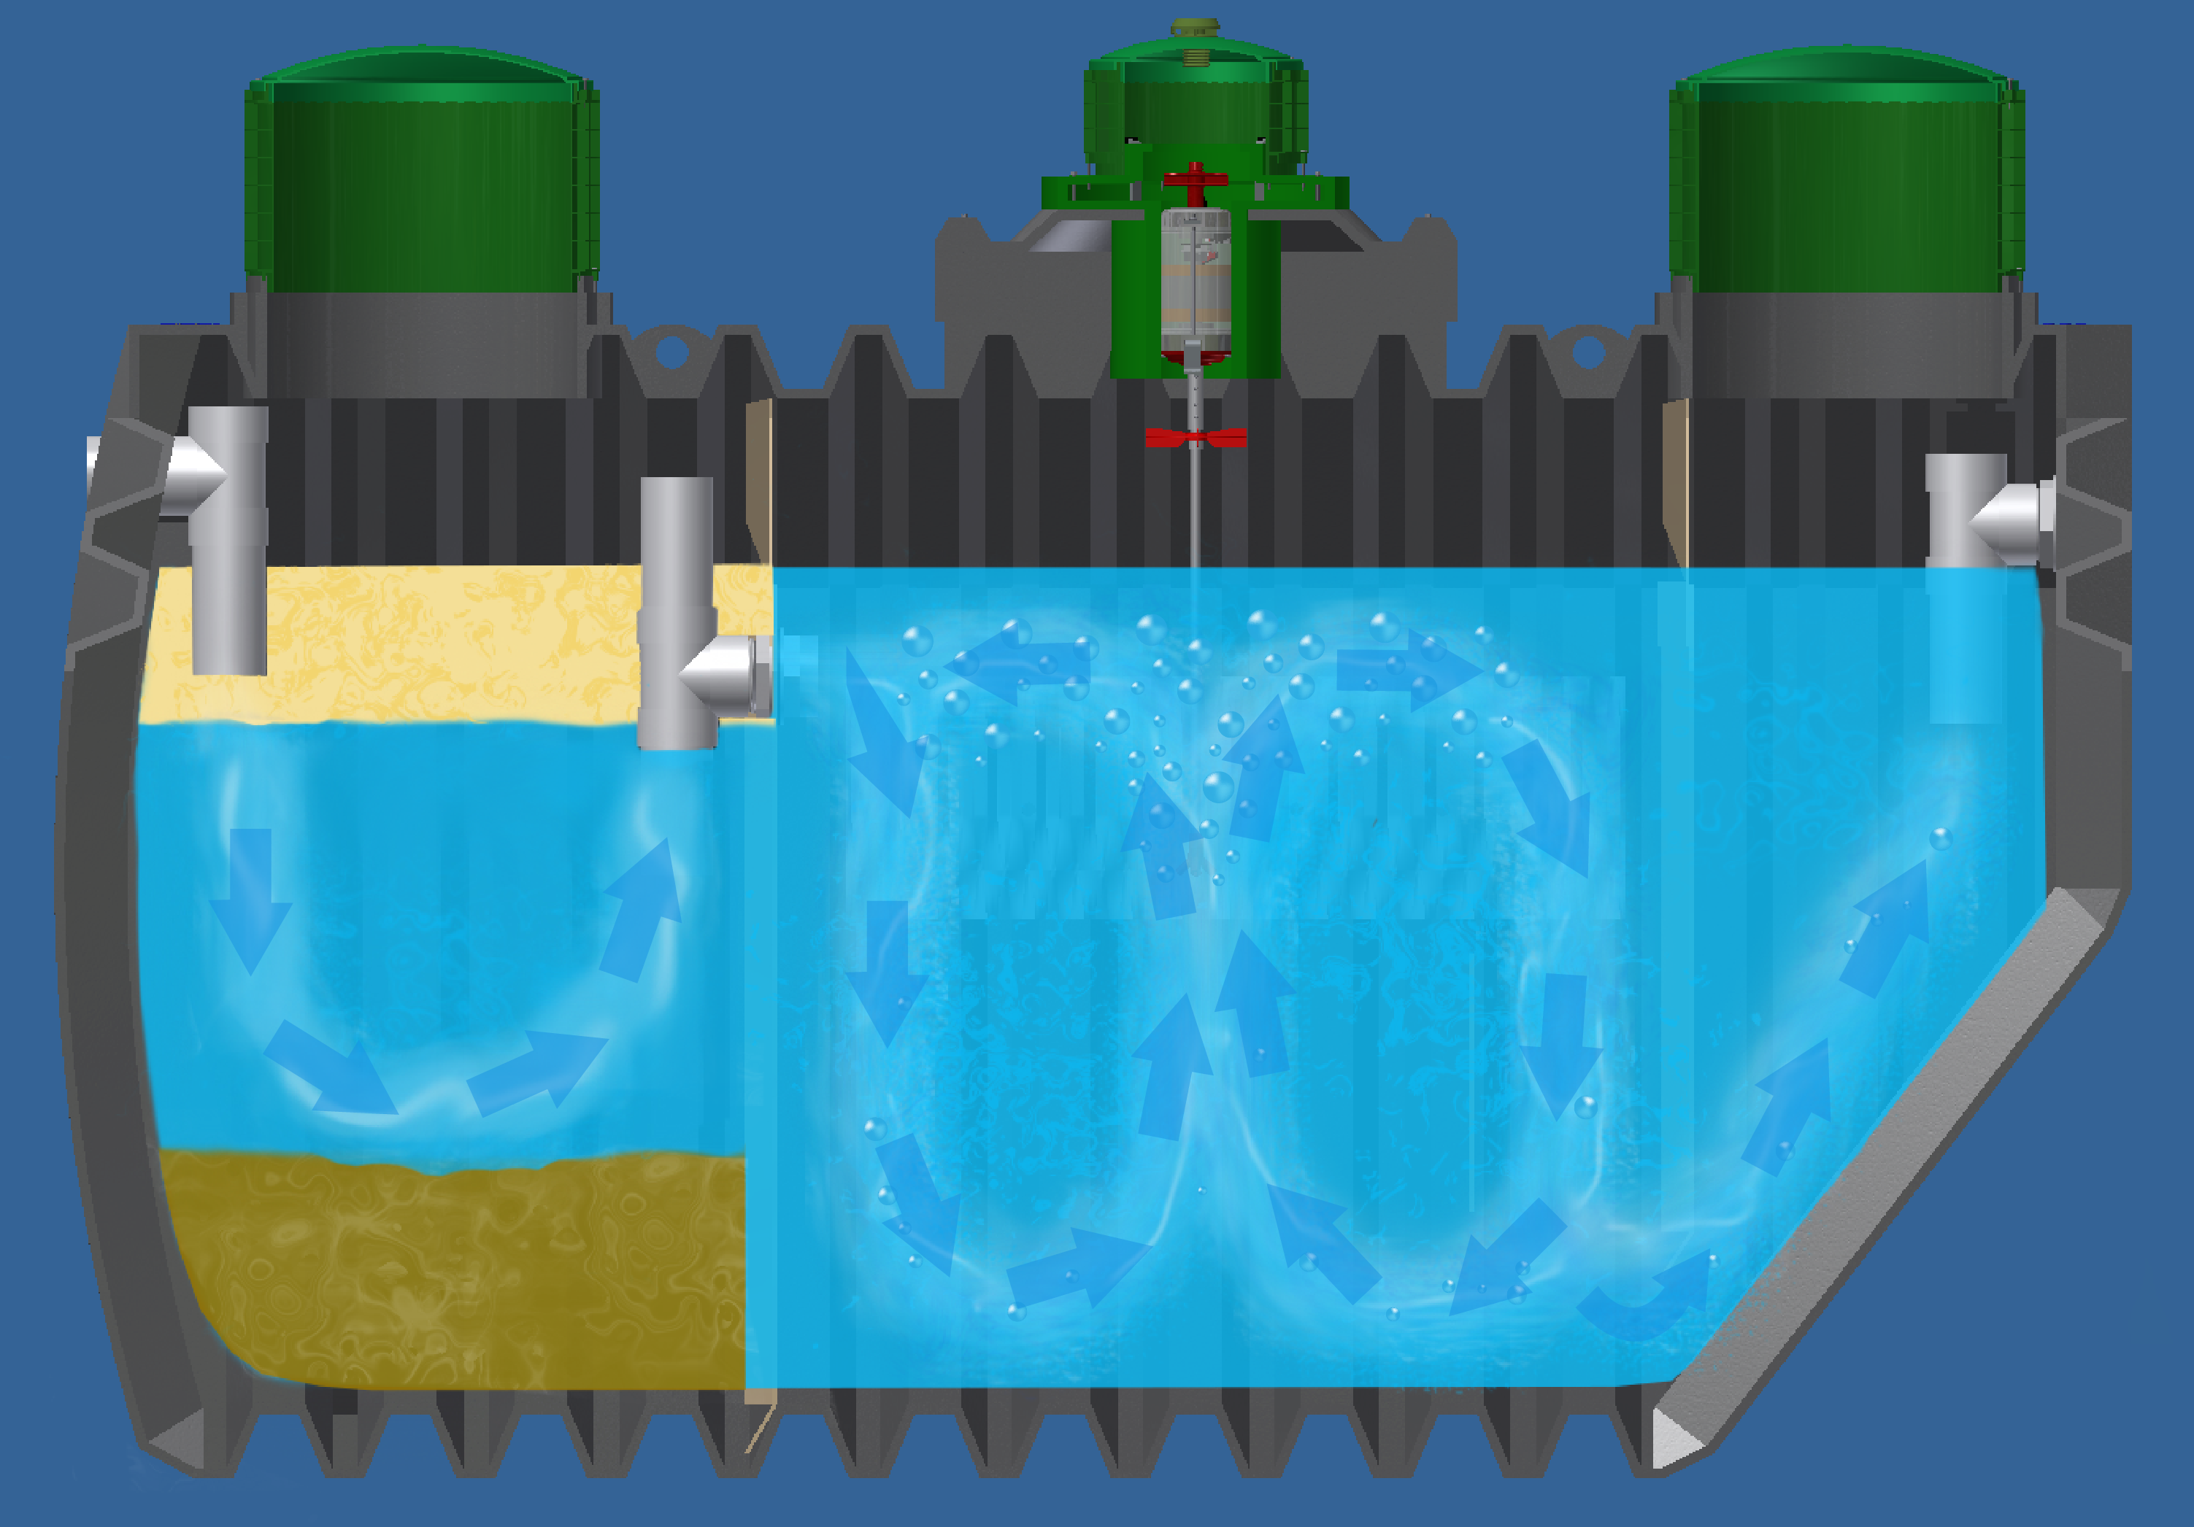
Jet BAT® Process Flow

Slide 16
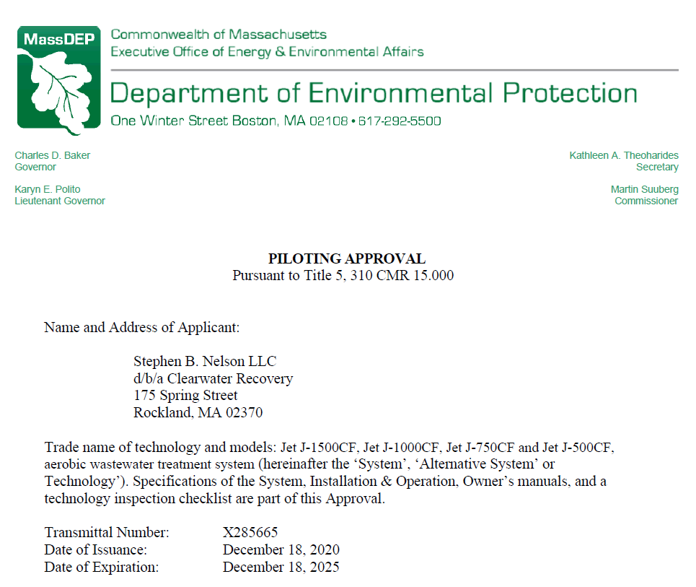

Slide 17
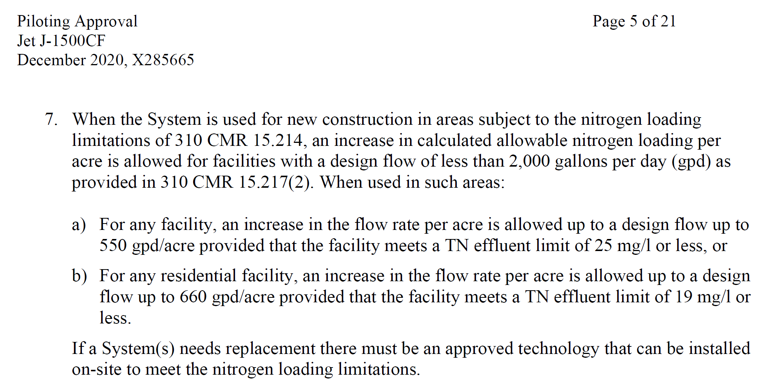

Slide 18
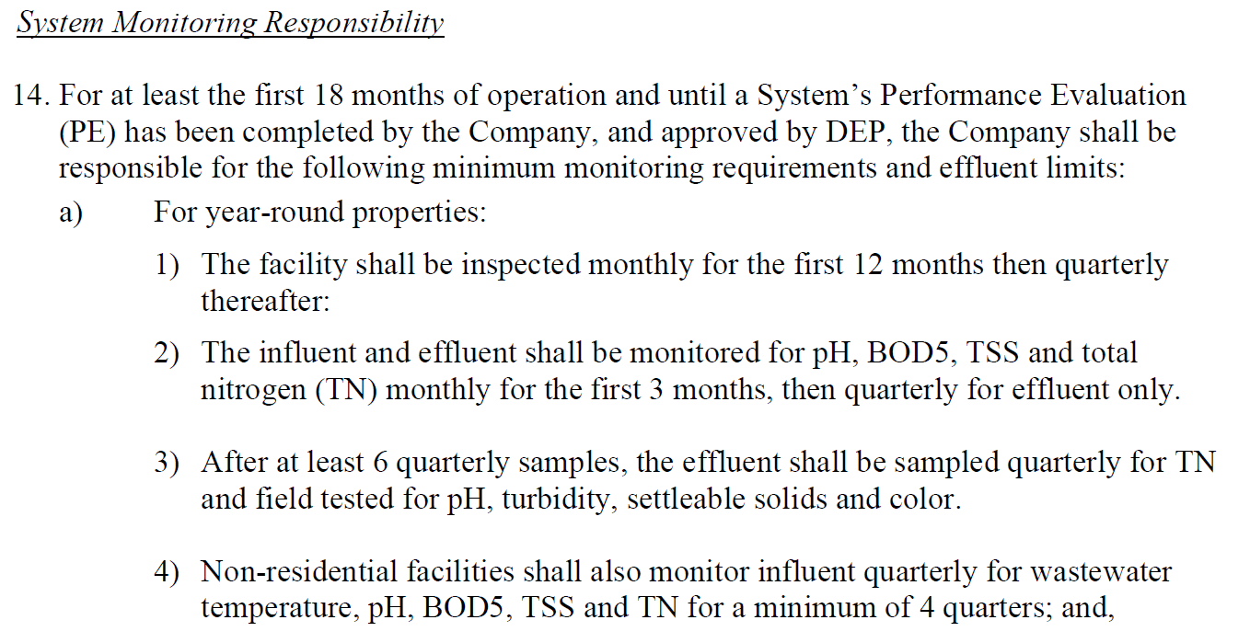

Slide 19

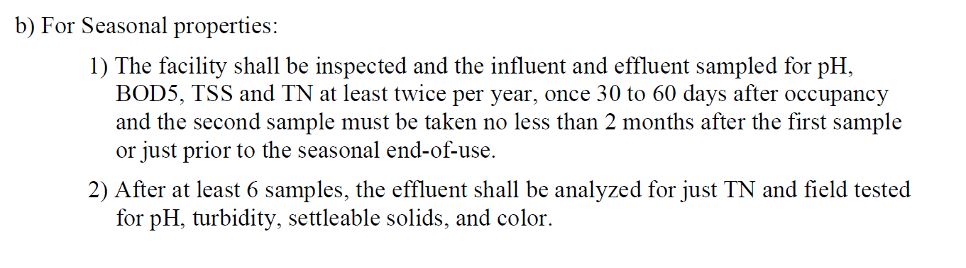

Slide 20
Pros and Cons
Of I/A systems
PROS
Advanced treatment - cleaner discharge to leach field. A permanent solution to leach field failure (conventional leach systems are doomed to failure)
Sites that do not meet Title V requirements can now have a fully functioning septic system
CONS
Homeowner perception that maintenance is a financial burden - The true cost of I/A maintenance is comparable to 'big pipe' sewer costs
Homeowner awareness - homeowners are not aware that they have to maintain an I/A system
Board of Health / local approving authority can be overwhelmed in trying to keep track of so many varied systems, permits, repairs, testing requirements, site conditions, contract expirations/renewals

Slide 21

&
Clearwater Recovery
175 Spring Street
Rockland, MA 02370
781.878.3849
info@clearwaterrecovery.com
Jet Inc.
750 Alpha Drive
Cleveland, OH 44143
800.321.6960
Email@jetincorp.com

