Slide 1
I/A On-site systems & BoH responsibilities

Slide 2
Alyssa Rusiecki, RS Environmental Health & Safety Email – arusiecki@umass.edu Office – 413-545-5110

Slide 3

IA $≠$AI
EH&S Rusiecki September 8, 2023

Slide 4
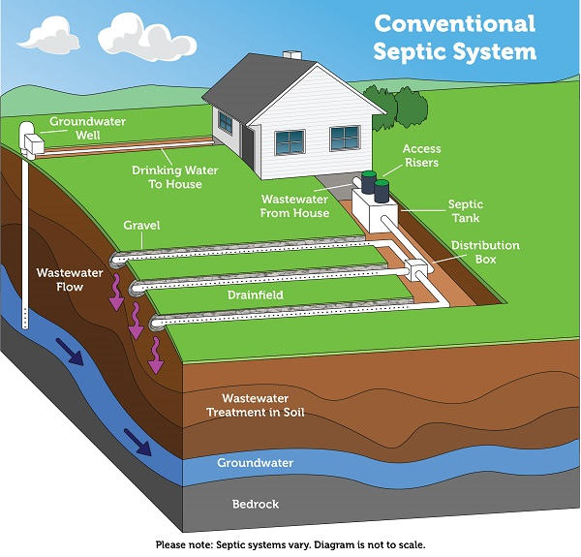
Conventional System
Epa.gov
EH&S September 8, 2023

Slide 5
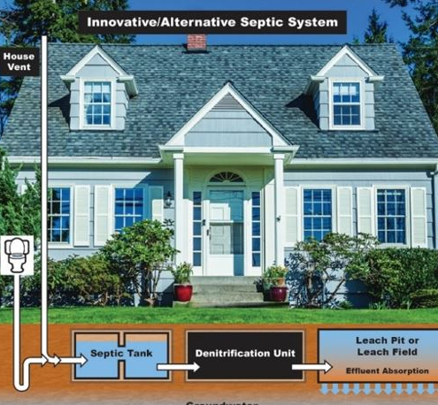
IA – Innovative Alternative Systems
Most common – Secondary Treatment Device
Works in tandem with a conventional system
Or, advanced components for primary, secondary, & tertiary units
EH&S Rusiecki September 8, 2023

Slide 6
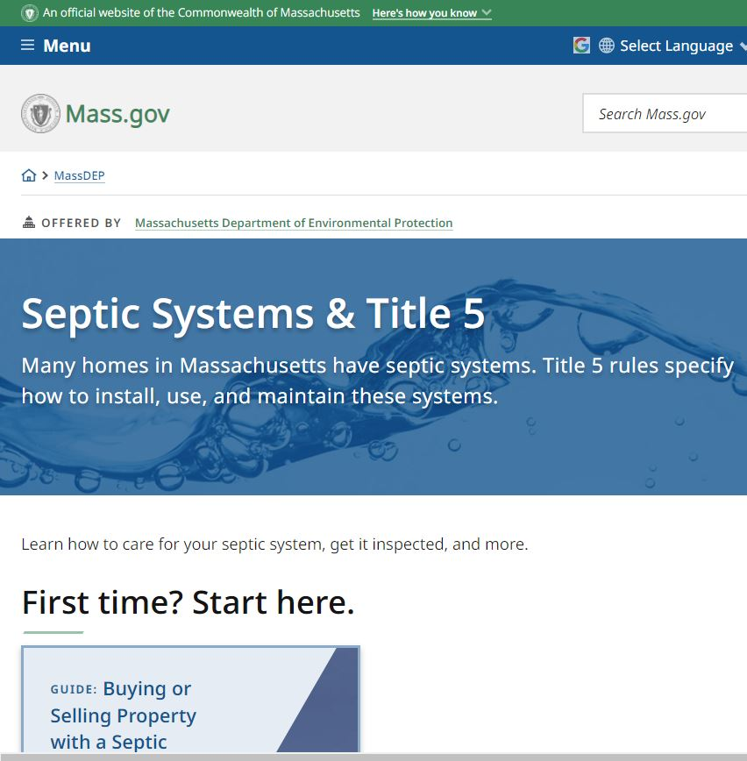
MA DEP Resources
Mass.gov
EH&S Rusiecki September 8, 2023

Slide 7
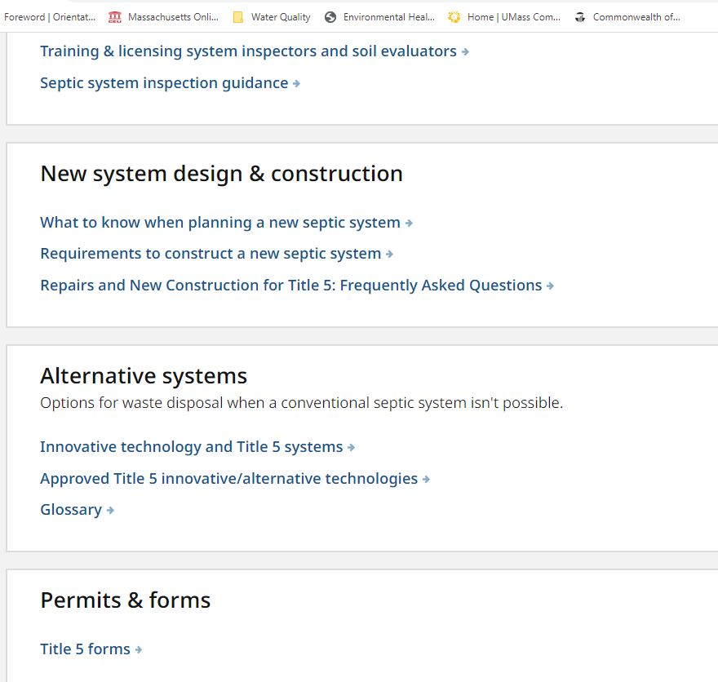
MA DEP Resources
Mass.gov con’t.
EH&S Rusiecki September 8, 2023

Slide 8
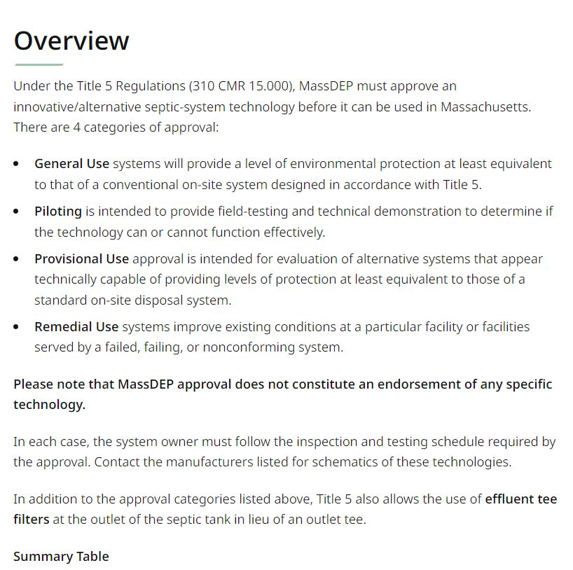
MA DEP Resources
Mass.gov con’t.
EH&S Rusiecki September 2023

Slide 9
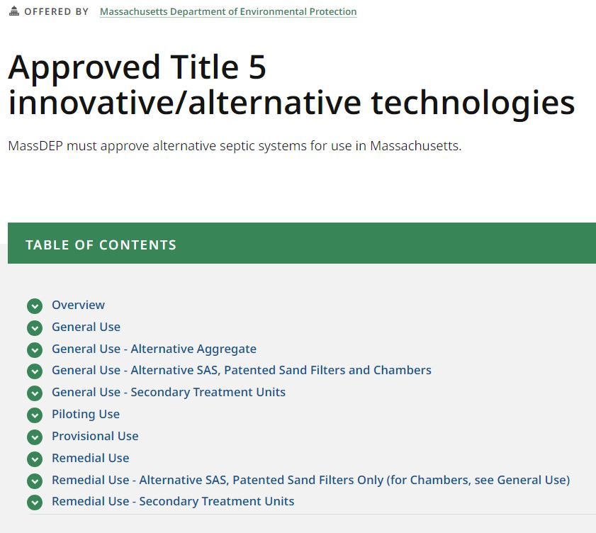
MA DEP Resources
Mass.gov con’t.
EH&S Rusiecki September 2023

Slide 10
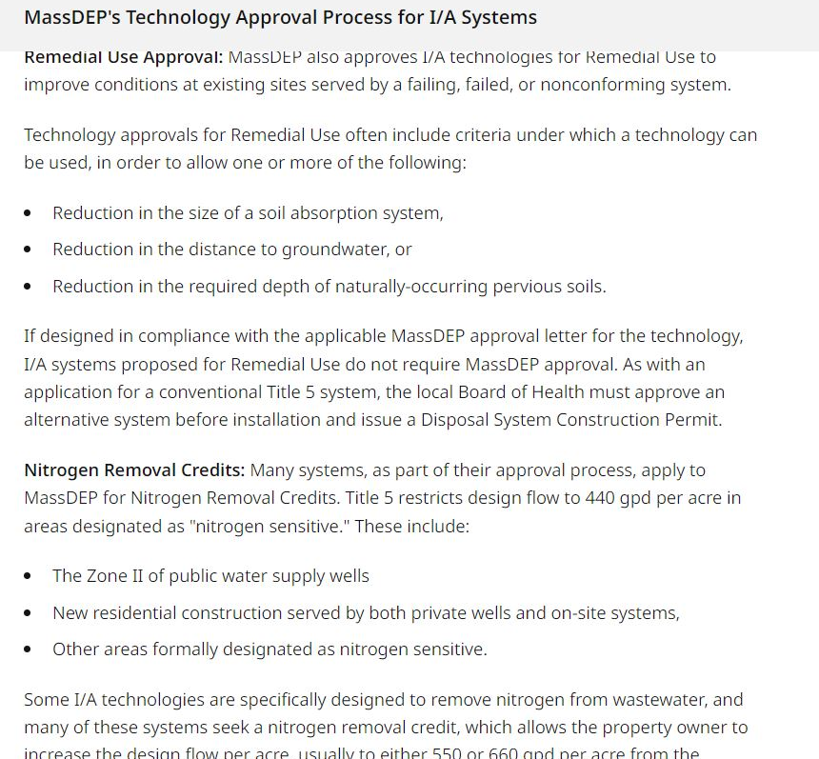
MA DEP Resources
Mass.gov con’t.
General use
Remedial use
Nitrogen removal credits
EH&S Rusiecki September 2023

Slide 11
MA DEP Resources
Mass.gov con’t.
Remedial Use
Secondary Treatment Devices
Alternate SAS’s
EH&S Rusiecki September 8, 2023

Slide 12
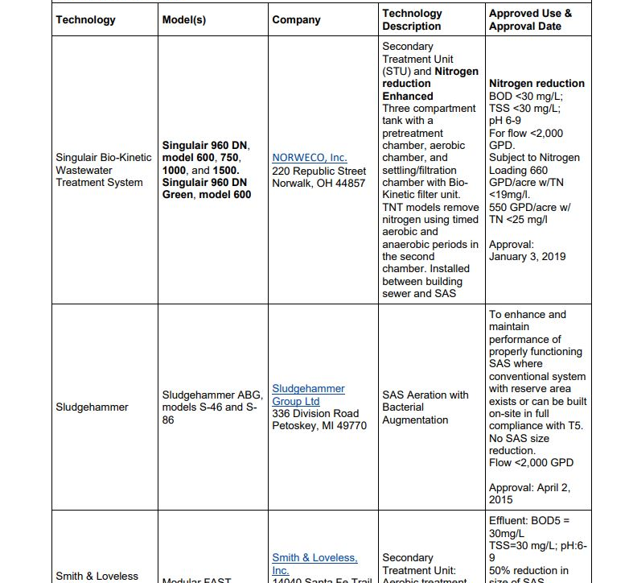
MA DEP Resources
Mass.gov con’t.
Technology Chart
EH&S Rusiecki September 8, 2023

Slide 13
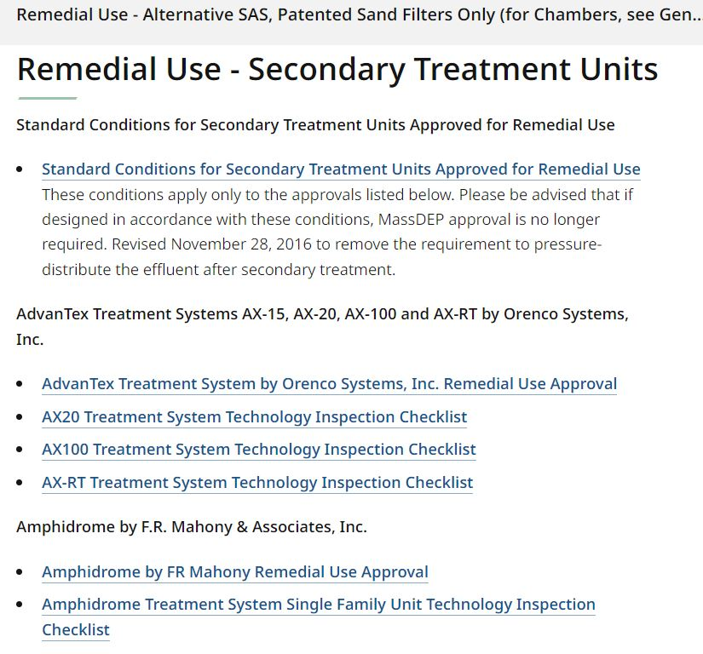
MA DEP Resources
Mass.gov con’t.
Secondary Treatment Units –
Standard Conditions
For Remedial Use
EH&S Rusiecki September 8, 2023

Slide 14
MA DEP Resources
Mass.gov con’t.
Standard Conditions Letter
EH&S Rusiecki September 8, 2023

Slide 15
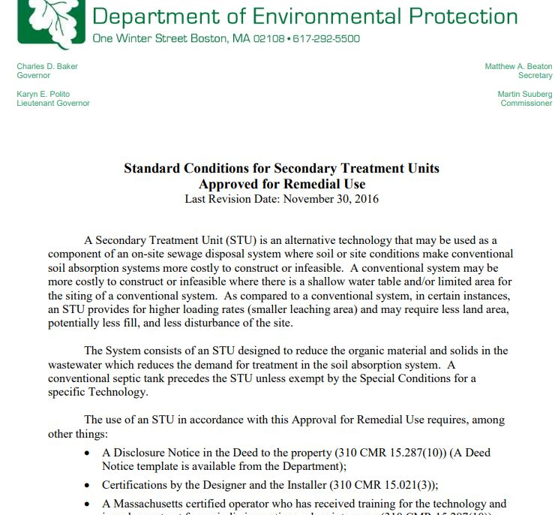
MA DEP Resources
Mass.gov con’t.
Standard Conditions Letter
EH&S Rusiecki September 8, 2023

Slide 16
MA DEP Resources
Review
Technology Approval Letter
General or Remedial
Alternate Soil Absorption Systems or Secondary Treatment Units
Approval up to date
Additional
Installation Instructions
Illustration
Operation & Maintenance Checklist
EH&S Rusiecki September 8, 2023

Slide 17
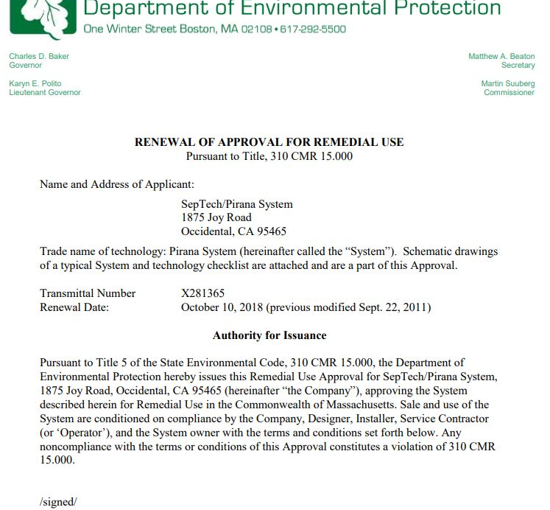
MA DEP Resources
Mass.gov con’t.
Approval Letters
EH&S Rusiecki September 8, 2023

Slide 18
Standard Conditions Letter
Review
Standard Conditions Letter
General or Remedial
Alternate Soil Absorption Systems or Secondary Treatment Units
EH&S Rusiecki September 8, 2023

Slide 19
Standard Conditions Letter
Discusses Operational Details
Disclosures, deed notices, certifications
Contract with an O & M provider
Requirements for sampling, reporting
Notice of failure
Pumping above the high-level alarm
System Owner acknowledgements
EHS Rusiecki September 8, 2023

Slide 20
Technology Approval Letter
Discusses Technical Details
Specific to the technology, i.e. soils, spacing, horizon location
Operational details, i.e. Timed dosing, backwashing cycle
Installation details
Conditions applicable to owner
Conditions application to company
EH&S Rusiecki September 8, 2023

Slide 21
Proprietary vs. Generic Approvals
Proprietary = Technology specific
Generic
Bottomless Sand Filters (RI DEM)
Recirculating Sand Filters
Composting Toilets
EH&S Rusiecki September 8, 2023

Slide 22
Various secondary treatment units with pressure distribution SAS final dispersal
Numerous approved I/A secondary treatment units
Advantex, Amphidrome, Bioclere, Busse-MA, Clean Solution, FujiClean, Hoot, JetBat, Low-Rate ISF, MicroFAST, ModularFAST, Perc-Rite, Puraflow, SeptiTech, Singulair BioKinetic
Restoration – Aerobic recovery system, SepTech Pirana, Soilair, Sludgehammer
Both – Perc-Rite
Alternate SASs
Eljen, GeoMat, Presby, Simple-Septic Wastewater System
Both – Perc-Rite
EH&S Rusiecki September 8, 2023

Slide 23
Remedial Use vs Local Upgrade Approval
Allowable to combine, but not stack major “variance” requests
At the Board of Health’s discretion
Certain criteria requires a hearing
Use the “variance” request framework
EH&S Rusiecki September 8, 2023

Slide 24
Plan Review & Document Submittal
Compliance with 310 CMR 15.000
Technology approval letter details
Standard Conditions letter requirements
Write a letter of review, citing deficiencies, state the date of submittal,
Document in tracking database
EH&S Rusiecki September 8, 2023

Slide 25
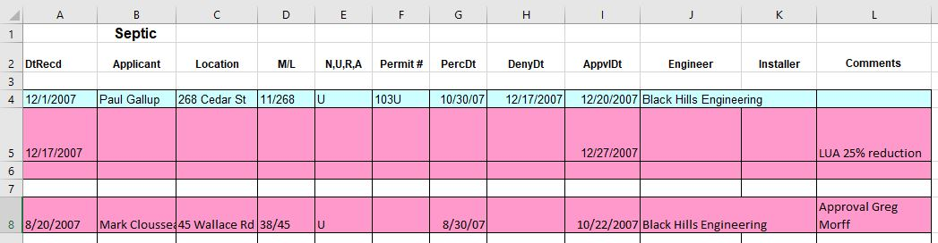
Plan Review Tracking
EHS Rusiecki September 8, 2023

Slide 26
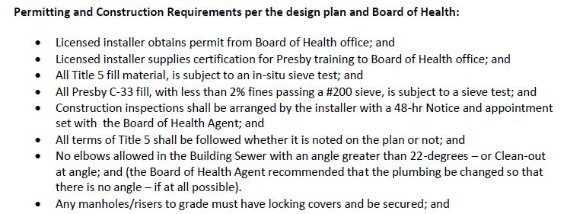
Letter sample
EH&S Rusiecki September 8, 2023

Slide 27
Installation Inspection & Details
Fill requirements,
Elevation & cover requirements
SAS - gravity feed w D-Box, or
SAS – pressure distribution
Pumps, floats, alarms
Control panels
EH&S Rusiecki September 8, 2023

Slide 28
Installation SAS inspection
Clear water test
Pump/alarm operation
D-Box connections, if applicable
Unit operation
Pressure, squirt height
Bedding, cover, slope requirements
EH&S Rusiecki September 8, 2023

Slide 29
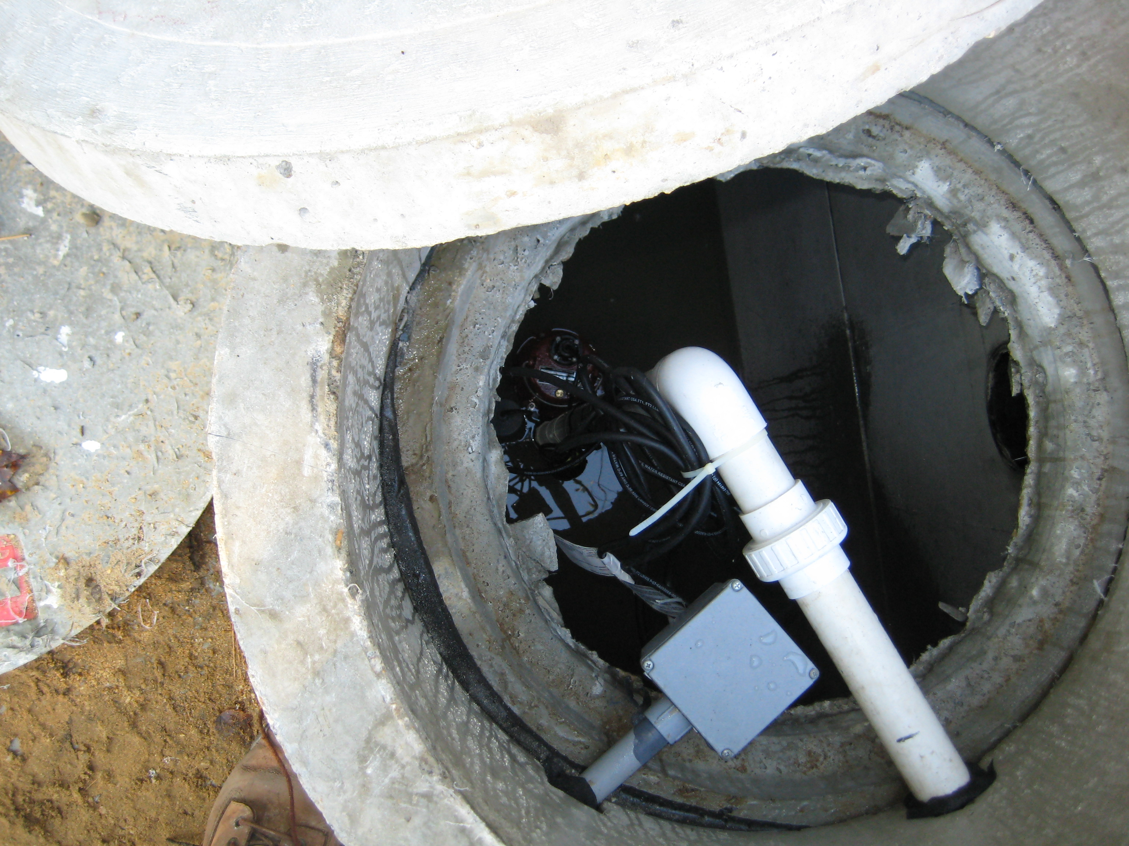
Installation Inspection con’t.
Pump Inspection
EH&S Rusiecki September 8, 2023

Slide 30
Installation SAS inspection
Alternative SAS requirements
Pressure distribution
Manifold
Laterals
Elevation
Orifice direction, covers
Distal pressure
Equal pressure, inspecting, cleaning
EH&S Rusiecki September 8, 2023

Slide 31
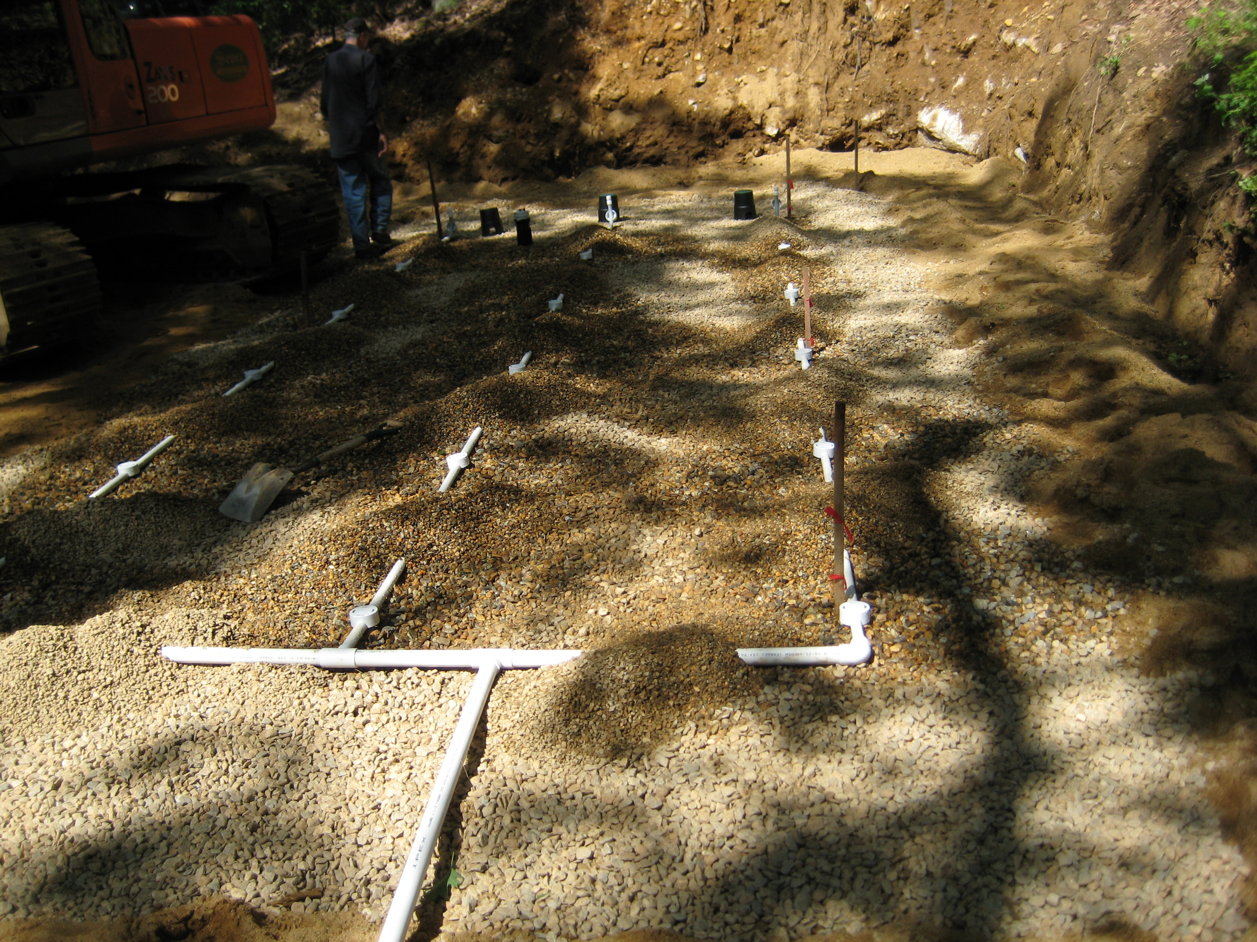
Installation inspection, orifice shields
EH&S Rusiecki September 8, 2023

Slide 32
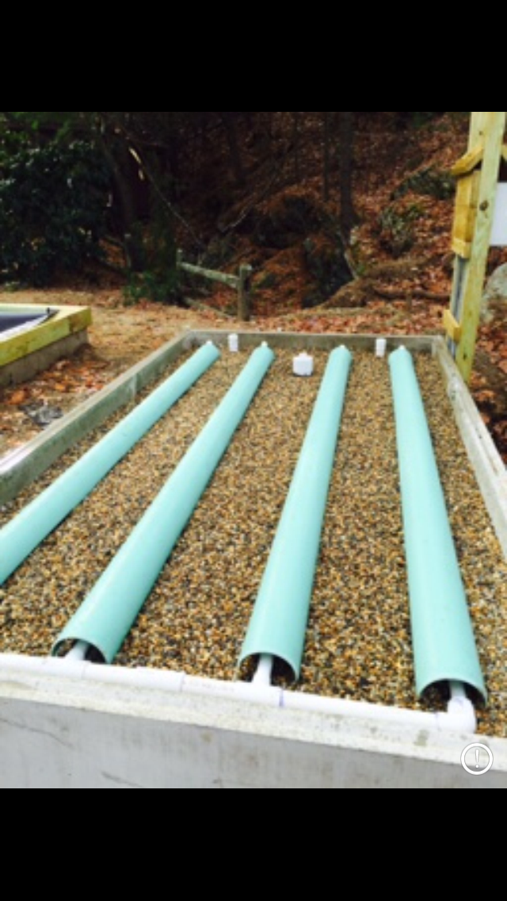
Installation inspection, shields
EH&S Rusiecki September 8, 2023

Slide 33
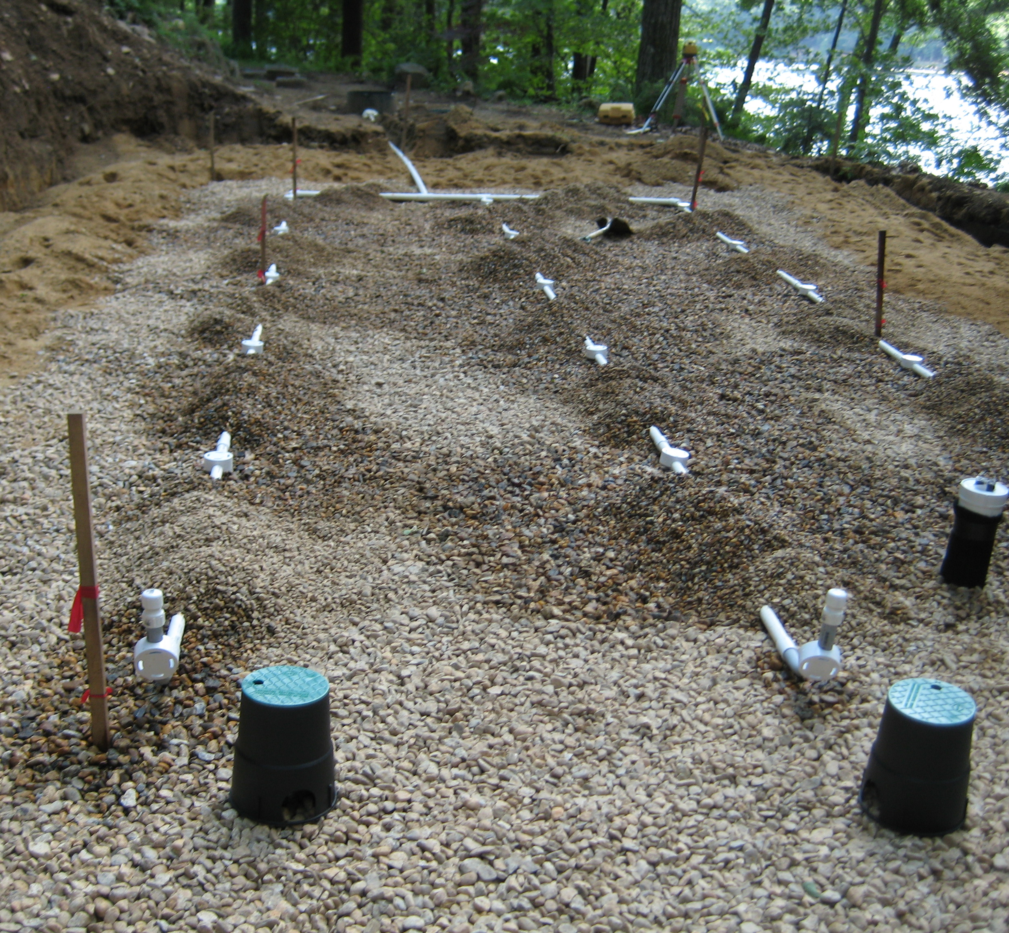
Pressure Distribution
Distal Pressure test and Landscape covers
EH&S Rusiecki September 8, 2023

Slide 34
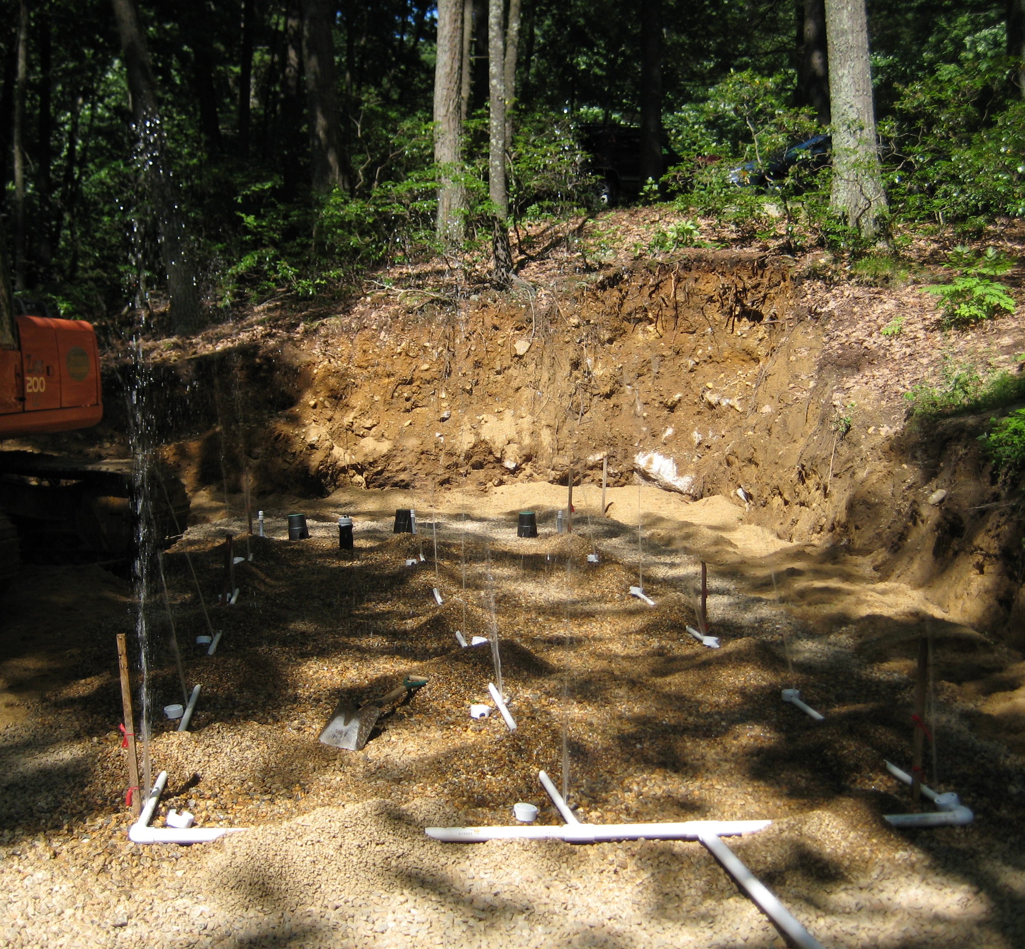
Pressure Distribution
Squirt test – No more than 10% variation, distal end
EH&S Rusiecki September 8, 2023

Slide 35
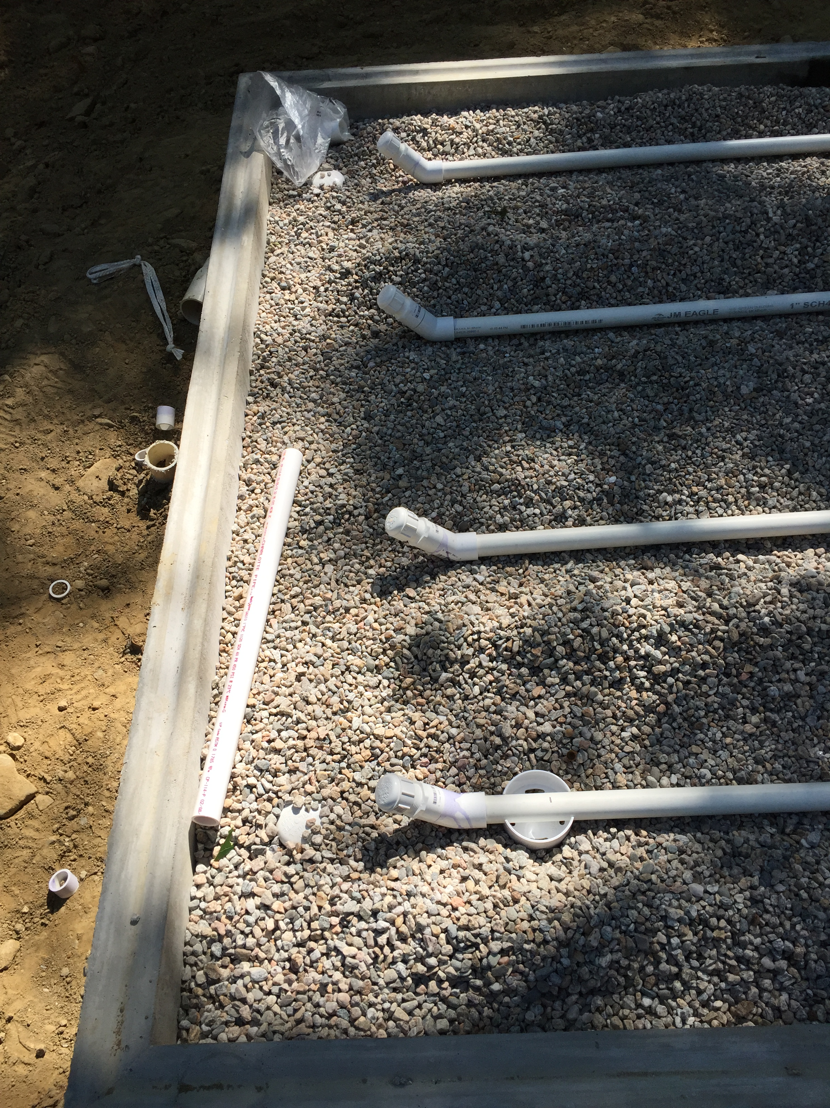
Pressure Distribution
Modify distal ends for squirt height
EH&S Rusiecki September 8, 2023

Slide 36
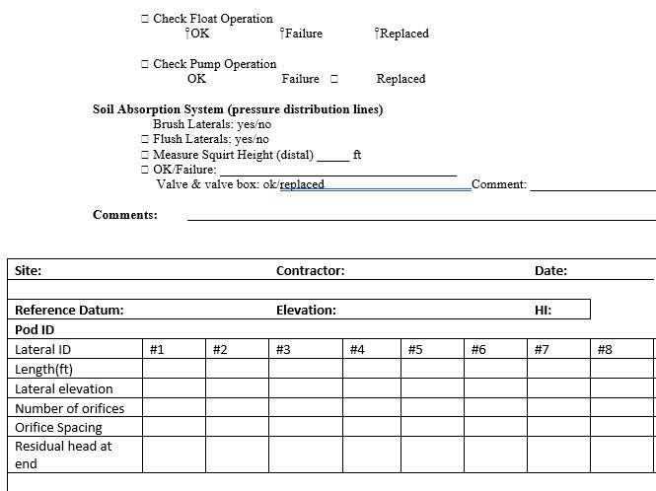
Installation SAS inspection - PD
EH&S Rusiecki September 8, 2023

Slide 37
Installation Documentation
Sand Fill certification (T5 vs. c-33, or other)
Aggregate certification
Impervious barrier specifications
Electrician
Take measurements, elevations
Record the PD squirt height
Photograph all features before backfill
Ask the designer to explain the process
EH&S Rusiecki September 8, 2023

Slide 38
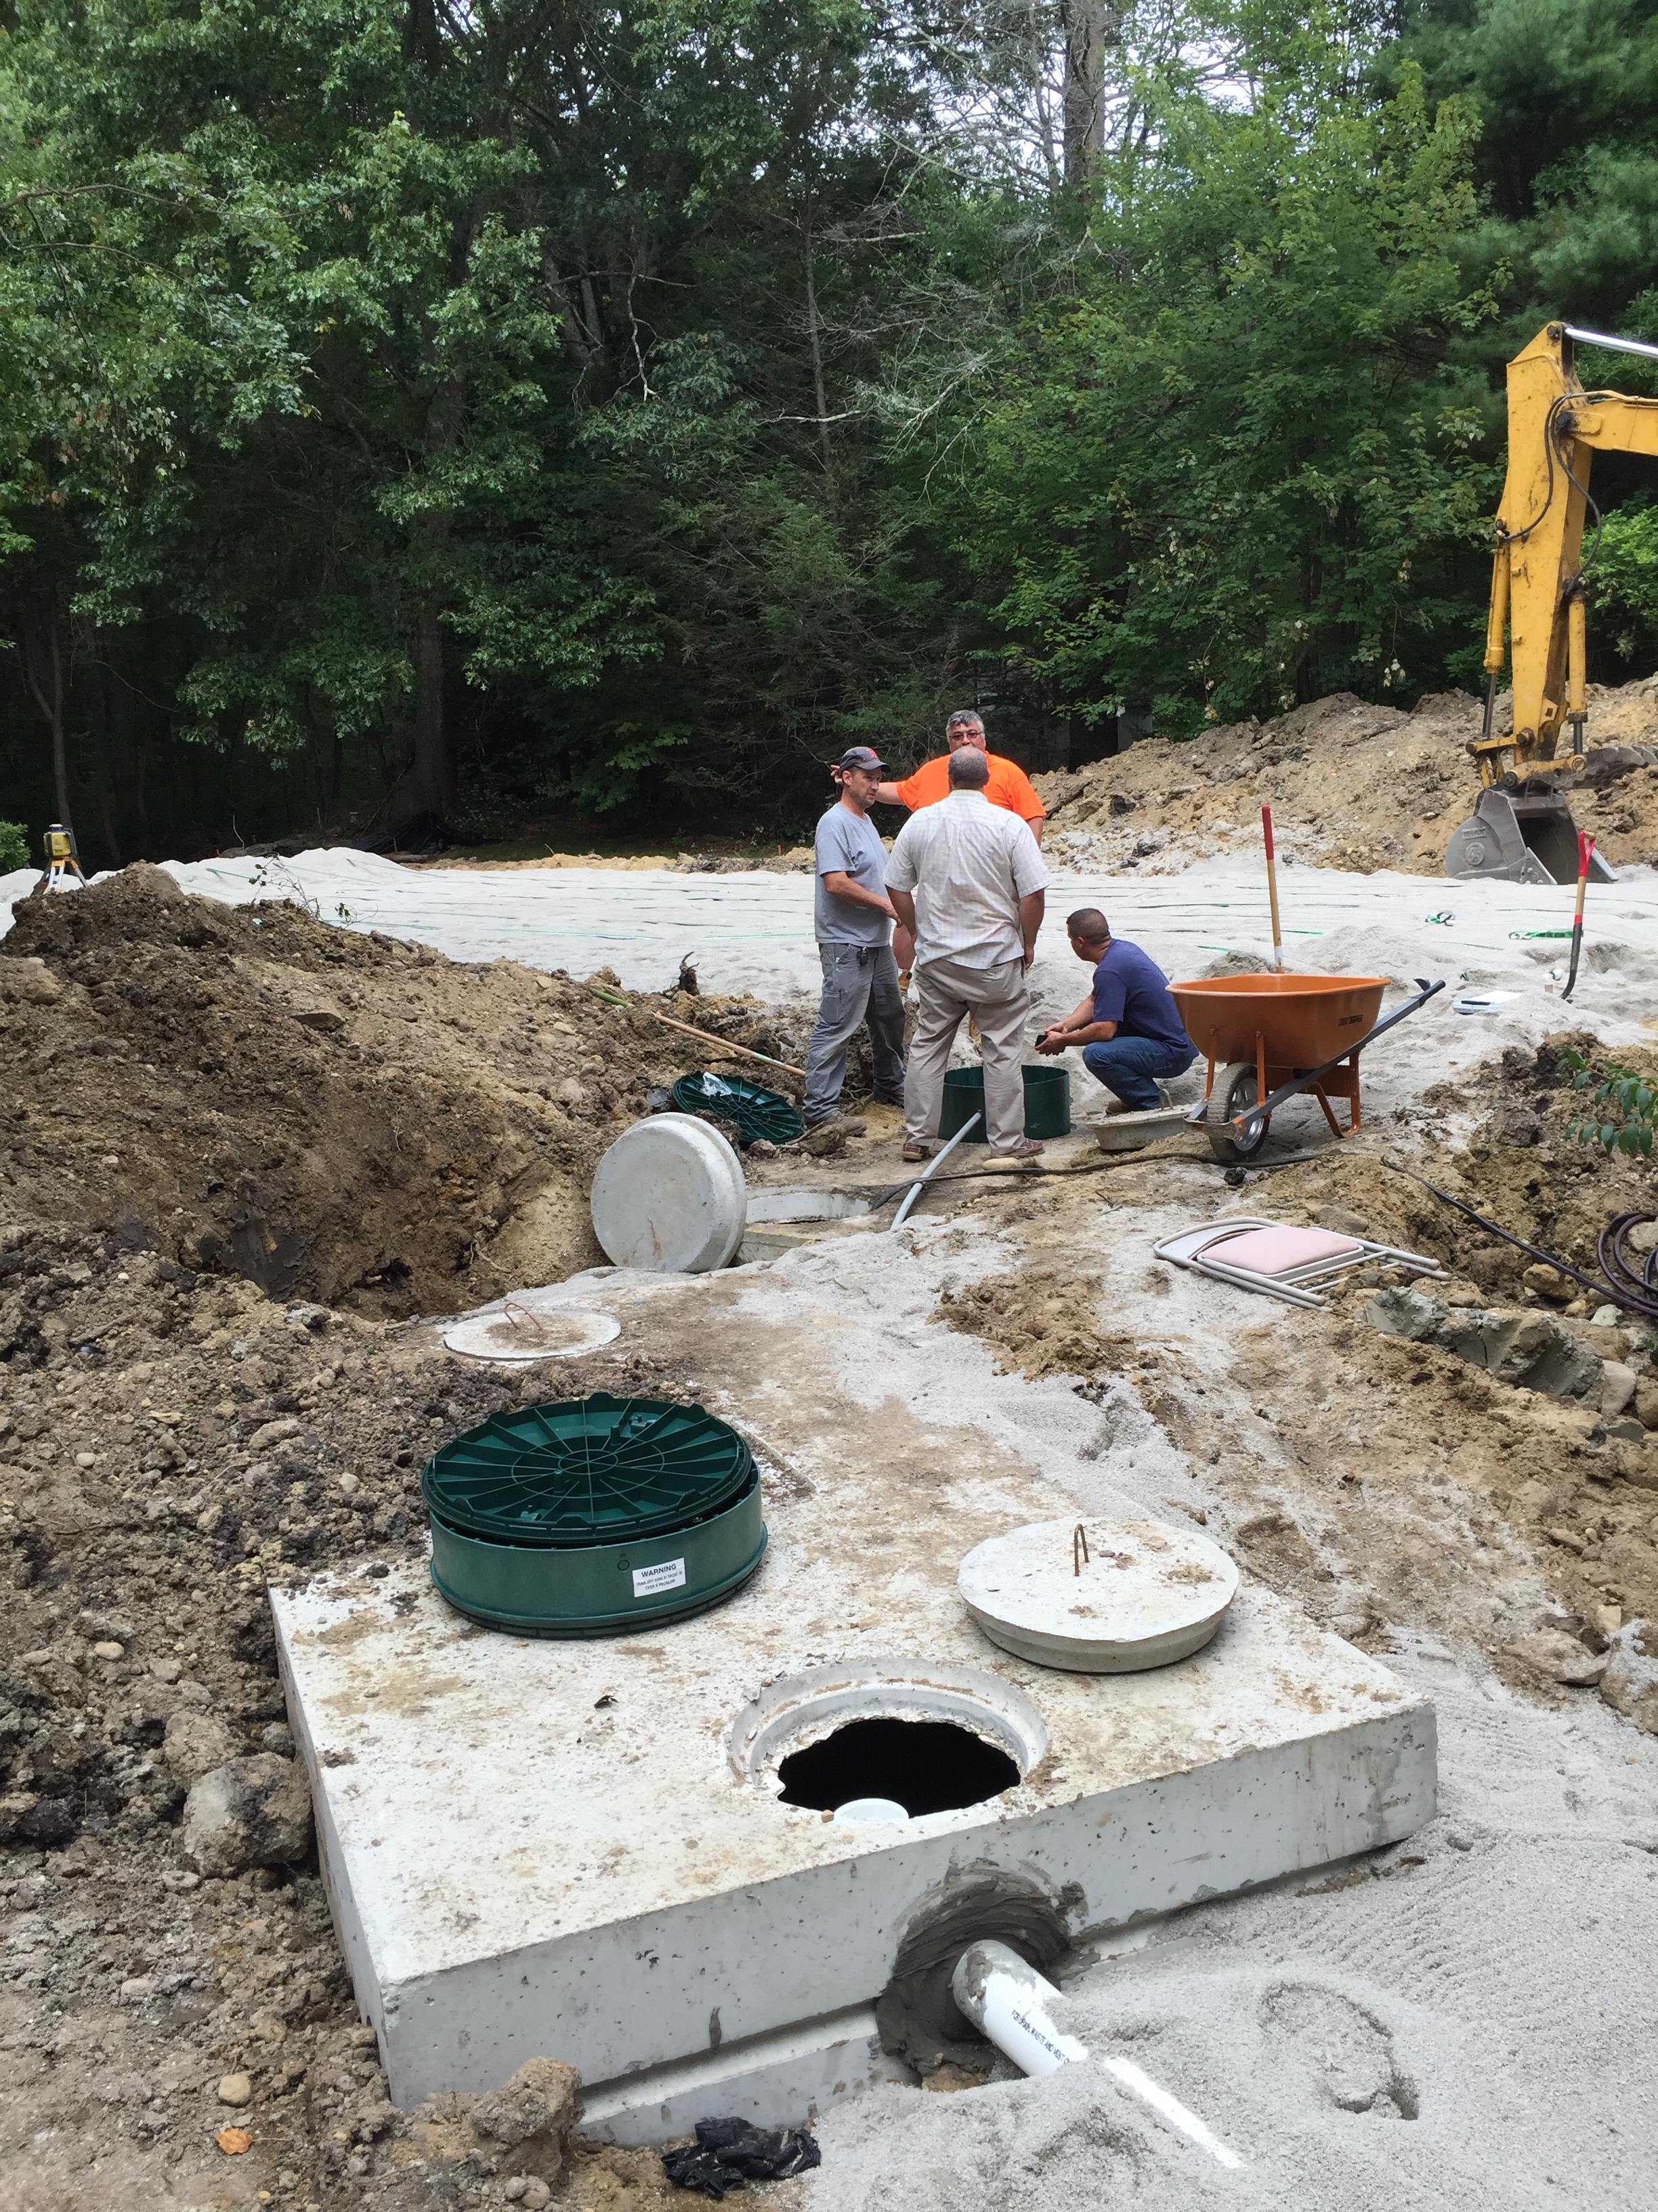
Photograph installation components, etc.
Overall conditions
Orientation of components
EH&S Rusiecki September 8, 2023

Slide 39
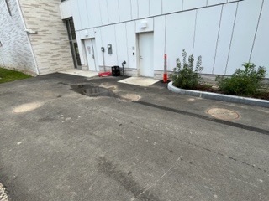
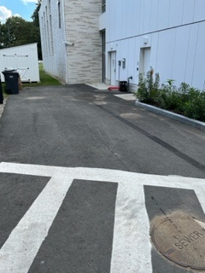
Once backfilled…MHs look all the same
EH&S Rusiecki September 8, 2023

Slide 40
As-Built submittal
As-Built reflects any approved minor differences
As-Built shows distances (“swing ties”)
As-Built is submitted with an updated Operations Manual
Time-dosed or
On-Demand
Alarm events, visual, audio, telemetric? PD Baseline
Name & phone number of O&M contractor
Evidence of recorded documents at Registry of Deeds (‘being clause” – property reference)
EH&S Rusiecki September 8, 2023

Slide 41
O & M Follow-up
Ensure a current O & M contract, renewable w/term
Name, address, phone number for O & M contractor
Contract states regular visits, testing type and frequency, and emergency on-call visits
Receipt of routine/event inspection report
Track minimum visits are done, with reports received (Remedial – by January 31st)
EH&S Rusiecki September 8, 2023

Slide 42
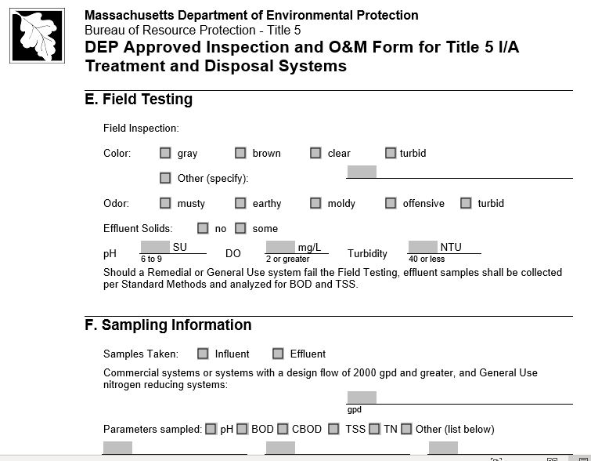
DEP O & M form
EH&S Rusiecki September 8, 2023

Slide 43
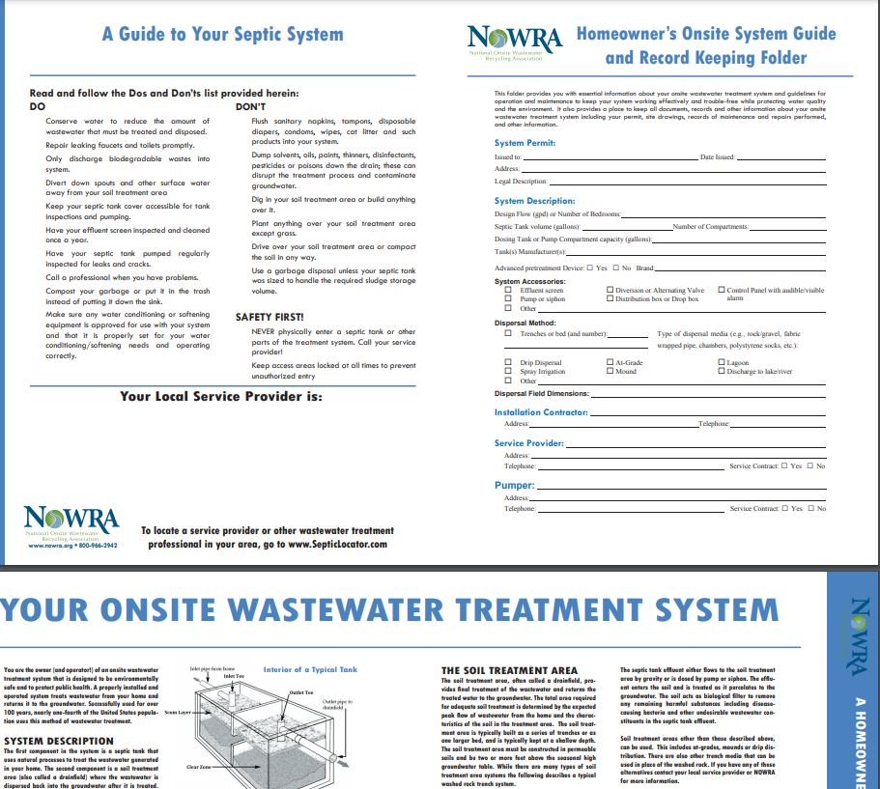
As-Built Package for Homeowners
CoC
Letter of approval with conditions
3. Photos
Pertinent documents, O&M, etc.
EH&S Rusiecki September 8, 2023

Slide 44
BoH O & M Follow-up
Enter data into a database*
Track routine inspections & alarm events
Ensure minimum visits are done, with reports received (Remedial – by January 31st)
Follow-up deficiencies with calls to O & M provider
Email or letters to owner
*Barnstable County database, masstc.org
EH&S Rusiecki September 8, 2023

Slide 45
Yankee On-site Wastewater Association https://www.yankeeonsite.org/membership/

Slide 46
QUESTIONS & ANSWERS

