Slide 1
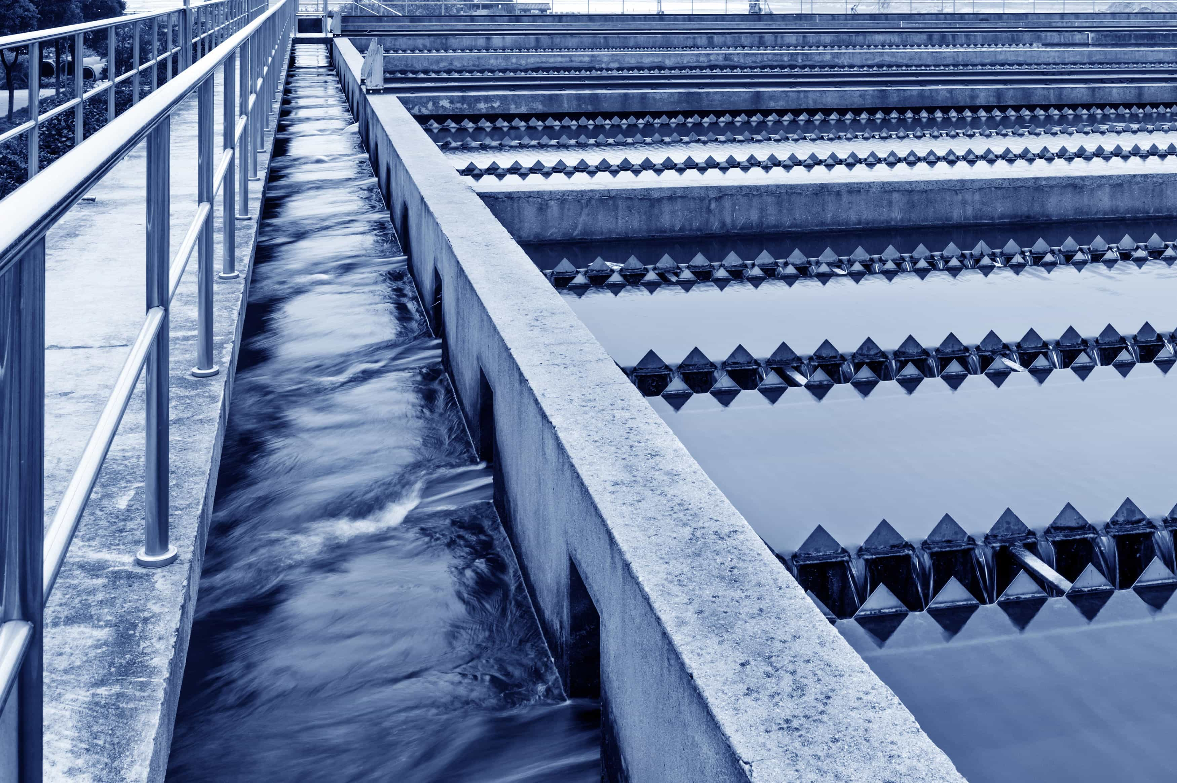


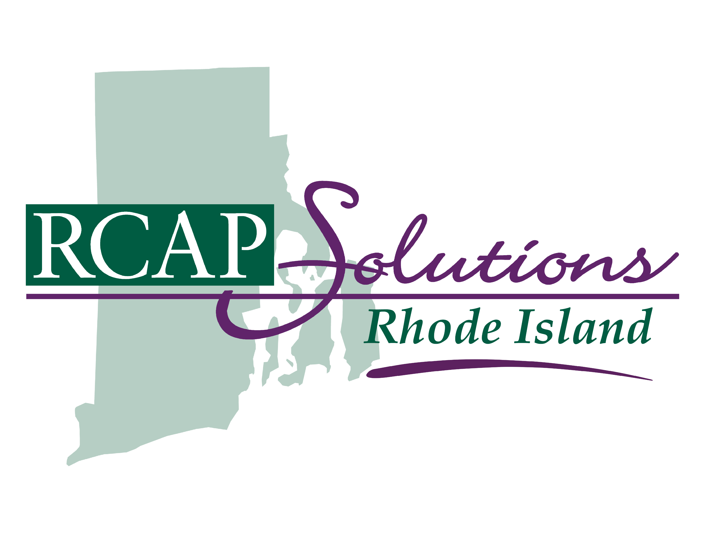
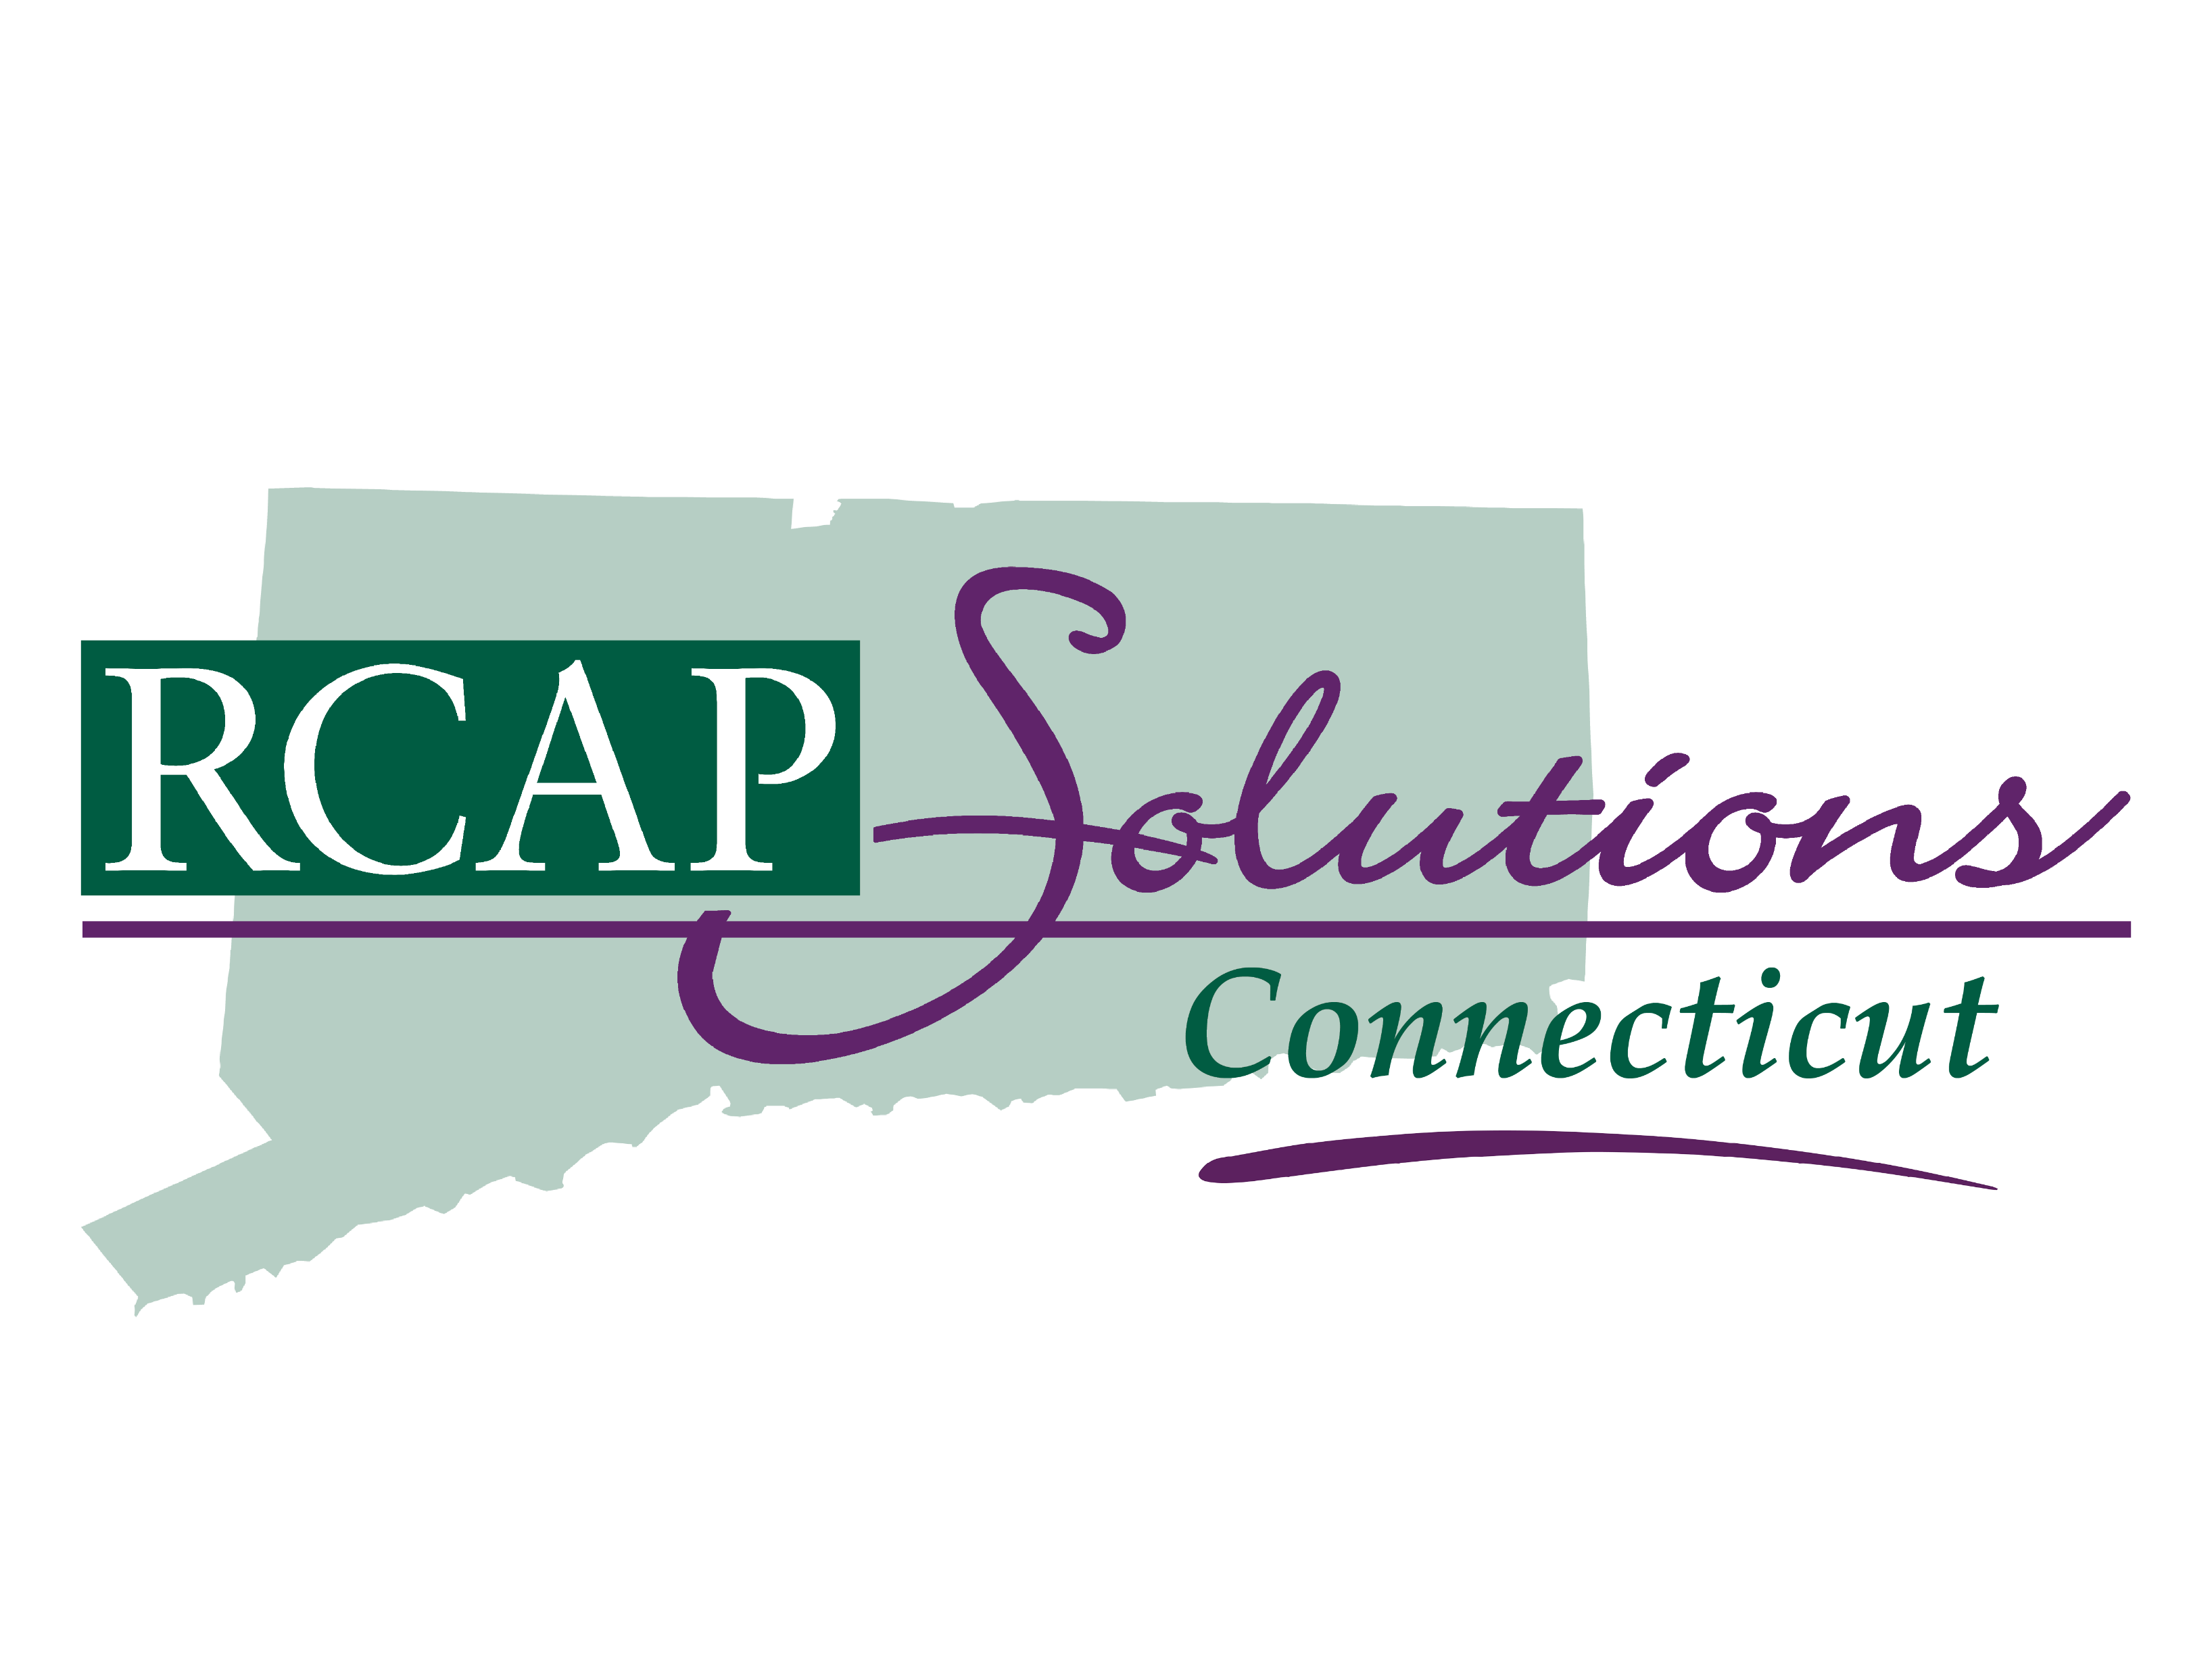
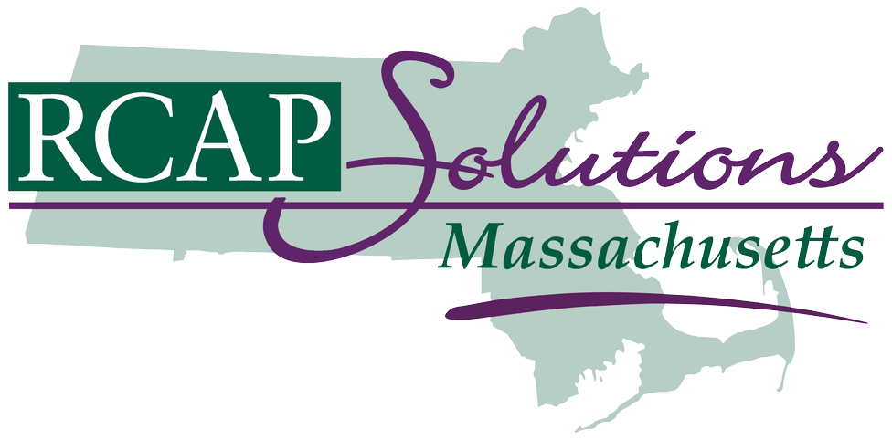

Public Drinking Water for Public Health Officials
Notes:
Be sure to type in your name and organization.
This Photo by Unknown Author is licensed under CC BY-NC-ND

Slide 2
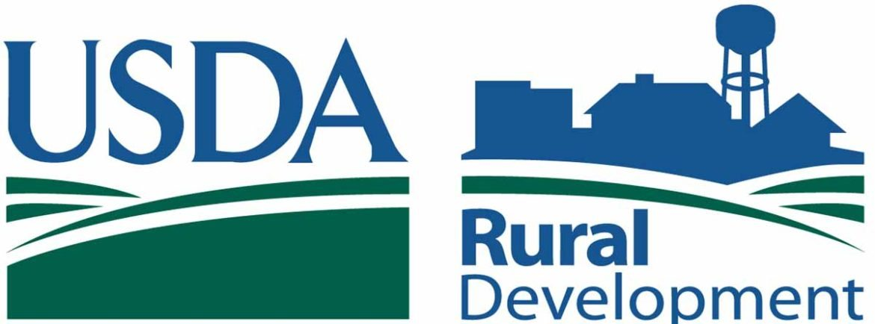
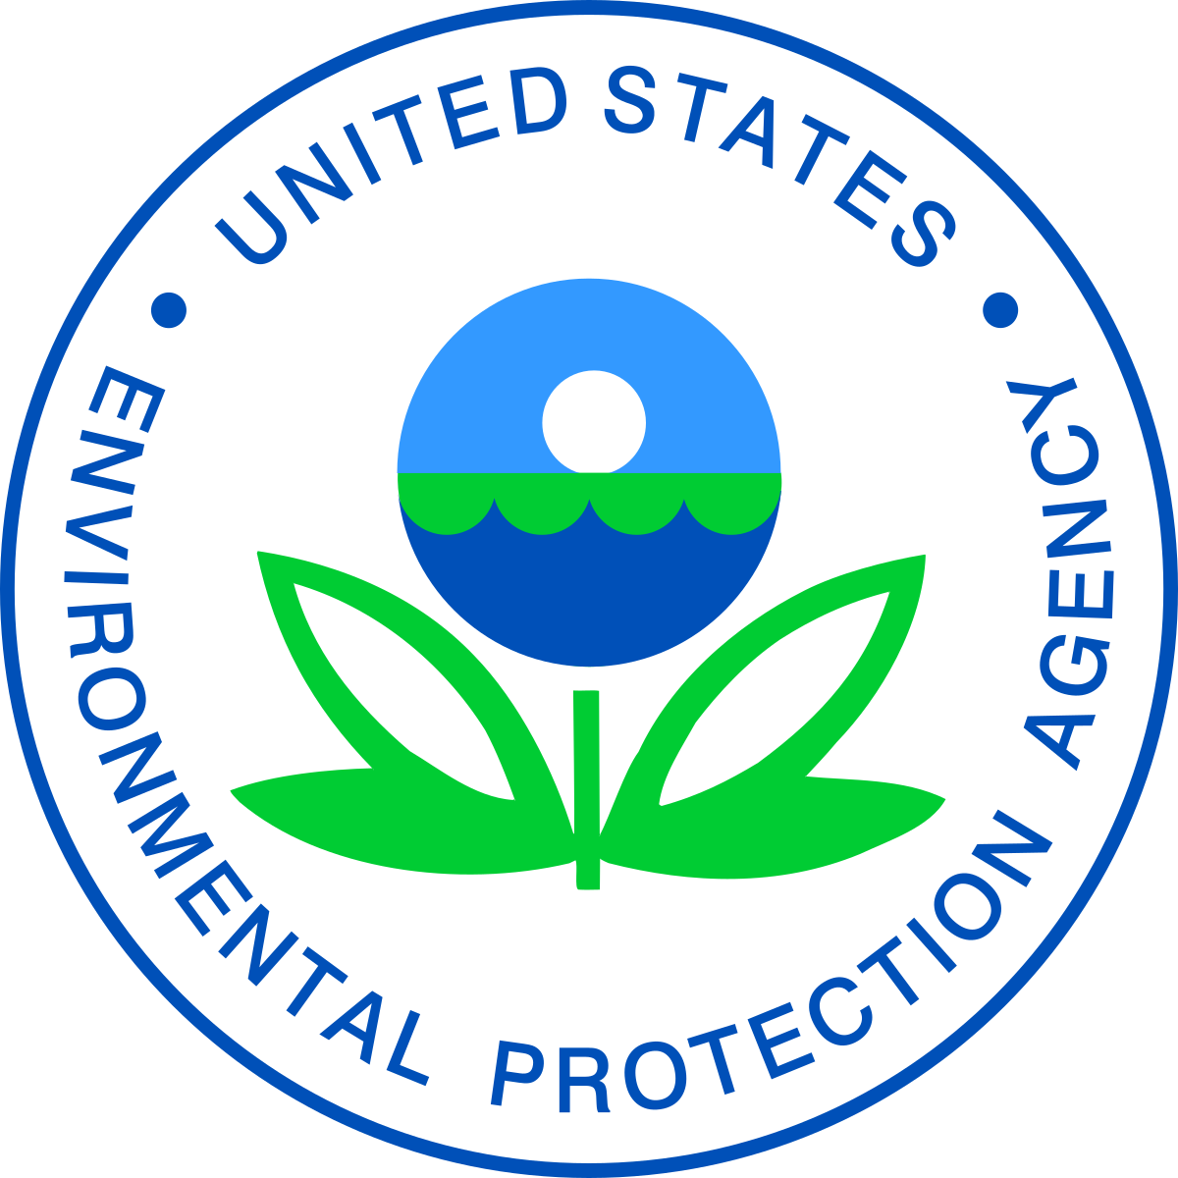
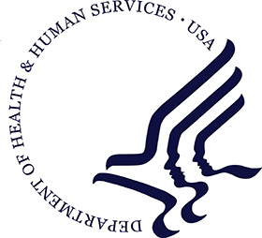
RCAP’s Primary Funders
US Department of Agriculture
Environmental Protection Agency
Health and Human Services

Slide 3

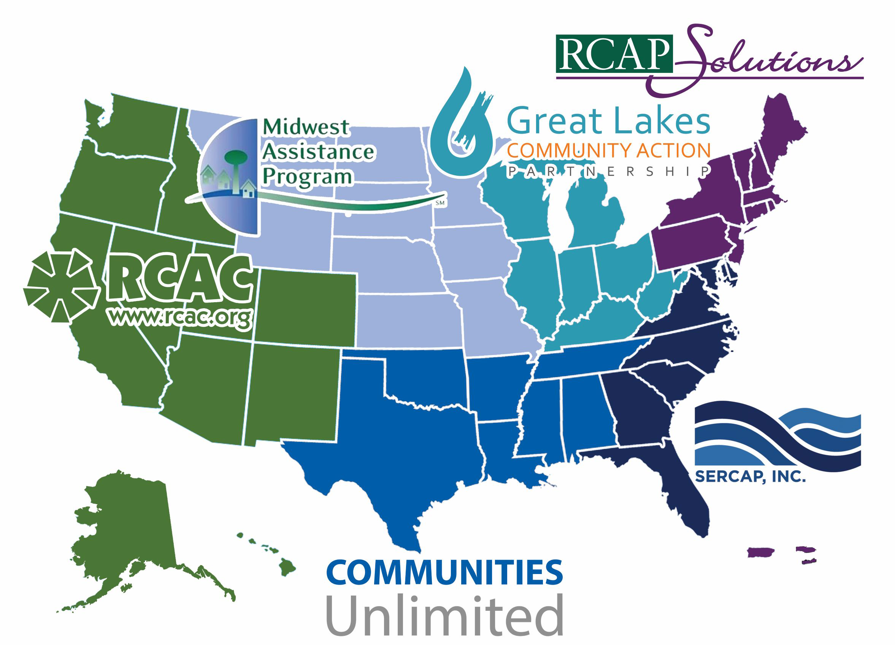
^{RCAP National Office}
^{1701 K St. NW, Suite 700}
^{Washington, D.C. 20006}
^{www.rcap.org}
Western RCAP
Rural Community Assistance Corporation
www.rcac.org
Midwestern RCAP
Midwest Assistance Program
www.map-inc.org
Southern RCAP
Communities Unlimited
www.communitiesu.org
Great Lakes RCAP
Great Lakes Community Action Partnership
www.glcap.org
Southeastern RCAP
Southeast Rural Community Assistance Project
www.sercap.org
Northeastern RCAP
RCAP Solutions
www.rcapsolutions.org
“Improving Rural Quality of Life”
Notes:
First, a word about RCAP.
(added by RN) RCAP Solutions is part of the nationwide network called RCAP, which stand for Rural Community Assistance Partnership, and the RCAP Solutions network is represented by the PURPLE States on the map there:
Non-profit providing training and TA to rural communities & tribes on DW & WW issues
Work in all 50 states, plus PR & USVI – 6 regional offices & one national
Funded by federal grants (USDA, HHS, EPA) and state grants
Staff have expertise in DW & WW treatment, utility financing, management & general administration

Slide 4
National Bureau of Economic Research
“Between 1900 and 1936 clean water was responsible for nearly half of the total mortality reduction in major cities, three-quarters of the infant mortality reduction, and nearly two-thirds of the child mortality reduction.” (Cutler and Miller, 2004)
Notes:
The association between cause and effect was compelling, and substantiated by the near eradication of typhoid as a waterborne disease.
Only infant mortality graph is shown here, but similar graphs exist for child mortality and total mortality reduction
In the 1800s, cholera, typhoid fever, dysentery and hepatitis A killed thousands of U.S. residents annually.
The introduction of chlorine disinfection in the early 1900’s made a large and continuous impact.
Clean water was responsible for:
nearly 1/2 of the total mortality reduction in major cities
3/4 of the infant mortality reduction
nearly two-thirds of the child mortality reduction. (Cutler and Miller 2004, 2005)
Improved sanitation and pasteurization of milk also contributed.

Slide 5
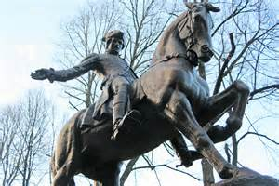
Massachusetts
Home of the first Health Department in U.S.
1799 in Boston
Formed to fight a potential outbreak of cholera
Paul Revere was first Health Officer

Slide 6
Connecticut
Chartered a state medical society in 1792 to address concerns from health threats
Smallpox, Tuberculosis, Cholera, Typhoid Fever
Medical Training became increasingly institutionalized (1800’s)
Increased sanitary practices (1900’s)
Notes:
Connecticut’s vital records office started recording births, deaths, marriages, fetal deaths for all vital events occurring from July 1, 1897 – present. Prior to this towns were maintaining records.

Slide 7
Private Vs. Public Drinking Water

Slide 8
Public Water System (PWS)
A Public Water System (PWS) provides water for human consumption through pipes or other constructed conveyances to at least 15 service connections or serves an average of at least 25 people for at least 60 days a year.
-US EPA, CT DPH, MA DEP
Notes:
The US Environmental Protection Agency or EPA classifies PWSs or public water systems according to the number of people they serve, the source of the water and whether they serve the same customers year-round or on an occasional basis. So on this slide we have the definition of a PWS. www.epa.gov/infrastructure/drinkingwater/pws/pwsdef2.cfm .
The common abbreviation for Public Water System is PWS.
This is the current and formal definition of a PWS in SDWA Section 1401(4) as amended by the 1996 SDWA Amendments.
In this definition constructed conveyances includes any manmade conduit such as ditches, culverts, waterways, flumes, mine drains or canals (63 FR 41940, 41941; August 5, 1998).
Human Consumption is defined as drinking, bathing, showering, cooking, dishwashing and maintaining oral hygiene.
In the handouts accompanying this presentation, we have included for your convenience this definition of a PWS taken from the Massachusetts Drinking Water Regulations.

Slide 9
PWS Classifications
Community PWSs (CWS) - People live there
Noncommunity PWSs - People don’t live there (two types)
Nontransient Noncommunity (NTNC) PWS - The same people return for work or school
Transient Noncommunity (TNC) PWS - Different people are just passing through
Notes:
EPA (Environmental Protection Agency) classifies these water systems according to the number of people they serve, the source of the water and whether they serve the same customers year-round or on an occasional basis.
Community systems: A PWS serving at least 15 service connections or at least 25 people year-round (counted as 2 people per bedroom).
Noncommunity Water System: A PWS that is not a community water system (two types)
Nontransient Noncommunity Water System: A public water system that is not a community water system and that has at least 15 service connections or regularly serves at least 25 or more of the same people about 4 or more hrs/day, 4 or more days/week, for more than 180 days per year. Examples are schools, businesses, daycare centers, large health care offices, and plazas that supply their own water. It can also be a workplace providing water to its employees.
Transient Noncommunity Water System: A public water system that is not a community water system that has at least 15 service connections or serves water to 25 different persons at least 60 days of the year. Ex: campgrounds, parks, community centers, restaurants, coffee shops, delis, rest areas, golf courses, ski areas, health clubs, sportsmen clubs, and motels that supply their own water.

Slide 10
Public Water System Basics
The US has approximately 161,000 public water systems.
More than two-thirds are privately owned.
Safe Drinking Water Act started it all
Notes:
It is a common misconception that public water systems are publicly owned. If a facility receives its water from a well on the property and requires a local food-handling permit, it is likely to meet the definition of a public water system. We also wish to introduce the concept that privately owned businesses may meet the definition of a PWS. For example, apartments or condo’s with their own well, manufactured housing parks, schools, daycares and gas stations with coffee shops with their own wells all serving an average of 25 or more people each day for at least 60 days of the year are considered public water systems because they serve the public.
Safe Drinking Water Act of 1974 and subsequent 1986 and 1996 – EPA National Standards for drinking water
In the next slide, let’s learn further about the classifications of Public Water Systems.

Slide 11
PWS in Massachusetts
Regulated by MASS DEP
1677 Public Water Systems
523 Community
260 non-transient
894 transient

Slide 12
PWS in Connecticut
PWS are regulated by Connecticut Department of Public Health, Drinking Water Section (CT DPH DWS)
1428 Public Water Systems
501 Community Water Systems (CWS)
505 Non-transient non-community (NTNC)
1,428 Transient non-community (TNC)

Slide 13
Many Types of Facilities Can Meet the Definition of a PWS
Mobile home parks, apartments, day care centers, campgrounds, restaurants, motels, golf courses, nursing homes, fitness centers
Multiple wells on commonly owned property may be regulated as a PWS

Slide 14
Changes in use
If a business changes its use and provides water from its own source, it can cause the system to be classified as a PWS.
The business would not be able to operate until all applicable MassDEP standards, permits and approvals have been met.

Slide 15
Common Changes in Use
Conversion from offices or stores in a strip mall to a day care facility, restaurant or fitness center. Expansion of a gas station and convenience store to include a coffee shop and restaurant.
Notes:
Increasing the average people being served in a strip mall may change the status of the drinking water system.

Slide 16
New PWS in Mass
“ Proponents creating any new or potential public water system should be directed by the local board of health, planning board, building department, and other local permitting offices to contact the MassDEP Drinking Water Program before finalizing a site plan or developing the property, as they could be subject to 310 CMR 22.0 and all applicable MassDEP standards, permits and approvals.”
“Constructing and /or Operating Unapproved Public Water Systems” MassDEP
Notes:
Speaker should read this directly from the slide as this is a key MassDEP regulation and note the handout that this comes from “Constructing and/or Operating Unapproved Public Water Systems.” This handout is included in the audience packet..
Also please be aware that if a facility is currently classified as a private water supply, any future changes in the use of the establishment that would cause the system to be classified as a public water system are prohibited till the facility meets and obtains all applicable MassDEP standards, permits and approvals.

Slide 17
Case Study: Colonial Convenience Store & Dunkin’ Donuts
Operated as an unapproved PWS
Water samples revealed over 2000 ppb MTBE (Methyl-tertiary-butyl-ether)
Food service shut down & food handling permit revoked

Slide 18
Condominium Developments & PWS Requirements
Some types of construction, such as residential or business condominium developments, proposing to use 2 or more wells to serve the on-site facilities, may be considered public water systems.
Refer the applicant to MassDEP for a written determination of public or private water system status during the design phase, and/or prior to issuance of local permits.
Communicate with local planning office, planning board, building inspector’s office and the applicant

Slide 19
Pre-existing wells
MassDEP “…reserves the right to evaluate and determine whether two or more wells located on commonly owned property, that individually may serve less than 25 people, but collectively serve more than 25 people for more than 60 days of the year should not be regulated as a public water system, taking into account the risk of public health.”

Slide 20
Semi-Private Wells
Not a PWS but high risk
Daycare w/ under 25 occupancy
Food establishment open less than 60 days a year
Sports Camp open less than 60 days a year
Campground or Hotel open less than 60 days a year
Shared well under PWS criteria
Vacation Housing Rentals

Slide 21
Boil Orders

Slide 22
Why a Boil Order?
E Coli (Human and/or animal poop) is detected in the water during routine or follow up sampling
24 hr. turn around from sample to lab notification
Lab analyzes for Total Coliform, if positive screens for E Coli
Triggers corrective actions and notifications
EPA’s Revised Total Coliform Rule (RTCR) dictates requirements

Slide 23
Public Health Concerns
Young/Old & immune compromised most at risk
Boil Water (at least 1 minute rolling boil) or Use Bottled Water
Bathing-Try not to swallow, sponge bath infants/young
Brushing teeth-Use boiled or botted water

Slide 24
Restaurants
Discard ice or any other product made with contaminated water. Make new with boiled or bottled water
Dishes-Wash as normal, finish with sanitizer bath (1 min.) and air dry
Washing food-With boiled or bottled water
Hand washing-With boiled or bottled water or finish w/ sanitizer

Slide 25
PFAS

Slide 26
What are PFAS?
PFAS are Per- and polyfluoroalkyl substances:
Man-made chemicals
Used in stain-resistant, water-resistant, and non-stick products, firefighting foams, food packaging, outdoor clothing, carpets, leather goods, ski waxes, and more.
Persistent in the environment, leaching into groundwater from spills, landfills, air deposition.
Linked to health risks, particularly in immunocompromised individuals, women who are pregnant or nursing, and infants

Slide 27
MA. PFAS Drinking Water Standard
“PFAS6” MCL is 20 ppt for the sum of six PFAS compounds
PFOS, PFOA, PFHxS, PFNA, PFHpA, PFDA
Applies only to Community and Non-transient Public Water Systems, not Private Wells or Transient PWS’s unless local Board of Health institutes a regulation
No federal standard: PFOS and PFOA health advisory only

Slide 28
PFAS for CT Drinking Water
2013-2015 - CT’s large PWS’s conducted testing (six compounds)
2018 - CT DPH and PWS’s collaborated on risk assessments
July 2019 - The Interagency Task Forces created
June 2022 - Action Level established (four compounds)
June 2023 - Added another six compounds
Notes:
Systems with more than 10,000 population were asked to conduct testing for six PFAS compounds per EPA.
To determine potential areas where PFAS contamination could be present, PWS’s and CT DPH worked on risk assessments.
Commissioners from CT DPH and CT DEEP were asked to lead a PFAS task force that includes 15 plus other agencies and state entities
From 2022 – 2023 CT DPH created Action Levels for and initial four compounds and later added six additional compounds

Slide 29
Overall Approach to PFAS
Minimize risk to Public Health
Minimize future releases of PFAS into the environment
Identify, Determine and Remediate previous environmental releases of PFAS

Slide 30
Proposed EPA Standard
PFAS Compound | Proposed MCLG | Proposed MCL
PFOA | 0 ppt | 4.0 ppt
PFOS | 0 ppt | 4.0 ppt
PFNA | 1.0 (unitless Hazard Index) | 1.0 (unitless Hazard Index)
PFHxS
PFBS
HFPO-DA (GenX)

Slide 31
New PFAS Standard Impact
POTENTIAL IMPACT ON COM AND NTNC PWS IF EPA PROPOSED REGULATION BECAME FINAL
 | Number of COM and NTNC PWS required to test for PFAS impacted by the draft EPA MCL* | % of total COM and NTNC PWS required to test for PFAS impacted by the EPA draft MCL
PWS currently over Mass PFAS6 MCL and working with MassDEP to reduce levels | 49 | 7%
PWS newly impacted by draft EPA MCL | 149 | 22%
Total PWS impacted by draft EPA MCL | 198 | 29%
*Includes both PFOA, PFOS and HI impacted systems

Slide 32
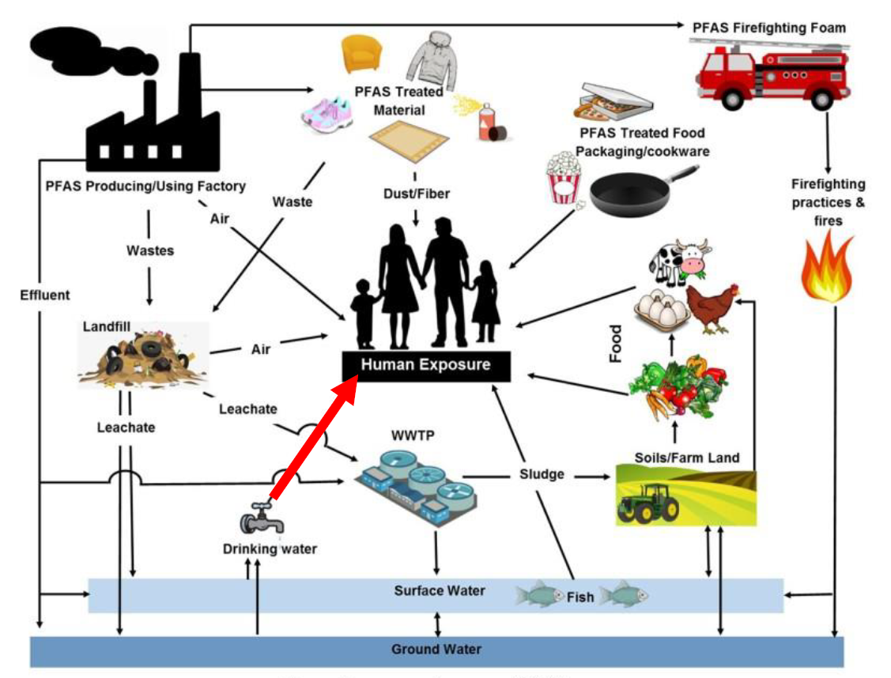
Human Exposure and sources of PFAS
Image from MassDEP, adapted from Oliaei et al. 2013

Slide 33
PFAS & Local BOH’s
DPH advisory for fish from certain lakes/ponds
Found in food products & bottled water
Compost facilities and waste disposal
Wastewater affluent from septic systems & plants
Firefighting activities (municipal responsibility)

Slide 34
Real Life Scenario
Dunkin Donuts tested for PFAS6 as required and has elevated levels. Treatment is not required by MASS DEP due to being a transient, non-community public water system.

Slide 35
Poll
Would you issue a food permit to an establishment who has PFAS6 over 20 PPT ?
A-Yes
B-No
C-Bring to BOH’s attention and let them decide

Slide 36
Support “An Act Promoting Drinking Water Quality for All” Bill SD.2387 / HD.3322
Authorize MASS DEP to write & implement a Minimum Standard for Private Wells
Join Coalition for Safe Drinking Water as an individual and/or as a Town Board of Health
www.whatsinyourwellwater.org
#whatsinyourwellwater

Slide 37
Questions?

Slide 38
Contact Information
Jim Starbard
Regional Director (CT, MA & RI)
jstarbard@rcapsolutions.org
978-502-0227
Matt Cassedy
CT State Manager
mcassedy@rcapsolutions.org
860-500-0713

Slide 39
Thank You!

