Slide 1
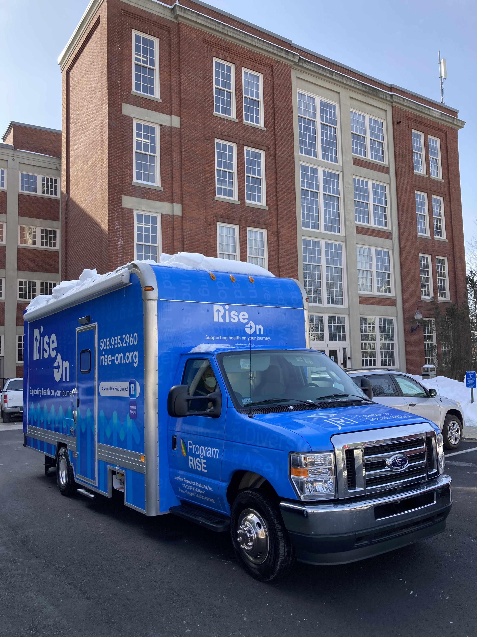
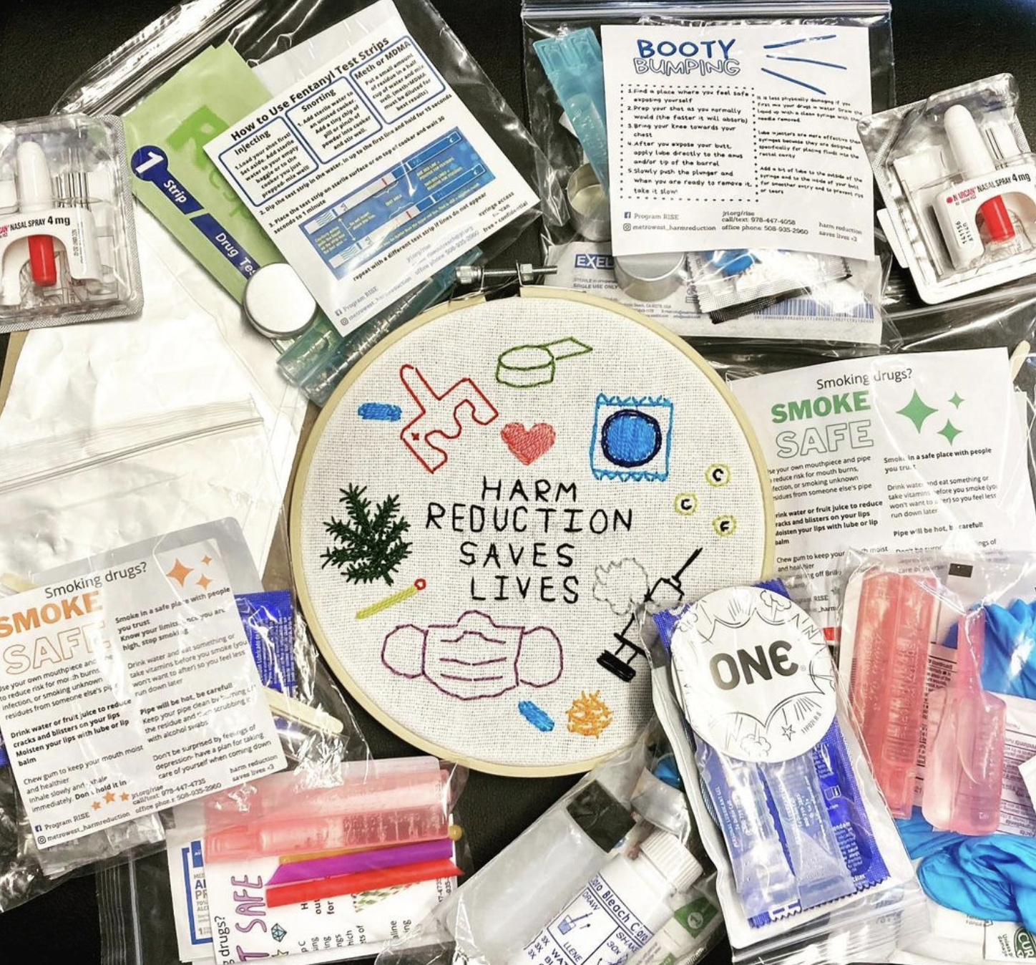


Meeting People Where They Are At
An Overview of Harm Reduction Services in Metro West MA
Aron Thiim (he/él)
Interim Program Director | Program RISE/JRI Health
MPH Student | Johns Hopkins Bloomberg School of Public Health
Bloomberg Fellow, Addiction & Overdose | Bloomberg American Health Initiative
Kelsey Rodrigues (she/her)
Harm Reduction Specialist | Program RISE/JRI Health

Slide 2
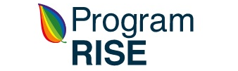
RISE Mission
Our mission is to promote health, prevent disease, and fight stigma by providing services to improve wellbeing in the Metro West region, centering communities of Color, LGBTQ+ people, immigrants, refugees, people living with HIV/AIDS, and people who use drugs.
Working within a social justice framework in partnership with the community and other provider agencies, we are committed to eliminating new infections for HIV, STIs, and Viral Hepatitis, treating current infections, reducing deaths from overdose, providing education, and improving overall health outcomes for clients and communities.

Slide 3
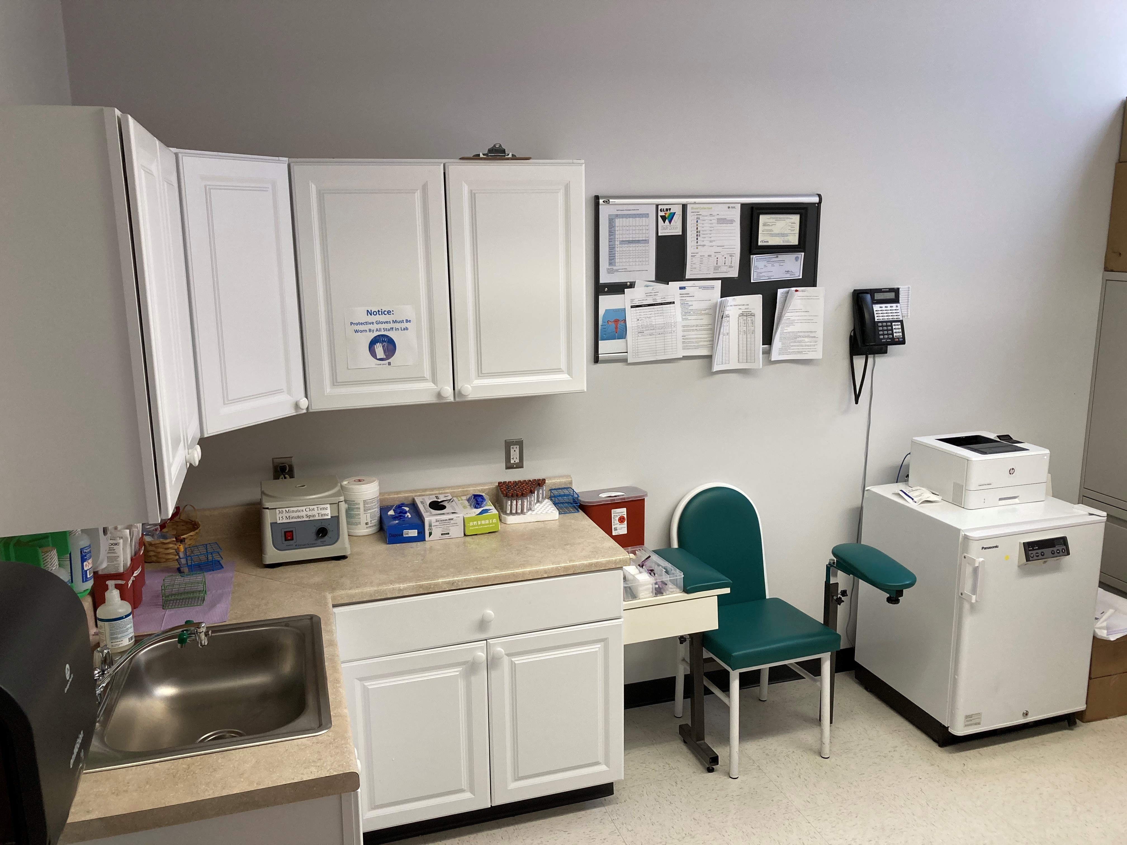
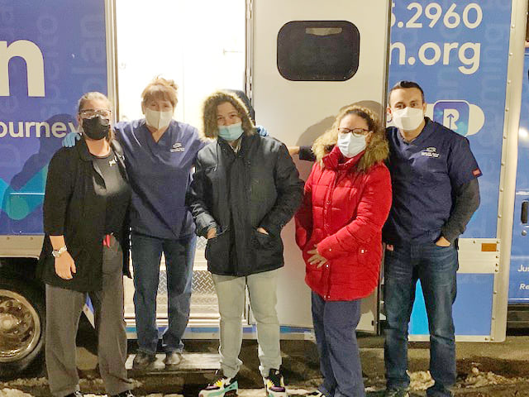
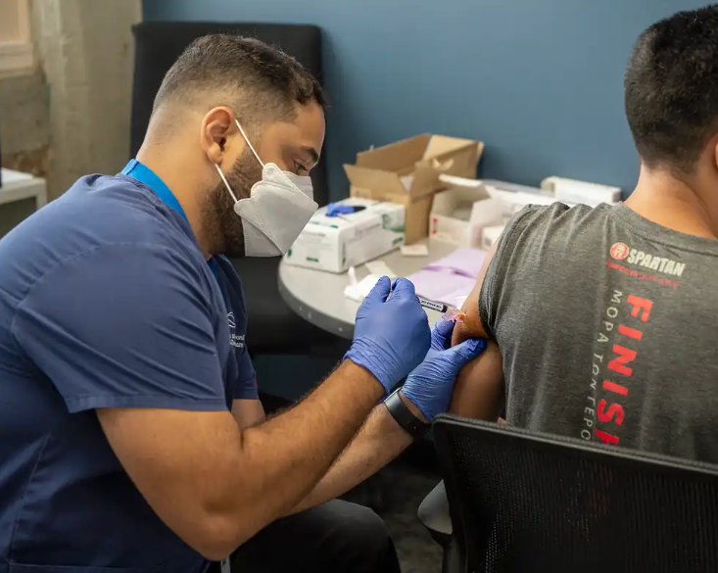
Overview of RISE Services
Infectious Disease Services
  HIV/HCV/STI Counseling & Testing
  STI (Chlamydia, Gonorrhea, Syphilis) Treatment
  New in 2023: HCV Treatment
Harm Reduction & Overdose Prevention
HIV Housing & Medical Case Management
HAV & HBV Vaccination (COVID & MPOX discontinued as of 6/30/2023)
Mobile Health Outreach (Testing & Harm Reduction Supplies)
Hours of Operation (52 hrs/wk)
  Monday 8am-4pm
  Tuesday 8am-7pm
  Wednesday 8am-7pm
  Thursday 8am-7pm
  Friday 8am-4pm

Slide 4
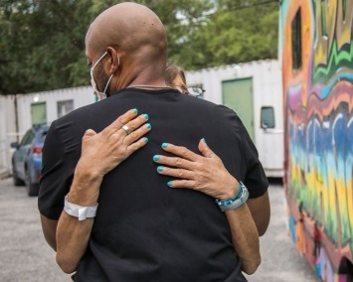
What is Harm Reduction?
Harm reduction is a set of practical strategies and interventions aimed at reducing negative consequences associated with drug use. Harm Reduction is also a movement for social justice built on a belief in, and respect for, the rights of people who use drugs (National Harm Reduction Coalition)
Model of substance use care distinct from treatment or recovery support, created by and for people who use drugs to improve health and wellbeing, including during active drug use (NIDA)

Slide 5
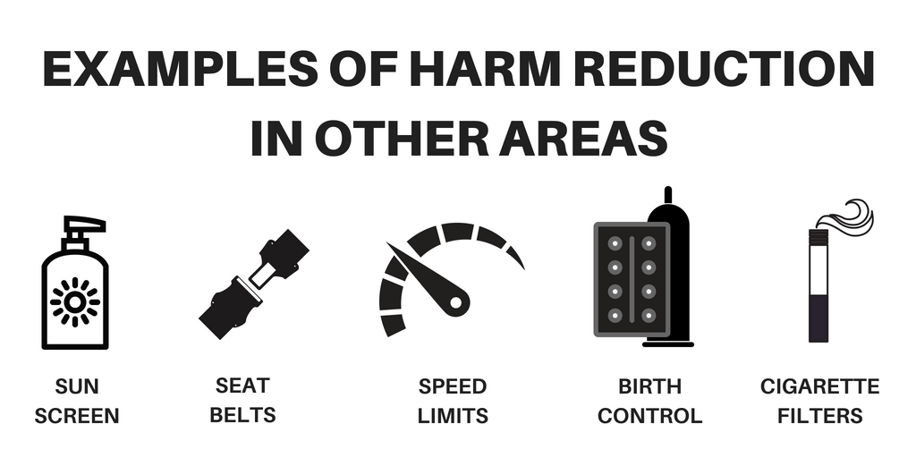

Slide 6
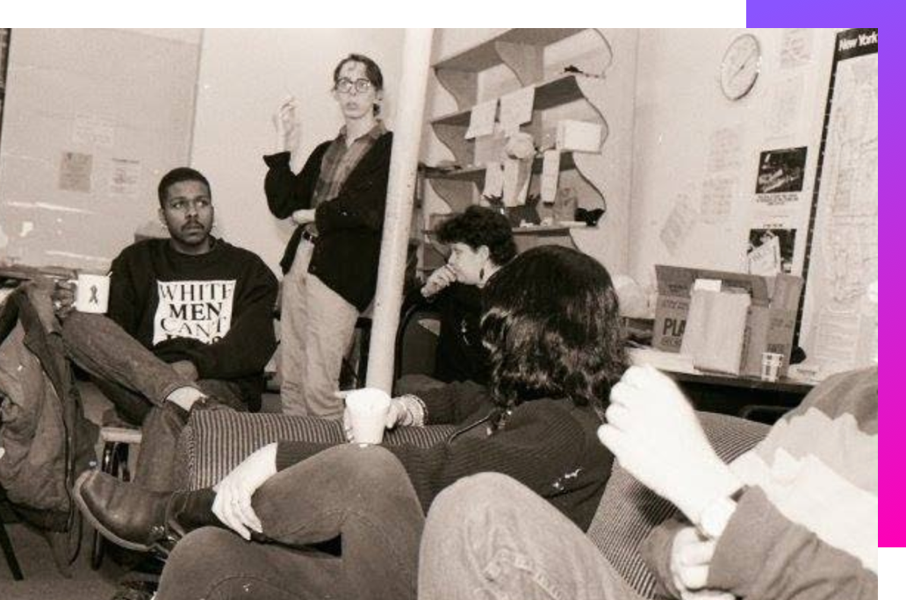
History of Harm Reduction

Slide 7
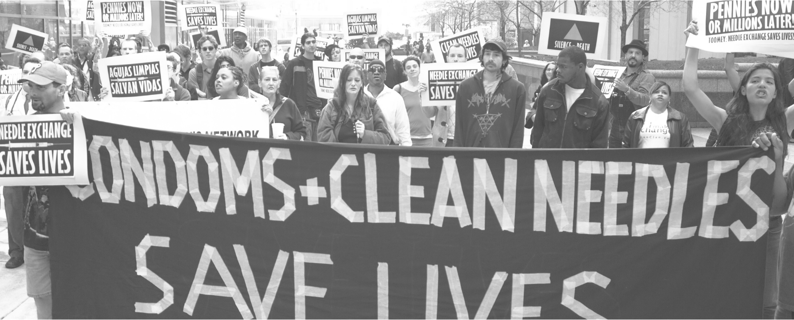
History of Harm Reduction
The origins of harm reduction came from a radical social movement fueled by community resilience, desire to push back on inequitable systems, and the belief that people most impacted should hold the mic.
Much greater than just the set of strategies and resources offered (e.g. syringe exchange, naloxone distribution, etc.)
Harm reduction challenges how society and policymakers conceptualize certain drugs and populations of people using those drugs.
Sources: The Humanities Truck & National Harm Reduction Coalition

Slide 8
History of Harm Reduction
Civil & human rights groups like the Young Lords Party and Black Panther Party began organizing community-based harm reduction & health-motivated direct action in the 1970s (not formally recognized as a public health model until the 1980s)
In the early 80s, a harm reduction model was implemented in the Netherlands with the increase in HIV/AIDS transmission and comorbidity with drug use
Prohibitionist model was not structurally sustainable and became unpopular with the public.
To combat the growing health concerns, the Netherlands expanded existing needle exchange and supply distribution programs.
Sources: The Humanities Truck & National Harm Reduction Coalition

Slide 9

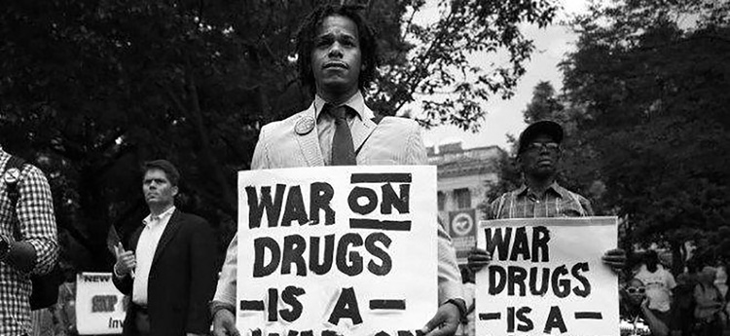
History of Harm Reduction
In the United States and Canada, organizers, advocates, communities, and renegade care-providers were already opposing legal restrictions on drugs and the criminalization, marginalization, and oppression of PWUD prior to the 80s (and before the “War on Drugs” was formally declared by Richard Nixon).
When the HIV/AIDS epidemic worsened and started to impact more people, grassroots harm reduction communities started to organize with LGBTQ+ groups to save each other’s lives.
If the government wasn’t going to help, then the people most impacted would help themselves.
Sources: The Humanities Truck & National Harm Reduction Coalition

Slide 10

History of Harm Reduction
Harm reduction started to gain traction out of necessity. However, people were already practicing risk reduction education and techniques well before this!
Communities were organizing to save themselves and their peers by teaching people who inject drugs to clean their needles with bleach and resist sharing when they could.
Local and federal U.S. government (which had a different socio-political landscape and history of strict prohibition and criminalization of Black and working class PWUD than the Netherlands) stumbled to find the legal support to implement needle exchange programs.
Despite the plethora of evidence from scientific studies proving the multitude of social, societal, and health benefits that syringe exchanges and safe consumption sites offer, stigma and opposition to needle programs made implementation difficult.
Driven primarily by state and federal legislature, drug-user stigma, misinformation campaigns, and existing punitive systems against PWUD; harm reduction work (such as syringe exchange) has been fragmented from the start and is still divided and contentious.
Sources: The Humanities Truck & National Harm Reduction Coalition

Slide 11
Why Syringe Exchange is Important?
In 2021, 106,699 drug overdose deaths occurred with the rate of drug overdose deaths involving synthetic opioids increased 22% (CDC)
The opioid crisis is fueling a dramatic increase in infectious diseases associated with injection drug use.
  Drug supply half-life and increased frequency of injection
  Syringe exchange programs are an effective way of reducing riskier behaviors related to injecting drug use, hence they are effective in reducing the spread of HIV & HCV among people who inject drugs.
Reports of acute hepatitis C virus (HCV) cases rose more than fivefold from 2010 to 2020, primarily due to increased injection of opioids and other drugs (CDC)
The majority of new HCV infections are due to injection drug use (CDC)
  66% of cases with risk information reported injection drug use
  4,798 new cases of acute HCV and 107,300 new cases of chronic HCV reported during 2020
Over 2,500 new HIV infections occur each year among people who inject drugs (CDC)

Slide 12
HIV Clusters in MA
In early 2019, a new cluster of HIV infection was identified in Boston among people who inject drugs (PWID) who were experiencing or had experienced recent homelessness, and the total statewide number of reported cases with IDU as the primary exposure increased to 76 in 2020.
As of December 31, 2021, a total of 164 cases diagnosed since November 2018 have been investigated and identified as part of the Boston cluster
Empirical and model-based evidence consistently shows that syringe services programs have the highest impact in HIV prevention for people who inject drugs
Massachusetts Department of Public Health, Bureau of Infectious Disease and Laboratory Sciences. Massachusetts HIV Epidemiologic Profile, Statewide Report – Data as of 1/1/2022 https://www.mass.gov/lists/hivaids-epidemiologic-profiles

Slide 13
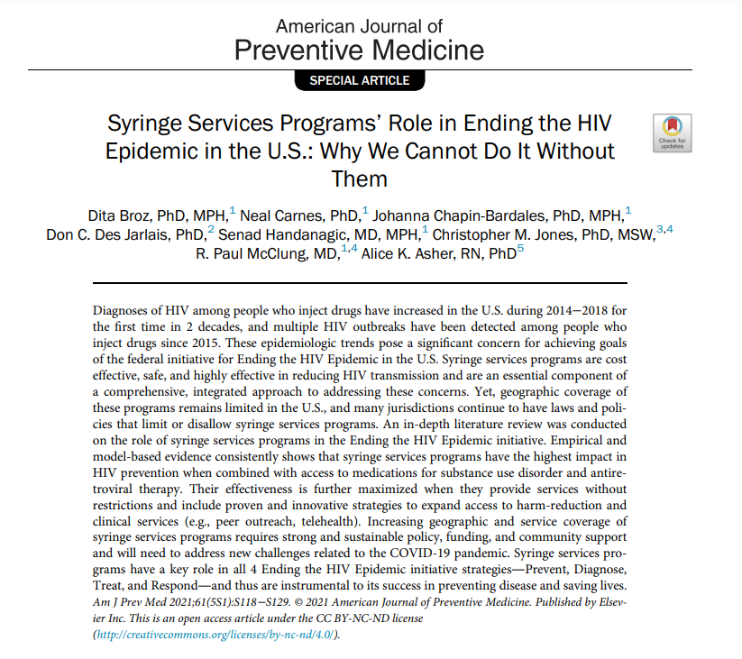

Slide 14
MA State & Federal SSP Data – Important Points
In MA, 67 cities and towns have approved syringe services program. There are 25 brick and mortar sites and an additional 29 mobile sites across the state.
The opioid epidemic requires multi-pronged, comprehensive approach to care, prevention and treatment. SSPs are not intended to “cure” the epidemic but to prevent the spread of disease associated with it and support changes in drug use behaviors and risks.
8 federal studies showed SSPs do not promote or result in increased drug use.
SSPs are a proven, cost-effective approach for HIV and HCV prevention among PWIDs.
SSPs are a bridge to other forms of care and treatment.
People who access SSPs are 5 times more likely to enter treatment and 3 times more likely to stop their use.
Many SSP participants walk or travel locally to the program. No data supports SSPs bringing more people who use drugs into the city.
Studies of SSP efficacy have decreased over time due to the consistency of findings.
Source: https://www.cdc.gov/ssp/syringe-services-programs-faq.html

Slide 15
Harm Reduction & Overdose Prevention at RISE
Syringe Exchange & Safe Disposal
  Access to and safe disposal of sterile syringes and injection equipment
  Protects the general public & first responders (e.g. IM syringes & other community sharps)
Safer Use Supply Distribution
  Infection prevention materials (e.g. clean/sterile injection equipment), safer smoking supplies, wound care kits, sharps containers, etc.
Naloxone Distribution & Overdose Prevention Education
  Clients & community trainings at health/social service programs (e.g. detox, shelter)
Post Overdose Outreach
  Partnerships with Police/Fire in Framingham, Natick, Ashland, Hudson & Marlborough
Street & Mobile Health Outreach
  Provide street outreach, syringe pickup, & use mobile health van at events
Behavioral Health Counseling
  ~40 client active caseload (50-50 scheduled vs. drop-in visits)
Short-Term Health Navigation & Referrals
  Shelter/Housing
  Detox
  MAT (Medication Assisted Treatment)
  Primary Care/Psychiatric Care
  MassHealth Insurance Enrollment

Slide 16
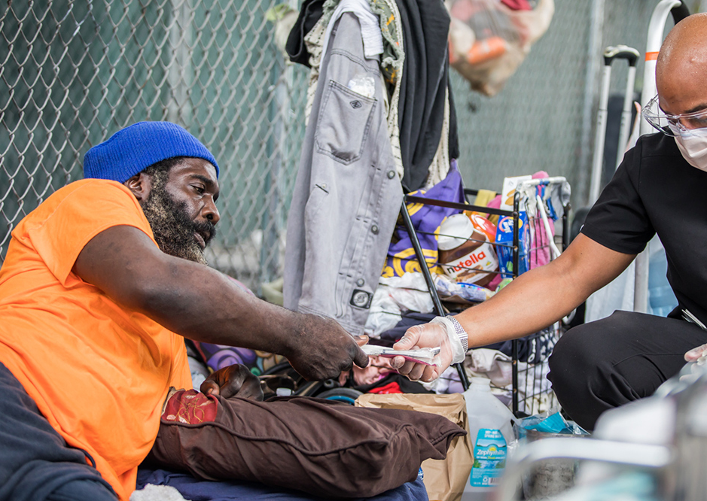
Meeting People Where They’re At
Working within a harm reduction framework allows us to offer support and services based on a person's expressed needs.
This might look like:
Offering safer drug use & safer sex supplies
Naloxone distribution to PWUD, non-drug users, and community partners
Conducting outreach
Non-coercive linkage to treatment
Stigma eradication

Slide 17
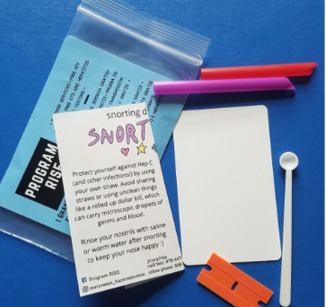
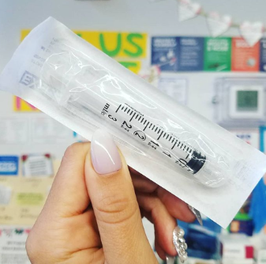
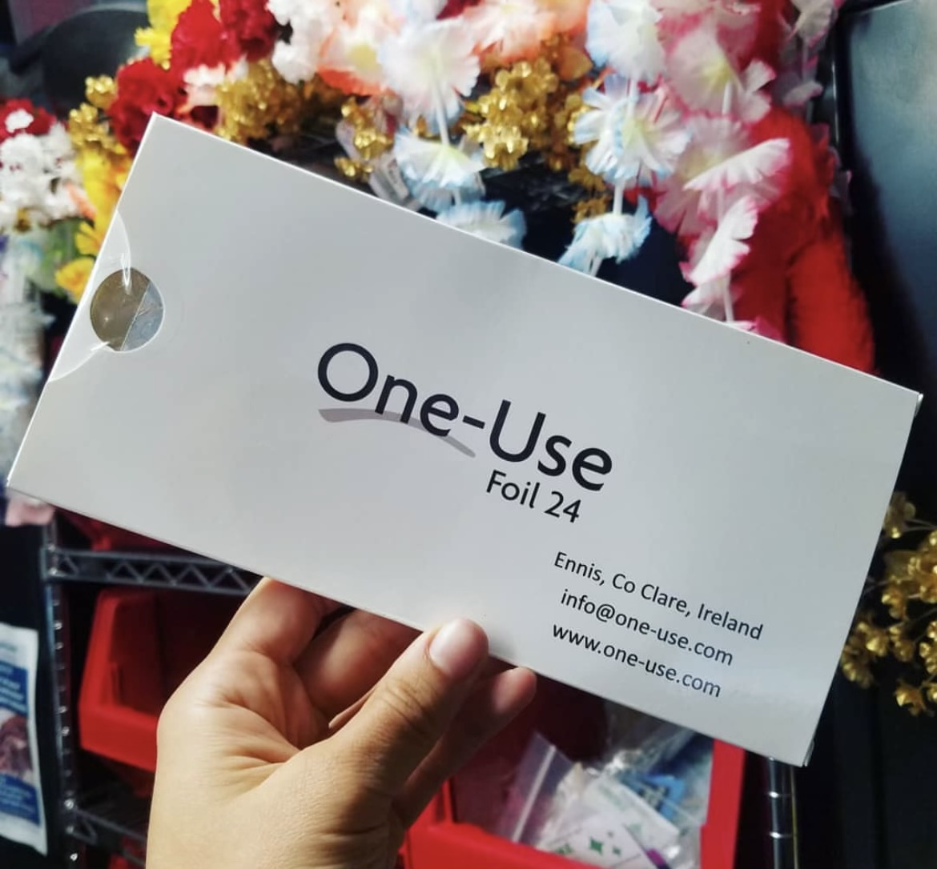
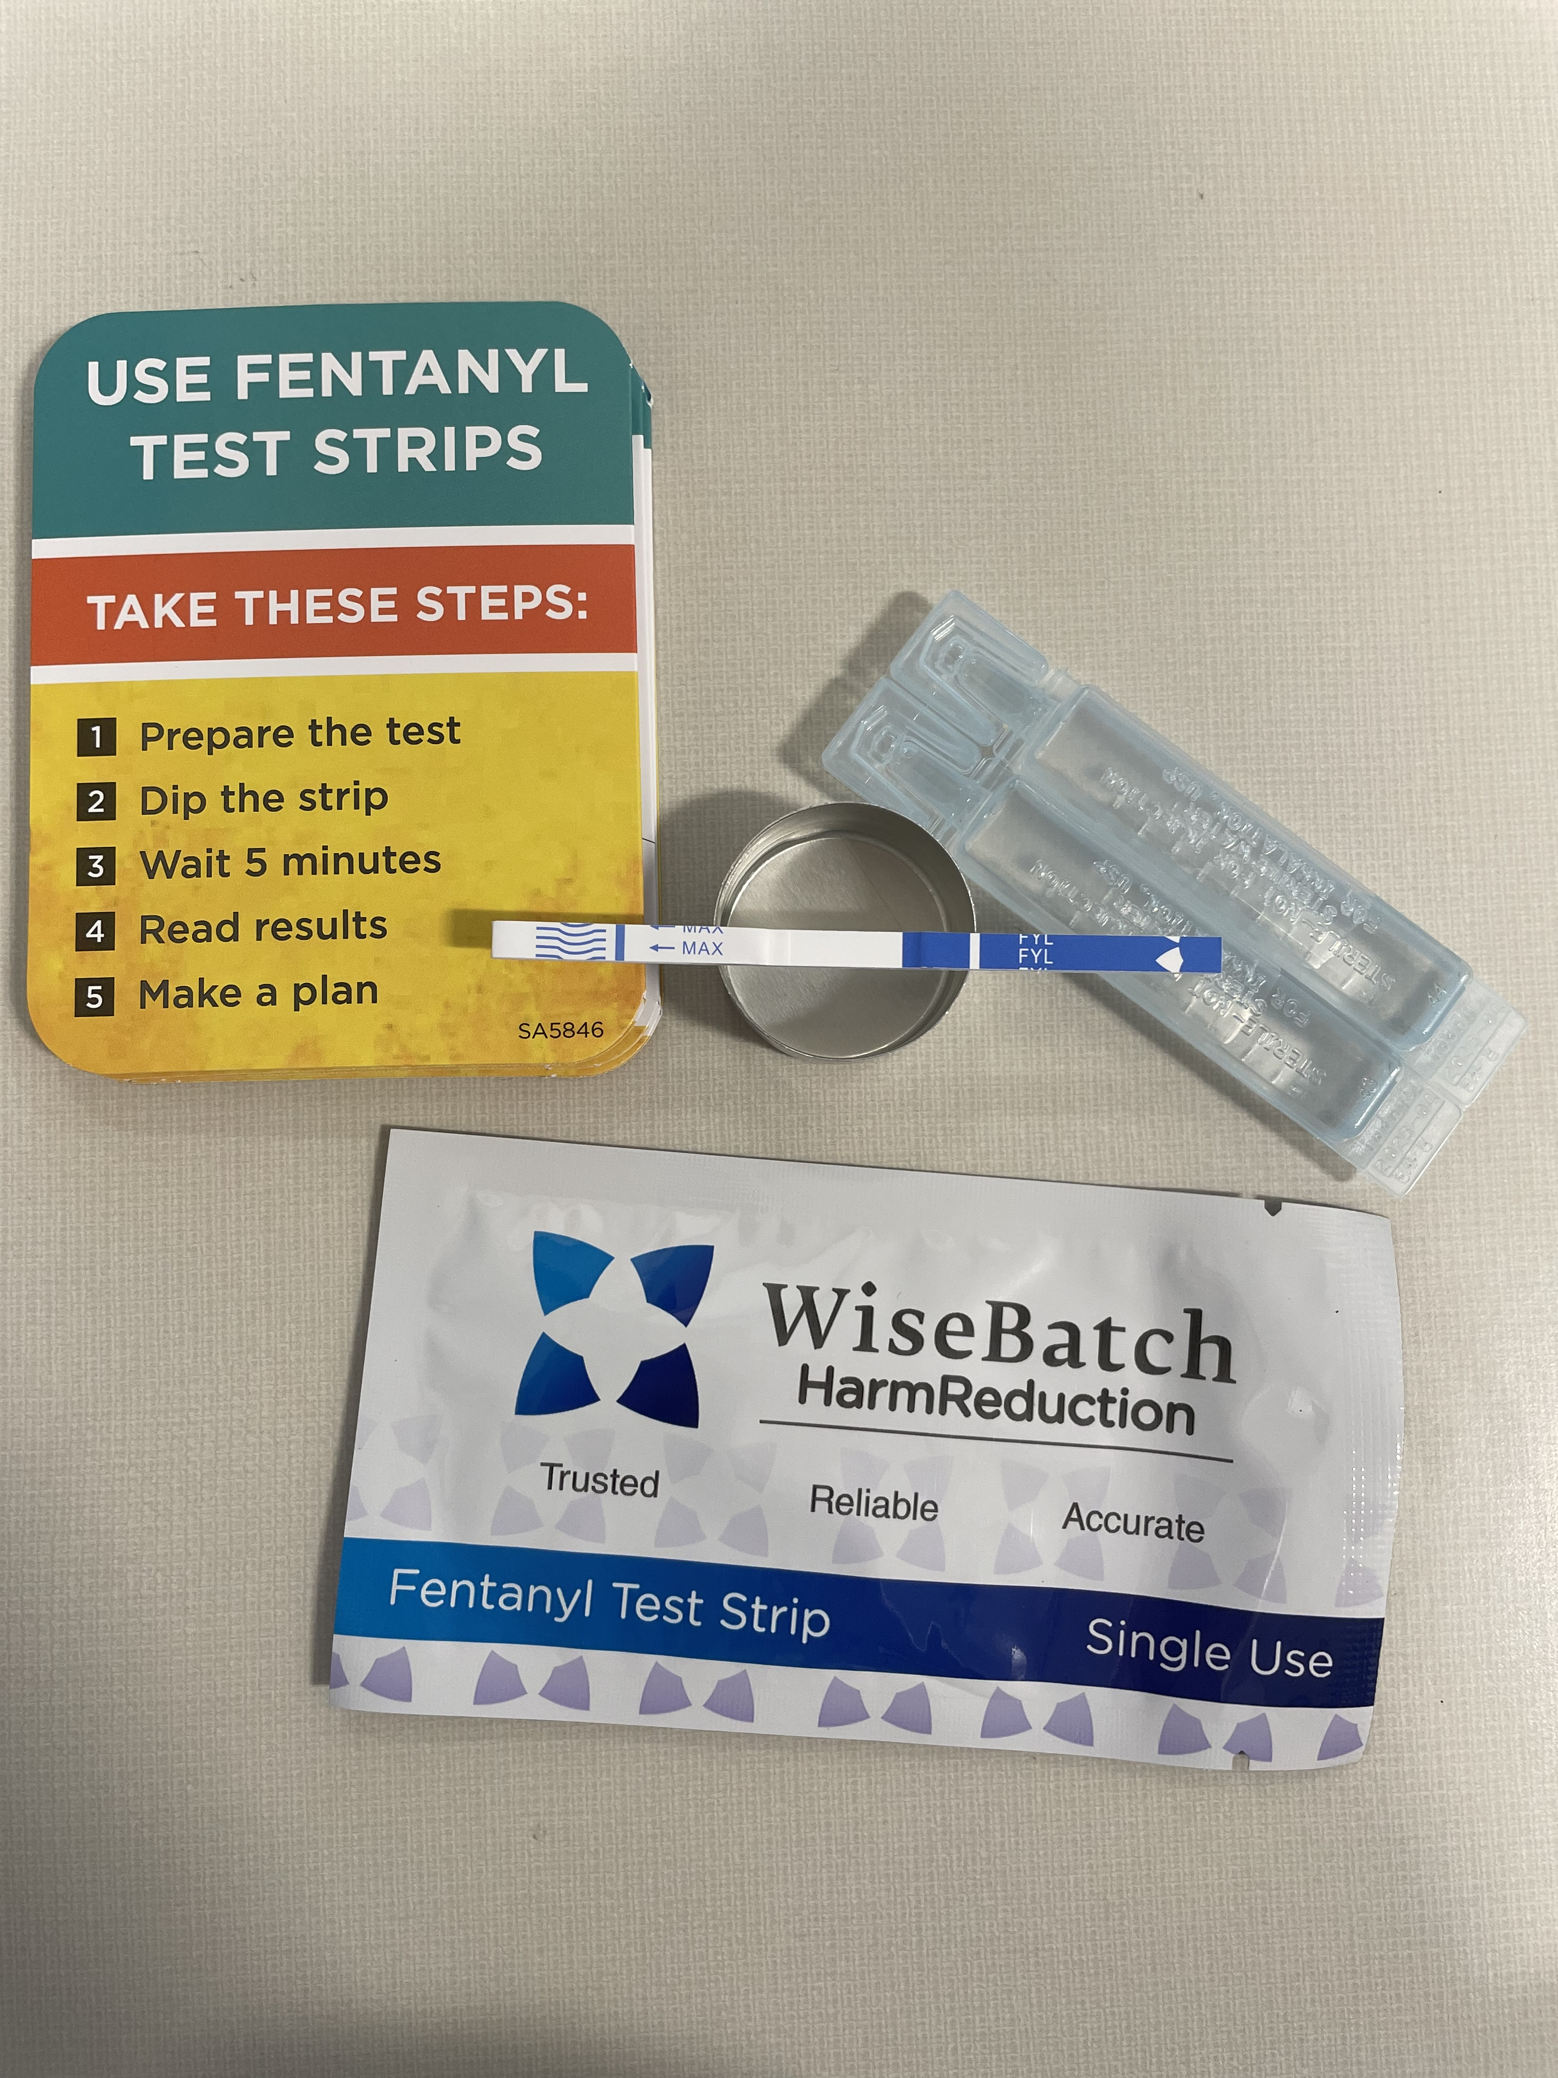
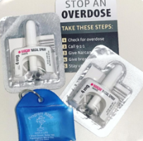
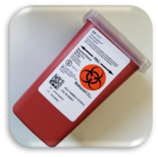
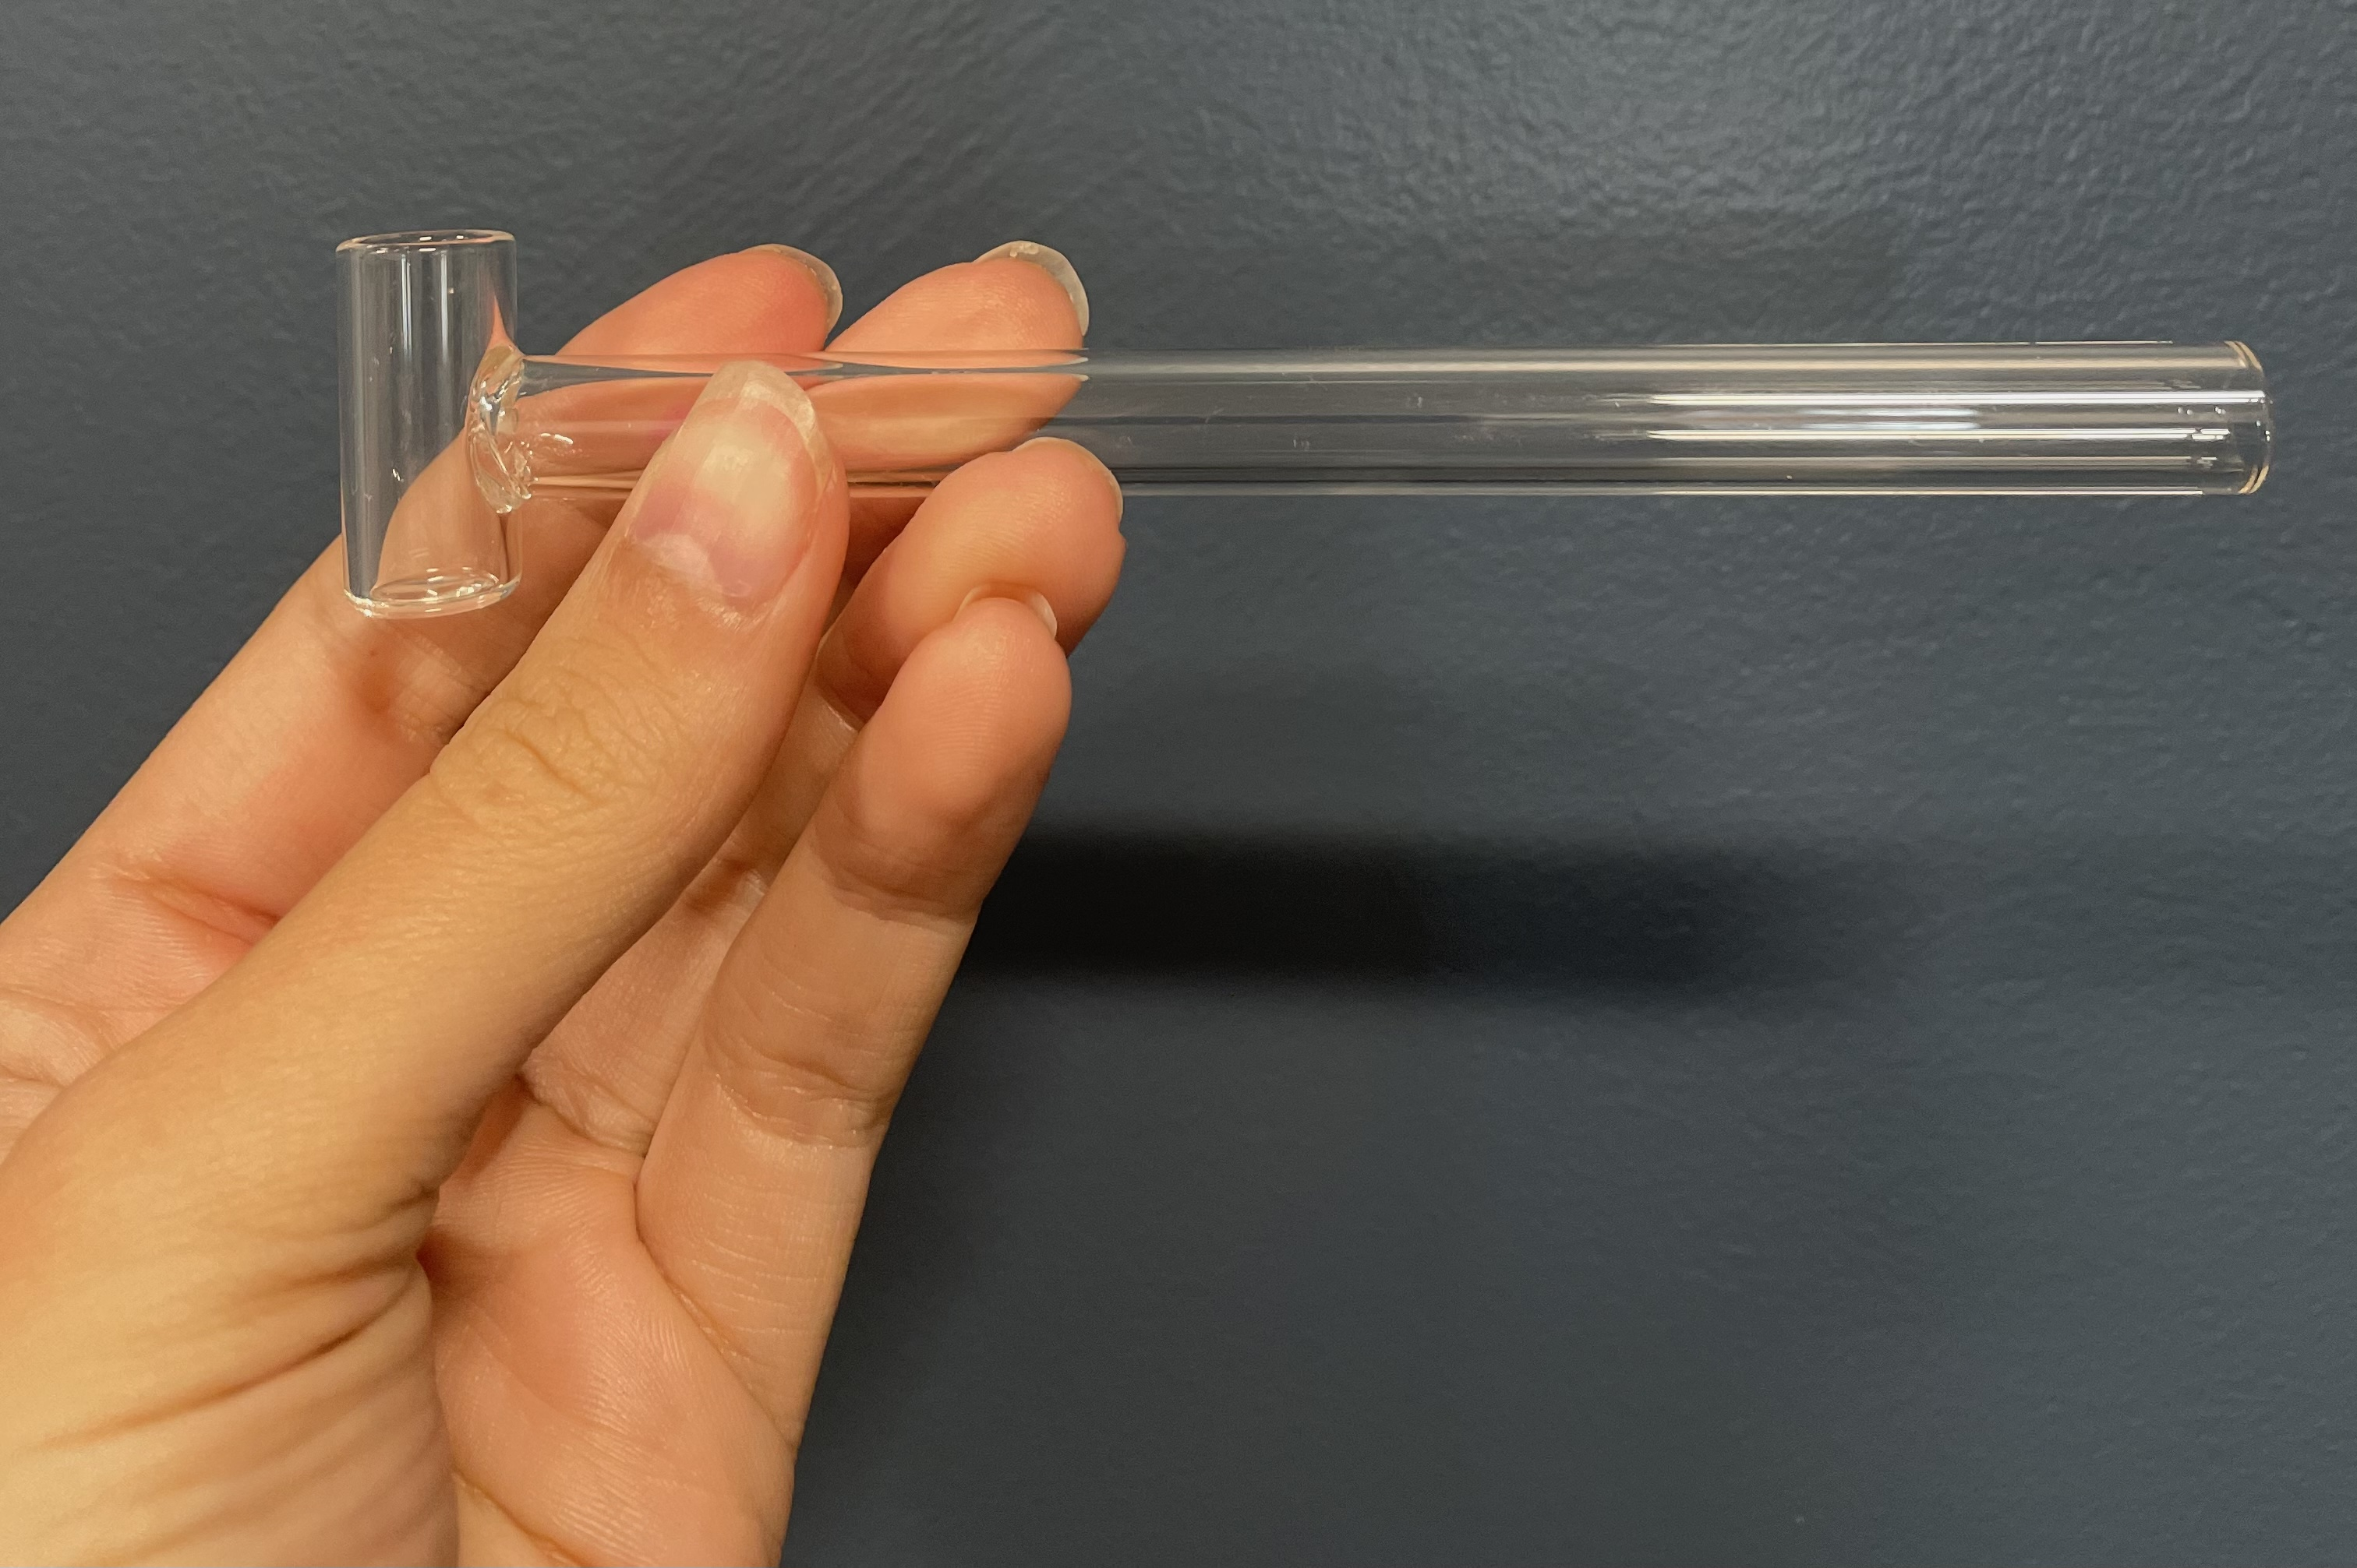
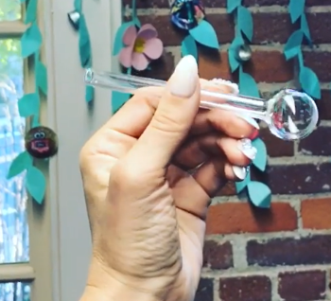
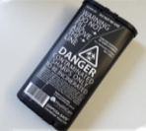
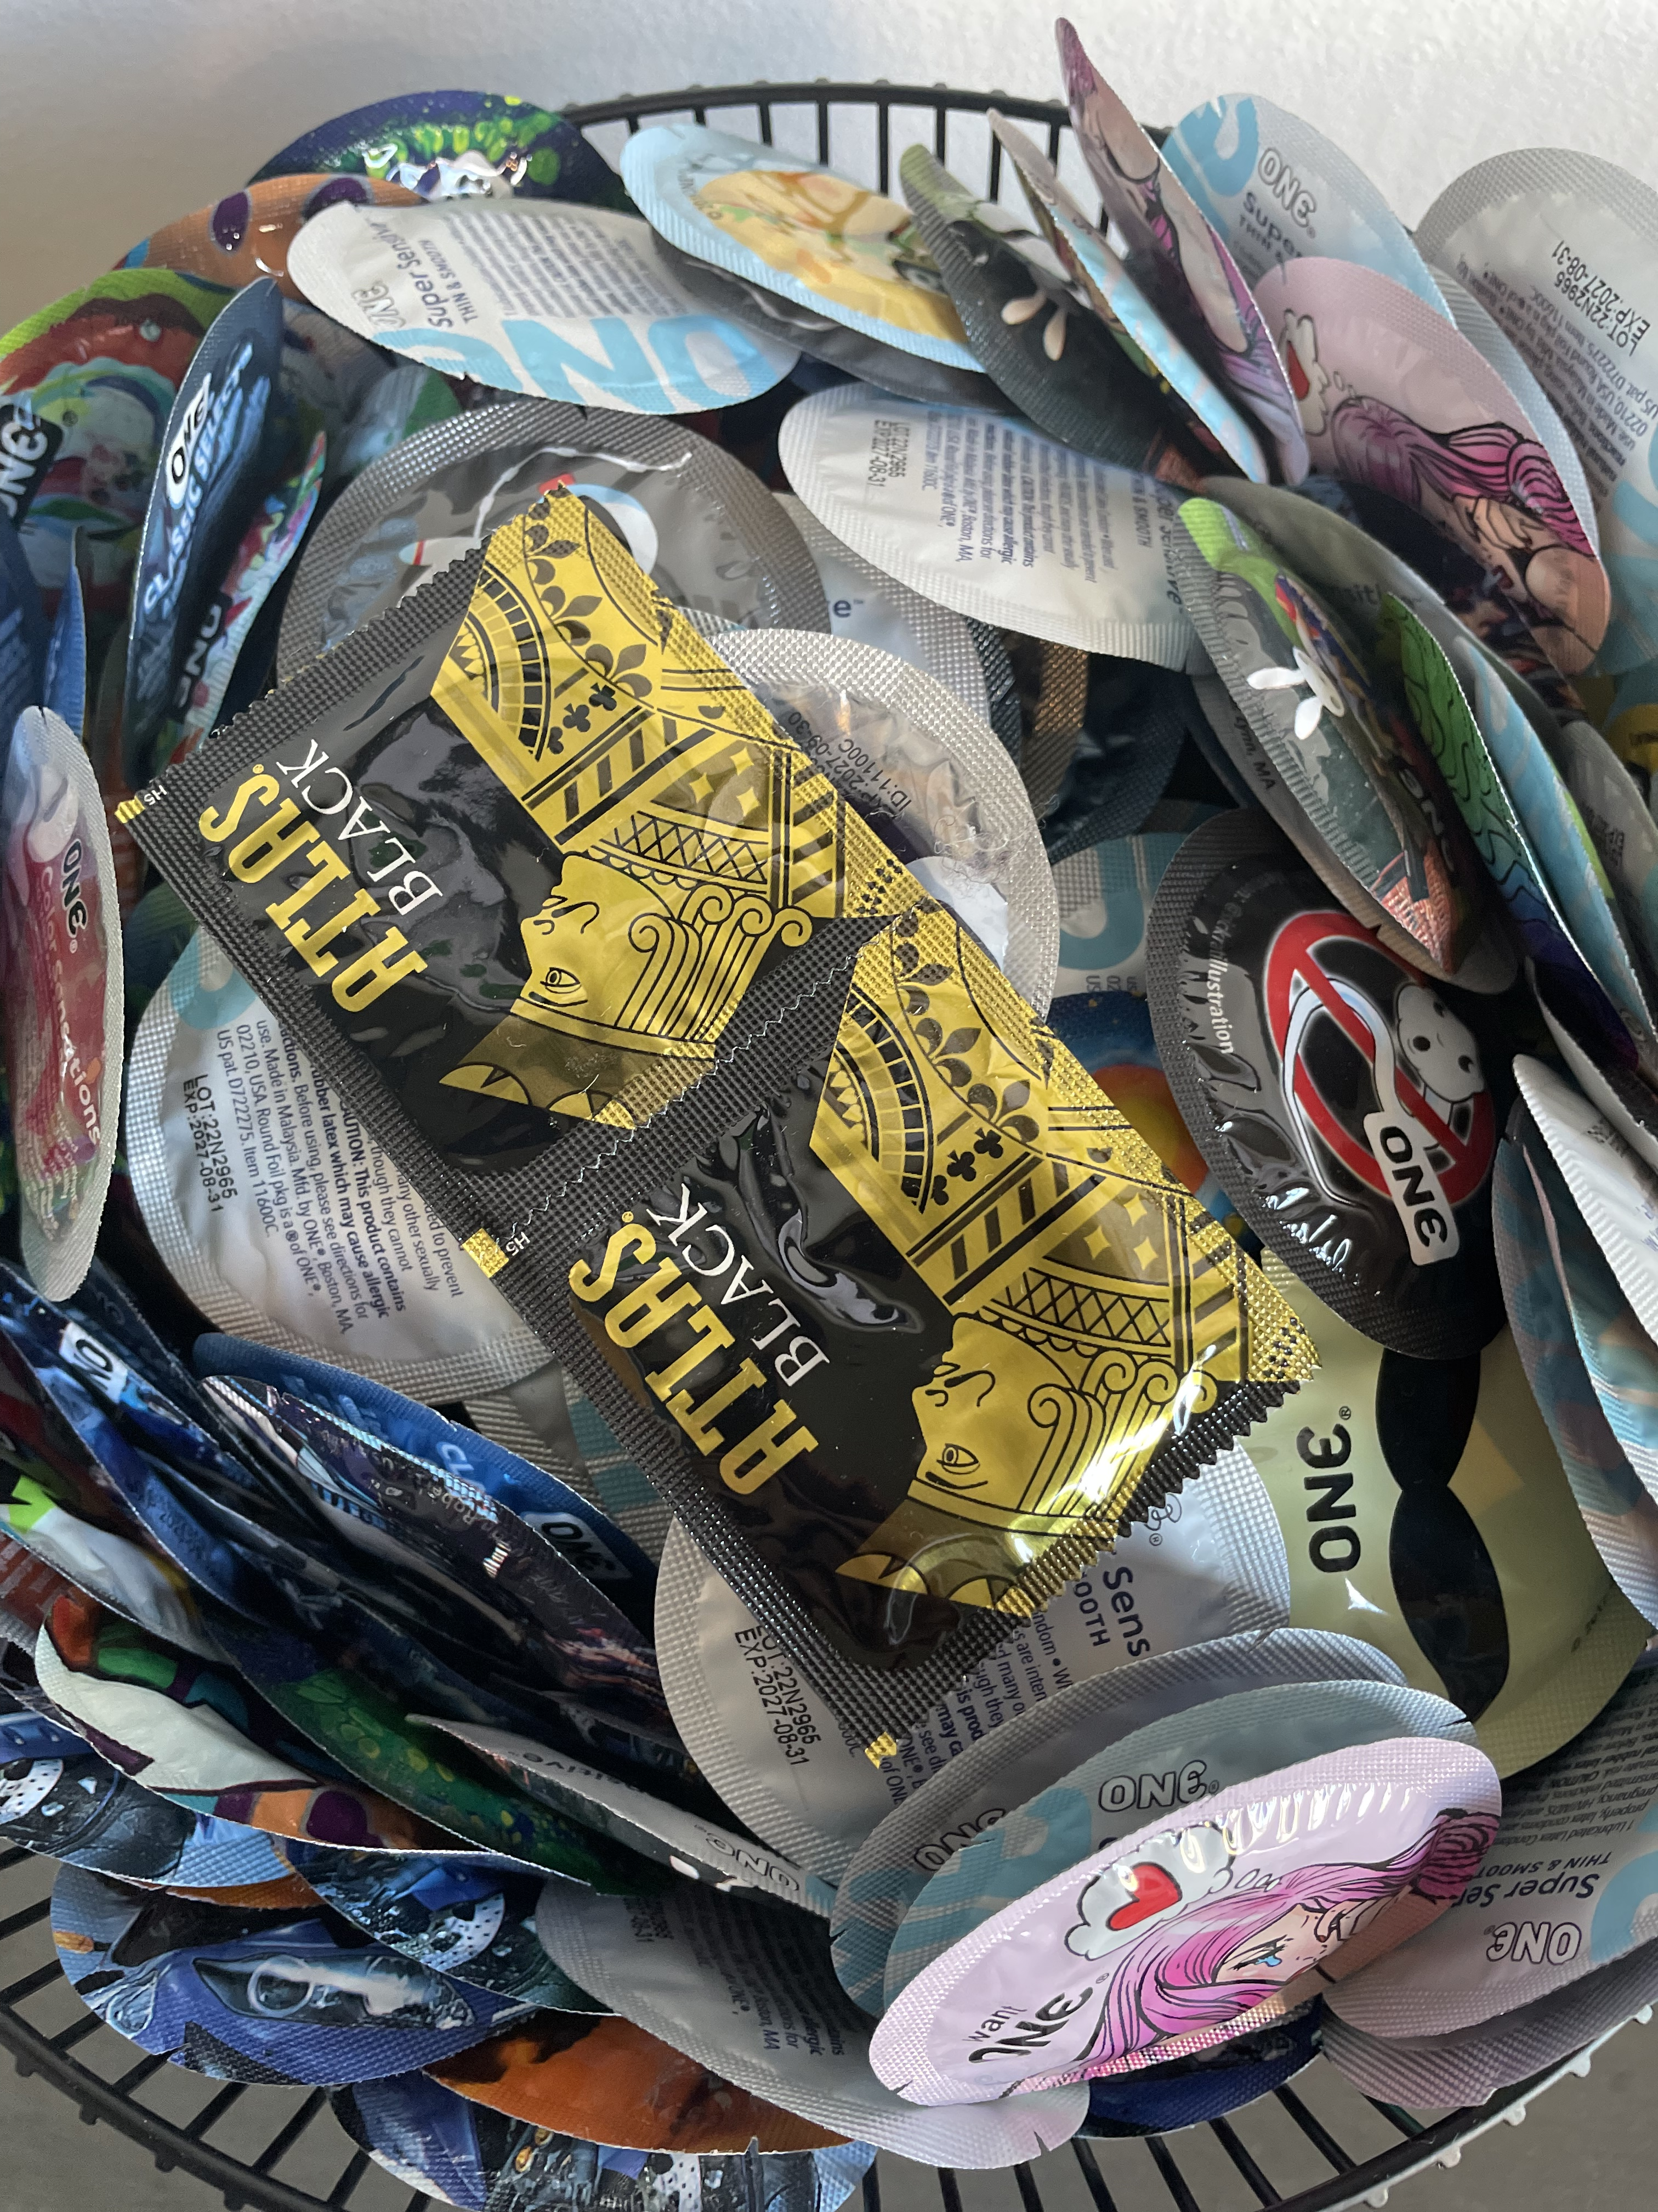
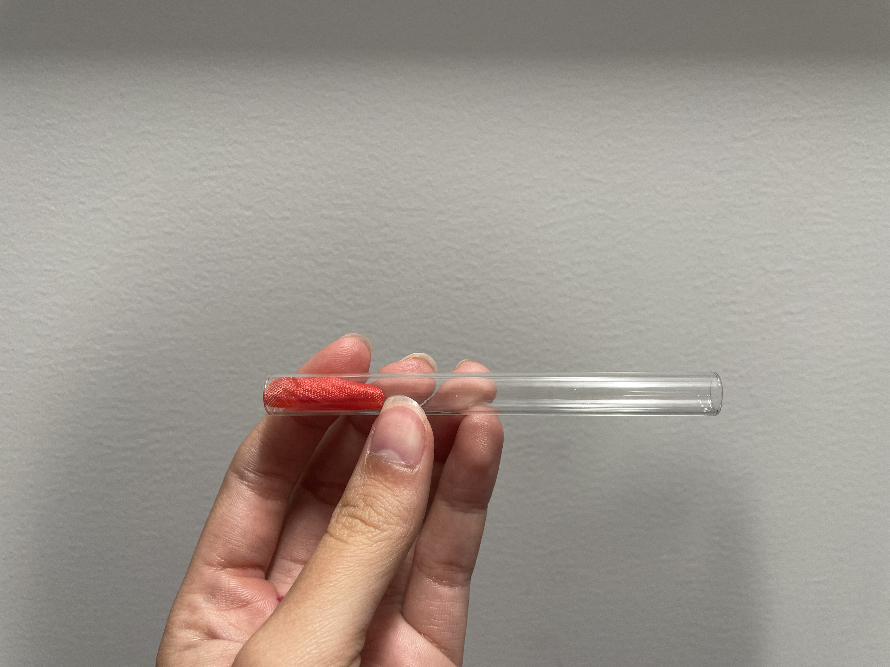

Slide 18
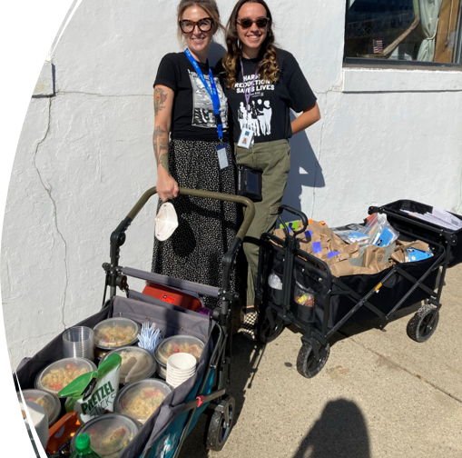
Why Do Outreach?
Outreach allows us to offer harm reduction and counseling services in low-barrier and non-traditional settings
Build new connections
Barriers to accessing services in a traditional office setting
  Transporation
  Internalized stigma
  Discomfort with new providers
  Discomfort interacting with other members of the drug using community
  Distrust based on past experiences providers

Slide 19

Non-Coercive Linkage to Treatment
Participation in accessing substance use treatment should be voluntary and self-ruled.
The use of threats and forcing PWUD to access substance use treatment does not improve outcomes and increases chances of human rights violations.

Slide 20

Language Matters
Feelings of stigmatization create barriers to accessing services and supports such as SSPs, MAT, and substance use treatment.
Stigmatizing language and behaviors can cause non-drug users to become fearful of PWUD and impact the way healthcare and social service providers provide care.

Slide 21
Approaches to Reduce Stigma
Use person-first language
Support the entire spectrum of substance use experiences
Create safe spaces for PWUD to share their experiences & expertise
Be willing to participate in trainings and conversations about the importance of using non-stigmatizing language for substance use and PWUD
SAY THIS | NOT THIS
Person who uses drugs Person living with substance use disorder | Addict Junkie Drug Abuser
Testing positive on a drug screen Testing negative on a drug screen | Dirty Clean
Person in recovery Substance-free | Clean

Slide 22
Enviromental Health Implications
Increase in community presence of discarded sharps
  Cities without SSPs are likely to find 8x as many discarded sharps compared to cities with SSPs (CDC)
Contamination of drug supply
  The street drug supply is unpredictable, increasing risk for overdose and skin wounds from xylazine use
  Access to drug checking services allows PWUD and people who sell drugs to make informed decisions about what substances they want to use and sell
  A 2019 study shows 89.5% of 334 PWUD in Baltimore, Providence, and Boston areas reported accessing drug checking services "makes them feel better about protecting themselves from overdose" (National Institute of Justice)
Lack of linkage to treatment and other supportive services

Slide 23
Enviromental Health Implications
Lack of adequate housing and shelter that embraces harm reduction
  Increases drug use in public spaces
There are environmental health factors that have a detrimental impact on PWUD in public spaces
  Lack of bathrooms/hygienic spaces, trash receptacles and adequate street lighting increases risk for overdose, wounds, bacterial and skin/soft tissue infections
Recovery and abstinence-only requirements, i.e. policies perpetuate stigma

Slide 24
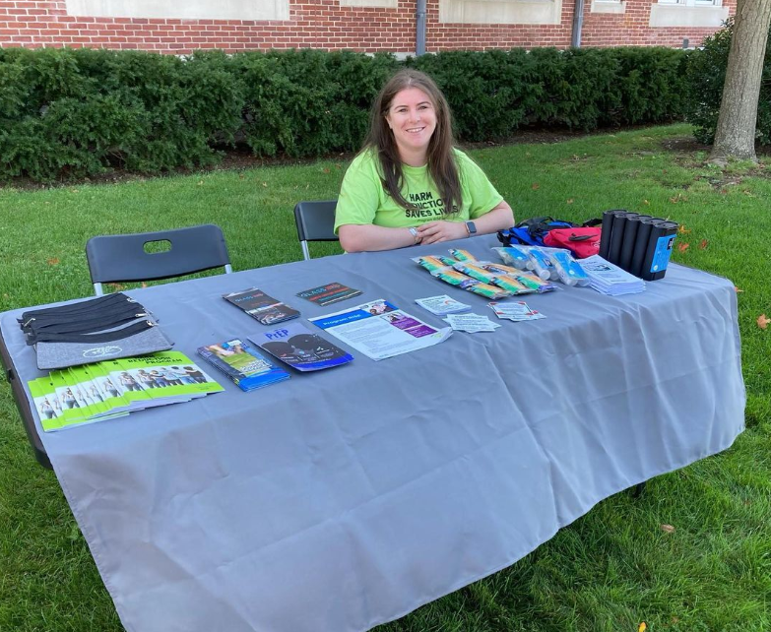
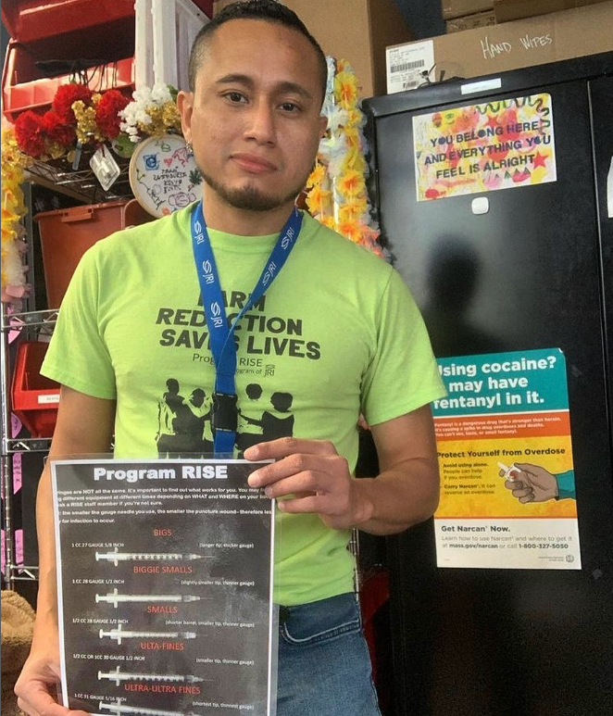
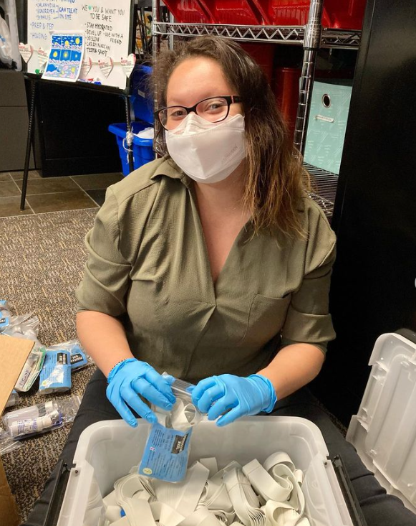
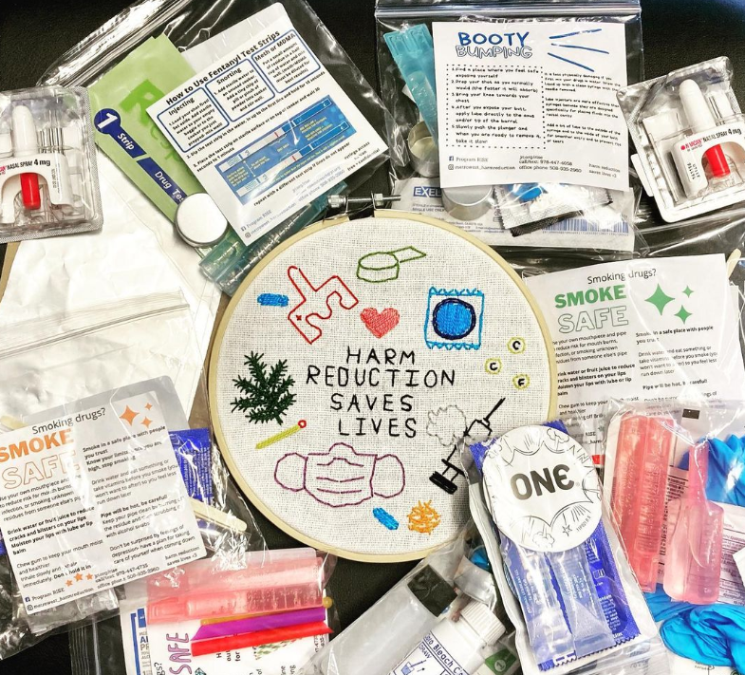
Our Staff in Action!

Slide 25
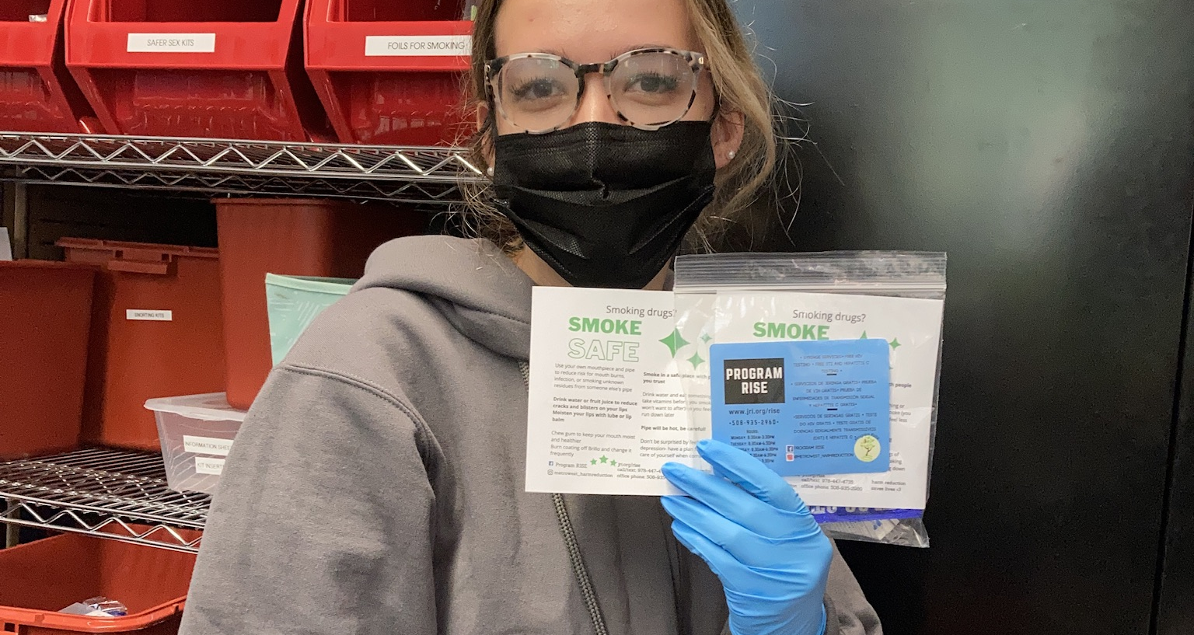
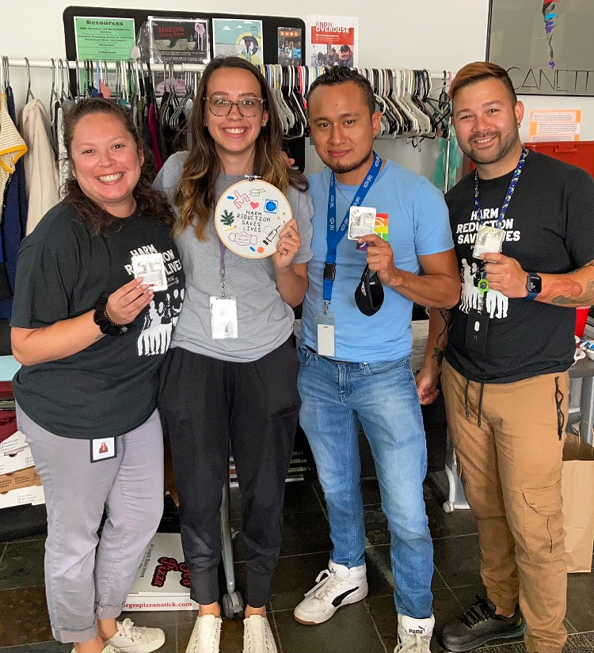
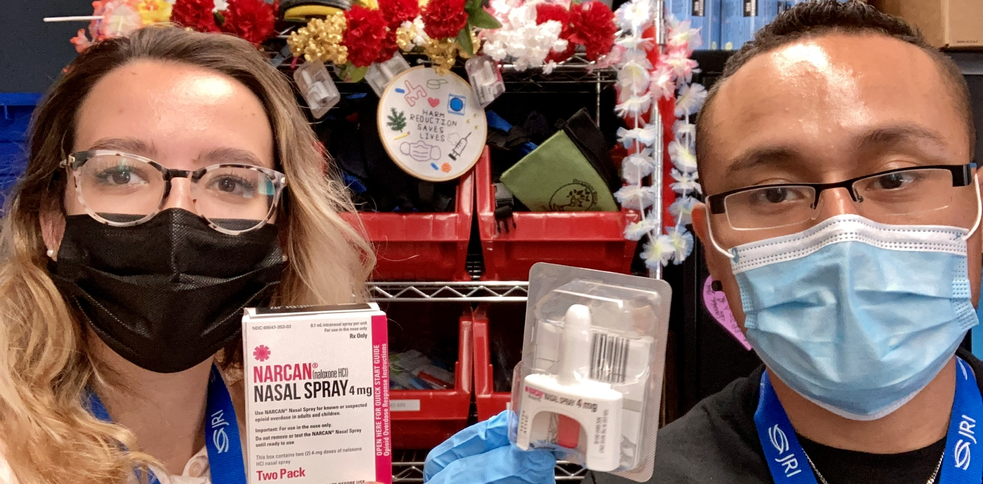

Slide 26
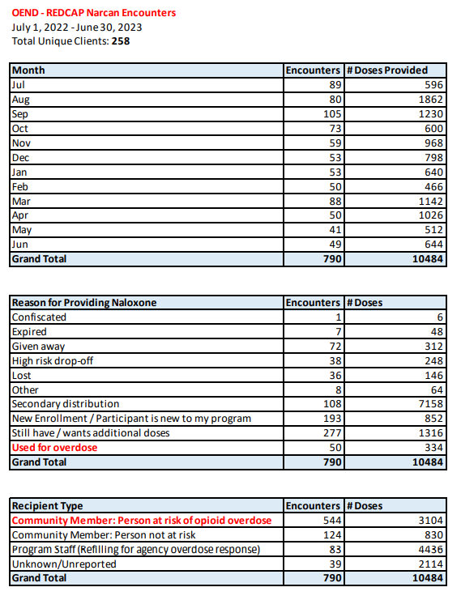
FY 2023 Opioid Education & Naloxone Distribution (OEND) Data (07/01/2022 – 06/30/2023)

Slide 27
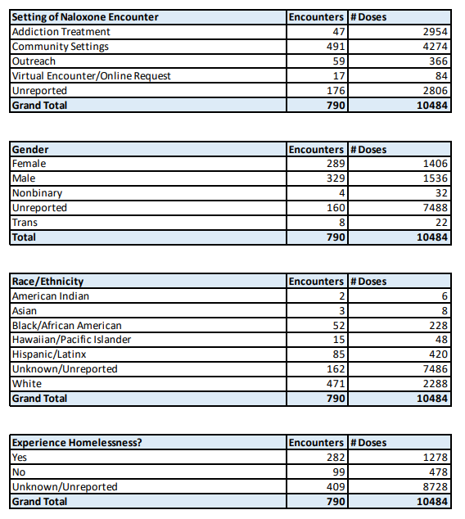
FY 2023 Opioid Education & Naloxone Distribution (OEND) Data (07/01/2022 – 06/30/2023)

Slide 28
FY 2023 Opioid Education & Naloxone Distribution (OEND) Data (07/01/2022 – 06/30/2023)

Slide 29
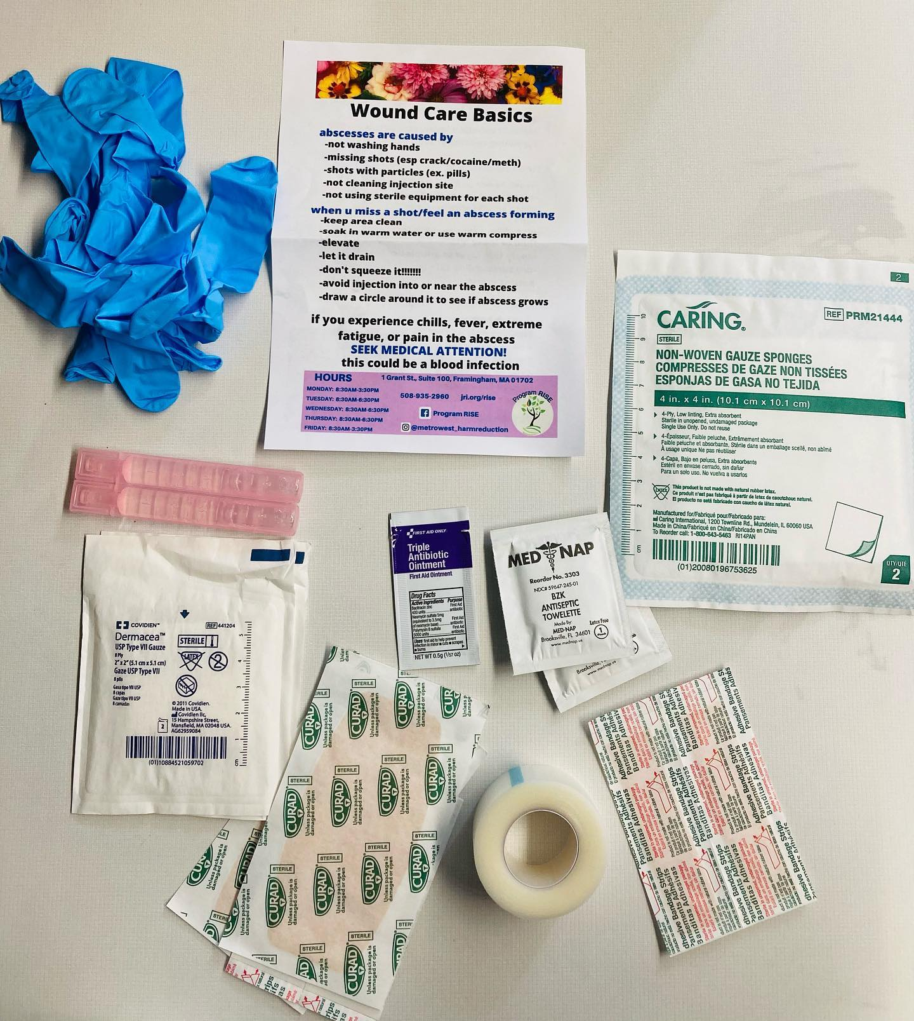
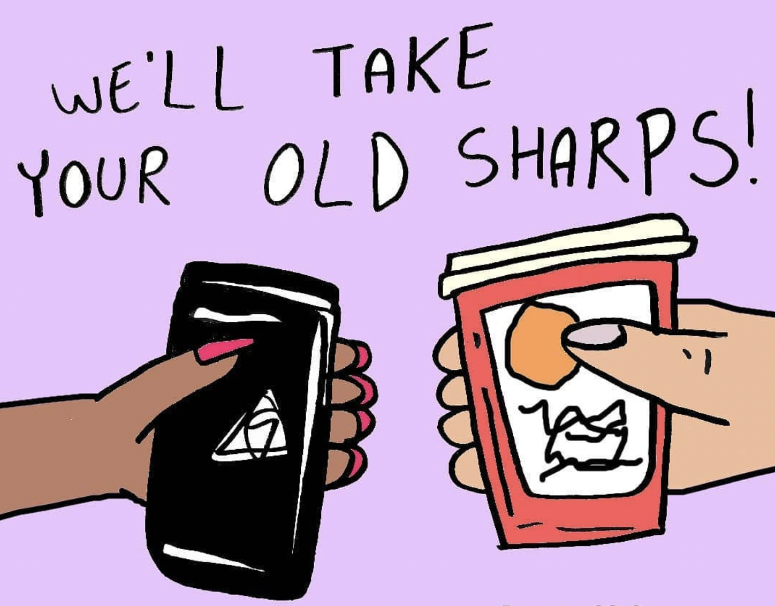
FY 2023 SSP Data (07/01/2022 – 06/30/2023)
Syringes Collected: 37,431
  Not including sharps kiosk in RISE waiting area
Syringes Distributed: 80,633
Return Rate
  ~46.4%
    Structural Barriers (e.g. distance to limited # of safe disposal locations)
    Stigma
Sharps Containers Distributed: 810
Wound Care Kits Distributed: 289
Fentanyl Test Strips Distributed: 390
Injection Alternatives: 4,630 Crack Kits Distributed

Slide 30

FY 2023 SSP Data (07/01/2022 – 06/30/2023)
Referrals
  HIV/HCV/Syphilis testing (56 sessions among PWID)
  HCV treatment (19 referred, 3 successfully treated at RISE so far!)
  Primary Care
  Detox & Medication Assisted Treatment (Spectrum, etc.)
  Shelter/Housing (SMOC, etc.)
Transportation Access
  Very limited in Metrowest
  Uber Health ($25k+ in FY23)

Slide 31
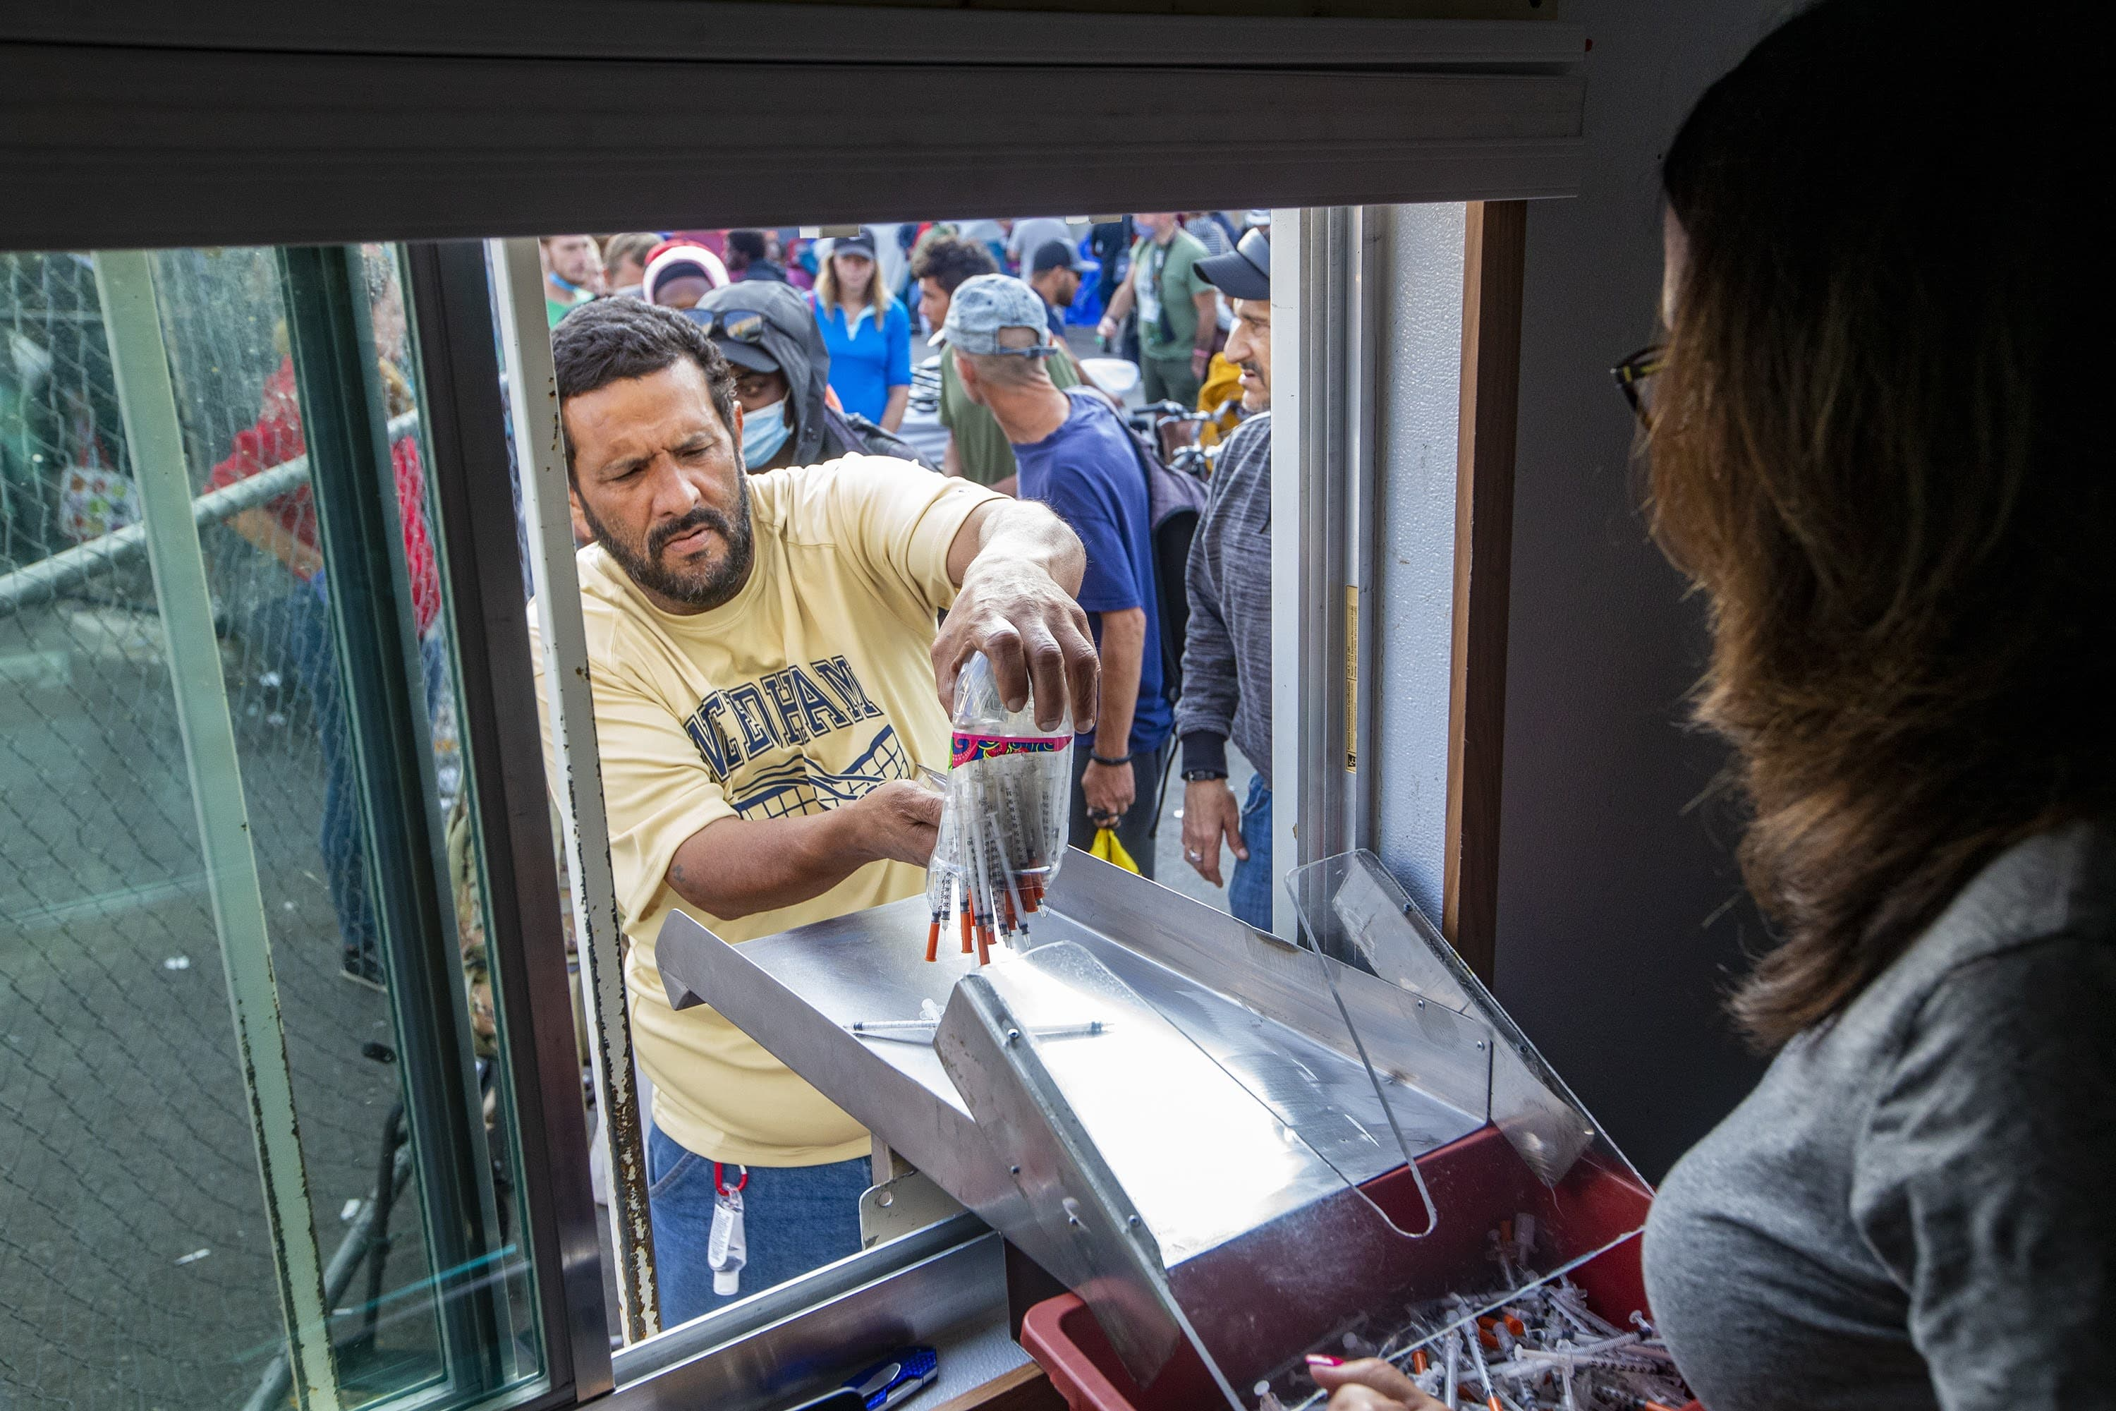
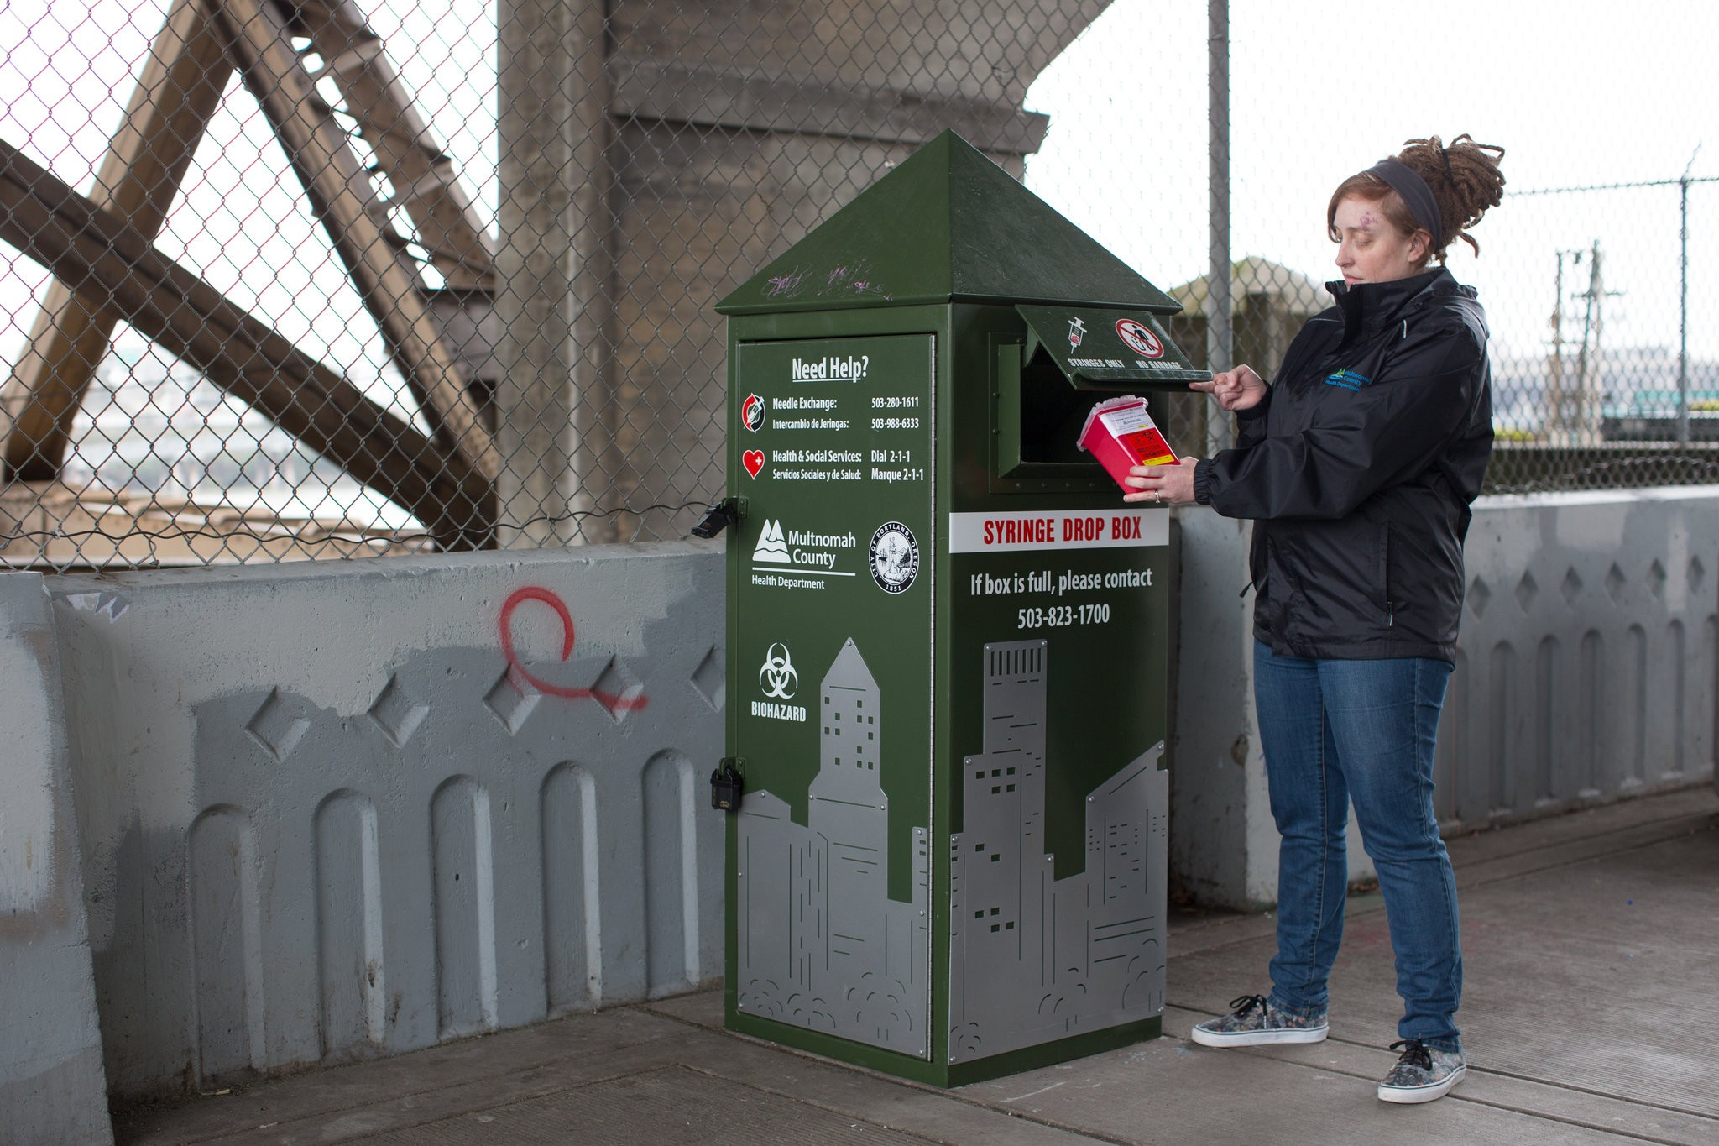
Areas for Improvement in Framingham/Metrowest MA
Identify a new physical location for RISE harm reduction services
More secure locations for safe syringe disposal downtown & in parks
Incentivize safer disposal (“buyback” program)
Increased street & community outreach
Greater community education & public health messaging
More affordable pathways to sustainable housing (Housing First model)
Harm reduction vending machines
All interventions support public & environmental health!

Slide 32

Questions?
Thank you!
Aron Thiim (he/él)
Interim Program Director RISE/JRI Health
athiim@jri.org
508-935-2960
Kelsey Rodrigues (she/her)
Harm Reduction Specialist RISE/JRI Health
kmrodrigues@jri.org
508-935-2960

