Slide 1
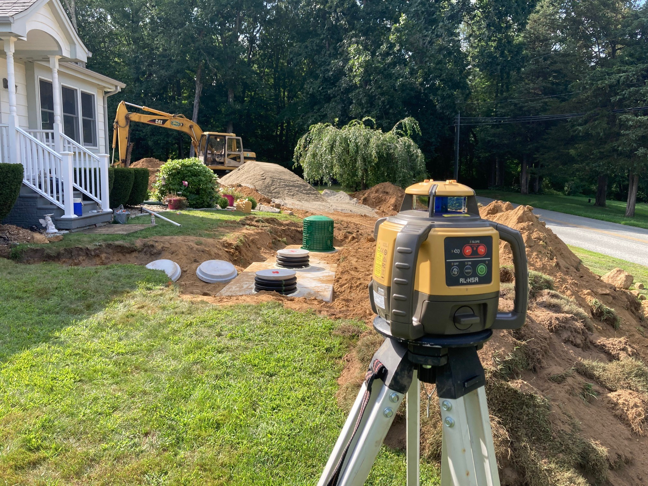

Why We Inspect Septic Systems

Slide 2
Regulatory and practical requirements for inspecting newly constructed subsurface sewage disposal systems in Connecticut
_____________________________________
Jeff Polhemus, RS - Instructor/President
Environmental Health Institute of Connecticut
September 20,2023

Slide 3
Septic System Inspectors in CT
What are the regulatory requirements for septic system inspections in Connecticut?
What are the goals and objectives of septic system inspections performed by certified public health officials in Connecticut?
What skills must an inspector possess to conduct effective inspections?
What training is available for public health officials inspecting septic systems in Connecticut?

Slide 4
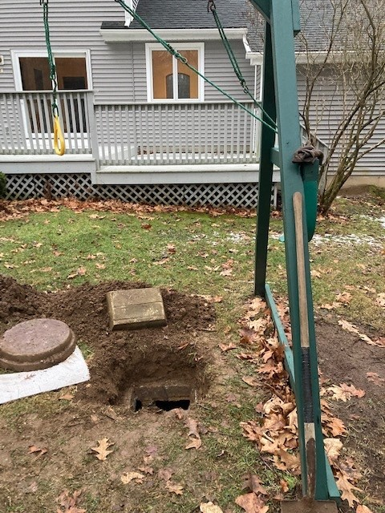
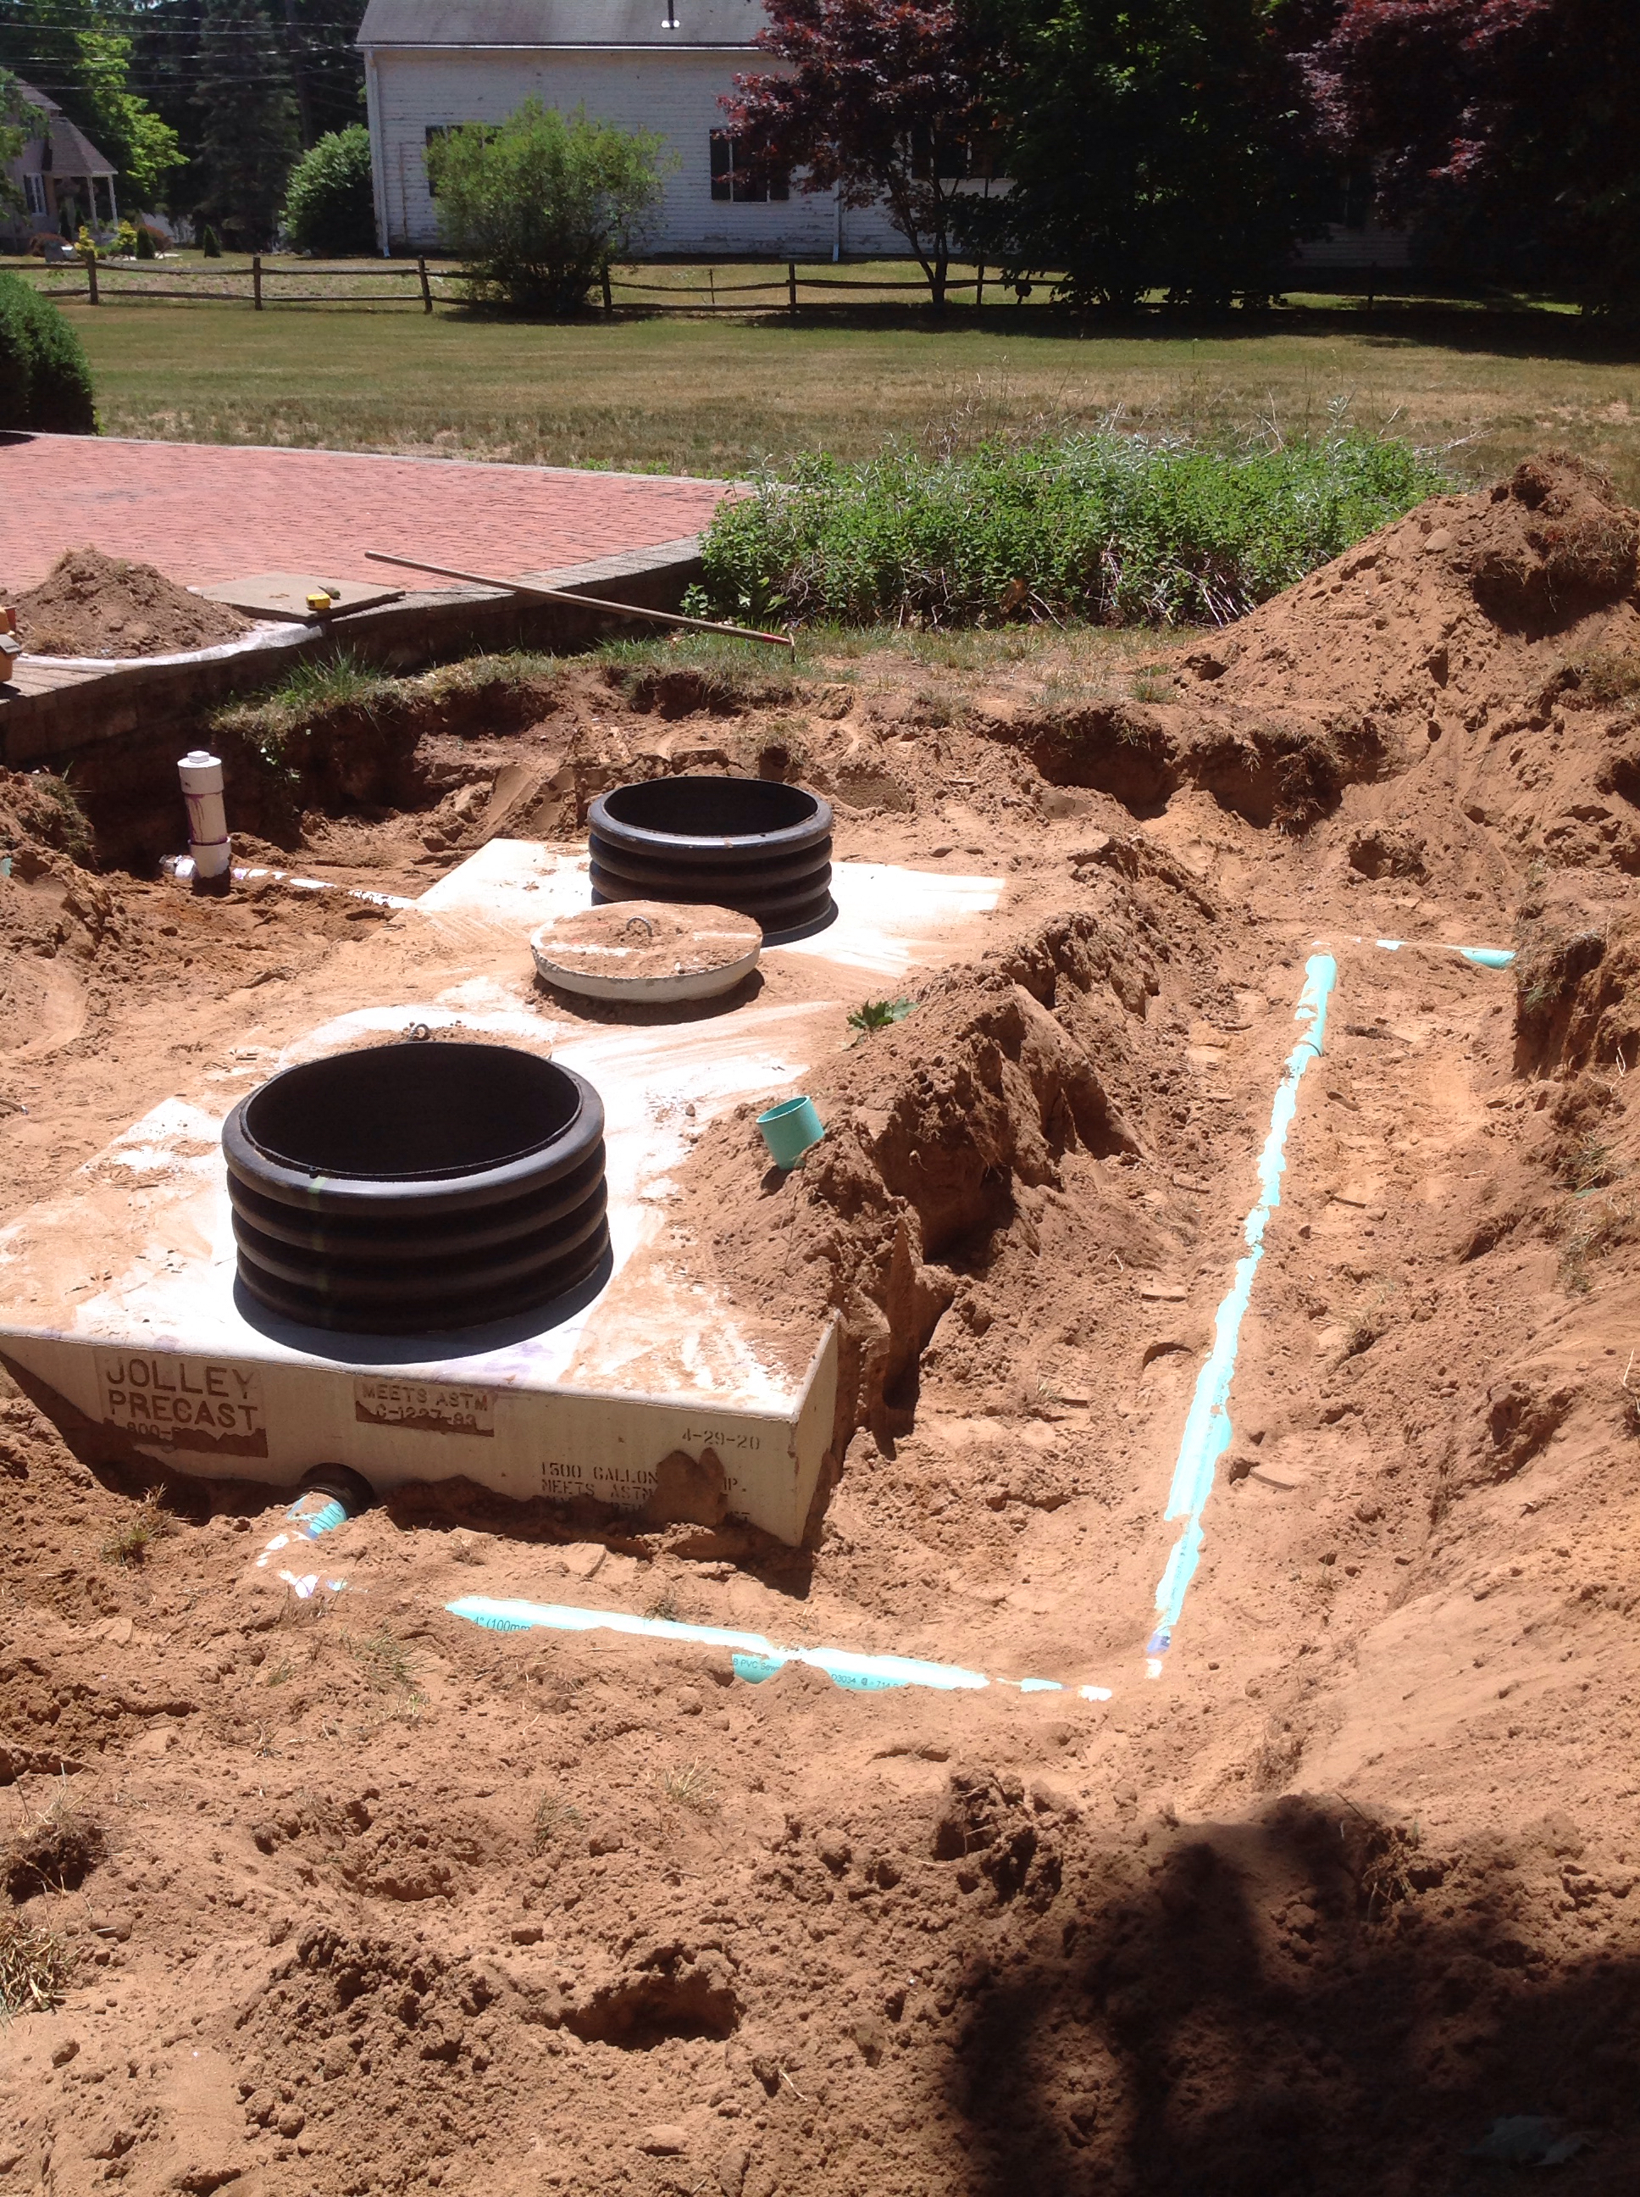
Septic Systems Requiring Inspections in CT:
Inspections required for all newly constructed, altered, repaired or extended septic systems
Inspections are not required for existing septic systems
(Real estate sales inspections are not regulated)

Slide 5
The Rule Book

Slide 6
CONNECTICUT PUBLIC HEALTH CODE B103 REGULATIONS
The local director of health shall: (A) Assure the accuracy of the findings of soil tests and deep observation pits.
Upon determination that the subsurface sewage disposal system has been designed in compliance with the requirements of Section 19-13-B103d of these regulations, the local director of health shall issue an approval to construct.
Inspection. (1) The local director of health shall inspect all subsurface sewage disposal systems for compliance with Subsection 19-13-B103d and the approved plans for construction prior to covering and at such other times as deemed necessary. – PHC Sec. 19-13-B103e. (g)

Slide 7
Septic System Construction Goals :
System must comply with Codes and Technical Standards.
System must comply with the approved design plan.
System must “provide for the preservation and improvement of public health.” - CT PHC Statement of Purpose.
System must function mechanically, without failure – day after day – for years and years.
The Septic System Inspection Goals are to verify that the Construction Goals are met.

Slide 8
Septic System Inspection Objectives
Confirm proper materials and components were used – per code and approved plan.
Component sizes, manufacturer’s specifications, material specifications
Confirm proper arrangement of component parts.
Tight fittings and seals, pipe slopes, stable and level structures, pipe bedding
Pumps, float switches, safety devices, etc.
Confirm proper component location and elevation.
Vertical and horizontal separating distances.
Create a clear record of the inspection.
Ensure and document that any construction errors are corrected.

Slide 9
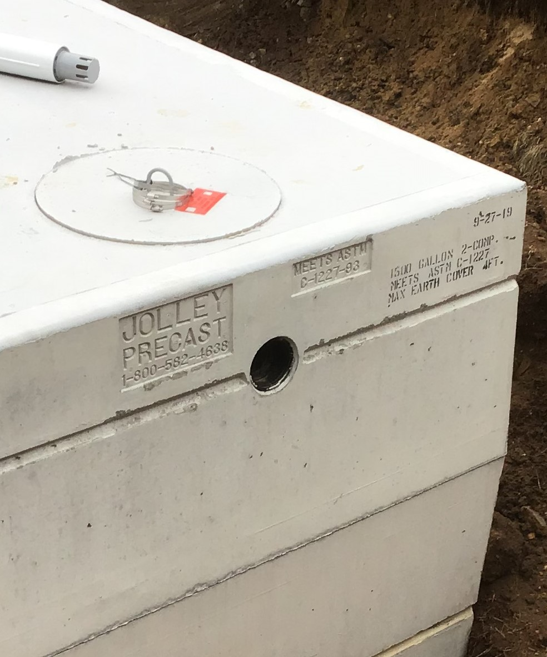
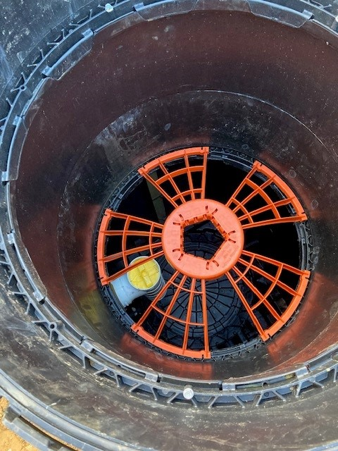
Component verification

Slide 10
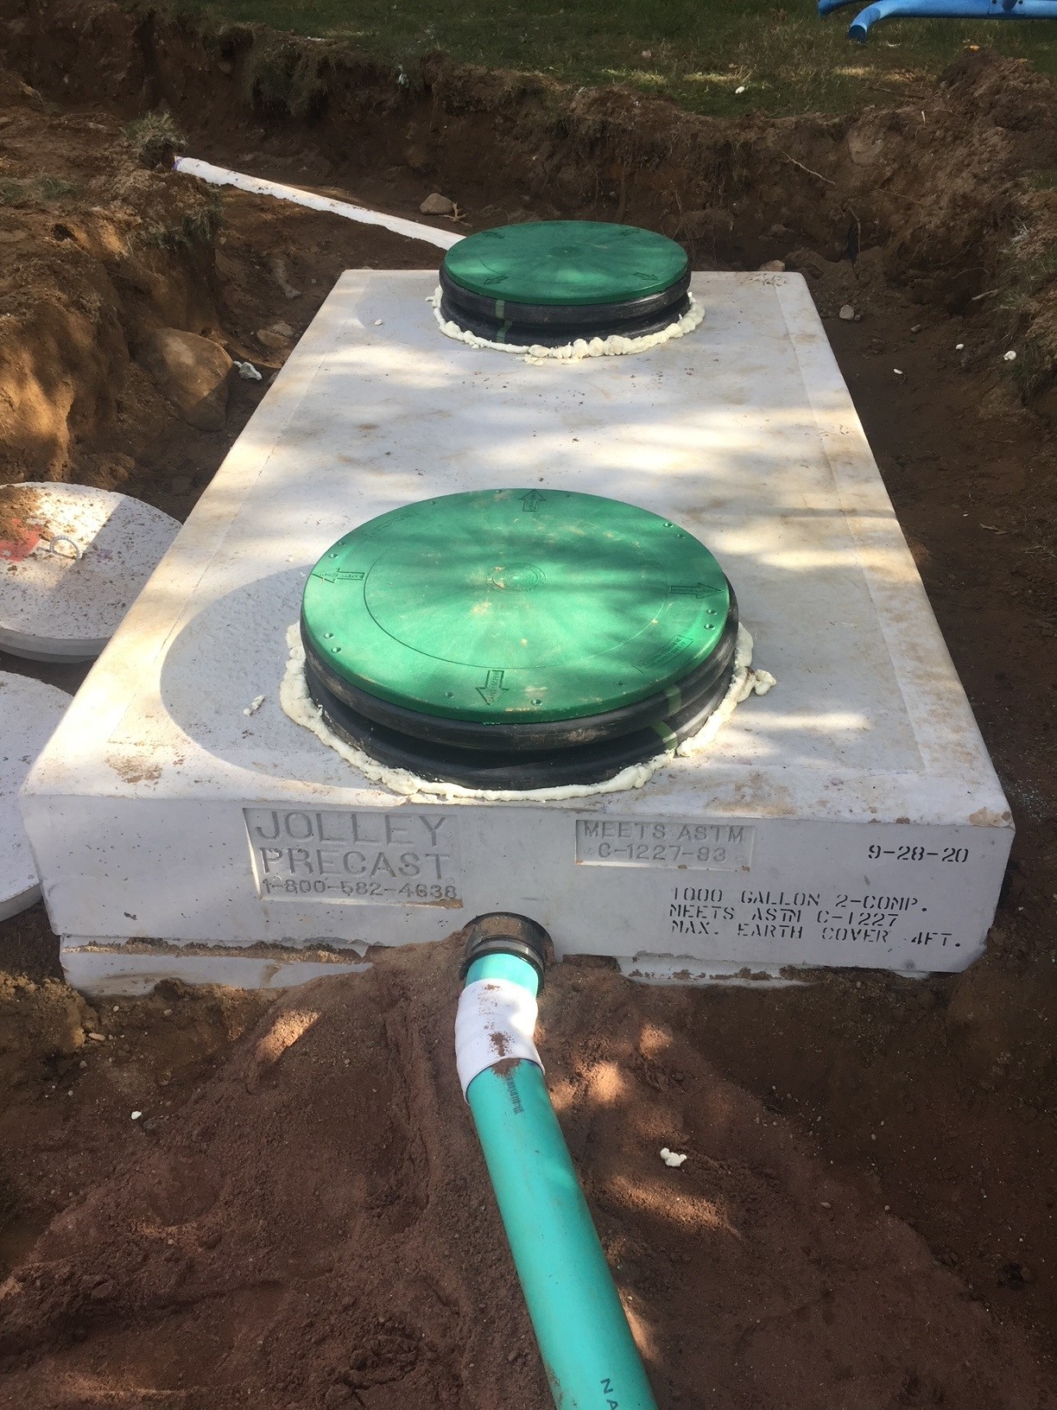
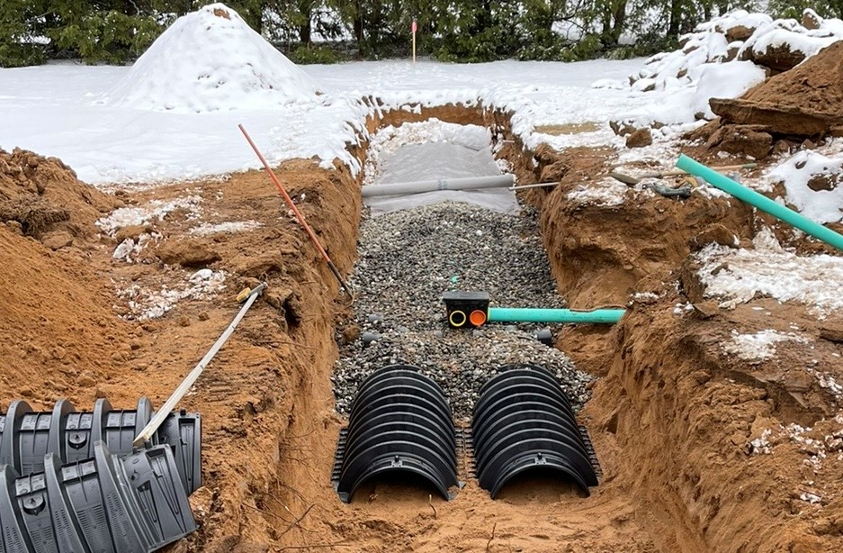
Arrangement of Component Parts

Slide 11
Critical Inspector Skills
Knowledge of Codes and Technical Standards
Organization and Preparation
Soils evaluation
Design plan interpretation
Vertical measurements and calculations
Understanding the relationship between soil conditions, the system design and the constructed system
Product identification
Use of inspection tools
Communication

Slide 12
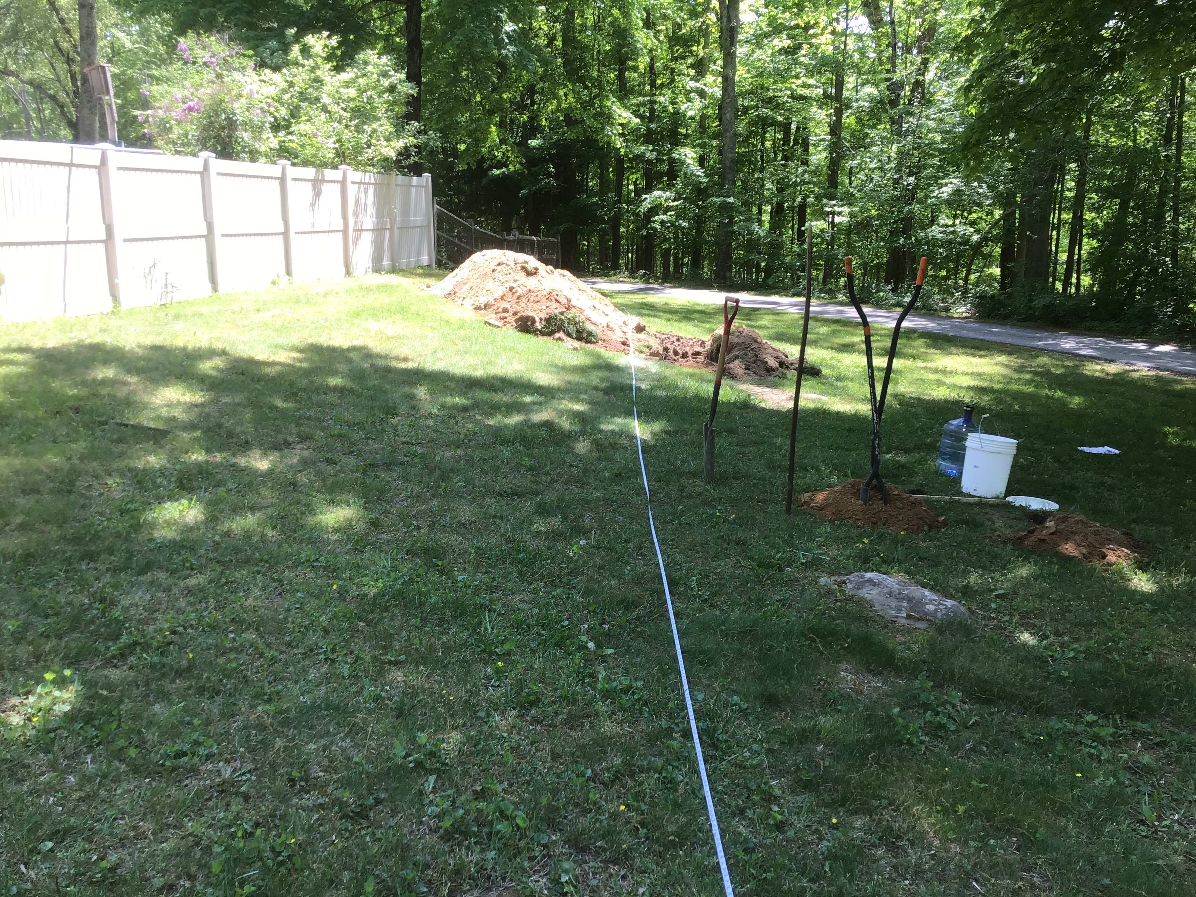
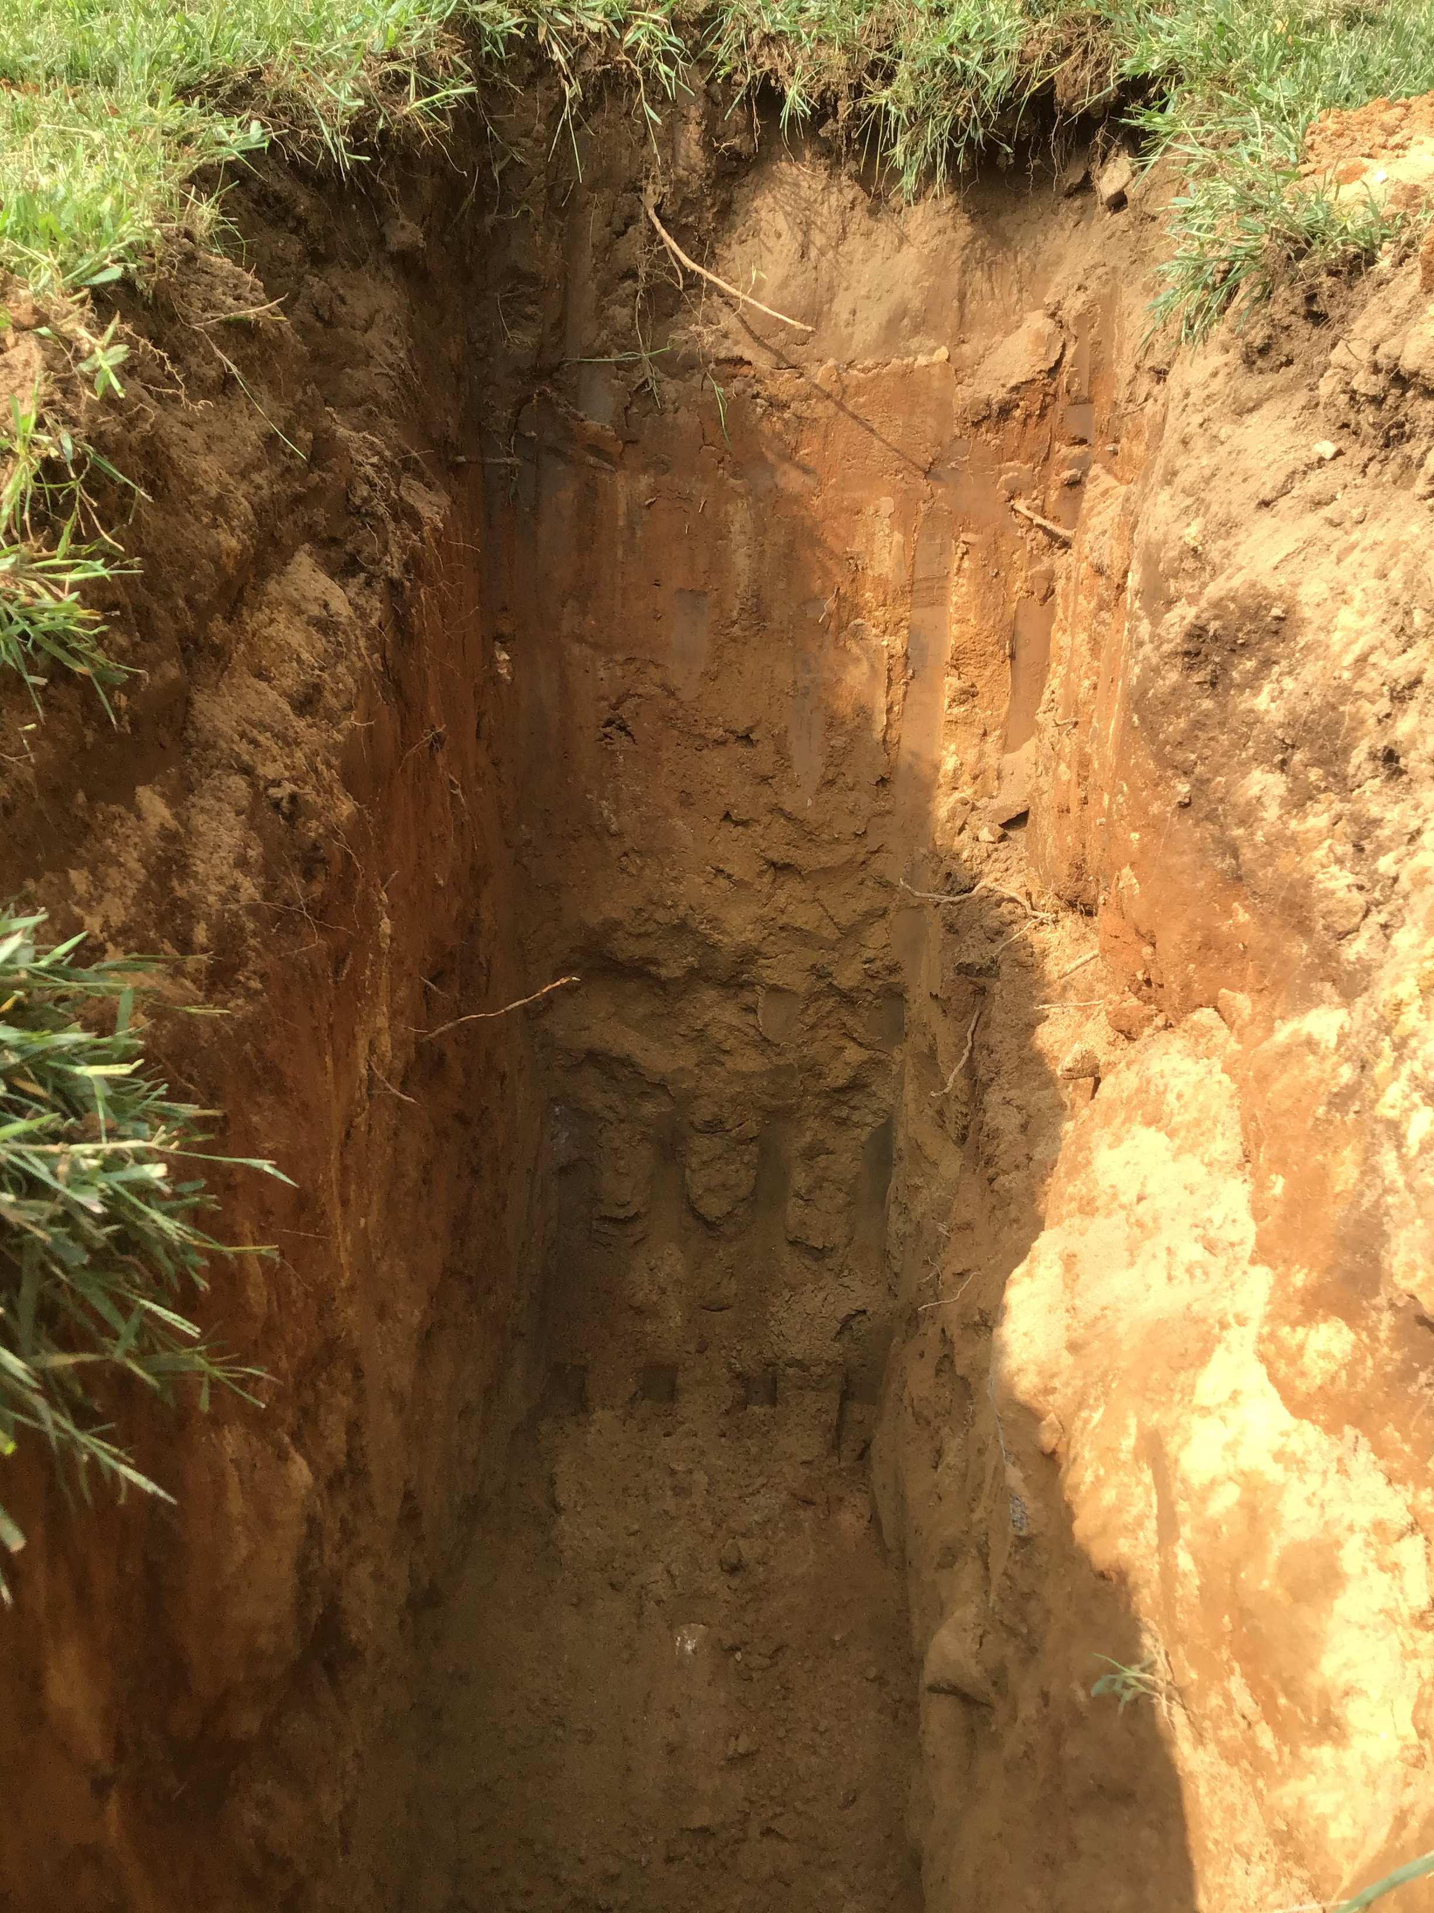
Soils Evaluation

Slide 13
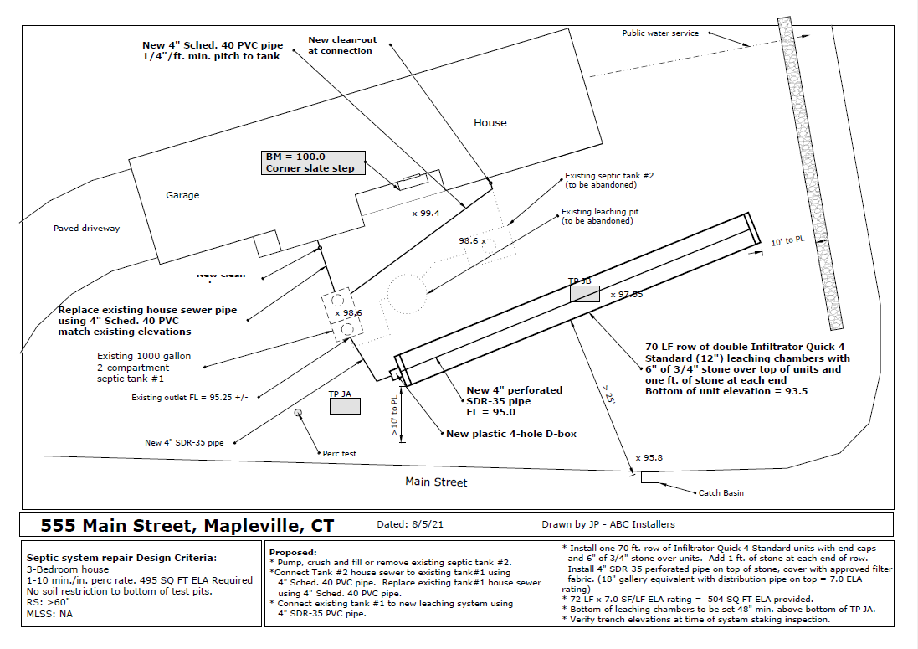
Design Plan Interpretation

Slide 14
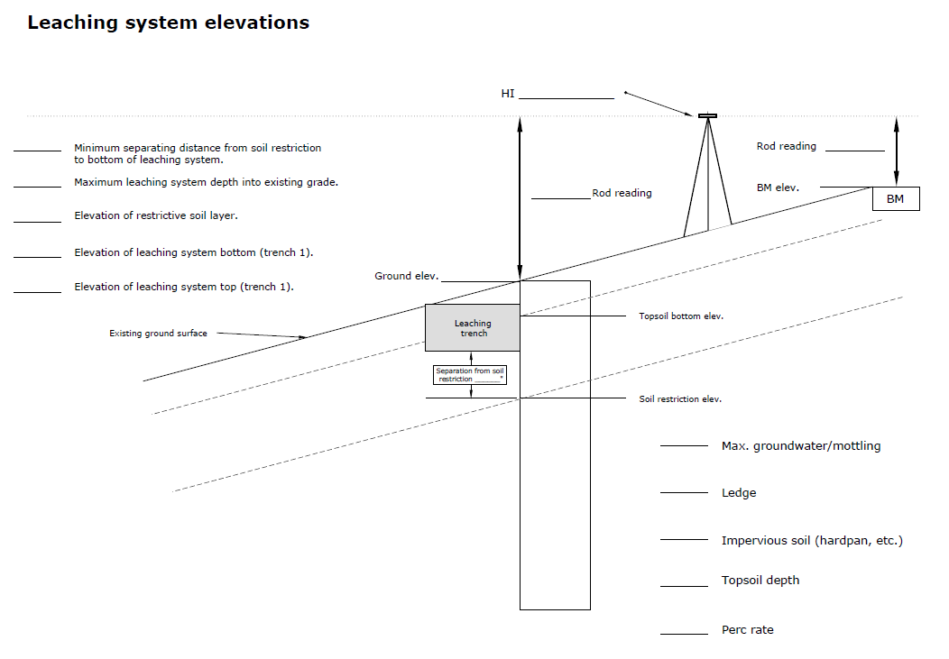
Vertical Measurements and Calculations

Slide 15
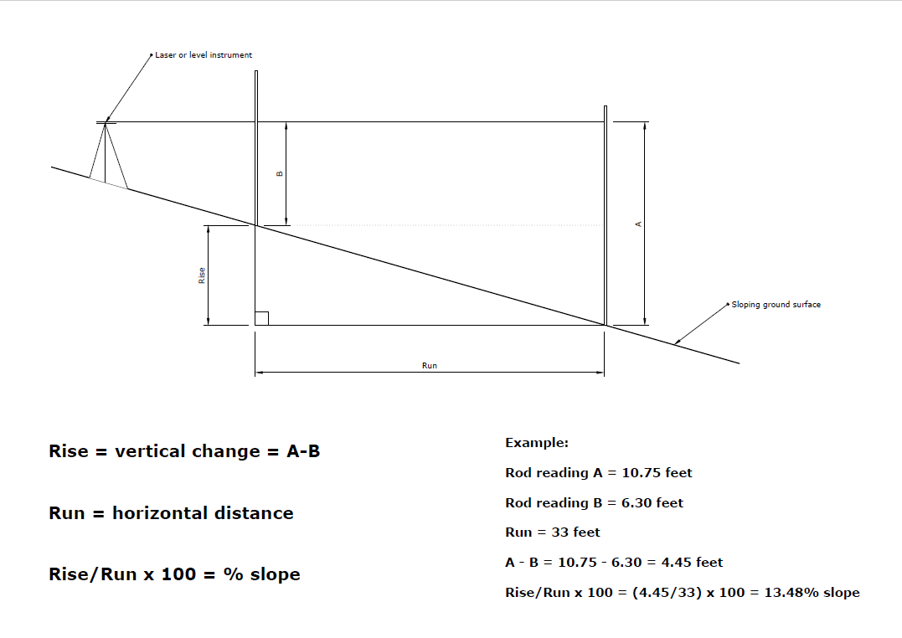
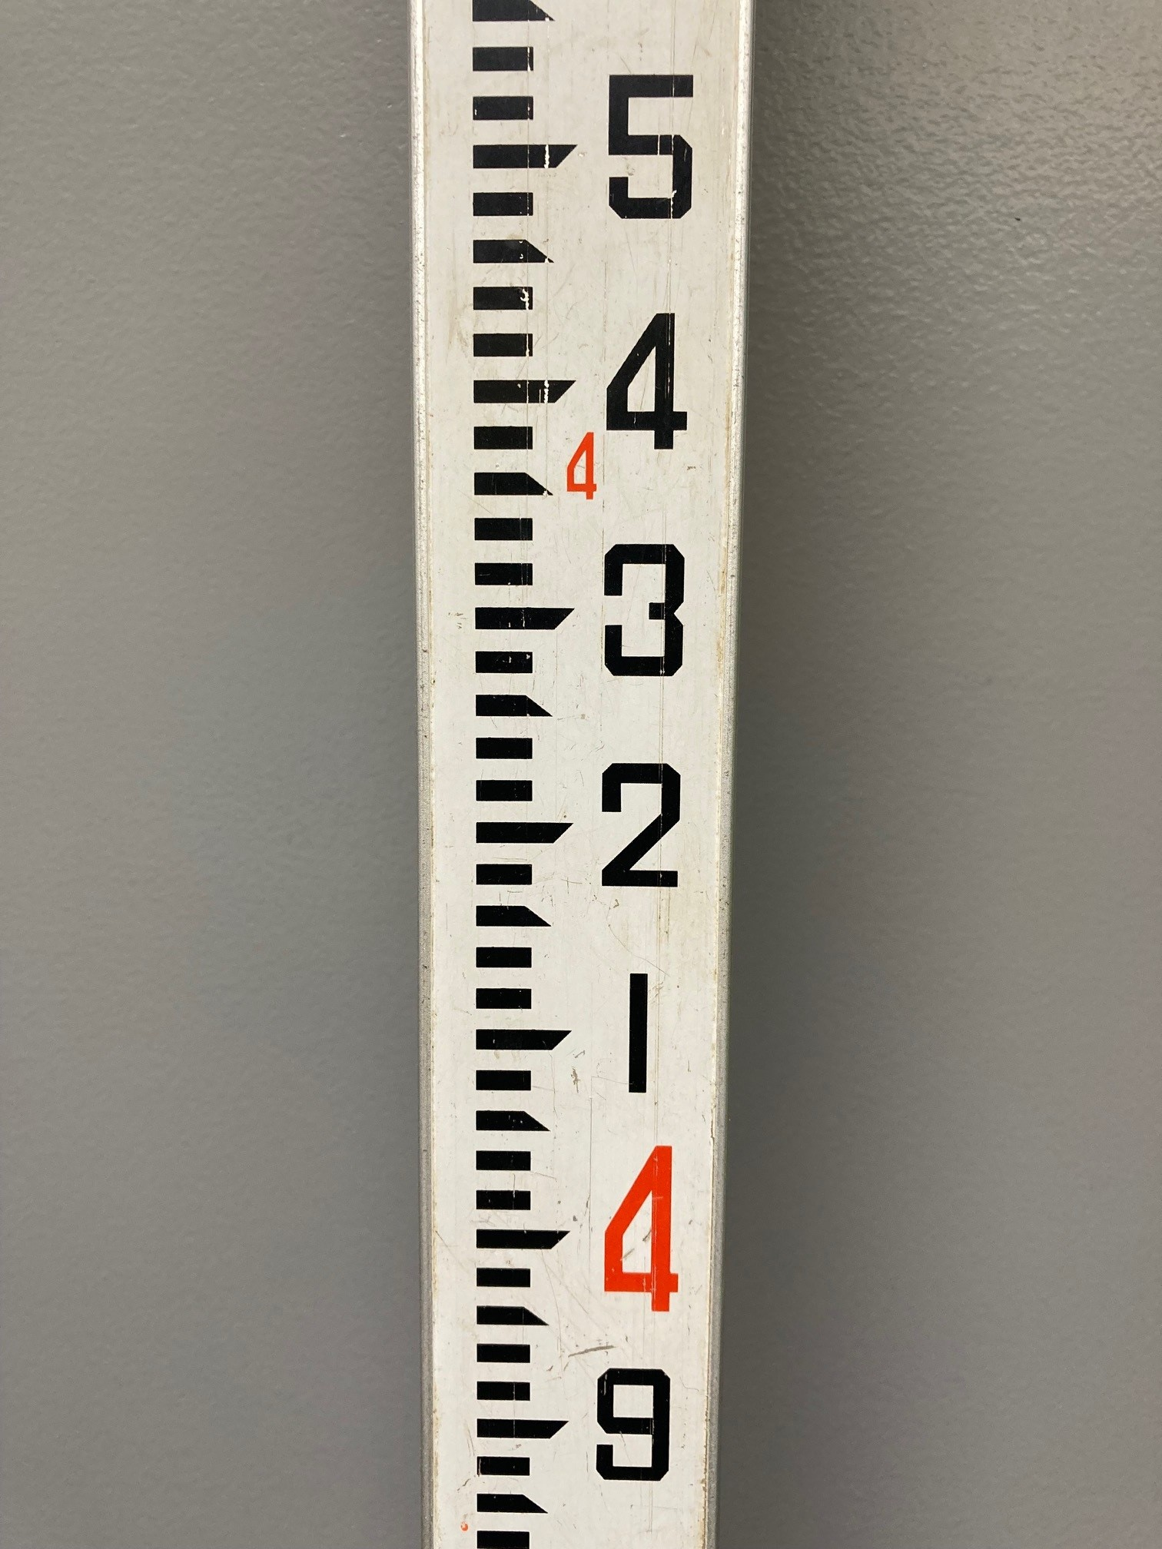
Vertical Measurements and Calculations

Slide 16
Soil Conditions – Design - Construction
The soil conditions observed and recorded during the initial site evaluation inspection will often dictate the leaching system depth into the existing grade where high groundwater conditions, ledge or compact soils pose a design depth restriction.
The system design plan must incorporate these vertical restrictions into the design specifications along with the other dimensional requirements and restrictions.
The constructed system must be built/installed to maintain the proper system depth into grade based on the design elevations and field conditions confirmed at the time of construction.
The inspector is required to verify the accuracy of the soil conditions, the accuracy of the plan and the accuracy of the built system.

Slide 17
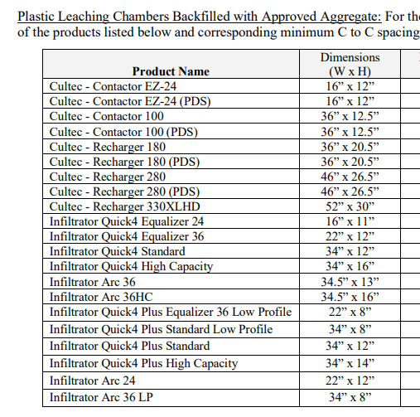
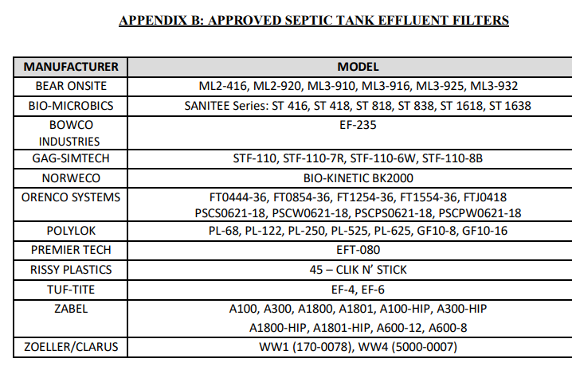
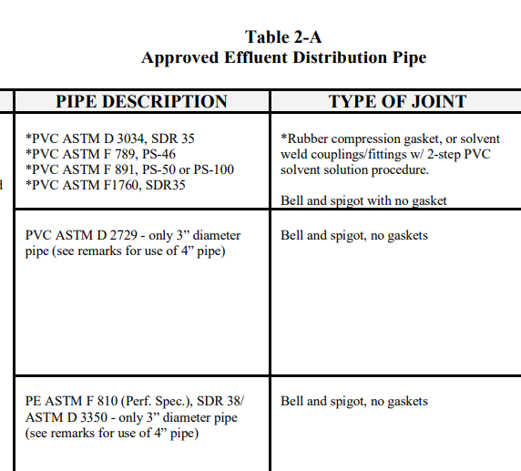
Product Identification

Slide 18
Training Requirements and Resources
Connecticut Public Health Code:
A local director of health shall authorize only persons approved by the Commissioner of Public Health to investigate, inspect and approve plans relating to subsurface sewage disposal systems.
The Commissioner of Public Health shall approve agents of the local director of health whose qualifications to investigate, inspect and approve plans relating to subsurface sewage disposal systems have been established by attending training courses and passing examinations given by the Department of Public Health…

Slide 19
Training for Certification as a Septic System Inspector does not Currently Include:
Soils evaluation training
Training for field Inspection of constructed systems

Slide 20
Soils Evaluation Training Resources
Connecticut DPH and Connecticut Environmental Health Association (CEHA) have jointly offered optional soils training programs for certified inspectors, professional engineers and licensed installers.
Soils field training is most often provided to new inspectors by experienced co-workers and supervisors at local health departments and districts in Connecticut.
Professional soil scientists and licensed professional engineers with soils experience are also valuable training resources for public health inspectors during site evaluations.

Slide 21
Field Inspection Training Resources
Post-certification on-the-job field training by experienced co-workers and supervisors at local health departments is currently the most common approach to providing septic system inspection training for new inspectors in Connecticut.
The Environmental Health Institute of Connecticut now provides Final Inspection Field Training for certified septic system inspectors in Connecticut at our Septic System Field Training facility in Ellington Connecticut.

Slide 22
EHICT – The Environmental Health Institute of Connecticut
EHICT is a state-of-the-art facility established in 2021 in the town of Ellington, CT displaying a variety of complete septic systems and septic system components in their properly installed state, ready for inspection.
EHICT offers field inspection training programs for Connecticut Certified Inspectors of subsurface sewage disposal systems.
Offering full-day and half-day training courses, a team of experienced local health department/district inspectors and state health department officials provide instruction in five areas of field inspection techniques and methodologies for conducting thorough code-compliance inspections of newly installed septic systems.

Slide 23
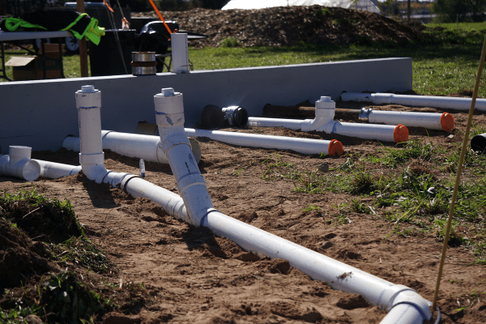
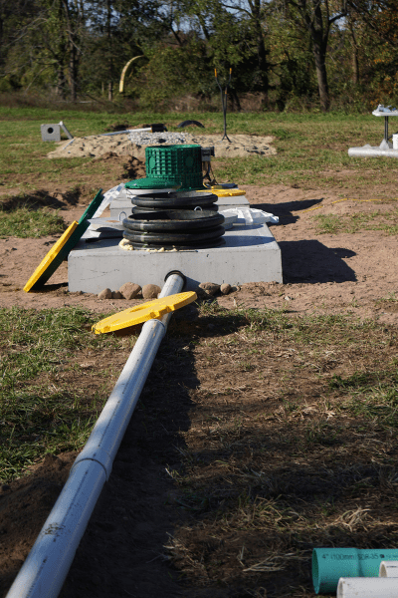
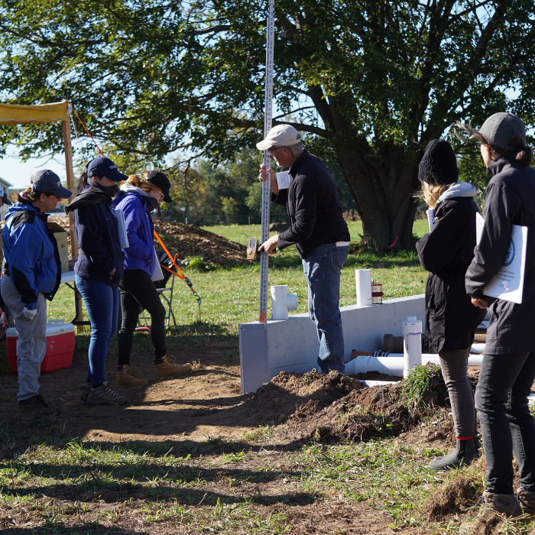
The Environmental Health Institute of Connecticut - EHICT

Slide 24
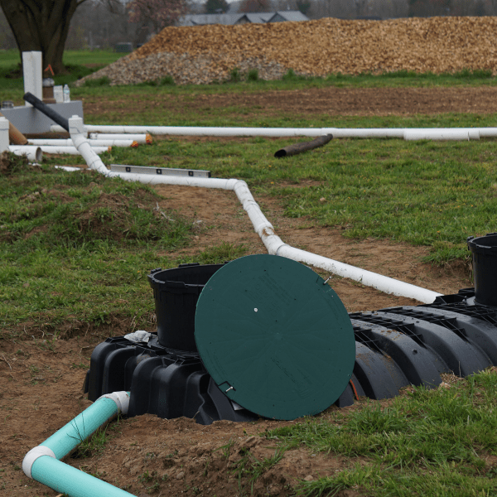
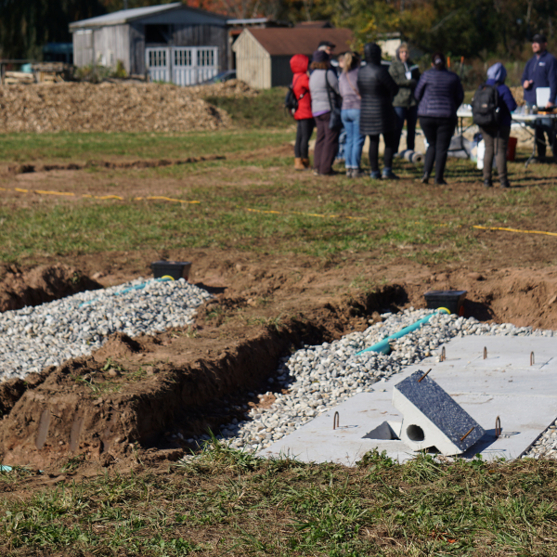
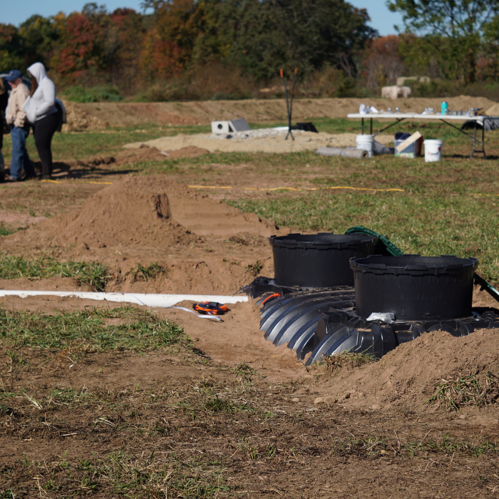
EHICT Septic System Field Training Facility 41 Courtney Drive, Ellington, CT

Slide 25
The future of field training in Connecticut…
Where do we go from here?
Q and A

Slide 26
Thank you!
Jeff Polhemus, R.S.
Email Address: jeff@ehict.org

