Slide 1
Boston’s Body Art Regulations:
24 Years of Lessons Learned
Paul Shoemaker, MPH, MBA
Director, Environmental & Occupational Health Division
Boston Public Health Commission
May, 2025

Slide 2

Disclaimers
This presentation describes the history, content, and implementation of regulations governing the body art industry in Boston. Other municipalities may have regulations that differ from those described here. Practitioners and business owners are advised to consult with their local regulatory agency for local specifics prior to taking any significant business actions relative to regulations.
Any opinions or speculation beyond the scope of current regulations and regulatory implementation are those of the presenter and not the views, opinions, or policy of the Boston Public Health Commission.

Slide 3
Where We’re Going
Public Health & Safety Concerns of Body Art
History of the Boston Body Art Regulations
Implementation and Enforcement
Regulatory Revisions and the Future
Challenges and Lessons Learned

Slide 4
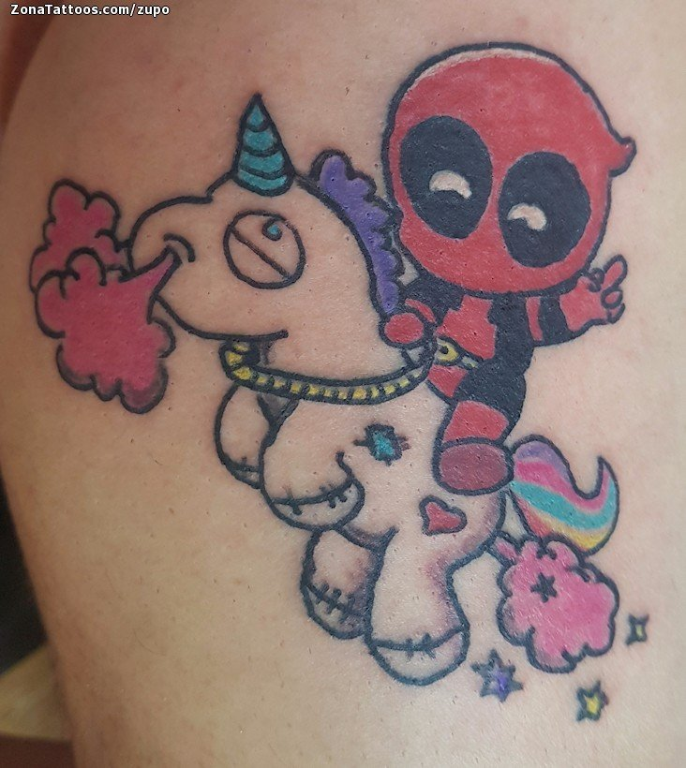
What is Body Art
Artistic or personal expression using the human body as medium. Common practices include:
  Tattoos (including medical)
This Photo by Unknown Author is licensed under CC BY-SA-NC

Slide 5
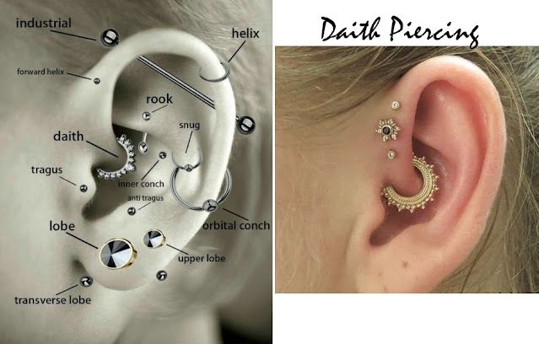
What is Body Art
Artistic or personal expression using the human body as medium. Common practices include:
  Tattoos
  Piercings
This Photo by Unknown Author is licensed under CC BY-NC-ND

Slide 6
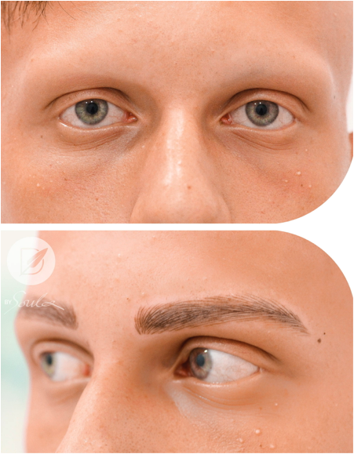
What is Body Art
Artistic or personal expression using the human body as medium. Common practices include:
  Tattoos (including medical)
  Piercings
  Microblading/permanent cosmetics
This Photo by Unknown Author is licensed under CC BY-NC

Slide 7
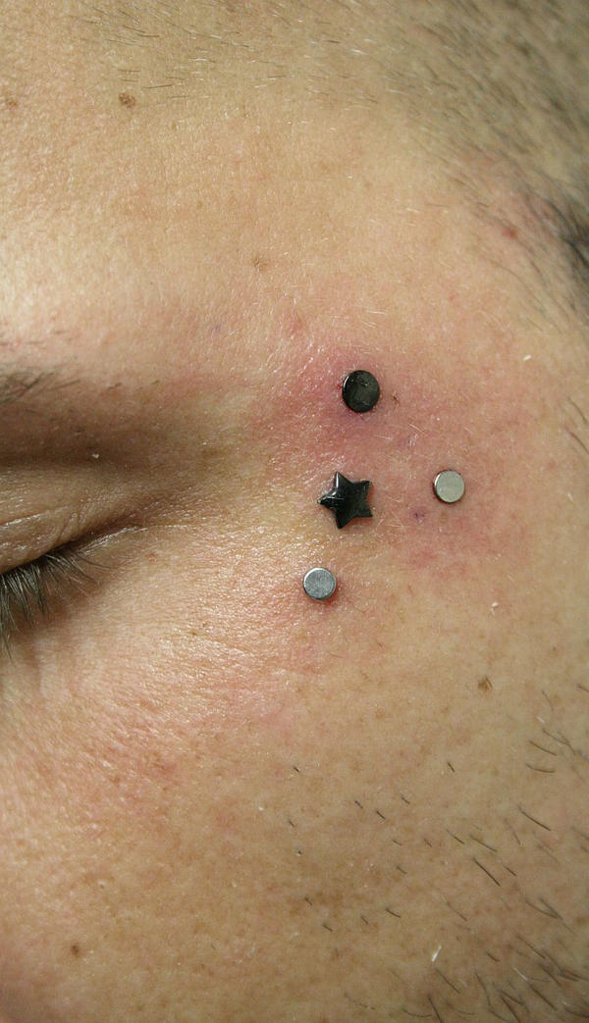
What is Body Art
Artistic or personal expression using the human body as medium. Common practices include:
  Tattoos (including medical)
  Piercings
  Microblading/permanent cosmetics
  Dermal implants
This Photo by Unknown Author is licensed under CC BY

Slide 8
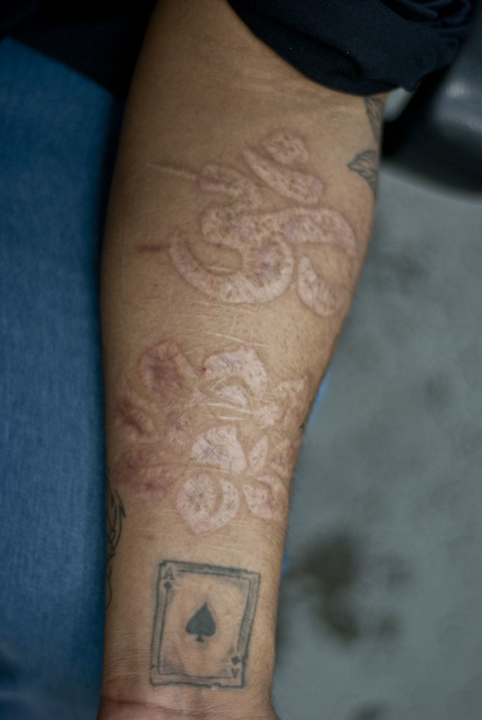
What is Body Art
Artistic or personal expression using the human body as medium. Common practices include:
  Tattoos (including medical)
  Piercings
  Microblading/permanent cosmetics
  Dermal implants
  Scarification and Branding
This Photo by Unknown Author is licensed under CC BY-NC-ND

Slide 9
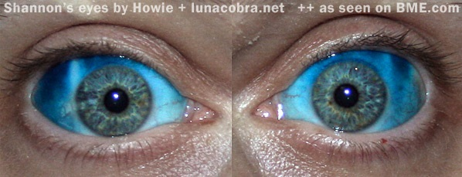
What is Body Art
Artistic or personal expression using the human body as medium. Common practices include:
  Tattoos (including medical)
  Piercings
  Microblading/permanent cosmetics
  Dermal implants
  Scarification and Branding
  Other
This Photo by Unknown Author is licensed under CC BY-SA-NC

Slide 10
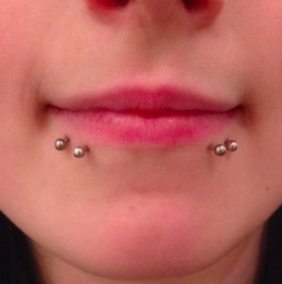
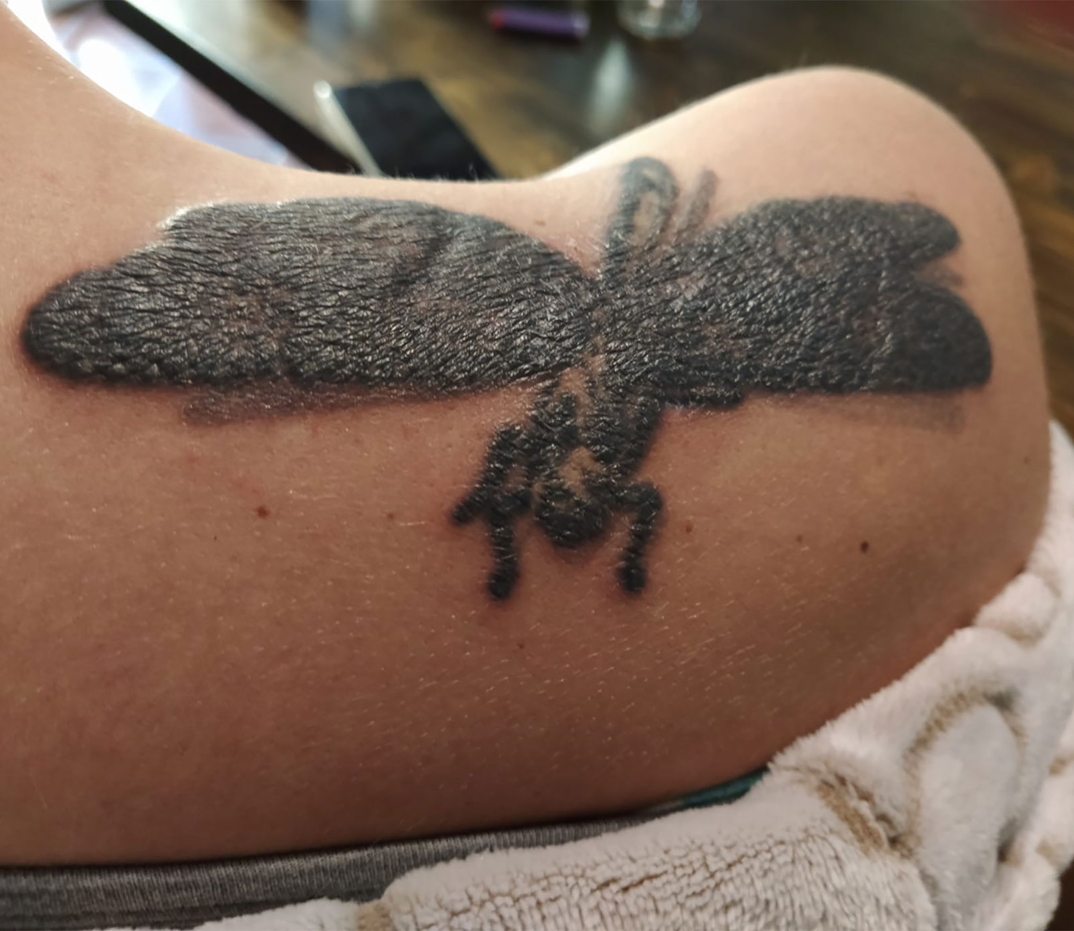
Public Health and Safety Concerns
Infection of client or artist due to non-sterile conditions/equipment
Physical injury from unsafe equipment or practices
Improper/unsafe disposal of biohazard waste
Legal considerations
This Photo by Unknown Author is licensed under CC BY

Slide 11
History of the Boston Body Art Regulations
1962
Massachusetts bans tattooing except by a physician
2000
State ban ruled unconstitutional by the MA Superior Court
Jan. 2001
MA DPH issues model body art regulations
23 May 2001
BPHC promulgates Boston Body Art Regulations
19 Sep. 2017
BPHC revises regulatory guidelines to include permanent cosmetics
Today
23 active body art establishments and 118 licensed artists (including apprentice and visiting)
2024
NEHA updated Model Body Art Code released

Slide 12
Requirements of the Regulations
Standard requirements for physical establishments including annual permit and inspection
Experience/training requirements for artist licenses and annual license renewal
Requirements for safe work practices & equipment
Restrictions on clients (age, impairment, health)

Slide 13
Establishment Requirements
Annual permit required except:
  licensed physician’s practice
  businesses that do only ear piercing
Zoning compliance and Use and Occupancy permit
Floorplan separates practice area from public and other businesses
Emergency plan
Medical waste disposal contract
Clean room and sterilization equipment
Workstations have sufficient size, lighting, and separation
Hand washing sinks

Slide 14
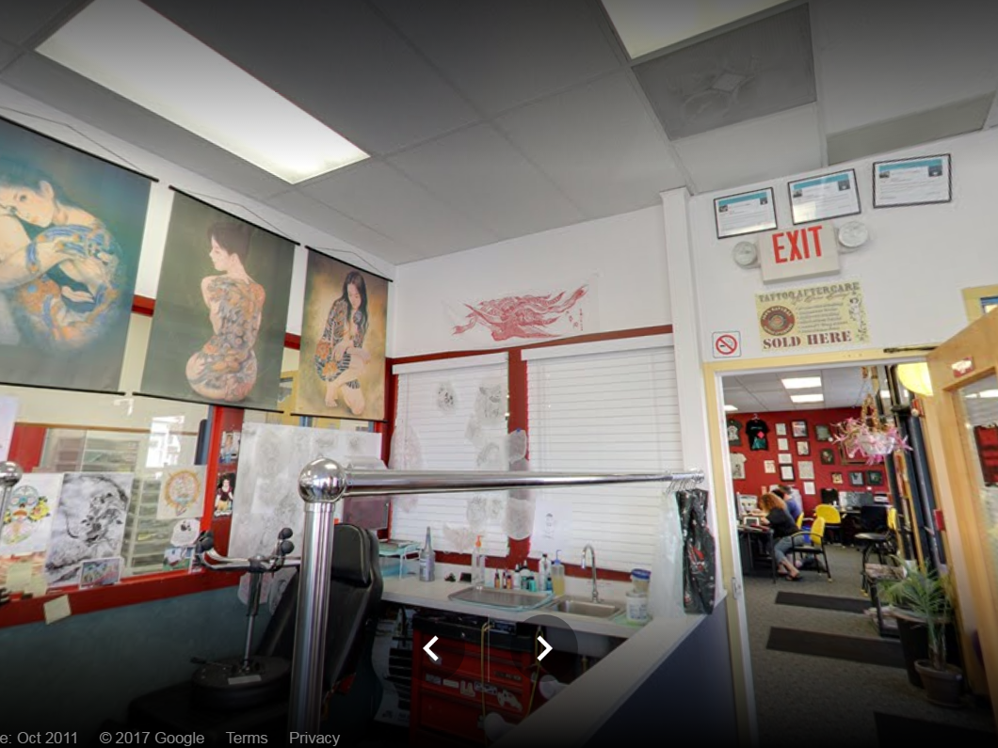

Slide 15
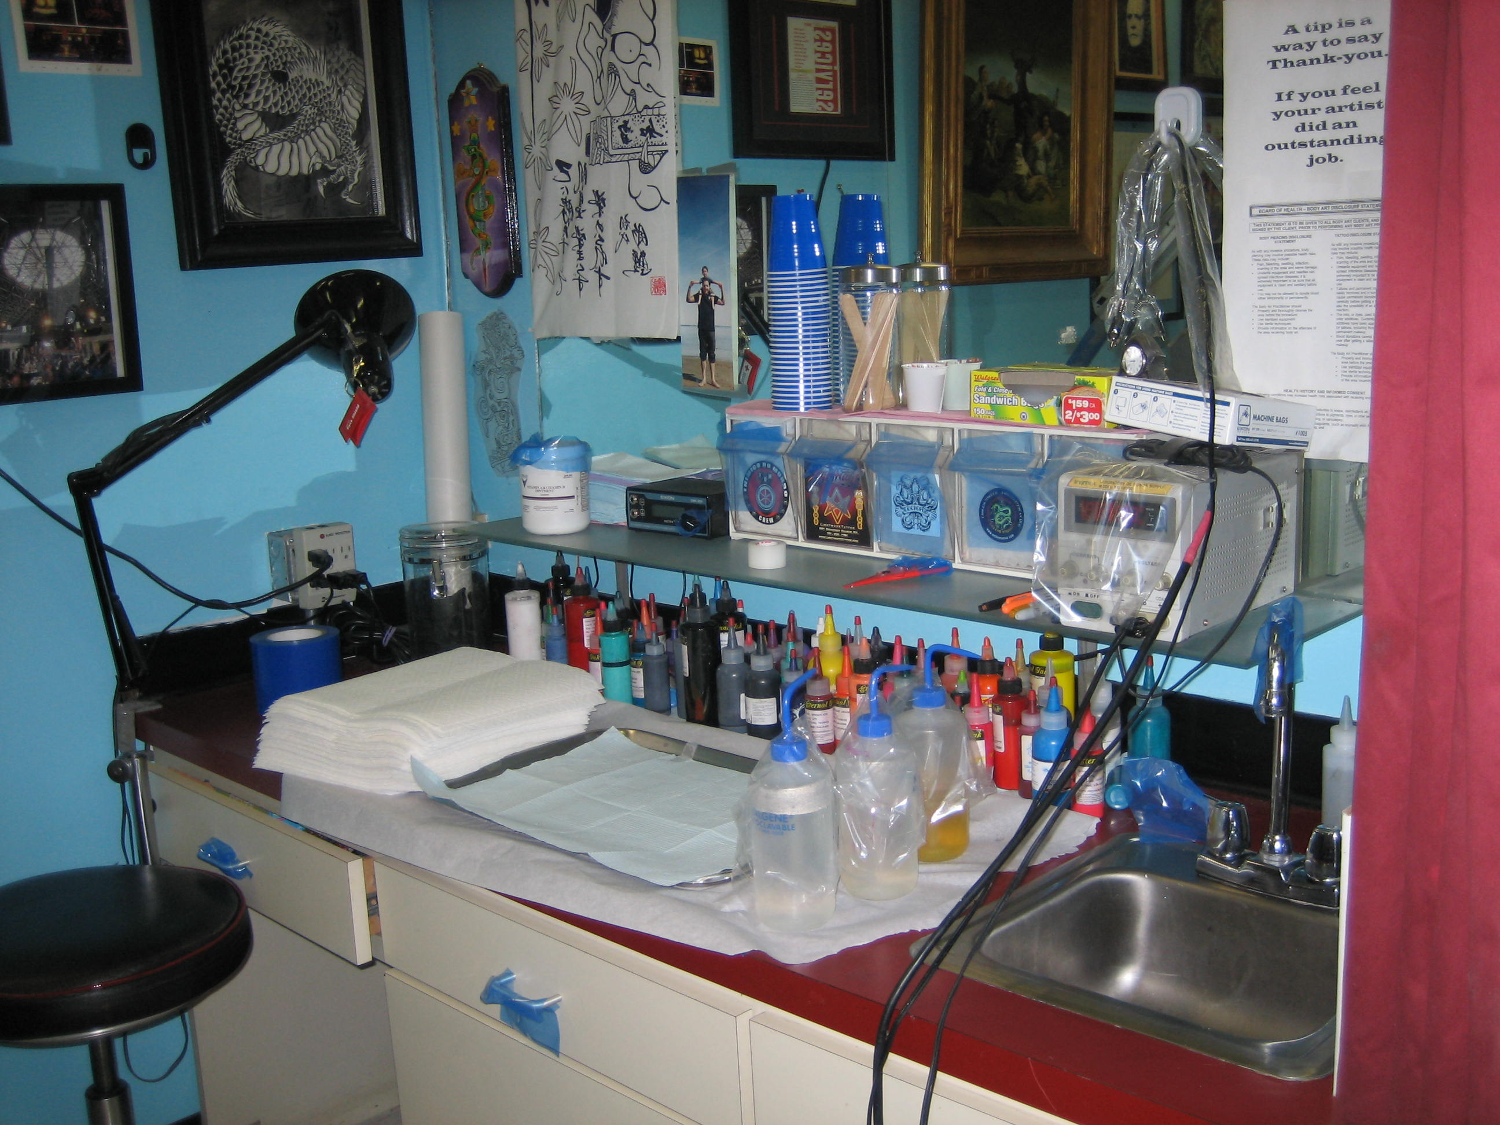

Slide 16
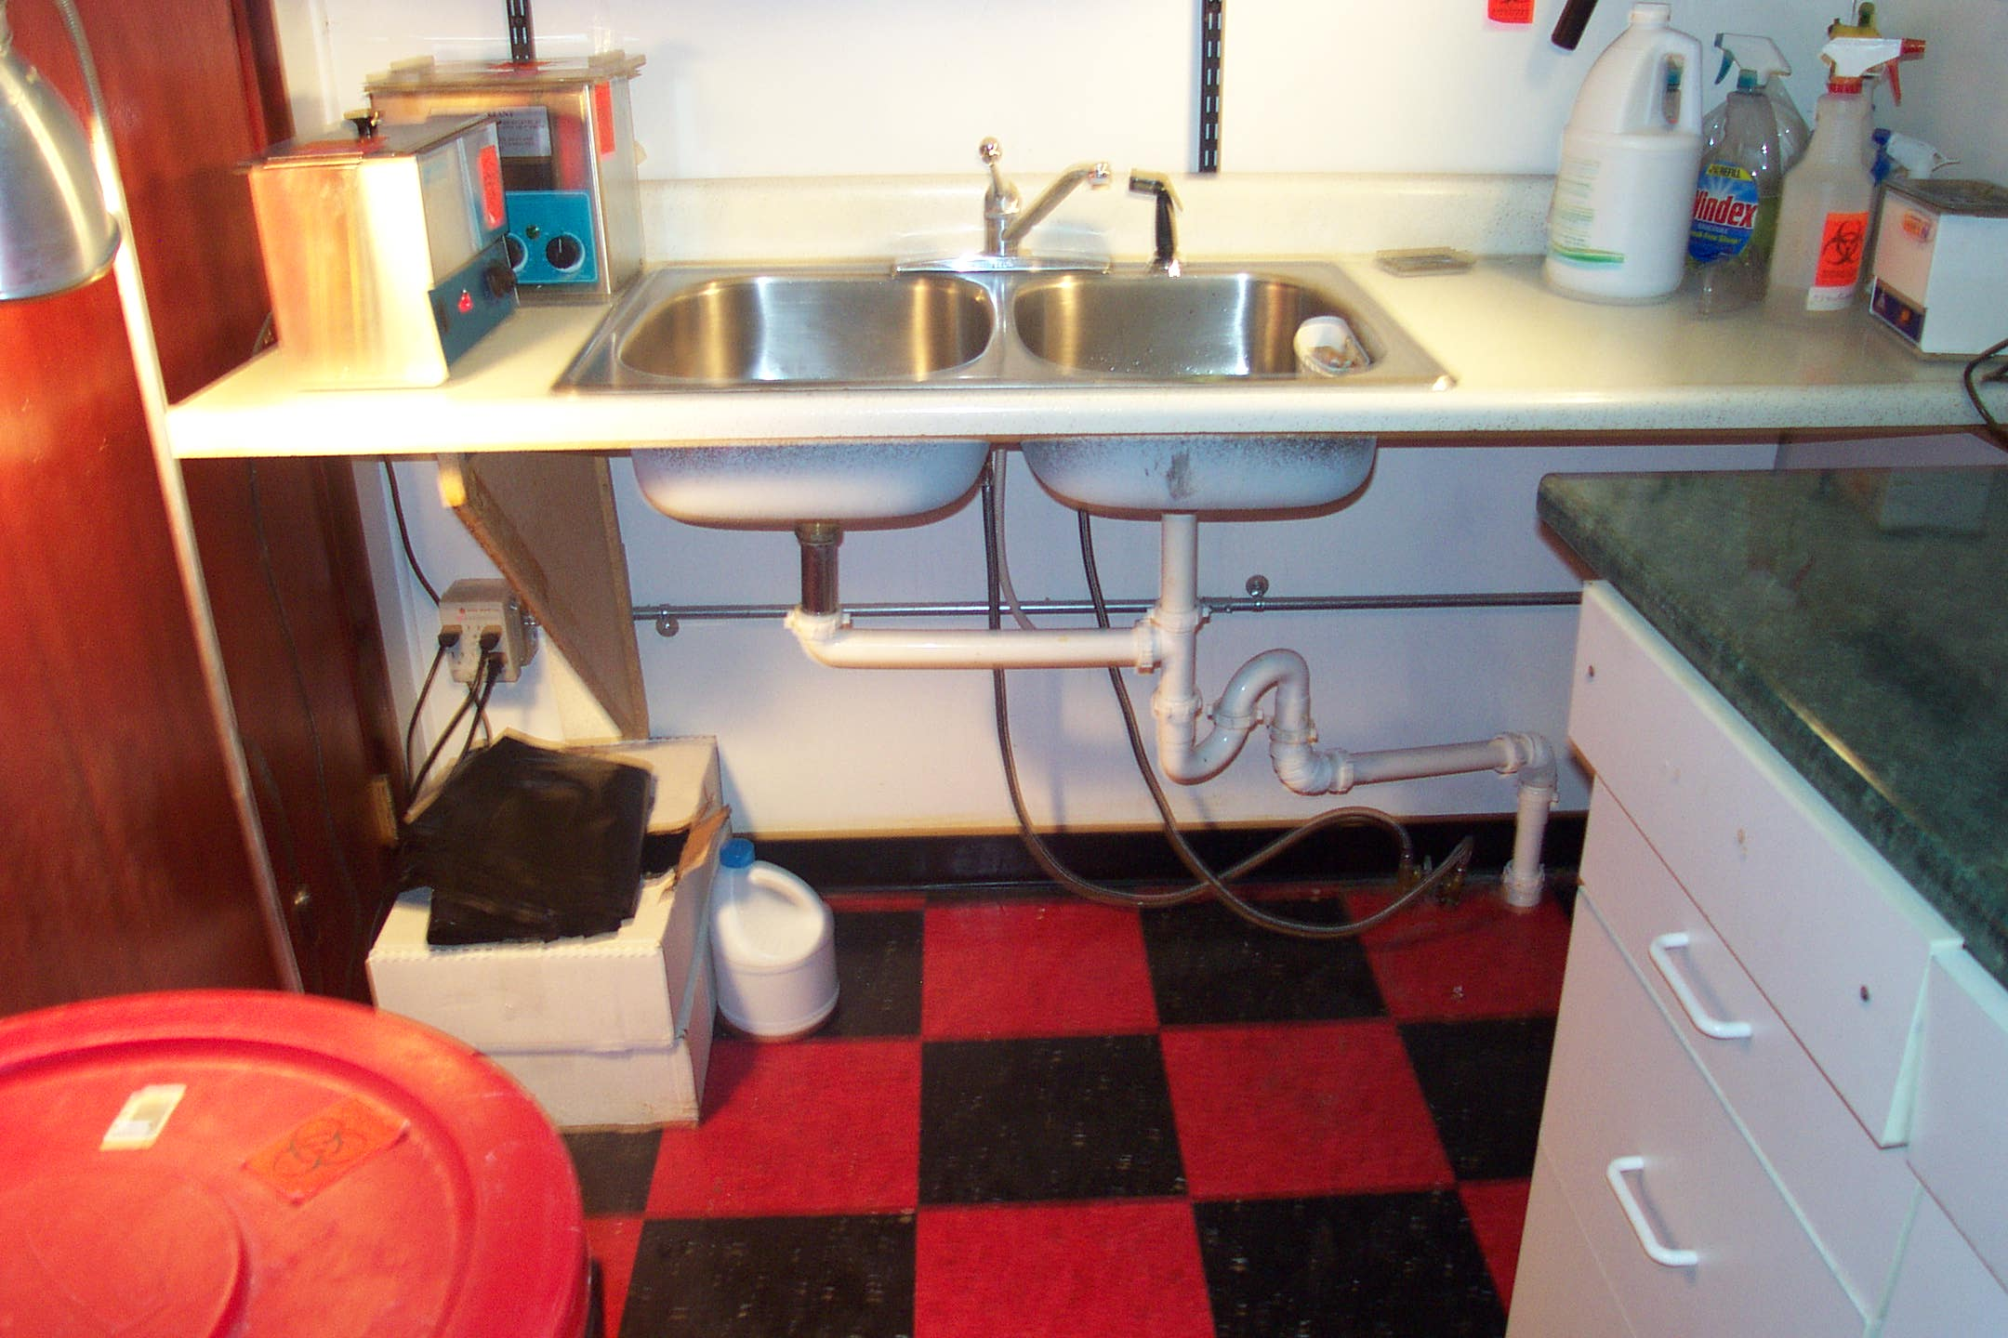

Slide 17
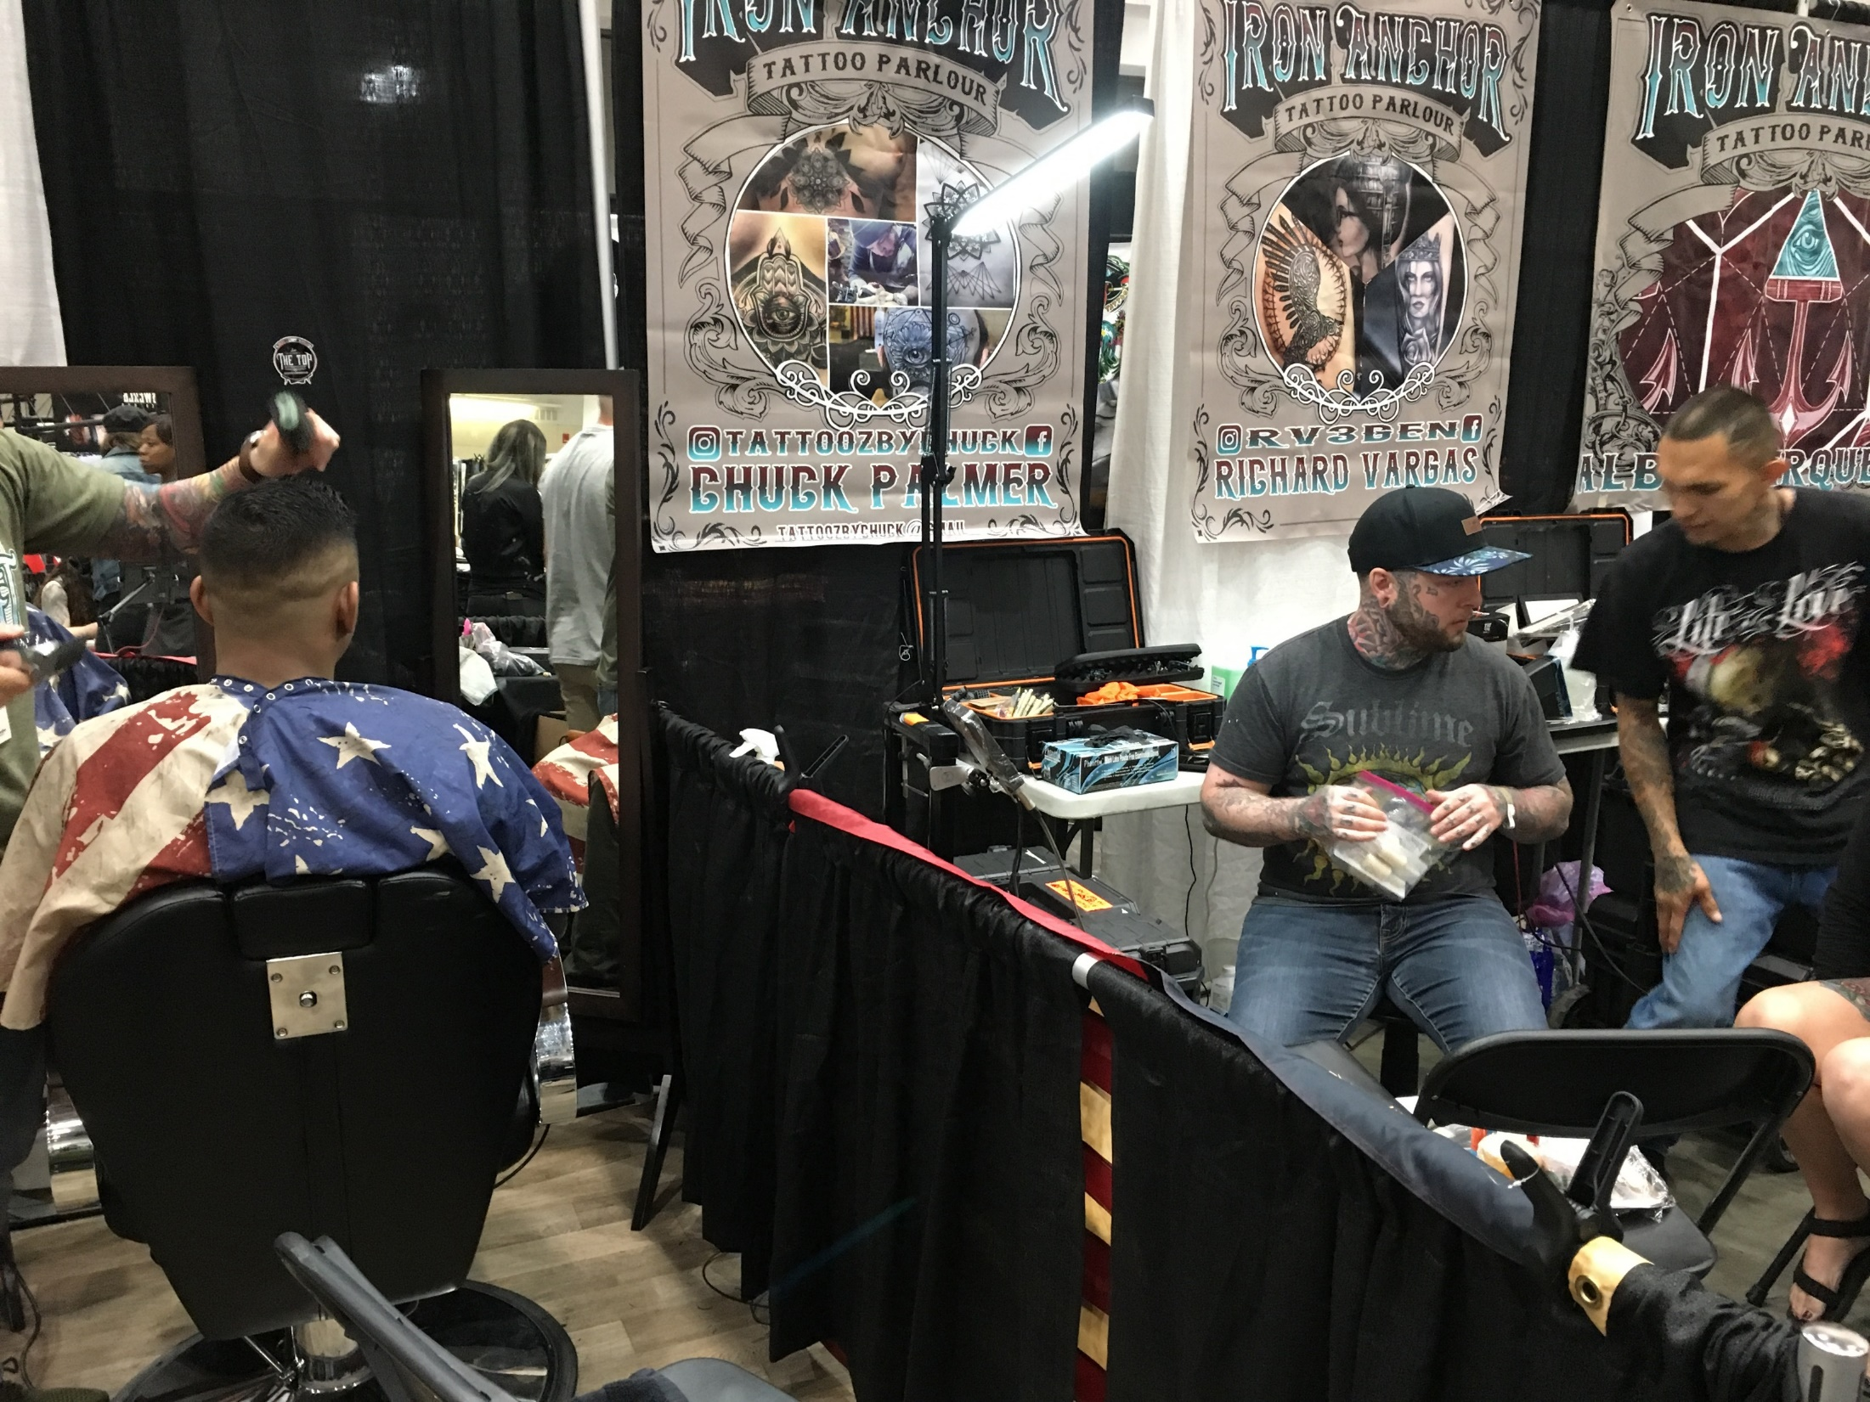

Slide 18
Artist Requirements
Documentation of prior experience in the body art type on initial application:
  Previous year’s Boston license
  One or more years of licensure in another jurisdiction
  Documentation of a successfully completed apprenticeship
  Completion of approved training course and apprenticeship (permanent cosmetics only)
Current First Aid/CPR training certification
Current Blood Borne Pathogen training certification
Completion of an Anatomy and Physiology course (piercer only on initial application)
On-site inspection of work practices

Slide 19
Work Practice Requirements
Client consent/release statement and record keeping
Screening of client for exclusion items (age, health factors, intoxication)
Sanitation of workstation
Covering of work surfaces with barrier film
Sanitation of tools – wash/ultrasonic cleaner and autoclave
Use of single-use tools
Single-use ink ‘caps’, bagging machine/cord (for tattooing)
Proper hand-washing and glove use
After-care instructions
Proper cleanup and disposal

Slide 20
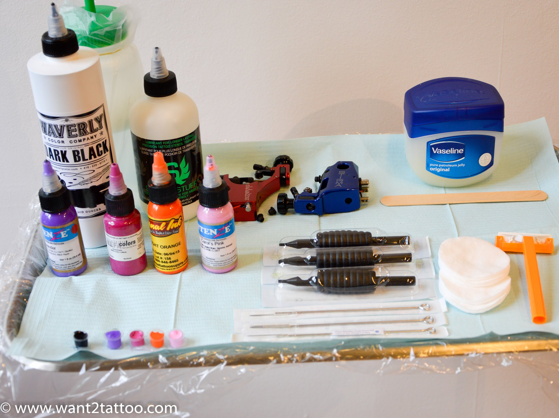

Slide 21
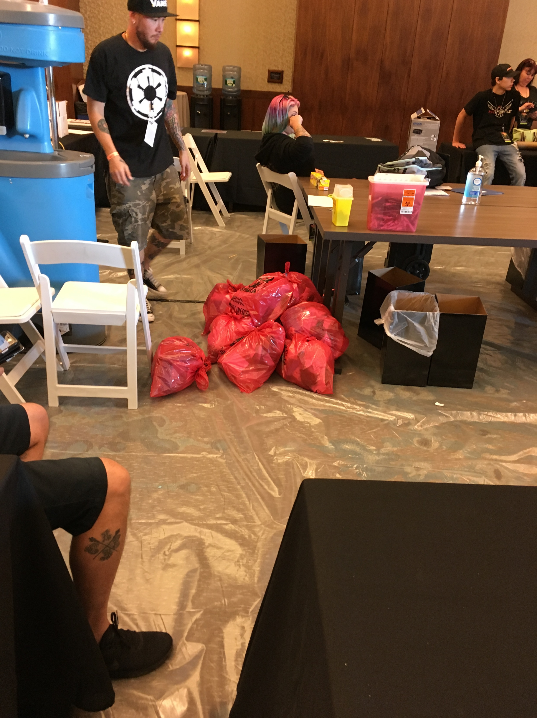

Slide 22
Client Restrictions
Under 18 – No tattooing, piercing genitalia, branding, or scarification
Under 14 – No piercing at all
14-17 y/o – Piercing (except genitals) if a parent or legal guardian is present and signs a consent
No body art if client impaired by alcohol or other drugs
No body art on any part of a client showing a visible rash, lesion, or sign of infection
Client must disclose certain medical information which the artist may use as a basis for refusing service

Slide 23
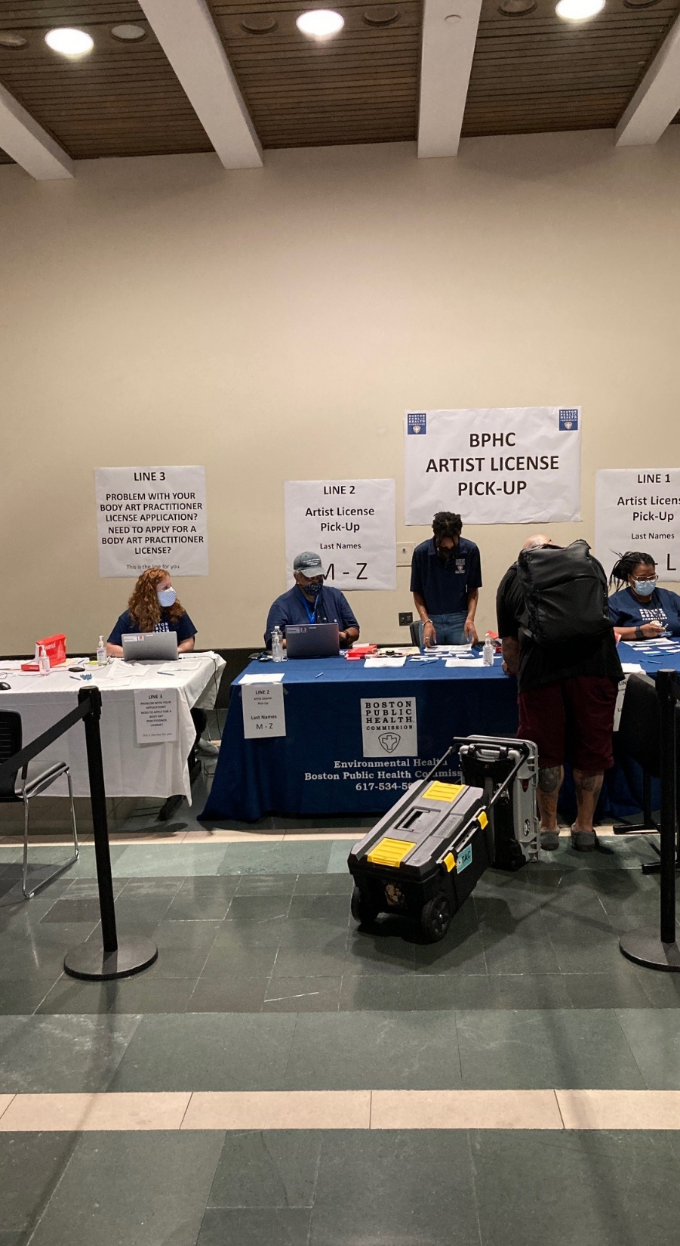
Implementation
&
Enforcement
Annual permitting of businesses and licensing of artists
Routine inspections
  Initial and annual inspections of permitted businesses
  Initial assessment/inspection of new artists
Complaint-based inspections of permitted businesses and licensed artists
Investigation of unlicensed artists/shops
Licensing guest/temporary artists and permitting temporary locations

Slide 24
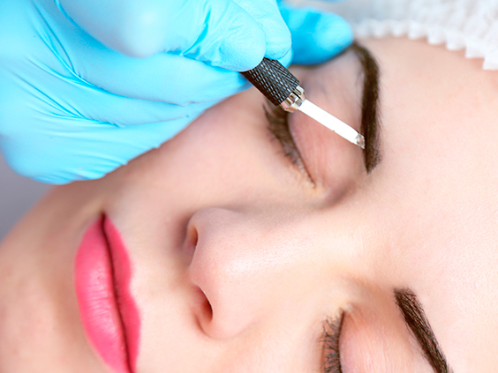
Challenges and Lessons Learned:
Microblading
Also called micropigmentation, permanent cosmetics, permanent makeup, cosmetic tattooing and similar
Uses the principles of tattooing to replicate the appearance of applied cosmetics, such as enhancing eyebrows, lip liner, eyeliner, etc.
New community of practitioners and businesses
  Until 2017, prohibited in salons licensed by the MA Board of Registration of Cosmetology and Barbering (BOC). Now allowed with certain conditions.
  Cosmetologists unable to meet the required documentation of prior experience in tattoo parlor and beauty salons do not have “body art” as part of their Use and Occupancy
  Tattoo industry trains practitioners using apprenticeships, while cosmetology industry focuses on formal classroom education
  Training classes for permanent cosmetics being offered across the country are of varying rigor

Slide 25
Challenges and Lessons Learned: Unpermitted Practitioners
Body art is a very mobile profession with artists traveling from state to state and regulations can vary greatly from state to stake or between municipalities within the state.
Businesses can open unaware of the requirement to be permitted and the requirements of that permit, leading to enforcement action.
Difficulty of catching unlicensed ‘artists’ and enforcing against them – anyone can buy a “tattoo kit” on Amazon.
Artists working out of their homes and doing house parties are difficult to enforce against and increased greatly during the COVID-19 pandemic.
Credentialling of artists can be difficult, especially with regard to apprenticeships/prior experience and microblading training course quality variability
The anatomy and physiology course requirement for piercers is difficult to implement due to limited
options and variable training course quality

Slide 26
Challenges and Lessons Learned: Evolving Practice and Standards
Increased interest in “open concept” body art shops currently prohibited by regulations
Rise of 100% disposable single use equipment making the need for autoclaves redundant
Varying requirements for apprenticeships and even less standardization on how apprenticeships are documented.
Rise in interest by some shops in running “schools” of body art with multiple apprentices. How many is too many?
Expanding field of body art practices with new risks. Sclera coloring, dry ice branding, saline injections to remove tattoos, etc.
Regulation variations between jurisdictions.
Quality control issues with inks and other products

Slide 27
Regulation Revisions:
Coming Soon
Update Boston regulations in 2025 to meet changes in the state of the industry.
Incorporate components from NEHA Model Code.
Standardize with other communities. Working with Cambridge and Chelsea currently.
You can join the conversation – we have a mailing list.
Key Topics:
Apprenticeship requirements
Standards for A&P and BBP training
Standards for equipment and supplies
Physical facility standards (all disposable,
open concept, etc.)
More

Slide 28
Questions? Discussion?
Paul Shoemaker
617-534-5965
pshoemaker@bphc.org
www.boston.gov/bphc-environment

