Slide 1

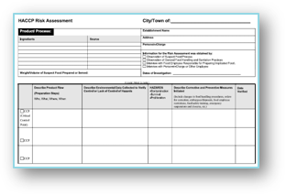
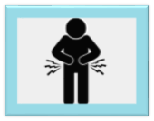
Foodborne Illness Investigation and
HACCP Risk Assessment Form​ Training​
May 28, 2025
Jessica L. Ferreira, CP-FS
Environmental Analyst III / Food Safety Trainer
MA DPH – Division of Food Protection

Slide 2
Introduction
Presenter: Jessica L. Ferreira, CP-FS
Bureau of Climate and Environmental Health, DPH, Division of Food Protection
Foodborne illness poses a significant threat to public health because it can cause severe illness, long-term health effects, and even death, especially among vulnerable populations. Effective investigations are essential for identifying the source of contamination, preventing further illness, and protecting the public through improved food safety practices.
This presentation provides training on conducting foodborne illness investigations and completing the Foodborne Illness Worksheet and HACCP Risk Assessment Form, with a focus on understanding the process and avoiding common mistakes.
Notes:
READ SLIDE.

Slide 3
Objectives
Understand the general process of a foodborne illness investigation.
Understand how to complete a Foodborne Illness Worksheet and HACCP Risk Assessment Form.​
Identify common issues and mistakes made when completing a HACCP Risk Assessment Form.
Notes:
Good Afternoon lets go over the objectives for this training. READ SLIDE.

Slide 4
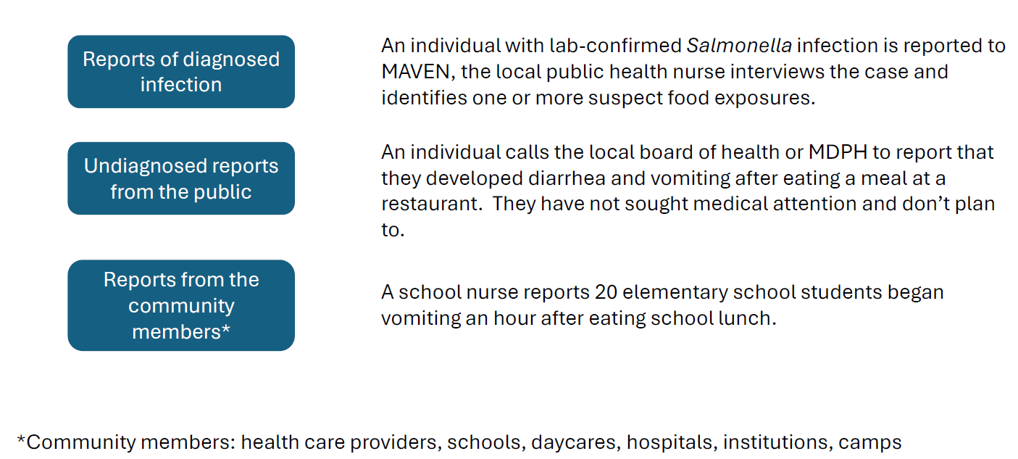
How we learn about foodborne illnesses
*CREDIT: Foodborne Illness Season is Here – Presentation July 2024.
Notes:
How to do local boards of health learn about foodborne illnesses? The first way is to be notified reports of a diagnosed infection such as an individual with a lab confirmed Salmonella infection that is reported in MAVEN, the local public health nurse interviews the case and identifies one or more suspect food exposures.
Next are undiagnosed reports from the public. For expel an individual calls the LBOH to MA DPH to report they developed diarrhea and vomiting after eating a meal at a restaurant. They have not sought medical attention and don’t plan to.
Lastly, are reports from community members. For example, a school nurse reports 20 elementary students began vomiting an hour after eating school lunch.

Slide 5
Regulations associated with reporting suspected / confirmed FBI’s
105 CMR 300.134 - Illness Believed to Be Part of a Suspected or Confirmed Cluster or Outbreak
Knowledge of the occurrence of any suspected or confirmed cluster or outbreak of illness must be reported to the LBOH by:
Healthcare providers
Those in supervisory positions at a school, day care, hospital, institution, clinic, medical practice, laboratory, labor or other camp, employers.
Reporting shall occur immediately by telephone, fax, or other electronic means to the LBOH in the community where the facility is located or MDPH directly
If MDPH is notified, it shall notify the LBOH within 24 hours
LBOHs should report any suspected outbreak of illness within 24 hours to MDPH:
Call the Division of Environmental Epidemiology (DEE) (617) 983-6800 or Division of Food Protection (DFP) 617-983-6712 Can also be reported as a MAVEN foodborne illness complaint event
*CREDIT: Foodborne Illness Season is Here – Presentation July 2024.
Notes:
READ SLIDE.

Slide 6
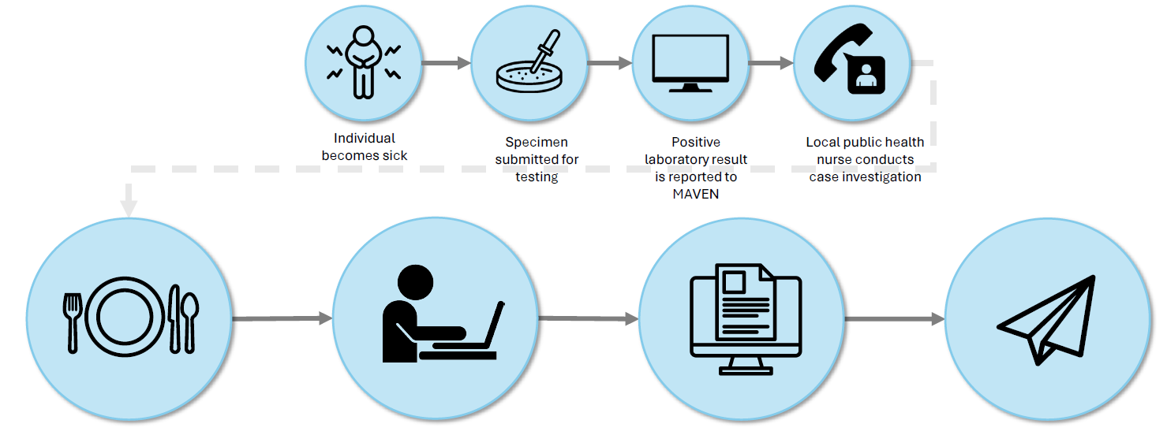
Reporting to Public Health
Case reports ≥1 food exposures during case interview
Local health investigator creates FBI complaint event in MAVEN
MDPH Division of Food Protection reviews complaint, shares with LBOH MAVEN users of named establishments
LBOH MAVEN users share information with health inspectors for follow up
*CREDIT: Foodborne Illness Season is Here – Presentation July 2024.
Notes:
To summarize the process reporting to public health is as follows.….READ SLIDE.
NOTE: > Greater than

Slide 7
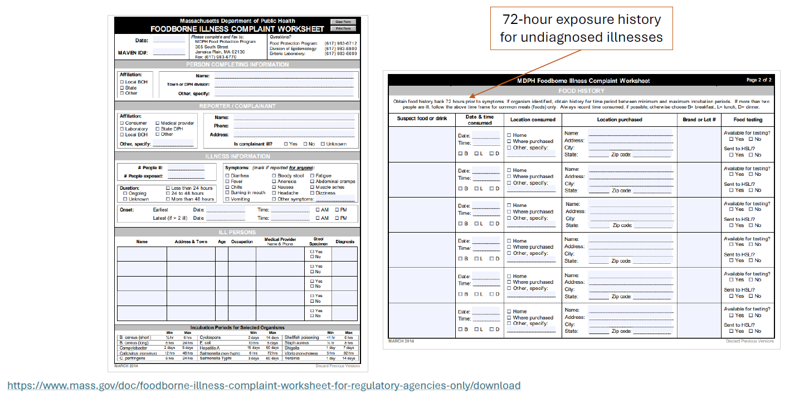
MAVEN FBI complaint event is based on paper-based report form
*CREDIT: Foodborne Illness Season is Here – Presentation July 2024.
Notes:
This is what the Foodborne Illness Form looks like. We will go over how to complete this form and in the information that is needed to help with the foodborne illness investigation.
If during the investigation, in response to a reported disease and it appears likely that food was the source of the illness, a Foodborne Illness Complaint Worksheet should be completed. The person who completes this form is the one who initially receives the complaint. Could be MA DPH or the LBOH. All foodborne illness complaints initially received by DPH will be forwarded to the LBOH.​
​
The Foodborne Illness Complaint Worksheet should be used to record all information and should be filed as a permanent record of the complaint.​
​
Notification is very important, and information needs to be entered into the MAVEN, FBI complaint module, or the case reported to the Division of Food Protection or EPI within 24 hours. ​
Once completed the worksheet is to be sent to the MA DPH Division of Food Protection!​
​

Slide 8

Completing a Foodborne Illness Complaint Worksheet
Collecting Information:
Collect as much information as possible.
A second interview may not be possible.
If the complainant lacks key details, identify and contact someone who may have the missing information.
Thorough initial information gathering helps assess the validity of the complaint and may prevent unnecessary investigations.
Notes:
Completing a foodborne illness compliant worksheet.
The first step is Collecting Information: Always try to collect as much information as possible from the complainant during the first interview.
A second interview may not be possible, as it might be difficult to contact this individual again, or they are unavailable, and/or or they may unwilling to be interviewed a second time.
If the complainant cannot provide critical pieces of information, then try to find out who may be able to and contact that person.
By collecting enough information in the initial stages, you will be able to determine the validity of the complaint more easily and possibly avoid conducting an unnecessary investigation.

Slide 9
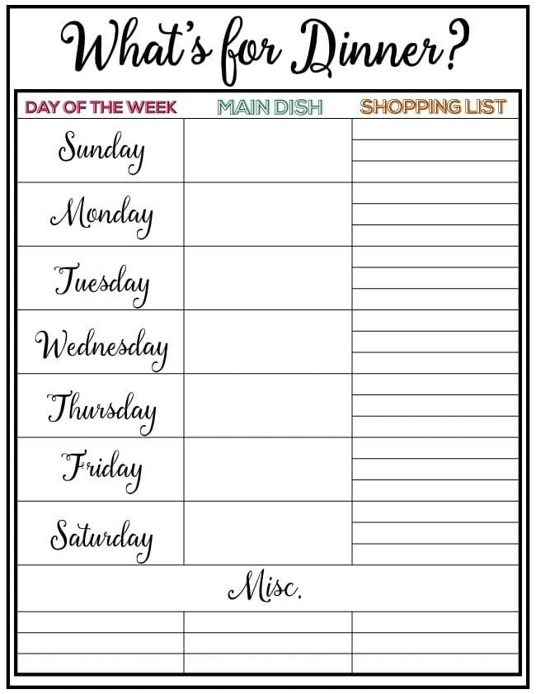
Completing a Foodborne Illness Complaint Worksheet​
Food Consumption History:
Complainants may focus on one suspected food.
Explain that gastrointestinal illnesses can result from water, animals, and/or person-to-person transmission.
Symptoms may appear minutes to weeks after exposure, making the actual source unclear.
Always collect a complete 72-hour food consumption history, regardless of initial assumptions.
Notes:
Next is the Food Consumption History: A complainant may be "sure" about the source of the illness and report only one suspect food or food establishment, but other sources may be involved.
Explain that there can be many sources of a gastrointestinal illness, including water, animals, and / or person-to-person transmission, and that symptoms appear from a few minutes to a few weeks after ingestion.
Do not be deterred from obtaining a complete, 72-hour food consumption history. Get as much detailed information on what they ate within this time period.

Slide 10

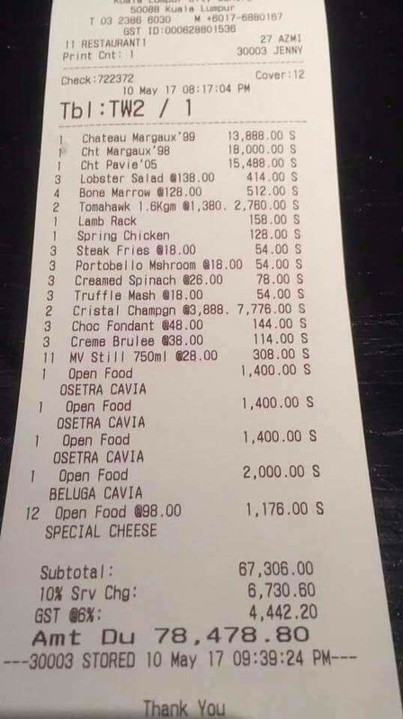
Completing a Foodborne Illness Complaint Worksheet
Accuracy of Recording:
Record dates and times of illness onset, food consumption, and symptoms accurately.
Request calendars, personal/work events, credit card receipts, and shopper cards to verify details.
Ask leading questions to help jog the complainant’s memory.
Emphasize that their input may help stop a potential outbreak and prevent further illness.
This Photo by Unknown Author is licensed under CC BY-NC-ND
Notes:
Accuracy of Recording: Be sure to accurately record dates and times of the onset of illness, as well as food consumption, and symptom information.
Ask them to look at their calendar, events, both personal and work; restaurant credit card receipts that they might have; and shopper cards that would enable them to give permission to access a record of purchases.
Ask leading questions that might jog their memory.
Remind them that their time could assist in ending a possible foodborne illness outbreak and prevent many other cases of illness.

Slide 11

Completing a Foodborne Illness Complaint Worksheet
File and Communicate:
The hard copy of the Foodborne Illness Complaint Worksheet should be filed in the LBOH office.
The information should be entered into the MAVEN FBI complaint module or provided to DPH.
A discussion between DPH and the LBOH could determine whether an environmental investigation should be done at the location.
If possible, several staff members of the LBOH should participate in the environmental investigation.
Notes:
The hard copy of the Foodborne Illness Complaint Worksheet should be filed in the LBOH office. If an illness does evolve into a large outbreak, these investigation forms will be vital in analyzing how many of the former cases were the beginning of the outbreak. The information should be entered into the MAVEN FBI complaint module or sent to DPH.
A discussion between DPH and the LBOH could determine whether an environmental investigation should be done at the location indicated in the complaint with the staff members who regularly inspect the food service establishment.
If the epidemiologists recommend an environmental investigation, it will be coordinated between DPH and the LBOH. Supplies and training will be discussed as part of the greater conversation.
Several staff members, not just the inspector or the sanitarian, but also the public health nurse, should participate in the environmental investigation since there may be multiple possible sources of illness, including ill food employees, and help make the sampling efficient with more than one person.

Slide 12
Initial Review of Foodborne Illness Complaint
Complete the Foodborne Illness Complaint Worksheet and file a hard copy in the LBOH office.
1
Enter the complaint into MAVEN's FBI complaint module or provide it to DPH.
2
Use an initial checklist to guide the review of the complaint and determine if further investigation is warranted.
3
Retain all documentation—these forms are critical for identifying early cases if the illness becomes part of a larger outbreak.
4
Notes:
The initial review of the foodborne illness complaint starts with a….READ SLIDE.

Slide 13
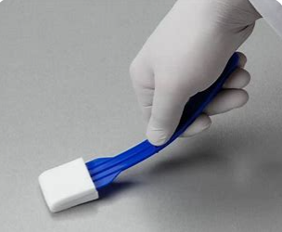
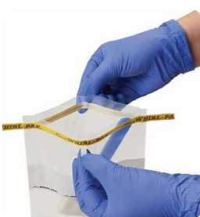
Determining and Conducting Environmental Investigations
Decide if an environmental investigation is needed.
If warranted, conduct a collaborative environmental investigation.
Include staff who regularly inspect the facility (e.g., sanitarians, public health nurses) in the environmental investigation.
BCEH provides training and technical assistance to LBOH on how to perform environmental investigations.
Ensure teams have access to the necessary supplies and guidance to conduct investigations effectively.
Notes:
Determining and Conducting Environmental Investigations> If one is needed… a decision on whether or not an environmental investigation is needed will be based on the initial review of the complaint—this should be a discussion among LBOH staff.
If warranted, conduct a collaborative environmental investigation with participation from multiple LBOH staff members.
Include staff who regularly inspect the facility (e.g., sanitarians, public health nurses) in the environmental investigation since there are multiple possible sources of illness, including ill food employees.
The Bureau of Climate and Environmental Health, DPH, will ensure LBOH have access to the necessary supplies and guidance to conduct investigations effectively. DPH will provide training and technical assistance to LBOH on how to perform environmental investigations.

Slide 14
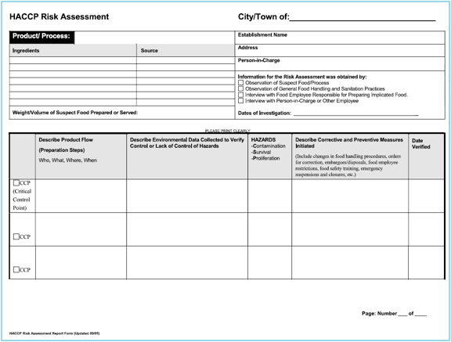
HACCP Risk Assessment Form
Notes:
This is a HACCP Risk Assessment Form. This is the form a LBOH staff member will be filling out if requested by DPH. We will go over how to fill out each section of the form in the next couple of slides.

Slide 15
How will the LBOH know when to fill out a HRA Form?
If there is an outbreak, DPH will contact the LBOH to know they are interested in a HACCP Risk Assessment for a specific dish / ingredient.
Not all outbreaks benefit from a HACCP Risk Assessment.
For example, if there is no common food item but multiple people report dining at the same restaurant.
It is possible an outbreak may begin without a common food dish, but later into the investigation DPH learns of a common dish or ingredient. DPH would then request a HACCP Risk Assessment at that time.
Notes:
How will a LBOH know when to fill out a HACCP Risk Assessment Form. READ SLIDE.

Slide 16
What is a HACCP Risk Assessment Form ?
Facilitate risk assessment of the suspect food.
A HACCP risk assessment must be conducted for each suspect food item prepared.​
Notes:
A HACCP Risk Assessment Form is used to facilitate risk assessment of the suspect food. The form is structured to assist with identifying the procedures used in the establishment in preparing the suspect food, as well as to identify corrective actions initiated because of the investigation.​
A HACCP risk assessment must be conducted for each suspect food item prepared. If baked chicken and gravy is the suspect food, the preparation of each must be evaluated separately. In outbreaks, when multiple foods have been identified, a HACCP Risk Assessment Form can be used to evaluate procedures for a particular category of food such as soups, salads, or sandwiches.
For example, one HACCP Risk Assessment Form would be needed if there were an outbreak of people eating already made chicken salad sandwiches, including the preparation and ingredients of the sandwich components like the bread, all ready to eat chicken salad, cut tomatoes, lettuce, mayo, etc.. Now if you were making chicken salad from scratch, that would be one HACCP Risk Assessment form, and the other components on another HACCP Risk Assessment Form. We will show this example later on in the presentation.
A HACCP Risk Assessment is not needed for a single complaint, unless it would be beneficial for the investigation and follow up. For example, maybe the complainant consumed chicken livers and was diagnosed with Salmonella or Campylobacter (which are commonly associated with undercooked chicken liver consumption), but you wanted to have on record the process in which they prepare and cook the livers.

Slide 17
Steps in a HACCP Risk Assessment:
1. Identify ingredients, weight/volume, and steps involved in the preparation of suspect food(s).
2. Identify food handling procedures at each step in the preparation of suspect food(s).
3. Based on observation or interview, identify potential hazards and critical control points (CCP).
4. Identify violations and initiate corrective actions.
5. Verify corrective actions undertaken by the food establishment.
Notes:
There are 5 steps to the HACCP Risk Assessment. We will go over them in detail in this next section. READ SLIDE.

Slide 18
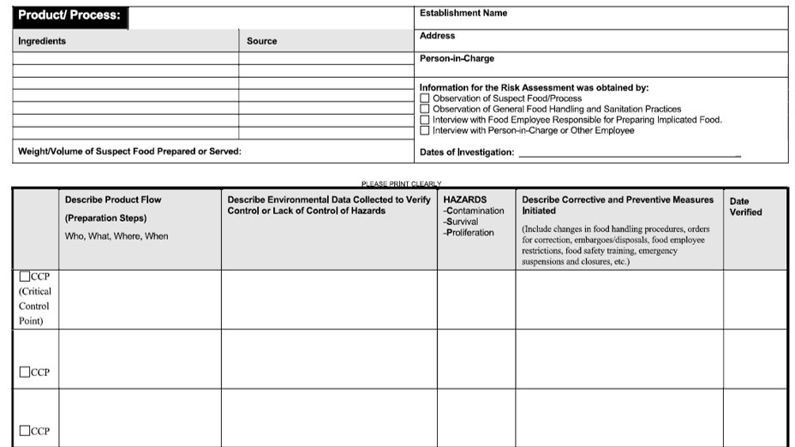
STEP 1: Identify ingredients, weight/volume, and steps involved in the preparation of suspect food(s)
Ingredients in the suspect food.
Where did the suspect food come from? The suspect food may be contaminated at the source (farm/ocean) or at the manufacturing level.
Weight / Volume of the suspect food prepared by the food establishment.
Suspect food preparation schedule.
Identify steps / control points in preparing the suspect food.
?
Notes:
Ingredients in the suspect food: Obtain recipes and list all ingredients for each suspect food item. Ingredients must be from an approved source, especially high-risk ingredients such as raw shellfish or canned low-acid foods. Note new changes in recipes or ingredient substitutions. Important to note that recipes are proprietary information and must be treated with strict confidentiality.​
​
Where did the suspect food come from?: Contaminated produce, eggs, seafood and commercially-processed foods have been implicated in many foodborne illness outbreaks. When such products, contaminated at the source, are implicated, it is crucial to obtain as much information as possible from the food establishment or consumer to identify the exact source and/or manufacturer/distributor. Product lot numbers, expiration dates and sales records are necessary when conducting a traceback to identify an implicated source. ​
​
List the weight/volume of the suspect food prepared: Large volumes may indicate problems with cooling or food handling procedures, especially if the food was prepared a day or more before service. If the volume was greater than what is normally prepared, different procedures may have been used.​
Food Preparation Schedule: and the length of time are important information needed to determine potential time/temperature abuse. It is important to document date and time prepared, when applicable, to determine if there was time for temperature abuse which may have resulted in the growth of pathogens or the production of toxin.​
Identify steps / critical control points in each step in the preparation of a food item is regarded as a "control point." List each step or control point on the HACCP Risk Assessment Form. Listing the steps as a flow chart permits the visualization of each preparation step.​

Slide 19
STEP 2: Identify food handling procedures at each step in their preparation​ of suspect food(s)
Clearly document how the food was handled at each step.​
Clearly document who prepared the food.​
Focus on the significant factors in foodborne illness outbreaks.
Reminder: This will become a public record and not confidential!
Notes:
READ SLIDE.
The method used to identify food handling procedures at each step is to observe the actual process. Since this may not be feasible in some situations, it is essential to interview the PIC and then walk through the preparation steps in the kitchen afterwards. Identify how suspect foods were thawed, cooked, cooled, reheated, and served. Identify how food employees determined final cooking temperatures. Indicate what equipment was used in the preparation of the suspect food. Specify if food workers use disposable gloves or utensils to handle cooked and ready-to-eat foods. Indicate handwashing practices observed.​
​
It is recommended that the initials of the employee responsible for handling food be documented. An infected food employee with poor hygiene may be the source of contamination. The initials of the actual worker, and not just his/her position are very helpful when comparing the positive or symptomatic food employees to their job functions, to determine if there is a relationship. Inquire if the food employee has been recently ill. Ask if the worker is a new employee, or new to the operation, because a new or different food employee unaware of the proper procedure may have been responsible for preparing the suspect food. Review the food establishment's sick or infected food employee policies.​
​
When conducting a HACCP Risk Assessment, focus on poor food handling practices which can contribute to foodborne disease. Define each significant factor, in addition to asking questions that may need to be addressed during your assessment.​
A reminder this form will become a public record and is not confidential.

Slide 20
STEP 3: Based on observation or interview, identify potential hazards​ and critical control points (CCP)
A critical control point (CCP) is a preparation step in which a hazard, if present, can result in a foodborne disease.​
The three main microbiological hazards are:​
Contamination (C)​
Survival (S) ​
Proliferation (Growth​ / Toxin Production)
Notes:
A critical control point (CCP) is a preparation step in which a hazard, if present, can result in a foodborne disease.​
The level of risk for a suspect food depends on the probability of occurrence of a hazard or the sequential occurrences of several hazards identified in the preparation procedure. The three main microbiological hazards are :​
Contamination (C)​
Survival (S) ​
Proliferation (Growth​ / Toxin Production)
We will go over and break down the three microbiological hazards in the next couple of slides.

Slide 21
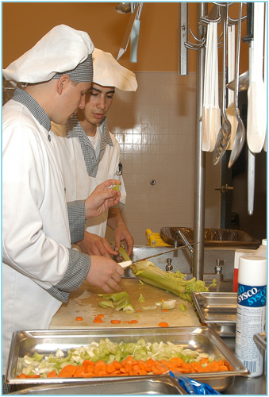
Contamination (C)
Evaluate each step in food preparation for potential microbial contamination.
Consider risks from food employees, contaminated food, or improperly cleaned and sanitized equipment/utensils.
Raw animal foods may already carry contamination.
Some foods, like lettuce, raspberries, and unpasteurized apple cider, can be contaminated at harvest and are often consumed raw.

Slide 22
Contamination (C)
Contributing Factors Associated with Contamination:
Contaminated Ingredients
Consumption of Raw or Lightly Cooked Food of Animal Origin
Unapproved Source
Infected Person
Cross-Contamination
Unclean Equipment
Hand Contact with Implicated Foods
Added Poisonous Chemicals
Natural Toxicant
Toxic Container
Notes:
Contributing factors associated with contamination:
Contaminated Ingredients: The suspect food or a component of the food contained the pathogenic agent when it arrived at the point of preparation. Determine if the suspect food harbors contaminants normally found in soil fertilizers or raw animal foods (e.g., raw meat, poultry, seafood, root vegetables, etc.). Check to determine if the water/ice supply was possibly contaminated, to determine if back-flow prevention devices were present on plumbing cross connections., to determine if the suspect food was from an approved source. to determine if the source may have contributed to the suspect food's contamination (e.g. shellfish from a contaminated growing bed).
Consumption of Raw or Lightly Cooked Food of Animal Origin: The suspect food was eaten raw or after a heat treatment that would not have reduced the level of agent contamination to below an infectious dose. Determine if the suspect food of animal origin was served raw or undercooked. Check if consumer advisories were properly posted.
Unapproved Source: The suspect food was obtained from a source that does not comply with appropriate regulatory standards (e.g., shellfish harvested from closed growing beds). Determine if all foods, including water and ice, were obtained from an approved source. Check identification tags on shellfish and if they are retained for 90 days. Check to see if there are vendor receipts or bill of ladings, showing proof of the vendor and where the product came from.
Infected Person: A food employee involved in the preparation of the suspect food was infected or was suspected of being infected at the time the food was prepared. This individual was identified as the probable source of the agent in the outbreak. Identify the persons responsible for preparing the suspect foods. Determine if any of the food employees were ill before, or during, the time that the suspect food was being prepared. Check if any of the food employees were observed with infected cuts or wounds on their fingers or hands.
Cross-Contamination: The pathogen was transferred to the suspect food during preparation by contact with contaminated worker hands, equipment, utensils, drippage, or spillage. If worker hands were the mode of contamination, the worker was not necessarily infected with or a carrier of the organism. Determine if raw foods were stored separately from cooked and ready-to-eat foods. Check if food employees were properly washing their hands and using a physical safety barrier such as disposable gloves, deli papers and utensils in-between handling raw, and cooked, or ready-to-eat foods. Check equipment, utensils and food contact surfaces for proper cleaning and sanitizing between uses.
Unclean Equipment: the suspect food was prepared with, or stored in, equipment that was contaminated with the agent. Check if the equipment and utensils used to prepare the suspect food were properly cleaned and sanitized in accordance with 105 CMR 590.000.
Hand Contact with Implicated Food: A food employee who was identified as the source of the agent prepared the suspect food with his/her bare hands. Check if infected workers used their bare hands to handle or to prepare cooked and ready-to-eat foods. Determine if food workers are trained to use physical safety barriers such as disposable gloves, deli papers and utensils in-between handling raw, and cooked, or ready-to-eat foods.
Added Poisonous Chemicals: The chemical agent was deliberately or inadvertently added to the suspect food. In former cases, this addition typically occurred at the time of preparation or packaging of the suspect food. Determine if any toxic substances were improperly stored or used around the suspect food. Check if there were any recent situations involving a disgruntled employee possibly seeking revenge. Investigate whether any toxic substance in the immediate vicinity of the suspect food may have been mislabeled.
Natural Toxicant: A chemical agent of biologic origin that occurs naturally in the suspect food or bioaccumulates in the suspect food, prior to, or soon after, harvest. Investigate whether a suspect food is known to harbor natural toxicants, such as histamine in scombroid fish, aflatoxins in grain, toxins in poisonous mushrooms, and dinoflagellate toxins in shellfish.
Toxic Container: A chemical agent originated in the material from which the food container was made. The agent migrated from the container into the suspect food. Determine if the suspect food was in direct contact with lead, copper, aluminum, tin, cadmium or other heavy metals. Is the suspect food acidic (pH less than 7)? The more acidic the product, the greater potential for the metals to leach into foods. Check to see that food is stored in the proper containers.

Slide 23
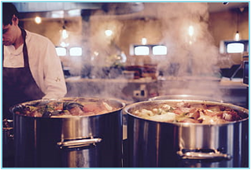

Survival (S)
Determine if pathogens survived the cooking process. The survival of pathogens is determined by the "thermalization" or cooking procedure used. Pathogens are easily destroyed by adequate cooking or reheating.
The consumption of undercooked or raw foods of animal origin is a significant factor in foodborne disease outbreaks. Complete cooking times and temperatures can be found in 105 CMR 590.000, Chapter 3, Section 3-401 Cooking.
Contributing Factors Associated with Survival:
  Inadequate Cooking
  Inadequate Reheating
Notes:
Read Slide.
Inadequate Cooking: The suspect food was not heated to a temperature and for a time adequate to destroy the agent or to reduce the level of contamination to below an infectious dose. Determine whether the raw animal origin foods were cooked to proper time/temperatures in accordance with 105 CMR 590.000. Check if the establishment has the required food thermometers and whether they are being used to test final cooking temperatures. Determine if cooking temperature logs are being used and maintained, if required.
Inadequate Reheating: The suspect food, which had been previously cooked and cooled, was not heated to a temperature sufficient to destroy the agent or to reduce the level of contamination to below an infectious dose. Determine how the suspect food was reheated, if the suspect food was properly reheated in accordance with 105 CMR 590.000, and if a thermometer was used to test the final reheat temperature of the suspect food.

Slide 24
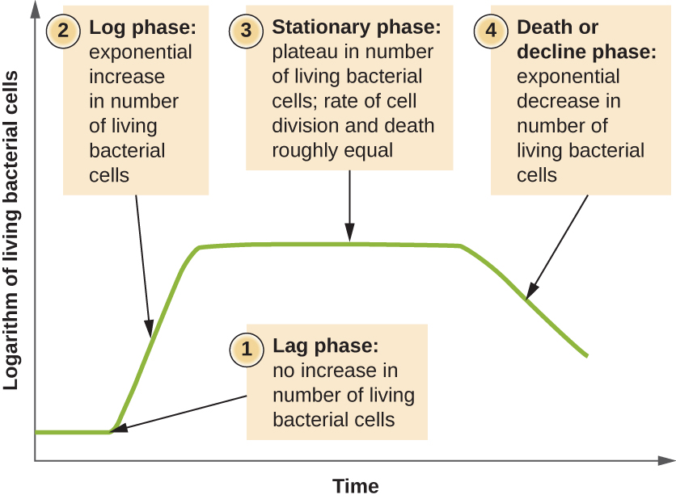
Proliferation
Also known as Growth / Toxin Production.
Determine if the pathogens had ample time to grow (G) and/or produce toxin (T).
The growth of pathogens and the production of toxins can occur in TCS foods which achieve temperatures between 41*F and 135*F for several hours.
Notes:
Read slide.

Slide 25
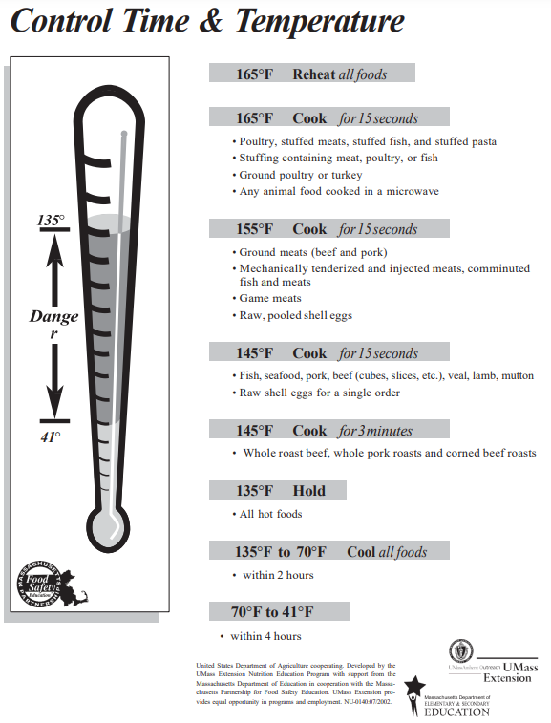
Proliferation
Time/temperature abuse can result from inadequate cooking procedures, holding at room temperature and inadequate hot and cold holding units.
While reheating contaminated food may destroy pathogens, it may not deactivate heat-stable toxins produced by pathogens such as Staphylococcus aureus.
It is recommended that TCS foods be cooled from 135*F to 70*F within two hours and from 135*F to 41*F or less within a total of 6 hours.
Notes:
Read slide.

Slide 26
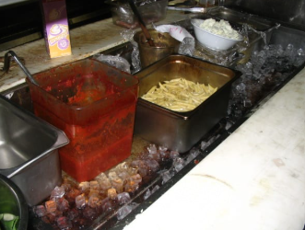
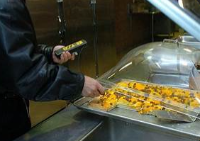

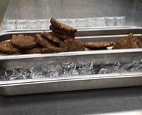
Contributing Factors Associated with Proliferation
Improper Cooling
Inadequate Refrigeration
Inadequate Hot Holding
Preparation Several Hours Before Service
Anaerobic (without oxygen) Packaging
Notes:
Contributing Factors associated with Proliferation:
Improper Cooling: The suspect food was cooled from a cooking or ambient air temperature to a refrigeration temperature by a means that allowed the growth of a pathogen to an infectious dose or the production of toxin. Determine if implicated TCS foods were cooled to 41 degrees F within 6 hours by pre-chilling ingredients, using shallow containers, ice baths or reducing the size of the product.
Inadequate Refrigeration: The suspect food was not held at a temperature of 41 degrees F or less either due to improperly functioning refrigeration equipment or because it was being held outside of refrigeration. The equipment or held at an improper temperature was sufficient to permit the growth of a pathogen to an infectious dose or the production of toxin. Determine if there was an adequate number of refrigeration units to maintain the suspect TCS food at or below 41 degrees F, and if refrigeration units were properly operating at or below 41 degrees F.
Inadequate Hot Holding: The suspect TCS food was not held at, or above, 135 degrees F due to improperly functioning hot holding equipment, or was not being held in hot holding equipment. The period of time the food was held was sufficient to permit the multiplication and growth of the pathogen
to an infectious dose. Determine if the suspect food was left out for storage or display at ambient air temperature, how long the suspect TCS food was below 135 degrees, if temperatures of suspect foods in hot holding units were at, or above, 135 degrees F, if the food employees have and use thermometers to measure temperatures of the suspect TCS food in hot holding units, and if required, check temperature logs for hot holding units.
Preparation Several Hours Before Service: The suspect food was prepared long before service, and this practice permitted a time/temperature abuse of the food. Determine the length of time between preparation and service of the suspect food, and how long the suspect food was stored between preparation and service.
Anaerobic Packaging: The suspect food was stored in a container that provided an anaerobic environment, which permitted the multiplication and growth of the agent. Check to determine whether the suspect food was stored in an anaerobic package or container (e.g., vacuum packaging, container filled to capacity and tightly covered, hermetically sealed containers, and garlic in oil products). If the suspect food was in a vacuum package or container, investigate at what temperature it was stored. Determine if the suspect food was prepared in a cook-chill or sous-vide operation. If the suspect food was in a vacuum package or container, review the label storage instructions, and make sure the food establishment was in compliance with label instructions.

Slide 27
STEP 4: Identify violations and initiate corrective actions
Accurate documentation of violations is essential, particularly if enforcement actions may follow.
Reference violations on the HACCP Risk Assessment Form using the "Item No." column.
Attach the HACCP form to the Food Establishment Inspection Report Form.
If a HACCP form is not completed, document violations in the narrative section of the inspection report.
Incomplete or missing documentation may lead to legal challenges against the LBOH.
Notes:
READ SLIDE.

Slide 28
STEP 4: Identify violations and initiate corrective actions
Record all corrective or enforcement actions taken at the time of the inspection.
Clearly indicate how and when violations will be corrected, especially for critical control points.
If violations involve critical control points, schedule a re-inspection within 24–48 hours to verify correction.
Use the "Verified" column on the HACCP Risk Assessment Form to note the verification date and the inspector’s name.
Notes:
READ SLIDE.

Slide 29
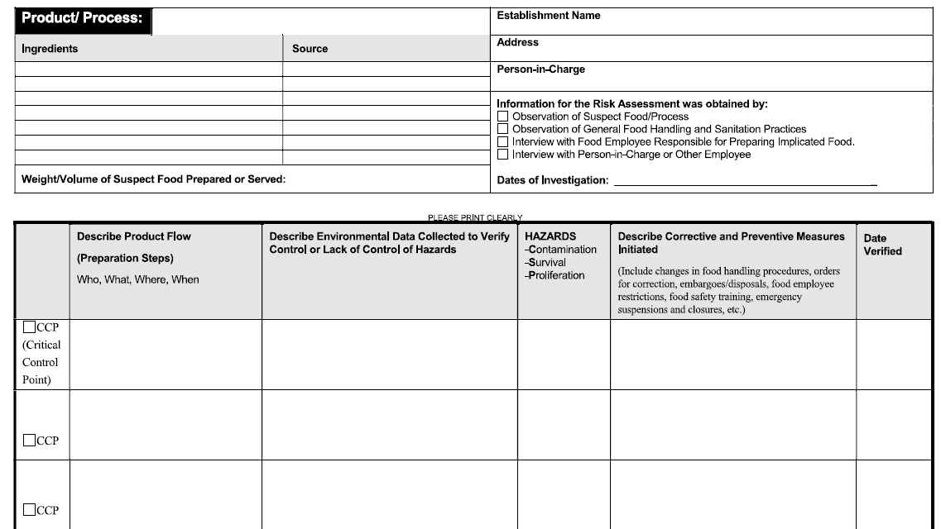
Notes:
These are the most important areas you will focus on this form. Ensure there is detailed information within these sections.

Slide 30
Corrective actions
May Include:
Modifying faulty food handling practices.
Education.
Removal of contaminated food from sale or distribution.
Restriction of infected food workers.
Emergency closure or suspension of operations.
Notes:
Corrective Actions may include:
Modifying faulty food handling practices: Initiating corrective actions is the most critical aspect of the environmental investigation, if unsafe food handling practices are discovered. Ensuring that faulty food handling practices which can result in foodborne disease are corrected is one of the primary objectives of the investigation. Emphasize critical control points correction. Discuss with the PIC monitoring procedures that can be implemented by the food establishment to ensure that steps designated as "critical" are properly carried out by food employees. Correction plans can include recommendations to improve food safety. For example, the use of raw eggs in a Caesar salad dressing may not be a violation of the regulations. However, recommending that the establishment use a pasteurized product is reasonable since the use of a pasteurized product can reduce the risk of disease transmission.
Education: Efforts to educate the owner/PIC on the risks posed by identified poor food handling practices should be made by the food inspector. In some situations, it may be necessary for the owner to hire a consultant to assist in making changes or training staff. The designated PIC will be required to participate in a food safety management program, if not already certified.
Removal of contaminated food from sale or distribution: If it is determined that food prepared on the premises is possibly contaminated and may cause a foodborne illness, the LBOH may initiate a voluntary disposal of the food or an embargo in accordance with 105 CMR 590.012. Such action should
be taken only with clear evidence of contamination or time/temperature abuse. Most of the focus should be placed on foods that will not receive further cooking or reheating, since it is these foods in which bacteria and toxins, if present, may survive until ingested. However, some food poisonings, such as scombroid poisoning can occur even after food is cooked. Remember that corrective actions may not always require disposal.
Restriction of infected food workers: If a sick food employee is noted at any time during the environmental investigation, work with the PIC to take steps to restrict the food employee from working with food in accordance with 105 CMR 590.000. A Food Employee Reporting Agreement can be used by food service establishments to assist with obtaining compliance with illness reporting requirements.
Emergency closure or suspension of operations: In certain situations, it may be necessary to close an establishment or suspend a particular operation if imminent health hazards exist that cannot be corrected immediately. Failure to immediately correct violations that may result in a foodborne disease, usually
associated with critical control points, should invoke an emergency closure or suspension of operation(s). For example, if it is discovered that a mechanical salad bar refrigeration unit is not maintaining TCS temperatures at or below 41 degrees F, and there is no ice source, the salad bar operation should be
closed until the unit is repaired. Another example that may warrant an emergency closure is in an outbreak situation when it is determined that the majority of the food employees must be restricted from working with food, and there are no replacement workers. A food establishment may desire to voluntarily close to avoid negative publicity. Remember, closures and suspensions are a serious matter to all involved and should be well planned before being implemented. If a closure or suspension is initiated, the permit holder and the PIC must be notified of the order in writing. The order is effective upon posting on the premises. Afterwards, the LBOH must hold a hearing within three business days after receipt of a written request for a hearing. Whether or not a hearing is requested, the LBOH may end the suspension at any time if the reasons for the suspension no longer exist.

Slide 31
STEP 5: Verify corrective actions undertaken by the establishment
All corrective actions must be verified by the LBOH .
Failure to correct critical violations or to comply with other necessary measures (e.g., food employee specimen submission or work restrictions) should result in the LBOH taking further enforcement actions such as suspension or emergency closure.
Verification may be completed during the investigation by source and the corrective actions, or by re-inspection.
Notes:
READ SLIDE. This is the area you would focus on the form for verification.

Slide 32
What is Verification?
8-405.20: Verification and Documentation of Correction.
  After observing at the time of inspection a correction of a violation of a PRIORITY ITEM or PRIORITY FOUNDATION ITEM or a HACCP PLAN deviation, the REGULATORY AUTHORITY shall enter the violation and information about the corrective action on the inspection report.
  (B) As specified under ¶ 8-405.11(B), after receiving notification that the PERMIT HOLDER has corrected a violation of a PRIORITY ITEM OR PRIORITY FOUNDATION ITEM or HACCP PLAN deviation, or at the end of the specified period of time, the REGULATORY AUTHORITY shall verify correction of the violation, document the information on an inspection report, and enter the report in the REGULATORY AUTHORITY'S records.
Notes:
***READ THIS FIRST:
What is Verification. Per the Oxford dictionary it is “the process of establishing the truth, accuracy, or validity of something. In this case it would be "the verification of official documents.“
What is required of the regulatory authority when it comes to verification? Per the MA Merged Food Code, 105 CMR 590….READ SLIDE.

Slide 33
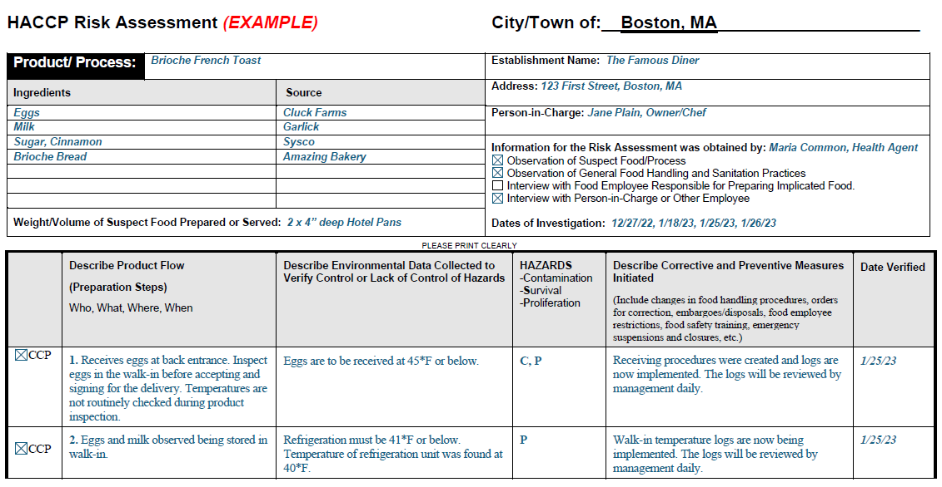
Correct Example – Brioche French Toast
Notes:
This is an example of how a HACCP Risk Assessment form is filled out appropriately.
Everything area of the form is filled out with no missing information. The information provided is as detailed as possible.
The description of product flow, environmental data collected to verify control or lack of, the hazards associated, description of corrective and preventative measures initiated, and the date verified.

Slide 34
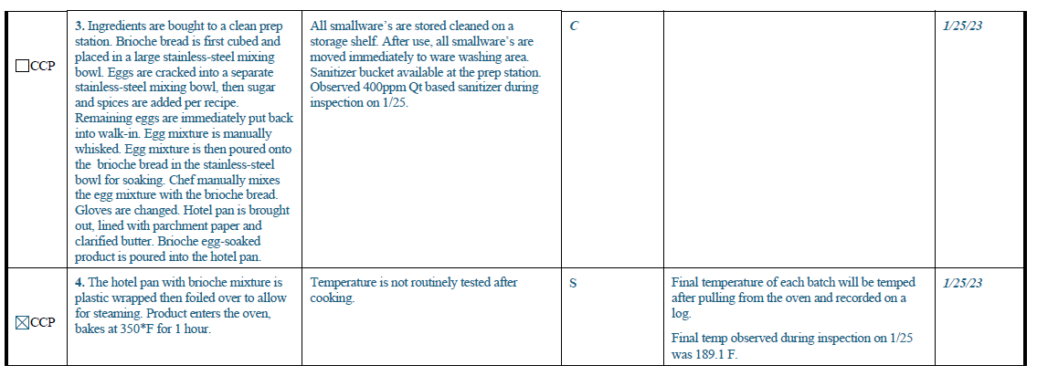
Correct Example – Brioche French Toast
Notes:
Here is where a CCP was identified and the observation made while on site.
The food establishment was not taking the temperature of the brioche French toast after cooking to ensure it was properly cooked all the way through.
Therefore, a corrective or preventative measure was provided and implemented. The establishment will now take a final temperature of each batch made and the temperature will be then documented onto a log.

Slide 35
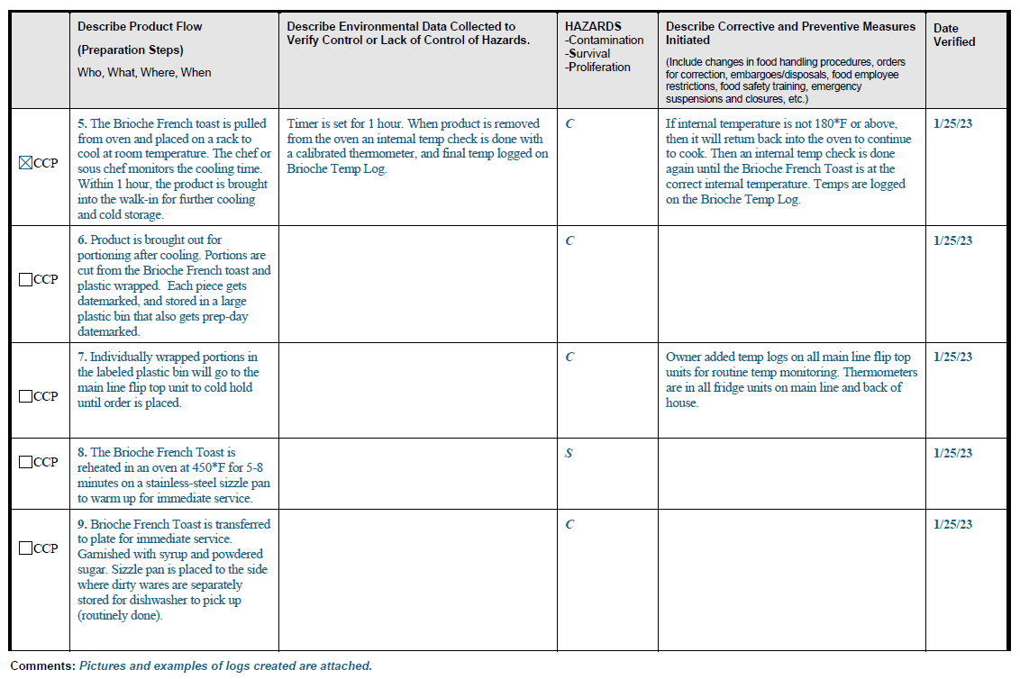
Correct Example – Brioche French Toast
Notes:
There is also a comment section at the bottom for any other information you would like to document but doesn’t fall under the other sections of the HACCP Risk Assessment form.
Here is says there are pictures and examples of logs attached to reference.

Slide 36
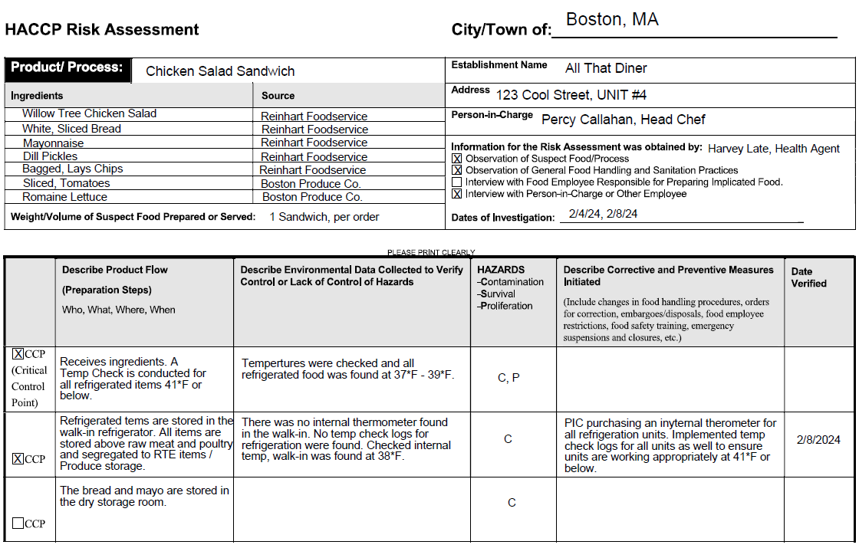
Correct Example – Commercially Prepared Chicken Salad
Notes:
Here is another example of a correctly filled out HACCP Risk Assessment Form for commercially prepared Chicken Salad used to make a sandwich.
Again, notice each section of the form is filled out and with detailed information.

Slide 37
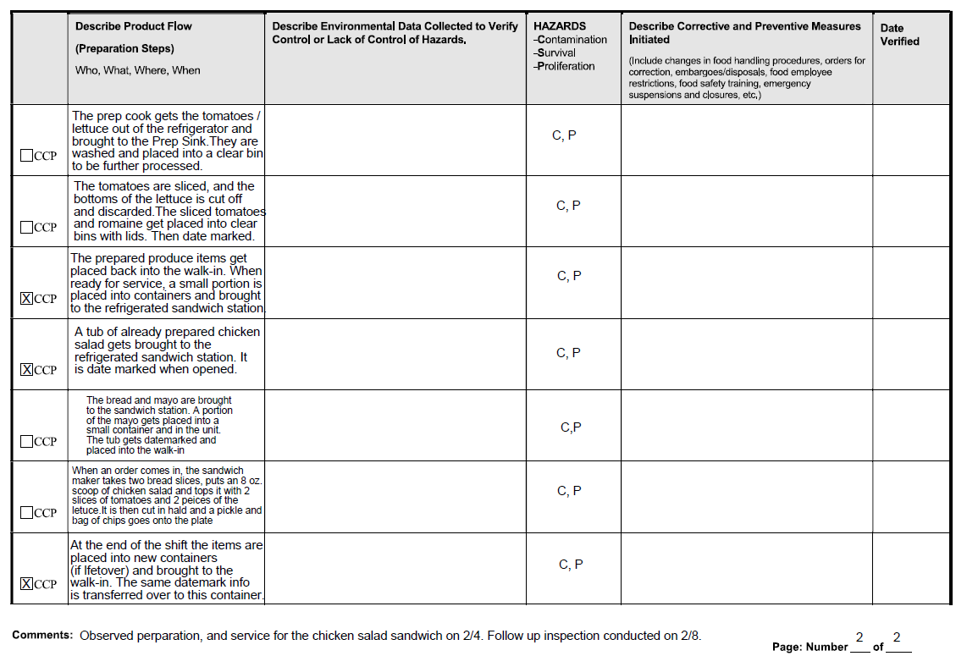
Correct Example – Commercially Prepared Chicken Salad
Notes:
CCP’s are identified and no issues were observed while on site.

Slide 38
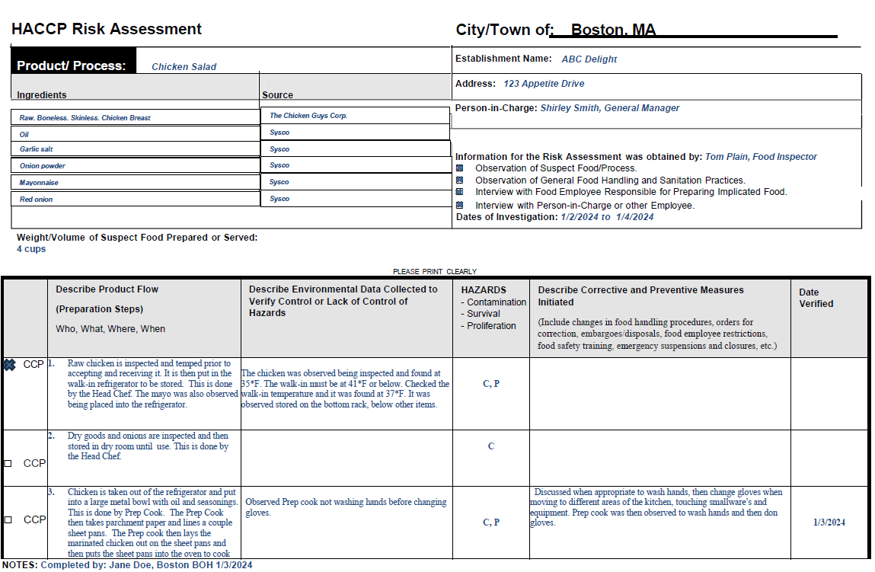
Correct Example – Homemade Chicken Salad
Notes:
Here is another example of a correctly filled out HACCP Risk Assessment Form for homemade chicken salad
Again, notice all areas are filled out in detail, CCP’s are identified, Verify of control or lack of is noted and corrective or preventative measures are noted for these observations.

Slide 39
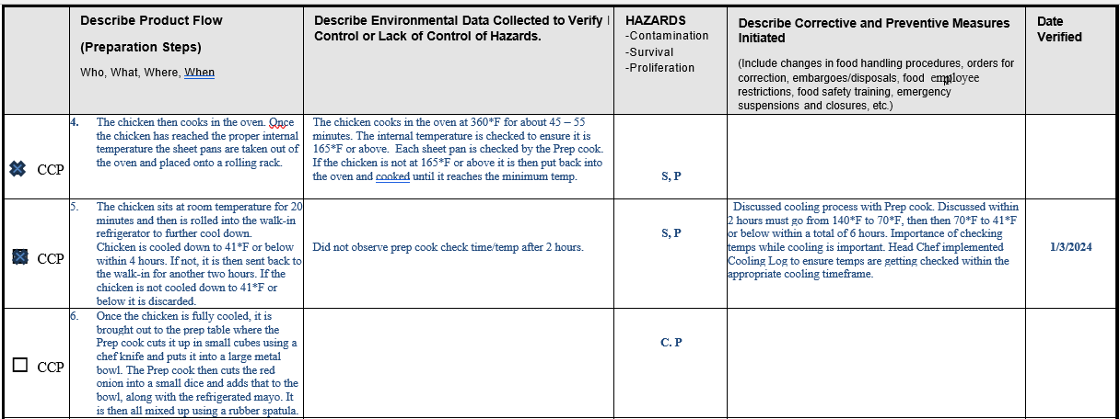
Correct Example – Homemade Chicken Salad

Slide 40
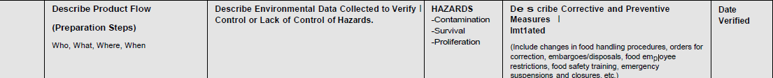
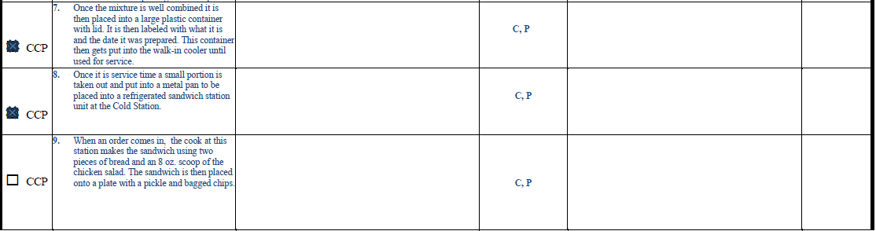
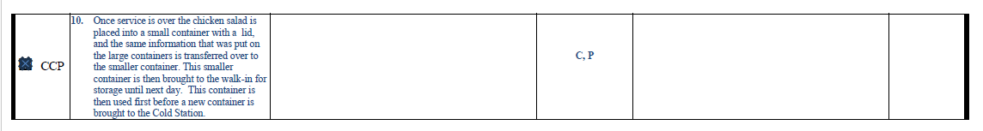
Correct Example – Homemade Chicken Salad
Notes:
CCP’s noted but no violations observed.

Slide 41
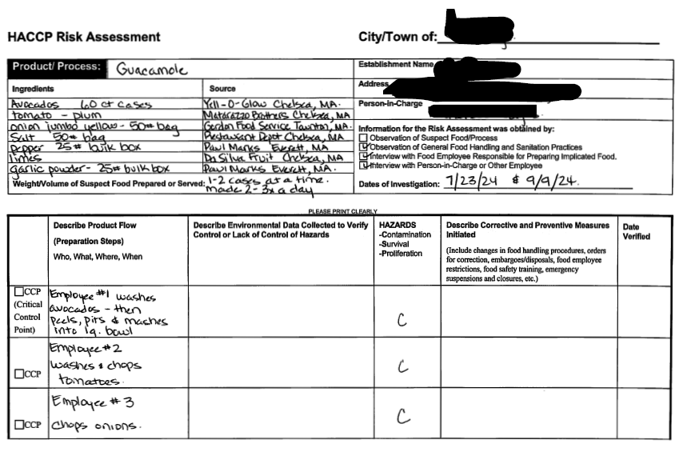
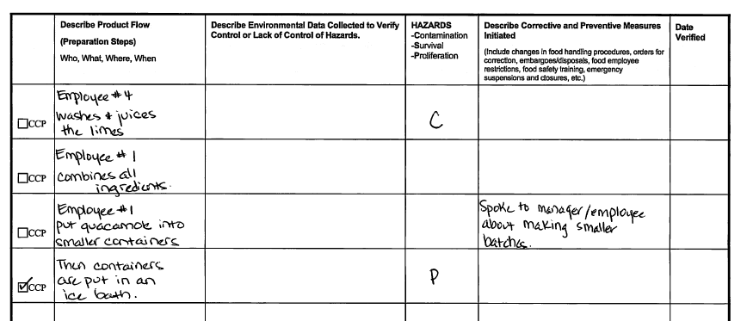
Incorrect Example
Notes:
Now here are some common mistakes when filling out a HACCP Risk Assessment Form.
Here is an example of a form not fully filled out. Sections are missing critical information needed such as observations made, whether they are good or bad observations, and the corrective actions or preventative measures taken by the food establishment to correct violations observed or bad practices.
Date of verification is missing as well.

Slide 42
Common Issues / Mistakes
Should be looking at a specific process in real time.
Not documenting the specific process at a high level of detail.
Some LBOH are using this “Foodborne Illness Complaint Environmental Investigation Summary Report” which is dated 2005 and is no longer used.
Getting all the information in a timely manner.
Notes:
Some more common mistakes or issues include
Not looking at a specific process in real time. Its best to physically observe what the food establishment is doing on site when making / preparing the food product. You can't observe good or bad practices through a phone call or email.
Not documenting the specific process at a high level of detail. The more detail on the process the better. Do not be vague. Include times, temperatures, amounts, specific equipment used, etc.
Some LBOH are using this “Foodborne Illness Complaint Environmental Investigation Summary Report” which is dated 2005 and is no longer used; but the form says to complete and submit a HACCP Risk Assessment. This leads to health agents conducting a HACCP RA (incorrectly) for multiple different food items and it doesn’t provide any useful information.
Getting all the information in a timely manner. DPH specifically asks for a HACCP RA to be completed during an outbreak when we have a suspect food item, and are concerned about the process regarding that dish. The quicker the information can be provided the better.

Slide 43

Important Reminders
A HACCP risk assessment may require more than one contact with the PIC during site visits or telephone calls source and obtain all the information necessary to assess the procedures.
Elements in the investigation may change and can require shifts of focus in suspect procedures.
Try to stay open-minded and patient.
When investigating suspect food items, which may have been contaminated prior to being received at the retail food establishment, it is important to obtain as much product information as possible to identify the exact source and remove contaminated products from distribution.
Conducting a HACCP risk assessment of the implicated food is necessary to effectively identify potential hazards or points of contamination and time/temperature abuse.
Notes:
READ SLIDE.

Slide 44

Important Reminders
A report that reflects a HACCP-based investigation provides specific information to the reviewer (permit holder, PIC, complainant, LBOH, MDPH Working Group on Foodborne Illness Control, lawyers, etc.) on how the food was handled by the establishment.
Findings may demonstrate how a food establishment is employing safe food handling procedures in preparing the suspect food.
Findings may also reveal critical control points in the preparation of the suspect food that were not being safely performed or monitored.
In this case, a HACCP risk assessment will clearly identify faulty food handling practices as well as the recommendations to initiate corrective actions.
Poor food handling practices can be replaced with safe practices and procedures, thereby averting future occurrences of foodborne disease.
Notes:
Read Slide.

Slide 45

QUESTIONS ???
Notes:
Any questions? I just wanted to note that if I am not able to answer your question, please come see me after the presentation so I can capture your question and get your email to follow up with.

Slide 46
Important Contact Information
Division of Food Protection: 617-983-6712
For policy and technical assistance with the environmental investigation such as conducting a HACCP risk assessment, initiating enforcement actions and collecting food samples. On-site investigation assistance is often available for larger outbreaks.
Division of Epidemiology: 617-983-6800
For assistance with the epidemiologic investigation including conducting case interviews, developing questionnaires, and performing analytic studies. Epidemiologists can also assist with coordinating food handler stool testing at the State Public Health Laboratory.
State Public Health Laboratory: 617-983-6616
For technical assistance with the collection protocol for food and enteric specimens.

Slide 47
Additional Contact Information
Jessica Ferreira, CP-FS
Food Safety Trainer
Email: Jessica.L.Ferreira@mass.gov
Mark Carleo, REHS, CP-FS
Senior Food Safety Trainer
Email: Mark.L.Carleo@mass.gov
Nichol Smith, MS
Outbreak and Response Coordinator
Email: Nichol.L.Smith@mass.gov

