Slide 1
Air Quality Nuisance Complaints Concerning Noise
Gregory C. Tocci, P.E., INCE Bd. Cert.
Aaron F. Farbo, INCE
Cavanaugh Tocci
Sudbury, MA
May 28, 2025
presented to
Massachusetts Environmental Health Association (MEHA)

Slide 2
A Complaint is Received
Addresses:
  Complainant
  Source
Find locations on
  Google Earth
  MA GIS/MassMapper
Characteristics of offending source:
  Steady State/Constant or Intermittent
  Tonal (whine, hum, etc.)
  Impact/Impulsive (cyclical, sporadic, intermittent of short duration

Slide 3

A Complaint is Received (cont’d)
Have there been complaints in the past?
Are there obvious sources? Are they observable or is occurrence unpredictable.
Is there a
contemporaneous
record of times and
dates sound has
been observed?

Slide 4
Noise Regulations/Codes
Exterior source—emission from exterior and transmitted to another building or property
  Local ordinance—general or with specific, measurable limits?
  MassDEP Noise Policy
Interior source—emission from with a building to another occupancy within the building
  Building code minimums on sound isolation
  Police action

Slide 5
Attributes of Environmental Sound
Sound Pressure Level (amplitude)
  Decibels (dB)
  A-weighted decibels (dBA)
Frequency (pitch, tonality, Hertz, Hz)
  Octave bands
  Most sensitive to 500-4000 Hz, less above/below
Time variation
  Energy average
  Percentile sound levels
  Min. and max. sound levels

Slide 6
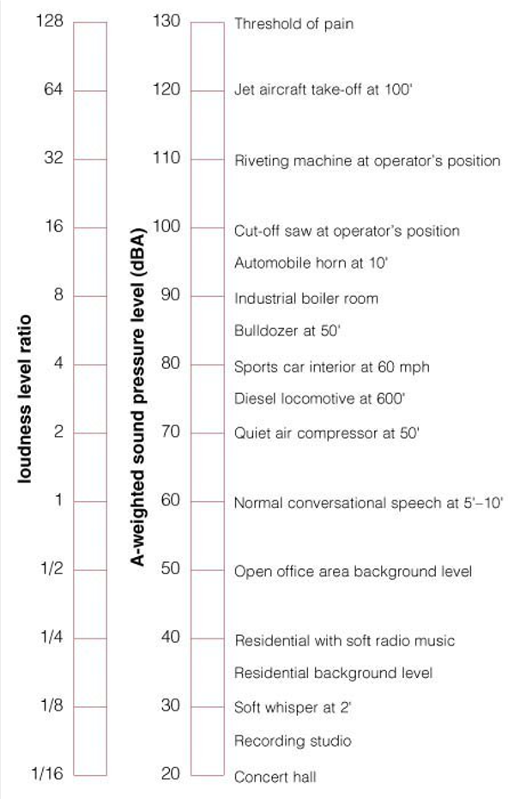
Sound Pressure Level
Common source comparisons
Problematic environmental sound often as low as
40-50 dBA
What may be a problem in a quiet rural area may not be offensive in a noisier, city area.
Missing from this for quantifying the environment is variability.

Slide 7
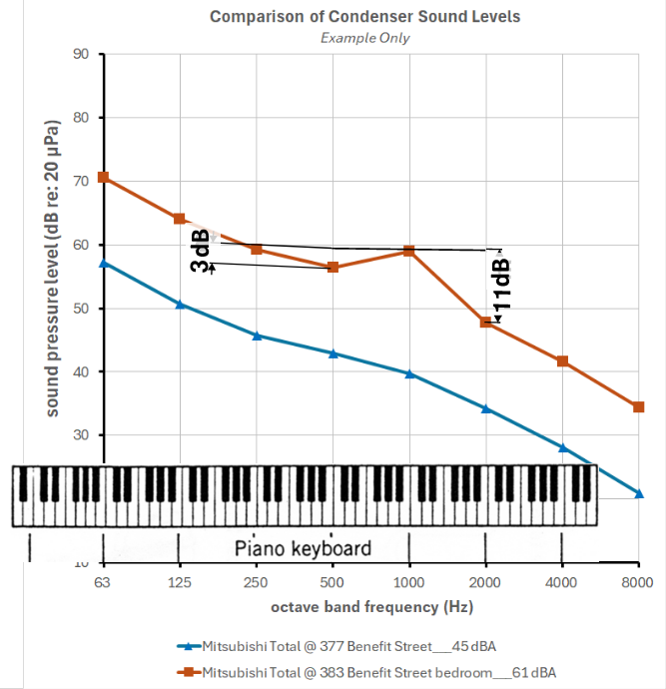
Frequency—Octave Band Spectra

Slide 8
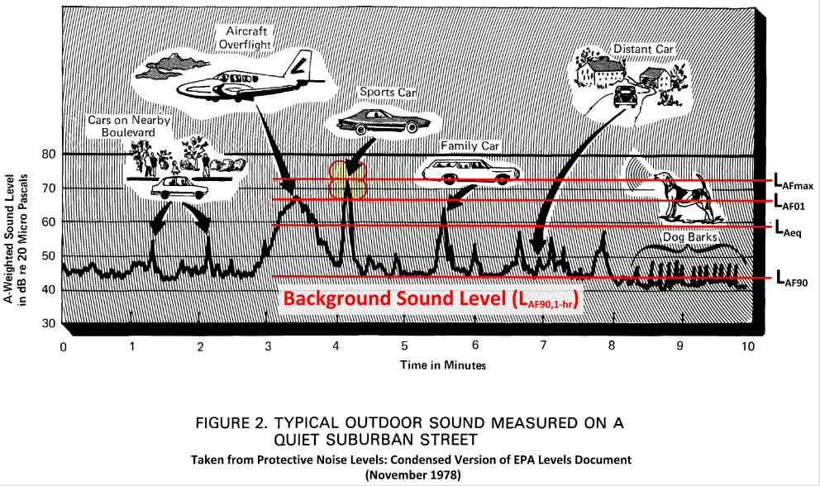
Time Variation Sound Level Descriptors

Slide 9
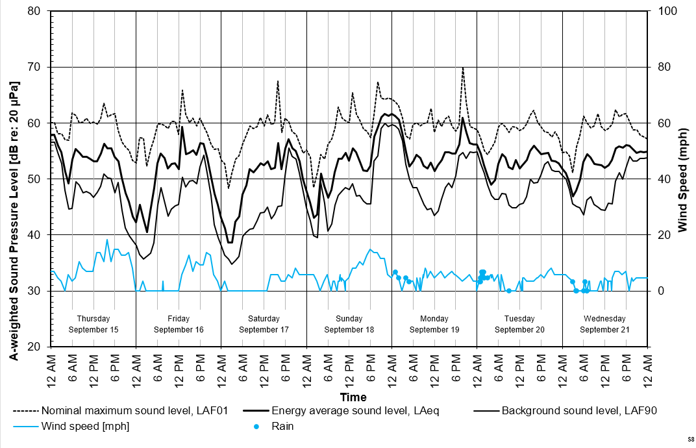
Hourly Percentile Sound Levels

Slide 10
Massachusetts Law (CMR)
Massachusetts 310 CMR 7.00 Definitions
  Noise is an “air contaminant”
Massachusetts 310 CMR 7.01 General Regulations
to Prevent Air Pollution
  “…a condition of air pollution” not permitted
Massachusetts 310 CMR 7.10U Noise
  (1) Noise not permitted (specific, measurable limits
  not specified)
  (2) Controls to be implemented when available
  (3) Exclusions

Slide 11

MassDEP Noise Policy
Massachusetts DAQC Policy 90-001
dated February 1, 1990
  10 dB max increase in “ambient”
  “Pure tone” condition not permitted
  “Air pollution” not permitted as per 310 CMR 7.01
Definitions
  Ambient—Lowest 1-hr background A-weighted sound
  pressure level exceeded 90% of the time during
  equipment operating hours
  Pure tone—Occurs when the level in an octave band exceeds the level in both adjacent octave bands by 3 dB or more
  Air pollution—Air contaminants not permitted. Sound is an air contaminant.

Slide 12
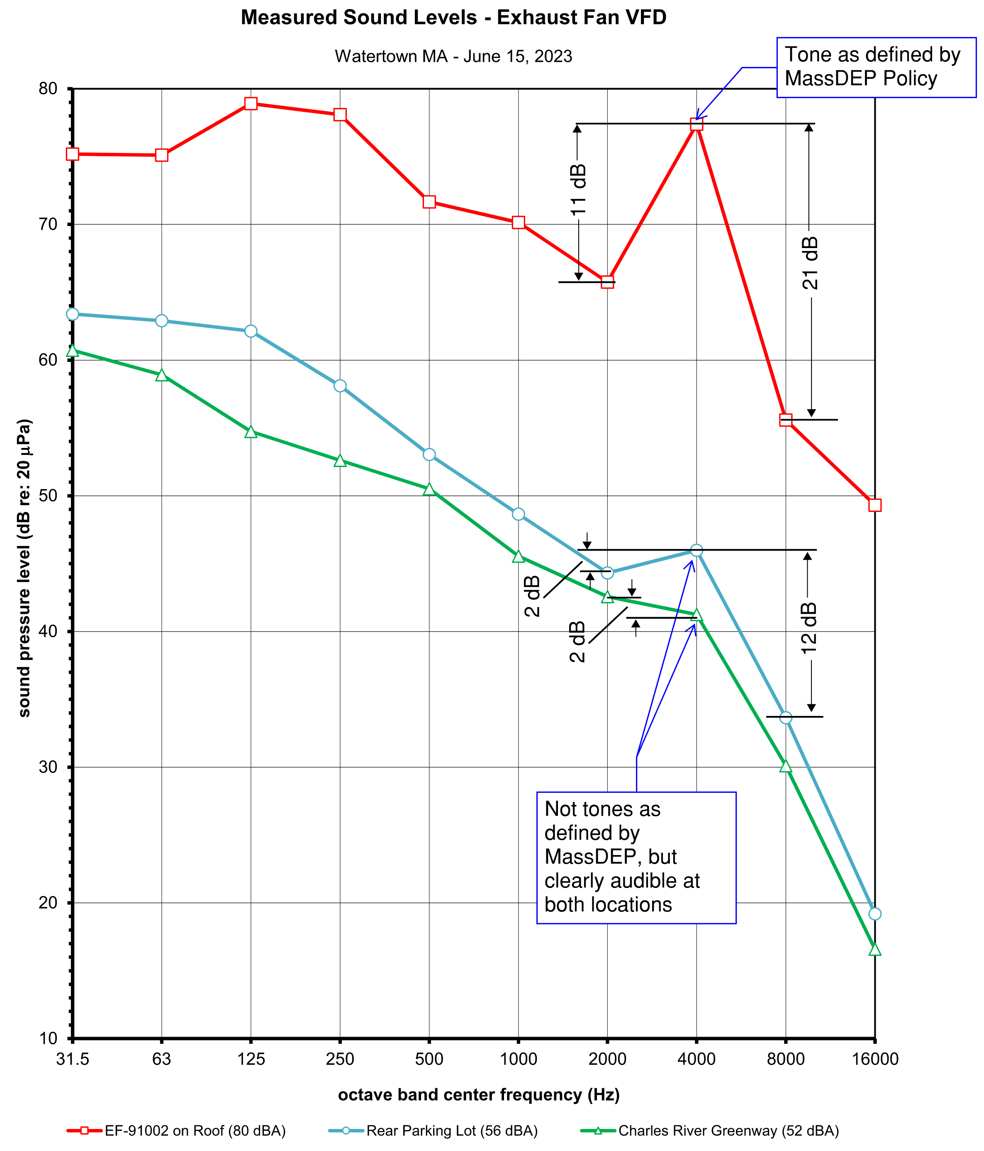
MassDEP Pure Tone

Slide 13
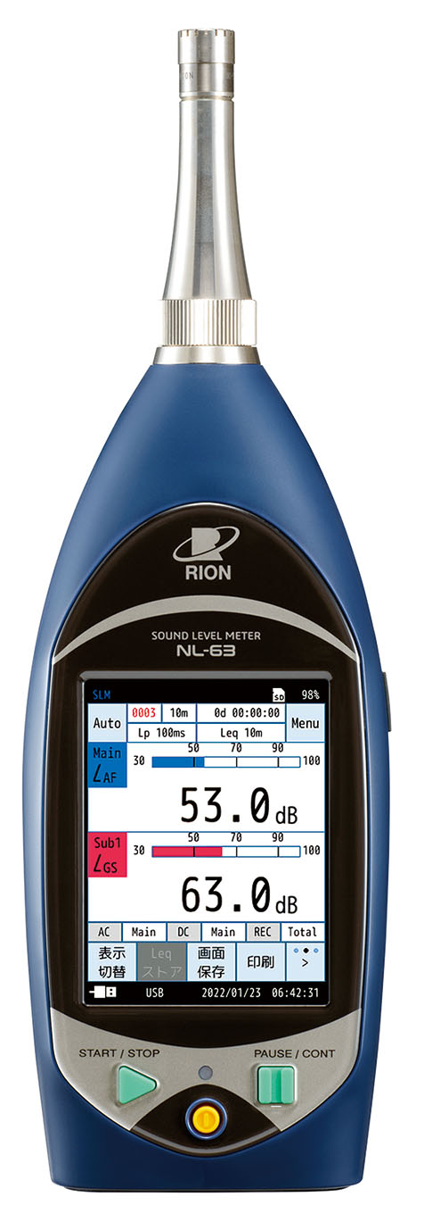
How can MassDEP Assist
MassDEP Guidance
  Does the sound level unreasonably interfere
  with neighboring use
  Does offending source have permits/approvals
  Does it violate local ordinance/zoning regs
  Contemporaneous log: Time/date, tonal/
  tonal/impulsive/broadband
  MassDEP can provide sound level
  meter and guidance on its use to health
  officials.

Slide 14
Responding to Noise Complaints
  BOH have broad authority under state law to investigate and control nuisance conditions
  BOH (Board of Health) is first line of defense for nuisance conditions
  Municipal officials should determine whether:
    Nuisance conditions unreasonably interfere with the enjoyment of residential property or operation of business
    The source of the nuisance, if a business, has the necessary licenses, permits and approvals to operate/conform to codes
    Offending activities constitute a violation of local nuisance by-laws or ordinances that may be more stringent than state
    Link to DEP Fact Sheet – Responding to Local Noise Complaints
  https://www.mass.gov/doc/how-municipalities-should-respond-to-noise-odor-dust-complaints-0/download

Slide 15
MassDEP Noise Contacts by Region
  Northeast Region – Quan Tat, 978-604-7309, quan.tat@mass.gov
  Central Region – Michelle Delemarre, 857-772-6966, michelle.delemarre@mass.gov
  Southeast Region & Cape Cod – Dan DiSalvio, 508-207-6027, dan.disalvio@mass.gov
  Western Region – Daniel Balboni, 413-355-6274, daniel.balboni@mass.gov
  Each region of MassDEP maintains a sound level meter for local health departments to borrow

Slide 16

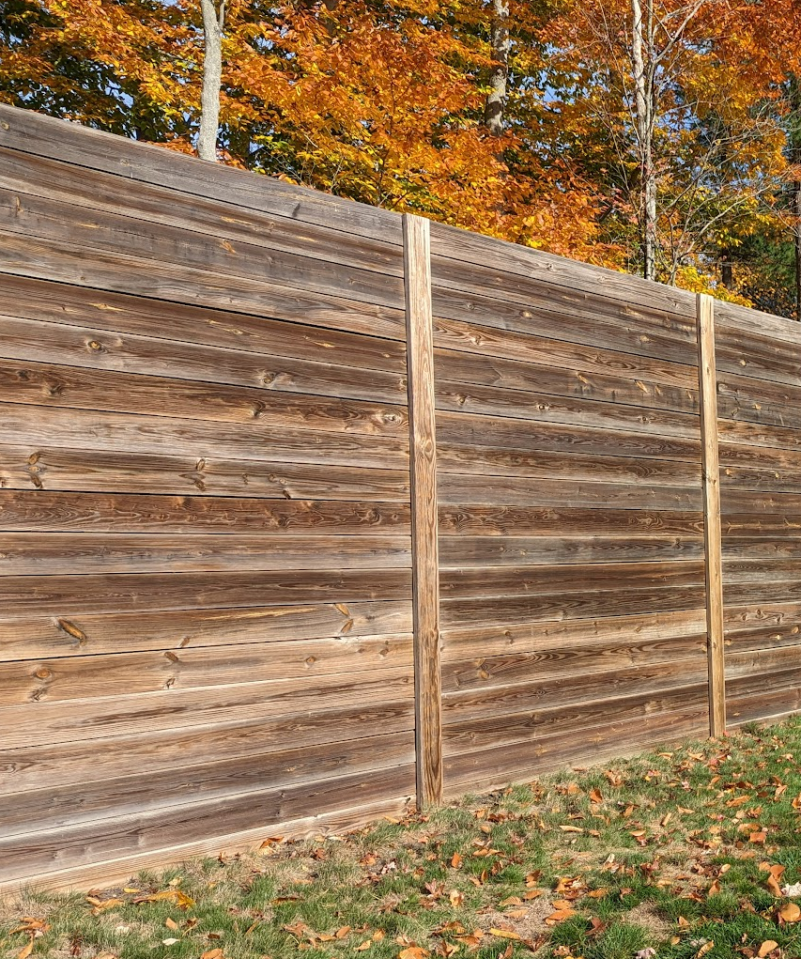
Precautions to Note For Measurements
    Avoid taking readings during adverse weather conditions
      Wind in excess of 12 mph – always use a windscreen!
      Rain/hail
    Avoid taking readings near surfaces that deflect sound (near walls, buildings, trees). These surfaces may reduce sound levels (obstruction) or increase levels (reflection)
    For maximum accuracy, hold the instrument away from you at an angle of approximately 70° from horizontal.
    For measurements longer than 2-3 minutes, use a sturdy tripod

Slide 17
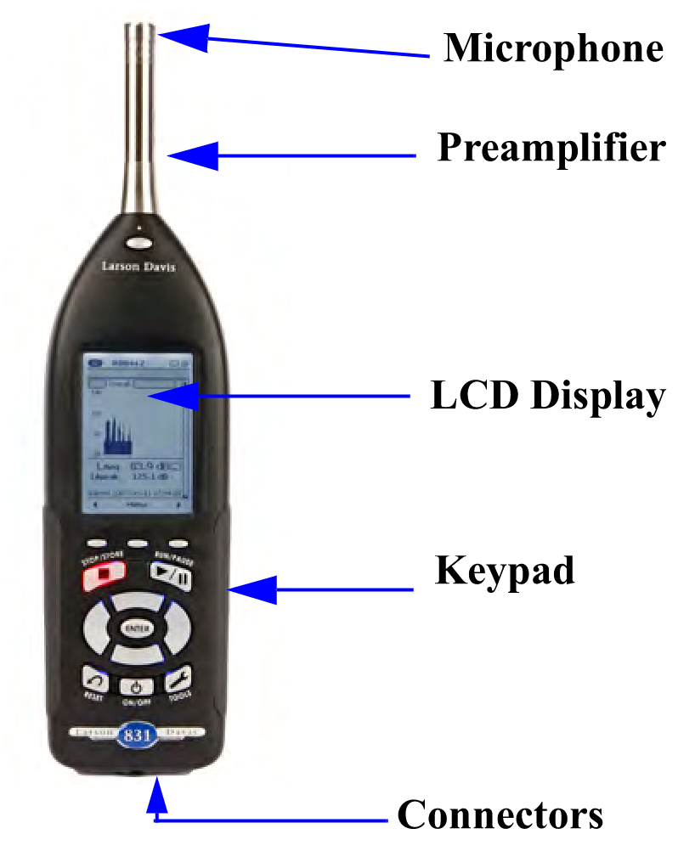
Sound Level Meter Setup
  Calibrate the meter
  Frequency Weighting – A
  Time Weighting – Slow or Fast
    DEP Guidance – Set to slow for most sources except where noise is not present long enough to obtain maximum reading

Slide 18
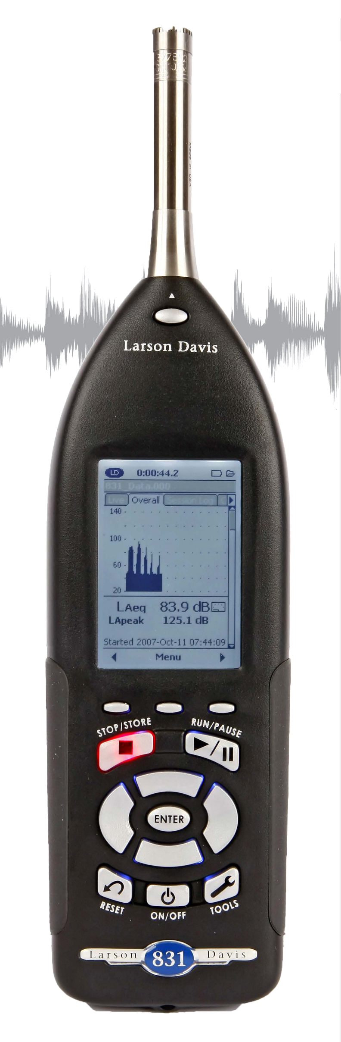
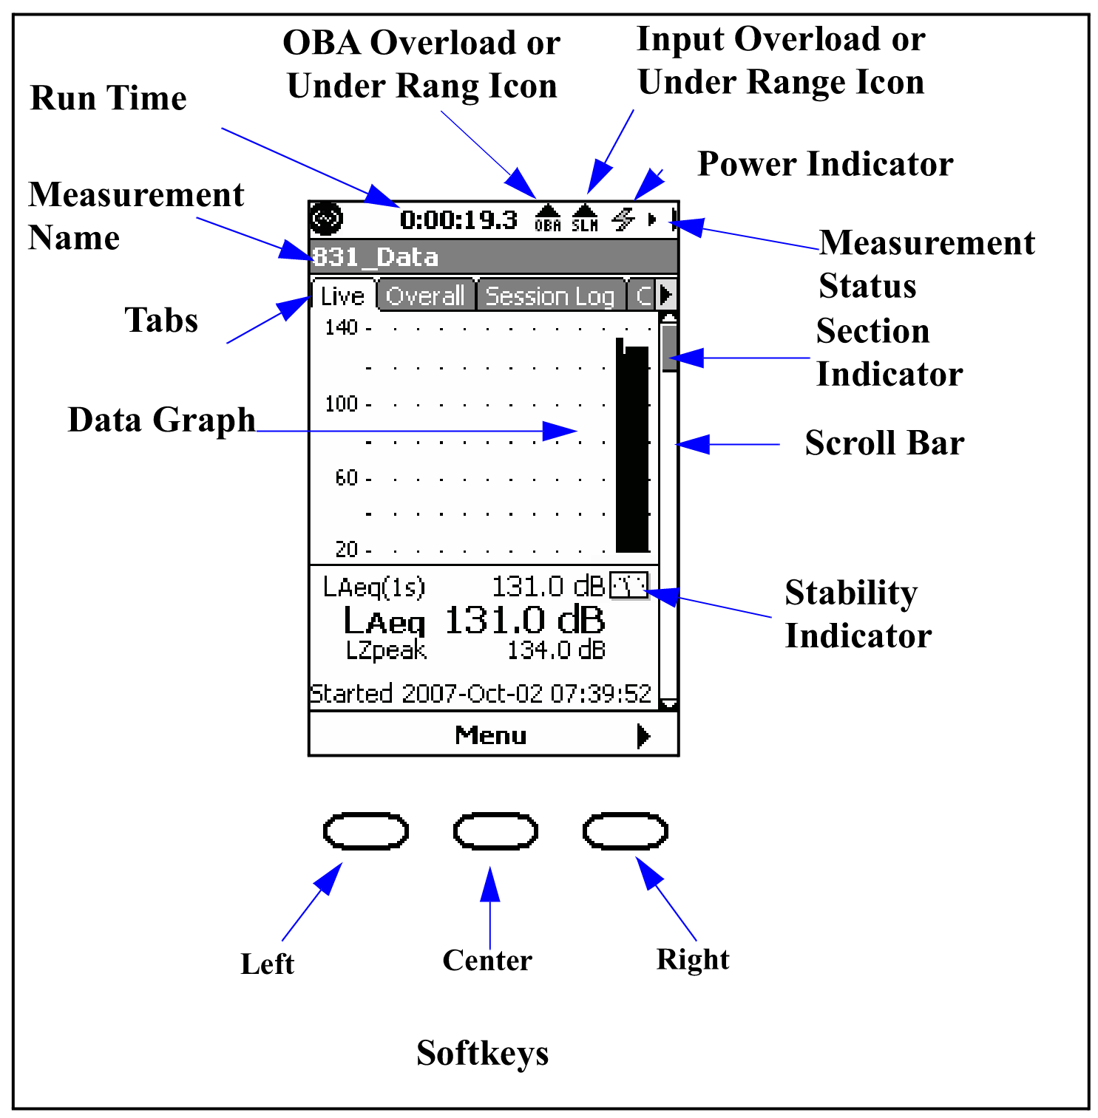
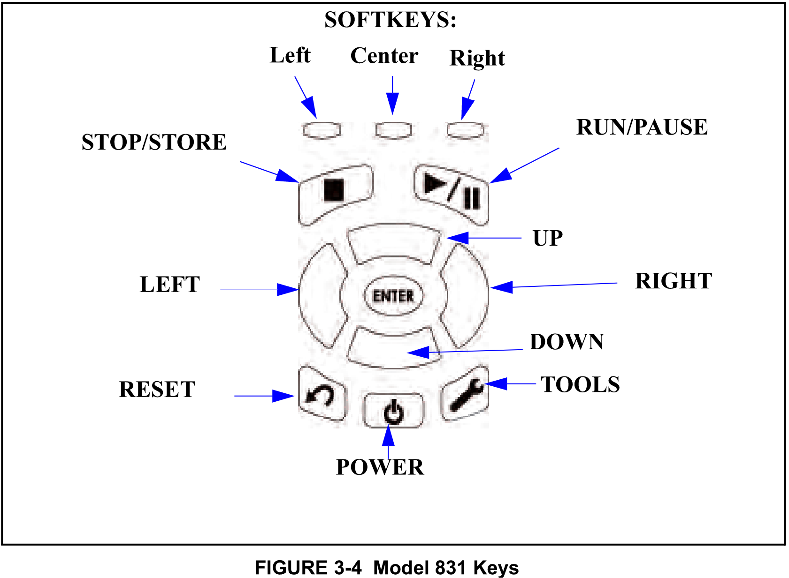
Larson Davis 831

Slide 19
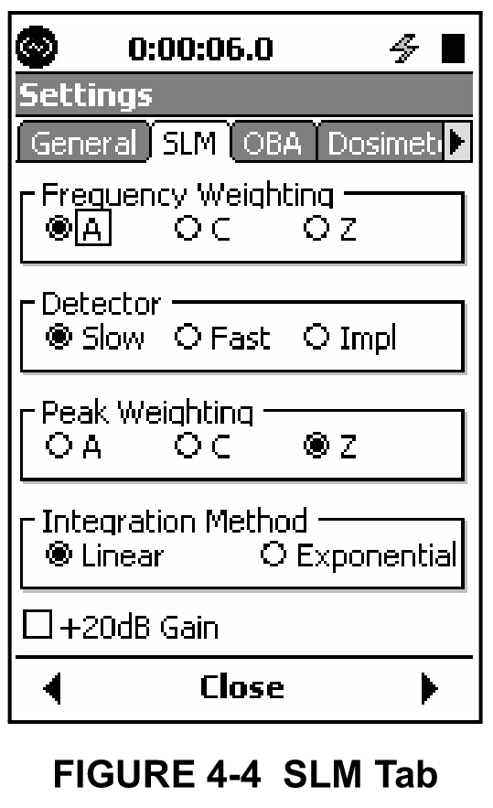
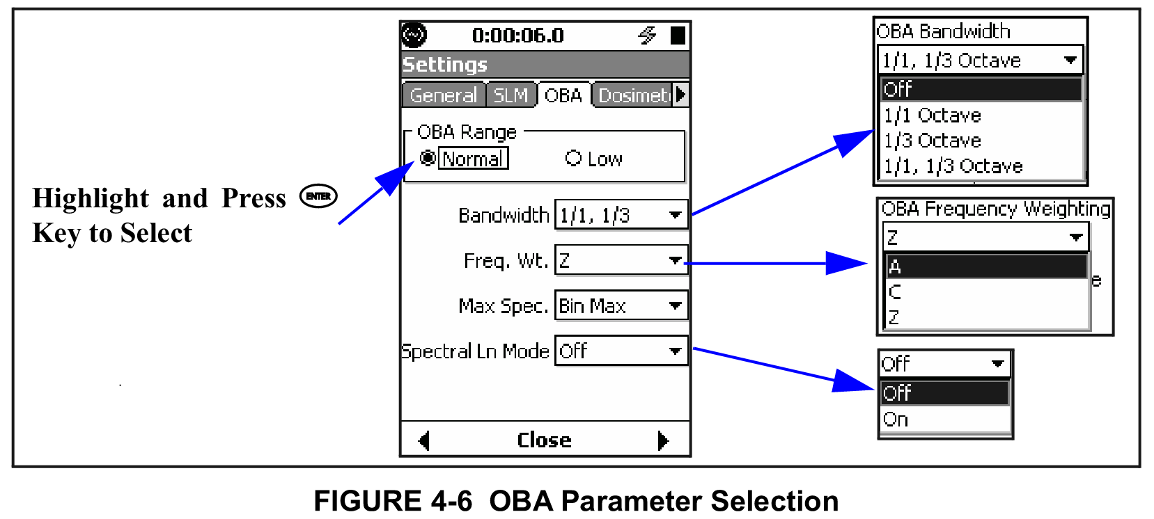
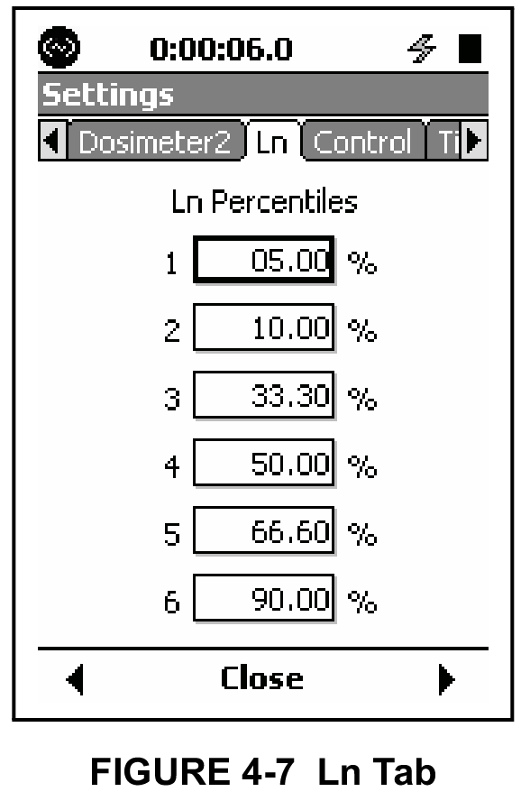
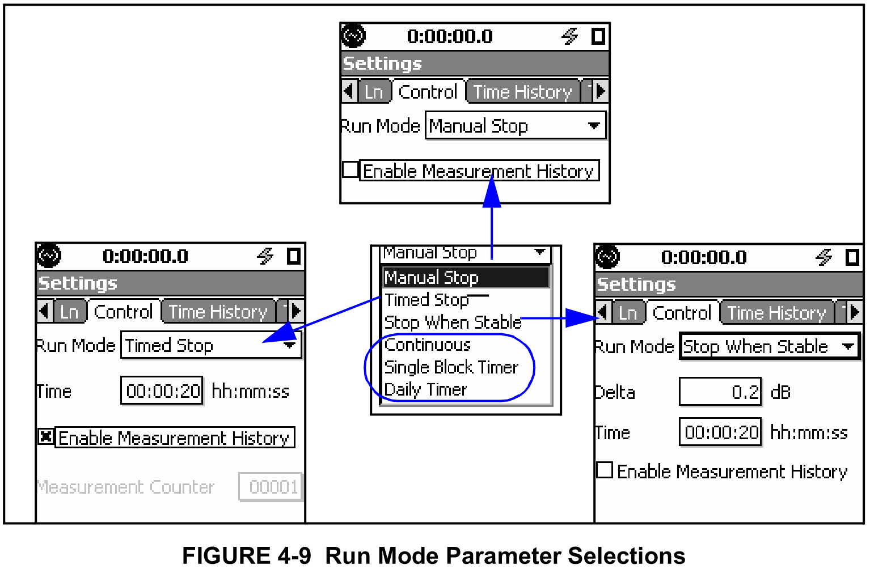
LD831 Settings

Slide 20
How to Measure Source Sound
    For sources that are steady/continuous in nature, do the following:
      Start a measurement and let run for 2-5 minutes (use tripod if available)
      Note any non-source sounds that may influence the measurement (traffic, plane flyover, dog barking, etc.)
      Try to get a good measurement period when the source constant
      Report Leq for the measurement period, this will be the source plus background level
    For non-steady sources
      Start a measurement for 2-5 minutes, set response to FAST
      Note highest sound level from source during measurement (LAF)
      After measurement, report L01 or Lmax
    Measure at the sound source property line and at the complainant’s location

Slide 21
How to Measure Background
    Two options to measure background sound level
      Option 1 – Turn off the source sound, if possible
      Option 2 – Find a proxy/remote location that is not influenced by the source sound
    Turn off the offending source – easiest option that will allow you to measure background at the PL and complainant’s location
    Proxy/Remote Location – Find a location where you cannot hear the offending source of sound. Opposite side of the building from the source, another location in the neighborhood where the source can’t be heard.
    Start a measurement and continue for 5-10 minutes (tripod). All sound other than the offending source should be included, such as traffic, plane flyovers, etc.
    Report the A-weighted L90 level from the measurement period

Slide 22
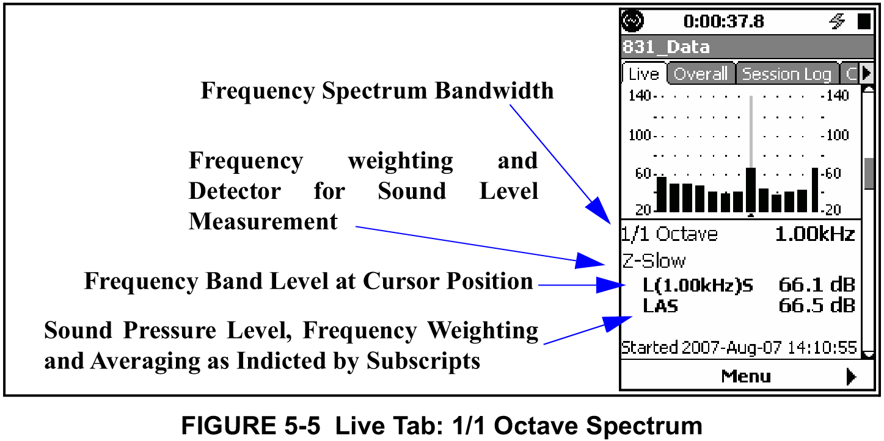
Tonal Sound and Pure Tones
    How to determine if there is a tonal sound or pure tone from the offending source of sound:
      Listen to the offending source, does it sound tonal or is there a buzzing/humming/beeping sound
      Review the octave band spectrum on the sound level meter
Look for octave bands (OB) that stick up above adjacent ones. If one OB exceeds the two adjacent bands by 3+ dB, it is considered tonal by MassDEP

Slide 23
Determine Mass DEP Compliance
    Compare source level to background level
      Broadband Check - If source level (LAeq) minus background level (LAF90) is greater than 10 dBA, then the source of sound is determined to be in violation of DEP Noise Regulation
      Tonal Check – If a tonal sound or pure tone is suspected, or there is no broadband violation, review octave band results
    MassDEP Violations include the following scenarios:
    The broadband source level is 10 dBA or more above the background level
    OR
    There is a tonal sound or pure tone condition where one octave band is 3 dB or greater than the two adjacent bands
    OR
    There is a broadband AND tonal violation

Slide 24
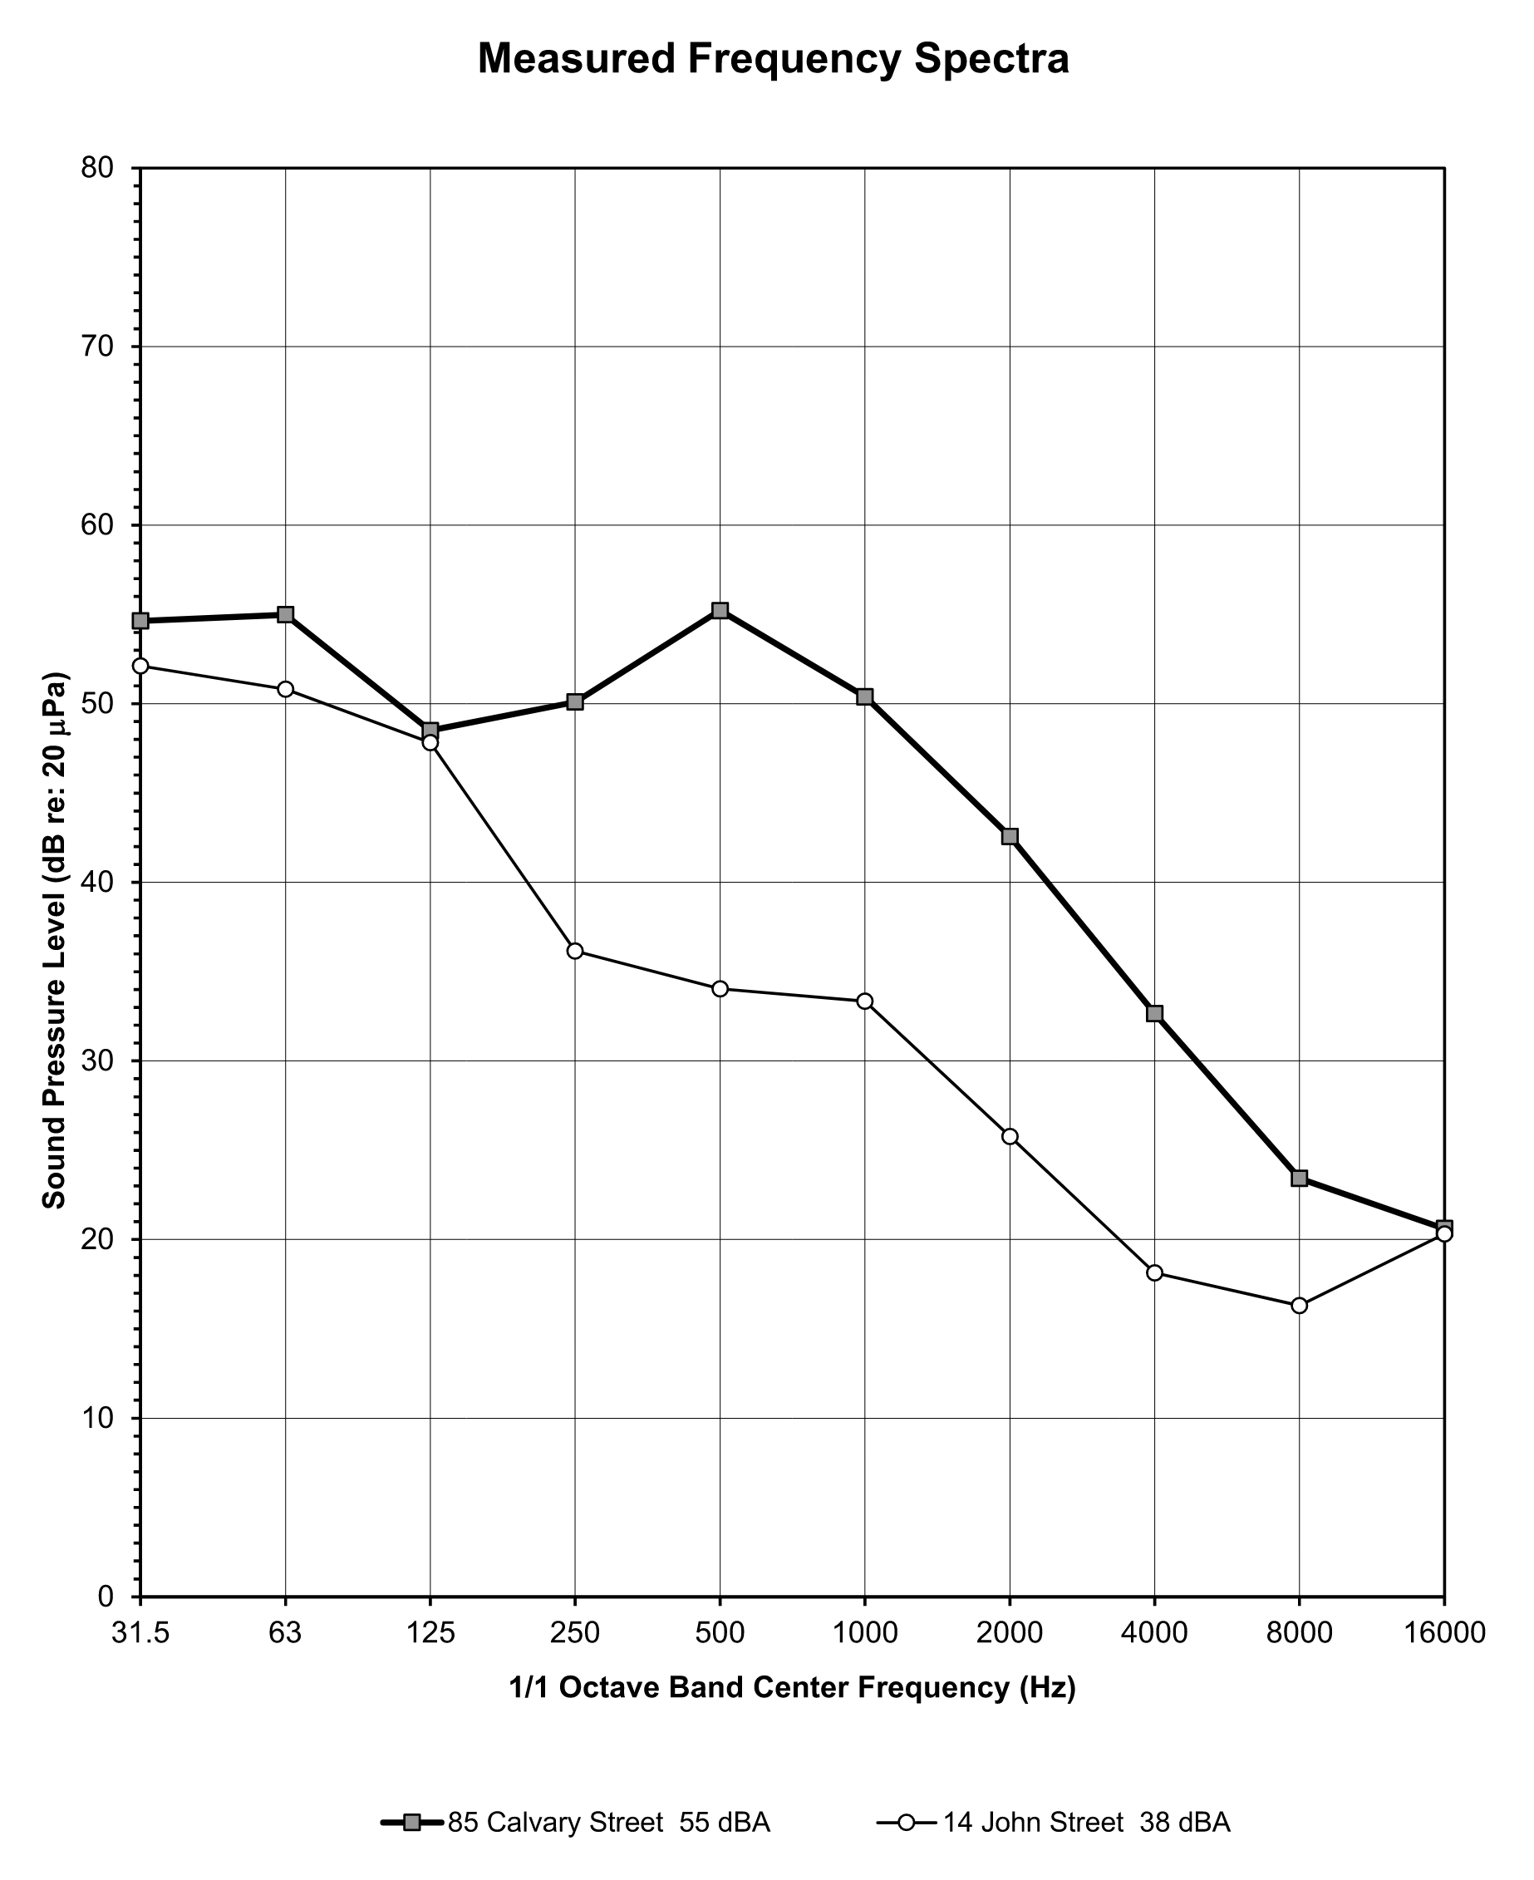
Example Source/Ambient Measurements
Tone at 500 Hz
Source
Ambient

Slide 25
Cell Phone Sound Measurements
    Can cell phone sound meter/analyzer apps be helpful/useful?
    Accuracy and Calibration – Cannot be used for compliance measurements and most apps/mics are not able to be calibrated
      Accuracy ranges from +/- 2dBA for best apps (NIOSH SLM) to much more
    Broadband Analysis
      Cell phone apps can be useful to determine the delta/difference between source and background levels
      The level difference between a source level and background can be useful to determine if there may be a violation (10+ dBA difference)
    Tonal Analysis
      Limited apps with octave band analysis capabilities
      May be useful for egregious or obvious audible tones
      May be difficult to determine if the tone doesn’t spike above adjacent octave bands

Slide 26
Cell Phone Apps
    iPhone
      NIOSH Sound Level Meter App – Broadband Only (+/- 2 dB accuracy)
        https://www.cdc.gov/niosh/noise/about/app.html
      NoiSee – Octave Band Analyzer ($0.99)
        https://ea-lab.eu/noisee/
    Android
      Sound Meter: SPL & dB Meter
        https://play.google.com/store/apps/details?id=com.ktwapps.soundmeter&hl=en_US
      Sound Meter
        https://play.google.com/store/apps/details?id=com.noise.sound.meter.decibel&hl=en_US
      Sound Analyzer App – Octave Band Analyzer
        https://sound-analyzer-app.en.softonic.com/android

Slide 27
Reference Links
MassDEP Form BWP-AQ Sound
https://www.mass.gov/doc/supplemental-form-aq-sound/download
MA Environmental Regulations
310 CMR 7.00
https://www.mass.gov/doc/310-cmr-700-air-pollution-control-regulation/download
MassDEP (DAQC) Noise Policy 90-001, February 1, 1990
https://www.mass.gov/doc/massdep-noise-policy/download?_ga=2.57625706.1740919039.1746126755-1049314081.1724679622&_gl=1*2j55cu*_ga*MTA0OTMxNDA4MS4xNzI0Njc5NjIy*_ga_MCLPEGW7WM*MTc0NjEyNjgyMy4xLjAuMTc0NjEyNjgyMy4wLjAuMA..
Responding to Local Noise, Odor and Dust Complaints
https://www.mass.gov/doc/how-municipalities-should-respond-to-noise-odor-dust-complaints-0/download

