Slide 1


Advocacy 101 for
Local Public Health
Cheryl Sbarra, MA Association of Health Boards
Alexis Walls, MA Public Health Alliance
MEHA Summit, May 28, 2025
Notes:
3 mins, Alexis

Slide 2
Learning Objectives
Develop a foundational understanding of how public health workers can harness collective power to influence state policy.
Develop an understanding of the differences between lobbying versus advocacy.
Learn tips and tricks for effectively engaging with policymakers.
Notes:
2 mins, Alexis

Slide 3
Legislative Structure & Process
How is this body set up and who controls the levers of change?

Slide 4

Which statements describe
the MA legislature?
The MA legislature discusses and votes on proposed state laws.
The MA legislature decides who will be governor every four years.
The MA legislature is made up of 40 senators and 160 house reps.
The MA legislature has three parts: the house, the senate and the town.
People can ask their state legislator for help with things in the community.
The MA legislature determines how we spend state tax dollars
every year.
Your congressperson and your state legislator are the same
person.
State legislators run for office every 3 years.

Slide 5

TRUE description of the
MA Legislature
The MA legislature discusses and votes on proposed state laws.
Registered voters decide who will be governor every four years.
The MA legislature is made up of 40 senators and 160 house reps.
The MA legislature has two parts: the house and the senate.
People can ask their legislator for help with things in the community.
The MA legislature determines how we spend state tax dollars every
year.
Your congressperson and your state legislator are different -
one works at the federal level and the other at the state level.
MA legislators run for office every 2 years.

Slide 6

Who holds the power?
House Leadership
  Speaker of the House
  Majority Leader
Senate Leadership
  Senate President
  Majority Leader
Committee Chairs
YOU

Slide 7
Committees Hold Power
Joint Committee on Emergency Preparedness and Management
Joint Committee on Mental Health, Substance Use and Recovery
Joint Committee on Public Health
Joint Committee on Housing
Joint Committee on Ways and Means

Slide 8

If you don’t know, that’s okay! You can identify both your MA House Representative and State Senator by visiting the following website: https://malegislature.gov/Search/FindMyLegislator
Enter your:
Street address
City/town
Zipcode
Who are your legislators?

Slide 9
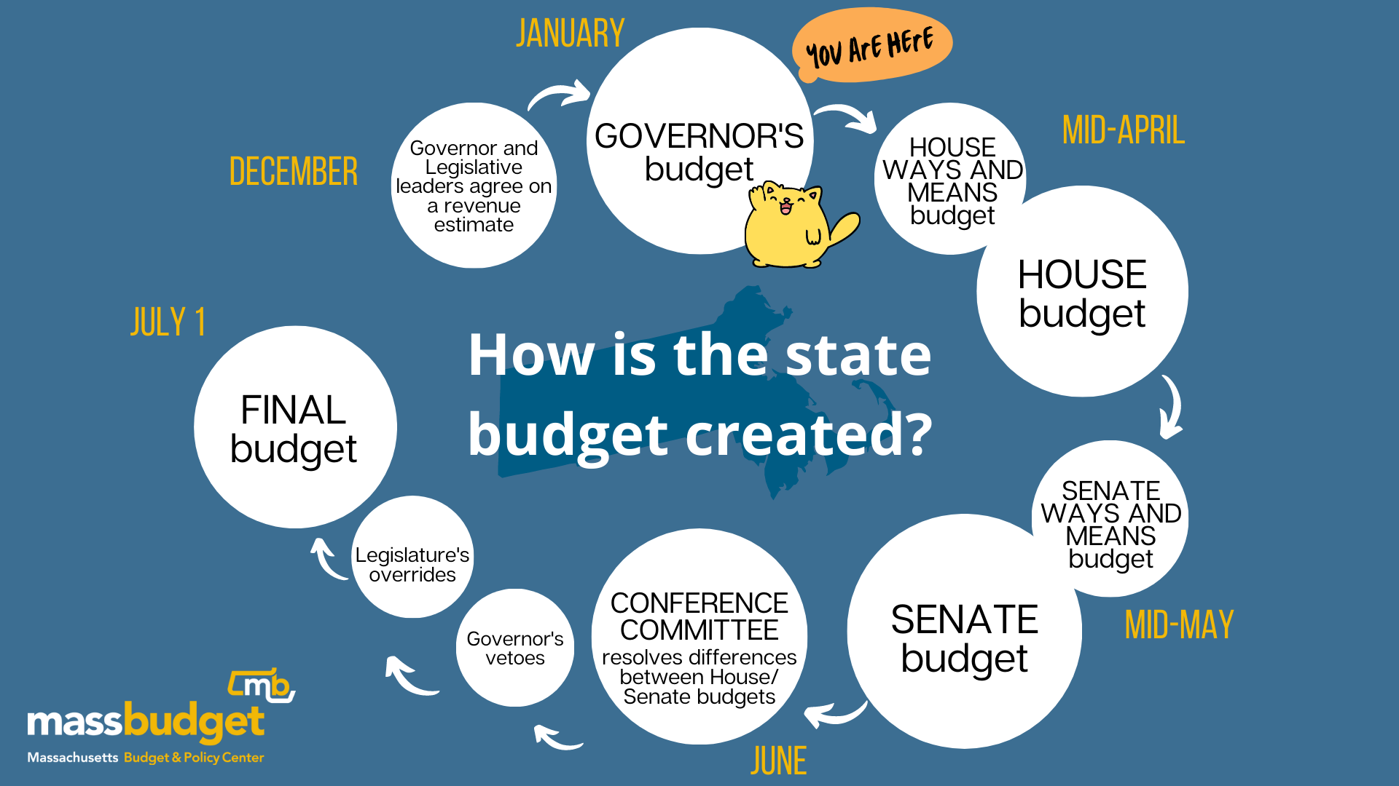
You are HERE

Slide 10
Local Public Health: A Collective Power
You see the problem: As leaders in public health, you see issues like homelessness, substance use disorder, and mental health issues play out first hand – way before our state leaders do
You know what works: Because of your expertise in local public health, you know the solutions that work best for YOUR community
More voices, more power: on their own, one person can make a difference - but adding the weight of municipal public health staff to across the state builds more momentum/credibility

Slide 11

Case Study: SAPHE 2.0 Campaign
Problem
Tactics
Outcomes
Massachusetts’ decentralized approach to delivering public health services leads to extreme variability in protections across municipalities. SAPHE 2.0 legislation would put us on a path to help fix this broken system.
Convene the local health workforce in a coalition
Develop messaging and communications tools
Organize members around the legislative process, including activities like:
rallies
hearings
budget advocacy
Engaged, statewide network of local health leaders
↑ public & decision- maker awareness of the role of local boards of health
↑ levels of funding to support local health
SAPHE 2.0 is now law!

Slide 12
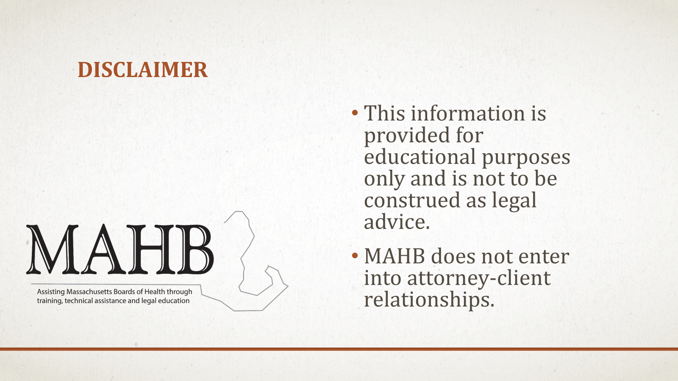

Slide 13
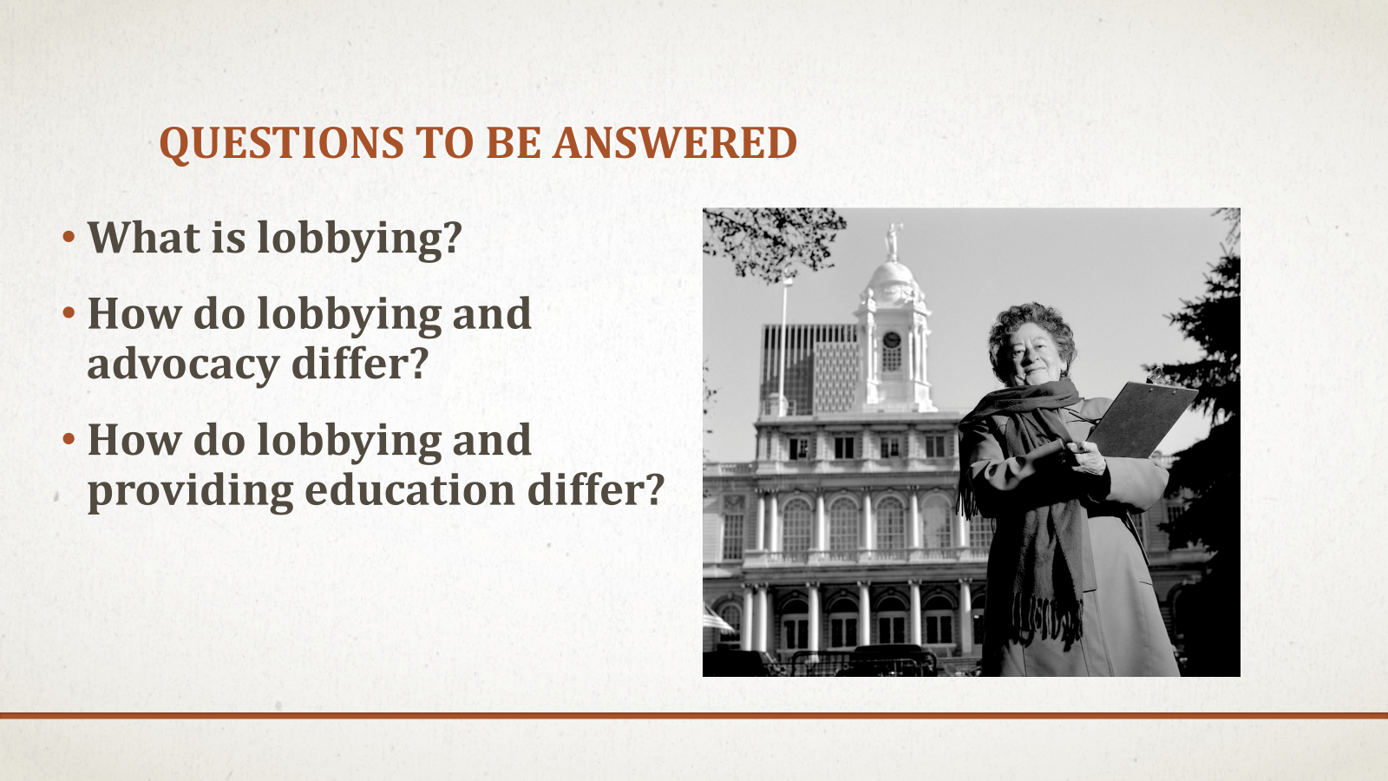

Slide 14
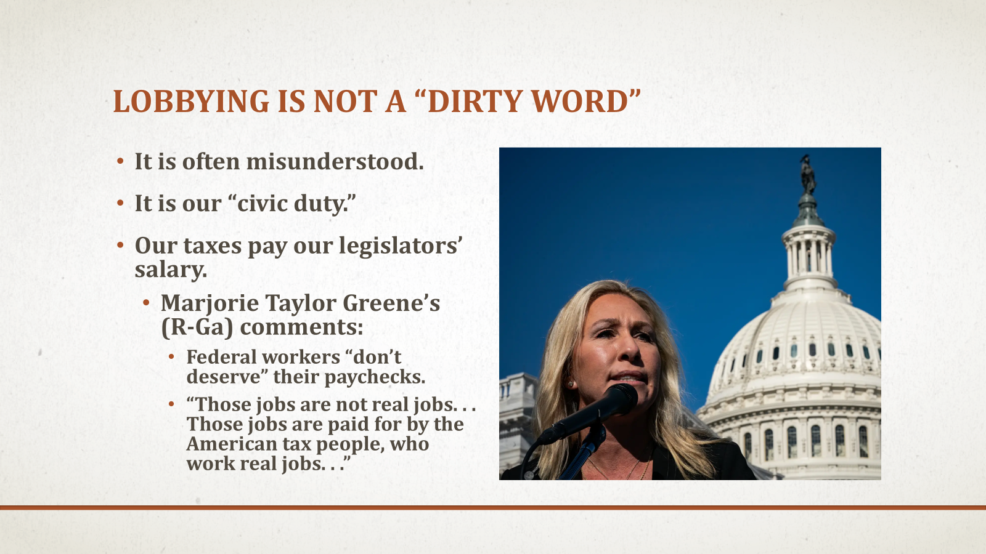

Slide 15
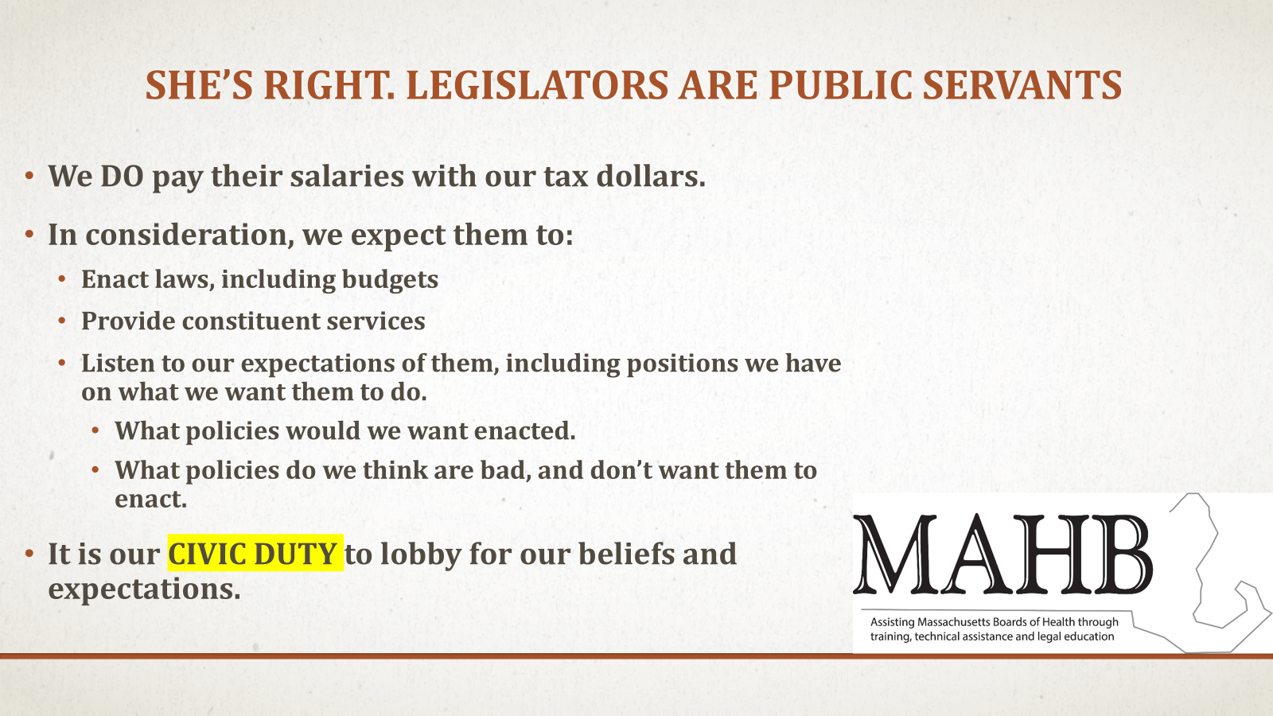

Slide 16
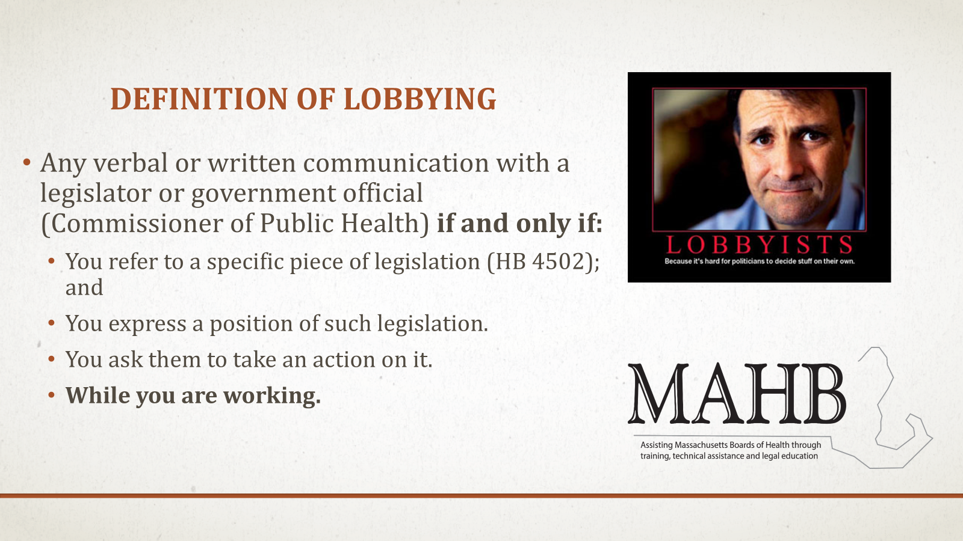

Slide 17
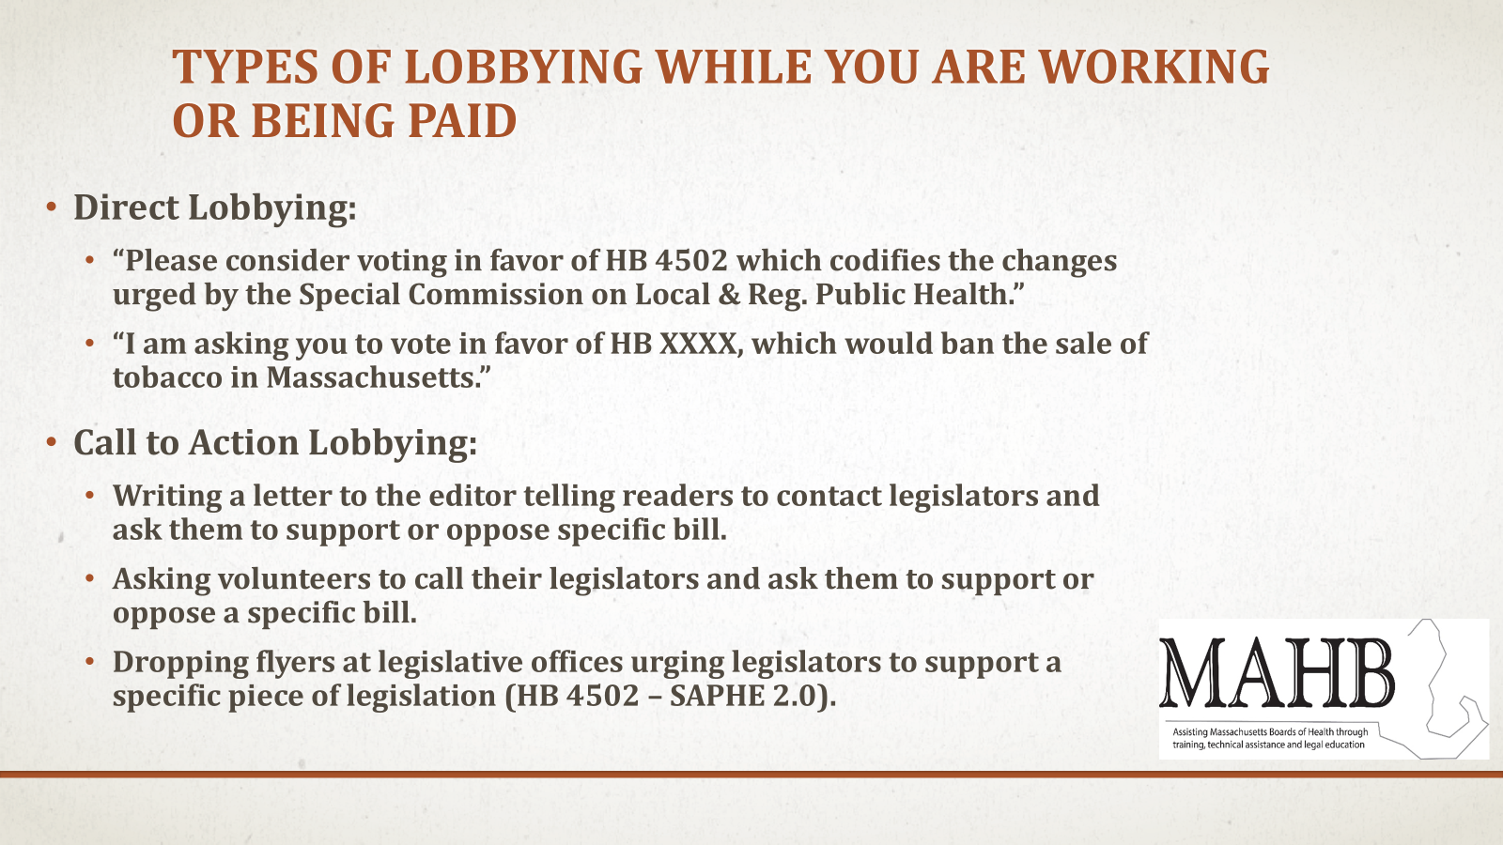

Slide 18
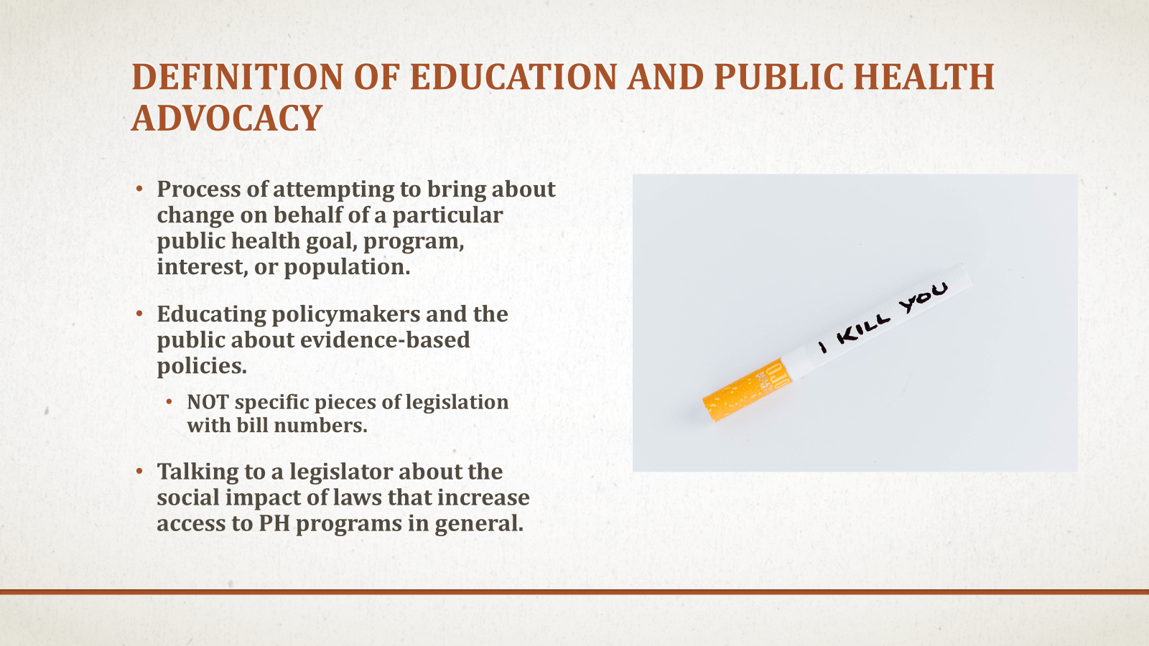

Slide 19

Notes:
2 mins, Alexis

Slide 20
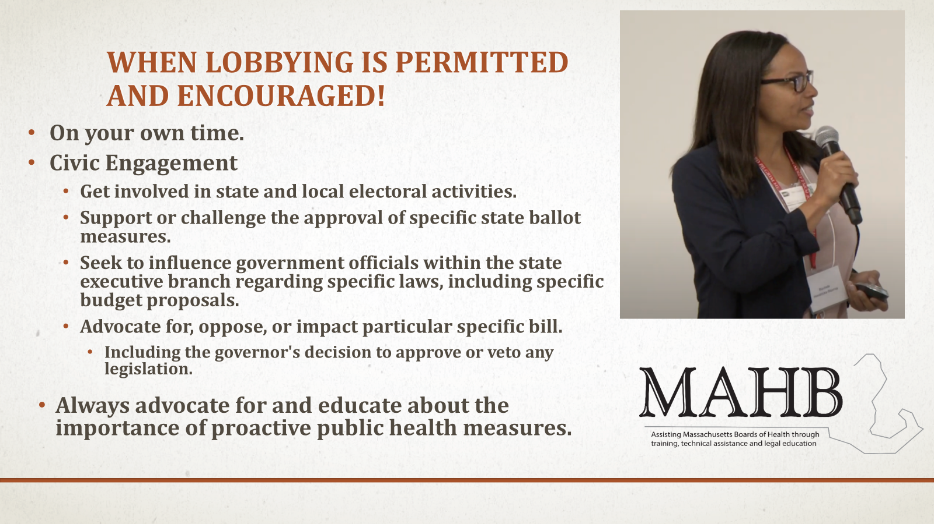
Notes:
2 mins, Alexis

Slide 21
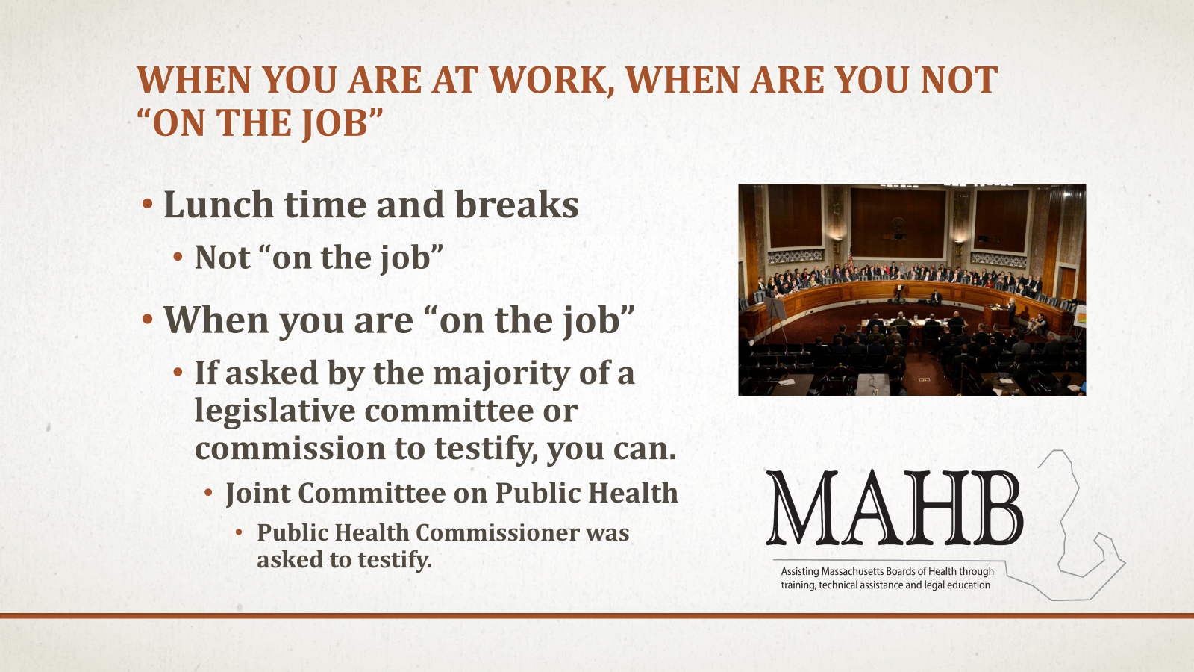
Notes:
2 mins, Alexis

Slide 22
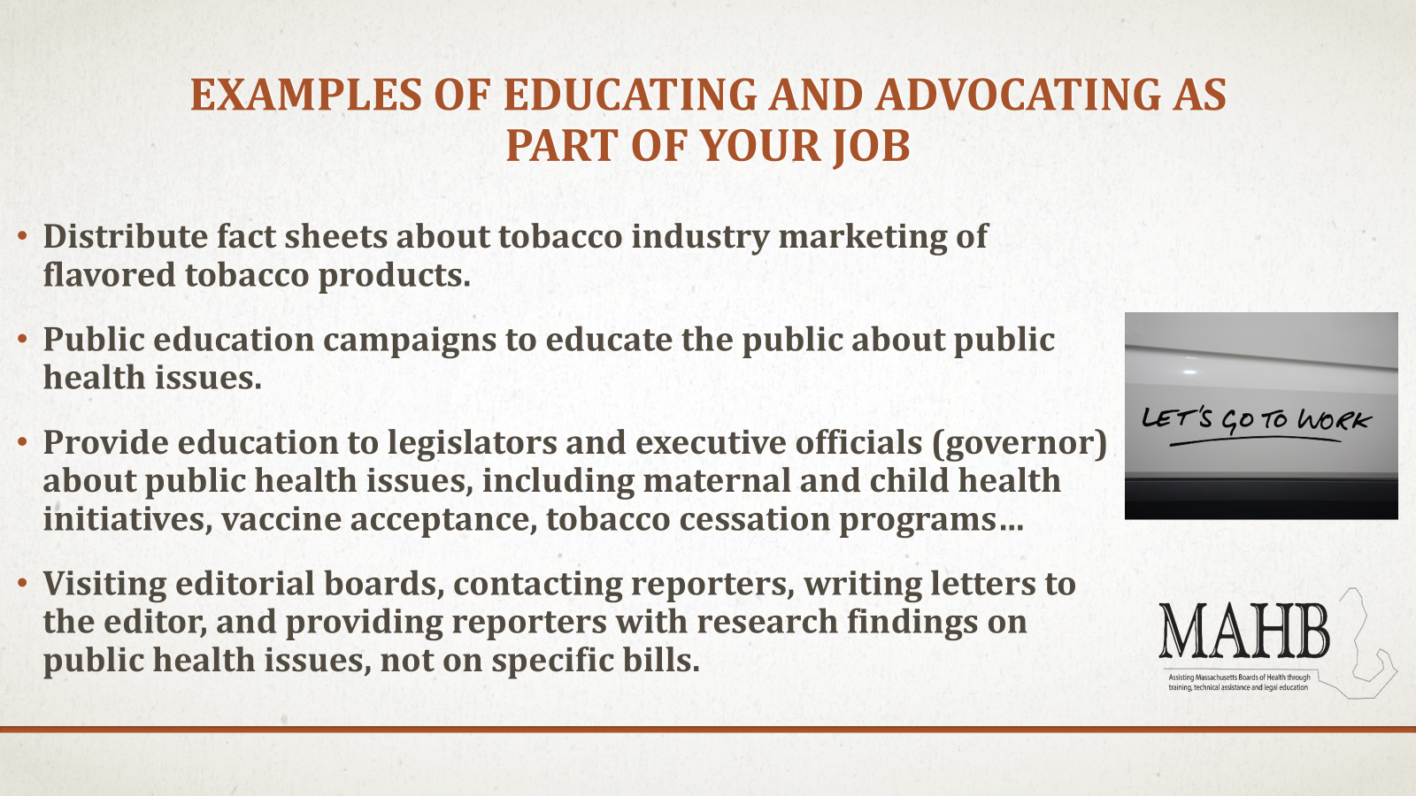
Notes:
2 mins, Alexis

Slide 23
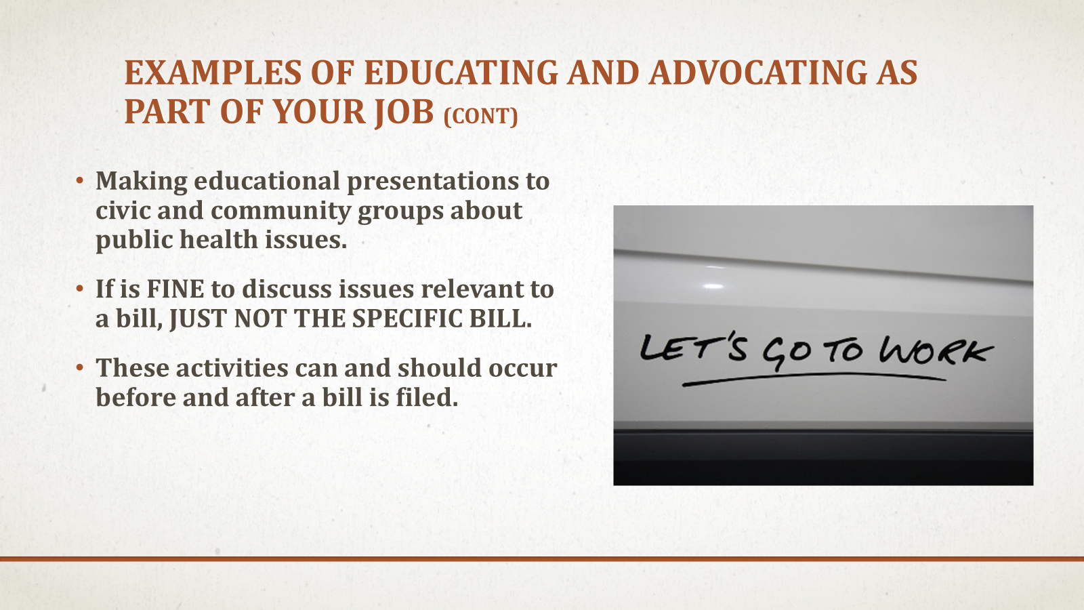
Notes:
2 mins, Alexis

Slide 24

Here are your secret ingredients!
When talking with decision-makers, it is important that we use plain language to communicate the what, the why and the how of public health challenges and policy solutions.
Here is a simple ‘recipe’ for effective communication with policymakers:
Step one. Share what the problem is, and emphasize the policy solution.
Step two. Share why your audience should care, using stories and data.
Step three. Share a clear ask regarding how they can support.

Slide 25
Advocacy Pro Tips
Do
Don’t
Remember legislators are just people
Lead with your experience/expertise
Be polite, friendly, and patient
Be concise and to the point
Make the issue personal (remember: stories are stickier than data)
Be prepared to talk with staff who work with your elected official
Thank them and follow-up
Assume someone else is contacting your legislators about this issue
Be intimidated
Be dishonest or exaggerate
Be afraid to say you don’t know
Forget your power

Slide 26

Let’s stay Connected!
Questions? You can reach us at:
Cheryl Sbarra, sbarra@mahb.org
Alexis Walls, awalls@mapublichealth.org
And don’t forget to stay connected with campaigns to support local public health! Scan the QR to stay up to date on public health policy updates and receive action alerts.

