Slide 1
How to Conduct a Retail
Vibrio Investigation
Jessica Ferreira, CP-FS
Environmental Analyst III, Food Safety Trainer
Department of Public Health - Division of Food Protection
Notes:
Introduction / Background

Slide 2
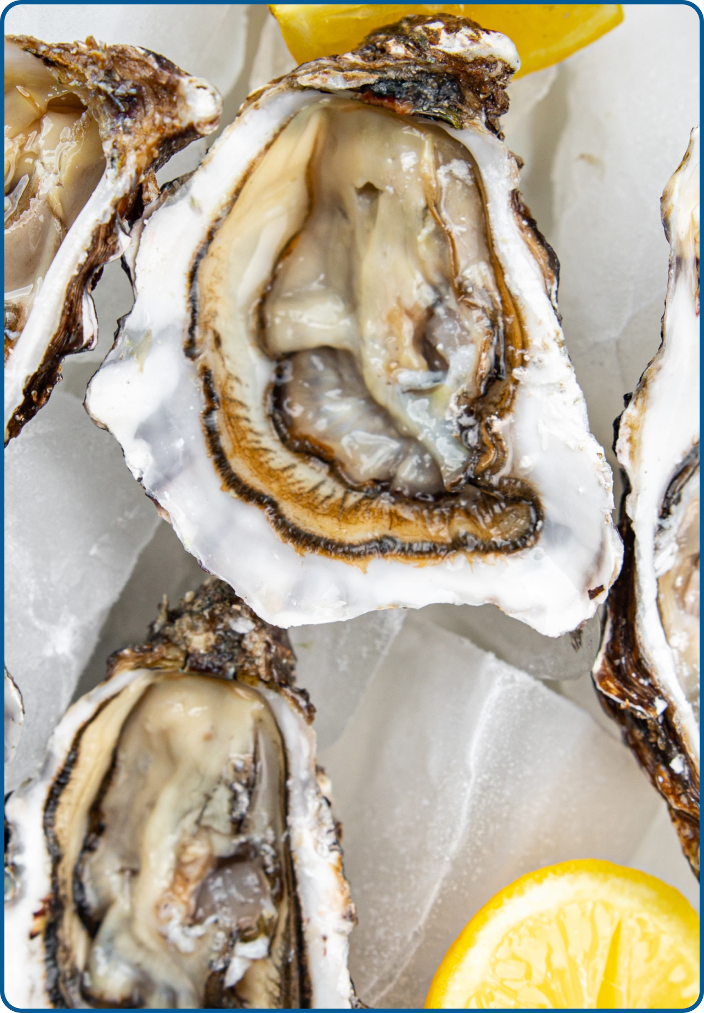
Introduction
Vibrio is a bacteria that occurs naturally in the United States and Canada's coastal waters and causes serious illnesses.
The Massachusetts Department of Public Health (DPH) and the Massachusetts Department of Fish and Game's Division of Marine Fisheries (DMF) have successfully partnered with the industry to develop controls to mitigate the risk of Vibrio associated with Massachusetts-harvested oysters.
The statewide Vibrio Control Plan is part of The National Shellfish Sanitation Program (NSSP), recognized by the FDA, and has been in effect since 2013.
The Massachusetts 2025 control season for Vibrio parahaemolyticus will begin on Sunday, May 19, 2025, and end on Saturday, October 19, 2025.
Notes:
Introductory Notes on the Program and its History. READ SLIDE.

Slide 3
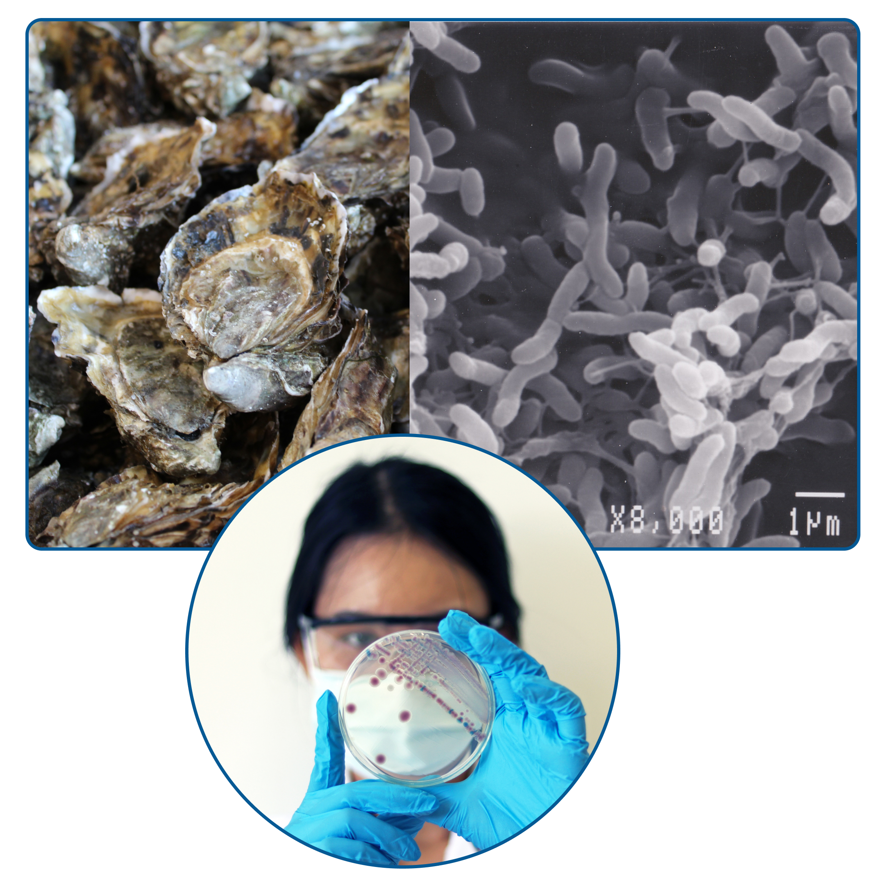
What is Vibrio?
Vibrio is a form of bacteria that naturally live in certain coastal waters and are present in higher concentrations between May and October when water temperatures are warmer.
Source of infection in humans:
eating raw or undercooked shellfish, particularly oysters
open wound is exposed to salt water or brackish water
When illnesses are identified, a detailed investigation at retail and wholesale is required to determine the source of the illness and to prevent further illnesses.
Vibriosis cannot be passed from one person to another.
Notes:
READ SLIDE

Slide 4
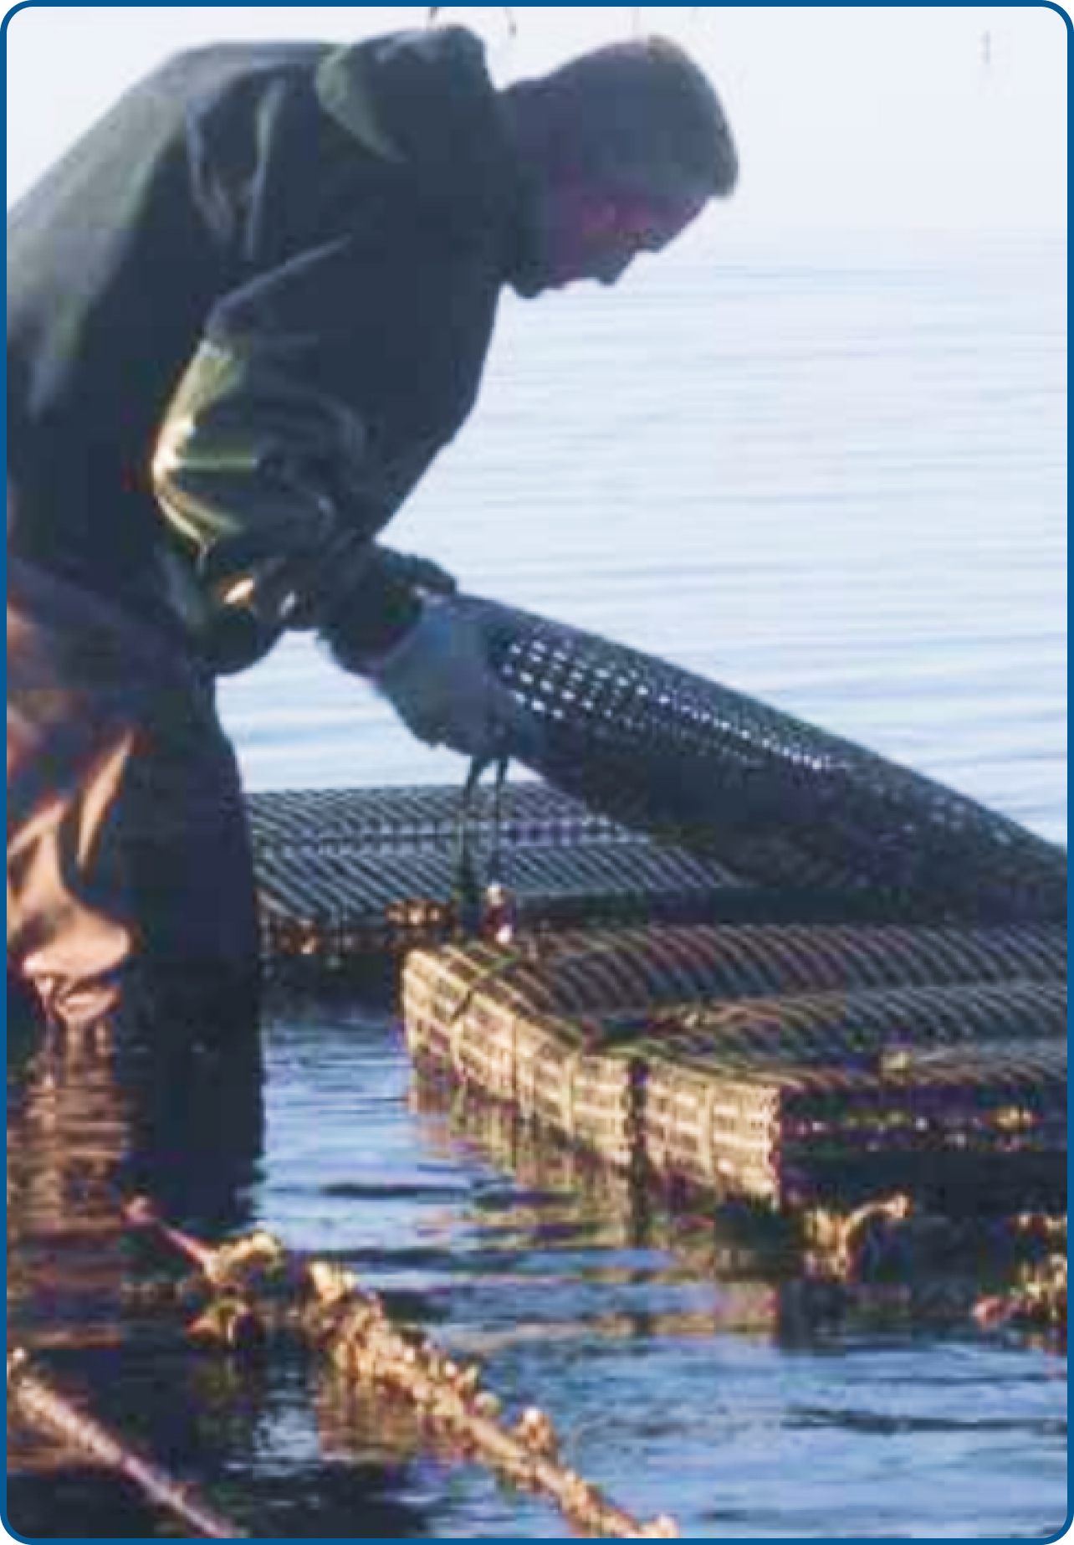
Why is Vibrio Control work so important?
The Vibrio Control Plan is a program to protect the public health of consumers by assuring the sale or distribution of shellfish from safe sources and that shellfish have not been adulterated during cultivating, harvesting, processing, shipping, or handling.
This program includes a collaborative effort by state, local, and federal officials as well as businesses and advocacy groups, and creates multiple layers of oversight to prevent injury and death because of Vibrio infection.
Due to climate change and overall warmer water temperatures, the reach of Vibrio bacteria is expanding; therefore, the need to protect public health and strictly monitor harvesting systems is greater than ever.
Notes:
READ SLIDE

Slide 5
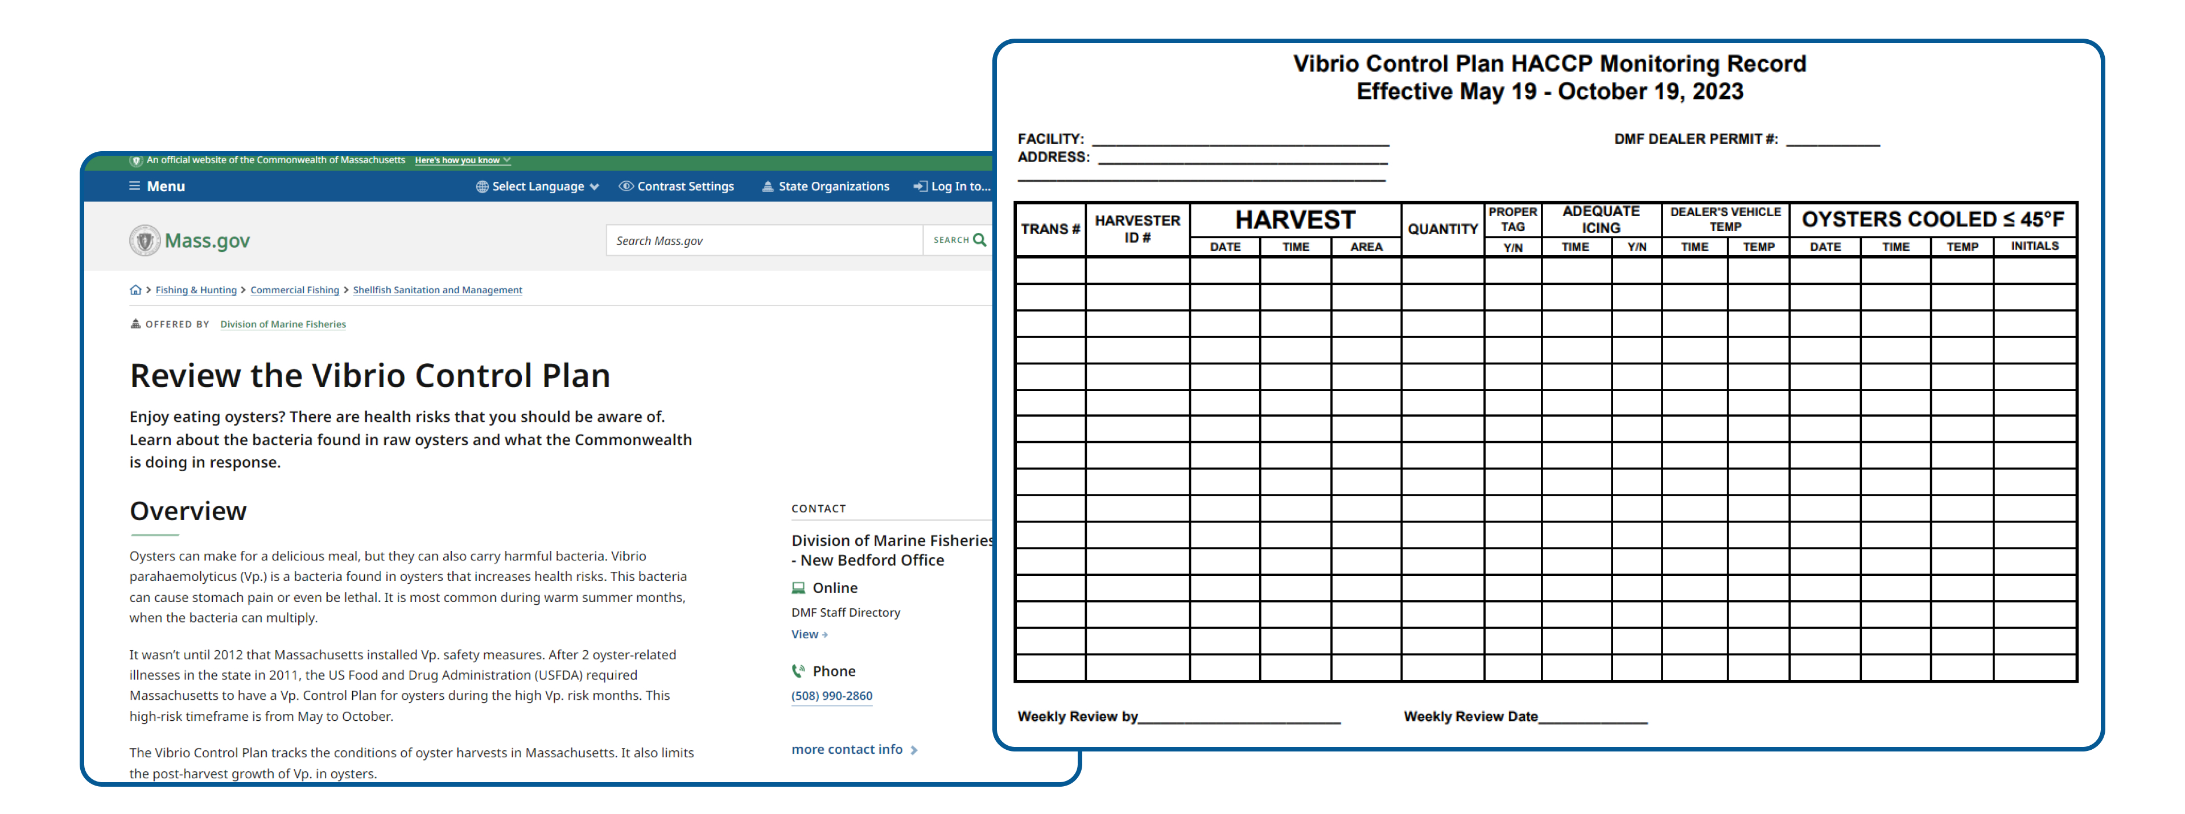
MA Vibrio Control Plan
A Vibrio Control Plan is a requirement for wholesale only. It requires specific icing times and logs to ensure the oysters were held at 45*F or below after harvesting. For more information, including training videos you can go to the MA Division of Marine Fisheries website.
Notes:
A Vibrio Control Plan is a requirement for wholesale only. It requires specific icing times and logs to ensure the oysters were held at 45*F or below after harvesting. For more information, including training videos you can go to the MA Division of Marine Fisheries website.
https://www.mass.gov/info-details/review-the-vibrio-control-plan

Slide 6
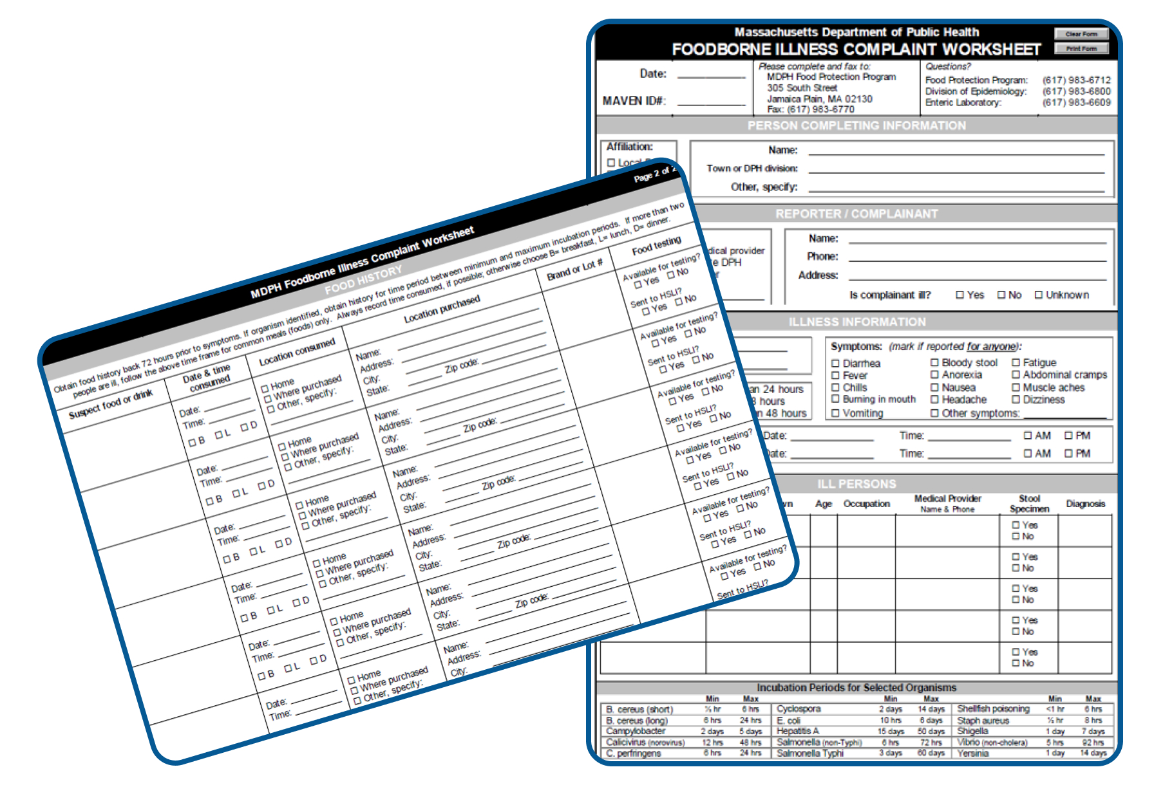
Food Complaint & Food History Forms
When a Vibrio illness is reported after lab testing, food histories are collected by an epidemiologist or public health nurse. This information is then provided to the Local Board of Health (LBOH).
Notes:
READ SLIDE

Slide 7
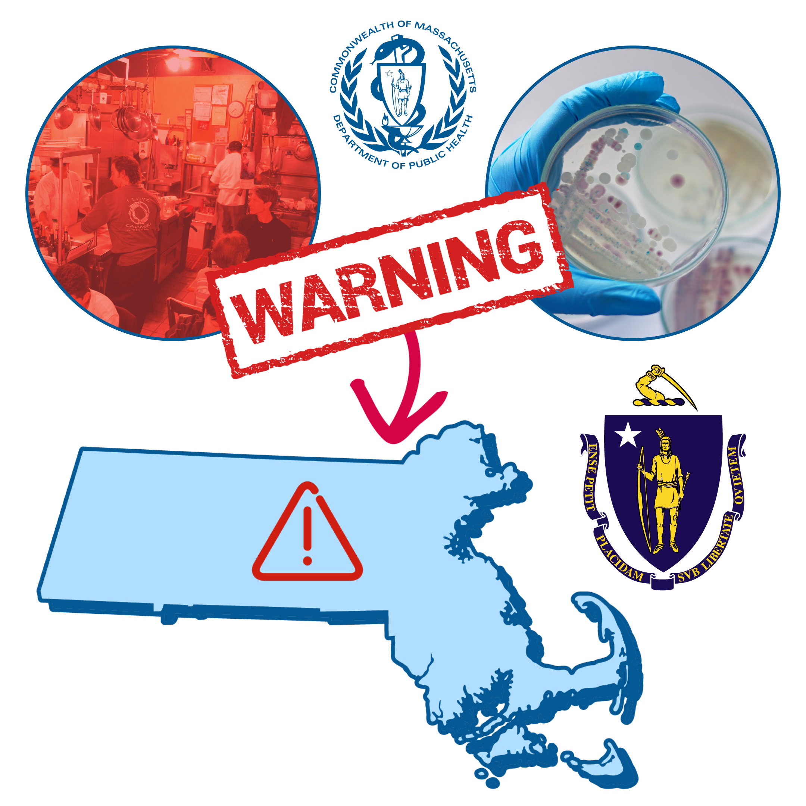
Initiating a Vibrio Illness Investigation
When a retail food establishment is identified in the food history of a Vibrio case:
The Division of Food Protection (DFP) will contact the LBOH and communicate objectives and a time frame for completion.
LBOHs overall goal is to identify any evidence of cross-contamination, mishandling, or temperature abuse.
DFP provides a guidance document to the local inspector(s) and encourages local inspector to contact DFP inspector with questions.
DFP will request for assistance from the LBOH to contact the retail site to collect tags, invoices, and other documents, and conduct a HACCP Assessment which then allows for a timely initiation of wholesale traceback by DFP.
Notes:
READ SLIDE

Slide 8
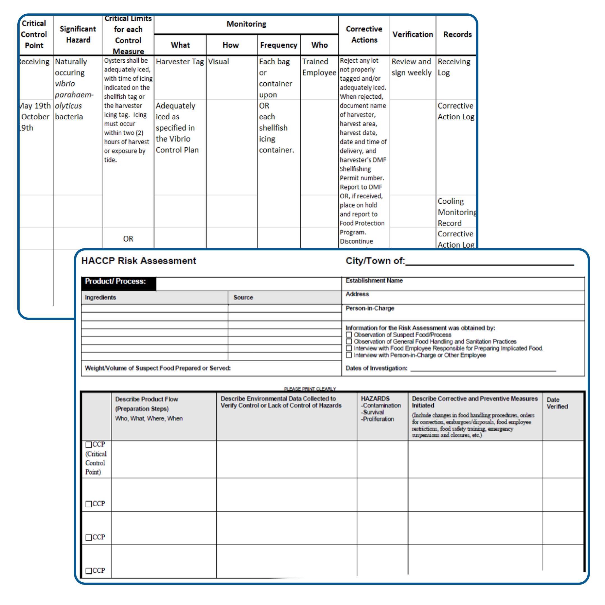
Conduct a HACCP Risk Assessment
The LBOH will then conduct a HACCP risk assessment of the implicated food at the retail food establishment.
Request a copy of the retail food establishments HACCP Plan as well to help you fill out the assessment form and collet information needed for your onsite visit.
Follow the flow of food by reviewing the HACCP Plan.
Get copies of the records noted in the Records column.
While doing a walk-though it is important to identify any evidence of cross-contamination, mishandling, or temperature abuse.
Other areas to focus on are outlined in the guidance document and overviewed briefly in the next slides.
Notes:
READ SLIDE

Slide 9
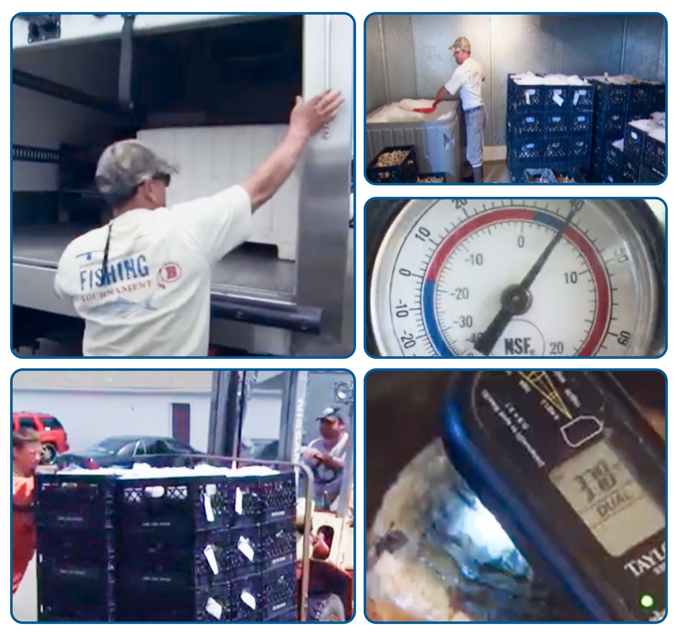
Observe Receiving
Observe how the oysters are received from the wholesale dealer.
Consider:
Are they picked up by the food establishment or delivered?
Are they refrigerated during transport?
Are they put away immediately or left out in the kitchen?
Who is responsible for putting them in the walk-in cooler?
When stored in the cooler, at what temperatures are the coolers set? Take a temperature of oysters in the food establishments cooler. Overcrowded coolers may have trouble maintaining temperatures <41℉.
Is there a cooler log with recorded temperatures?
Notes:
READ SLIDE

Slide 10
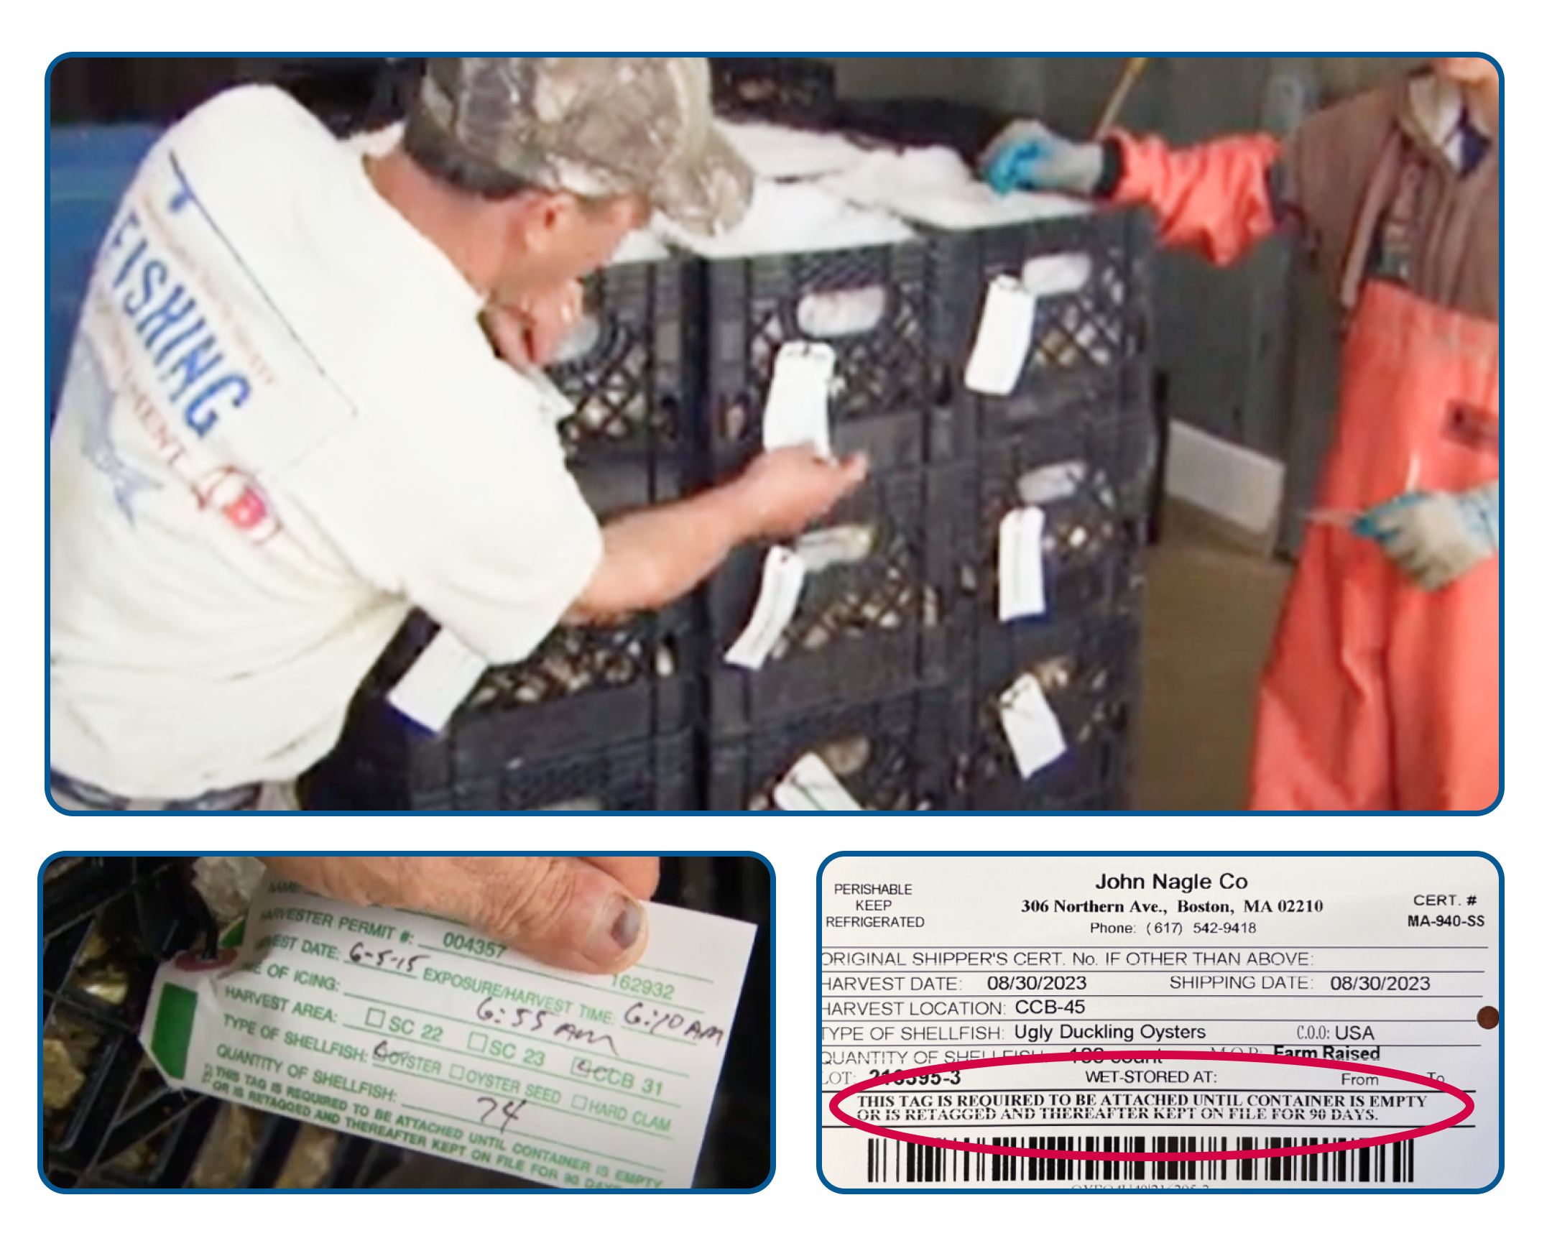
Review Tags
Consider:
Are all bags or containers properly identified with tags?
Does the firm maintain the tags for 90 days following the consumption of the last oyster?
Are the tags held in an organized manner?
Has the firm recorded the date on the tag that the last oyster was served from a bag?
Notes:
READ SLIDE

Slide 11
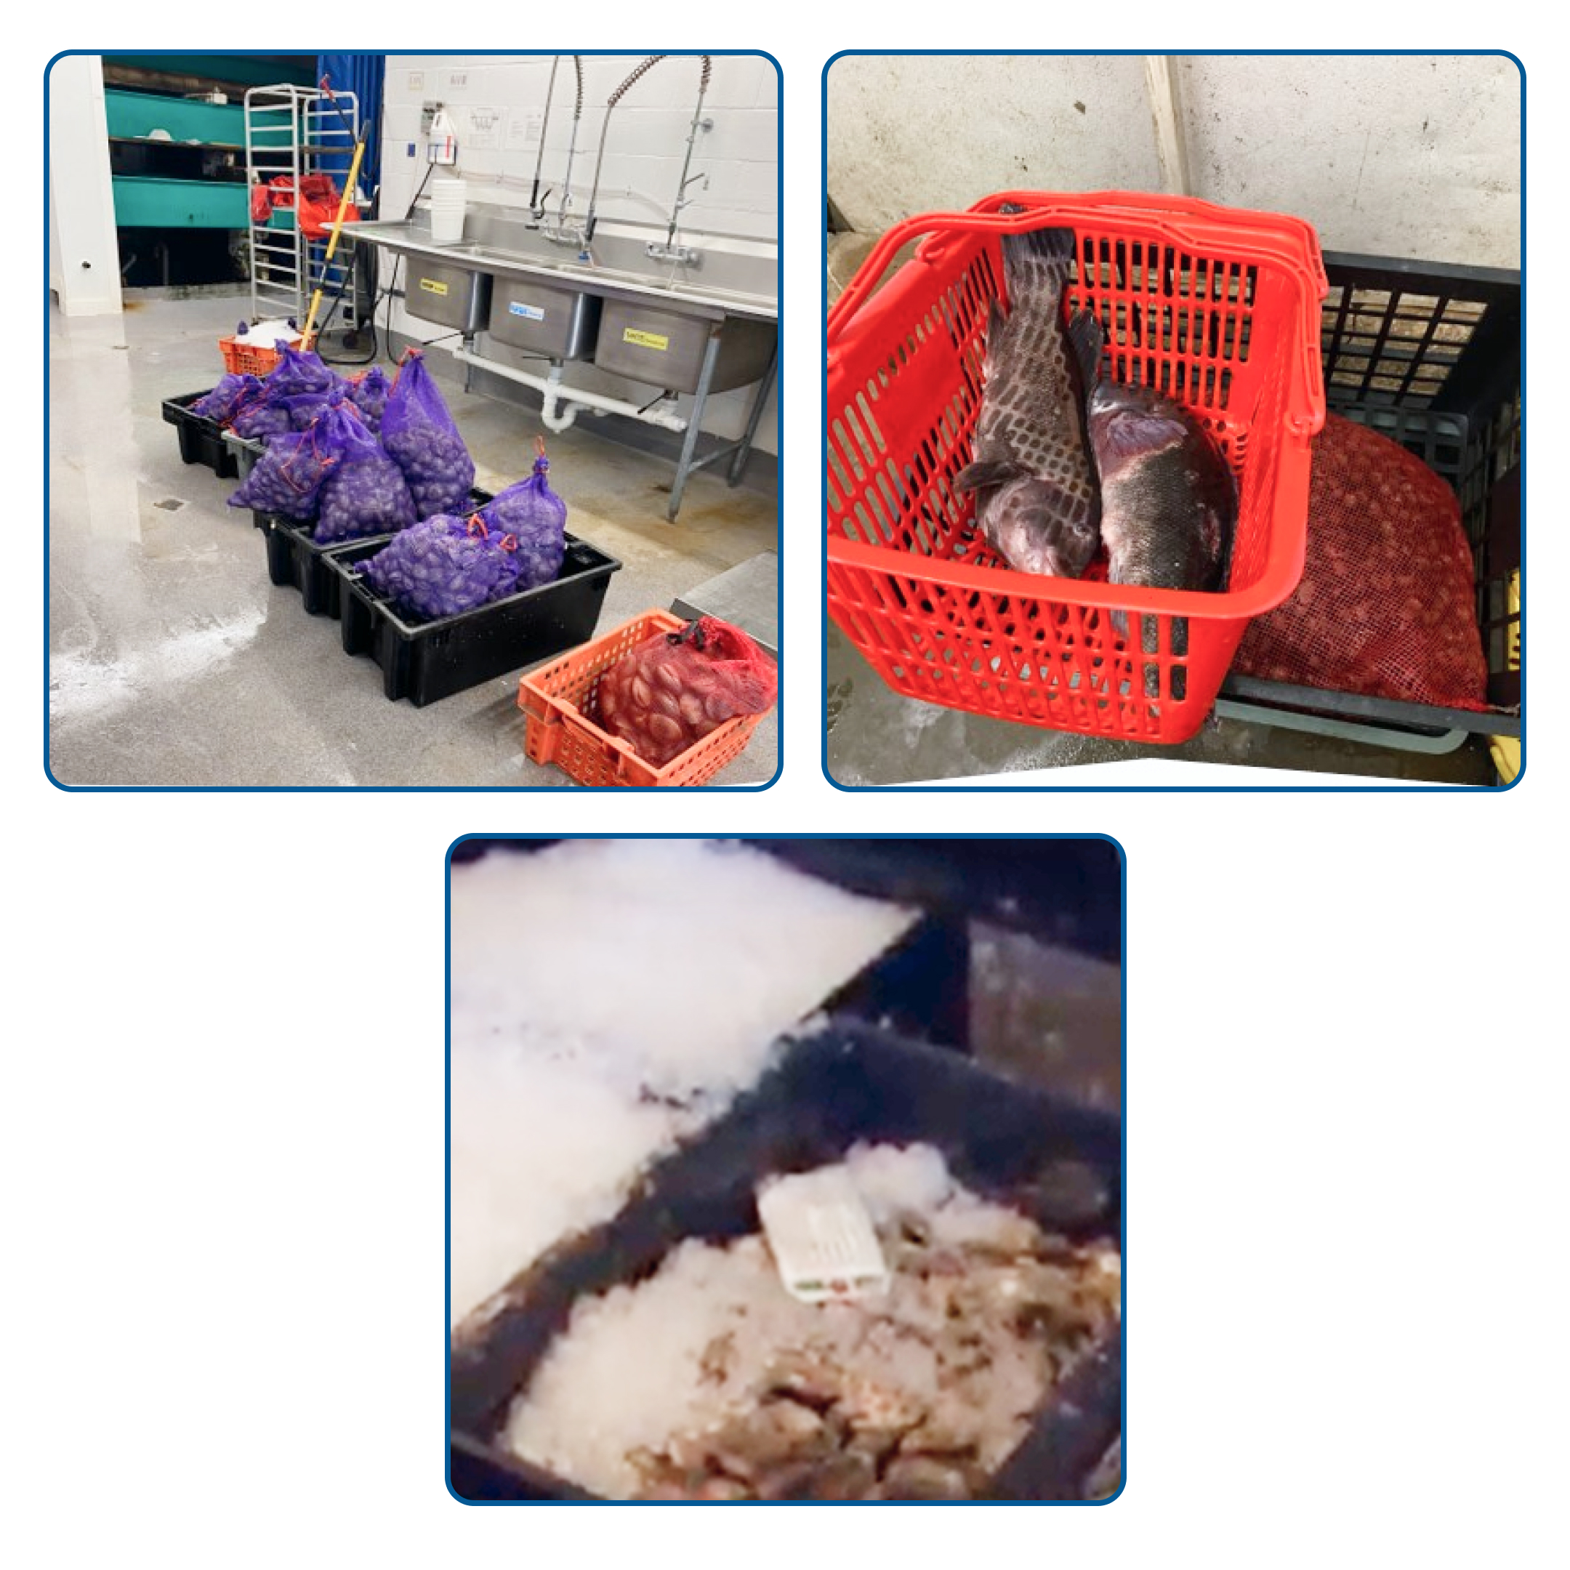
Review Storage
Consider:
How is shellfish stored?
  e.g., Are they held separately, or do they set one lot on top of one another (nesting)?
Does the firm segregate the shellfish from other hazardous foods?
Is the shellfish iced?
Is there a FIFO rotation of inventory?
What sanitation practices are in place for the areas of storage, preparation, holding, and service?
Notes:
READ SLIDE

Slide 12
Review Service
Consider:
When readied for service, how are the oysters (or other shellfish) prepared and held prior to service?
Are the oysters shucked in advance or shucked to order?
What are the practices of the person who shucks the oysters?
  How many people typically shuck shellfish?
Are the oysters exposed to warm temperatures for any extended periods of time?
How are oysters handled when ordered from the menu vs. when ordered from the raw bar?
How are varieties of oysters displayed at the raw bar?
How are oysters identified in the oyster display?
Is there a “specials” board for branded oysters served?
Does the firm keep track of what oysters were served on each date?
What does the firm do when they run out of a particular oyster?
What does the firm do with oysters prepped for service, but not sold on a particular evening?
Are there adequate hand washing facilities for those at the raw bar?
Have any illnesses been reported by staff to management?
Notes:
Consider asking the following questions about service. READ SLIDE.

Slide 13
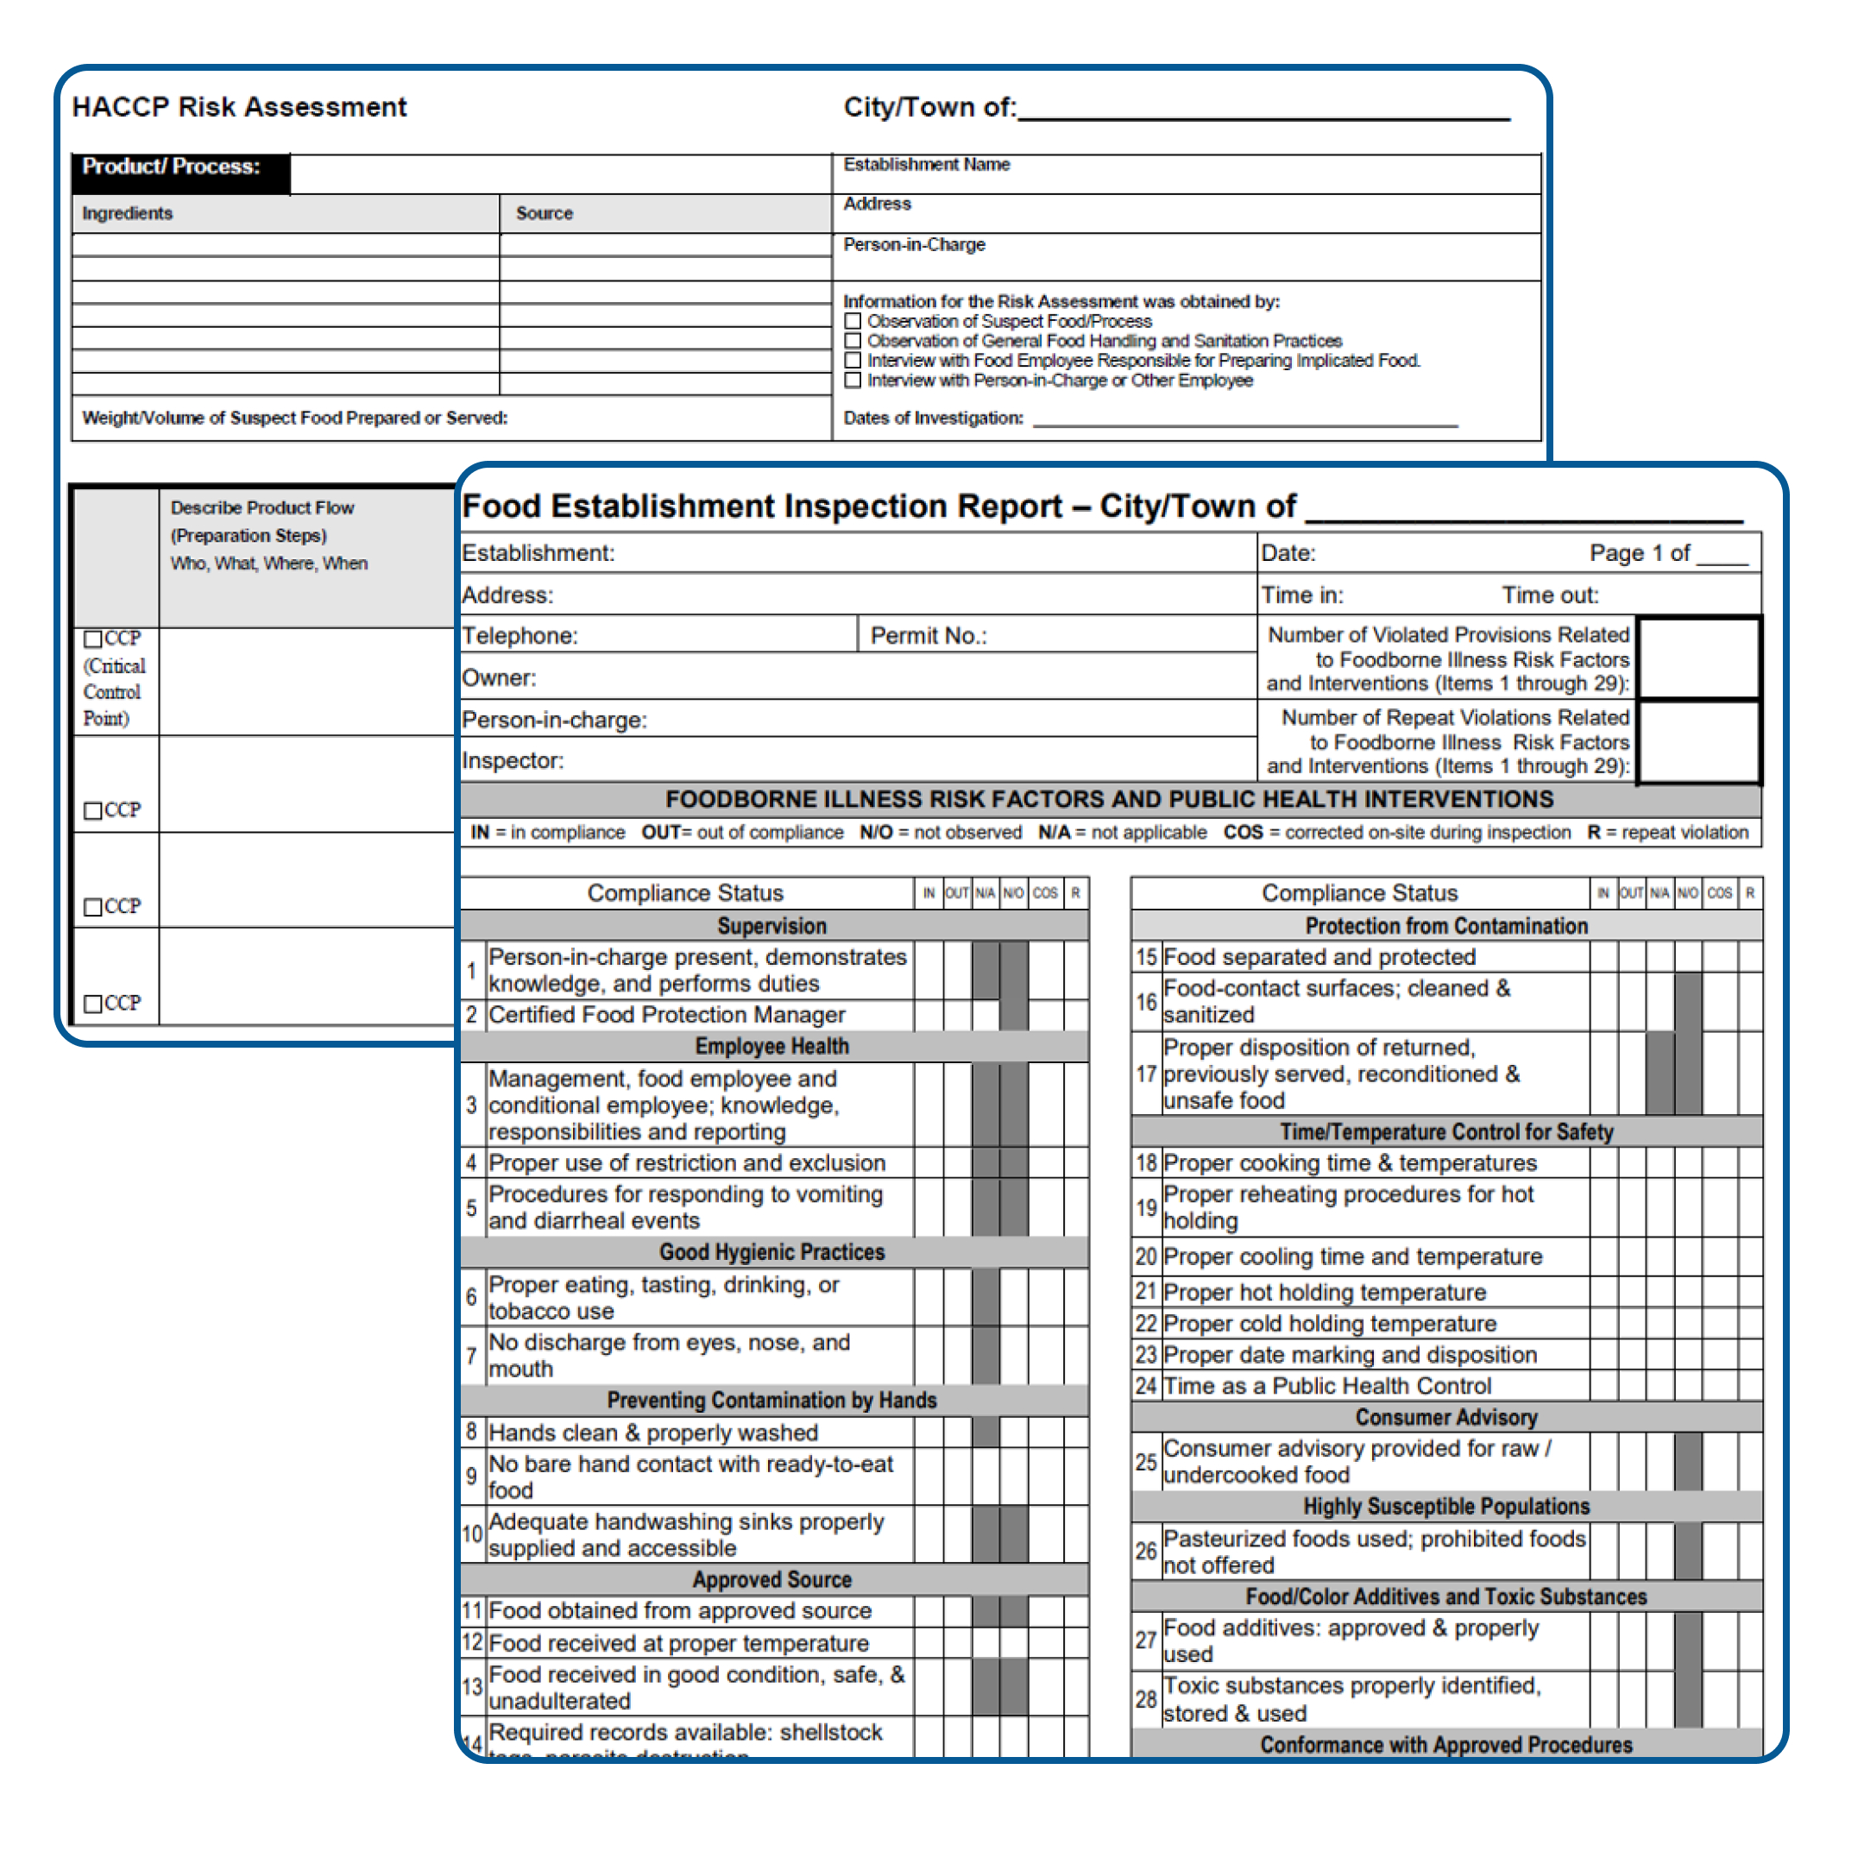
Post on Site Investigation
For Vibrio investigations inspection reports, write ups, tags, pictures, etc., are not typically confidential or sensitive. Those can be emailed back to the requestor or attached directly to an applicable MAVEN event.
Return inspection report, HACCP risk assessment, and any other notes from the investigation to DFP ASAP or within 2 business days.
DFP will then conduct a wholesale traceback with the documents obtained from the LBOH from the retail food establishment.
DFP will incorporate LBOH findings into overall traceback report.
Notes:
READ SLIDE

Slide 14
Special Thank You
Steven Rice | Steven.Rice@mass.gov
Supervisory Food Inspector III, Seafood Unit
Division of Food Protection
Bureau of Climate and Environmental Health
Nichol Smith, MS | Nichol.L.Smith@mass.gov
Outbreak and Response Coordinator
Division of Food Protection
Bureau of Climate and Environmental Health
Notes:
Special thank you to these two individuals from the MA Division of Food Protection for providing information. You may be in contact with either of these two when getting involved in a vibrio investigation.

