Slide 1

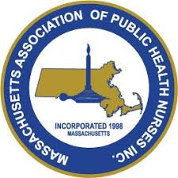

DEVELOPING PARTNERSHIPS
Public Health Nurse Allies in Environmental Health
Tiffany Beniot, MAPHN President Simone Carter, MAPHN President Elect

Slide 2
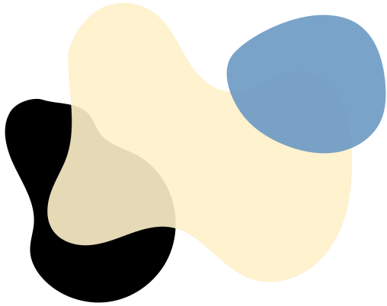
OBJECTIVES
  Increase Awareness of PHN roles
  Promote Collaboration with PH colleagues
  Strengthen Public Health Practice

Slide 3

WHY ARE WE HERE?
Outcomes are improved when public health nurses collaborate with environmental professionals, as such partnerships enhance intervention effectiveness, preparedness, and health equity across communities.
Partnerships between public health nurses and environmental professionals facilitate the translation of environmental risk assessments into actionable health promotion strategies, such as household interventions targeting lead, radon, and other hazards, resulting in measurable improvements in self-efficacy and risk reduction behaviors.[1]

Slide 4
WHAT IS PUBLIC HEALTH NURSING?
Public Health Nursing (PHN) addresses the health of all people and populations within communities. Public Health Nurses (PHNs) strive to ensure health equity and well-being for everyone by working upstream to address the root causes of health disparities.
PHN practice is population-based and focuses on multiple levels of influence within the context of the community as a whole. The specialty employs all levels of prevention, with a particular emphasis on primary prevention, by addressing the social, physical, and environmental determinants of health.
Public Health Nurses engage in assessment, program planning, evaluation, advocacy, outreach, cross-sector collaboration, research, policy development, and the creation of multi-sector partnerships.
Using the nursing process, PHNs work upstream to advance health equity and well-being within the broader practice of public health, collaborating closely with our public health colleagues to address the root causes of health disparities.

Slide 5
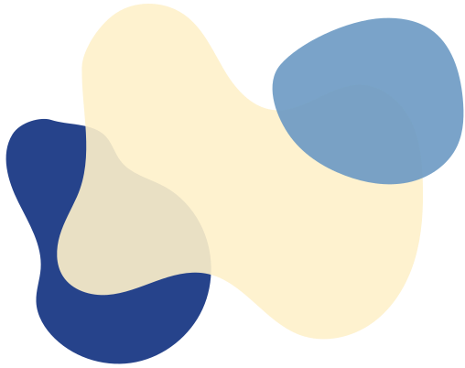
A DAY IN THE LIFE OF A PHN
8:00 AM – Morning Briefing
  Check MAVEN and run reports
9:00 AM – Case Management
  TB and any new communicable disease investigation, home visits.
10:30 AM – Departmental Collaboration
  collaborate with Public Health Team for cross-sector follow-up
12:00 PM – Access and Linkage with Clinical Care
  Health screening, vaccinations, educational outreach & programming
2:00 PM – School/Community Outreach
  Collaboration with School Nurses and follow-up with community members
3:30 PM – Emergency Preparedness Work
  Attend a planning meeting
4:30 PM – Data & Reporting
  Circle back with MAVEN and documentation

Slide 6

MAVEN
Massachusetts Virtual Epidemiologic Network
  Contains epidemiological, clinical, laboratory, and case management data
  90 reportable infectious diseases
  Enables state and local health officials to
    Notify and triage cases in real-time
    Monitor disease trends over time
    Rapid detect increases in disease occurence
    Implement control measures
    Identify high risk group
    Allocate resources accordingly
  Results in real-time interventions that improve community health outcomes.
Examples include:
  Foodborne illnesses
  Aborovirus Monitoring
    Tick monitoring program--invest bugdet on evidence based programming
    Central Massachusetts Mosquito Control--organic larvacide spring and summer to interrupt breeding patterns of mosquito population
j

Slide 7
Inter-Departmental Collaboration
Benefits of Interdisciplinary collaboration
  stenghtens surveillance, early warning, and response systems for climate-related health threats
  supports health equity and community-level education and preparedness.[4-6]
  positions communities to address climate-sensitive conditions,
  advocates for planetary health, and lead community outreach efforts that mitigate the impact of extreme weather events and environmental exposures.[4][6]
Cross-sector collaboration is essential for addressing complex environmental health challenges, facilitating policy development, and building capacity for prevention-oriented, comprehensive approaches to healthy living environments.[7-9]

Slide 8
CHRONIC DISEASE & INJURY PREVENTION
  Early identification of persons at risk for cancer or other illnesses due to environmental hazards (pfas, water quality, air quality, climate change and impact on asthma, COPD, heart failure)
  Develop educational programming that conform to state/local laws on tabacco use. Advocate and build coalitions fo tabacco cessation, decrease youth use rates and reduce second smoke exposure.
  Plan and provide programming/education that promotes public safety and injury prevention. Community safety outcomes improve and the strain on EMS is reduced. ($$$$$$)

Slide 9



ENVIRONMENTAL PH NURSING
51% of PHNs surveyed request envirnomental health training to better understand how to work better as a cohesive team with our public health partners.
Coordinated and integrate environmental public health prevention programs:
  childhood lead poisoning prevention
  air and water pollution
  climate change
  link to remediation services

Slide 10
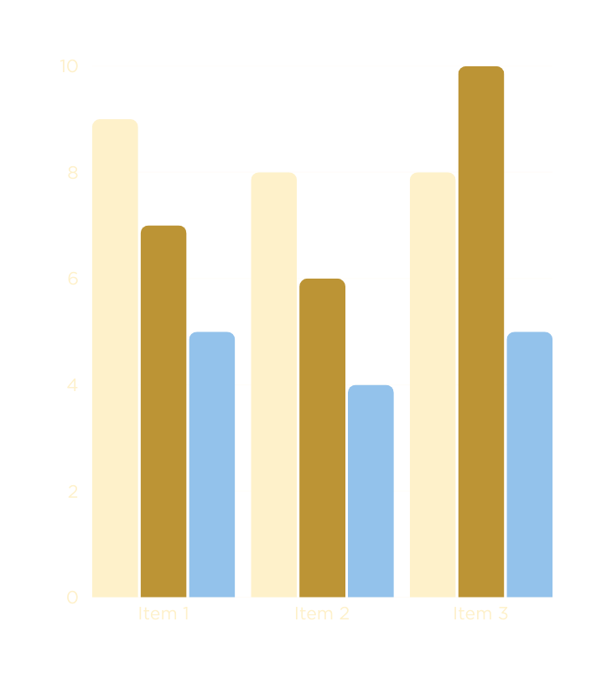

RESULTS OF COLLABORATION
Cross-sector collaboration is essential for addressing complex environmental health challenges, facilitating policy development, and building capacity for prevention-oriented, comprehensive approaches to healthy living environments.[7-9] Such partnerships bridge gaps between public health, housing, and environmental policy, enabling integrated interventions that address upstream determinants of health and reduce disparities. Effective collaboration is contingent on clear roles, trust-building, and active engagement among stakeholders.[7-8]

Slide 11
CONCLUSION
In summary, the medical literature supports that collaboration between public health nurses and environmental professionals leads to enhanced health outcomes through improved intervention delivery, preparedness, and policy development, particularly in populations at greatest risk from environmental hazards.

Slide 12
COVID-19 VACCINE DISCUSSION
Who is Eligible
    65+
    Immocompromised (high risk)
Vaccines Available
  Pfizer
    5-64 years high risk only
    65+
  Moderna
    6 mos-64 years high risk only
    65+
  Novavavx
    12-64 years high risk only
    65+
Bottom Line: FDA changed the Covid-19 label, but for now the “high-risk” list is still broad.
Sept 18th ACIP meeting and expecting more changes to come.

Slide 13
Thank You
For your attention

Slide 14
REFERENCES
1.Effectiveness of a Household Environmental Health Intervention Delivered by Rural Public Health Nurses.
Butterfield PG, Hill W, Postma J, Butterfield PW, Odom-Maryon T.
American Journal of Public Health. 2011;101 Suppl 1:S262-70. doi:10.2105/AJPH.2011.300164.
2.Protecting Children's Environmental Health in a Changing Climate: A Model Collaboration of the Maternal and Child Health Section and the Environment Section of APHA.Trousdale K, McCurdy LE, Witherspoon NO, Alkon A.Maternal and Child Health Journal. 2023;:10.1007/s10995-023-03756-8. doi:10.1007/s10995-023-03756-8.
3.Changing Health Outcomes of Vulnerable Populations Through Nursing's Influence on Neighborhood Built Environment: A Framework for Nursing Research.
DeGuzman PB, Kulbok PA. Journal of Nursing Scholarship : An Official Publication of Sigma Theta Tau International Honor Society of Nursing. 2012;44(4):341-8. doi:10.1111/j.1547-5069.2012.01470.x.
4.Defining Roles and Responsibilities of the Health Workforce to Respond to the Climate Crisis. Sorensen CJ, Fried LP. JAMA Network Open. 2024;7(3):e241435. doi:10.1001/jamanetworkopen.2024.1435. Leading Journal
5.Building Healthy Community EnvirONMENTS: A PUBLIC HEALTH APPROACH. KOEHLER K, LATSHAW M, MATTE T, ET AL. PUBLIC HEALTH REPORTS (WASHINGTON, D.C. : 1974). 2018 NOV/DEC;133(1_SUPPL):35S-43S. DOI:10.1177/0033354918798809.
6.PLANETARY HEALTH AND NURSING: EMBEDDING VALUES INTO STANDARDS, BEHAVIOURS, AND EDUCATION. WARD A, CHARALAMBOUS J, ANTONIOU C, ET AL. NURSE EDUCATION TODAY. 2025;153:106806. DOI:10.1016/J.NEDT.2025.106806. NEW RESEARCH
7. CROSS-SECTOR COLLABORATION FOR A HEALTHY LIVING ENVIRONMENT-WHICH STRATEGIES TO IMPLEMENT, WHY, AND IN WHICH CONTEXT?. VAN VOOREN NJE, DREWES HW, DE WEGER E, BONGERS IMB, BAAN CA. INTERNATIONAL JOURNAL OF ENVIRONMENTAL RESEARCH AND PUBLIC HEALTH. 2020;17(17):E6250. DOI:10.3390/IJERPH17176250.
8. LINKING PUBLIC HEALTH, HOUSING, AND INDOOR ENVIRONMENTAL POLICY: SUCCESSES AND CHALLENGES AT LOCAL AND FEDERAL AGENCIES IN THE UNITED STATES.
JACOBS DE, KELLY T, SOBOLEWSKI J. ENVIRONMENTAL HEALTH PERSPECTIVES. 2007;115(6):976-82. DOI:10.1289/EHP.8990.
9. ENVIRONMENTAL HEALTH: ADVANCING EMANCIPATORY POLICIES FOR THE COMMON GOOD. VALENTINE-MAHER SK, BUTTERFIELD PG, LAUSTSEN G. ANS. ADVANCES IN NURSING SCIENCE. 2018 JAN/MAR;41(1):57-69. DOI:10.1097/ANS.0000000000000194.
10. PROPOSED MINIMUM STANDARDS FOR PUBLIC HEALTH NURSING PROVIDING MUNICIPALITIES WITH PUBLIC HEALTH SERVICES. MASSACHUSETTS ASSOCIATION OF PUBLIC HEALTH NURSES. LEADERSHIP MATTERS INNOVATION PROJEXT (2023).
11. PUBLIC HEALTH ACCREDITATION BOARD. (2025, AUGUST 15). THE FOUDNATIONAL PUBLIC HEALTH SERVICES. RETREIVED FROM HTTPS://PHABOARD.ORG/INFRASTRUCTER/PUBLIC-HEALTH-FRAMEWORKS/THE-FOUNDATIONAL-PUBLIC-HEALTH-SERVICES/

