Slide 1

Canning and home food preservation:
Updates for Public Health
Kimberly Concra, MS, LDN
Nutrition & Food Safety Specialist
Cape Cod Cooperative Extension
kconcra@capecod.gov

Slide 2
Why are we having this conversation?
An online survey of >2000 individuals found that:
76.9% freeze or refrigerate for food preservation
50% used 1 of at least 16 types of food preservation
11% use methods USDA says are unsafe
about 39% are using recipes with limited research
Supply chain, food cost, control of ingredients and less preservatives are contributing factors.
Pandemic shortages and time at home led to home gardens, sourdough and thoughts of self-sufficiency. Millenials and Gen Z are increasingly interested in homesteading. Almost half of the Homesteaders of America survey respondents were 39 or younger (Business Insider, Jan. 2024)
National Trends in Home Food Preservation and Outreach
Routh, B. et al.
Journal of the Academy of Nutrition and Dietetics, Volume 124, Issue 10, A59

Slide 3
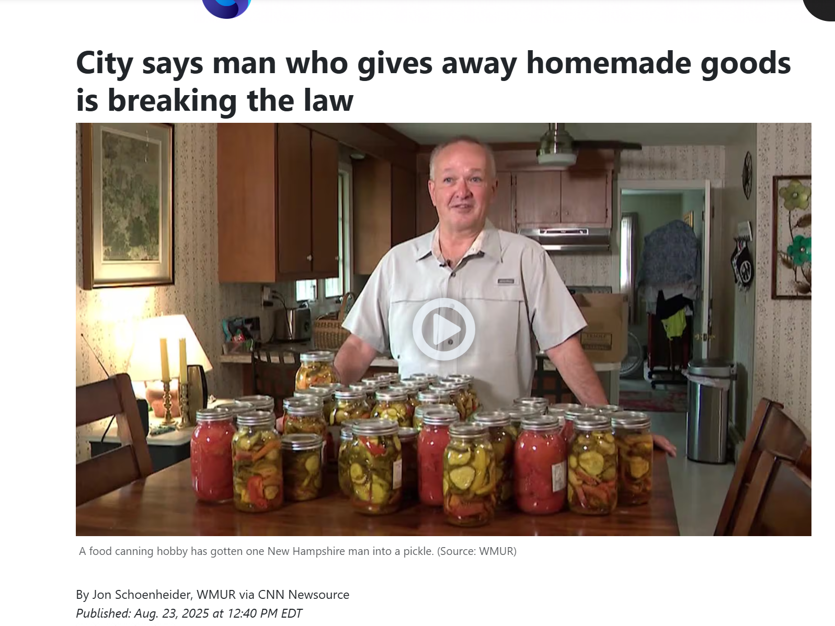
Coming to a town near you?
Food pantries can’t take home preserved food.
Many people give homemade goods for gifts.
Is it legal? It may depend on your town/city.
Think about hometown fairs. Even with provided recipes, what are people doing in their own kitchens? Should training be offered?
City says man who gives away homemade goods is breaking the law

Slide 4
About Extension
The Smith-Lever Act of 1914 established the Cooperative Extension Service, a partnership between land grant colleges nationwide, as a means for disseminating and implementing research-based information from land-grant universities, including the University of Massachusetts.
Much of the focus was on homemaking and agricultural practices and the sharing of science-based information.
Master Gardeners
Horticulture/Entomology
Nutrition & Food Safety Education
4-H youth services
Buy Fresh Buy Local, Marine services
Coastal Processes, Hazardous Waste and Water Quality

Slide 5
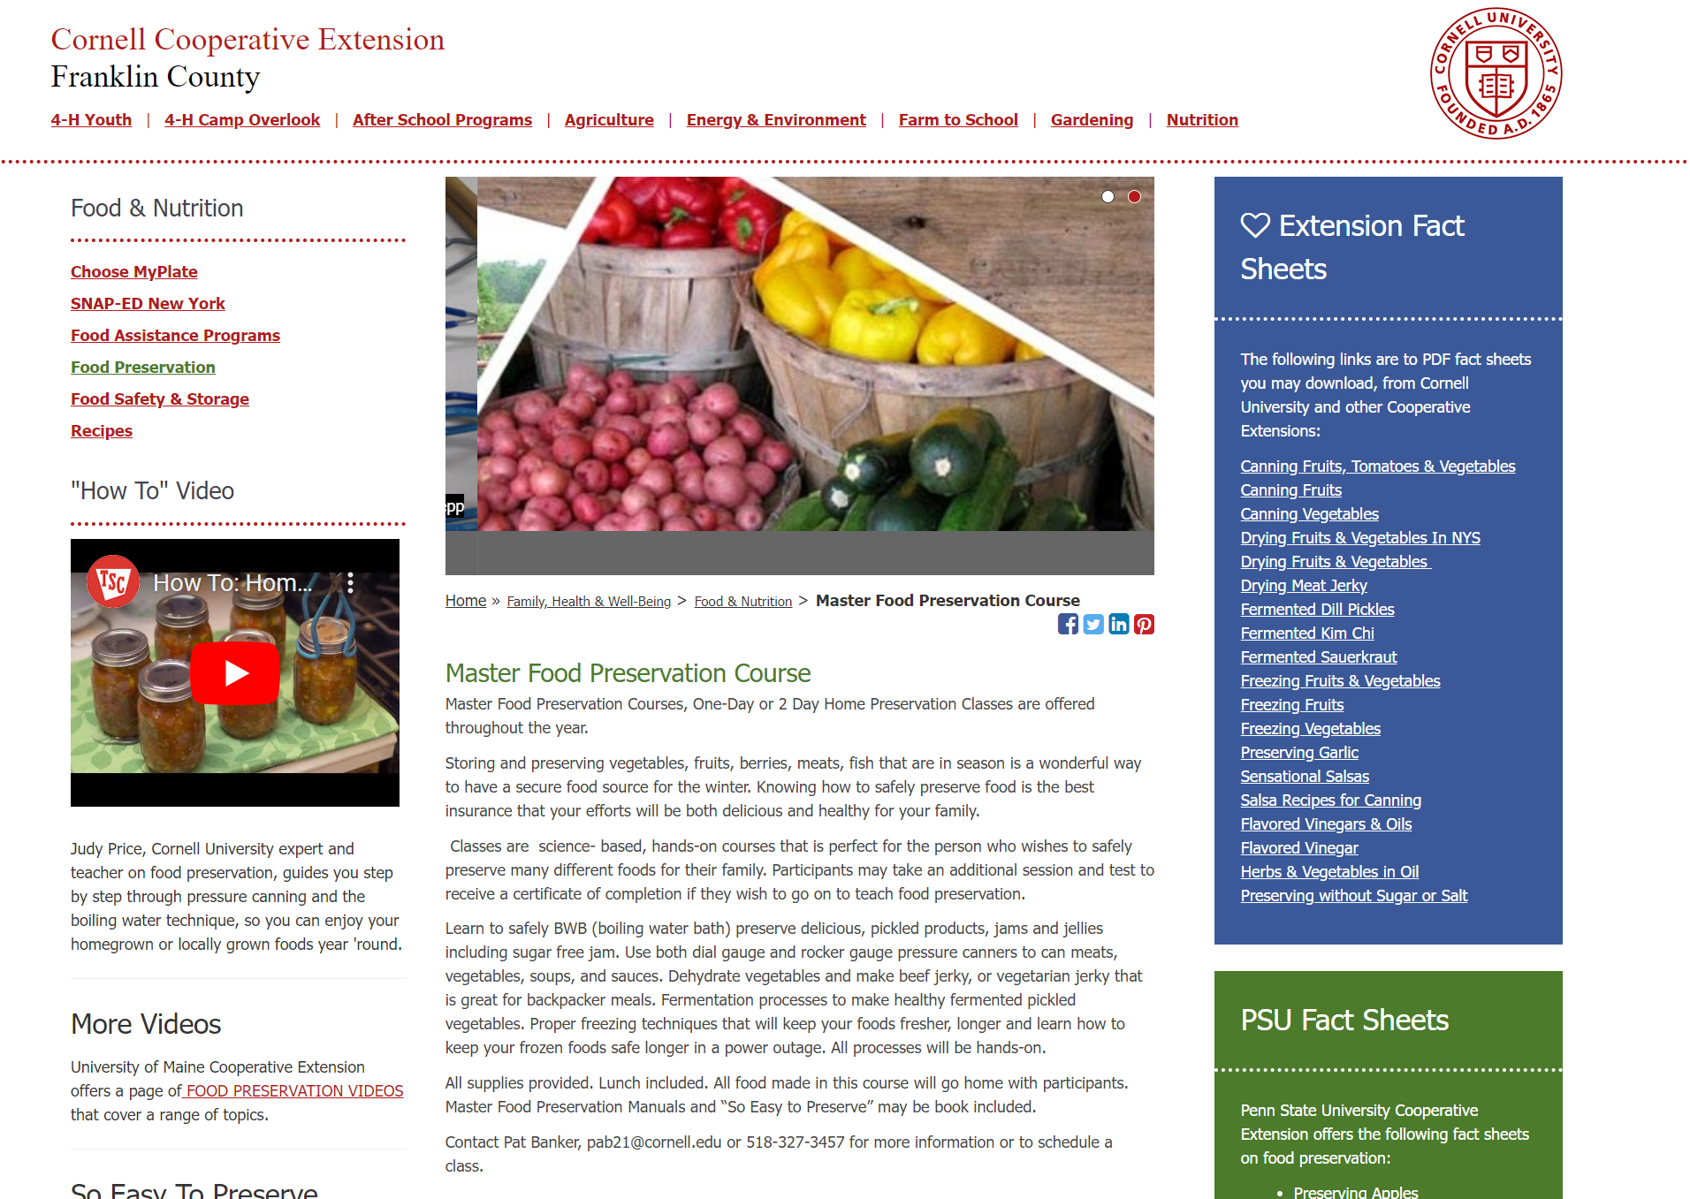

Slide 6
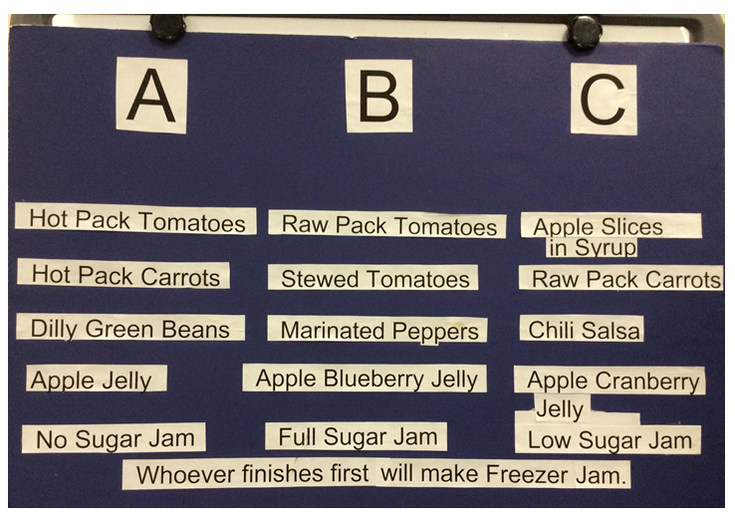

3 Days, boil water and pressure canning, drying, fermenting… testing on day 3!

Slide 7
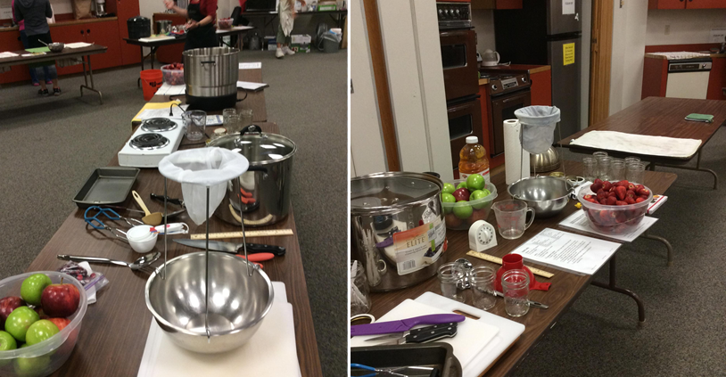

Slide 8
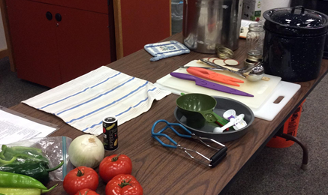
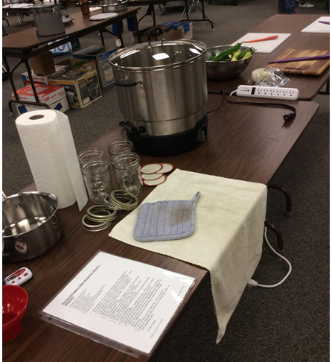
Canning salsa and making Jam in the demo kitchen

Slide 9
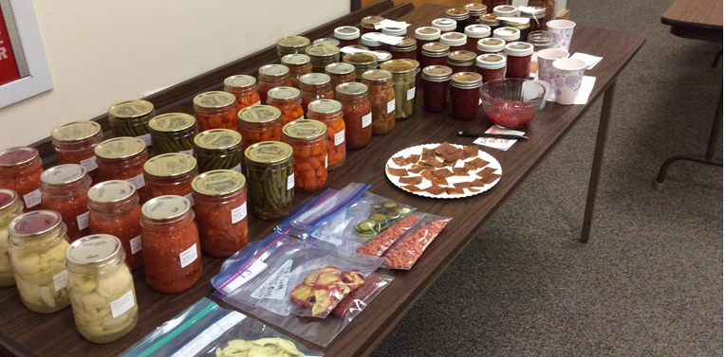

Slide 10
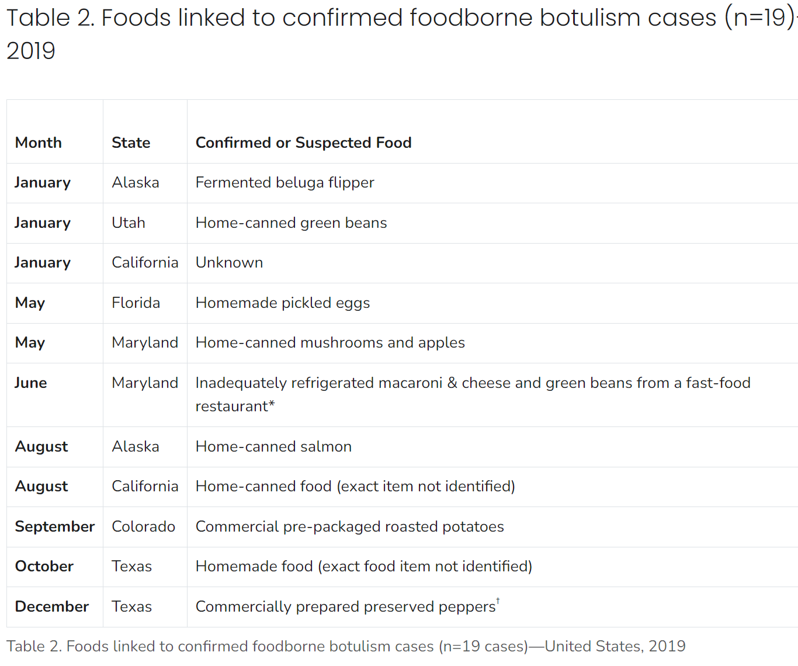
Centers for Disease Control
Home Canning is Back!
And botulism still does occur…
Done safely, canning preserves foods in a form that makes meal preparation a snap and captures peak-of-season flavor for enjoyment year round
Things do change… Stay current!

Slide 11
What we know: aW
Water Activity
Minimum needed for bacteria to grow
Fresh and canned
Fruits and vegetables
Dried fruit
Cocoa
0 0.1 0.2 0.3 0.4 0.5 0.6 0.67 0.7 0.75 0.8 0.85 0.9 0.92 0.95 0.98 1.0
Dry Egg Noodles
Crackers
Jams & Jellies
Meats, Fish
Poultry
Dried Whole Milk
Sugar
Distilled Water
Potentially Hazardous Foods
Flours
Candy
11
Notes:
11
Moisture: Like most other forms of life, moisture is an important factor in bacterial growth. Scientists have determined that the amount of water available affects bacterial growth. This is why man has dried foods for thousands of years as a way to preserve them.
Water activity, simply, is a measure of available water in the food.

Slide 12
What we know: pH
Acid
Alkaline
0 1.0 2.0 3.0 4.0 4.6 5.0 6.0 6.4 7.0 8.0 8.5 9.0 10.0 11.0 12.0 13.0 14.0
Distilled
Water
Egg White
Commercial Mayonnaise
Apples
Orange
Juice
Chicken
Milk
Corn
Soda
Crackers
Beef,
Veal
Pork
Carrots, Pumpkins
Sweet Potatoes
Cheddar Cheese
Limes
Pickles
Vinegar
Acidity levels affect bacterial growth
Different bacteria, different acid tolerance
Notes:
12
Low Acidity – Bacteria do not like an acid environment. The pH symbol is used to designate the acidity or alkalinity of a food. A pH of less than 7.0 indicates that food is considered acidic; however, slightly acidic foods like chicken, beef and pork support growth well. Disease- causing bacteria grow best when the food they live in and on has a pH of 4. 6. to 7.0. Examples: Meat, fish and milk. Also many fruits and vegetables fall into this range.

Slide 13
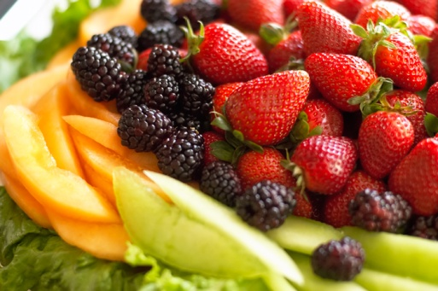
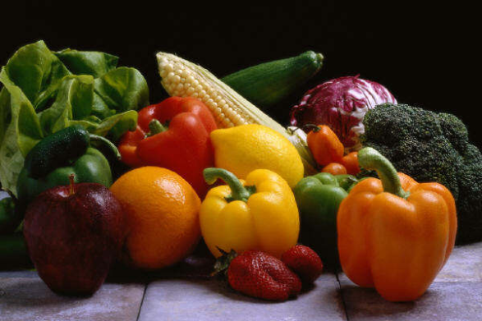
How do we know which canning method to use?
What is the pH (acidity) of the food?
below pH 4.6 above pH 4.6
HIGH Acid
LOW Acid
Boiling Water Canning
Fruits, Pickles, Salsa
Pressure Canning
Meat, Vegetables
Notes:
pH is the measure of acidity in a food. Foods with a pH below 4.6 are high in acid; fruits are high in acid and can be boiling water canned. Acidified foods (foods where we add acid) like pickles and salsa (and tomatoes) are also high in acid and can be water bath canned. Some fermented foods are also high in acid.
Foods that are low in acid have a pH above 4.6. Meat, cheese, vegetables, and a few fruits have a pH above 4.6. Foods with a pH above 4.6 (meat/vegetables) must be pressure canned.

Slide 14
Food Preservation Methods:
Refrigeration: Extends shelf life
Freezing: Lowers temperature, so it lowers available water microbes may want
Drying: Lower available water
Canning: Removal of oxygen, sealed jar, uses heat (or pressure)
Pickling: Increases acid, used heat with boil water method, removal of oxygen, sealed jar
Fermentation: ’good’ bacteria change carbohydrates/sugars to acids.

Slide 15
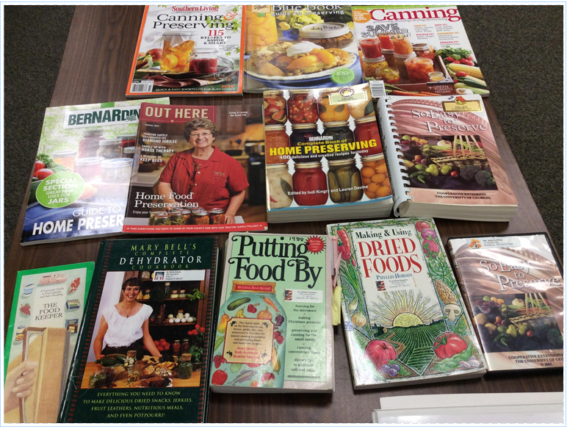
Information Overload!
Tip: Use tested recipes with dates after 1994
(new info suggests to use recipes after 2016!)

Slide 16
Times Change… Home Canning Updates
-Add acid to all tomato products.
-Alum is no longer recommended to firm pickles (if used, for crock pickles only).
-Lime (calcium hydroxide) is used only as an initial soak to firm pickles; remove excess by rinsing.
-For firm pickles – pickle fresh cukes, remove 1/8” from blossom end, pack cukes in ice, use CaCl₂ (pickle crisp).
-Do not use paraffin to seal jars of jam & jelly.
-Jar lids must be single use; seal finger-tip tight before processing, remove bands after processing, clean/dry.

Slide 17
More recent updates
Recipes that call for vinegar-- vinegar needs to be 5% acidity.
  (In 2023, there was chaos with 4% vinegar found at stores, and consumers were not aware or weren't looking for the 5%).
Fresh lemon juice shouldn't be used to acidify recipes (i.e., acidification of tomatoes);
  it should be bottled lemon juice, given that the pH of fresh lemon juice may be inconsistent.
Recent publication on an outbreak linked to improperly canned cactus in CA.
There are no safely tested recipes for white peaches.
For more outbreaks related to botulism: https://www.cdc.gov/botulism/php/national-botulism-surveillance/index.html
  Elderberries have been removed as a safe recipe as the pH of the berries has increased over time.
  This page contains good information (usually missed by consumers):
  ps://nchfp.uga.edu/resources/entry/backgrounder-heat-processing-of-home-canned-foods
For hot topics in HFP, monthly newsflash with the most commonly asked questions through the NCHFP. The question bank can be found here: https://nchfp.uga.edu/newsflash
Notes:
pH is the measure of acidity in a food. Foods with a pH below 4.6 are high in acid; fruits are high in acid and can be boiling water canned. Acidified foods (foods where we add acid) like pickles and salsa (and tomatoes) are also high in acid and can be water bath canned. Some fermented foods are also high in acid.
Foods that are low in acid have a pH above 4.6. Meat, cheese, vegetables, and a few fruits have a pH above 4.6. Foods with a pH above 4.6 (meat/vegetables) must be pressure canned.

Slide 18
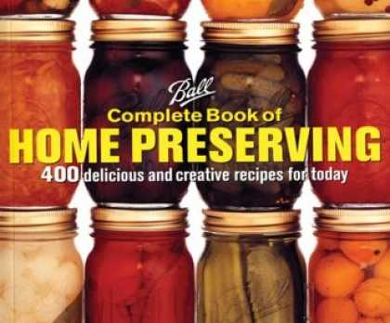
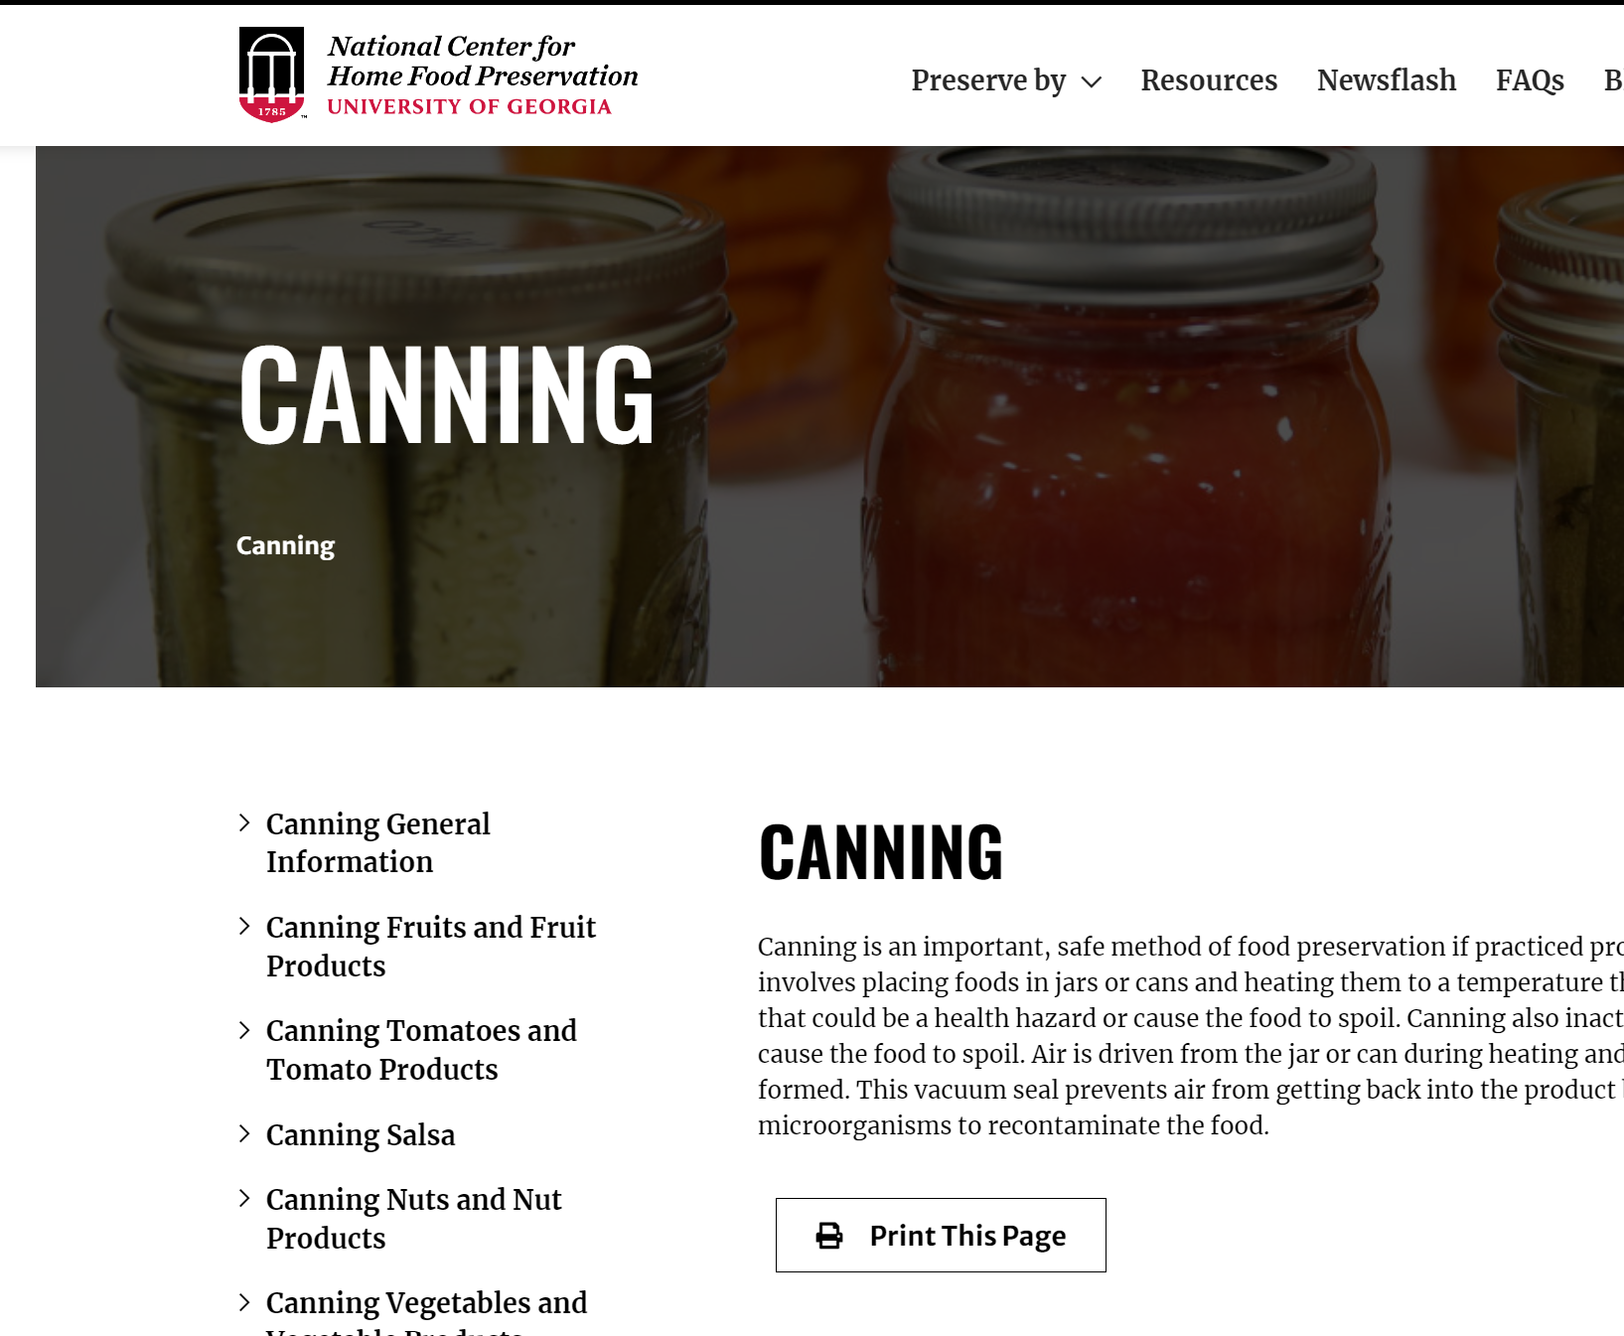
Getting Started:
TIP: Use ONLY up-to-date, research-tested recipes!
-Current canning instructions dated from at least 1994
-Don’t (necessarily) do what Mom told you!
-Leave creativity behind (when home preserving)
-National Center for Home Food Preservation –
Canning - National Center for Home Food Preservation (uga.edu)
-Ball and Bernardin www.freshpreserving.com
- www.healthycanning.com
Notes:
Depending on the method of home food preservation that you choose, you may have a variety of recipes to choose from, or your choices may be limited. Every year, check to make sure your canning recipes are up-to-date. Leave the creativity behind when home canning! Don’t experiment with your health and that of your family.
Be sure that you:
Use recipes as they are written, don’t adapt . Changing the amount of sugar and salt is sometimes OK, but making other changes is generally not alright. As we talk about specific recipes later this summer, I will make sure to mention if any modifications are safe.
For instance, it generally isn’t OK to add more onion or celery than is called for; it isn’t OK to add butter or flour if it isn’t called for; and it isn’t OK to use a larger jar and ‘guess’ on the processing time. It also isn’t OK to leave a critical ingredient like acid out of canned tomatoes.
Follow current recipes. Research published in 1994 indicated that some canning procedures were no longer safe. For instance, before 1994 it appeared to be safe to can tomatoes without added acid, but we now know that this isn’t true. So, if your canning recipes pre-date 1994, be sure to order new publications.
Call for help BEFORE canning, not after. If you aren’t sure if you are following a safe method, call your county extension office before you start, not while you are waiting for the jars to cool.

Slide 19

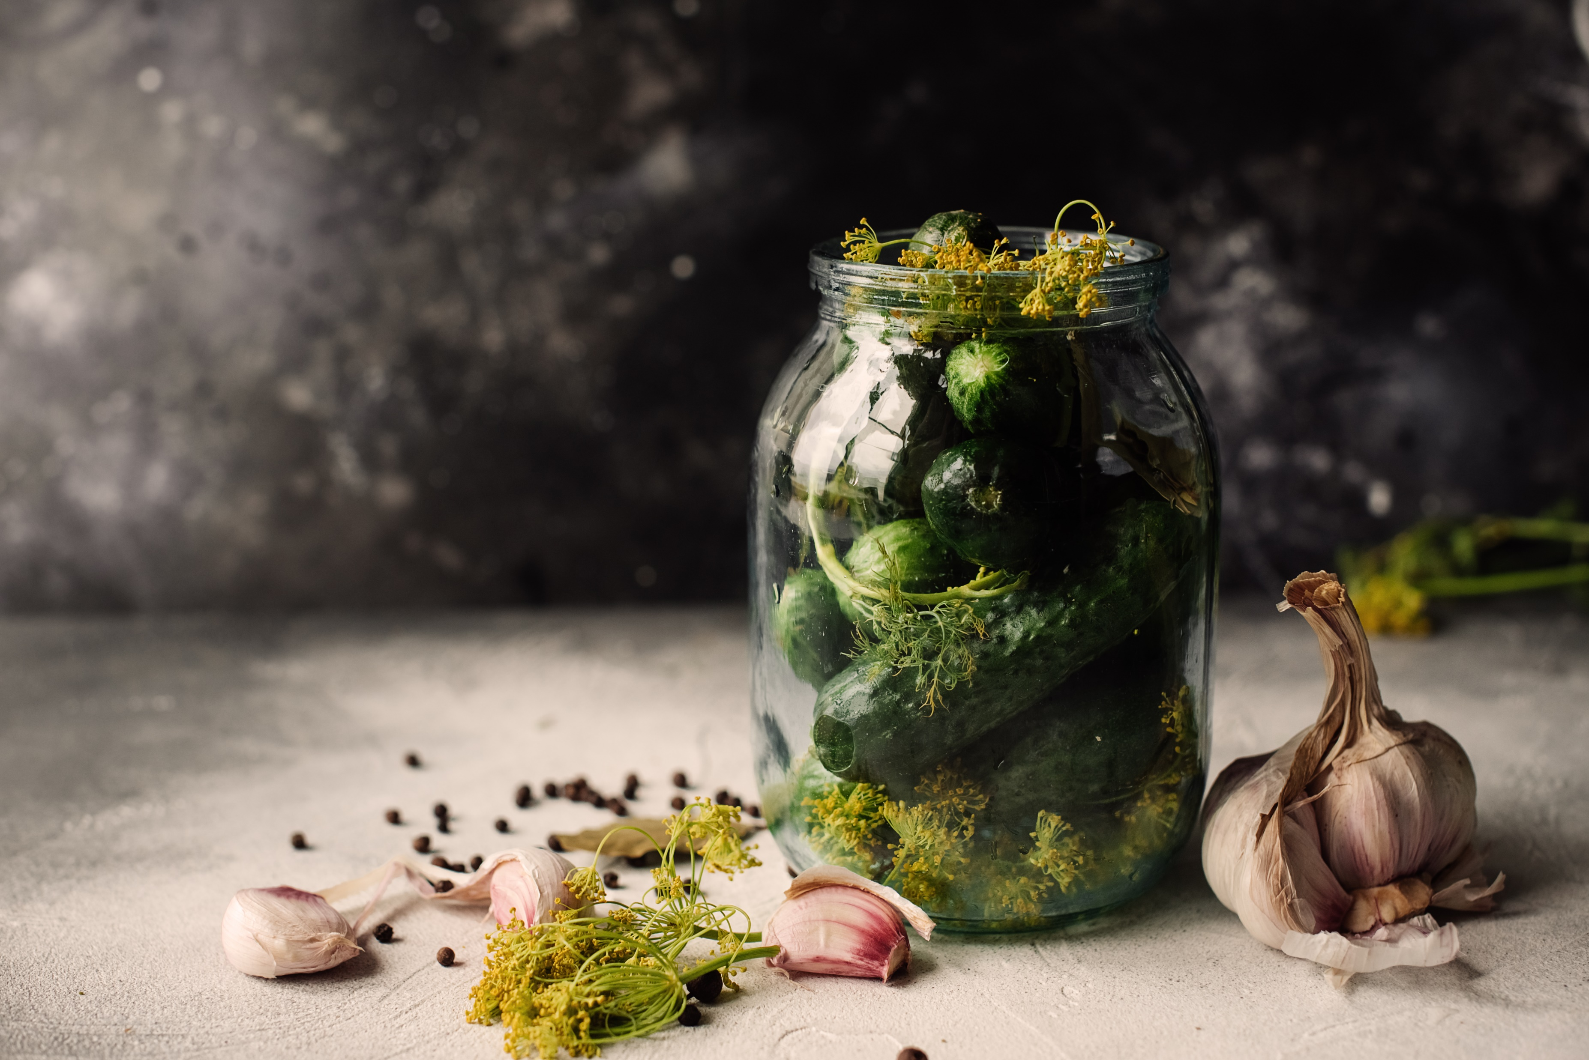
Improper Methods You May Have Heard Of:
-Boiling water canning of low-acid foods (meats, vegetables)
-Open-kettle canning (filling the jar, putting lid on…and you are done??)
-Dishwasher canning
-Oven canning
Notes:
Some home canning practices to avoid at ALL COSTS:
Do not use a boiling water canner for low-acid foods. Always use a pressure canner for low-acid foods. You risk botulism poisoning if you do not.
Never open-kettle can foods. Open-kettle canning is when you place hot food in hot, clean jars and seal, with no further processing. Open kettle canning is NOT acceptable for any type of foods: fruits, tomatoes, or vegetables. With open kettle canning you risk spoilage or even food poisoning.
Never oven can foods. Oven canning is when you place canning jars with food such as meat in the oven, heat the jars for a period of time, remove the jars and seal. The jars are likely to break, and the food is not heated sufficient to ensure safety.
Here’s an easy way to explain why oven canning does not ensure safety. Think of the last time you had your oven heated to 375 degrees F. You can open the oven door, and place your hand in the oven and, as long as you don’t touch anything, you can leave your hand there a few seconds. But, consider holding your hand over a kettle of boiling water. The boiling water is at 212 degrees F, 163 degrees cooler than the oven, and yet your hand is instantly burned by the steam. So…we can say that dry heat (like an oven) does not act in the same way as moist heat (steam). In home canning we use steam in a pressure canner, or boiling water in a BWC to create the heat needed to ensure safe food.

Slide 20
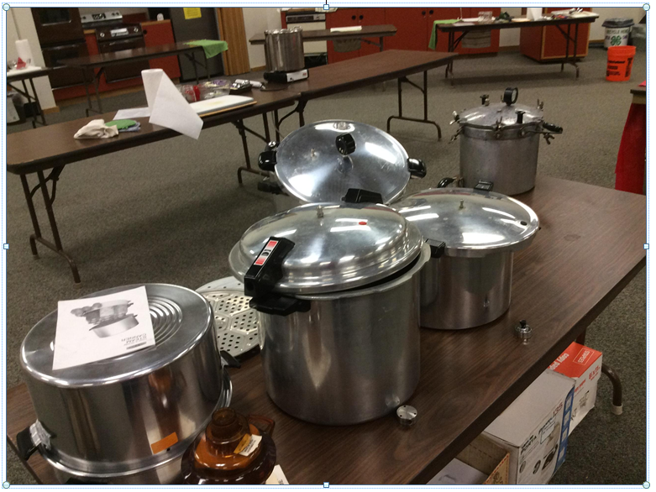
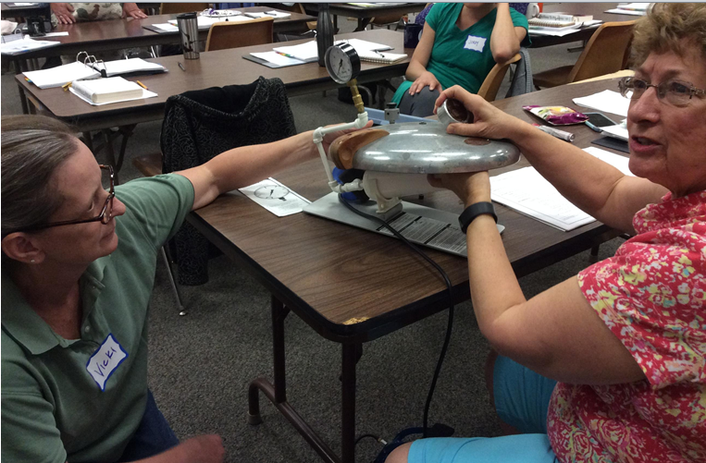
Using the Correct Equipment: What’s the difference????
Atmospheric Steam Canner
Pressure Canner testing
Home canning pressure gauges are to be checked YEARLY! Who is doing that?

Slide 21
And now a word about…canners vs. cookers
Pressure canners and pressure cookers are NOT necessarily the same thing.
Pressure canners must hold at least 4 Quart jars and be able to regulate pressure at 5, 10, 15 pounds (psi).
➔Pressure cookers are NOT recommended for home canning.
Notes:
Pressure canners are not necessarily the same thing as pressure cookers.
Small pressure cookers or pressure saucepans are used to rapidly cook meats, vegetables and other foods for a family meal. But they may not maintain adequate pressure, and they heat and cool too quickly to use them to safely pressure can foods.
Pressure canners have either dial or weighted gauges. Pressure canners are necessary to safely can foods such as meats and vegetables that are low in acid.
Pressure canners and pressure saucepans come in a wide variety of sizes. Pressure canners may hold up to 22 Quarts of canned food, and are able to process food at pressures up to 25 pounds of pressure. Some popular brands of pressure canners are Mirro, Presto, and All American. Pressure cookers usually hold no more than 4 to 6 Quarts of liquid, and they may, or may not, have a way to regulate the pressure. Some pressure cookers come equipped with a weight to cook at 5, 10 or 15 pounds of pressure, while others have no way to regulate pressure settings, or simply have settings of ‘low’, ‘medium’ and ‘high’. Pressure cookers are not recommended for home canning.

Slide 22
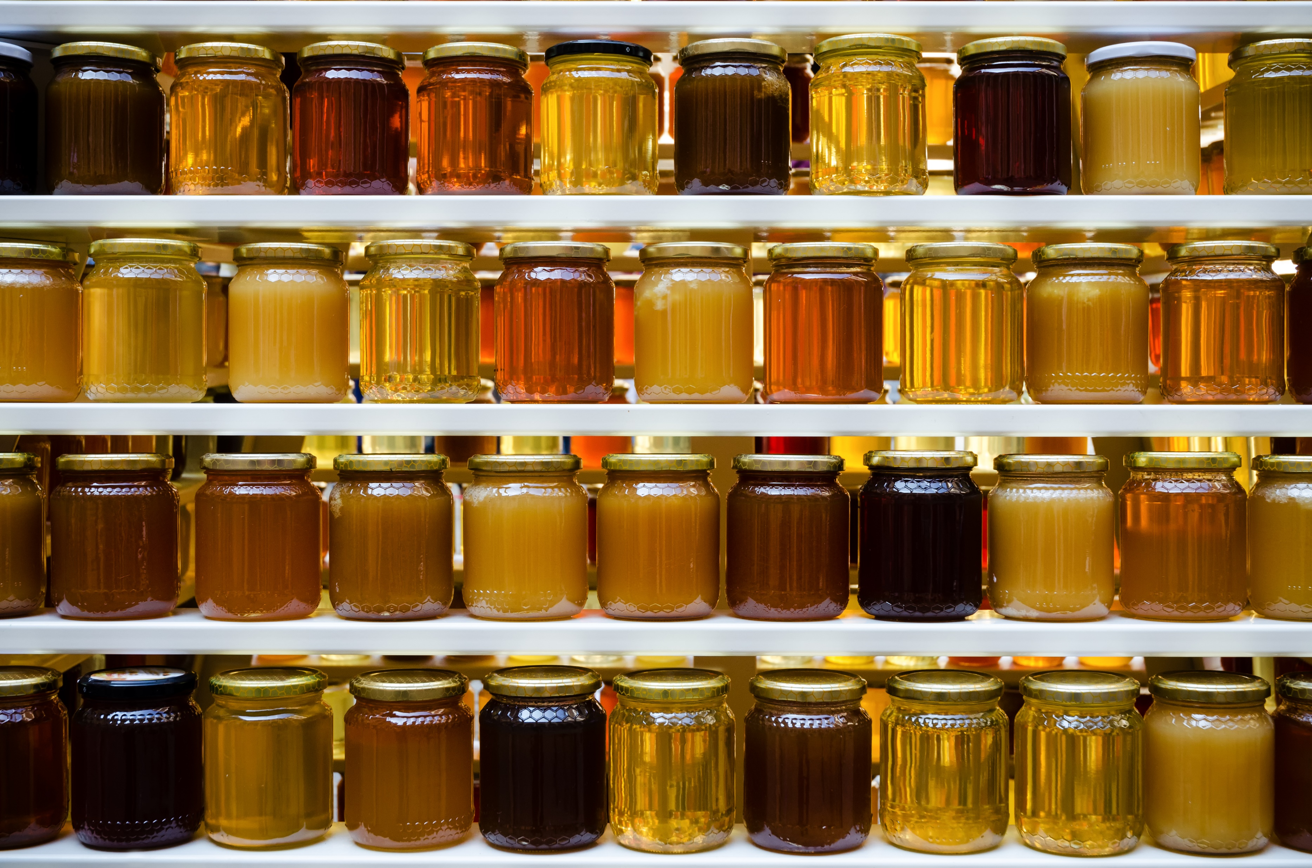
Tips for Successful Canning:
-Properly pre-treat jars and lids
-Fill jars with hot liquid (never cold!)
-Leave the proper headspace
-Boiling water canning: jars must be covered with 1-2” of boiling water during processing
-Pressure canning: vent canner for 10 minutes before pressurizing
-Adjust for elevation

Slide 23
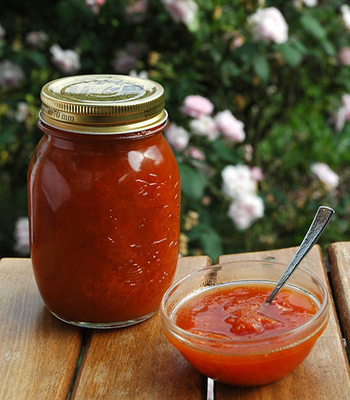
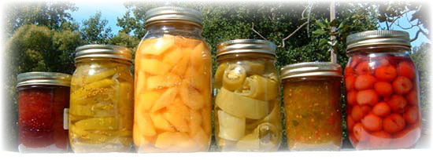
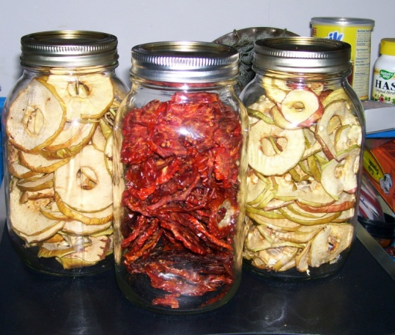
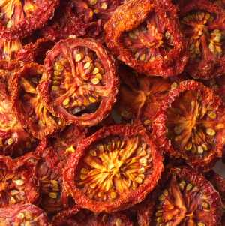
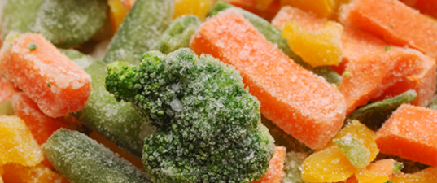
The Goal: food safe, high quality home preserved food.
Notes:
There are 3 main methods of food preservation: canning, freezing and drying. The method you choose will depend on whether there are safe guidelines for preserving your food using that method; and which method best suits your needs. For instance, you may want to can a new salsa recipe, but if there are no safe guidelines for doing so, you may end up freezing the product instead. Or, if you have a bounty of delicious strawberries from your garden, you might consider canning strawberry jam, or freezing the berries ‘as is’ … but not drying, because drying strawberries results in a poor quality product. Canning, freezing and drying, if done correctly, can help you store safe, high quality food for later use.

Slide 24
Thank you!
Kim kconcra@capecod.gov

