Slide 1
What is a Training Hub
&
What’s in it for me?
Kerry Dunnell
Manager
NorthCentral MetroWest Training Hub
Bri Dupras, REHS/RS
Lead Public Health Trainer
Franklin-Berkshire Training Hub
Derek Macedo
Public Health Training Coordinator
Baystate Training Hub

Slide 2
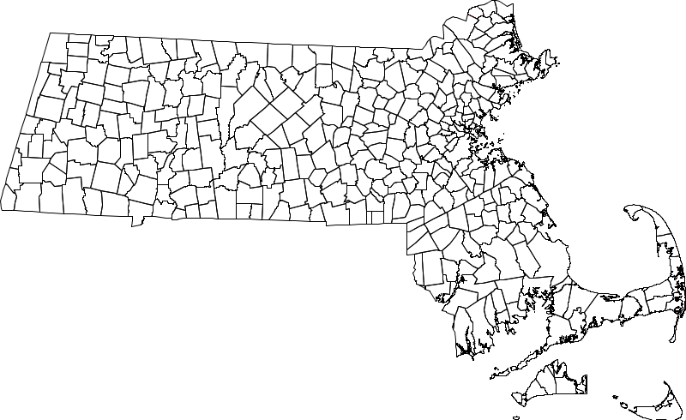
History
Coalition for Local Public Health (2006) Strengthening Local Public Health in MA: A Call to Action
Local Public Health Institute Competencies Report (2010)
Public Health in MA was...
Most decentralized in the nation
One of the only not funded by state funds (until 2019)
No required credentials for inspectors
No performance standards
Dramatic variability in public health protections
In 1979, Paul Revere was chairman of the Board of Health in Boston, the first local board of health in Massachusetts. He and his fellow board members were given broad authority to control the “filth and offal” that contaminated the environmentan producted deadly epidemics

Slide 3

More History
The Special Commission on Local and Regional Public Health (the Special Commission) was established in August 2016 to:​
Assess the effectiveness and efficiency of municipal and regional public health systems
Make recommendations regarding how to strengthen the delivery of public health services​

Slide 4

Blueprint for Public Health Excellence 2019
The Massachusetts local public health system was not meeting national public health standards
Many Massachusetts cities and towns struggle to carry out statutory duties and responsibilities
Massachusetts has more local public health jurisdictions than any other state (351)—one for each city and town
Cross-jurisdictional sharing of services is limited despite evidence that it improves effectiveness and efficiency
Data to measure local public health system performance is limited
Funding for local public health is inconsistent and inequitable

Slide 5
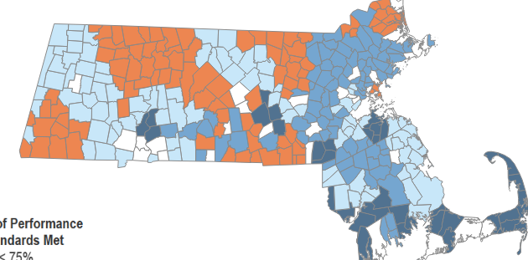
Taking Steps to Improve
Support ability to meet statutory and regulatory requirements Created opportunity for shared services arrangements
Train the public health workforce to the same standard and make sure all communities have access to public health excellence
Created training hubs

Slide 6
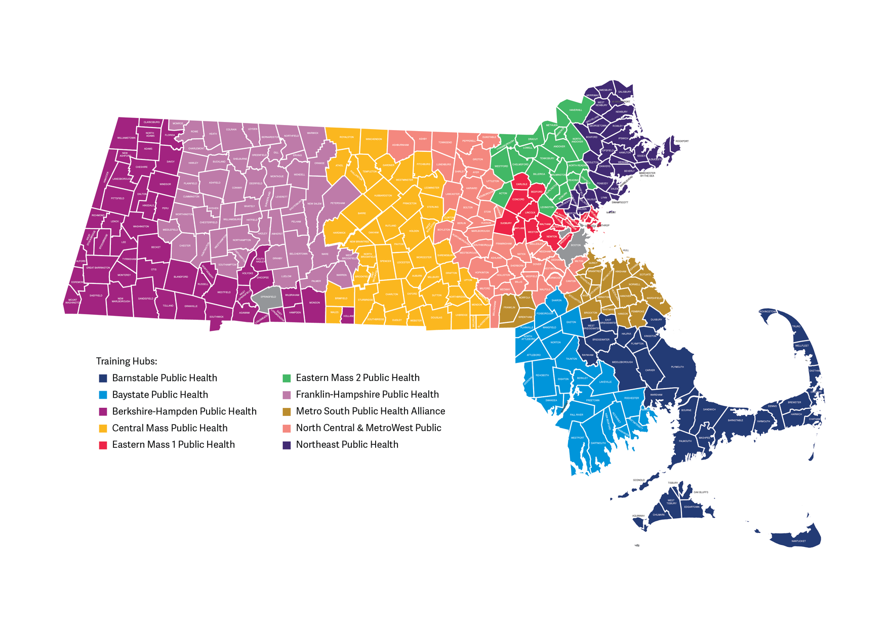
Training Hubs
Barnstable Public Health
Baystate Public Health
Berkshire-Hampden Public Health
Central Mass Public Health
Eastern MA Public Health
Franklin-Hampshire Public Health
Metro South Public Health
North Central MetroWest Public Health
Northeast Public Health

Slide 7



Training Hub Program
All inspectors and health agents are expected to participate and complete the training hub program & curriculum
This also includes BOH members and directors who conduct inspections
Workforce Standards
Essential Knowledge
TIER 1
(Pre-Requisites)
Instructor Guided Learning
TIER 2
Applied Practice
TIER 3
(In-Person Inspections)

Slide 8
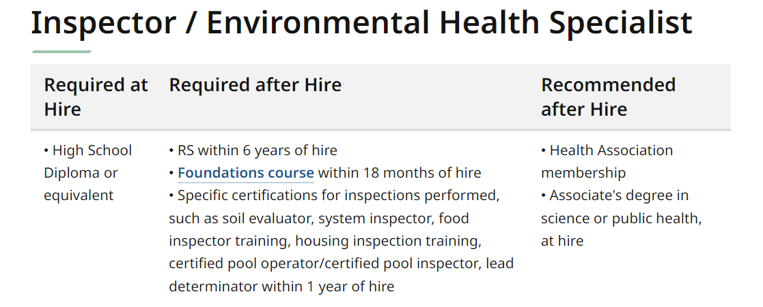
Workforce Standards

Slide 9
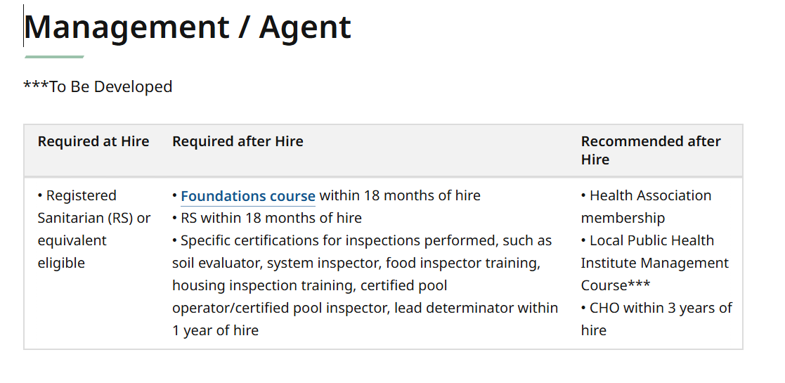
Workforce Standards

Slide 10
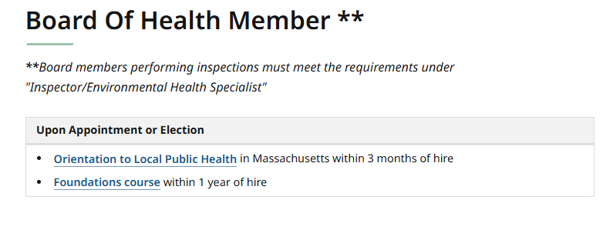
Workforce Standards

Slide 11

TIER 1
Essential Knowledge
Prior to signing up for the Tier 2 instructor-guided courses, all pre-requisite courses must be completed.
Housing Pre-Requisites: https://www.train.org/ma/training_plan/7233
Food Pre-Requisites:
https://www.train.org/ma/training_plan/7697

Slide 12
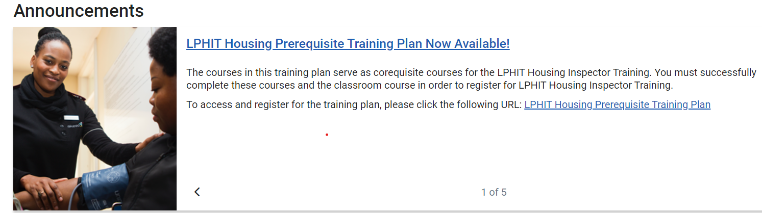
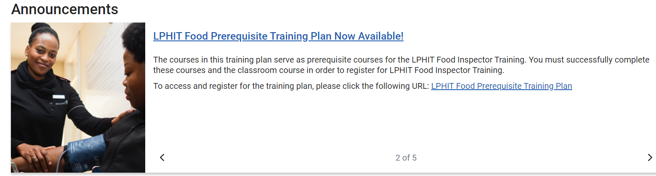

Slide 13
TIER 1
Essential Knowledge
FAQs
I’ve taken some of the FDA courses, do they count?
-Yes! You can submit the certificate, or if you no longer have it, you can reach out to the FDA help desk for your transcript: appsdesk@fda.hhs.gov
I took a lot of these on the old LPHI platform, do they count?
-Yes! You can submit those certificates.
Some of these courses were included in the Foundations Course. Do I have to retake them?
-No! You can submit your Foundations Certificate on behalf of those trainings that were included in the course.
Email: OLRHtrainingsupport@mass.gov

Slide 14

Instructor Guided Learning
TIER 2
Previously known as MA PHIT, the Tier 2 Local Public Health Training Program (LPHTP) trainings are offered multiple times a year, and are either in-person, virtual, or both.
Courses will be announced via email, and can also be found on your Training Hub web page
Available LPHTP Courses:
Housing
Food
In Development
Camps
Pools
Wastewater/Title 5
Nuisances
Body Art

Slide 15
Instructor Guided Learning
TIER 2
FAQs
I took the MA PHIT Housing training and completed the in-person inspections. Do I have to retake the course and complete the 4 inspections?
No - if you have a MA PHIT Housing certificate of completion, you do not need to retake the course or complete the in-person inspections.
I took the MA PHIT Food training already. Do I have to retake it?
Yes
I’m an FDA standardized food inspector. Do I have to take LPHIT Food?
No - you do not need to take LPHIT Food or complete the in-person inspections with the training hub.

Slide 16
Instructor Guided Learning
TIER 2
FAQs
I’m a Health Director, and inspections are not my primary role, but I still conduct some inspections, such as when our inspector is on vacation or if the inspector position is vacant. Do I need to complete the training hub curriculum?
Yes
I’m a per diem/on-call inspector and only conduct inspections on a very temporary basis, such as filling in for weekend events. Do I need to complete the training hub curriculum?
Yes

Slide 17

Applied Practice
TIER 3
(In-Person Inspections)
After completing Tier 1 & Tier 2, you will be eligible for the 1:1 in-person inspectional trainings.
Food
Minimum of 5
Risks 2-4 as outlined in the Food Code Annex 5 (page 591)
HACCP (i.e. sushi)
Highly susceptible population
Full-service establishment
Housing
Minimum of 4-5
Category 1- Controlled (i.e. staged scene/photos)
Category 2- Pre-Occupancy (i.e. pre-rental/MRVP)
Category 3- On Demand (i.e. full housing inspection)

Slide 18

Applied Practice
TIER 3
(In-Person Inspections)
Hub trainers will use assessment tools created by DPH’s central trainers
The assessment tools will be provided prior to the inspections
Minimum of:
5 inspections - Food
4-5 inspections - Housing
These inspections are not tests! As trainers, we want to provide you with all of the tools necessary to be successful.
You will meet with your trainer prior to beginning inspection series to discuss expectations, answer questions, and provide important documents, cheat sheets, etc.

Slide 19
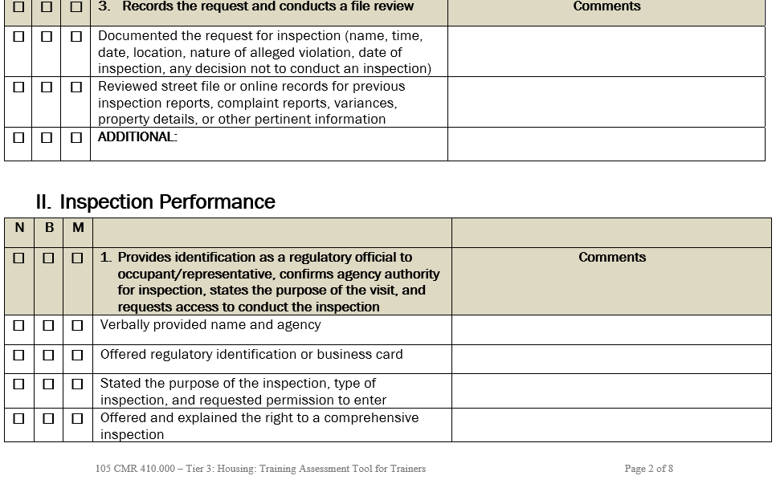
Housing Assessment Tool

Slide 20
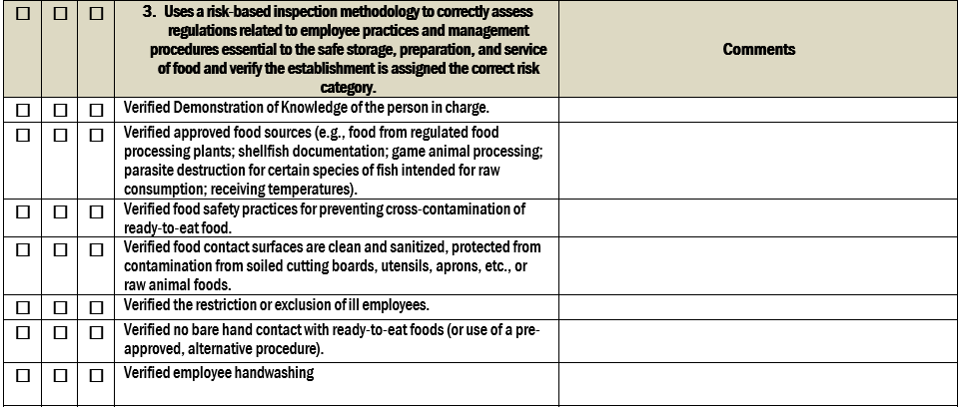
Food Assessment Tool

Slide 21
Applied Practice
TIER 3
(In-Person Inspections)
FAQ’s
We don’t have any establishments that operate under a HACCP plan - how do we fulfill this requirement?
While we work first with communities that you have authority in, Training Hubs can utilize other communities in their region to fulfill the inspection requirements. And, if none of the communities we have authority in have the type of inspection necessary, we have other options to assess your knowledge of HACCP plans.
Should we schedule the food inspections?
It depends. ☺

Slide 22
Applied Practice
TIER 3
(In-Person Inspections)
FAQ’s
I don’t feel ready to inspect by myself yet. Can we do some training beforehand?
YES!- We can go out together as many times as you need before you want to start ‘counting’ the minimum of 5 inspections needed. Trainers can lead a few inspections and then let you try. We can take as much time as needed.
Do you share my assessment with my supervisor?
No – assessments are only shared with you

Slide 23
Applied Practice
TIER 3
(In-Person Inspections)
FAQ’s
We use an inspectional software. Can we use it for the trainings with you?
Housing - inspectors use MA DPH templates during Tier 3
Food - using software is acceptable
We get only a few housing inspections a year. Does that mean we may have to wait years to complete our training?
No – To help fast track the in-person trainings, Training Hub staff can arrange for inspections in other communities

Slide 24
Applied Practice
TIER 3
(In-Person Inspections)
FAQ’s
I’ve finished Tier 1 & Tier 2. Now what?
Training Hub staff will reach out, but inspectors can reach out as well
Can we send out multiple of our inspectors with you to get their in-person trainings done quicker?
FOOD - due to the thoroughness of the assessment tools, only one inspector can go at a time. We may be able to accommodate one other person as an observer.
HOUSING - It depends. We are able to host multiple inspectors for the ‘Controlled’ and ‘Pre-Occupancy’ portion for the housing training, but for the ‘On-Demand inspections, only one inspector can be assessed at a time.

Slide 25
Miscellaneous FAQs
FAQ’s
What about pools, camps, Title 5, nuisances, etc.?
Curriculum for other topics such as pools, camps, Title 5, and nuisances are in development and will be offered in future years.
Once I complete all 3 tiers, do I get a certificate?
Yes - certificates are issued once all 3 tiers are completed.

Slide 26
Current Housing and Food Program Completions
Food
Housing
Tier 2 Complete Food: 120
Tier 3 Ready Food: 75
Tier 3 Compete Food: 31
Tier 2 Compete Housing: 159
Tier 2 Ready Housing: 152
Tier 3 Housing in progress: 23

Slide 27
Additional Training Hub Resources
‘Unofficial’ training
Food, housing, Title 5, camps, pools, nuisances, body art, etc.
Help with onboarding new inspectors
Technical assistance (inspection questions, code interpretation, etc.)
Guidance documents, cheat sheets, etc.

Slide 28
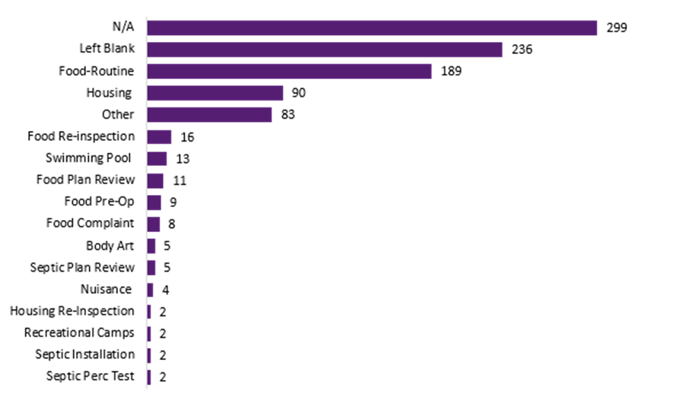
Training Log Report - Quarter 3

Slide 29
Testimonials
“On-site inspections allowed for an interactive and engaging atmosphere allowing questions and shared thoughts. Learned skills that helped me understand challenges and to be better equipped to handle them. Trainer was a pleasure to work with and encouraged open dialogue fostering trust and collaboration. Looking forward to further opportunities with the training hub”
I recently completed my Tier 3 Food training with Bri. The evaluation process was thorough and fair. I received helpful on-site feedback as well as valuable notes on the completed Assessment Forms, which I received soon after the training was completed.
-JJ Prusak
Regional Health Inspector
Hampshire Public Health Shared Services Collaboration
-Donna Bowman
Northampton Department of Health and Human Services

Slide 30
Testimonials
As a new inspector without any public health background, having access to the resources and trainings provided by Baystate Public Health Training Hub has been a tremendous asset to my growth in this position. They’ve been more than just a resource — they’re a friendly and supportive presence in the field, especially during times of uncertainty.
I’d like to give special thanks to Derek, my one-on-one trainer, who made me feel comfortable throughout the learning process. He never made me feel intimidated by my lack of experience and took the time to teach rather than simply correct. His patience and willingness to explain each step made a huge difference in my confidence and development.
Thank you to Baystate for all your hard work, dedication, and your continued support!
-Megan Moselsky
Health Inspector
Foxborough Health Department

Slide 31

Resources
Registering for Food & Housing PHIT
www.train.org/ma/home
Public Health Nursing
www.umass.edu/nursing/local-public-health-nurse-consultant-program

Slide 32
Questions?
Kerry Dunnell
North Central MetroWest Training Hub
kdunnell@needhamma.gov
Bri Dupras, REHS/RS
Franklin-Hampshire Training Hub
bdupras@frcog.org
Derek Macedo
Baystate Training Hub derek.macedo@newbedford-ma.gov

