Slide 1

Basics of a Risk Based Inspection
Presented By:
Derek Macedo- Coordinator
Margaret Juneau, CP-FS- Trainer
Joshua Montella, CP-FS- Trainer
www.Baystatehub.com
Baystate@newbedford-ma.gov

Slide 2


Risk-Based Inspections (RBI)
Risk-Based
=
HACCP-Based
HACCP Principles
The utilization of HACCP principles to control risk factors in a retail food inspection program.
Risk
Factors
FOOD DAY 4
2
Notes:
Let's dive in!
As a reminder, HACCP is a systematic approach to the identification, evaluation, and control of food safety hazards
It is the responsibility of the operator to establish systems to ensure food safety.
We are there to evaluate those systems using a HACCP and Risk-based approaches and achieve active managerial control over foodborne illness risk-factors.
Our goal is to be proactive rather than reactive.
It is upsetting when you have repeat violations. Try to break the chain, shift the focus to assisting food establishments develop/enhance their food management systems and prevent foodbourne illness risk factors from occurring in the first place.
When I was trained, it was all about “Floors, walls and ceilings” Food safety and risk factors were becoming the way to inspect, but we were still in a change.

Slide 3



5 Risk Factors
Approved Source
Improper Cooking
Improper Holding
Contaminated Equipment
Poor Personal Hygiene
Five important practices or procedures are identified by the CDC as the most prevalent contributing factors of foodborne illness or injury.
Notes:
So I've mentioned foodbourne illness risk factors a couple times now, but what exactly am I talking about?
QUESTION: Who here has had a foodborne illness before? Did you go to the hospital?
In an ideal world we would want to determine how effective our food inspection programs are by actual foodbourne illness data. Unfortunately, foodborne illness is vastly underreported.
The Centers for Disease Control and Prevention (CDC) Surveillance Report for 1993- 1997, “Surveillance for Foodborne-Disease Outbreaks – United States,” identified the most significant contributing factors to foodborne illness. Five of these broad categories of contributing factors directly relate to food safety concerns within retail and food service establishments and are collectively termed by the FDA as “foodborne illness risk factors.”
* You will see the foodborne illness risk factors referenced on the model food inspection report as the first major category of violations, #1-29. This is the reason why you are required to try and observe these areas during the inspection and mark them as "IN, OUT, NA, or NO".
So let's discuss these 5 foodborne illness risk factors.

Slide 4
5 Interventions for Control
Demonstration of Knowledge
Time/Temperature Relationships
Implementation of Employee Health Policies
Hands as a Vehicle of Contamination
Consumer Advisory
Notes:
So I've mentioned foodbourne illness risk factors a couple times now, but what exactly am I talking about?
QUESTION: Who here has had a foodborne illness before? Did you go to the hospital?
In an ideal world we would want to determine how effective our food inspection programs are by actual foodbourne illness data. Unfortunately, foodborne illness is vastly underreported.
The Centers for Disease Control and Prevention (CDC) Surveillance Report for 1993- 1997, “Surveillance for Foodborne-Disease Outbreaks – United States,” identified the most significant contributing factors to foodborne illness. Five of these broad categories of contributing factors directly relate to food safety concerns within retail and food service establishments and are collectively termed by the FDA as “foodborne illness risk factors.”
* You will see the foodborne illness risk factors referenced on the model food inspection report as the first major category of violations, #1-29. This is the reason why you are required to try and observe these areas during the inspection and mark them as "IN, OUT, NA, or NO".
So let's discuss these 5 foodborne illness risk factors.

Slide 5
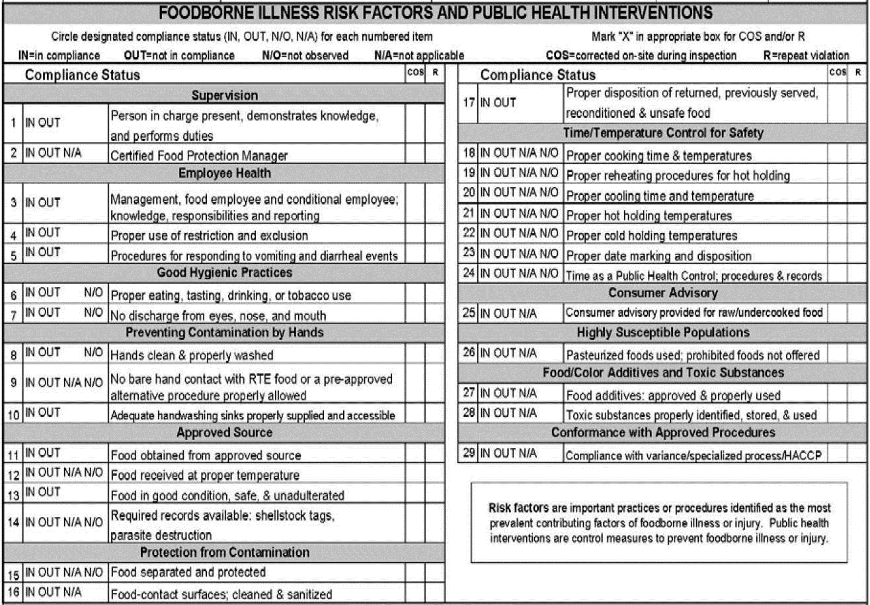
First Page of the Inspection Form – Items 1-29 Address the 5 Risk Factors and the 5 Interventions used to control those Factors.
These are the Most Important to Prevent Foodborne Illness.

Slide 6
Elements of Risk-Based Inspection (RBI)
Routine, periodic inspections conducted as part of an ongoing regulatory scheme (More Risk=More Inspections)
An RBI goes beyond assessment of code compliance and evaluates the degree of Active Managerial Control (AMC)
We are prioritizing the risk factors, not strict code enforcement, and take a more educational role to aid and collaborate with the PIC in controlling those factors.
Through assessment of the products, processes, and flow of food within the establishment
Notes:
Regarding RBI/assessment of code compliance, we are systems analysts not code enforcement inspectors.
Risk-based inspections help us focus and set priorities.
This doesn’t mean that we’re going to completely ignore “floors, walls, and ceilings” or that we only look at the 5 Risk Factors, but we do prioritize the risk factors.
Our primary focus should be on those behaviors that are directly responsible for putting hazards into the food or failing to remove them.
Conducting a risk-based inspection requires you to focus on evaluating the degree of active managerial control that an operator has over risk factors.
You will need to spend most of your time observing the practices and procedures that lead to out of-control risk factors and asking staff questions to assess the operation.
QUESTION: I know you all talk to the PIC on an inspection, but how many ask questions to the staff?
Explain its ok to ask questions, but do not harass staff.

Slide 7
Active Managerial Control (AMC)
Preventive Management vs Crisis Management
Let’s prevent the environments that can lead to problems instead of dealing with them after they have become a problem!
The purposeful incorporation of specific actions or procedures by industry management into the operation of their business to attain control over foodborne illness risk factors.
Notes:
I have used the term Active Managerial Control enough to turn it into a drinking game, so let define it:
READ SLIDE
What does that REALLY mean- DO YOU JOB!!!!
QUESTION: What is the difference between a mistake and a problem?
If you have AMC, then you may have mistakes, but should rarely have problems. Problems come with no AMC
The goal for operators and regulators is to achieve ACM over the food establishment, with a strong focus on risk factors and interventions.

Slide 8
Questions to Assess AMC
Ask lots of open-ended questions
The answers should supplement your quantitative measurements or observations on the day of the inspection
Take the time to observe employee practices both for personal hygiene and how food is handled at each step in its process.
Notes:
An establishment may be complying on the day of the inspection but still lack AMC. It other words, (YOU GOT LUCKY!)
We need to ask a lot of open-ended questions and really observe employee practices.
Try to focus questions on assessing AMC of risk factors.
It may not be possible to observe all activities like receiving or cooling. It is critical to ask questions that can help you assess if there are AMCs happening in these areas. You can also ensure that any answers the PICs are giving are consistent with employee practices and measurements taken.

Slide 9
Process Approach
The process approach is best described as dividing the many food flows in an establishment into broad categories based on activities or stages in the flow of food through your establishment, then analyzing the hazards, and placing managerial controls on each grouping. This type of approach is often more efficient and useful.
These processes are defined by the number of times the food passes through the Temperature Danger Zone (TDZ).
Notes:
Let's talk about the process approach and why is this approach more efficient and useful than HACCP
QUESTION: Why don’t we just require a HACCP for everything?
Firstly, conducting a hazard analysis on each individual food item would be way too time and labor intensive to be practical. Also expensive.
Unnecessary because we can more easily group foods into food preparation processes and identify and control the hazards for the entire groupings.
In the retail setting, we generally stress the process approach because it is too chaotic otherwise.
The process categories should be defined by the number of times the food passes through the temperature danger zone.
QUESTION: Is everyone aware of what the temperature danger zone is? (41-135F)

Slide 10
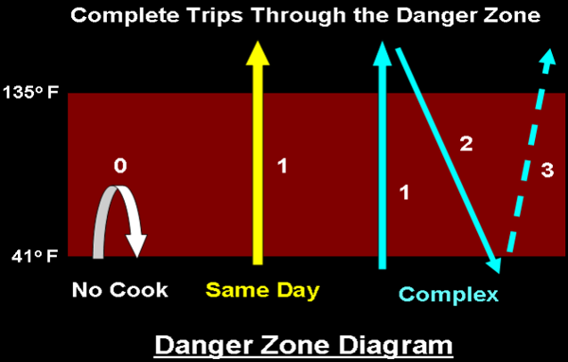
Temperature Danger Zone Diagram
Notes:
Note that while foods produced using process 1 may enter the danger zone, they are neither cooked to destroy pathogens, nor are they hot held. Foods which go through the danger zone only once are classified as Same Day Service, while foods that go through more than once are Complex.
QUESTION:
Can I get some examples of No Cook?
How about Same Day?
And Finally, Complex?

Slide 11

No Cook Step Priorities
Cold Holding or Time as Public Heath Control (TPHC)
Food Source
Shellfish, sashimi, etc.
Receiving Temperatures
Tuna, etc.
Parasite Destruction Letter
Freezing to Destroy Parasites
Raw fish consumption
Cooling from Ambient Temperature
Notes:
Looking further at the risk factors, let's relate them to no-cook step processes.
Your priorities in a no-cook step process are going to be:
Cold holding or TPHC.
Food sources (again), but more specifically for common no cook step or "raw-ready-to-eat" foods you may want to see shellfish tags for example.
You want to capture receiving temperatures if they happen to be receiving while you're there. This means if receiving begins, you may need to drop what you're doing to investigate this.
In sushi operations, or where fish is sold raw read to eat, you'll want to review for parasite destruction in lieu of cooking. This can be a vendor certification, or even a log of freezing temps that the establishment maintains themselves.
And don't forget that "cold" foods made from ambient temperature ingredients still may require cooling. That tuna salad in the fridge is sketchy, so get a temp of it as soon as you're able.

Slide 12

Same Day Service Priorities
Cooking
Hot Holding
TPHC
Notes:
In same day service processes, cook temps are typically a priority.
Getting cooking temperatures can be tricky. You must be in the right place at the right time. When you see that chicken breast on the grill, or the fish in the fryer, ask the PIC or the cook on the line to let you know when that food is done cooking. You'd be surprised how often they will hand you a piece of undercooked food knowing you're going to look at it. (EXPLAIN WHAT CARRY OVER COOKING IS AND HOW IT MIGHT MESS WITH THE TEMP!)
This could indicate a lack of active managerial control and training lapses.
Hot holding is static, so you don't have to rush into that, but catching it earlier in the inspection can help prevent food waste.
If they are using TPHC make sure you've reviewed their procedures.
Holding times should be appropriate, either 4 or 6 hours depending on if they are holding hot or cold foods, and there should not be foods beyond their hold time being held. (SIGNAGE)

Slide 13
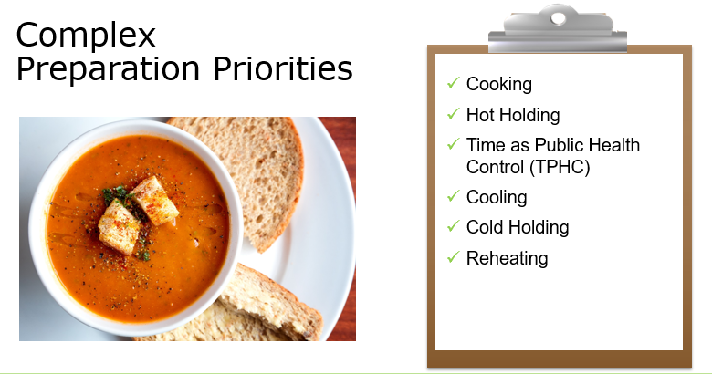

Slide 14
1. Identify ingredients, weight/volume, and steps involved in the preparation of suspect food(s).
2. Identify food handling procedures at each step in the preparation of suspect food(s).
3. Based on observation or interview, identify potential hazards and critical control points (CCP).
4. Identify violations and initiate corrective actions.
5. Verify corrective actions undertaken by the food establishment.
Steps in a HACCP Risk Assessment

Slide 15
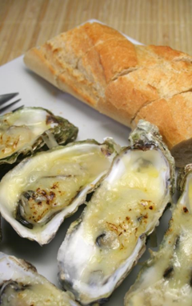
Assessing Approved Source
Time and day of inspection is important
Evaluate international and/or imported foods
Invoices or certifications
Shellfish tags
Don’t assume anything
Notes:
Approved sources – You know what they say about assumptions? Well, this is one of the situations where you never want to get caught making assumptions.
The time and day may be important, but realistically you can only catch what you can catch and we have to do our inspections when they're due. Don't stress about that.
You want to carefully evaluate foods imported directly by the retailer. If you are unsure of a product, take photos and send them to your hub trainer or DPH staff.
What kind of evidence do you want to see to know that the vendors are approved?
Most commonly, you will ask for invoices, or shipping receipts.
Also ask if they have copies of their vendor licenses which they almost never have, but that is the only way you can truly know that they are licensed and inspected.
Again, don't make assumptions. That tray of baklava on the counter at the local house of pizza just might be made in mom's house.
You can also look for inadequate labels too. If they are missing information required by the code, it might be from an unapproved source. Ask those questions.

Slide 16

Assessing Personal Hygiene
Take the time to observe handwashing and the assignment of duties
Employee health/sick policy
Location/convenience of hand sinks
Supplies at hand sinks
Don’t forget the wait staff
Ask questions
Notes:
How do we assess personal hygiene? I like to stand around for a little while and focus just on handwashing. Literally just stand there and watch the food handlers as they leave the kitchen and return, taking out the trash, prepping raw meats.
When you see occurances where hands should be washed, step in and get corrections done immediately. On site corrections like that as they occur are the best way to train food handlers on when to wash. Also watch for how they wash. How long, do they even use soap? Do they take their gloves off first?
Are the hand sinks in appropriate locations or are they kind of far away from all the action?
Are they stocked with soap and towels?
Do not forget that the wait staff need to wash their hands too!
Employee sick policies are important.
QUESTION: How do you ask an open-ended question about this?
I like to ask, tell me how you communicate the employee health requirements to your employees?
It must be done in a verifiable manner if you recall from your code.
If they have nothing, or just provide a verbal "if they're sick they call out" be sure to have some employee health reporting agreements on hand.
Provide them the tools to succeed.
QUESTION: How many of you carry handouts to give to your establishments? YOU SHOULD!

Slide 17
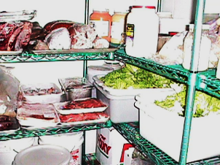
Assessing Cross Contamination
Take the time to watch the flow of food
Observe the placement of sinks and splash from the sinks
Storage practices
Warewashing operations (manual and mechanical)
Food contact? Non-food contact?
Visual inspection of surfaces
Notes:
Cross contamination is just gross if I'm being honest.
It's not always as obvious as someone cutting chicken thighs on a board and then moving on to cutting the lettuce on the same surface. You're going to have to spend some time watching what is going on, asking questions about the processes occurring in front of you, and then assessing for a risk of cross contamination from there.
You'll want to pay special attention to the sinks watching for splash For example is there a prep table next to the 3 bay with no guard in place?
You'll want to assess their storage practices, or order of storage as its often called. Is the chicken down bottom with the fish near the top? Ready to eat foods above all the raw product? Where are the raw ready to eat foods stored like oysters?
Are surfaces even being effectively cleaned? Take a close look, use a flashlight if you need to, to assess surfaces of equipment like deli slicers for example.

Slide 18
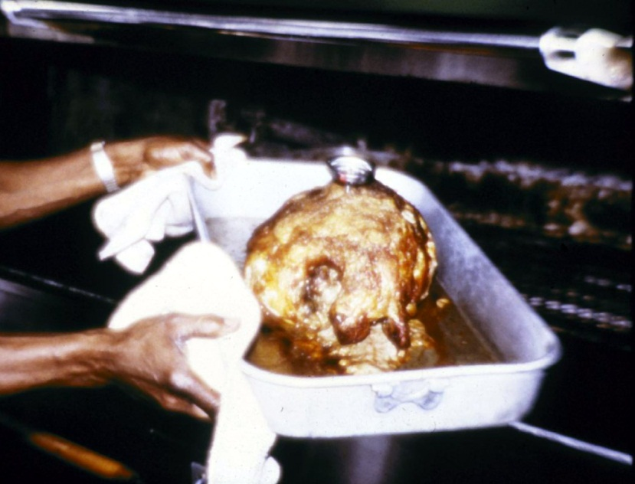
Assessing Temperatures
Proper use of thermometers
Dial, thermocouple, or infrared
Calibrated
Proper procedures used
Time of inspection is important
Notes:
You'll want to start by asking the establishment if they have their thermometer handy.
It can be a dial, or thermocouple. If they have an infrared, that's cool and all, but make sure they understand the limitation of it which is that it only takes a surface temperature.
When they pull out their thermometer, ask them if its been calibrated lately. Regardless of the answer, go through the calibration process with them as this is a great learning experience. Grab a cup of ice, add a minimal amount of water, and let it sit. Calibrate your own while you're at it.
You'll want to get some cook temperatures, as many as possible really.
When temping meats, avoid grizzle and bone, and shoot for the thickest part, dead center.
You need to wait for them to indicate that it is done prior to temping if you want to use it for a violation.
Hot and cold holding will need to be checked.
There is always debate as to what an adequate sample size is within a refrigerator. Don't sweat the small stuff. Get a couple from the top of the reach in, get a couple from the bottom. In the walk in, get some temps from each area.
If there are items that look like they were made in house and cooled, even if date marked the day prior, check it.
If you feel like maybe something should be temped, follow your instinct.
Hot holding, I love this debate that goes on with hot holding.
DISCUSSION: Do you stir the soup before temping, or not? Anyone want to opine on this?
My answer is depends. Thicker products like a broccoli cheddar soup if not stirred may cool near the top. That's a potential issue and should be discussed with the PIC.
If you're on site in the morning, often times you might catch the soups having just been reheated and at 180 degrees. This obviously isn't really representative of their actual hot holding temps.

Slide 19
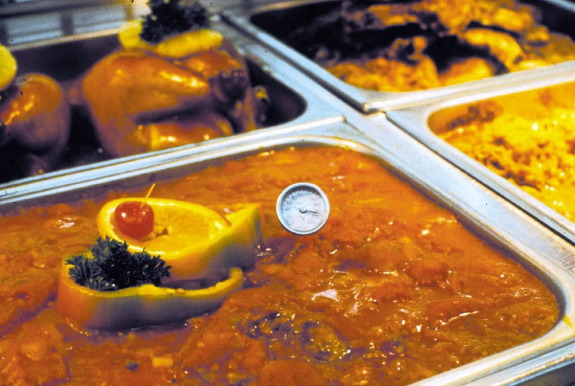
Assessing Reheating
Time of inspection is important
Making the correct call
Hot holding vs. reheating
Reheating methods
Knowing the equipment’s capabilities
Notes:
Typically you're going to need to be on site earlier in the day to assess reheating practices.
You want to make sure they're employing rapid methods for reheating and not just placing cold food into hold holding equipment.
QUESTION: If you find food in the hot holding equipment and its way below temp, do you cite them for a hot holding violation, or a reheating violation and how do you know?
Let me also ask, how long does the code allow for reheating to take place?

Slide 20
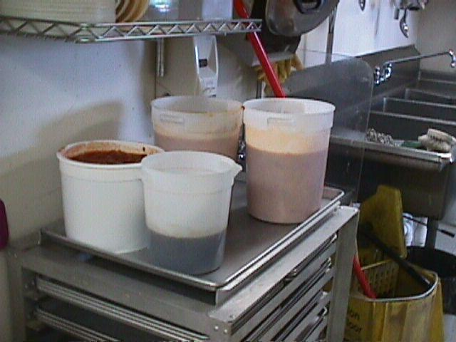
Assessing Cooling
Time of inspection is important
Blast chillers are great, but have a back-up plan such as using smaller/shallower pans and an ice paddle
Use proper method for taking cooling temperatures
Follow-up on suspicious containers
Notes:
It's complicated, its an active very involved process, and its so often done incorrectly.
Risk Control Plans are a fantastic way of getting active managerial control over this process.
What time you arrive can be important. A lot of the cooling starts after morning prep. And you want to catch this process early.
Remember that the process starts at 135 degrees, not when the product is pulled from the heat.
Record the temperature in your notes, but also record the time. You may be coming back to this.
Say you catch a food at 135, and you're going to be there for 2 hours, you'll want to check back at 2 hours to see if you crossed the 70 degree mark or else that food may need to be disposed of.
We mentioned this already, but 99% of the time, you'll be assessing methods not time temp parameters.
You'll want to see shallow pans, smaller portions, rapid cooling equipment like a blast chiller or ice wands, ice water baths, using metal versus plastic containers to facilitate heat transfer, using ice as an ingredient or anything else you can possible think of to speed things up.
Keep in mind that during cooling, the food may be somewhat exempt from the covering requirement. A tight lid will retain heat, so loosely covered, or uncovered if protected from overhead contamination is acceptable.
Take a good look at anything suspicious, such as huge containers of food prepped on site or anything with a lot of condensation inside the container.
Make sure that you're talking to the PIC the whole time about their processes and how long it takes for items to cool. Sometimes they will give you answers that are just demonstrably false but keep at it. Drill into them for the right answers.

Slide 21
Flow Diagram
Flow Diagram (Flow Chart)
Shows the step-by-step progression or “flow” of food through a food preparation process or the path that food follows from receiving to service or final sale to the customer
May help to identify shortfalls in existing recipes that could result in an out-of-control hazard
May help to develop SOPs for procedures that are common to all recipes
Notes:
Next we'll talk about flow diagrams, or flow charts.
Some of you may be familiar with flow diagrams from formal HACCP plans you may have reviewed
During my time in food manufacturing, we lived by Flow Charts and HACCP paperwork at each step. EXPLAIN
Flow diagrams can also be used to help develop SOPs for general food processes and identify shortfalls in food safety.
Flow diagrams will show the step-by-step progression of food from receiving to service.

Slide 22
Application of HACCP Principles
Process vs. Product Specific Approach
Risk-based Inspection Methodology
On-site correction based on hazard analysis
Industry Food Safety Management Systems:
Standard Operating Procedures
Purchase Specifications
Recipe Development
Risk Control Plans
HACCP Plans
Notes:
I'm hoping by now we are starting to understand how the application of HACCP principles can be achieved by the following:
READ SLIDE
HACCP is easy if you live it every day. Otherwise, it is complex and people need help to understand it.
(BREAK???)

Slide 23
Inspection Focus
Most of your time should be spent on assessing active managerial control of risk factors.
Good Retail Practices (GRPs) are also assessed in a risk-based inspection, but time constraints must be considered.
Most GRPs tend to be static, whereas risk factors tend to be more dynamic.
Consider risk when budgeting your time.
Understanding the food prep processes is VITAL.
Setting the example is important.
Notes:
QUESTION: On average, how much time do you spend on an inspection of a Risk Level 3 Establishment?
If you have a limited amount of time to conduct the average inspection, where do you put most of your emphasis?
If the average inspection time is 45 minutes to 1 hour, you probably only have a few minutes of the operator’s completely undivided attention.
Very limited opportunity to make an impression on that operator and affect a change in the operation.
Use that time to help the operator focus on the MOST important food safety issue. If you just list 20 or 30 things that need to be corrected, it could very well be that NONE of them will be fixed.
If we don’t seem to have any priority of importance as regulators, then operators won’t either.

Slide 24
Examples of Intervention Strategies
Develop Food Safety Management Systems based on HACCP Principles
Change Equipment or Layout
Change Buyer Specifications
Develop Recipe/Process Instructions
Implement Standard Operating Procedures (SOPs)
In-service Training
Implement Risk Control Plans (RCPs)
Notes:
These are just a few examples of intervention strategies that could be taken.
READ SLIDES
QUESTION: Any other intervention strategies you can think of?

Slide 25

What is a Risk Control Plan?
A simple, effective tool to help establish active managerial control of risk factors
Mutually agreed upon by PIC and Inspector
Must describe system for mitigating harm
Reminder: A risk control plan is not a substitute for a HACCP plan.
Notes:
A risk control plan is a concisely written management plan developed by the retail or food service operator with input from inspectors that describes a management system for controlling specific out-of-control foodborne illness risk factors.
This is a very simple document.
They do not need to bring on a consultant to help them write this.
The plan is intended to be a voluntary strategy that inspectors and the person in charge jointly develop to promote long-term compliance for specific out-of-control foodborne illness risk factors.
It requires that the basic control systems in the plan be implemented for a designated time period (e.g., 60 – 90 days) and allows inspector oversight.
The longer the plan is implemented, the more likely it is that the new controls will become "habits" that continue to be used in the food establishment after inspector oversight ends.

Slide 26
Risk Control Plan (Sample Form)
Food Establishment:_____________________ Person in Charge / Manager:_________________________ Address:_____________________ Phone Number:_____________ Inspection Date:______
TO BE FILLED OUT BY THE INSPECTOR:
Describe the violation (Risk Factor):____________________ Food Code Section Number:_________
TO BE FILLED OUT BY THE PERSON IN CHARGE: (Use additional sheets if needed)
Describe the problem. Why is this problem occurring? Why is it difficult to control this problem?
How will you correct the problem?
Will staff need to be re-trained? Who will train them?
How will the corrective action be monitored? (logs, charts, visual monitoring of staff, etc.)
Who will be responsible for monitoring it? How often?
Who will check that the monitoring was done? How often?
What will be done if the correction is not working to control the violation?
How will you communicate the results to the inspector?
Submitted by:_________ Approved by:____________ Person in charge ____________ Inspector ______________
Notes:
By implementing an RCP, the retail or food service operator will have the opportunity to determine the appropriate corrective action for the identified problem and design an implementation strategy to best suit the establishment and operation.
Since the RCP is tailored to meet the needs of the food establishment, the operator takes complete ownership of the plan and is ultimately responsible for its development and implementation.
The role of inspectors are to consult with the operator by suggesting ways that the risk factor(s) might be controlled.

Slide 27
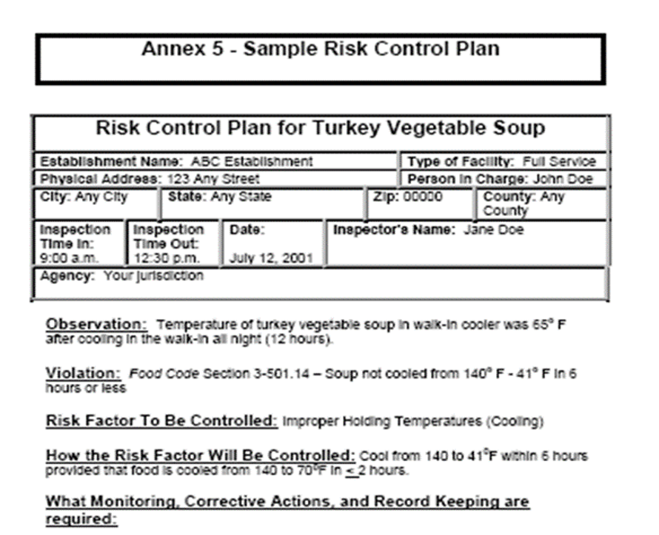
Annex 5: Sample Risk Control Plan
Notes:
Facilitator: Here’s another type of Risk Control Plan form in all its splendor and glory.
27

Slide 28
Benefits of a Risk Control Plan
The plan, developed by the operator, allows the operator to consider all the options and decide what is best for their establishment
The plan is mutually agreed upon by the operator and/or the inspector
It describes a system for mitigating harm
Input from the sanitarian helps to create a team approach to problem solving.
Creates long-term behavioral changes.
Restores managerial control over procedures that have the potential to cause foodborne illness
Notes:
By implementing an RCP, the retail or food service operator will have the opportunity to determine the appropriate corrective action for the identified problem and design an implementation strategy to best suit the establishment and operation.
Since the RCP is tailored to meet the needs of the food establishment, the operator takes complete ownership of the plan and is ultimately responsible for its development and implementation.
The role of inspectors are to consult with the operator by suggesting ways that the risk factor(s) might be controlled.

Slide 29

Contents of a Risk Control Plan
No specific form is required. What to include:
Hazard to be controlled
How the hazard will be controlled
Who is responsible for control
What are the critical limits (where safety is compromised)
What monitoring, corrective actions and record keeping are required
The corrective action that will be taken, should the limit not be met
The agreed time frame for correction
How the results are to be communicated back to the Inspector
Accurate and complete documentation
Notes:
Here are some of the typical contents of a risk control plan. And as we said before, a risk control plan is not a substitute for a HACCP Plan.
READ SLIDES

Slide 30
When to Require an RCP
Continuous and/or chronically uncontrolled processes or practices that can lead to hazards that require more than the typical inspection report.
Hazards brought about by procedural or behavior issues, such as equipment cleaning and ongoing maintenance, equipment monitoring, employee hygiene.
Do I do a RCP after 2 consecutive violations? 3?
It will be on a case-by-case scenario. (As you see fit)
Notes:
When you have continuous, or chronic uncontrolled processes that lead to hazards which require more than just your inspection report provides.
It is especially good for addressing hazards which are behavioral in nature such as employee hygiene.
QUESTION; Are you issuing a RCP after the first violation? 2nd? 3rd?
Answer is case by case basis and severity of the violations.
30

Slide 31
Sample Hazards
Uncontrolled Process | Hazard
Food Source | Presence of Pathogens, toxins or chemicals
Freezing | Failure to destroy parasites/pathogen growth
Cooking | Failure to destroy pathogens
Cooling | Failure to prevent growth of pathogens
Reheating | Failure to destroy pathogens
Hot Holding | Failure to prevent growth of pathogens
Cold Holding | Failure to prevent growth of pathogens
Thawing | Failure to prevent growth of pathogens
Cleaning | Failure to prevent transfer of pathogens
Sanitizing | Failure to destroy remaining pathogens
Employee Health | Failure to prevent disease transmission
Employee Hygiene | Failure to prevent physical contamination
Knowledge of PIC | Inability to manage food safety effectively
Notes:
Here are some uncontrolled processes and the hazards which may occur.
READ SLIDE
Next, we’ll look at a couple of inspection scenarios where Risk Control Plans come into play.
31

Slide 32
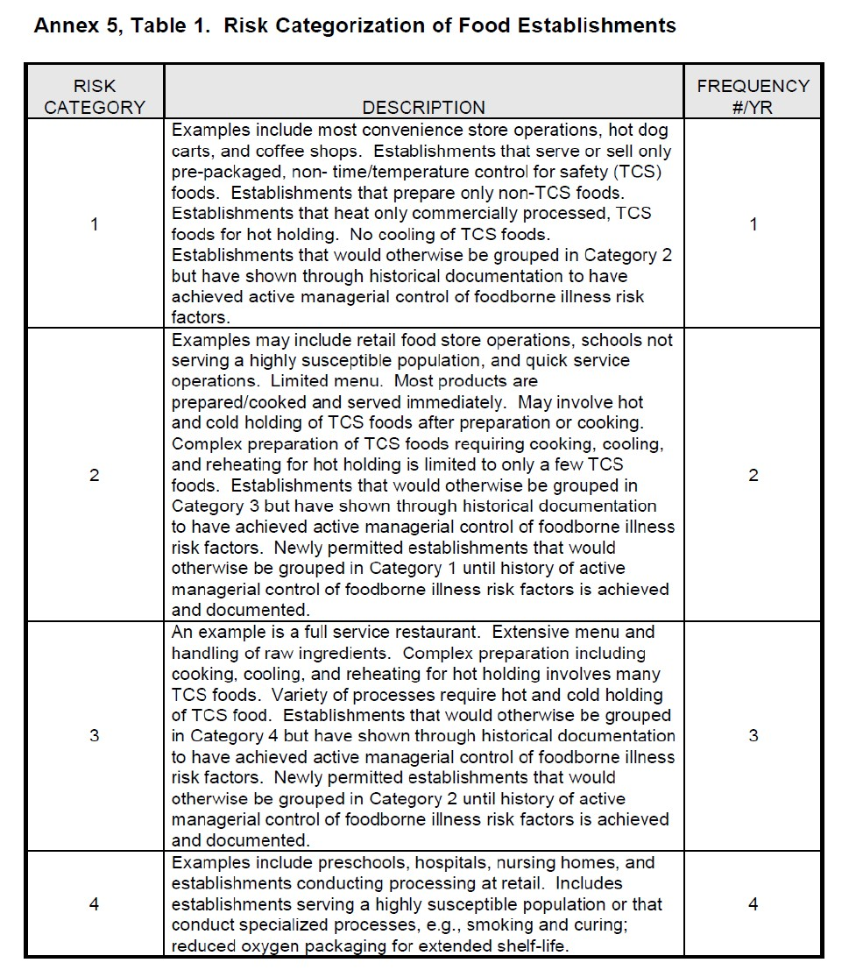
Inspection Schedule Based On Risk
Annex 5, Table 1. Risk Categorization of Food Establishments
Notes:
Let's look at the FDA Risk Categorization of Food Establishments
Can be found in Annex 5 of the FDA food code.
Categories take into consideration things like what type of food processes in the establishment conducting, compliance history, # of people served, HSP, and specialized food processes conducted.
This type of categorization allows us to spend more time in establishments that inherently pose a higher risk.
Risk 1 might be a convenience store or coffee shop because they mainly sell pre-packged and non-TCS foods.
Risk 2, might be an elementary school or fast food because they are mainly serving foods for immediate service.
Risk 3 will be most of your full-service restaurants who are conducting complex food processes.
Risk 4 might an establishment serving a highly susceptible population or conducting specialized food processes.
Depending on the establishment's compliance history, they may move up or down these risk categories.
Most communities follow the schedule in the appendix, but some jurisdictions deviate from it for one reason or another.

Slide 33
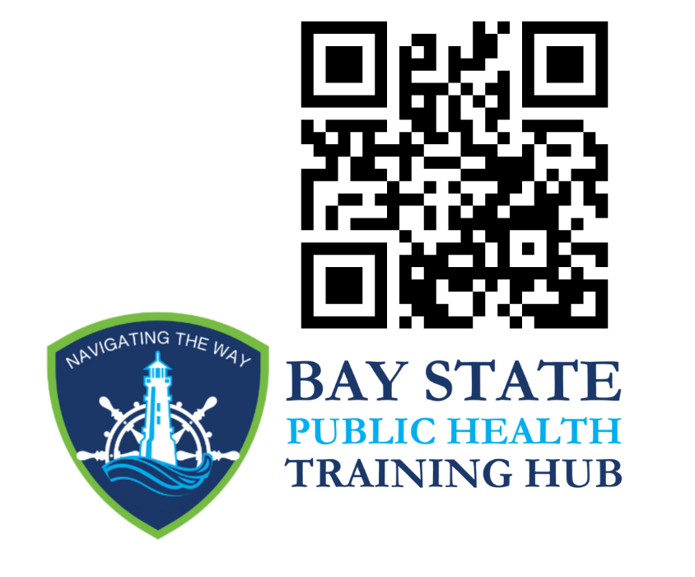
QUESTIONS? THANK YOU for attending!!!
Baystate@newbedford-ma.gov

